Slide 1
Pass the torch CEREMONY Campus Recreation Sport Programs

Slide 2
TABLE OF CONTENTS
01
02
03
04
05
06
Mingle
Sport CLub Stats & Awards
Sport Club Reminders
Get to know other sport clubs & Campus Recreation Staff
Required forms before Summer
Sport Club of the Year, Officer of the Year and Club Athlete of the Year
Pass the Torch
Preparation
Closing remarks
Leaving officers share sport club specific information with new officers
Upcoming reminders and information from Campus Recreation
Congratulations & Thank You

Slide 3
01
Mingle and get to know other Officers

Slide 4
Grab a snack and get to Know your fellow sport clubs & officers!

Slide 6
02
Sport Club Statistics
What have y’all been up to this year?

Slide 7
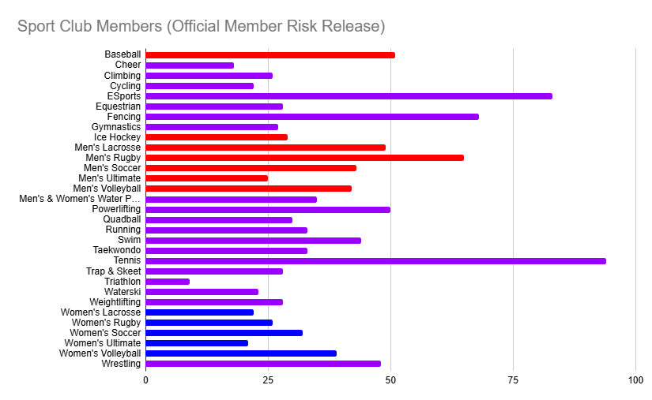
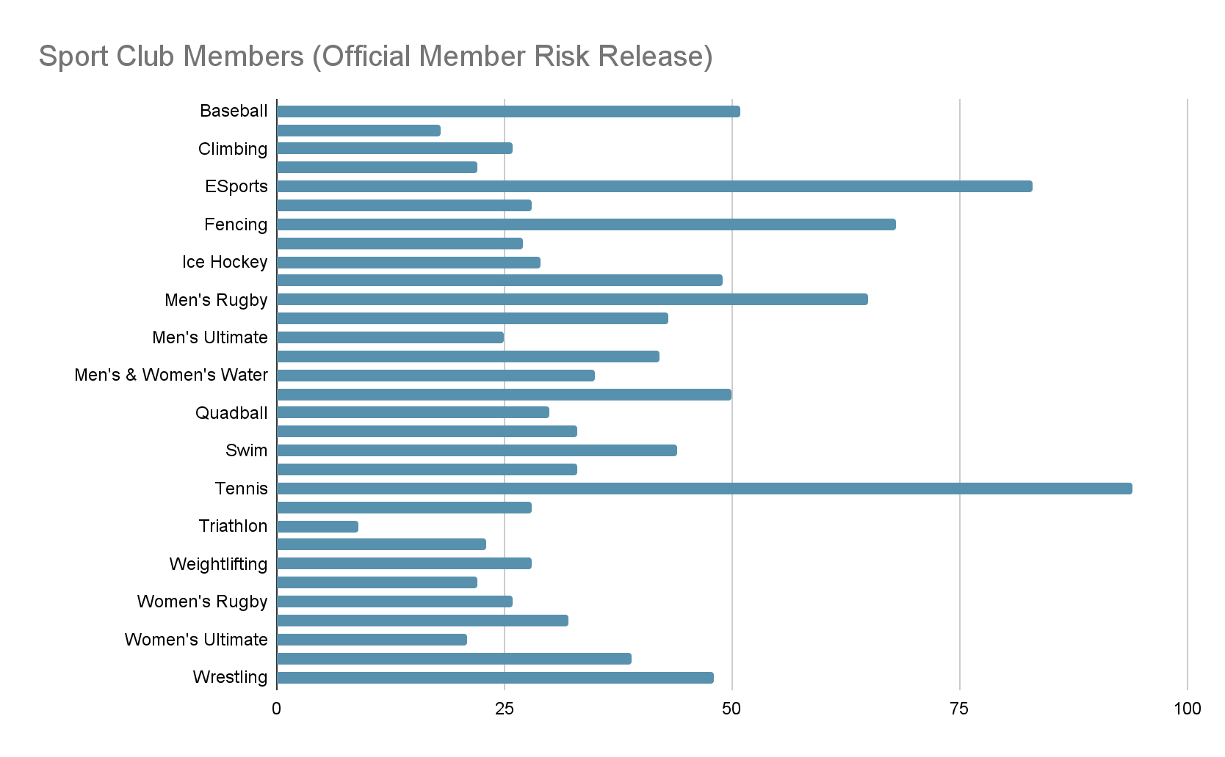
Total Sport Club Members (Official Risk Release)
Most Risk Releases Signed:
Tennis (94)
Esports (83)
Fencing (68)
Men’s Rugby (65)
Baseball (51)
TOTAL Sport Club Members: 1,171
Overall Sport Clubs:
CoEd Teams: 19
Men’s Teams: 7
Women’s Teams: 5
Total Teams: 31

Slide 8
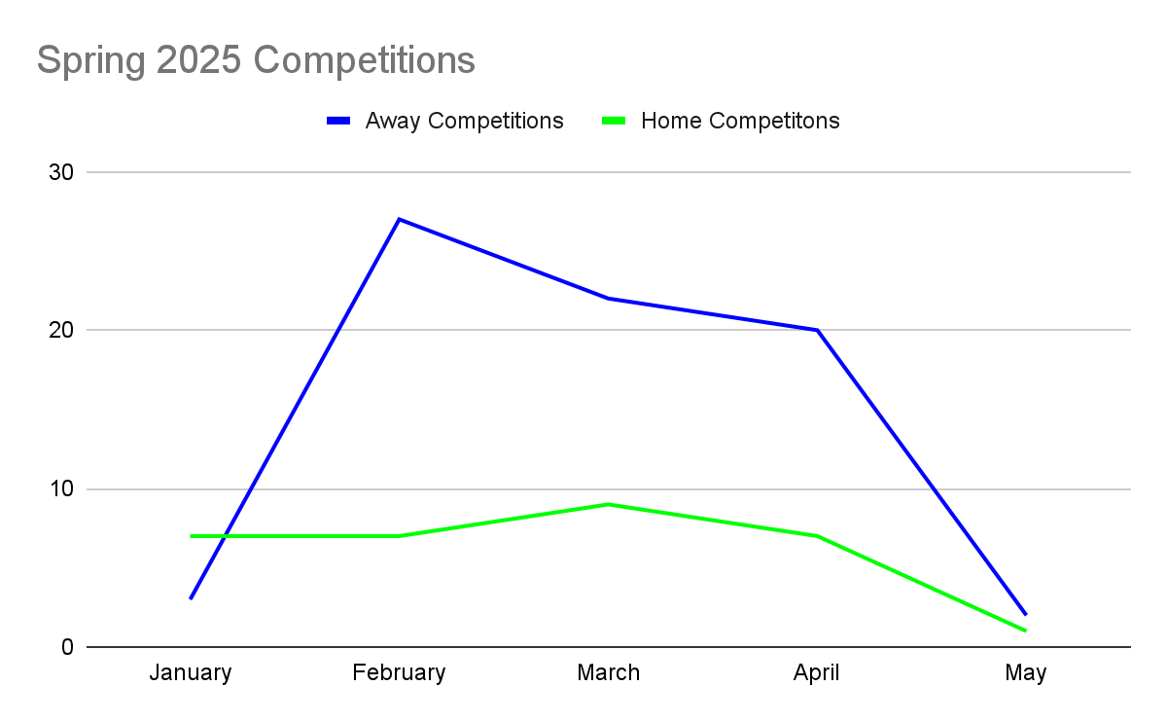
Sport Club Competitions
Total Away Competitions:
74
Total Home Competitions:
31

Slide 9
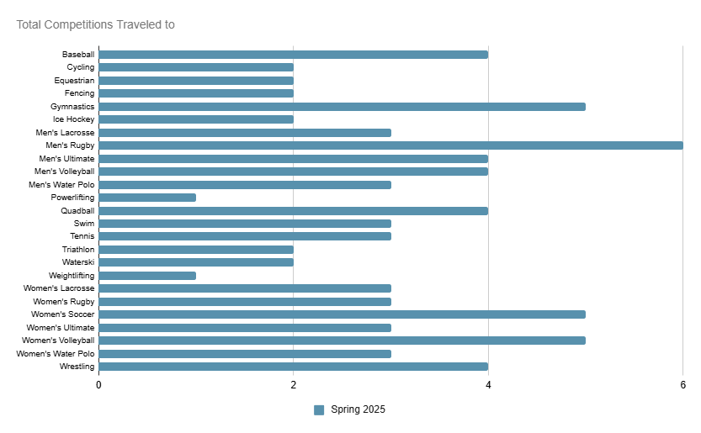
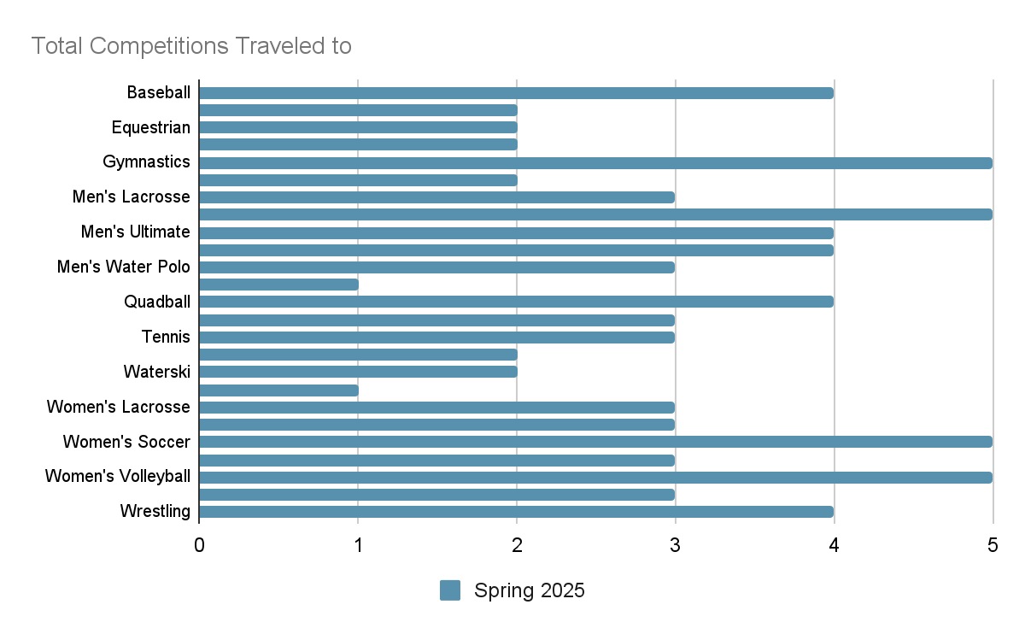
Spring 2025 traveled to competitions
Most Competitions Traveled To:
Men’s Rugby (6)
Women’s Soccer (5)
Women’s Volleyball (5)
Gymnastics (5)
Men’s Volleyball, Quadball, Men’s Ultimate, Baseball (4)

Slide 10
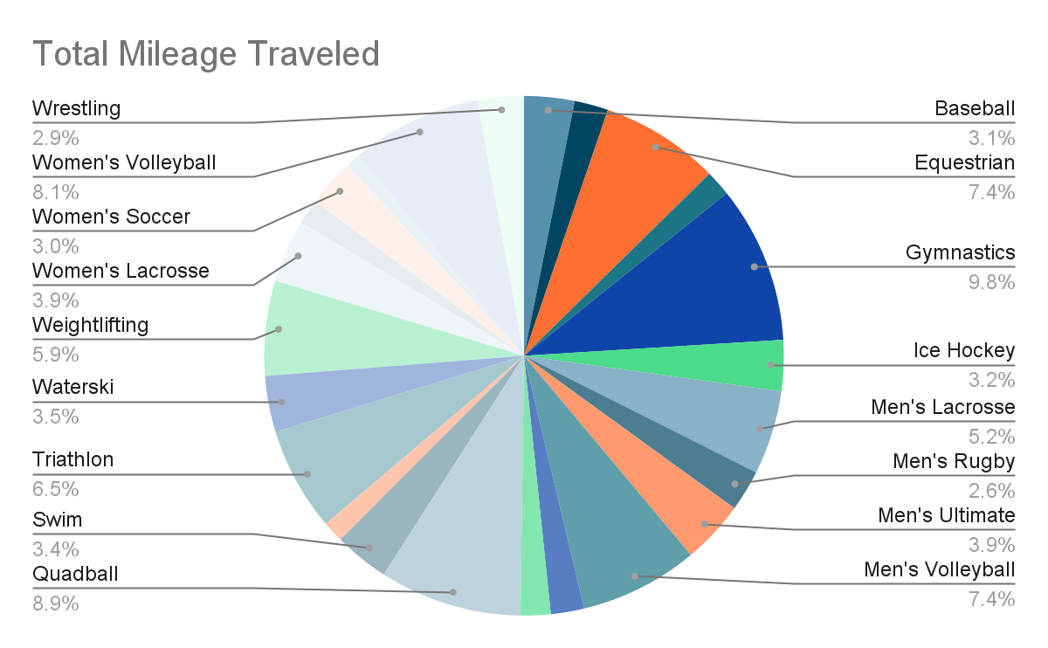
Total Miles Traveled
Most Miles Traveled in a single trip:
Gymnastics (3,284 miles)
Most Miles traveled in spring semester:
Gymnastics (4,182)
Quadball (3,791)
Women’s Volleyball (3,467)
Equestrian (3,172)
Triathlon (2,764)

Slide 11
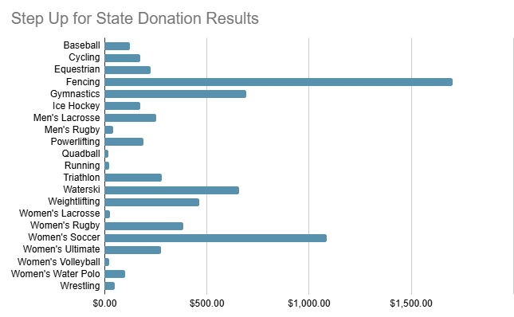
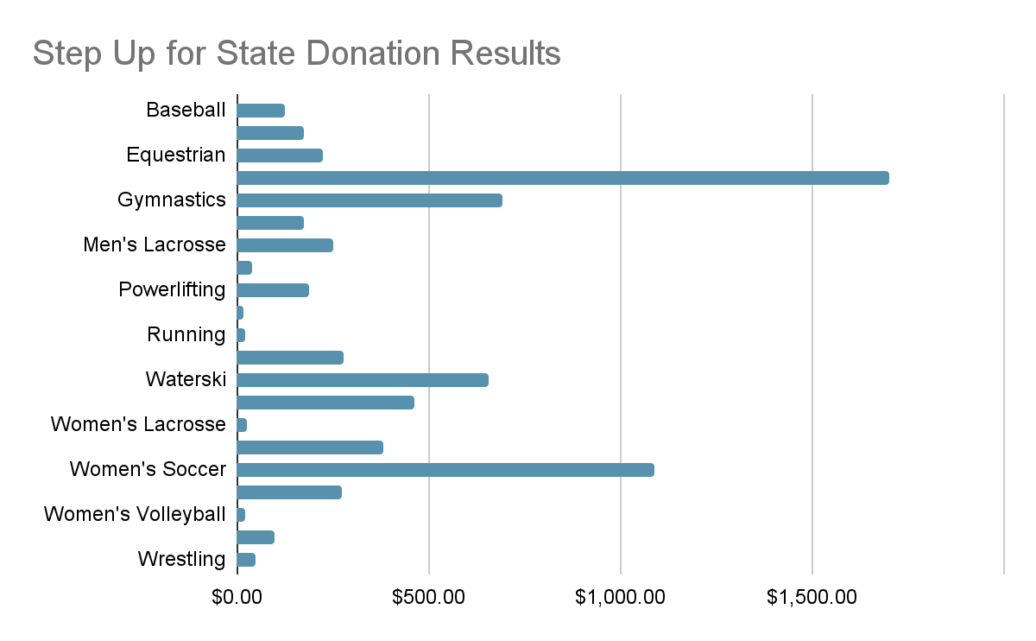
Step up for state results
Top Donation Earners:
Fencing ($1,701.93)
Women’s Soccer ($1,087.00)
Gymnastics ($692.29)
Water Ski ($658.42)
Women’s Rugby ($383.99)
Total Donations: $7,404.00
Sport Club Participation: 21/31 (66%)

Slide 12
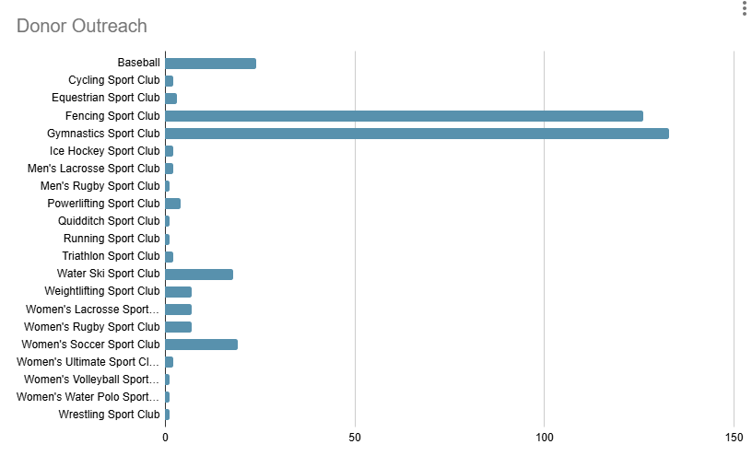
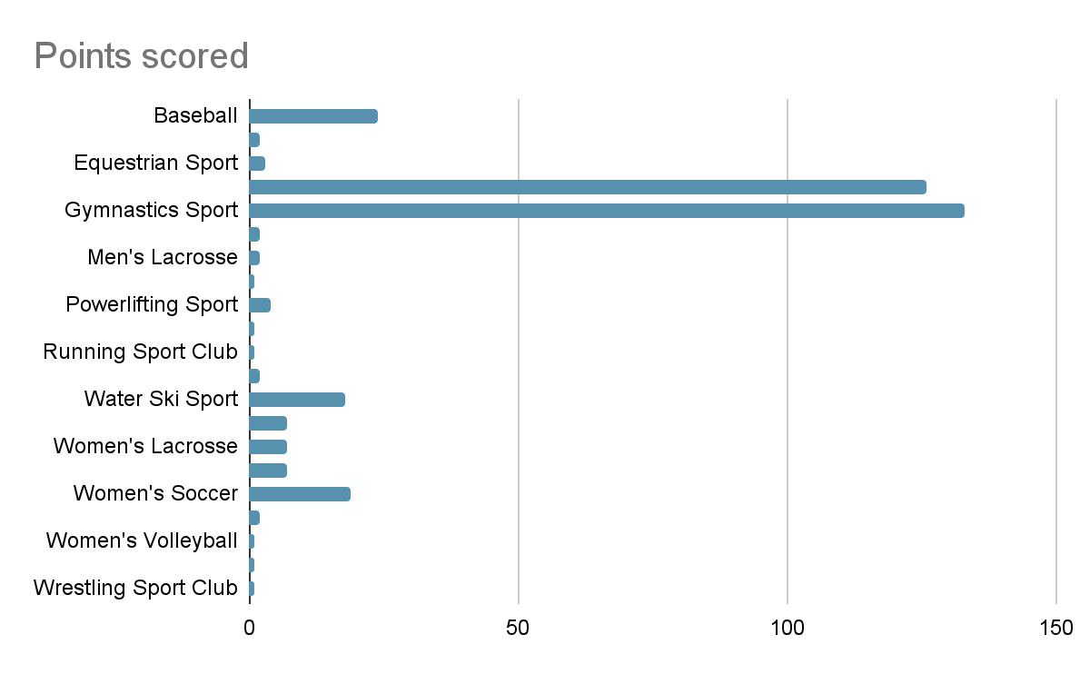
Step up for state results
Donor Outreach:
Gymnastics (133)
Fencing (126)
Baseball (24)
Women’s Soccer (19)
Water Ski (18)
Total Donors: 409

Slide 13
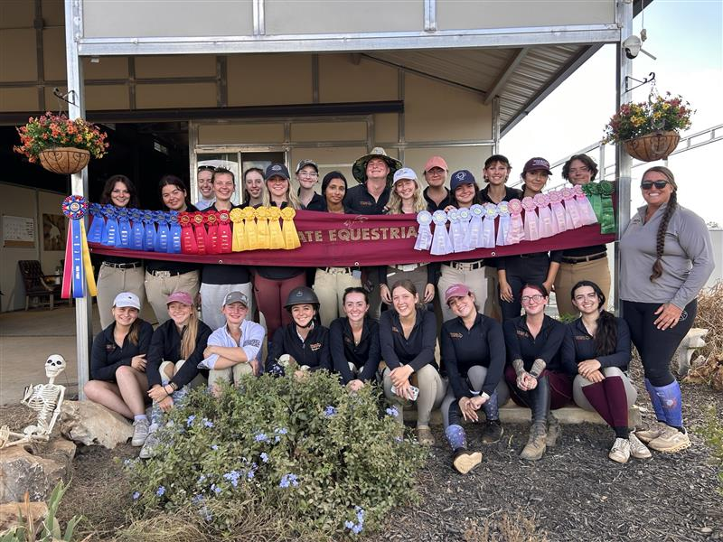
Sport Club Results & Accomplishments
Notes:
home show: day 2 won against tulane, a&m sam houston, lsu, schriner, mcneese and UT, away show: day 2 came in first place

Slide 14
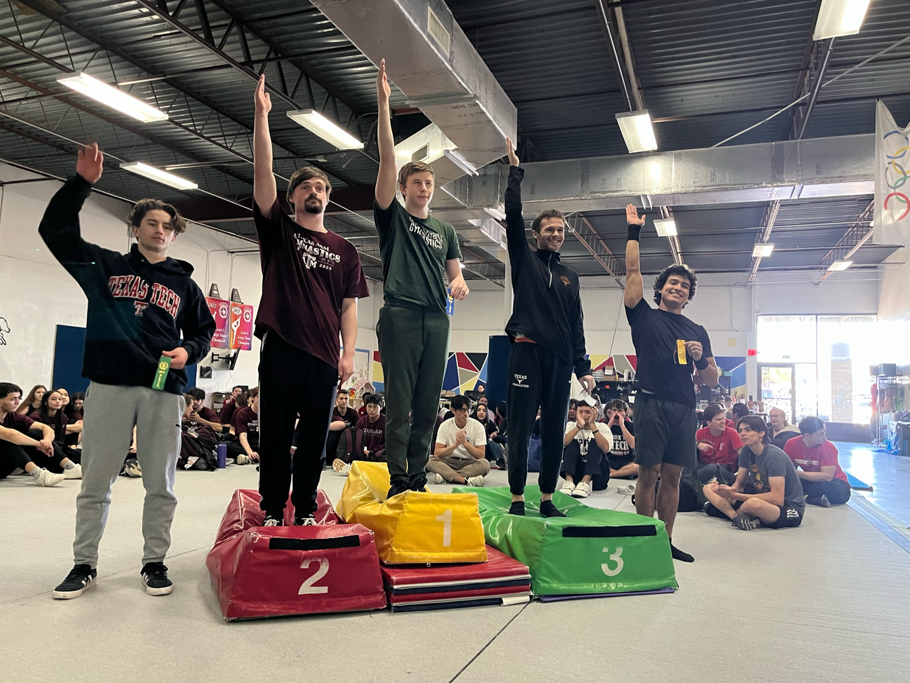
Sport Club Results & Accomplishments
Notes:
morgan kessler won 1st on floor exercise and beam and 3rd on vault, eddie almanza won 4th all around

Slide 15
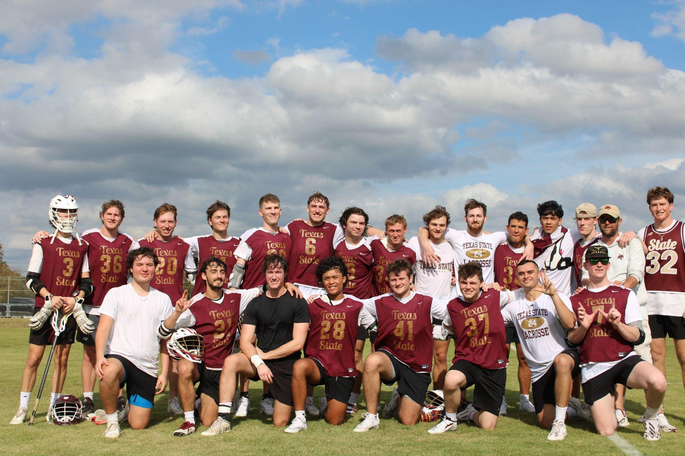
Sport Club Results & Accomplishments
Notes:
traveled to missouri and battled. UFCU stadium match against Ole Miss

Slide 16
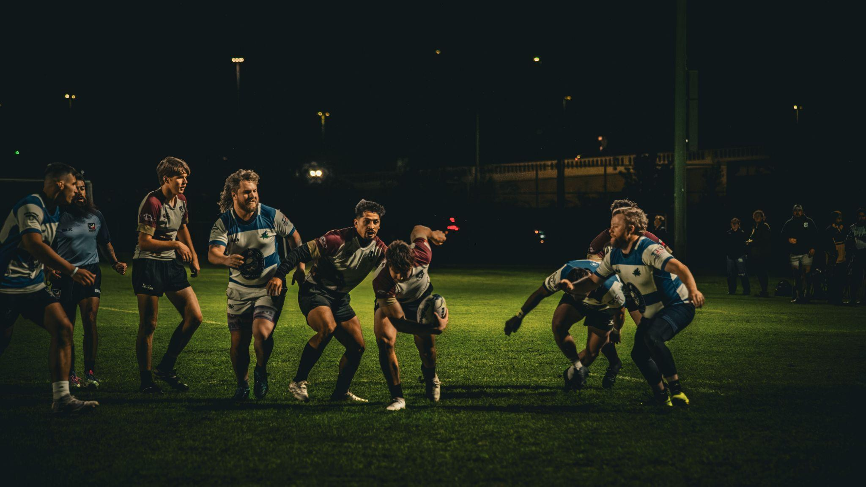
Sport Club Results & Accomplishments
Notes:
finished the season 9-1, qualified for nationals and engaged with community

Slide 17
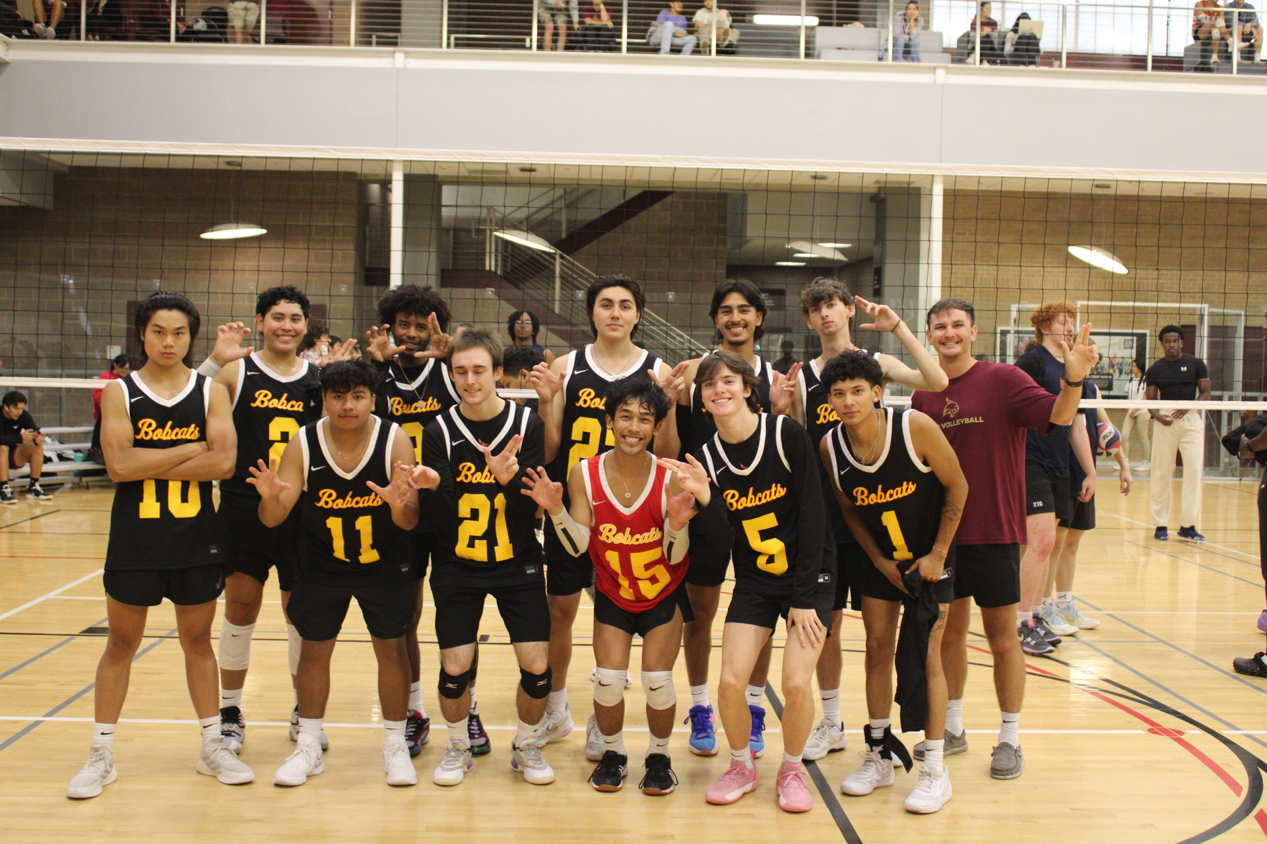
Sport Club Results & Accomplishments
Notes:
5th and 11th out of 20 teams (UTSA Tournament), a team got 2nd place in gold bracket and b team won 1st place in silver bracket!

Slide 18
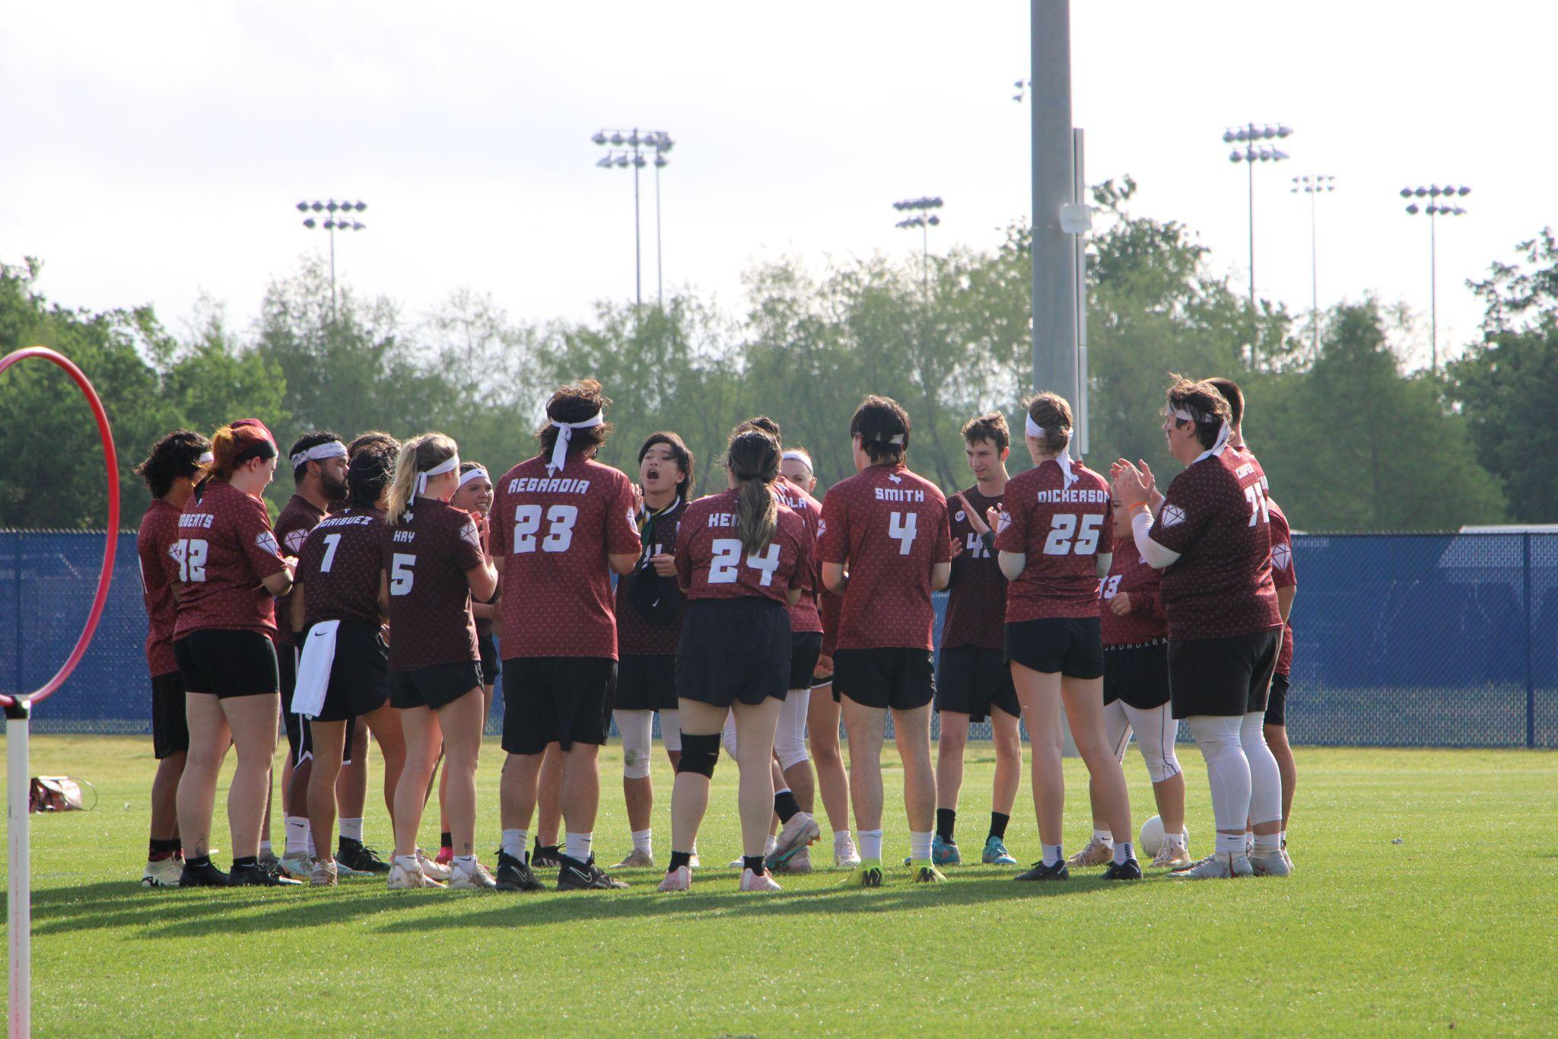
Sport Club Results & Accomplishments
Notes:
5th and 11th out of 20 teams (UTSA Tournament), a team got 2nd place in gold bracket and b team won 1st place in silver bracket!

Slide 19
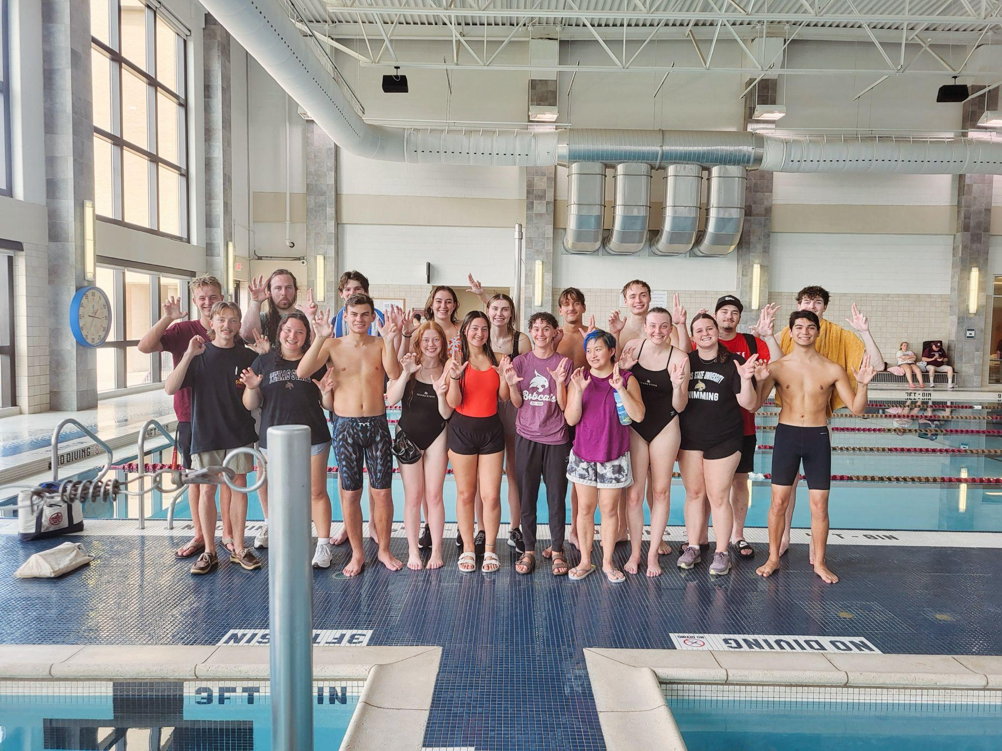
Sport Club Results & Accomplishments
Notes:
Armando Estrella broke both the 400 IM men's record and the 200 breaststroke men's school record! 3rd place in 1st swim meet in the fall 2024

Slide 20
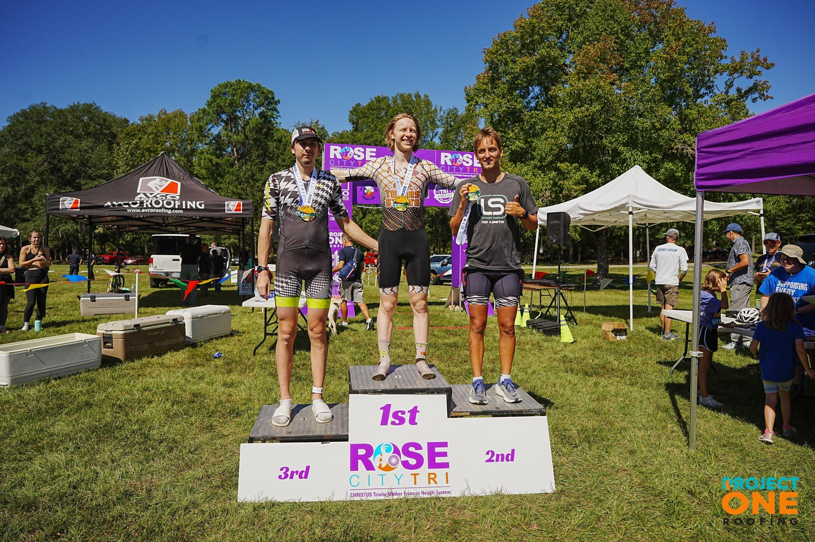
Sport Club Results & Accomplishments
Notes:
joseph stone 1st in age group, 4th overall, lucy hailey 2nd in age group, another teammate placed 3rd in collegiate women's division

Slide 21
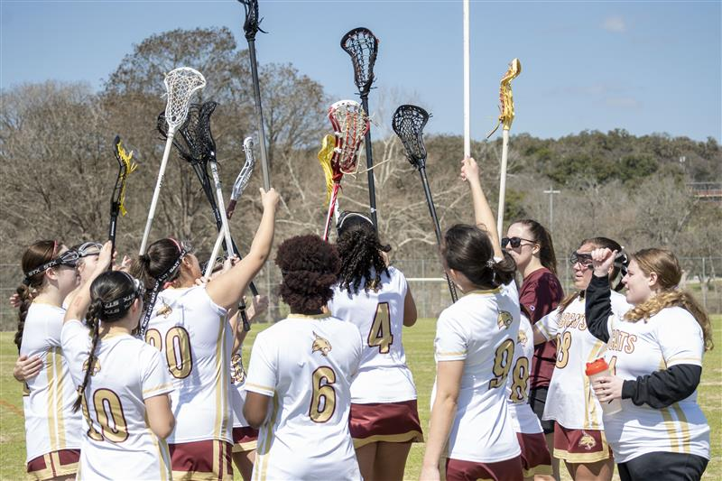
Sport Club Results & Accomplishments
Notes:
qualified for state

Slide 22
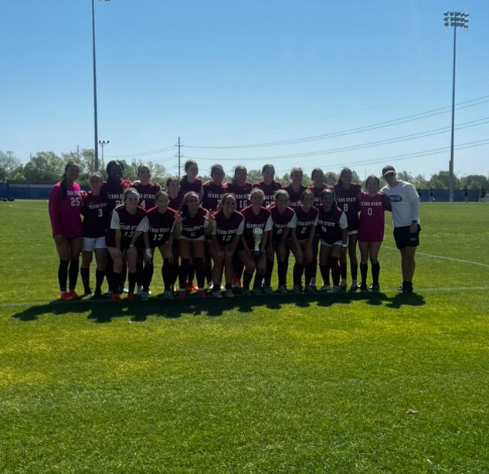
Sport Club Results & Accomplishments
Notes:
won 1st place in spring 2025 Nirsa Regional championship!

Slide 23
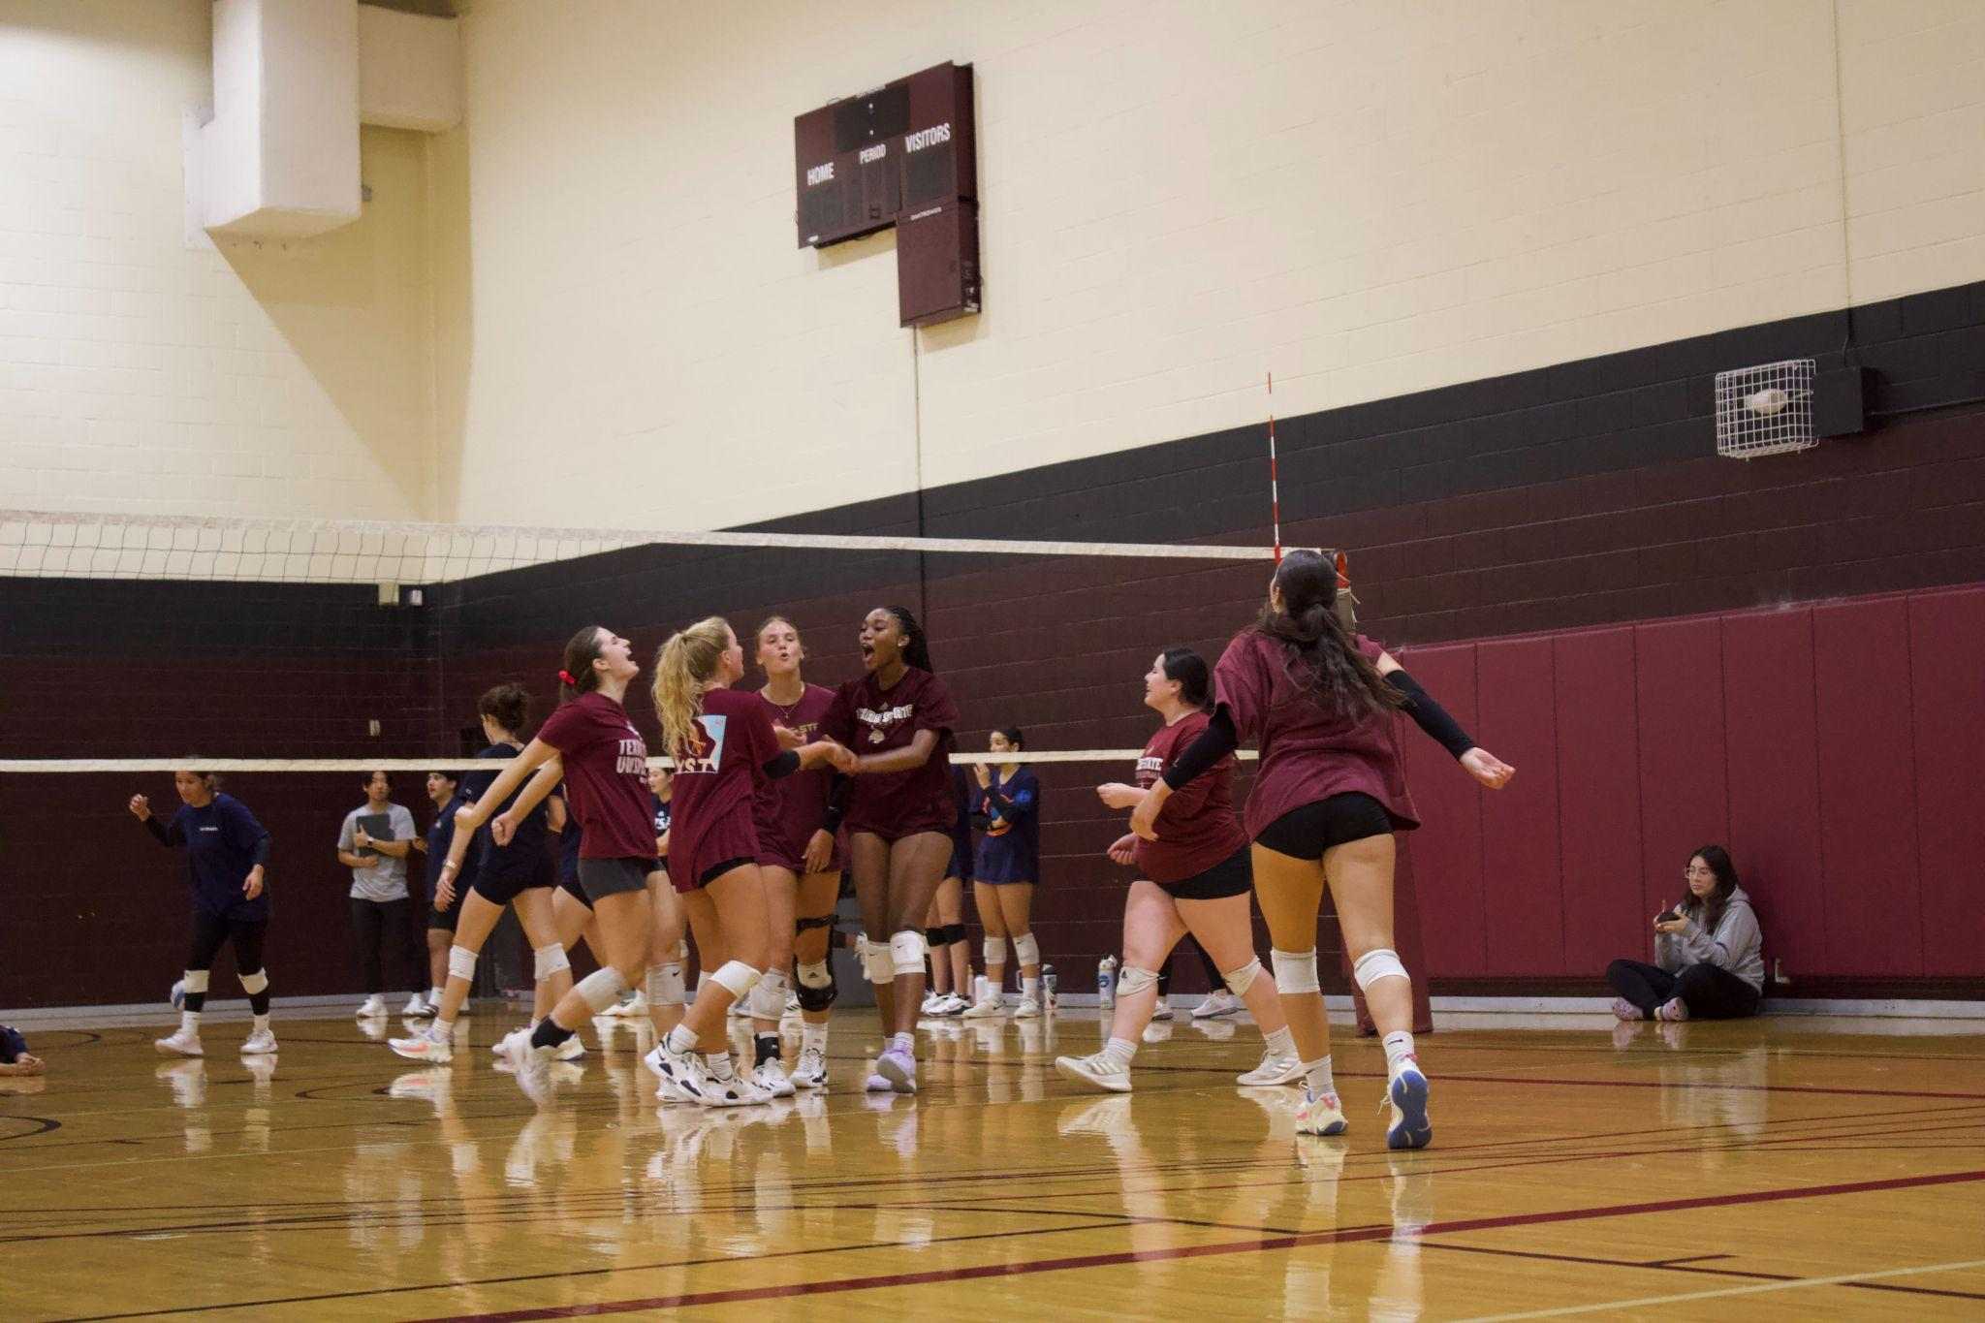
Sport Club Results & Accomplishments
Notes:
1st in the silver bracket (TAMU tournament) & qualified for nationals and elite 8

Slide 24
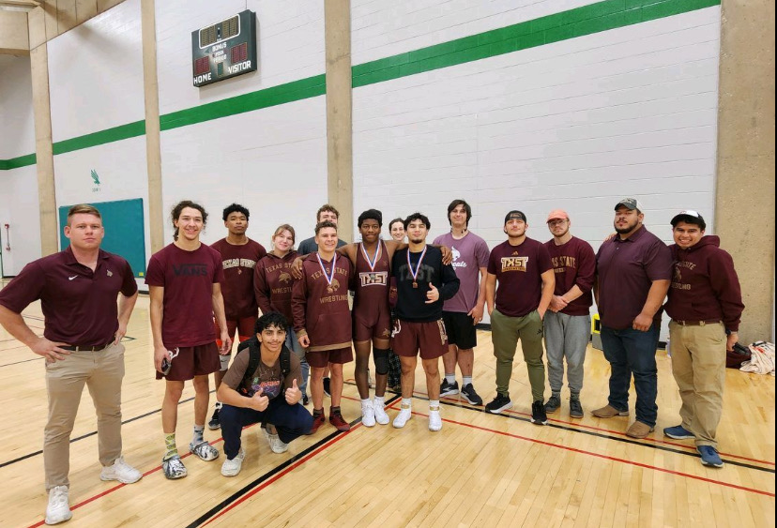
Sport Club Results & Accomplishments
Notes:
7 competitors brought, one got 2nd, 3 got 4th places and 2 got 3rd.

Slide 25
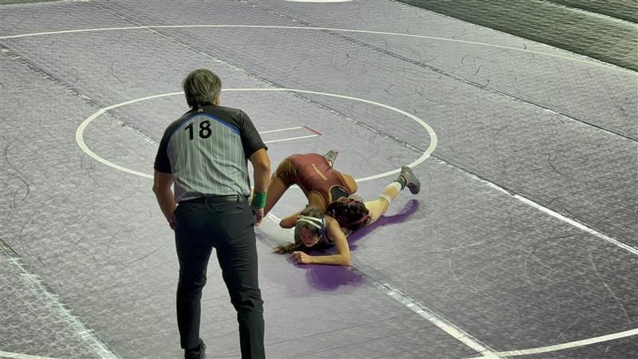
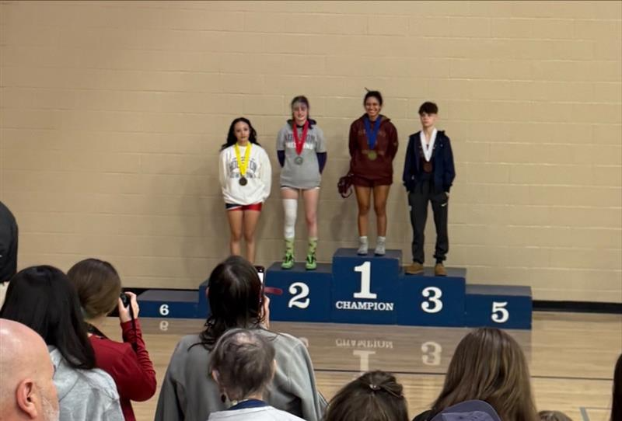
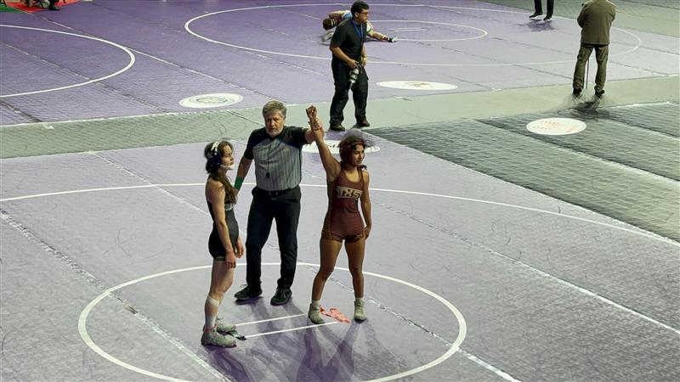
Sport Club Awards
Sport Club Athlete of the Year
3 time Conference Champion
2 time NCWA National Runner Up (2nd in the Nation)
Dedicates most of their time coaching youth team in San Marcos
Jasmine Cortez (Wrestling)
Notes:
Need to list accomplishments

Slide 26
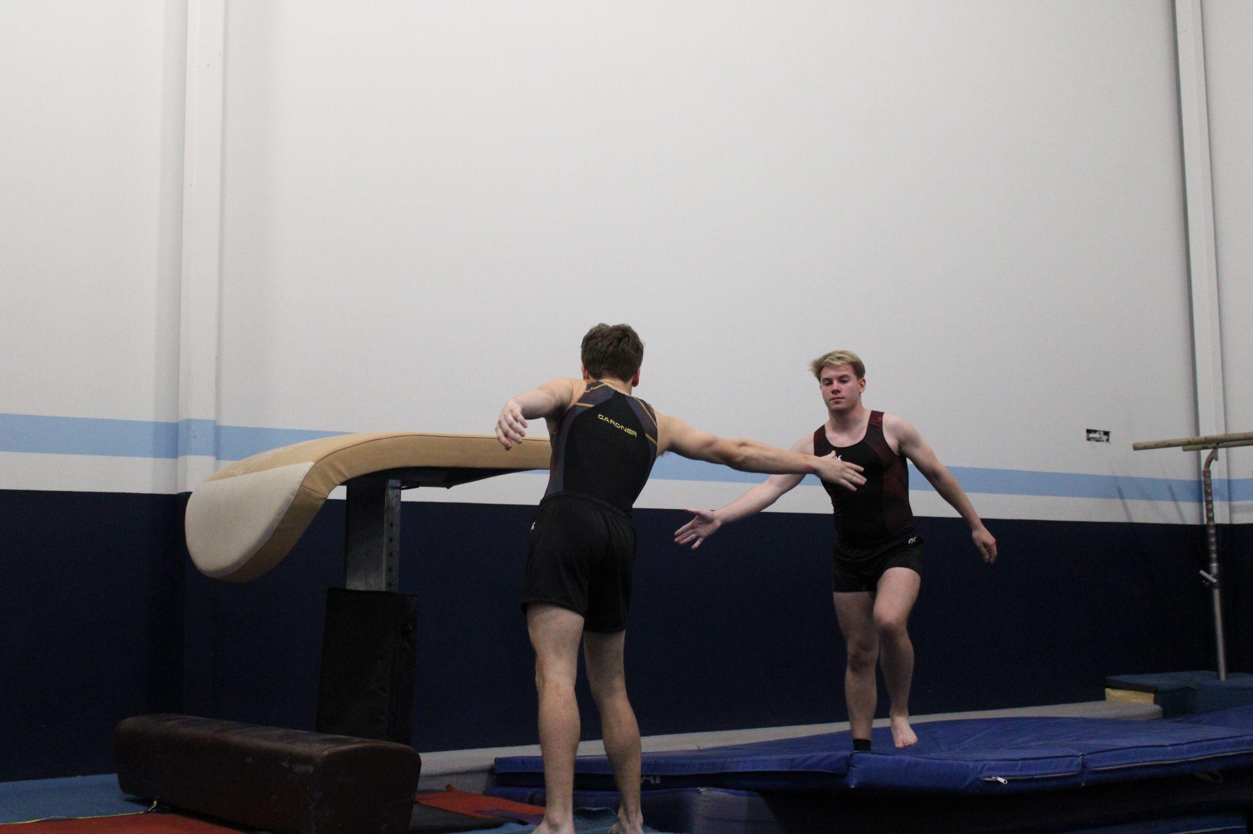
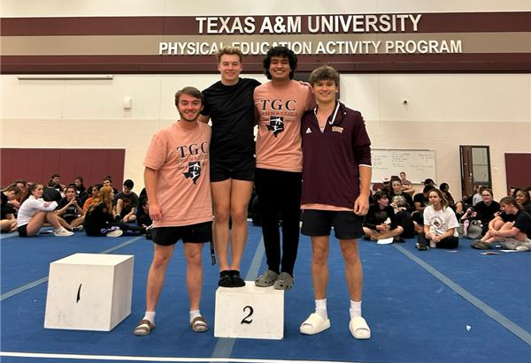
Sport Club Awards
Sport Club Officer of the Year
Submitted all Sport Club Forms prior to deadlines
Handled all member dues & external gym partnership
3rd most donations for SUFS
Successfully planned all logistics for National Competition (Pennsylvania)
Successfully led men’s team to compete and placed 2nd in UH and A&M meets (Conference Champions)
Placed top 3 in all regular season competitions
National Champion in power tumbling, 2nd in floor exercise and 3rd in balance beam
Morgan Kessler (Gymnastics)
Notes:
Need to list accomplishments

Slide 27
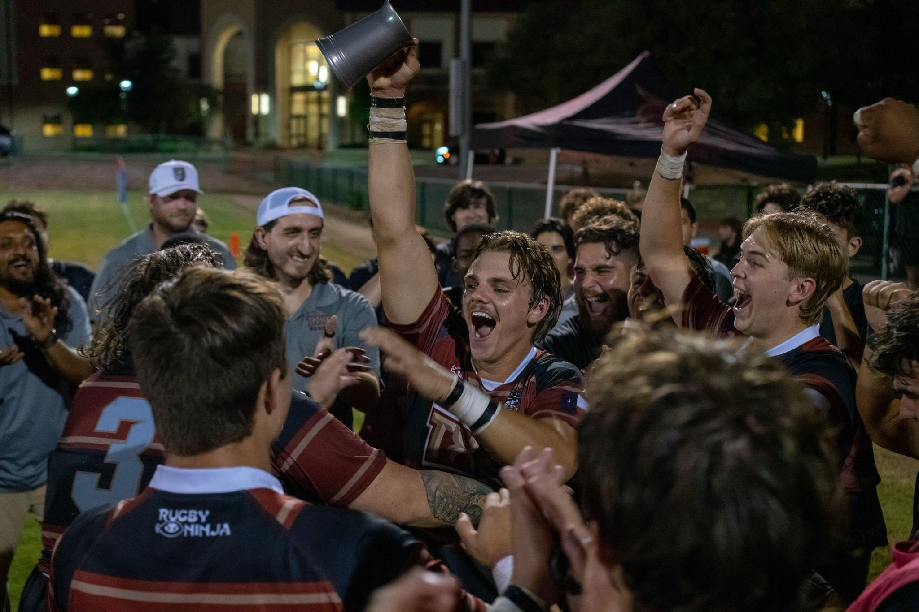
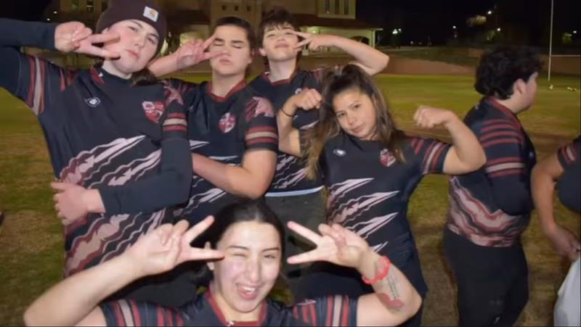
Sport Club Awards
Sport Club of the Year
Strong alumni base and coach support helped lead the team to a 9-1 season, undefeated in Conference
Ranked #10 in the Nation
Hosted and traveled to the most competitions
Hosted community & service events
Gifted a fellow sport club new jerseys
Hosted a clothing drive for a local women and children shelter
Sent gifts and sport club gear to a young Australian fan who is battling cancer
Men’s Rugby
Notes:
Need to list accomplishments

Slide 28
03
Sport Club Reminders & Deadlines

Slide 29
Sport Club Reminders & Deadlines
 | What | When | WHere
New Student Orientation | Recruitment throughout the summer! | Early June- Mid August | Student Recreation Center
RecFest | Recruitment at the beginning of Fall Sem | August 22, 2025 @ 4 pm | Student Recreation Center
Student Org. Fair | Recruit with Student Involvement & Engagement | TBD | LBJ Grand Ballroom

Slide 30
Sport Club Reminders & Deadlines
 | What | When | WHere
Sport Club Re-registration | Must complete to be a Registered Student Organization (RSO) | Sept 30, 2025 | Bobcat Organization HUB
Mandatory Risk Management Training | Must attend to become a Registered Student Organization (RSO) | Sept 30, 2025 (multiple dates for training) | In-person & virtual options
Campus Recreation Sport Club Officer Training | Attend officer training for Fall 2025 | August 29, 2025 3-5 PM | Spring Lake Conference Room

Slide 31
Sport Club Reminders & Deadlines
 | What | When | WHere
Sport Club Profile Form | Notify office on changes | May 1, 2025 | Microsoft Form
Home Event Request Form | Request Campus Recreation Facilities or equipment | July 1, 2025 | Microsoft Form
Away Event Request Form | Inform office on travel schedule | July 1, 2025 | Microsoft Form
Practice Preference Form | Request space for practices | July 1, 2025 | Microsoft Form

Slide 32
Passing the torch
04
What information is relevant to your sport club that will keep the organization successful for years to come?

Slide 33
Passing the Torch
(Take 30 minutes to discuss details!)
Referee or Athletic Trainer contacts & Process
NGO/League Contacts
Social Media Passwords
Share info on league representatives and registering for league
Disclose social media passwords and strategies
Share info on how referees / AT’s are scheduled and who to reach out to
Fundraising Strategies
Donor Information
Budget & Expenses
Step Up for State information and keeping accurate alumni & donor contact info
Previous years expenses and budget strategy (dues, apparel, officials, equipment, etc.)
Share insights on how team gathered funds (what worked/what didn’t, profit shares, hosting events, sales, etc.)

Slide 34
Thank you Graduating Sport Club Officers!

Slide 35
05
Campus Recreation Reminders & Preparation

Slide 36
Sport Club Summer Tasks
Sport Club Resource Website
Bobcat Organization HUB
Sport Club Officers Teams Channel
Has hyperlinks to forms, resources & tutorials!
All communication will happen here! Ensure you have downloaded and are added!
Re-register, remove all inactive members, assign new roles, keep accurate roster info & upload sport club specific information
Prepare for NSO & Recfest
Donor Appreciation
potential Sponsors
Tabling to recruit new members. Strategize how to encourage sport club membership
Establish relationships with new alumni and send custom “Thank You’s” to recent donors!
Reach out to potential sponsors based on sport club needs
Notes:
Changing info

Slide 37
Other Responsibilities to prepare for
Travel Requests, forms & Documents
Purchase Requests & Accounts
Home/away Event Requests
2 accounts managed by Campus Recreation
Agency & Restricted
Purchase request withdrawals money (cash advance or reimbursement)
Form on Bobcat Organization HUB
Submit microsoft form on all away competitions
Submit travel request (PDF) for each away competition
Ensure all drivers are approved drivers (Bobcat Org HUB form)
Submit microsoft form on all home / away competitions
Ensure all details are discussed with Sport Programs Office
Roster Verifications
Plan for Fundraisers & SUFS
Review Sport Club Manual
Review changes and become familiar with new policies!
Ensure that all sport club members have a current risk release on file
Profit shares, invitational tournaments/events, concessions, etc. for FY 2026
Notes:
Changing info

Slide 38
Questions or COncerns?
Mobile Contact information
Available via Teams messages (M-F 8 am - 5 pm)
In person appointments
Reach out to schedule an appointment for in depth tutorials or brainstorming ideas (M-F 8 am - 5 pm)
Other resources
Sport Club Resource webpage & Sport Club email sportclubs@txstate.edu

Slide 39
Thank You!

