Slide 1
Family Experiences
Building support and connection
Notes:
Greetings and introduction of presenter
Welcome to New Student and Family Orientation; glad you are here!
Today I will cover how you can support your student on their journey at TXST and stay connected to campus resources and engage with our parent and family activities.

Slide 2
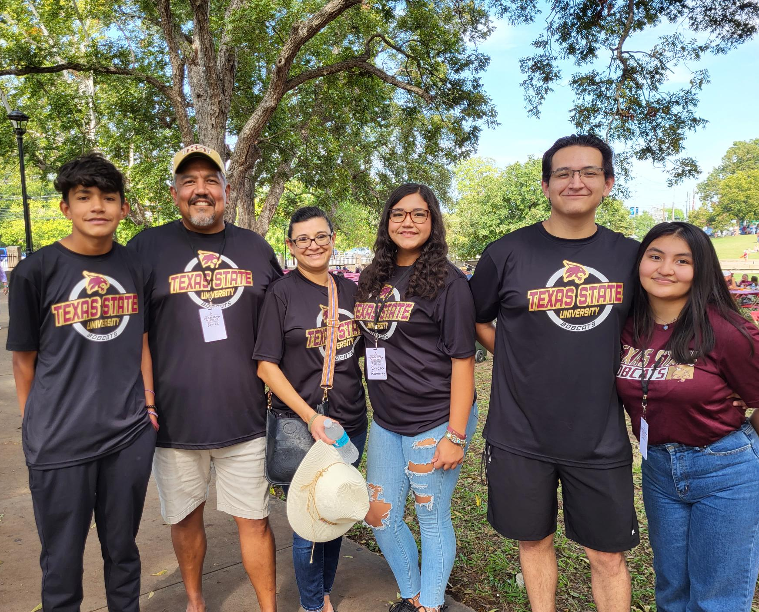
Family support Makes a difference
Notes:
Students benefit from family support and encouragement. We know from our own experiences with students that they will often ask a family member questions or seek guidance from you before they ask us, the staff. By providing you with campus information and resources, you serve as an extension of the university. When you know the basics about academic support resources, campus safety resources, and ways your student can get involved on campus, then you can coach your student towards those resources or engagement in your family communication.

Slide 3
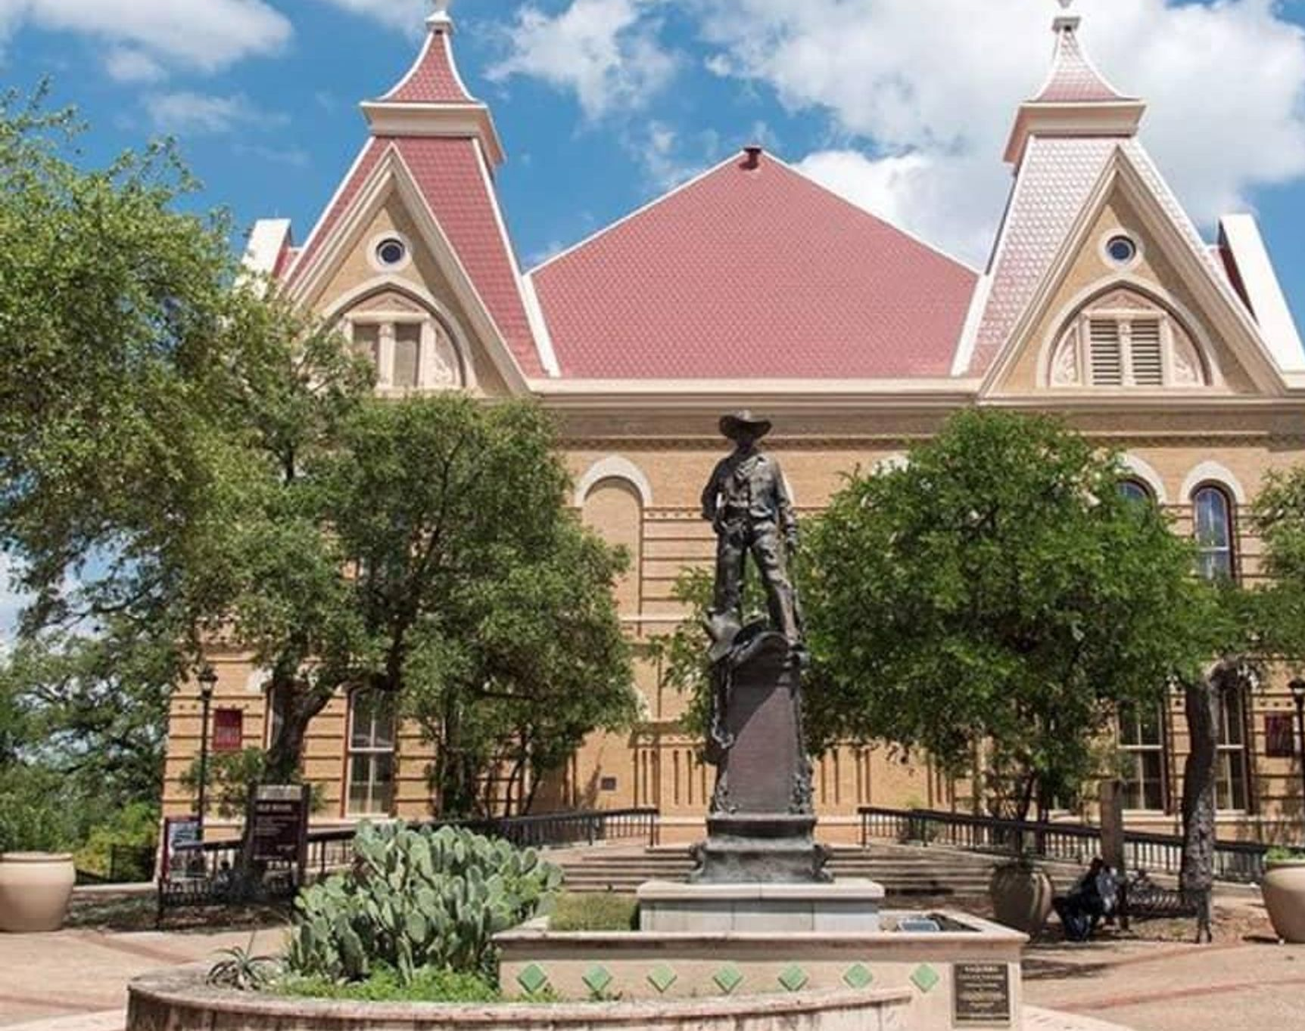
Your role as coach
Students Take the Lead
Notes:
The transition from actively parenting your student to a coach/mentor role evolves over time. As your student begins their TXST journey we encourage students to lead the transition and to take the necessary actions to ensure their success. Students should contact faculty when needed, handle roommate challenges, complete scholarship applications, and similar actions that lead to their growing autonomy. Family members can support this necessary growth by encouraging students to take the lead and seek their advice when needed.
I keep an image in my head of a bicycle. If you have ever taught someone to ride a bike, you know the last phase of that training is you pushing them from behind, letting go, and sending them forward. They might be wobbly, but as they continue to practice, they get better and more confident in themselves. I think that is a good metaphor for this college transition. Let them take the lead on riding the bike. They will circle back around to you to celebrate accomplishments, seek advice, and connect along the way.

Slide 4
Communication
Notes:
v

Slide 5
family Communication Channels
Bobcat Family Portal
Family Experiences Website
Family Experiences Facebook
New Student and Family Experiences
Notes:
The Bobcat Family Portal is an online service that provides e-newsletters for families highlighting important dates and deadlines, campus resources and upcoming events.
Our website has resources and tools you can access on demand.
Our Facebook page is the official university account for parents and families.

Slide 6
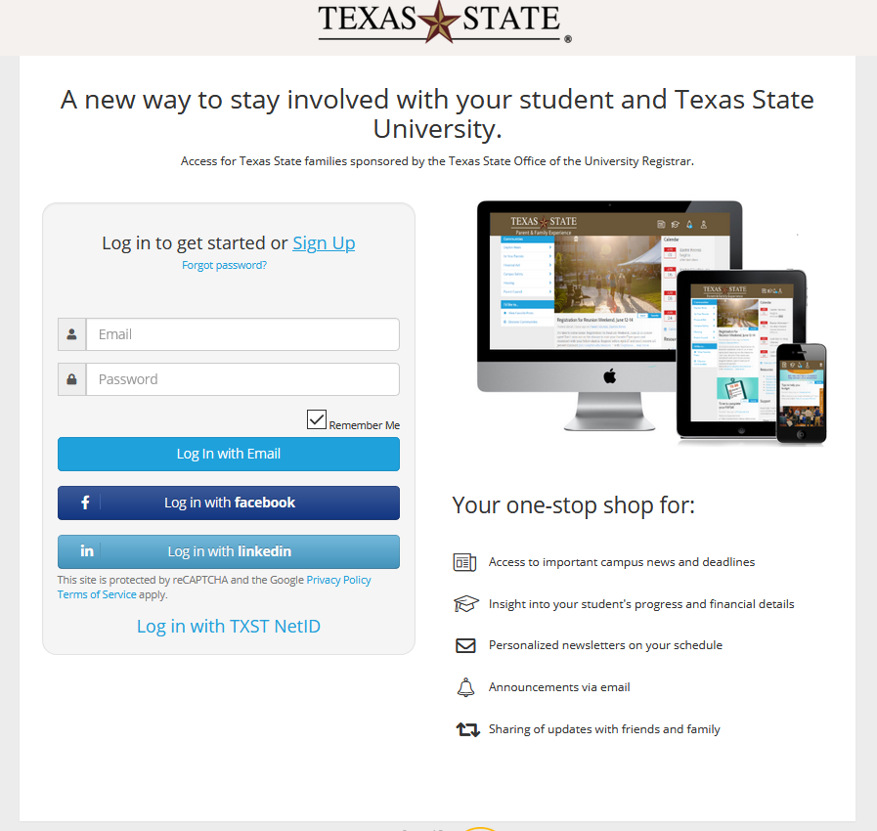
Bobcat family portal
Free!
Join with your email
FERPA Access/Student Connection
The Family Educational Rights and Privacy Act governs access to educational information and records
Stay connected
Bobcat Family Portal Live
New Student and Family Experiences
Notes:
The Bobcat Family Portal is free for all parents and family members. You can create an account using your email address. Through the portal you will receive a bi-weekly e-newsletter with short articles about campus resources, important dates and deadlines, and other helpful information for you and your student. I encourage you to use the e-newsletter as a tool to help your student when they come to you with questions or guidance. This is a great way to digest in small bites the information shared with you at NSO, plus useful and timely information throughout the year.
Lets jump into a live tour so I can show you the portal components and how to connect with your student, which is optional.

Slide 7
Notes:
The Bobcat Family Portal is free for all parents and family members. You can create an account using your email address. Through the portal you will receive a bi-weekly e-newsletter with short articles about campus resources, important dates and deadlines, and other helpful information for you and your student. I encourage you to use the e-newsletter as a tool to help your student when they come to you with questions or guidance. This is a great way to digest in small bites the information shared with you at NSO, plus useful and timely information throughout the year.
Lets jump into a live tour so I can show you the portal components and how to connect with your student, which is optional.

Slide 8
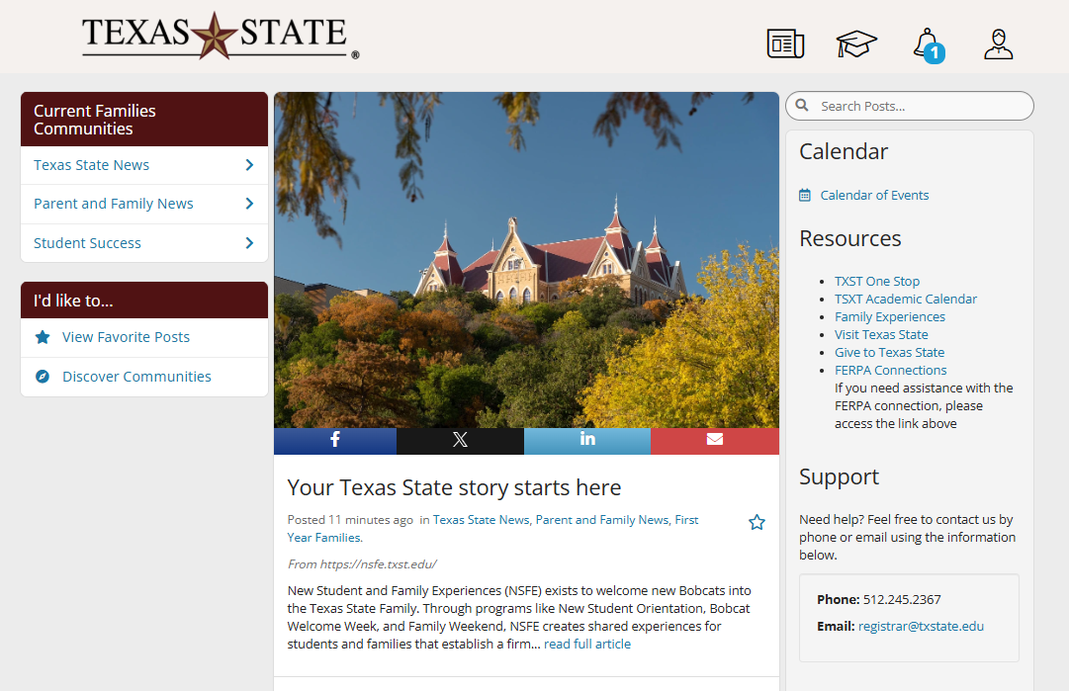
Bobcat Family Portal Live
Notes:
The Bobcat Family Portal is free for all parents and family members. You can create an account using your email address. Through the portal you will receive a bi-weekly e-newsletter with short articles about campus resources, important dates and deadlines, and other helpful information for you and your student. I encourage you to use the e-newsletter as a tool to help your student when they come to you with questions or guidance. This is a great way to digest in small bites the information shared with you at NSO, plus useful and timely information throughout the year.
Lets jump into a live tour so I can show you the portal components and how to connect with your student, which is optional.

Slide 9
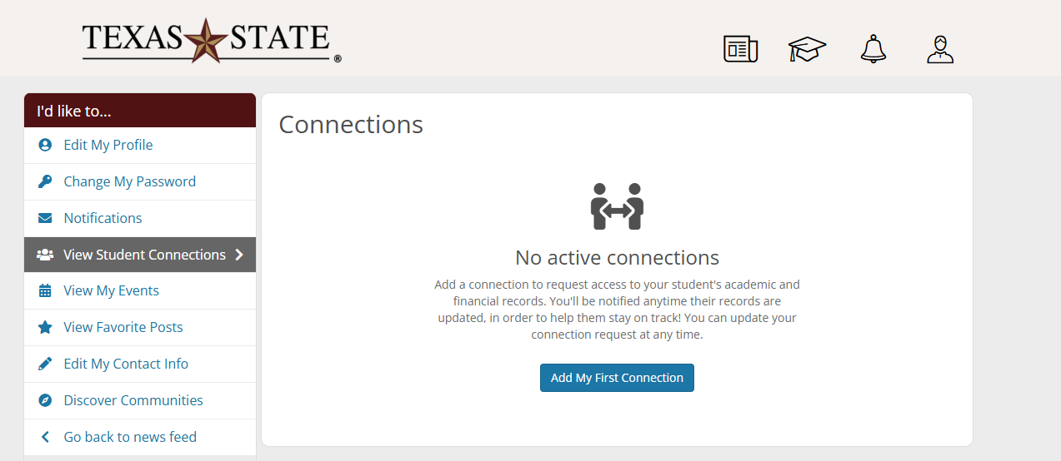
Notes:
The Bobcat Family Portal is free for all parents and family members. You can create an account using your email address. Through the portal you will receive a bi-weekly e-newsletter with short articles about campus resources, important dates and deadlines, and other helpful information for you and your student. I encourage you to use the e-newsletter as a tool to help your student when they come to you with questions or guidance. This is a great way to digest in small bites the information shared with you at NSO, plus useful and timely information throughout the year.
Lets jump into a live tour so I can show you the portal components and how to connect with your student, which is optional.

Slide 10
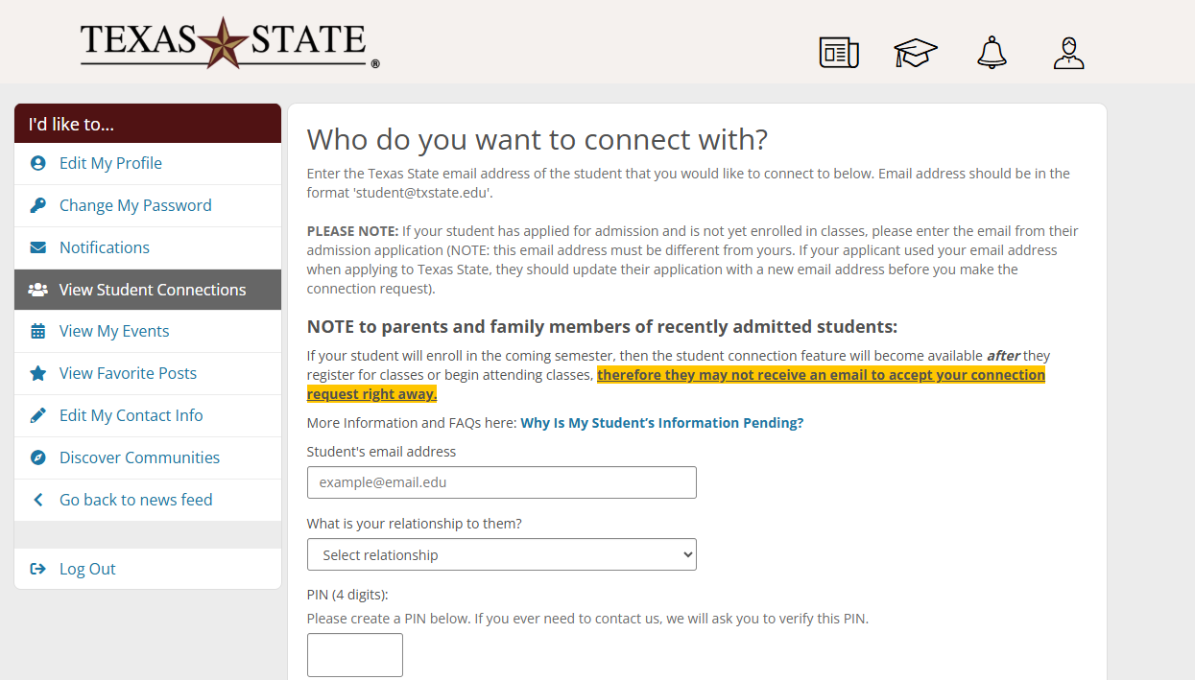
Only Student EMAIL
njn32@txstate.edu
Notes:
The Bobcat Family Portal is free for all parents and family members. You can create an account using your email address. Through the portal you will receive a bi-weekly e-newsletter with short articles about campus resources, important dates and deadlines, and other helpful information for you and your student. I encourage you to use the e-newsletter as a tool to help your student when they come to you with questions or guidance. This is a great way to digest in small bites the information shared with you at NSO, plus useful and timely information throughout the year.
Lets jump into a live tour so I can show you the portal components and how to connect with your student, which is optional.

Slide 11
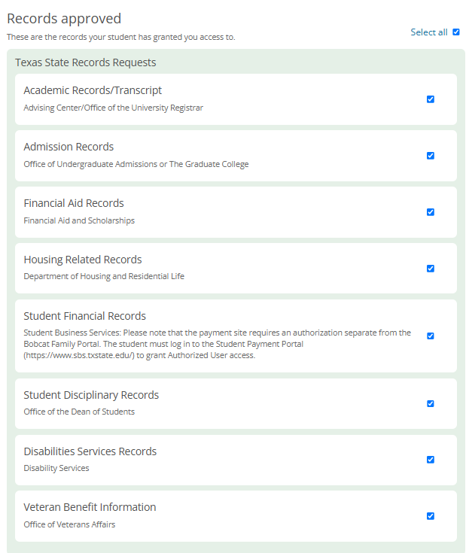
Notes:
The Bobcat Family Portal is free for all parents and family members. You can create an account using your email address. Through the portal you will receive a bi-weekly e-newsletter with short articles about campus resources, important dates and deadlines, and other helpful information for you and your student. I encourage you to use the e-newsletter as a tool to help your student when they come to you with questions or guidance. This is a great way to digest in small bites the information shared with you at NSO, plus useful and timely information throughout the year.
Lets jump into a live tour so I can show you the portal components and how to connect with your student, which is optional.

Slide 12
Notes:
The Bobcat Family Portal is free for all parents and family members. You can create an account using your email address. Through the portal you will receive a bi-weekly e-newsletter with short articles about campus resources, important dates and deadlines, and other helpful information for you and your student. I encourage you to use the e-newsletter as a tool to help your student when they come to you with questions or guidance. This is a great way to digest in small bites the information shared with you at NSO, plus useful and timely information throughout the year.
Lets jump into a live tour so I can show you the portal components and how to connect with your student, which is optional.

Slide 13
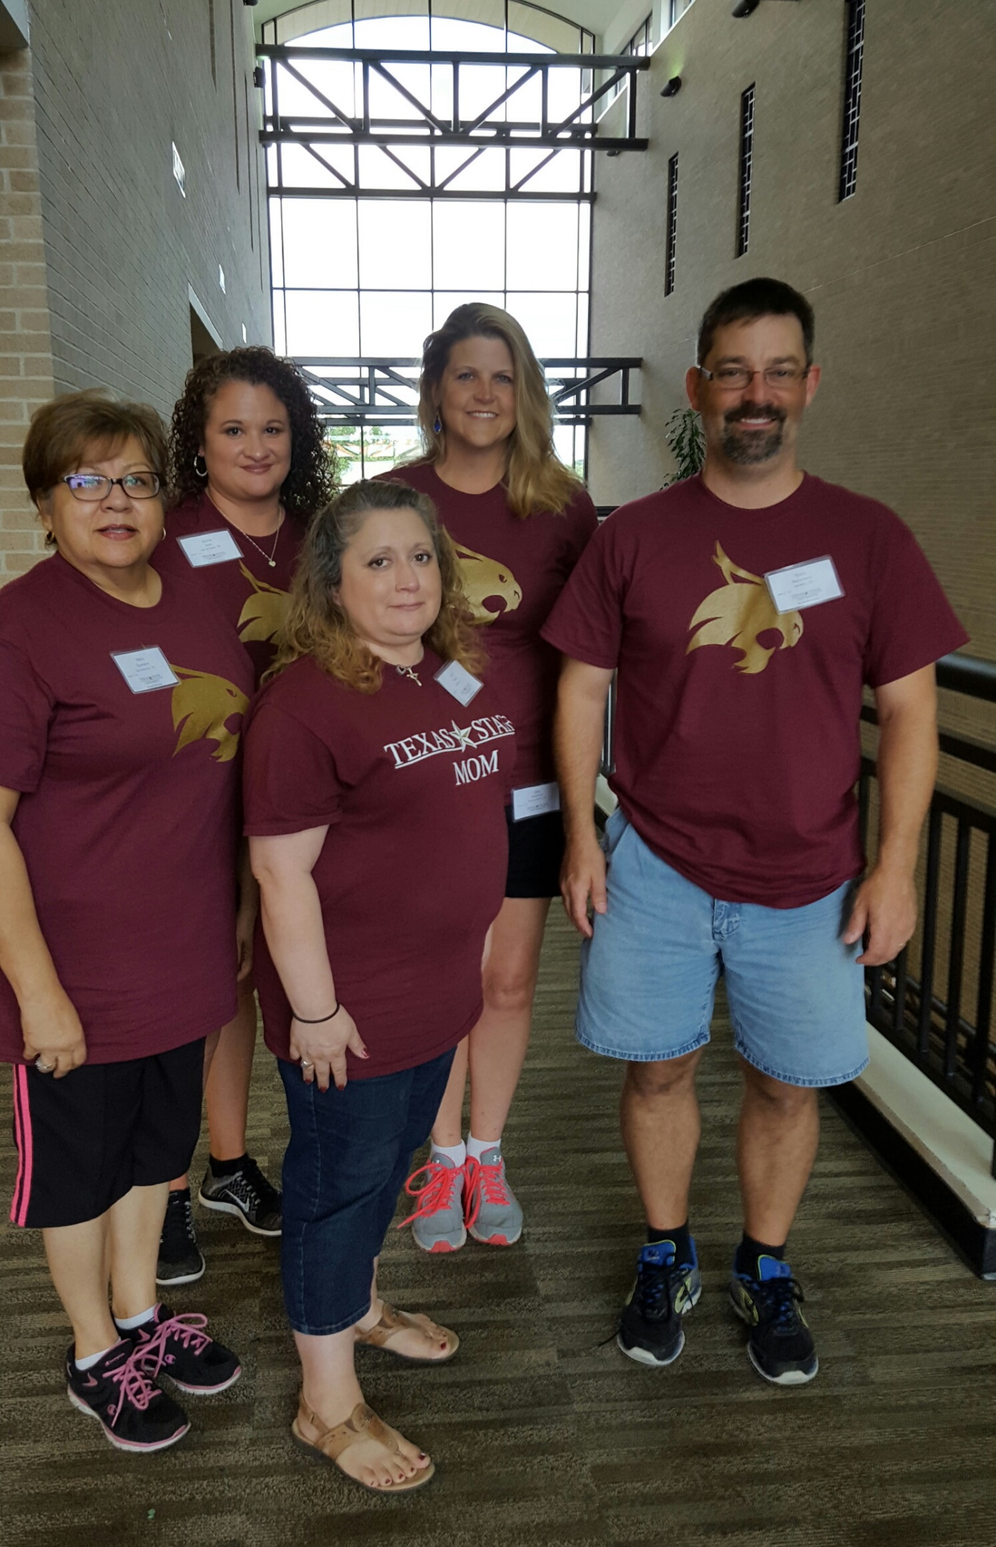
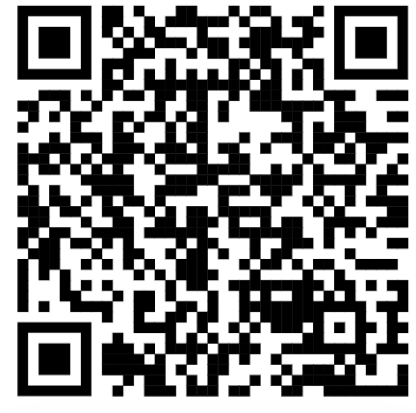
Website
Resources and Tools
Family of the Year
Family Association
Recursos en Espanol
A-Z Guide
Conversation Starters
In An Emergency
Recommended Reading
Stay Informed
Bobcat Family Portal
Webinars
Facebook
New Student and Family Experiences
Notes:
Our website is full of resources, and I invite you to browse the website over the summer to familiarize yourself with information that might be helpful now, and other information that might be helpful in the future. I will briefly describe a few now.
Our brand new A-Z guide can help you quickly find the campus department or resource you need to find by category. This new resource was co-created with our families who serve on our Parent and Family Advisory Council. Their goal was to help families connect with campus departments and services using common words family members use when looking for information.
In An Emergency gives the blueprint for communication and resources for a campus emergency. Should we experience an emergency, this page will post updates and connect you with other resources. Additionally, our office will share those messages through our Facebook page and through the Bobcat Family Portal. I encourage you to review this information this summer with your student to be prepared to know about these resources should they become necessary.
Our website can link you to the Bobcat Family Portal, our Facebook page, and other resources. I encourage you to bookmark our page and use it to help navigate campus. You will also find our contact information so we can assist you with any questions.

Slide 14
Family Association
Notes:
The Family Association supports our Parent and Family program in many ways and has been the foundation for serving families at TXST for almost 50 years.

Slide 15
Family Association
Since 1976
Supporting all Bobcat families through a dues-based organization
Student Scholarships
Five endowed scholarships provide students with financial awards to support their success
Parent and Family Advisory Council
Members provide the voice of the TXST family community
New Student and Family Experiences
Notes:
The Family Association began in 1976 with the goal of supporting Bobcat families through a dues-based organization. Similar to high school booster clubs, the Family Association uses member dues to support student success. The Family Association awards annual scholarships through 5 endowed scholarships, with students receiving up to $2000 each. Students compete for these scholarships each spring semester through a competitive application process and their awards are applied for the next academic year bill. On our website you will find a list of requirements for each scholarship. We just announce our winners, and the scholarship will open again next spring for students who qualify.
The Family Association also hosts the Parent and Family Advisory Council. Made of 20 family members, these volunteers come to campus 3 times per year plus digitally engage throughout the year to provide feedback on the resources and services our program provides to parents and family members. Council members serve on our scholarship committee, provide feedback on Family Weekend plans, and listen to the needs of family members to make the best recommendations for our services. Our council is currently full, but when we have open seats available, current members of the Family Association are invited to apply.

Slide 16
Family Association Scholarships
2022
12 students
$22,500
2023
14 students
$25,200
2024
13 students
$25,800
2025
14 Students
$25,800
New Student and Family Experiences
Notes:
The Family Association has a long history of providing student scholarships. Here is the breakdown of the past 3 years, including this year where we reached our record high amount of $25,800 in student scholarships. Over 500 applications are received for these scholarships, and we can award more students with more fundraising. With the support of Family Association members, we hope to continue to grow the number of students we support through scholarships.

Slide 17
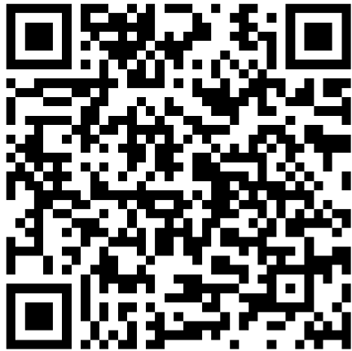
Join us!
All memberships are one per household
Memberships are tax deductible
Annual membership $40
Four-Year membership $150
New Student and Family Experiences
Notes:
Family Association memberships are tax deductible donations through the university. Memberships are one per household. A 1-year membership is $40, and a 4-year membership is $150. When you join as a new member this summer, you will be entered into an opportunity to win one of 6 scholarships provided through our partners at University Federal Credit Union, known as UFCU. They will provide 6 families who have joined this summer, selected at random, with a $500 scholarship to apply towards your student’s bill in August. You don’t have to take any additional actions to be entered into this drawing, other than joining the Family Association through one of the membership options by July 31.

Slide 18
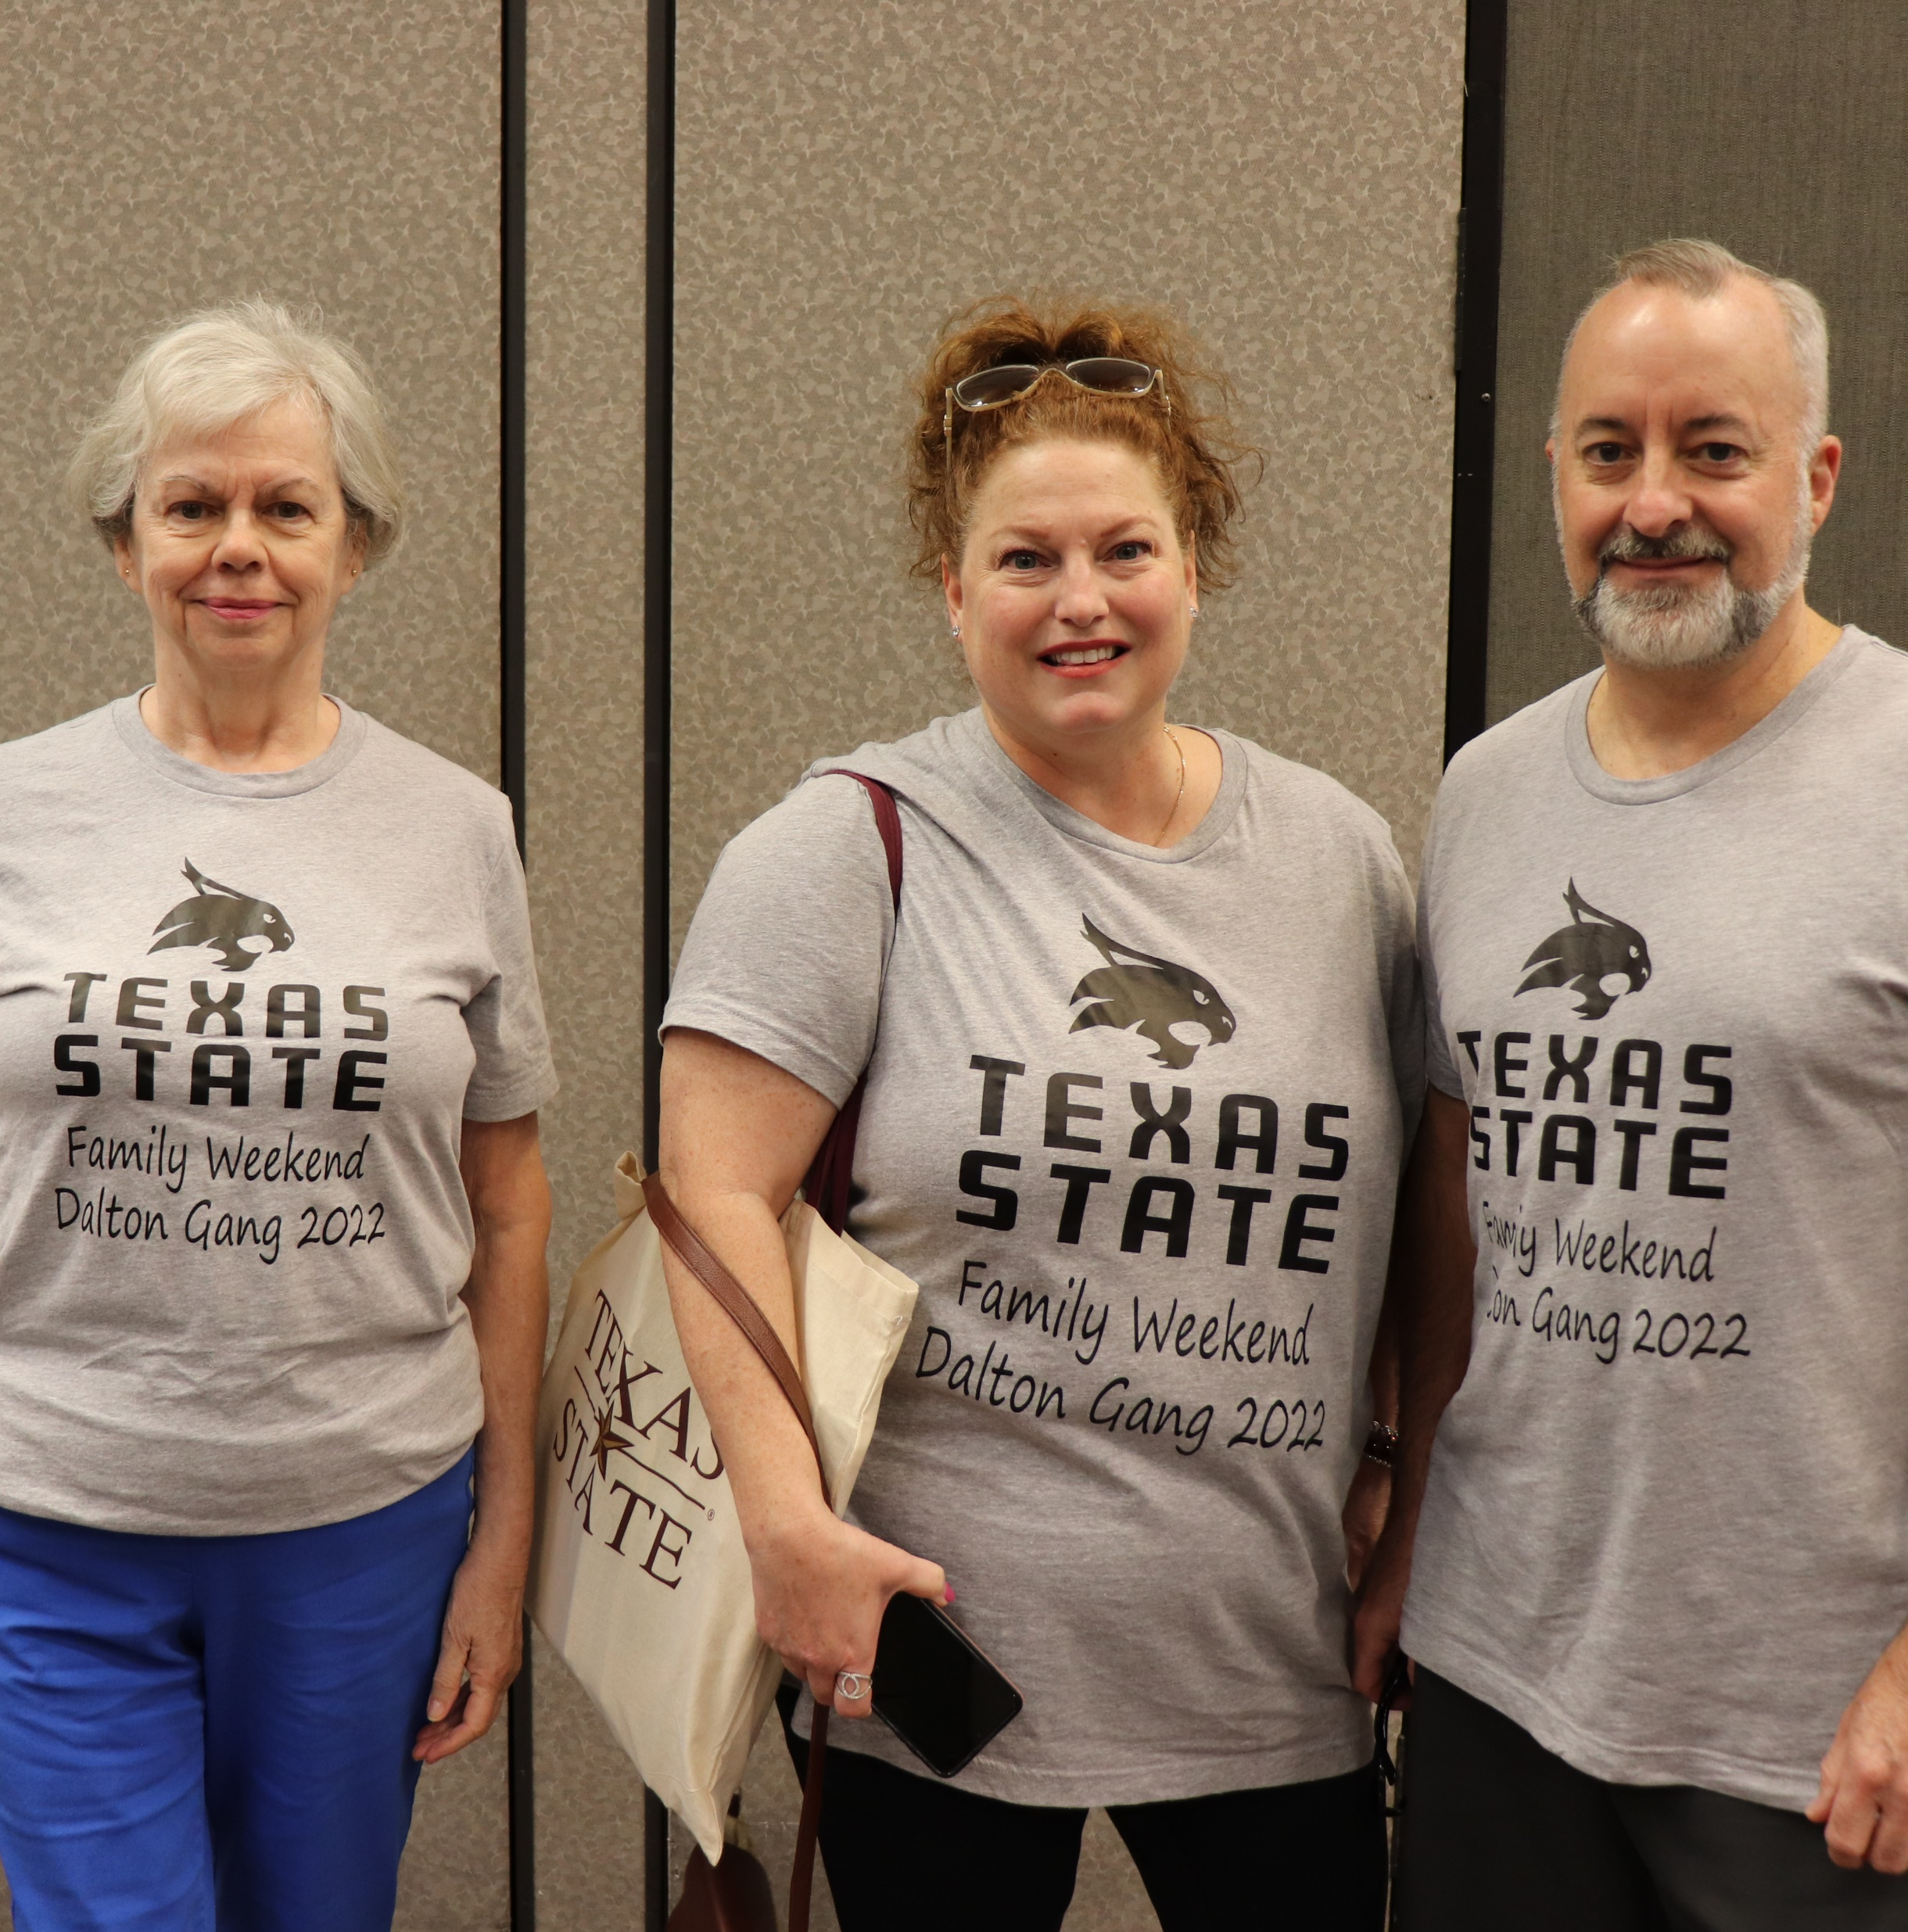
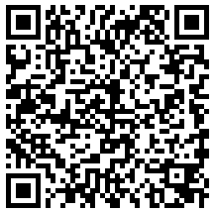
Win Tuition!
$5 per raffle ticket
(3)Students win $2,000 each
(3)Students win $1,000 each
Purchase on our website
Drawing held end of July
Funds applied to the fall bill
New Student and Family Experiences
Parent and Family Relations
Notes:
One way we raise funds for our program is through our annual Tuition Raffle. Raffle tickets are $5 each, and you can purchase as many as you like. All purchases are done online through our Parent and Family Relations website. On July 31 we will conduct the drawing for winners, and 3 students will win $2,000 each, and 3 students will win $1,000 each. These funds will be applied towards your student’s fall bill. No scholarship essay, no minimum GPA, just a chance (or 2 or3!) to win money to be used to credit their bill in August.

Slide 19
Family Weekend
Notes:
Finally, lets share some information about our annual fall Family Weekend.

Slide 20
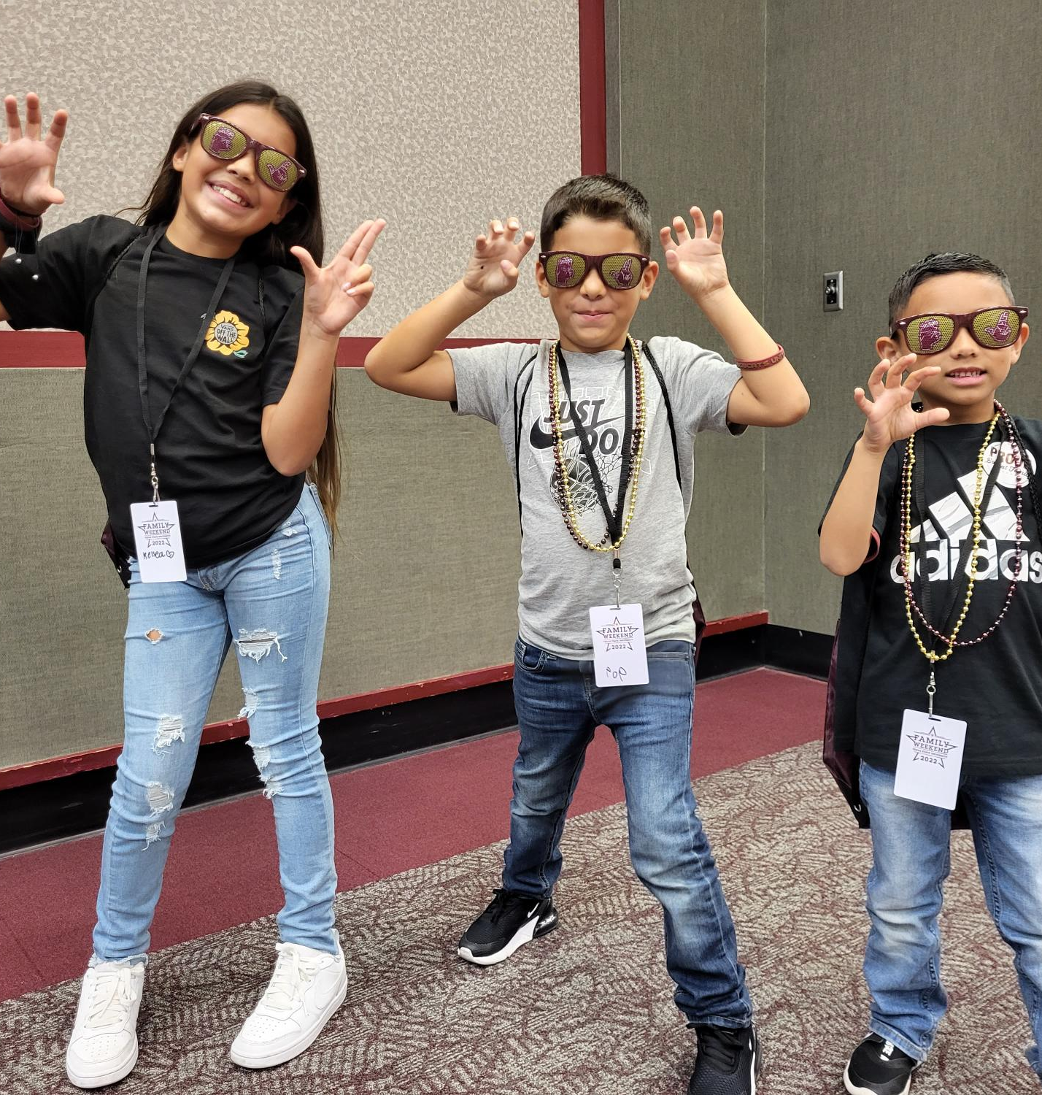
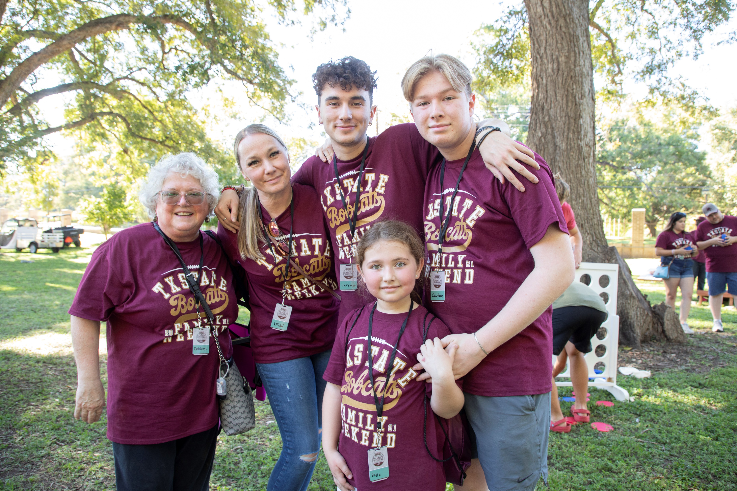
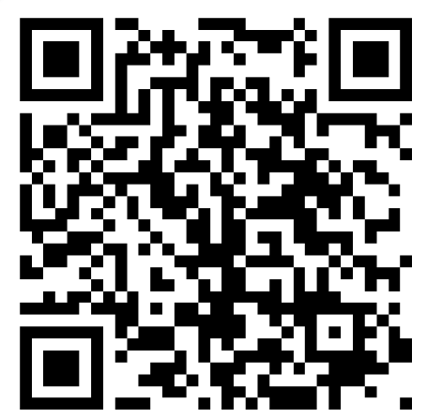
Come Back for Family Weekend
New Student and Family Experiences
Notes:
Family Weekend is set for October 11-12, when our TXST Bobcats take on University of Louisianna Monroe at our home football game. In addition to cheering on the Bobcats, we will have activities both on and off campus for families to enjoy. We are actively working on building our schedule of events and ticket information. This is a family-friendly event, and all family members are welcome to participate. Over the next several months we will provide updates and information through our communication channels mentioned earlier.

Slide 21
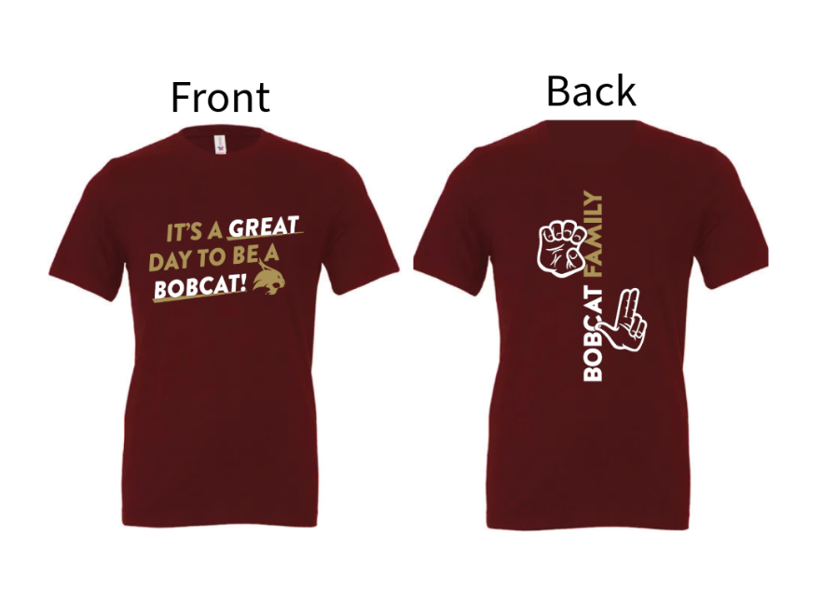
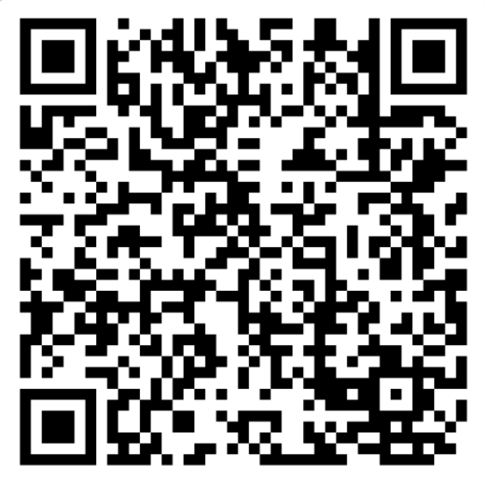
Don’t forget your Family orientation Shirt
$15
Student shirt
Family shirt
New Student and Family Experiences
Notes:
Family Weekend is set for October 11-12, when our TXST Bobcats take on University of Louisianna Monroe at our home football game. In addition to cheering on the Bobcats, we will have activities both on and off campus for families to enjoy. We are actively working on building our schedule of events and ticket information. This is a family-friendly event, and all family members are welcome to participate. Over the next several months we will provide updates and information through our communication channels mentioned earlier.

Slide 22
Stay Connected New Student and Family Experiences
512-245-4326
parentandfamily@txstate.edu
parentandfamily.txstate.edu

Facebook.com/BobcatFamily
New Student and Family Experiences
Notes:
If you have your phone handy, this is a great slide to take a photo of so you know how to get back in touch with us. Joining the Bobcat Family Portal, following us on Facebook, and joining the Family Association are all great ways to stay connected and engaged with our program.

Slide 23
THANK YOU!
Notes:
Thank you for participating in NSO with your student!
Visit our table in the hallway for some goodies.
Questions?

