Slide 1






YOUR STUDENT'S SAFETY, HEALTH,
& WELL-BEING
What You Need to Know to Support Your Student!
Sponsored by:
Associate Vice President for Student Success and Dean of Students

Slide 2

OUR TIME TOGETHER...
Because...
  Texas State University is the equivalent to a small city...
  TXST is a small city within a bigger city - San Marcos...
  we understand that many students are navigating living on their own for the first time...
  we understand that Safety, Health, and Well-Being are linked to academic success...
WE’RE HERE TO HELP!

Slide 3






WHAT WE KNOW ABOUT YOUR STUDENT...
TYPICAL STUDENT EXPERIENCE
  Academic / Class Concerns
  New Environment Concerns
  Personal Changes
  Emotional Challenges and Growth
  First Onset of Mental Health Concerns
  Continued Mental Health Concerns
  Loneliness
  Roommate Conflict
  Poor Diet
  And More…
SPECIFIC TO TEXAS STATE
ANXIETY
LACK
OF SLEEP
ILLNESS
POOR
RELATIONSHIPS
NOT
“BELONGING”

Slide 4
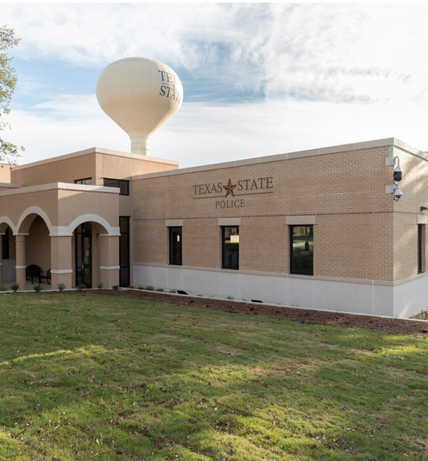

CAMPUS SAFETY
UNIVERSITY POLICE DEPARTMENT
  Full-service police department.
  Employs various highly trained individuals:
    State Certified Officers
    Public Safety Officers
    Student Public Safety Officers
  Patrol and Dispatch operate 24/7.
  Administration operates
M – F, 8 a.m. to 5 p.m.
SAN MARCOS STATION
Pecan
1321 Academy Street
ROUND ROCK STATION
Campus Services
155 University Blvd
NON-EMERGENCY: 512-245-2805
EMERGENCY: 911

Slide 5

SAFETY RESOURCES & TRAININGS
  Bobcat Safe Rides
  Blue Light Call Boxes
  Emergency Safe Rides
  Naloxone
  Student Police Academy
  Civilian Response to Active Shooter Events (CRASE)
  Emergency Response Training
  Personal Safety
  Rape Aggression Defense System (R.A.D.)
  Self Defense
  Stop the Bleed
  CPR/First Aid/CPR
EMERGENCY NOTIFICATIONS
Emergency notifications via text, email, banner, on the homepage, social media, and desktop alerts (desktops must be owned by the University).
TXSTATE ALERTS
  All users with a @txstate.edu email are automatically opted in.
  Users must opt in to receive text message alerts.
  Bobcats may add other email/phone numbers.
JEANNE CLERY ACT
  Crime statistics provided in Annual Security and Fire Report
  Link to report on the UPD website
IN COMPLIANCE WITH THE JEANNE CLERY DISCLOSURE OF CAMPUS SECURITY AND CAMPUS CRIME STATISTICS ACT
(20 USC §1092(F), 34 CFR 668.46)

Slide 6
STUDENT CONDUCT & COMMUNITY STANDARDS
A UNIT WITHIN THE DEAN OF STUDENTS OFFICE
STOP CAMPUS HAZING ACT!
TXST prohibits hazing in any form by or to students and employees.
  University Penalty for Violation of the TXST Hazing Policy - Code of Student Conduct
  State of Texas Violation of the Texas Ethics Commission 37.152
  Individual & Organizational Investigations
Student Conduct is an
Adjudication Process that Covers:
  Behavior On/Off Campus
  Interpersonal Student Behavior
  Classroom Behavior
  Housing Behavior
Students Must Understand this
Governing Document
Code of Student Conduct
  Individual Student Rights & Responsibilities
  Prohibited Conduct
  Disciplinary Procedures for Alleged Violations
  Student Organization Rights & Responsibilities
DRUG FREE SCHOOLS
AND COMMUNITIES ACT
TXST prohibits the unlawful possession, use, or distribution of illicit drugs and alcohol by students and employees on the institution’s property or as any part of the institution’s activities.
  University Penalty for Violation of the TXST Drug-Free Schools and Communities Policy - Code of Student Conduct
  State of Texas Violation of the Texas Ethics Commission 37.152
TRANSPARENCY IS KEY!
POLICIES, RESOURCES, AND SANCTIONS/FINES RELATED TO UNIVERSITY, STATE, AND FEDERAL VIOLATONS ARE FOUND ON THE DEAN OF STUDENTS WEBSITE.
Notes:
Hazing means any intentional, knowing, or reckless act, occurring on or off the campus of an educational institution, by one person alone or acting with others, directed against a student, that endangers the mental or physical health or safety of a student for the purpose of pledging, being initiated into, affiliating with, holding office in or maintaining membership in an organization.

Slide 7
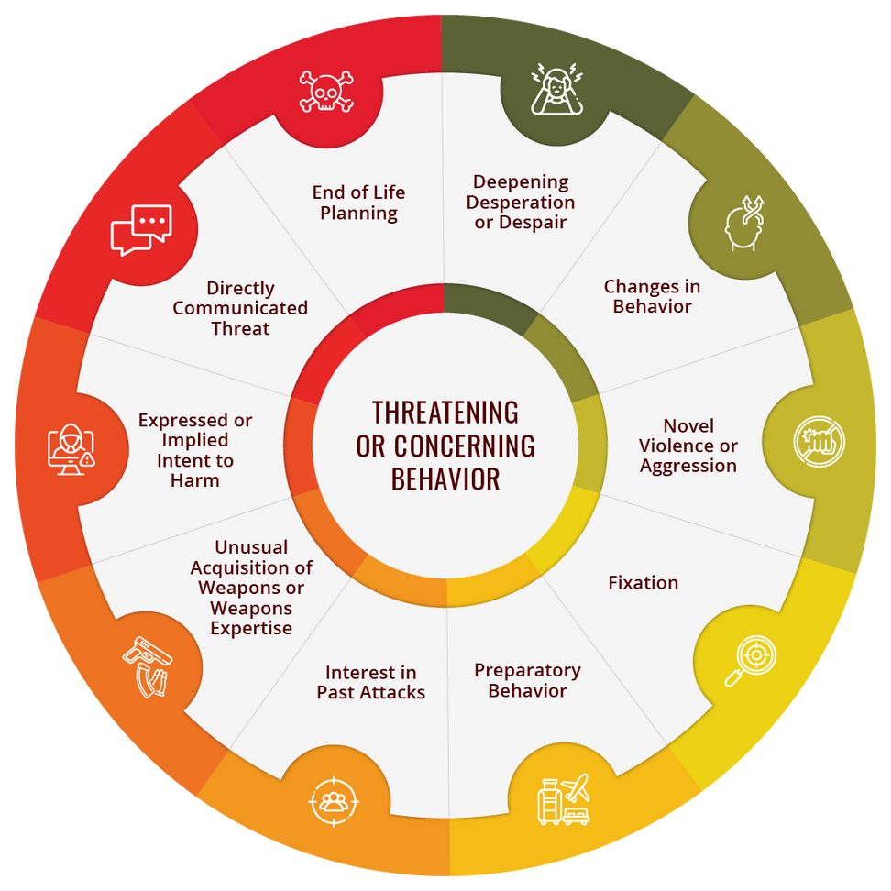
STUDENT BEHAVIOR ASSESSMENT TEAM
A RESOURCE WITHIN THE DEAN OF STUDENTS OFFICE
The Student Behavior Assessment Team (SBAT) reviews cases of a student's disruptive behavior(s), which includes online activities, that interrupt the learning environment and/or
functions of the university.
Please note that the Family and Educational Rights and Privacy Act (FERPA) allows student information to be shared when the information contains direct observations and/or concerns for a student's health or safety.
Notes:
SBAT provides consultations to those who have expressed concern about the behavior of a student who appears potentially dangerous to the university community or could be disruptive to the academic mission of the university.

Slide 8
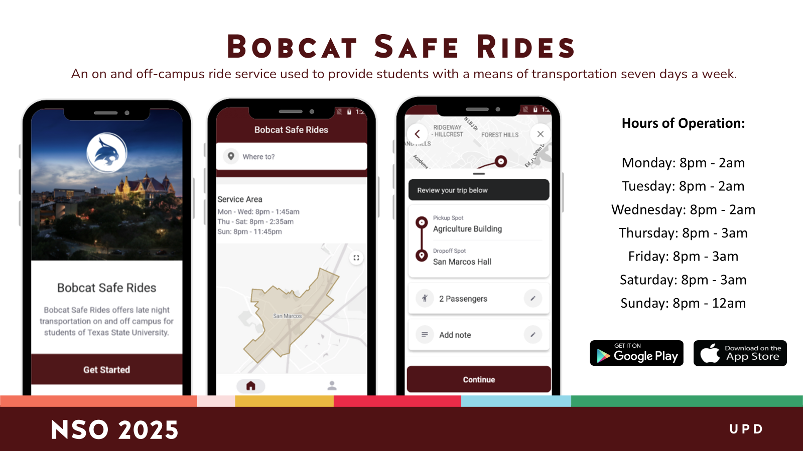

Slide 9
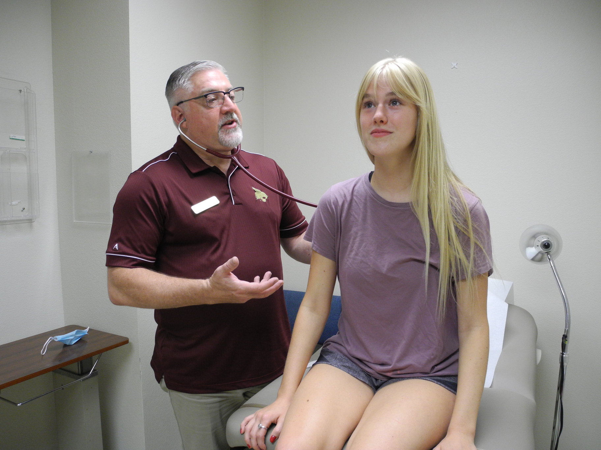
UNIVERSITY HEALTH SERVICES
COMPREHENSIVE SUPPORT
Student Health Center
  Same-Day Healthcare
  Primary Care
  Preventive Services
  Mental Health Services
  Reproductive and Sexual Health
  Travel Health
  Sports Medicine
  On-Site X-ray and Lab
Licensed, Accredited & Confidential
College Health Professionals

Slide 10
AFFORDABLE CARE
Private insurance
Visiting the SHC is the most affordable option for TXST students. Check out our payment options!
We will always care for a student, regardless of their ability to pay.
Discounted care for uninsured patients
Additional discounts for those with Medicaid
Pay now or transfer to student account

Slide 11

COUNSELING CENTER
COMPREHENSIVE SUPPORT
Located in LBJSC
  Individual Short-Term Counseling
  Group Counseling
  Urgent Services & Crisis Response
  Psychiatric Referrals
  Consultations
  Community Resource Coordination
Licensed, Accredited & Confidential
Mental Health Professionals

Slide 12
1
PREPARE
YOUR STUDENT BY CREATING A MENTAL HEALTH GAME PLAN
Consult with current provider(s)
2
Consider maintaining current provider(s)
3
Review website for assistance locating long-term therapy options
If you are already receiving mental health services…
4
Start creating routines this summer that will promote good mental health

Slide 13
CARE TEAM
COMPASSION, ADVOCACY, RESOURCES, AND EDUCATION
A UNIT WITHIN THE DEAN OF STUDENTS OFFICE
1 on 1 Direct Support and
Access to Resources
The CARE Team is Here to Help!
Complete a
“Here to Help” Form
on the TXST website to request
support for a student of concern.
Wellness Checks
CARE Team
Department of Housing and Residential Life
University Police Department
  Troubles navigating the everyday and don’t know where to turn
  Concerned about a friend and don’t know where to start to get them help
  Referrals to Financial Support
  Referrals to Physical & Mental Health Support
  Food Security Resources
  Housing Security Resources
  Child Care Resources
  Referrals to University Police Department
  Referrals to the Title IX Office
  Referrals to Academic Support

Slide 14
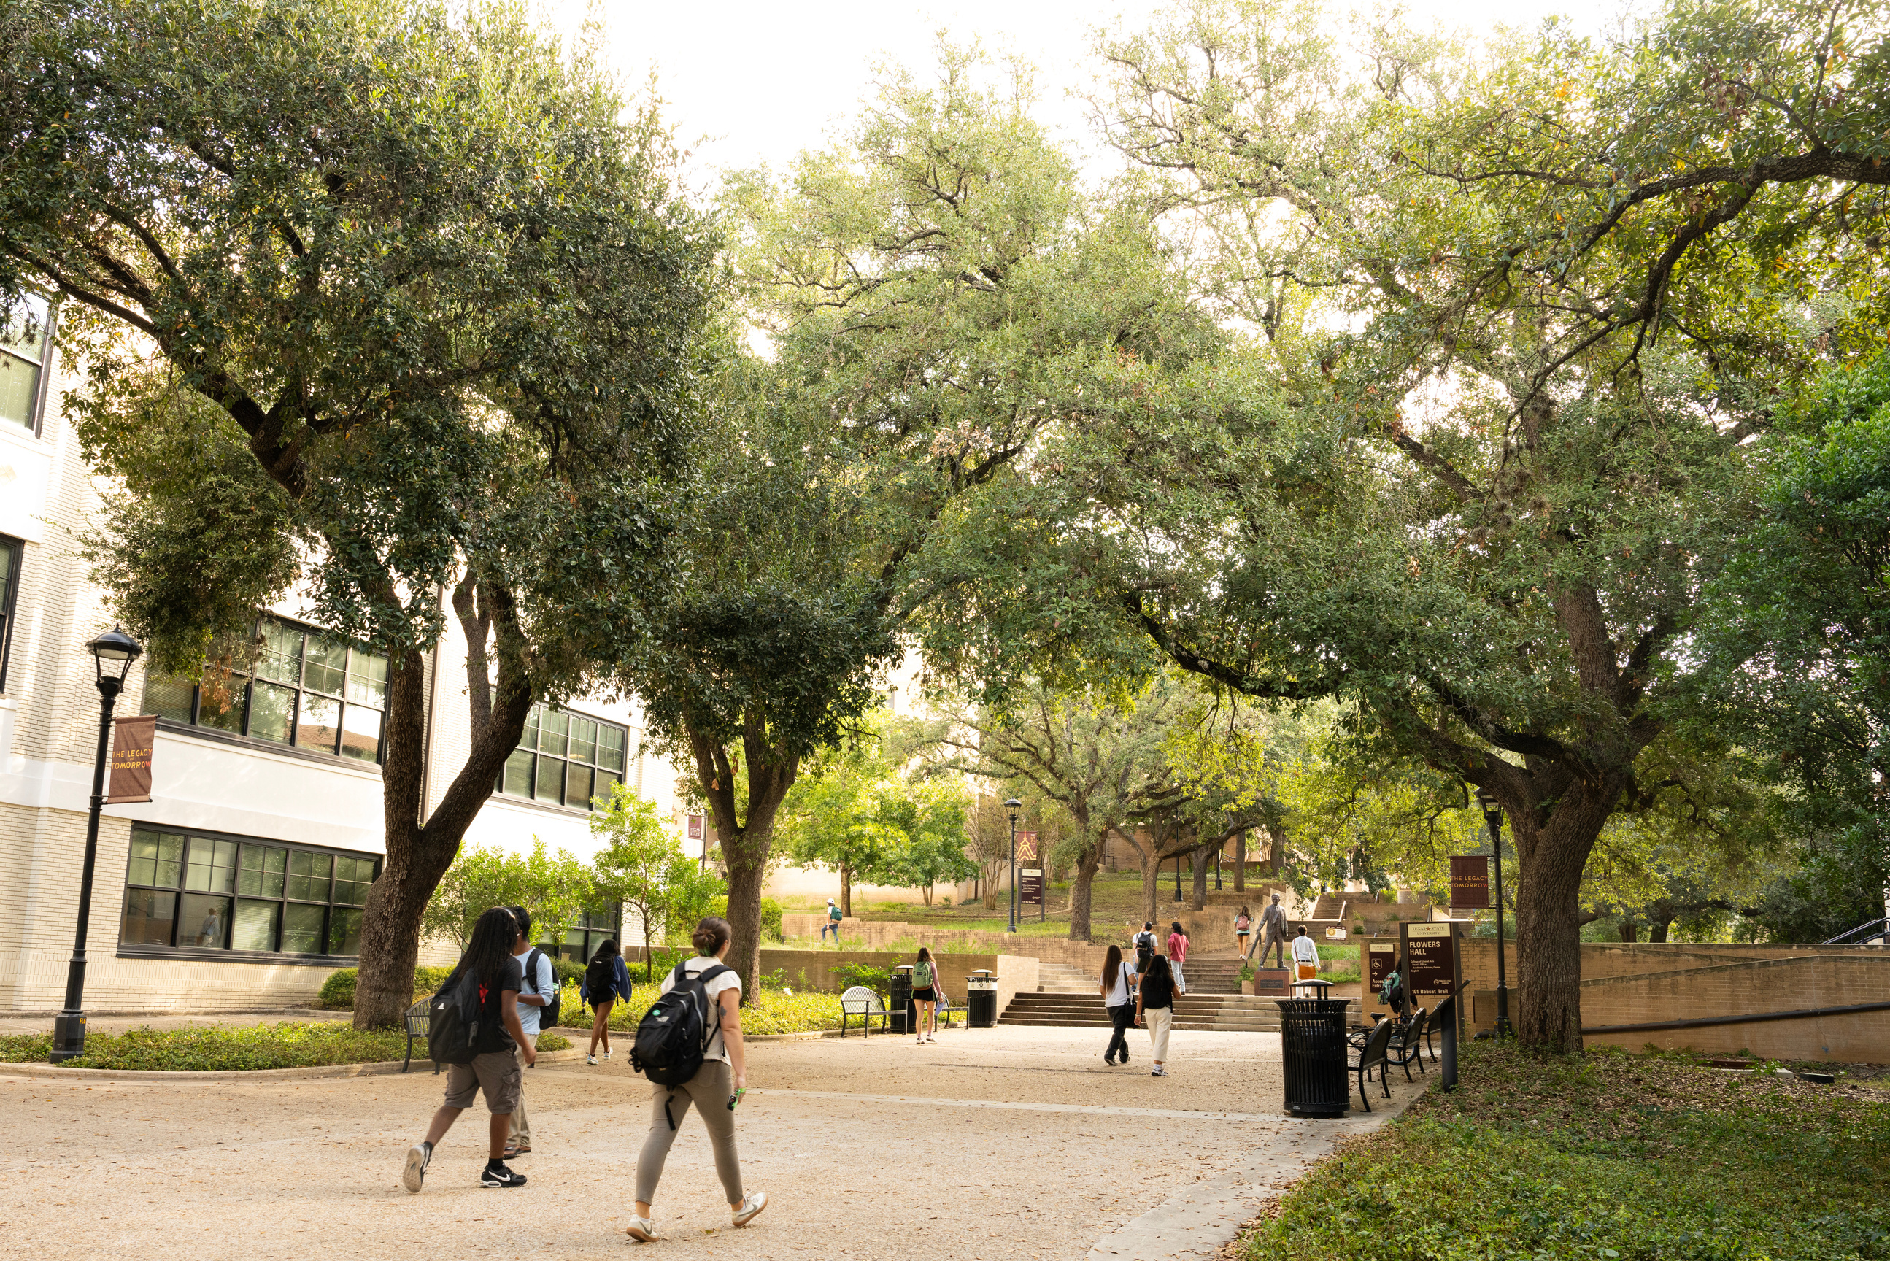
Dean of Students Office
Services and Resources are
Available to All TXST Students
  Absence Notifications
  Basic Needs Hub
  Emergency Funding
  Support for Students Affiliated with the Foster Care System
  International Student Support
  Ombudsperson to discuss Academic concerns and options informally with.
  Parenting Students Support
  Support for Students Needing an Attorney
  Veterans and Military Connected Student Support
  and more...

Slide 15
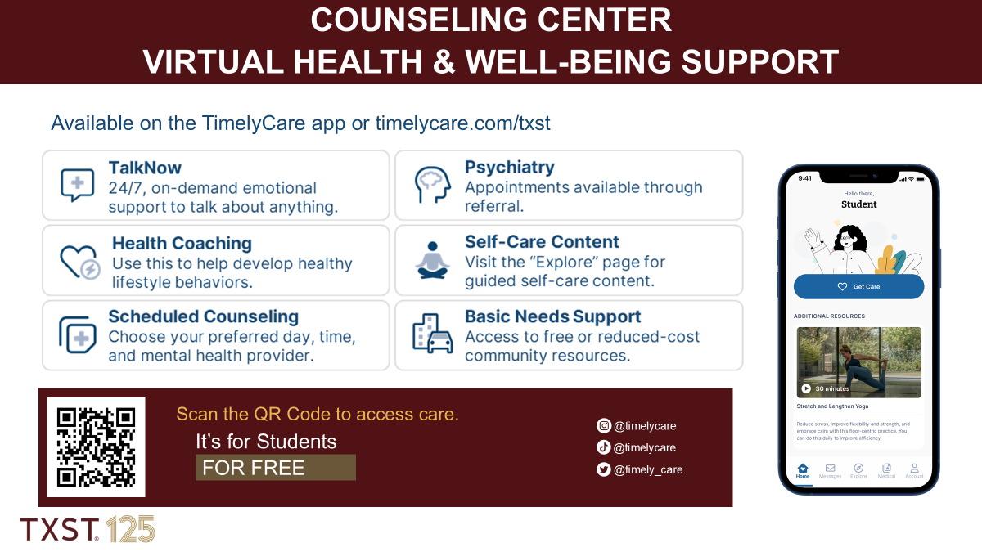
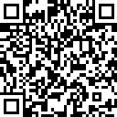
TIMELY CARE VIRTUAL HEALTH & WELL-BEING SUPPORT

Slide 16
FREQUENTLY ASKED QUESTIONS
Q: What can I do if my student gets sick?
You can advise them to contact the Student Health Center to schedule an appointment or they can schedule an appointment online. They can also call the Health Center’s phone number after hours to be connected to a registered nurse and get advice on how to care for themselves.
Q: What does it cost for healthcare?
The Student Health Center takes private insurance. There are discounts for students without insurance and those with Medicaid. Students may pay at the time of service, or have the charge placed on their student account.

Slide 17
FREQUENTLY ASKED QUESTIONS
Q: What does my student need to do if they miss class?
First, they should communicate with their professor. They may also submit an Absence Notification Form through the Dean of Students Office due to emergency absences such as hospitalization. A Here to Help form can also be submitted if your student would like to talk through why they need to miss class.
Q: What can I tell my student if they see something unsafe?
Suggest they talk to their RA, submit a Here to Help Form, and/or contact the Dean of Students Office. If it is urgent, and your students’ safety feels threatened, they should contact the University Police Department immediately.
Q: What can I expect if I submit a Here to Help Form?
A staff member from the Dean of Students Office - CARE Team will contact you to discuss your concerns.

Slide 18
FREQUENTLY ASKED QUESTIONS
Q: Is counseling offered for conditions that require specialized treatment?
No, the Counseling Center doesn’t offer treatment requiring specialized treatment - you can consult with the Counseling Center to learn in your condition applies or not.
Q: What can I do if I’m concerned for my student’s health and
well-being?
You can submit a Here to Help form, email the Dean of Students Office, call the Dean of Students Office, or walk-in to the Dean of Students Office.

Slide 19
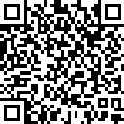
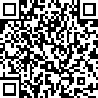
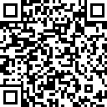
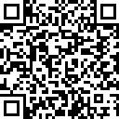
QUESTIONS FOR THE REPRESENTATIVES?
DEAN OF STUDENTS
UNIVERSITY POLICE
dosoffice@txstate.edu
512.245.2124
512.245.2805
UNIVERSITY HEALTH SERVICES
COUNSELING CENTER
counselingcenter@txstate.edu
512.245.2208
healthcenter@txstate.edu
512.245.2161

