Slide 1
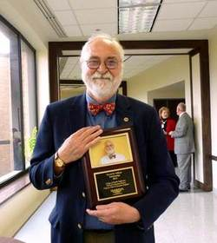

David M. Falleur Scholarship
The David M. Falleur Scholarship for College of Health Professions’ (CHP) students was established in honor of Mr. David Falleur for his service as chair for 39 years in the Clinical Laboratory Science Program.
Mr. Falleur received his Bachelor of Science in Medical Technology and Master of Education degrees from the University of Florida. Mr. Falleur was appointed as Program Chair in 1974. He has stepped down as Program Chair, but continues his service to CHP students as an Associate Professor of Clinical Laboratory Science.
Application deadline: April 1, 2026
Scholarship Guidelines:
· Recipient must be enrolled at Texas State University in a minimum of 12 semester credit hours for undergraduate students or 6 semester hours for graduate students.
· Maintain a minimum GPA of 3.0
· Admitted to a major in health professions: Clinical Laboratory Science, Communication Disorders, Health Administration, Health Information Management, Nursing, Physical Therapy, Radiation Therapy, and Respiratory Care.
How to apply: Application for scholarships can be completed through the Bobcat Online Scholarship System (BOSS) at https://onestop.txst.edu/financial-aid/scholarships/boss.html
Texas State University is a tobacco-free campus.

