Slide 1

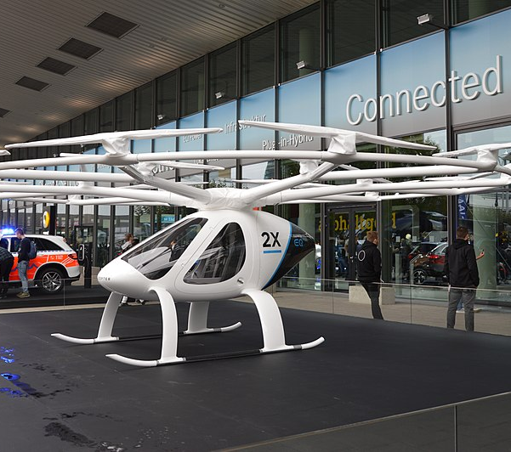
Management of Organizations
MGT 3303
Simulation 1
Creative Commons Attribution-Share Alike 4.0 International

Slide 2

What are E-VTOLs?
Electric Vertical Take-Off and Landing aircraft…take off and land like a helicopter.
Also known as ”air taxis”
What’s the Market Opportunity?
global market projected to reach US$18 Billion by 2030 (47.5% CAGR from 2023 to 2030)
What’s Driving Growth?
traffic congestion and need for efficient mobility in densely populated areas
growing emphasis on sustainable, low-emission transportation
advancements in electric propulsion, battery technology, and autonomous flight systems
significant investment and interest from private companies, startups, and public authorities to develop urban air mobility
ongoing development of regulatory frameworks for urban air mobility

Slide 3
Teams and Objectives
Teams of 8-9 members
Teams work together throughout semester on 4 simulations and a final team “synthesis” presentation
Teams will take an EVTOL start up through its evolution by making decisions on strategy , planning, organizing, leading and controlling
Team goal for each simulation: research issues, make recommendations, have a rationale for recommendations
Teams will use Generative AI to do more thorough research and refine recommendations/rationale
Teams present findings, recommendations on “poster” (more to come)
Team graded as a whole, but team may decide to allocate points differentially among members participating in the workshop
Team members not present for a workshop receive a zero grade.
Team may recommend chronically non-participating member be terminated from team

Slide 4
Grading Rubric
INSIGHT
Does the team thoroughly research issue (within time allotted)?
Does the team have clear point of view/recommendations?
Are recommendations logical – do arguments "hold together"?
EVIDENCE
Does team provide data and proof points to back up point of view/recommendations?
Does team provide examples for recommendations; ie, "how it would work?"
AI PROMPTS
Does team develop quality prompts through careful construction and refinement?

Slide 5

What to Do Next
Log in to Canvas course site
Select "People"
Click Groups tab
Browse the list of groups
Select group you want to join
Click Join
Important Things to Know
Talk with others with whom you'd like to form a group, then pick a specific group and join
A group is limited to 9 people; you cannot join a group that has hit that limit
If you don't join a group by the deadline, you will be placed in one

Slide 6
Simulation 2: Creating a Strategic Plan
Management of Organizations | MGT 3303

Slide 7
Section: Team Number: | Rationale
Team Member Names Present
In what markets should we be active?
How do we get into those markets?
How will we win in those markets (cost, service, technology, etc)?
What should be our first steps to win?
What are our target first year revenue & profit percent? How will we generate those results (low cost, premium price, etc)?

Slide 8
AI Prompts
Topic | Prompt(s)

Slide 9

AI as Your Business Co-Pilot
A guide

Slide 10
Why Use Generative AI?
Increase Efficiency - help with baseline research and completing tasks
Sharpen Critical Thinking – through prompt creation & analytical thinking
Boost Innovation – through rapid idea generation
Promote Ethical Decision Making – bias awareness and data-driven decisions
Build a competitive edge in the job market

Slide 11
Installing and Using Generative AI*
*This example is for ChatGPT. If you use Gemini, CoPilot or other tools, the process is much the same
Sign Up or Log In:
Viisit ChatGPT's website. If you’re new, click "Sign Up" and create an account using your email, Google, or Microsoft account.
If you already have an account, click "Log In" and enter your credentials.
Explore the Interface:
Once logged in, you’ll see a chat interface where you can type prompts. No need to install anything; it works directly in your browser.
Start Writing Prompts:
Begin by typing a specific question or directive related to your research topic.
For example, "What are the best practices for managing remote teams in a global company?"
Press "Enter" to submit the prompt.
Review and Refine Responses:
Read through the AI’s response to see if it meets your needs.
If the answer isn’t quite right, you can refine your prompt by adding more details or asking follow-up questions.
Use Information Responsibly:
Remember to critically evaluate the AI’s responses. Double-check facts and consider the context in which information is provided.
Use the insights you gain as a starting point for deeper research.
Ethical Considerations:
Be mindful of ethical implications of AI-generated content. Consider biases and ensure information aligns with academic standards.

Slide 12
How to Create a Quality Prompt
1. Understand Problem
a. Identify the Core Issue: Clearly define problem you're researching, such as employee retention or conflict resolution.
b. Gather Background: Collect relevant background information to frame problem. Includes understanding industry, company size, and specific organization challenges.
2. Define Objective of Your Prompt
a. Determine Specific Outcome: Decide what information or insights you want AI to provide—whether it’s strategies, case studies, best practices, or theoretical frameworks.
b. Clarify Scope: Be clear whether prompt should focus on broad overview or specific aspect of problem.
3. Structure Your Prompt
a. Start with Clear Question or Directive: Begin prompt with specific question or instruction, such as "What are effective strategies for improving employee engagement in large organizations?"
b. Include Contextual Details: Add any necessary details, like industry, company size, or specific challenges (e.g., "in tech companies with over 500 employees").
c. Specify the Format: If needed, tell AI how to structure response, such as bullet points, pros and cons, or step-by-step guide.

Slide 13
How to Create a Quality Prompt (Cont)
4. Iterate and Refine Your Prompt
a. Test and Review: Run prompt and review output. Assess whether results are relevant and actionable.
b. Refine for Clarity: Based on initial results, refine prompt by adding or removing details as necessary.
5. Consider Ethical Implications
a. Be Aware of Bias and Fairness: Pay attention to potential biases in AI responses, especially in areas like hiring practices, diversity, and inclusion.
b. Protect Data Privacy: Ensure you’re not including sensitive information when framing prompt.
6. Use Examples for Practice
a. Review Sample Prompts: Look at examples of well-constructed prompts to understand best practices.
b. Experiment: Practice creating multiple prompts on same topic to see how variations affect AI responses.
7. Evaluate and Reflect
a. Assess the Quality of the Response: Critically evaluate AI-generated content for accuracy, relevance, and comprehensiveness.
b. Reflect on Your Process: Think about what worked well and what could be improved in future inquiries.

Slide 14
Example of High-Quality Prompt
Prompt:
"What are the most effective strategies for improving employee retention in mid-sized tech companies with a high turnover rate, particularly among software developers? Provide examples from companies that have successfully implemented these strategies, and outline the key challenges they faced and how they overcame them."
Why This Prompt Is High-Quality:
Specific and Clear: clearly defines problem—employee retention in mid-sized tech companies, with focus on software developers.
Contextual Details: includes details about company size and specific issue of high turnover.
Desired Outcome: prompt asks for strategies, examples, and discussion of challenges and solutions, making it clear what is needed.
Comprehensive: By asking for examples and challenges, prompt encourages a well-rounded response that provides practical insights.

