Slide 1
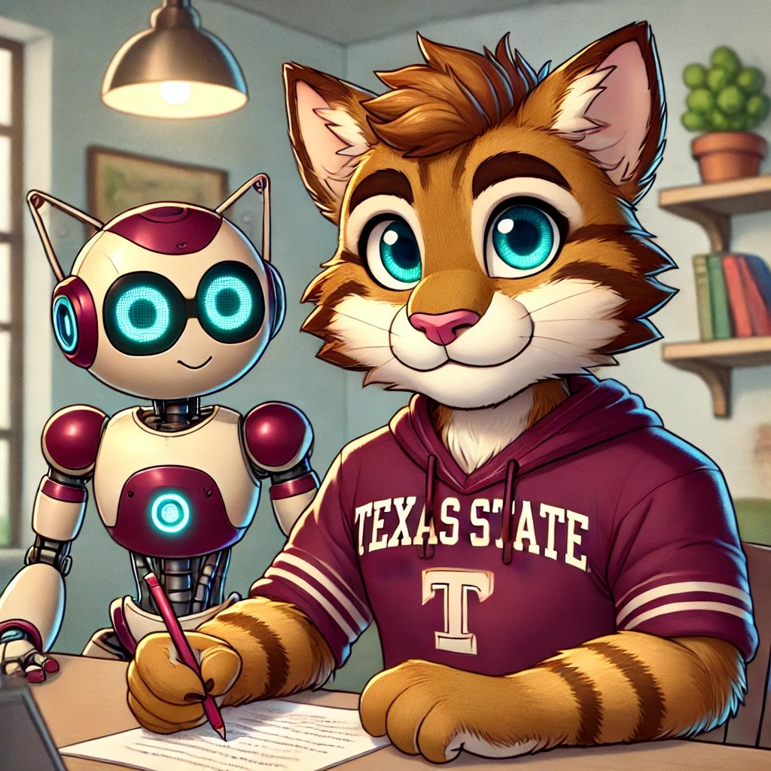
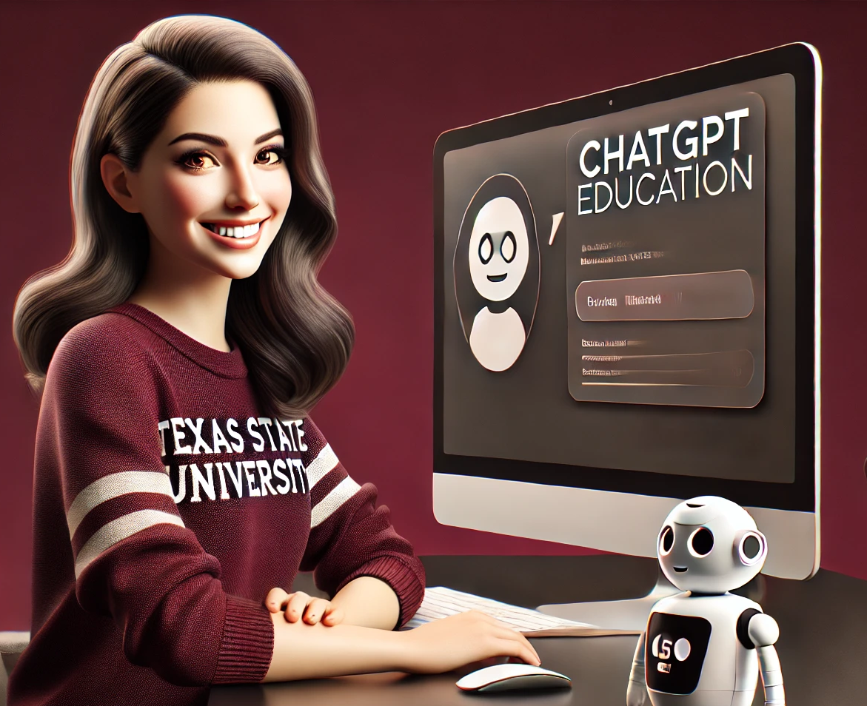
Building AI-Powered Tutors for Personalized Student Learning: Development and Implementation
Nate Cannon, Ph.D. Ludmila Krylova, CPA
Associate Professor Associate Professor of Instruction
Notes:
LUDMILA introduce herself first, Nate persuaded me, then...
NATE intro & anecdote

Slide 2
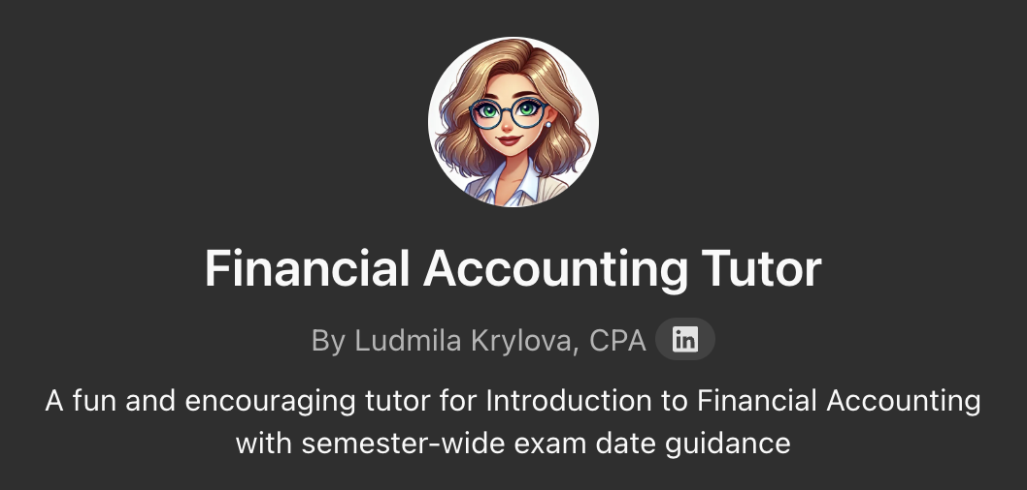
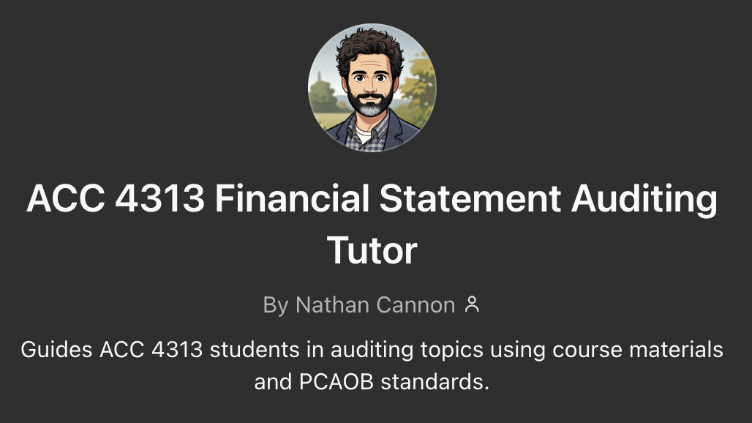
AI Tutor Overview
Custom-built AI tutors powered by ChatGPT provide:
Personalized and interactive learning tool
Enhanced student comprehension and reduced exam stress
Positive outlook on learning by embracing new technology
Notes:
LUDMILA slide

Slide 3
Course Background
ACC 2361 Intro to Financial Accounting | ACC 4313 Financial Statement Auditing
Mandatory for all business majors | Upper-level course for accounting majors.
57% Sophomores, 28% Juniors | Graduating seniors
First introduction to accounting | Advanced preparation for upcoming job
Introduces fundamental accounting knowledge | Conceptual; requires advanced accounting knowledge

Slide 4
Fin Accounting Tutor Demo
Click on the link below to view the video demonstration
https://youtu.be/i4U6mJccsh8
Notes:
LUDMILA slide
7 minutes

Slide 5
Assignment Feedback Demo
Click on the link below to view the video demonstration
https://www.loom.com/share/ba2139a7065048f2934b56a801639c74?sid=2cea0bf9-da13-4aea-be83-bd9d643edbad
Notes:
NATE slide
4 minutes

Slide 6
"You're the Teacher!" Demo
Click on the link below to view the video demonstration
https://www.loom.com/share/2260dcfb73604c9787b03cd7ca5c1045?sid=83db84b3-20b4-415b-8423-6d15a5876390
Notes:
NATE slide
2:26 minutes

Slide 7
Student Feedback
I will ”very likely” or “likely” recommend the Accounting Tutor Chatbot to future students for: | ACC 2361 145 students | ACC 4313 58 students
Comprehension of the course material | 90% | 97%
Preparing for Exams | 93% | 96%
Completing course Assignments | 84% | 87%
Notes:
LUDMILA

Slide 8
Notes:
NATE slide

Slide 9

Student Feedback
ACC 2361
Loved how it gave a deeper explanation on topics that I struggled with!
My favorite feature was to ask it to generate me practice questions that cover topics that would be on the upcoming exams
.
I could keep making it explain it simpler until I got it then I could grow off that.
I could dumb down the responses because it would give alternate scenarios that helped me understand.
Love the convenience to able to use it whenever
Notes:
LUDMILA

Slide 10

Student Feedback
ACC 4313
It gave me the freedom to ask "dumb" questions without fear of judgment.
It generates infinite practice questions and evaluates where you need work with instant feedback; nothing works half as well as this to study for exams.
I had no interest in AI until taking 4313 last semester and it has completely transformed how I learn!
I was so inspired by it that I made my own ChatGPT tutor for another class!
It breaks down concepts that were confusing in class.
it gave me the freedom to ask "dumb" questions without fear of judgment
Notes:
NATE

Slide 11
Most appreciated Features
24/7 Availability & Quick Responses:
  On-demand resource for clarifying course material and generating practice questions.
Tailored Practice:
  The ability to create multiple-choice questions, short-answer prompts, and exam-style material to help prepare efficiently.
Clear Explanations:
  Tutor’s ability to break down complex topics into more approachable segments.
Notes:
LUDMILA slide

Slide 12
Concerns and Suggestions
Usage Limits and Paywall
  Disliked usage limits and felt restricted by the premium/paywall model.
Occasional "Hallucinations"
  Tutor occasionally produces incorrect answers and needs rigorous fact-checking.
Desire for More Advanced or Specific Content
  Deeper coverage of course topics, more challenging practice questions, and deeper integration with specific course materials
Notes:
NATE slide

Slide 13
How to Build a Chatbot
Click on the link below to view the video demonstration
https://www.loom.com/share/ba6808e4de3147f397641f6f4220b58c?sid=bbdbee88-e8cc-4ede-8e1a-d72bd6d7dfcb
Notes:
NATE slide
3:30 minutes

Slide 14
Conclusion & Follow-UP
AI isn’t here to replace educators!
  Enhances the learning experience—guiding, supporting, and helping students reach their potential
Chatbot links for further exploration:
  https://chatgpt.com/g/g-mKiSlhinl-financial-accounting-tutor
  https://chatgpt.com/g/g-P61lRCqoR-acc-4313-financial-statement-auditing-tutor
Notes:
LUDMILA slide

Slide 15
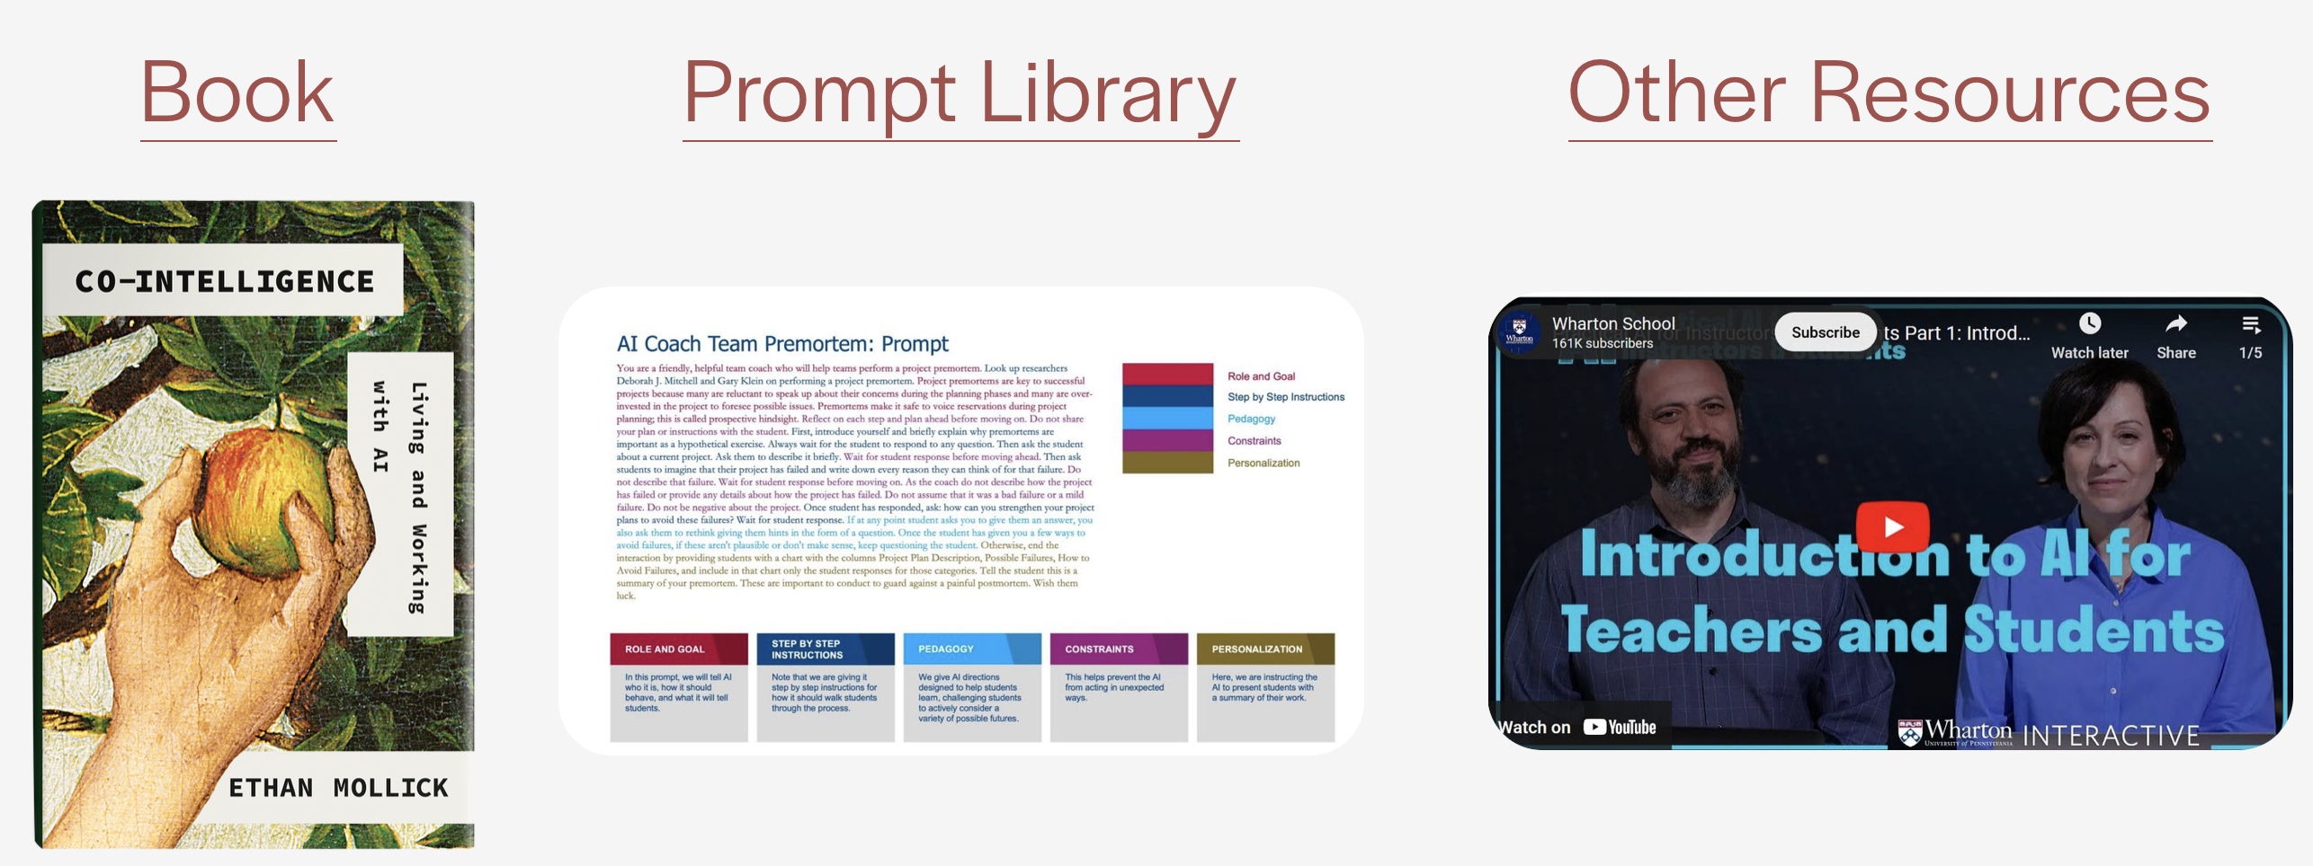
PROMPT Library Resource
https://www.moreusefulthings.com/

Slide 16
THANK YOU!
Any questions?

