Slide 1
Overview of the Research Enhancement Program at Texas State University
A summary of the REP mission, guidelines, application and review processes, and post-award policies and procedures

Slide 2
REP Core Principles
The REP is established to enhance research and creative expression opportunities for eligible Texas State University faculty.
The faculty have a major role in decision making concerning REP policies and procedures and in the administration of the program
The awarding of grants is determined through a peer competitive review process
The primary consideration in the awarding of grants is the quality of the proposed project.

Slide 3
REVISED REP Mission
To contribute to the greater body of knowledge in all disciplines through research, scholarship and creative expression.
REP has been aligned with the Run to R1 initiative.
Total funding has been increased to $900,000 with the intent of leveraging the creativity, energy and innovation generated by out faculty in all disciplines.
The increase is based on data that clearly demonstrates the REP’s impact on faculty development for tenure and promotion, student learning opportunities and creating new knowledge.
All REP awardees are required to submit a proposal to an external federal, state or private funding agency. This proposed change aligns with Texas State’s goal to attain and sustain R1 classification through leveraging its partnership with the faculty.
The office of Research Development, led by Assistant VP Dr. Jennifer Speed will assist faculty with identifying an appropriate sponsor if requested by the principal investigator.
Within three months of being awarded REP funding, recipients must meet with a member of the research development staff to explore ideas for pursuing external funding or other activities that broaden the impact and reach of the REP-supported research.
For those REP recipients whose work is suitable for external funding, a second deliverable is a brief timeline for applying for a specific external funding opportunity.

Slide 4
The REP Experience
The REP process intentionally mimics the external submission process to provide some experience in proposal preparation and project execution.
Guideline Requirements (rules, format, evaluation criteria)
Concept Development (Fundable Idea)
Team Building (project roles and responsibilities, dynamics)
Literature Survey (only the most relevant)
Proposal Writing (well-defined scope of work, clearly written, adherence to guidelines and rubric)
Budget Development (commensurate with scope of work presented)
Project Timeline (management)
Online Application (time stamp)
Panel Review (feedback is essential for improvement)
Research Compliance Approvals (IRB, IACUC, IBC)
Project Execution (preliminary results, modifications to original ideas, re-budgeting, disseminations, etc.)
Terminal Report (accountability, reporting outcomes)
Leverage to other funding (Flip My REP coming in the Spring)
Personal, Societal and Institutional Benefits

Slide 5
REP Administration
  The Faculty Senate
  The University Research Enhancement Committee (UREC)
  The College Research Enhancement Committees (CREC)
  The Division of Research
  The General Accounting Office
  The Budget Office

Slide 6
FY26 REP Timeline
Aug 15 Call for CREC representatives goes out from ORSP
Aug 25 Program Announcement and call for proposals is sent from Provost Office
Sept 10 REP Zoom workshop for general audience
Sept 17 CREC nominees due
Oct 8 Due date for proposals at 5 pm Central Time
Nov 21 Scores are due from CRECs
Dec 3 Senate takes final action on funding recommendation
Dec 5 ORSP posts proposals recommended for funding on REP website, sends email notification to all PIs and begins send out of award packages

Slide 7
REP Guidelines: Eligibility
All full-time Texas State faculty members with continuing nine-month academic appointments may apply as Principal Investigators (PIs) or co-investigators (CIs).
Full-time nontenure line faculty at the rank of Senior Lecturer may apply only as co-investigators with tenured or tenure-track faculty. Lecturers are not eligible.
Clinical Faculty may apply as PIs or CIs, but Research Faculty and Program Faculty are not eligible.
NEW: Faculty of Practice may serve as PI or Co-I
Department Chairs, School Directors, Program Directors and Deans are not eligible to apply.

Slide 8
Guidelines: Continued
Faculty may submit only one proposal.
For collaborative proposals, one PI must be designated.
Faculty may not receive REP funds in consecutive years.
REP grantees with delinquent final reports are not eligible to apply.
The maximum award level for individual projects is $12,000. Collaborative projects of two or more eligible faculty may be awarded a maximum of $24,000.
Salary stipends may not exceed $10,000 and may be requested only for summer months. The combined summer teaching salary (if any) and REP salary stipend may not exceed one-third of the applicant’s nine-month salary.

Slide 9
Non-Allowed Expenses
Any research associated with the completion of the applicant's master's thesis or doctoral dissertation
Any faculty education or training not directly relevant to the grant project
Course or curriculum development projects
Conference registration and travel to conferences
Course buyouts during the long semesters

Slide 10
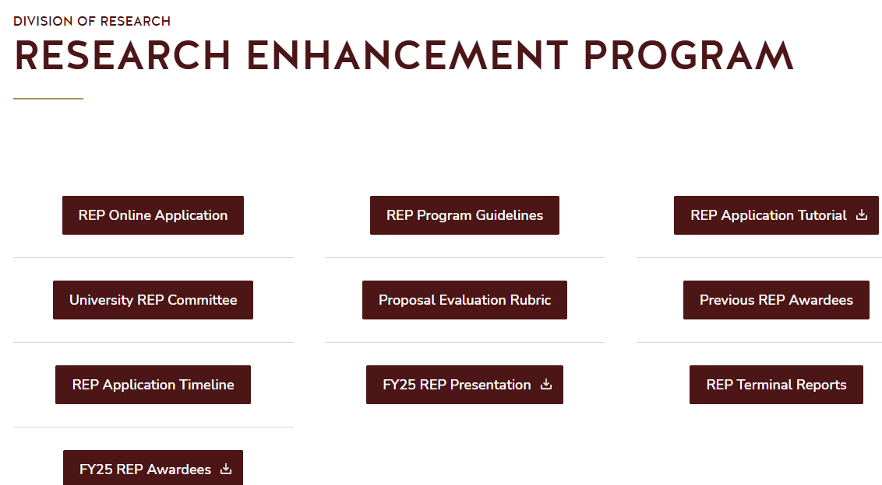
Application: On-line Submission
NOTE: The REP is an internal funding process. As such, OSP’s pre-award and post-award support services are not involved.
All proposals must be submitted electronically through the online application provided on the Research Enhancement Program (REP) website.
CAUTION: Proposals that are not completed and submitted by 5pm CST on the due date will not be accepted. PLEASE allow enough time to work through the online application.

Slide 11
Application: Proposal Narrative
The narrative is a PDF document, maximum five pages (including any literature citations) double-spaced in 12 point, Times New Romans font with one-inch margins. References and citations may be single-spaced.
An introduction, including literature citations (if appropriate), and statement of hypothesis or purpose.
A specific explanation of the project's methodology detailing project design, data collection/analysis procedures (if appropriate), etc.

Slide 12
Application: Narrative
A description of the project, with an emphasis on the creativity, organization and presentation of ideas. Statements detailing the importance of the project to the applicant's field and personal scholarly/creative development, and the applicant’s access to necessary resources.
A detailed budget justification especially for equipment and travel.
An explanation of the explicit roles of each applicant if there are multiple investigators.
Tip: Work off-line on narrative/vita then upload final document for submission. The abstract can be cut and pasted into online application field.

Slide 13
Application: Curriculum Vitae
A two page maximum CV (single spaced in 12 pt. Times New Roman) for each applicant that summarizes the applicant’s research, and scholarly/creative activities. The CV(s) should detail outcomes from previously funded REP grants. For collaborative projects, up to two additional vita pages per applicant are allowed if needed.
The CV(s) must be added to the end of the narrative so that both comprise a single PDF document.

Slide 14
Budget
There is a specific budget template to use for the REP in Excel format. This is separate from the Budget Justification portion of the Narrative.
The budget lines are: Faculty Salaries, Hourly wages and Maintenance and Operation (M&O).
Note 1: Don’t budget for Fringe Benefits
Note 2: Consultants and funds for payment of human subjects are listed under M&O.

Slide 15
Proposal Submission Confirmation
An auto-generated email will be sent to the Principal Investigator after the “Submit” is clicked. When “Saved as Draft” is click, edits can be made, but no notification is sent.
CAUTION: Deleting a proposal after it has been “submitted” can take up to 48 hours. So once inside that time frame be very careful to use Save as Draft to ensure last minute edits can be made safely.

Slide 16
REP Review-General
Four essential aspects will be evaluated:
Introduction (statement of objectives and/or research questions) - 10 pts.
Methodology (overall project design) - 25 pts.
Quality of proposed project (creativity, organization and presentation of ideas, importance to field, access to resources) - 55 pts.
Budget request detail and justification - 10 pts.
NOTE: Refer to the REP website for individual college scoring rubrics.

Slide 17
REP Review Process-CREC
All proposals from a college are discussed and scored numerically.
CREC may disqualify proposals that do not conform to submission guidelines.
Budgets may be adjusted by the CREC if non-allowed costs are identified or for other specified reasons.
Evaluation scores are submitted via the online system. Proposals are ranked in descending numerical order.
In general, the highest rated proposals within a college should be fully funded.
Partial funding of proposals may result from ties of numerical score and/or proposals at the funding cut off score.

Slide 18
REP Review Process-UREC
The UREC oversees each college’s funding process and resolves any conflicts.
The UREC may examine proposal budgets and amend them according to the recommendations of the CREC.
After the UREC has approved each CREC’s funding recommendations, the UREC Chair and AVPR present recommendations to the Faculty Senate for final approval.
Faculty Senate acts on UREC recommendations.

Slide 19
REP Review-Notifications
Once the Faculty Senate has taken final action, the list of funded projects will be posted on the REP website.
Unsuccessful applicants are encouraged to contact Dr. Yongxia Xia in the Office of Research and Sponsored Programs to obtain review scores.
Successful applicants will be sent an award package via email containing the award amount and a new account request form to complete and return.

Slide 20
REP Post Award
The project period for Research Enhancement Program grants is from January of one fiscal year through May 31 of the next fiscal year.
A minimum project period of 12 months is guaranteed if account set up is delayed due to pending compliance approval. START EARLY!
Extensions are possible with approved justification.
Recipients of awards must submit a written terminal report via the online system. Faculty may not submit new REP proposals while reports from past grants are overdue.

Slide 21
Proportional College Funding Allocation (FY26 Applications)
College | Number of Proposals Submitted | Assistant | Associate | Professor | Requested Amount | Proportional Funding to College
Applied Arts | 7 | 6 | 1 | 0 | $79,924 | $26,958
Education | 15 | 12 | 1 | 2 | $172,267 | $58,106
Fine Arts and Communication | 25 | 5 | 16 | 4 | $264,034 | $89,059
Health Professions | 6 | 2 | 4 | 0 | $79,378 | $26,774
Liberal Arts | 25 | 11 | 9 | 5 | $217,117 | $73,234
McCoy Business | 21 | 17 | 4 | 0 | $185,500 | $62,569
Science and Engineering | 33 | 19 | 7 | 7 | $335,899 | $113,299
Total | 132 | 72 | 42 | 18 | $1,334,119 | $450,000
 |  | 55% | 32% | 14%
Overall Funding Rate = total available/total requested = 0.2840
Funding to College = total available/total requested x Amt. Requested by College

Slide 22
FY26 Funding Stats
The distribution of funds correlates closely with the submission of proposals.

Slide 23
University Research Enhancement Committee (UREC)
Augustine Agwuele (UREC Chair-at large)
Kelly Clary (CREC Chair-School of Soc Work)
Jaymeen Shah (CREC Chair-McCoy College, Business)
Alyson Collins (CREC Chair-Education)
Kelly Kaufhold (CREC Chair-Journalism & Mass Comm
Ram Shanmugam (CREC Chair-Health Prof.)
Alexandria Perkins (CREC Chair-Liberal Arts)
Caitlin Gabor (CREC Chair-Science & Engineering
Michael Blanda (AVP-Research, ex officio)

Slide 24
Administrative Contact Information
Michael Blanda, Assistant Vice President for Research and Federal Relations
  Email: MB29@txstate.edu | Telephone: 512-245-2314
Augustine Agwuele, UREC Chair
  Email: AA21@txstate.edu
Technical Support: Yongxia Xia
  YS11@txstate.edu
Leticia Ramirez, Senior Administrative Assistant
  Email: GLY19@txstate.edu | Telephone: 512-245-2654
NOTE: The REP is an internal funding process. As such, the Division of Research Pre-award and Post-award support services are not involved. These offices manage externally sponsored programs.

