Slide 1
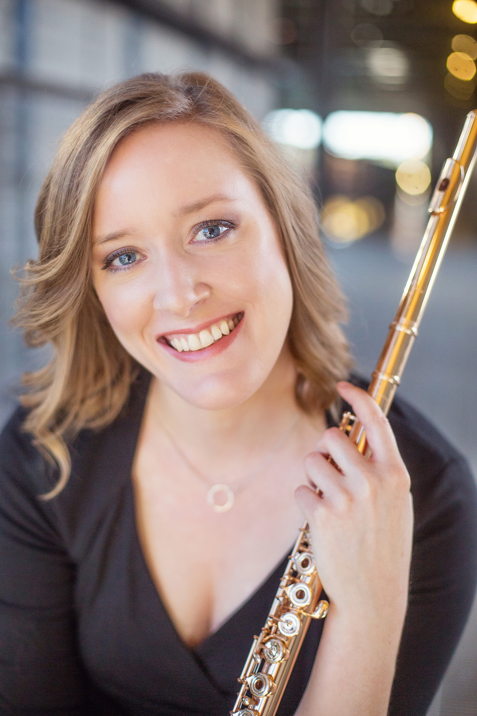

“Winds of Change”
Senior Recital
Jane Doe, flute
John Doe, piano
Day, Month Date, Year
Time a.m./p.m.
Venue
2025-2026
Student Artist Series

