Slide 1
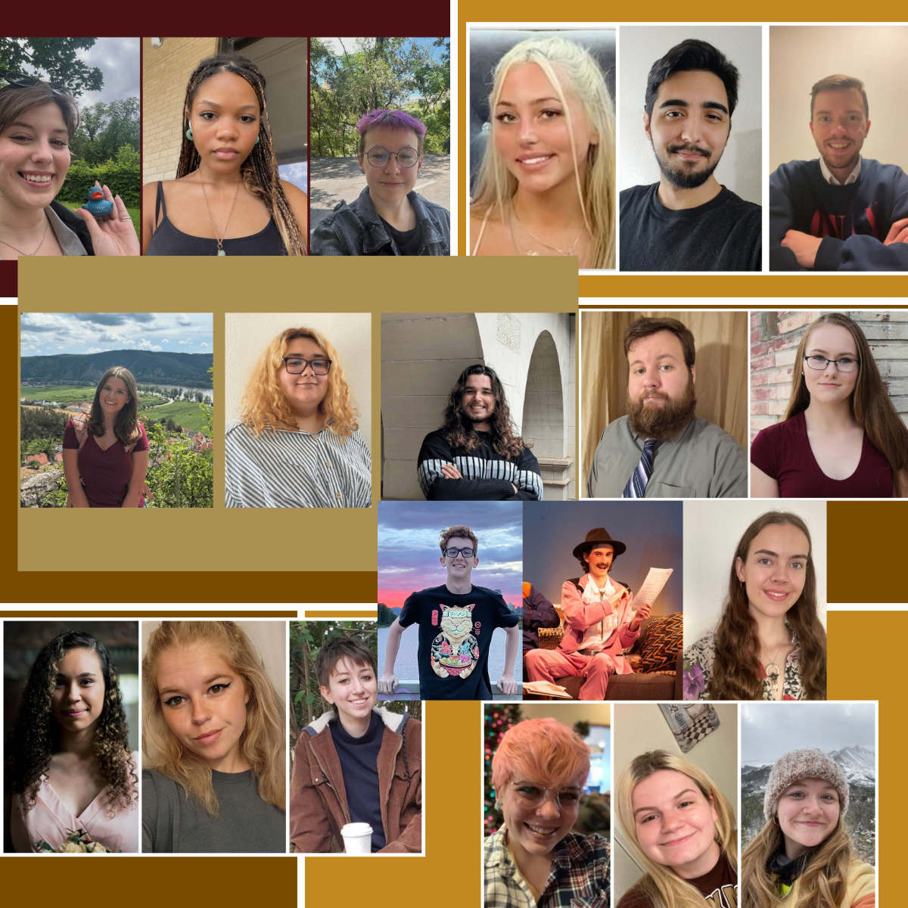
SPARK! at TX State:
A High-Impact
Service Internship
Ewa Siwak, PhD
Professor of Instruction in German Studies
Dept. of World Languages and Literatures
Texas State University
Presented at the 2025 German Studies Association Convention
as part of the Roundtable
“Language Education in a Multilingual Nation:
Challenges and Opportunities for German Studies,”
sponsored by the Goethe Institut

Slide 2
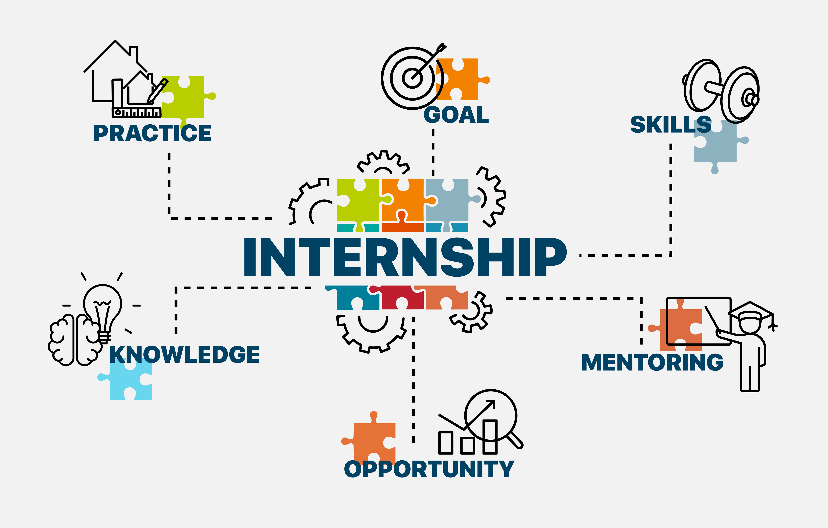
Push for Professionalized Curricula
SPARK is one of our two professional internships available to juniors and seniors.
SPARK provides career preparation by training students in soft skills such as teamwork and effective presentation and communication, crucial in most careers.

Slide 3
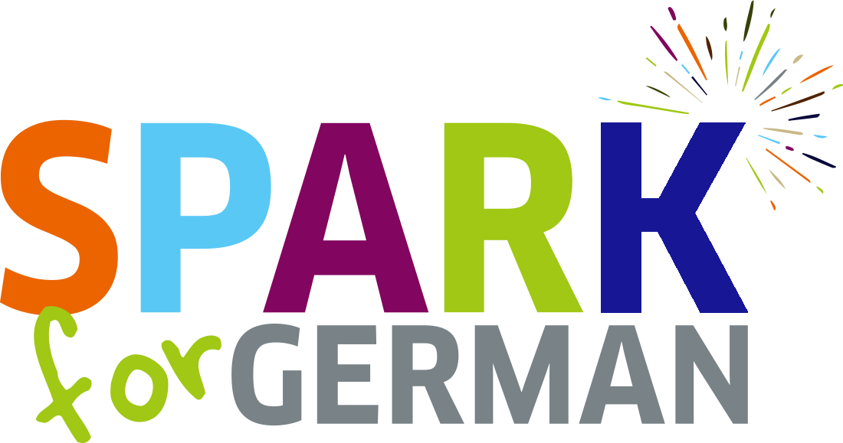
SPARK for German! A High- Impact Practice
Common Elements of
High-Impact Practices:
Application and testing of classroom learning
Effort
Substantial relationships
Cross differences
Rich feedback
Opportunities for reflection

Slide 4
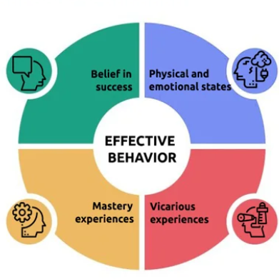
Hybrid service-learning / professional internship that fosters socially responsible leadership
Integrating experiential and classroom learning, the program enhances students’ critical thinking and communication skills.
SPARK promotes a shift young adults’ orientation from self to others.
SPARKlers engage in meaningful community service, reflection, and reciprocal learning, leading to increased self-efficacy.
The embedded mentoring model creates significant outcomes for students from underrepresented backgrounds.
The program supports multiple learning theories, including situated learning, cognitive apprenticeship, and transformative learning.
SPARK builds social capital within the Central Texas community and strengthens university-community partnerships.
Image credit: https://psychology-spot.com

Slide 5
Reciprocal Learning: “The best part of this internship was teamwork. My co-teachers are strong leaders and have a great passion for German. Tori is amazing at marketing, creating posters, and being consistent. Joci’s knowledge of German and explosive energy kept the students consistently engaged.”
– Crann
Orientation Shift from Self to Others: “The most fun part for me personally was planning lessons and thinking about what I would like to learn if I were a student in the course.” – Piper
Social Capital within Our Community: “The best part of SPARK was getting to share my passion for German with younger kids. I hope I was able to inspire even just one kid to pursue a future in German. ” - Spencer

Slide 6
Service Internships Foster
Socially Responsible Leadership
Students intern for … communities, not corporations!
Service learning is a predictor of future political and community engagement. Students develop a belief in their own impact at a crucial age.

Slide 7

SPARK Internships:
A Guarantee of Opportunities
90% of TXST SPARK instructors have received at least one of the following:
Fulbright
Congress Bundestag fellowships
teaching assistantship offers.

Slide 8
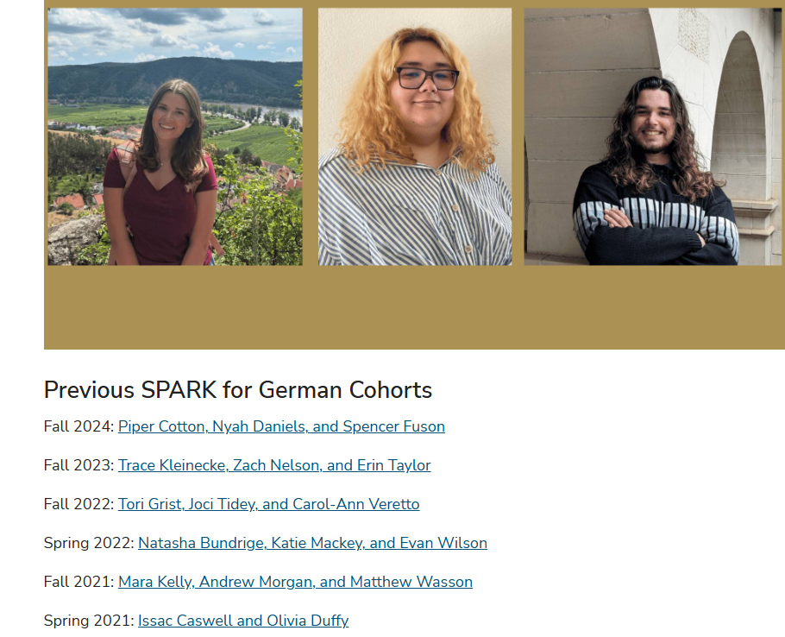
Dedicated German program website tab
Links to all prior cohorts
Graduates can reference the SPARK tab on resumes
https://www.worldlang.txst.edu/german/spark-for-german.html

Slide 9
SPARKing via Zoom since Spring 2021
First SPARK outreach: Spring 2021
Pandemic + Geography (Central Texas) =>Zoom
Focus: middle school students
Goal: bolster area high school programs
We are slowly welcoming freshmen who had been our SPARK students 5 years ago!

Slide 10
OUR PROGRAM AND OUR SPARK INTERNS
17
30
German Majors
3
SPARK instructors / semester
German Minors
15
pupils per semester
SPARK interns recruited by invitation only
Some have attended the Goethe Institut summer SPARK training
Internal training
Design and lead three lessons each per semester
Lesson reflections
Semester reflection

Slide 11

Bibliography:
Arnold, Maik. "Problem-based learning and community engagement: A service-learning project with social pedagogues." In Hochschullehre erforschen: Innovative impulse für das scholarship of teaching and learning, pp. 199-214. Wiesbaden: Springer Fachmedien Wiesbaden, 2022.
Bradberry, Leigh A., and Jennifer De Maio. "Learning by doing: The long-term impact of experiential learning programs on student success." Journal of Political Science Education 15, no. 1 (2019): 94-111.
Cooper, Linda Z. "Student reflections on an LIS internship from a service learning perspective supporting multiple learning theories." Journal of Education for Library and Information Science (2013): 286-298.
Hastings, Lindsay J., Milan Wall, and Kurt Mantonya. "Developing leadership through “serviceship”: Leveraging the intersection between service-learning and professional internship." Journal of Leadership Education 17, no. 1 (2018): 141-151.
O'Neill, Nancy. "Internships as a high-impact practice: Some reflections on quality." Peer Review 12, no. 4 (2010): 4-9.

