Slide 1

Texstunde
8.10

Slide 2
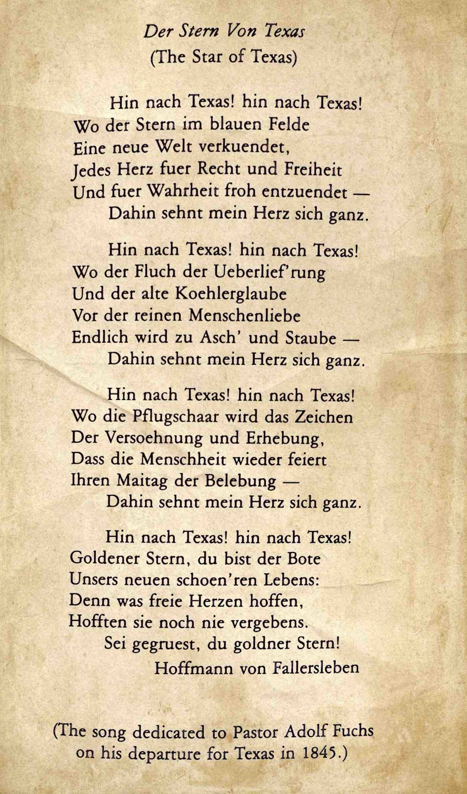
Der Stern Von Texas
Der Stern von Texas.
Hin nach Texas! Hin nach Texas!
Wo der stern im blauen felde
Eine neue Welt verkuendet,
Jedes Herz fuer recht und Freiheit
Und fuer wahrheit froh entzuendet
Dahin sehnt mein herz sich ganz
Hin nach Texas! Hin nach Texas!
Wo der fluch der ueberlief’rung
Und der alte Koehlerglaube
Vor der reinen menschenliebe
Endlich wird zu asch und Staube
Dahin sehnt mein herz sich ganz.
Hin nach Texas! Hin nach Texas!
Wo die pflugschaar wird das zeichen
Der versoehnung und erhebung
Dass die menschheit wieder feiert
Ihren maitag der belebung
Dahin sehnt mein herz sich ganz.
Hin nach Texas! Hin nach Texas!
Goldener stern, du bist der bote
Unsers neuen schoen’ren lebens:
Denn was freie Herzen hoffen,
Hofften sie noch nie vergebens.
Sei gegruest, du Goldner stern!

Slide 3
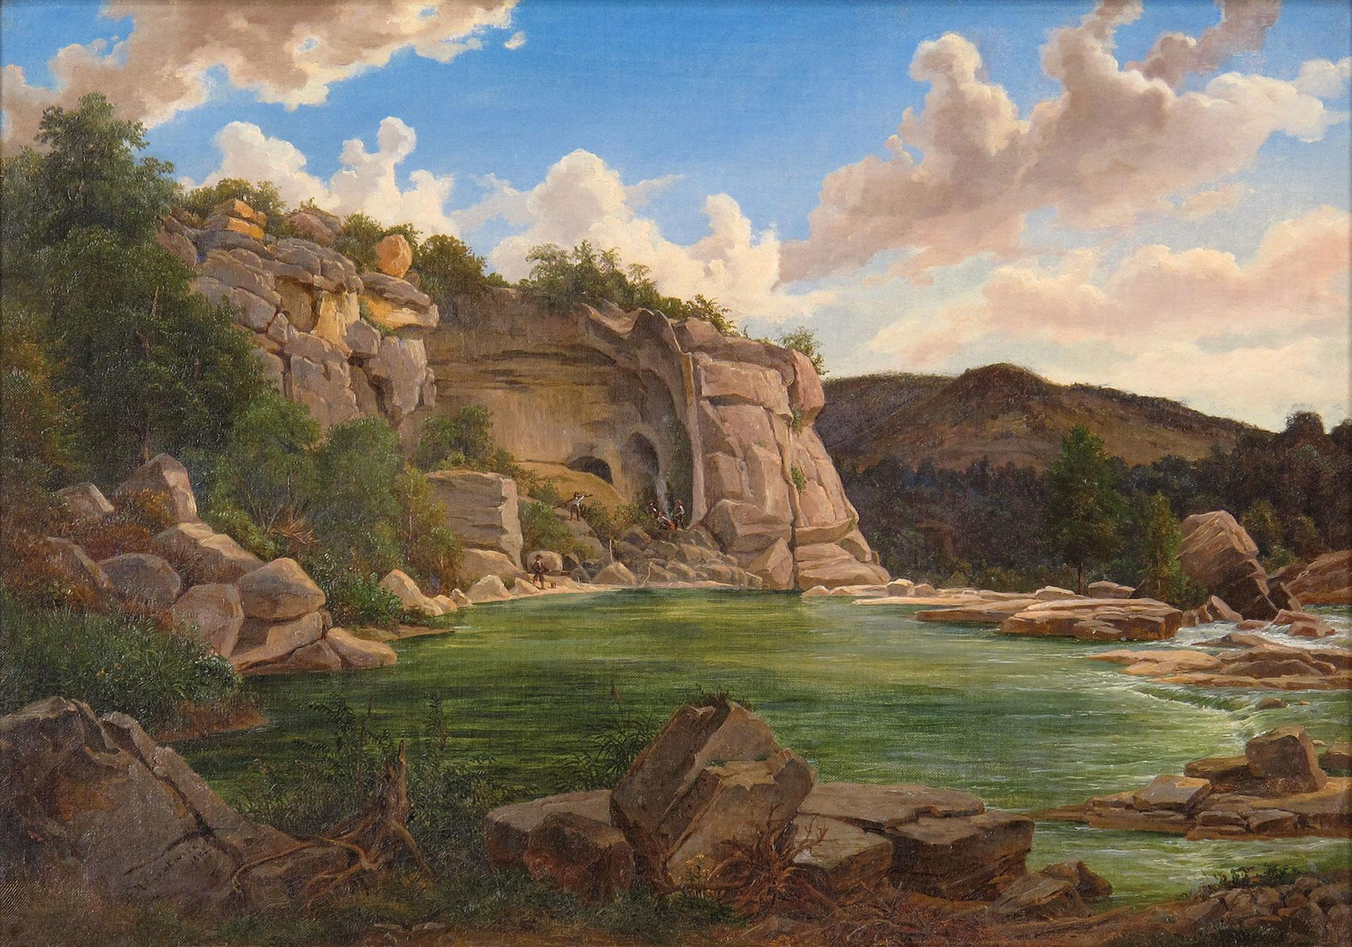

The Star of Texas
On to Texas, on to Texas!
Where the star in blue fields
Proclaims a new world,
Every heart for justice and freedom, and for truth joyfully ignited -
For there my whole heart longs.
On to Texas, on to Texas!
Where the curse of tradition
And old charcoal-beliefs,
Finally turn to ash and dust
Before the pure love of humanity -
For there my whole heart longs.
On to Texas, on to Texas!
The ploughshare will be the sign
Of reconciliation and elevation,
That mankind once again celebrates
Their holiday of enlightenment -
For there my whole heart longs.
On to Texas, on to Texas!
Golden star, you are the messenger
Of our new beautiful lives:
Where what free hearts hope for
They never hope in vain.
Be greeted, you golden star.

Slide 4
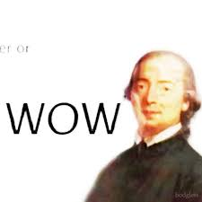
‘German Enlightenment’ (1)
“Enlightenment is man’s release from self-incurred tutelage. Tutelage is man’s inability to make use of his understanding without direction from another. Self-incurred is this tutelage when its cause lies not in lack of reason but in lack of resolution and corrage to use reason without direction from another. ‘Sapere aude!’ ‘Have courage to use your own reason!’ - That is the motto of enlightenment.”
Immanuel Kant, “Was ist Aufklärung?” - 1784

Slide 5
‘German Enlightenment’ (2)
“The Officer says: ‘Do not argue but drill!’ The tax collector: ‘Do not argue but pay!’ The cleric: ‘Do not argue but believe!’ Only one prince [Prince Frederick II] in the world says, ‘Argue as much as you will, and about what you will, but obey!’”
Immanuel Kant, “Was ist Aufklärung?” - 1784

Slide 6
‘German Enlightenment’ (3)
“Which restriction is an obstacle to enlightenment, and which is not an obstacle but a promoter of it?
I answer: The public use of one's reason must always be free, and it alone can bring about enlightenment among men.”
Immanuel Kant, “Was ist Aufklärung?” - 1784

Slide 7
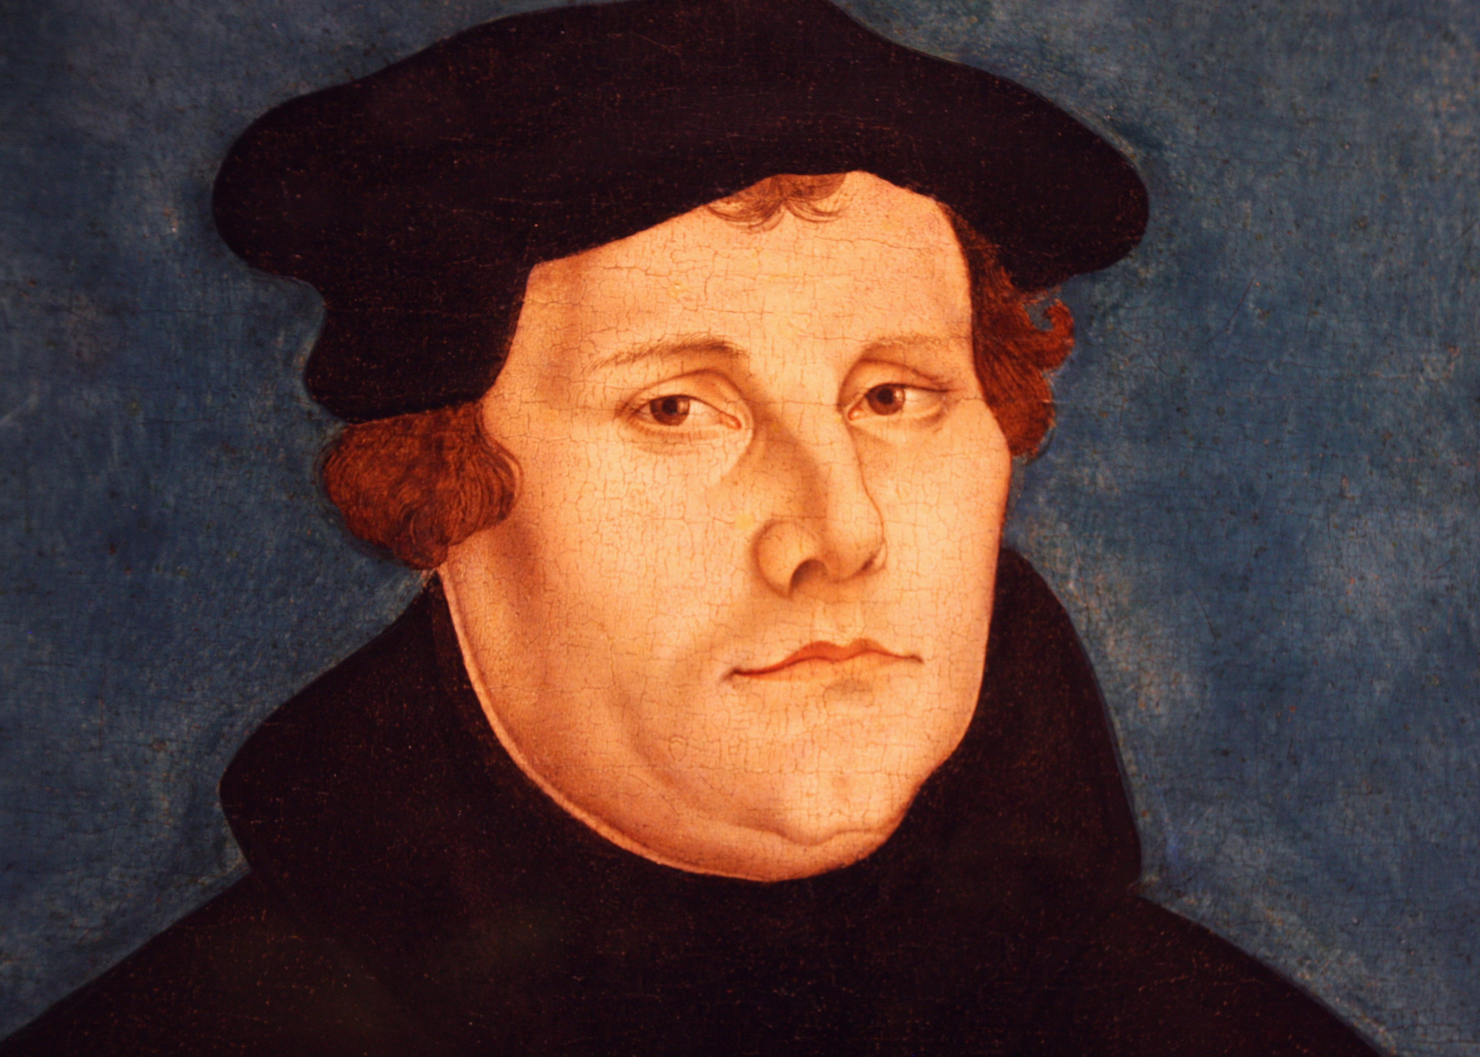
“Köhlerglauben”
“Beliefs of the Collier”
During a sermon, Martin Luther famously asked a Köhler what his religious beliefs were. The man responded, “I believe what the church tells me to believe.”
Kant asks us to avoid Köhlerglauben and utilize our natural and individual ability to reason in order to determine right from wrong.

Slide 8
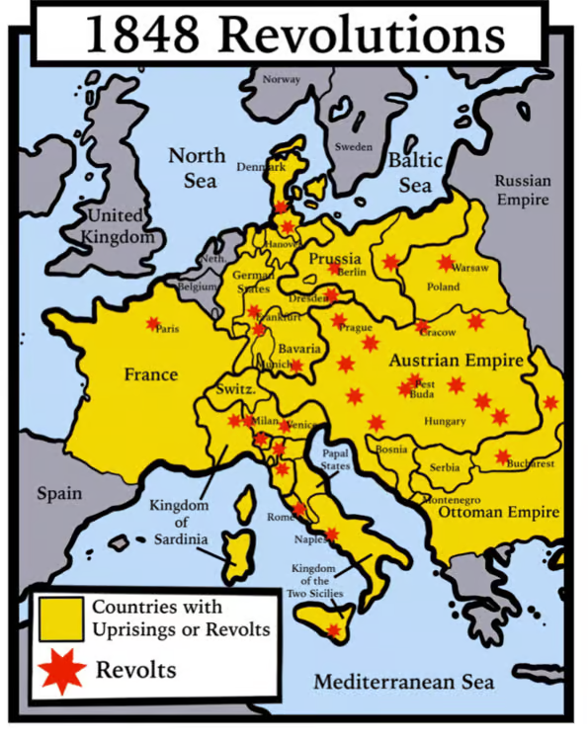
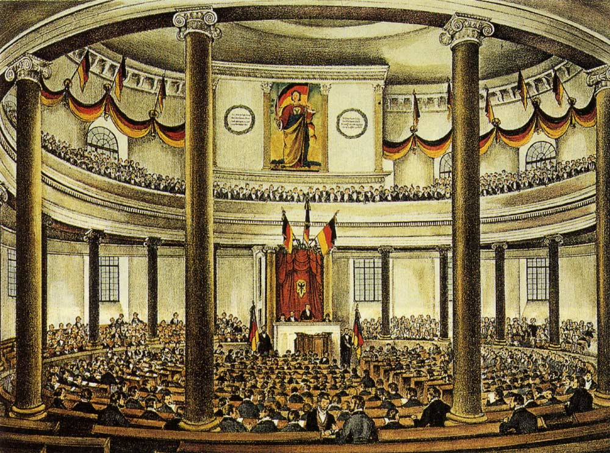
1848 Revolts - “The Springtime of the Peoples”
Frankfurt National Assembly

Slide 9
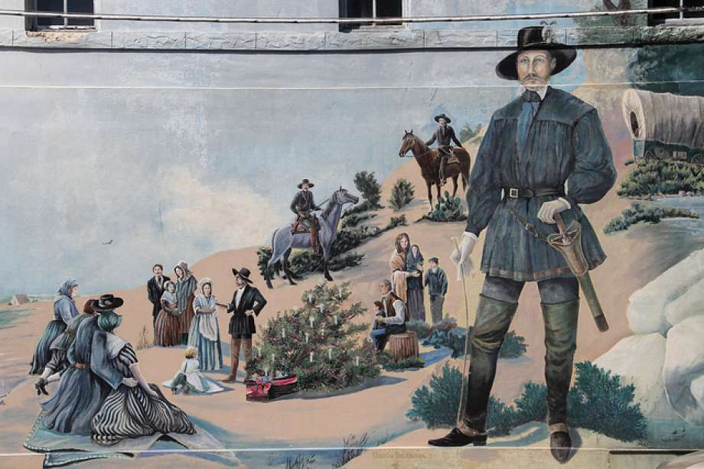

Early migration to Texas

Slide 10
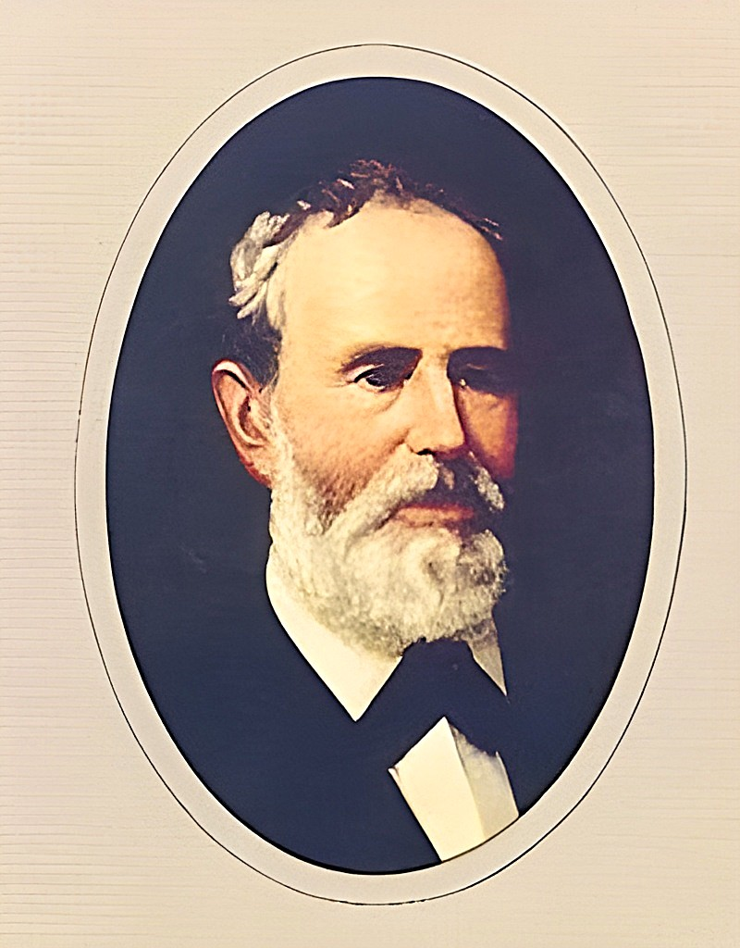
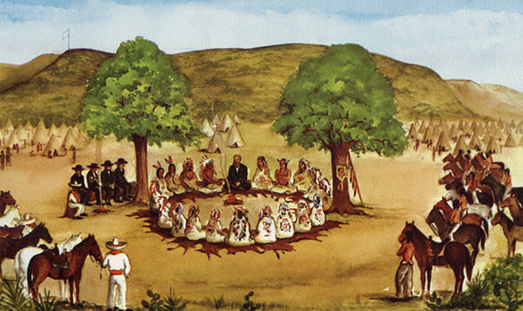
Meusebach-Comanche Treaty, 1847

Slide 11
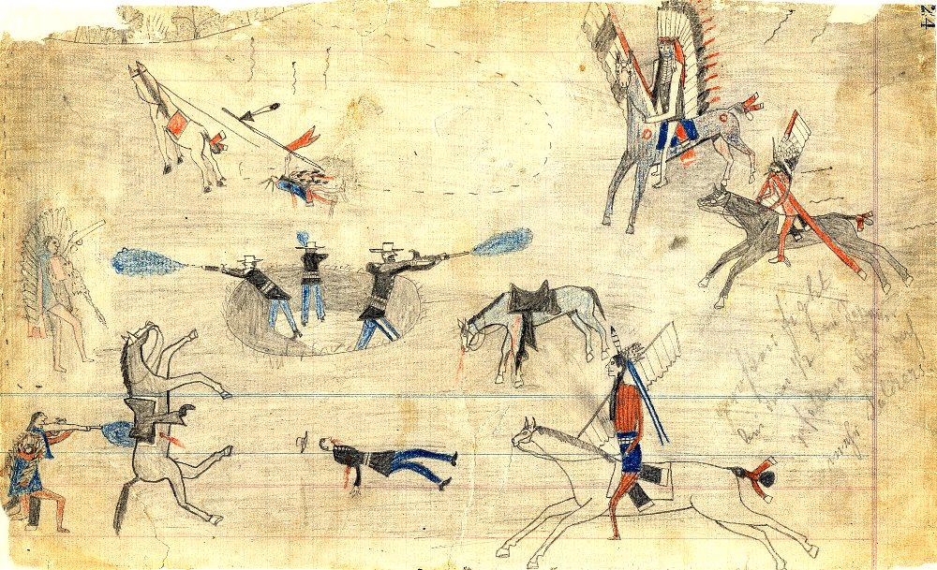
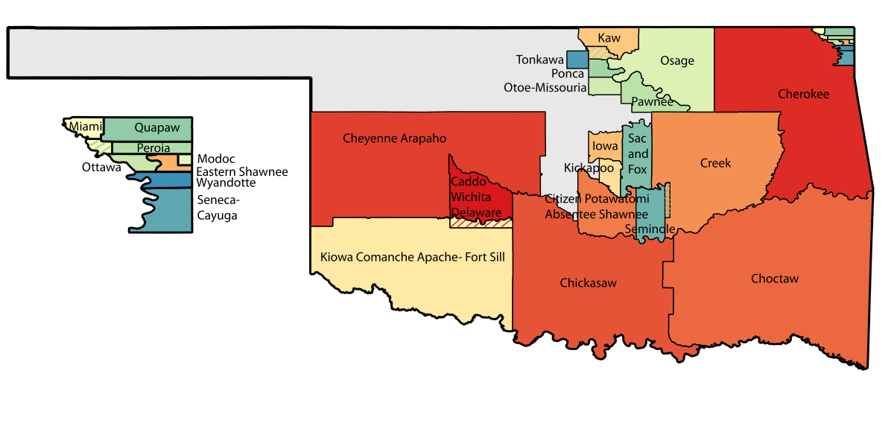
American Indian Removal
"The entire subjugation of the Comanches in particular, and probably of other tribes, or their early removal, will be inevitable.”
David G. Burnet, Former President of the Republic of Texas

Slide 12
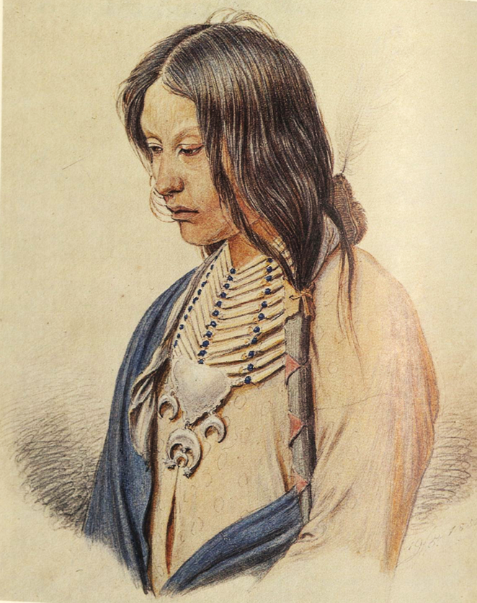
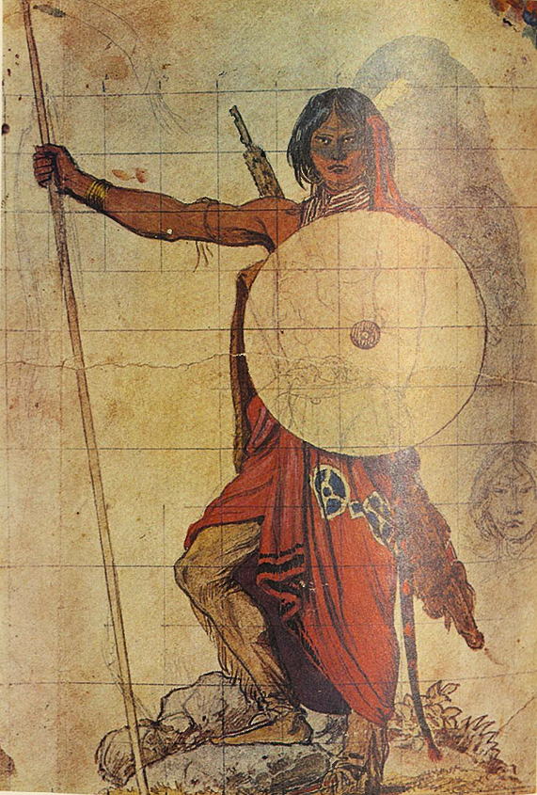
Theodore Specht to the New Braunfels Zeitung, 1855 (1)
“I have for almost nine years dealt with Indians, learned their customs and character, and have found among these so-called ‘wild people’ good and bad persons, but never such poor specimens as are to be found among civilized nations. … These friendly relations endured for several years, nobody feared them, and they often camped in our very town. Often single Comanches even slept in the houses of the settlers.”
Newcomb, William W., Friedrich Richard Petri, Mary S. Carnahan, Southwestern Writers Collection., and Texas Memorial Museum. 1978. German Artist on the Texas Frontier, Friedrich Richard Petri / by William W. Newcomb, Jr., with Mary S. Carnahan. University of Texas Press.
Boeck, Brian J. “‘They Contributed Very Much to the Success of Our Colony’: A New Source on Early Relations between Germans and Indians at Fredericksburg, Texas.” The Southwestern Historical Quarterly 105, no. 1 (2001): 81–91.

Slide 13
Theodore Specht to the New Braunfels Zeitung, 1855 (2)
“The Society for the Protection of German Immigrants in Texas furnished the great number of settlers very sparingly with provisions, which were often spoiled. Meal and corn were full of worms, the meat being that of half-starved and sick cattle, particularly in the fall and winter of 1846. The pork and salted meat were seldom good. A great mortality prevailed and in almost every family the scurvy raged along with other severe diseases. Many families perished, and I am firmly convinced that all would certainly have shared the same fate, but for the Indians, who furnished us daily with fresh deer and bear meat. … I am sure that without this commerce with the Indians, Friedrichsburg would for a long time not have become what it is today, but instead would have vanished without a trace.”
Newcomb, William W., Friedrich Richard Petri, Mary S. Carnahan, Southwestern Writers Collection., and Texas Memorial Museum. 1978. German Artist on the Texas Frontier, Friedrich Richard Petri / by William W. Newcomb, Jr., with Mary S. Carnahan. University of Texas Press.
Boeck, Brian J. “‘They Contributed Very Much to the Success of Our Colony’: A New Source on Early Relations between Germans and Indians at Fredericksburg, Texas.” The Southwestern Historical Quarterly 105, no. 1 (2001): 81–91.

Slide 14
Theodore Specht to the New Braunfels Zeitung, 1855 (3)
“The state has spent enormous sums to reign in the Indians and eradicate them, but this was of no help to the Indians. … The Indians have themselves told me that pushed back high into the prairies they must nearly starve to death, since their best hunters can no longer shoot enough game to provide for their families. The numerous military posts and expeditions by soldiers with obligatory blasting of guns and noise-making frighten everything wild and drive game away. Where only a few years ago thousands of buffaloes could be found, now there is not a trace of them and only here and there can a timid deer be seen. If these useless forts would be withdrawn, then the wild animals would begin to gather again and multiply.”
Newcomb, William W., Friedrich Richard Petri, Mary S. Carnahan, Southwestern Writers Collection., and Texas Memorial Museum. 1978. German Artist on the Texas Frontier, Friedrich Richard Petri / by William W. Newcomb, Jr., with Mary S. Carnahan. University of Texas Press.
Boeck, Brian J. “‘They Contributed Very Much to the Success of Our Colony’: A New Source on Early Relations between Germans and Indians at Fredericksburg, Texas.” The Southwestern Historical Quarterly 105, no. 1 (2001): 81–91.

Slide 15
Theodore Specht to the New Braunfels Zeitung, 1855 (4)
“I assume that to begin with the two nearest Comanche bands under Ketemosi and Sanaco would be assured a fixed annual salary while at the same time they must be allowed to freely travel to Friedrichsburg and San Antonio in order to purchase for themselves with their own money the goods that they desire, except for whiskey and other strong alcoholic drinks. … Only gradually with the advance of the settlements would they be driven back. Thus, the Indians could be assured of their means of subsistence until they all are settled. The Indians know all this very well. My suggestions don't emerge from my own ideas but come from the Indians themselves. Many hours and days I have discussed this issue with Ketemosi, Sanaco, Mulaqui tap and all the old and understanding Indians.”
Newcomb, William W., Friedrich Richard Petri, Mary S. Carnahan, Southwestern Writers Collection., and Texas Memorial Museum. 1978. German Artist on the Texas Frontier, Friedrich Richard Petri / by William W. Newcomb, Jr., with Mary S. Carnahan. University of Texas Press.
Boeck, Brian J. “‘They Contributed Very Much to the Success of Our Colony’: A New Source on Early Relations between Germans and Indians at Fredericksburg, Texas.” The Southwestern Historical Quarterly 105, no. 1 (2001): 81–91.

Slide 16
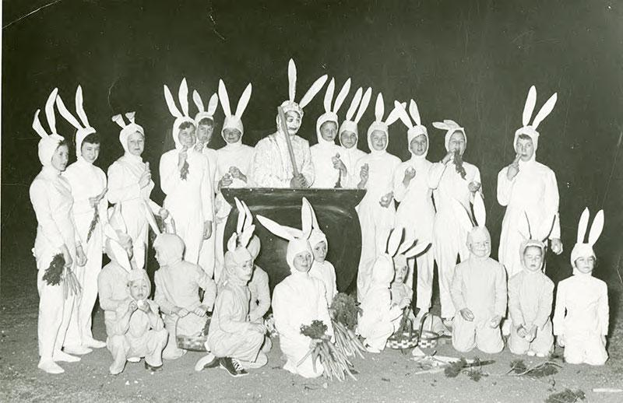
Fredericksburg Osterfeuern
Boas, Hans. “Meusebach Makes Peace with the Comanches.” Texas German Dialect Archive. Texas German Dialect Preservation Project, WAV audio.
“Ja, der Meusebach ist raufgegangen nach vier Meile westlich von San Saba un’ hat Frieden gemacht mit die Comanche Indianner, un’ das ist der einzigste Frieden was gehalten worden ist in die Vereinigten Staat. Wenn mir unser Gründerstag ham, die komm’n runde von Oklahoma un’ dun mit uns Feiern. Die dun Zelten auf hier un’ bei Fort Martin Scott, un’ ham tanzen un’ allerhand.”
“Alle die Berge die Indianner hatten uns Feuer un’ das war den Abend vor Ostern, un’ die Muttern ham die Kinder erzählt ‘das ist die Osterhase an Eier kochen für die Kinder zu beräumen.’”
Boas, Hans. “Easter Fires.” Texas German Dialect Archive. Texas German Dialect Preservation Project, WAV audio.

Slide 17
Discussion Questions!
Despite willingness to cohabitate, what do we make of Specht’s colonial language? “...with the advance of the settlements would they be driven back.” or “...the Indians would in a friendly and courteous manner, so to speak, be expelled from their own homes.” Does his altruism and idealism justify the desire to displace native peoples?
What place to traditions like the Osterfeuern have in the modern world? Do they celebrate the realization of German enlightenment ideals? Or do they perpetuate old colonial narratives? Do they provide a genuine space for the expression of indigenous culture?
How much of a choice did the Comanches have in this proposed integration? How might Theodore Specht’s plan be improved?

