Slide 1



Ostracod Diversity, Disturbance, and Conservation of Springs and Groundwater Habitats in the Great Basin and Texas
The 7th Annual Texas Groundwater Invertebrate Forum (TGIF)
November 7, 2025
Texas A&M San Antonio
Prof. Dr. Okan Külköylüoğlu
Department of Biology
Faculty of Arts and Science
Bolu Abant İzzet Baysal University
Bolu, Türkiye
e-mail: okankul@gmail.com

Slide 2
Thanks
TGIF 2025 Planning Committee
&
Prof. Dr. Benjamin Schwartz
Dr. Benjamin Hutchins
(Edwards Aquifer Research & Data Center, TSU)
Elizabeth Borda - Texas A&M University San Antonio
Fernando Calderon-Gutierrez - Stephen F. Austin State University
Kathryn Perez - University of Texas at Rio Grande Valley
Amelia Hunter - USFWS - Southwest Regional Office
Randy Gibson - USFWS– San Marcos Aquatic Resources Center
Benjamin Hutchins - Edwards Aquifer Research & Data Center
Victor Castillo III - Edwards Aquifer Research & Data Center

Slide 3
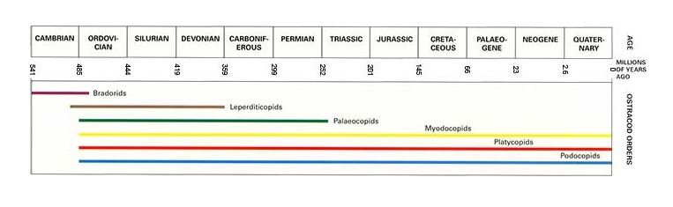
Class Ostracoda (Crustacea) is one of the most abundant (ca. 65K spp) & well preserved small (0.3 to 5 mm length) microscobic invertebrates.
→Since Cambrian (ca. 540 mya) but first true ostracods appeared during the Ordovician Period (485 to 443 million years ago), and colonised inlanwaters in the Carboniferous Period (359 to 299 million years ago) (Sars 1928, Wilkinson 1996, Williams et al. 2008).
(Wilkinson, 1996)
Notes:
Chris Wardel. https://www.bgs.ac.uk/discovering-geology/fossils-and-geological-time/ostracods/
Wilkinson, I P. 1996.

Slide 4
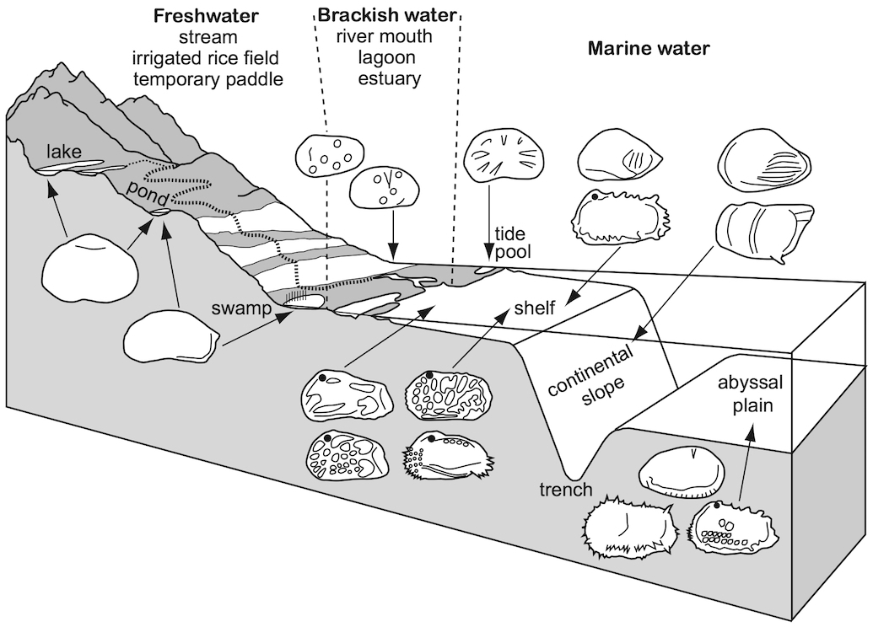
Species of the class Ostracoda are known from variety of surface and underground freshwater and marine habitats.
They can be used to understand water quality measures due to their species-specific habitat requirements (modified from Külköylüoğlu 2024)
Distribution and dispersion
15000m
Schematic hypothetical profile of terrestrial aquatic to abyssal habitats of living ostracods progressing toward coastline, modified from Benson (2003).
9307 m below the sea level (Brandão et al. 2019) and 6000 m asl (Pinto 2013)

Slide 5
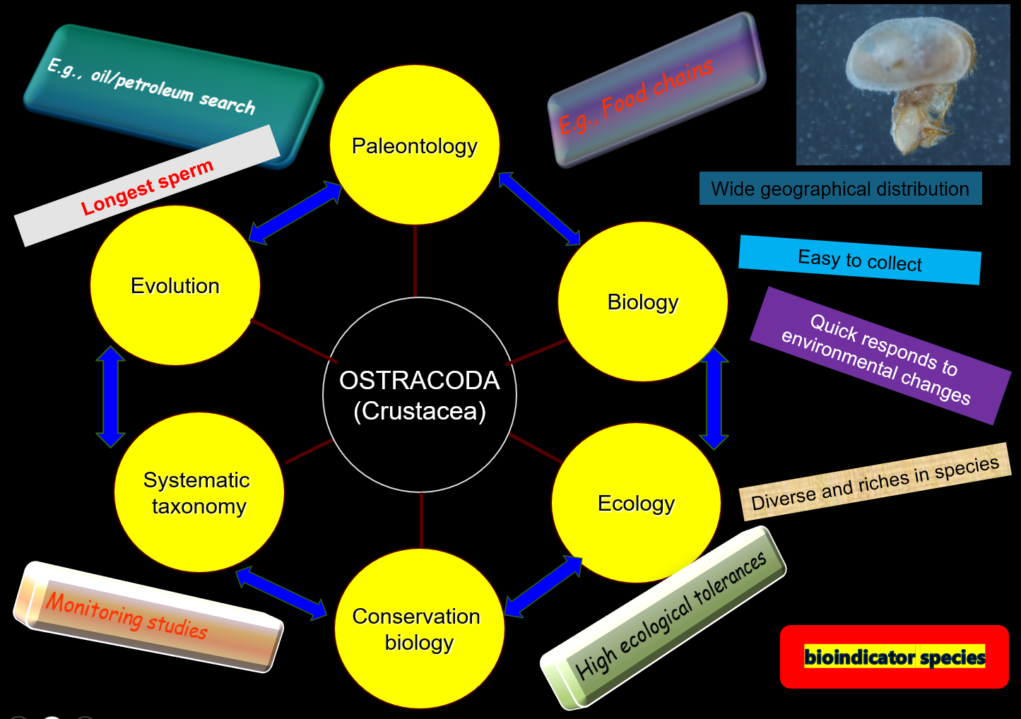
Ostracods can be used in different ways:

Slide 6
Group | Habitat Use | Adaptations | Examples
Stygobiotic (Gidó et al. 2007; Sket 2008; Culver & Pipan 2009;Botosaneanu 1986) | Obligate subterranean aquatic habitats (groundwater, aquifers, caves, interstitial waters). Cannot survive long-term in surface waters. | Strong cave-adapted traits: loss of eyes, depigmentation, elongated appendages, slow metabolism. | Ostracods, amphipods, blind cavefish, subterranean isopods.
Stygophile (Gibert et al. 1994, Deharveng et al. 2009) | Can live in both surface and subterranean waters; not restricted to underground habitats. | Few or no cave-specialized traits; tolerant of dark and nutrient-poor environments. | Ostracods, copepods, snails, and amphipods that occur in both rivers and groundwater.
Stygoxene (Sket 2008, Culver & Pipan 2009, Deharveng et al. 2009) | Accidental or occasional subterranean inhabitants; enter caves or groundwater passively. | No special adaptations; rely on surface traits. | Ostracods, surface insects swept into caves, fish carried by floods, detritus-associated fauna...

Slide 7
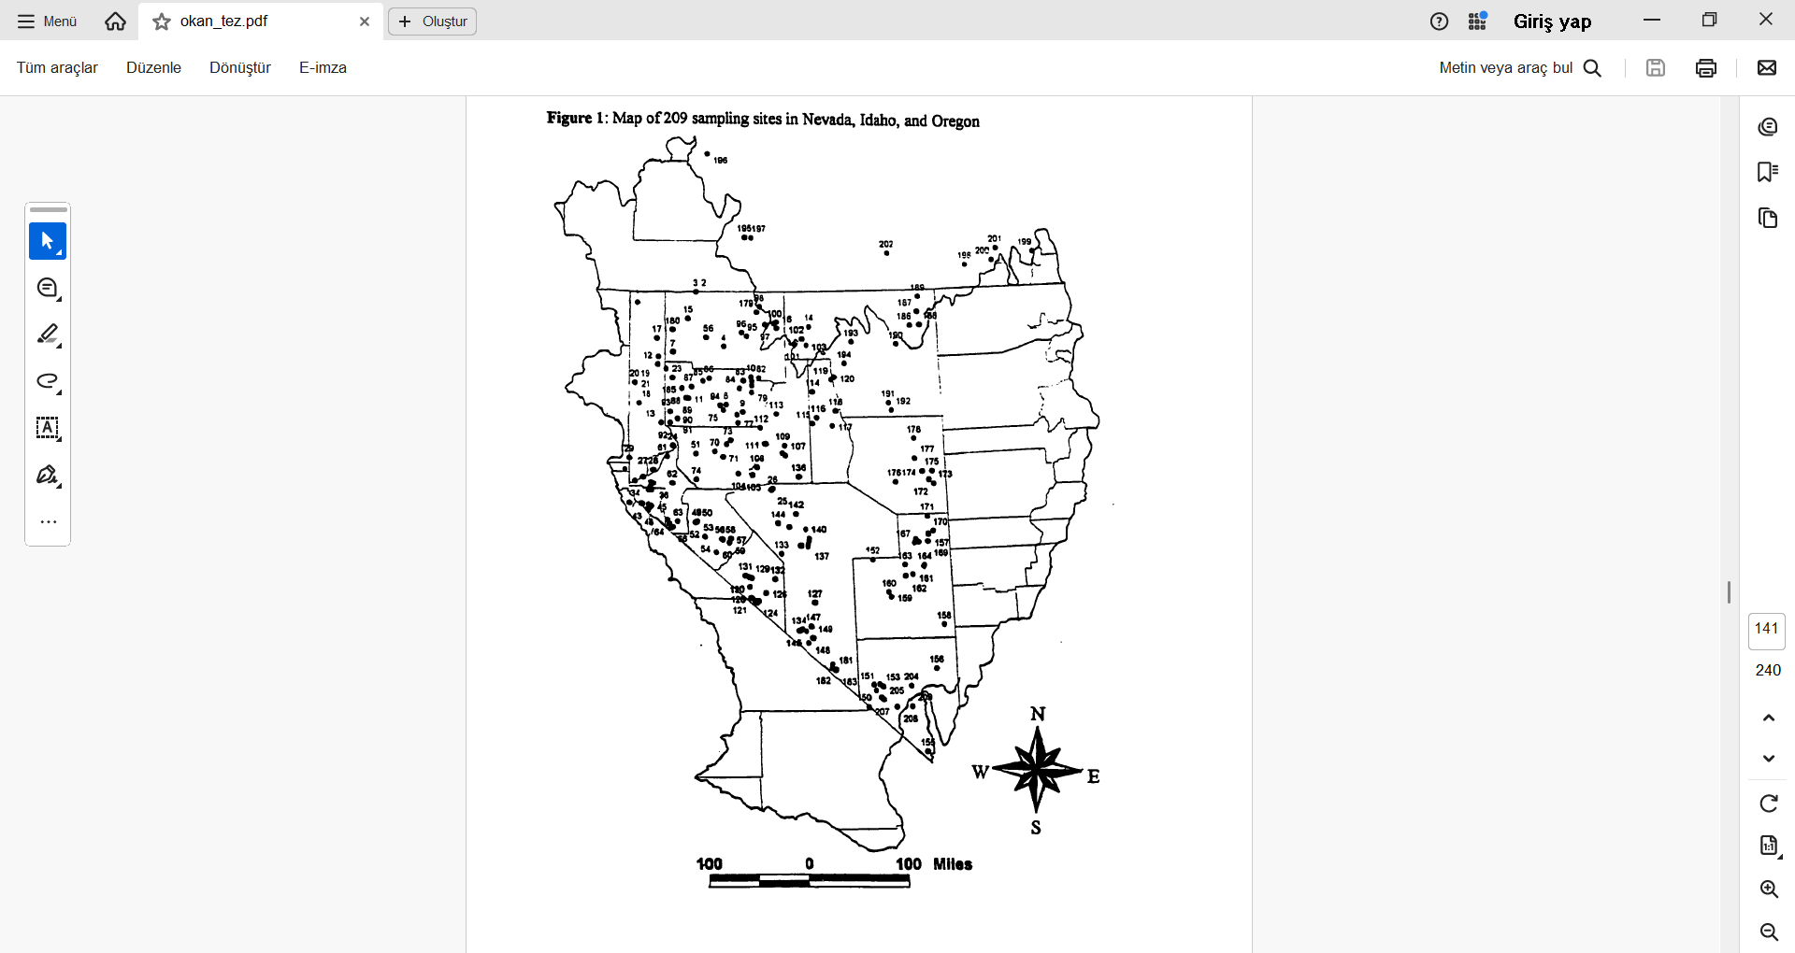
-Külköylüoğlu (1999) visited
>400 sites (of which 209 springs) between 1992 and 1998 across three states of the Great Basin area (most of Nevada, half of Utah, and sections of Idaho, Wyoming, Oregon, and California).
-and observed variety of threats on these sites.
-but this has not been analyzed in details.
Külköylüoğlu 1999.

Slide 8
Hutchins et al. (2025), introduced a new idea on the relationship between groundwater ostracods and their importance in the conservation issues, listed 14 endemic ostracods which are restricted to groundwater habitats in Texas.
Most ostracod sites displayed only a single groundwater species, but two sites (Comal Springs and the San Marcos Artesian Well) had 6 and 7 species, respectively.
Species | Habitat | Threat Impact
Bicornucandona fineganensis | large karst springs, hyporheic zone | high
Cabralcandona mixoni* | Edwards Aquifer phreatic zone | low
Comalcandona gibsoni* | large karst springs | medium
Comalcandona tressleri | large karst springs, small karst springs, hyporheic zone, Edwards Aquifer phreatic zone | high
Cypria lacrima | large karst springs, Edwards Aquifer phreatic zone | medium
Hobbsiella moria | caves (ectoparasite) | medium
Indocandona rusti* | hyporheic zone | medium
Lacrimacandona wisei* | Edwards Aquifer phreatic zone | low
Namiotkocypria haysensis* | Edwards Aquifer phreatic zone | low
Pseudocandona lordi | large karst springs, hyporheic zone | high
Rugosuscandona scharfi | large karst springs, hyporheic zone, Edwards Aquifer phreatic zone | medium
Schornikovdona bellensis | caves, small karst springs, large karst springs | high
Tuberona leonidasi* | small karst springs | high
Ufocandona hannaleeae | large karst springs, Edwards Aquifer phreatic zone | medium

Slide 9
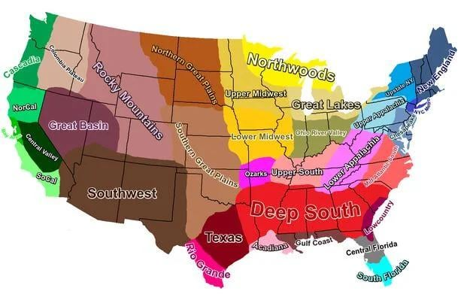
The Great Basin (541,730 km²) vs Texas (695,620 km²)
Aims
Elucidating and
comparing ostracod
diversity in both the Great Basin and Texas,
2) Inquiring into the levels of disturbance with conservation status of species,
3) Exploring the potential role of ostracods in conservation issue.
Notes:
Look at the size of Texas compared to Texas : r/mapporncirclejerk

Slide 10
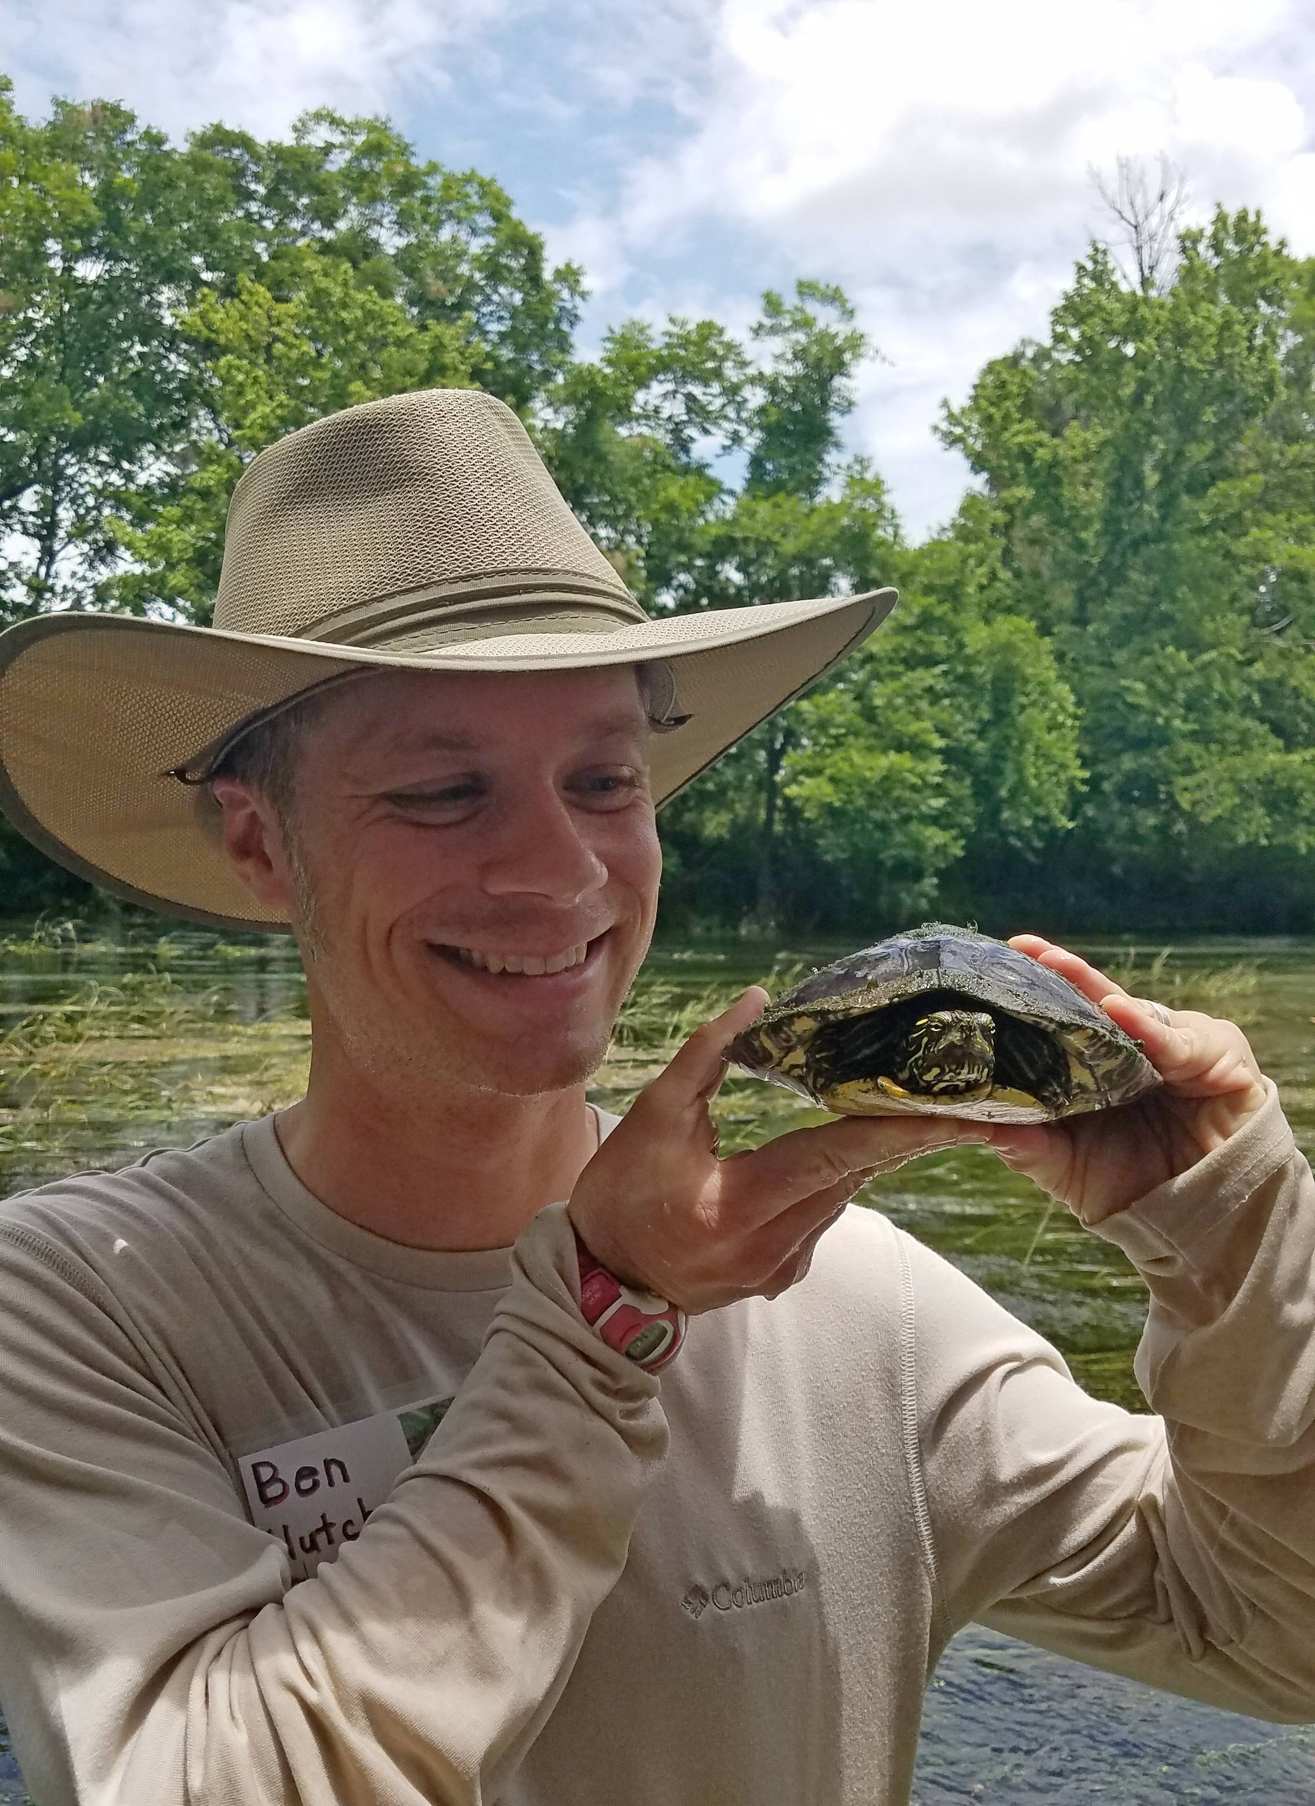
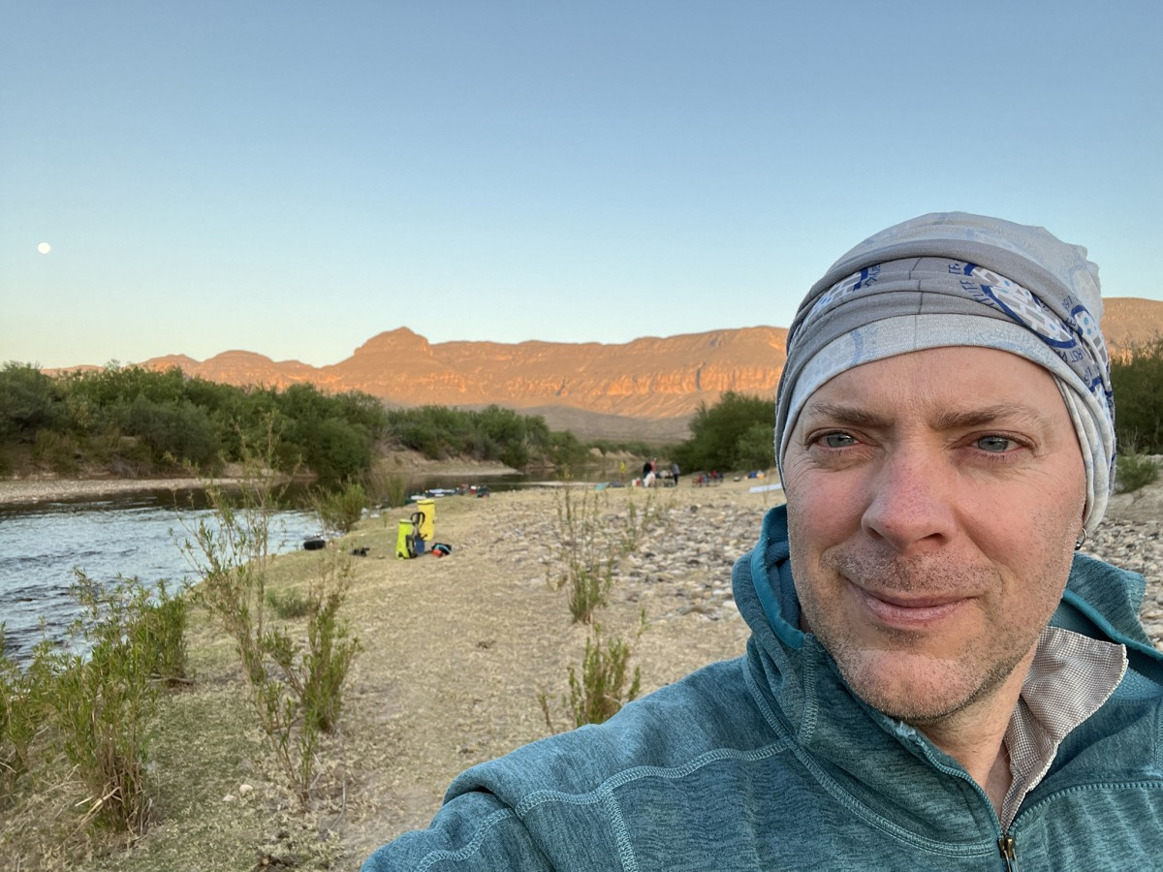
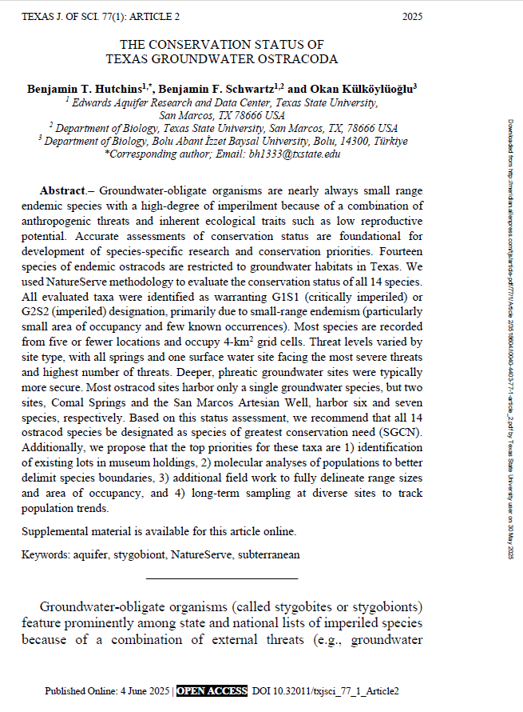
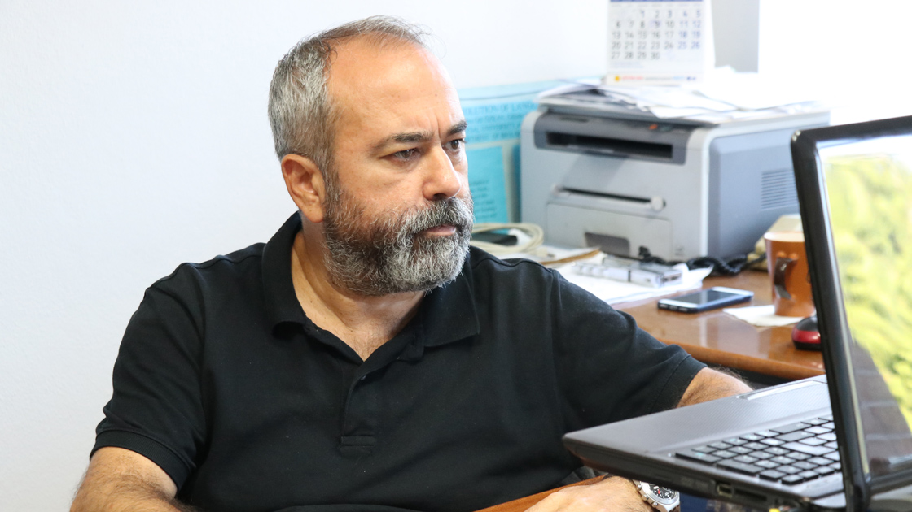
Materials and methods
-Data from the study of Hutchins et al. (2025) was partially used (details are available in there)

Slide 11
-The data evaluted during this study were gathered from 209 springs between 1992 and 1998 across three states of the Great Basin area (most of Nevada, half of Utah, and sections of Idaho, Wyoming, Oregon, and California).
-Springs were classified as either disturbed or undisturbed based on direct field observations.
Four types of disturbance—cattle or livestock, recreation, diversion, and residency—were documented in 132 of the 209 surveyed springs in the Great Basin, with disturbance levels categorized as heavy, medium, or low.
-The idea was:
Cosmopolitans do better in increasing disturbance.
-Hypothesis:
Numbers of Cosmopolitan = No. Noncosmopolitan
Külköylüoğlu 1999.

Slide 12
Classification of the levels and types of disturbance
Livestock or cattle: Heavily disturbed sites include the presence of cattle at the study sites, presence of fresh cow-dung, uncertain water flow direction due to heavy impact of cattle, no vegetation in and/or around (1m²) the sites, other vegetation heavily chopped and trampled, and deep tracks left by the cattle. Moderately disturbed sites by cattle were characterized with the presence of cow-dung, water flow relatively on one direction, vegetation present but showing indication of grazing. Low disturbed sites were defined with the presence or absence of dry cow dung, abundance of vegetation, and with a normal water flow.
Recreation: Heavily disturbed sites are those open to public access and visiting, easy road accessibility, and any artificial structure that affects the vegetation (1m²) around the spring. Medium disturbance includes any structure established for recreation purposes but have moderate disturbance on vegetation around the spring. Low disturbance consists of slight impacts of artificial structures established for the recreational purposes around the springs where vegetation structure is not changed, and the difficulty in accessibility to the spring.
Diversion: Dry springs due to water diversion by pipes, presence of any equipment for water diversion purposes, presence of mining activities and agricultural fields are categorized as heavily disturbed sites. Medium disturbance due to diversion covers any site which are almost dry, observation of pipes or such structures used for water diversion but vegetation is still present, and presence of slow moving or stagnant water. In low disturbed sites, diversion has slight impact on vegetation around the study site.
Residency: Observation of the presence of new or old residency and/or road accessibility within 100 meters around the sites were considered as heavily disturbed sites. If this distance is between 100 and 200 meters, it was medium disturbance. If the disturbance is 300 meters or greater, it was classified as low.

Slide 13
The classification of ostracods as cosmopolitan or noncosmopolitan was determined using both literature sources (e.g., Meisch 2000, Külköylüoğlu 2000, 2013) and personal observations.
Nonparametric Spearman Rank Correlation analyses and Chi-square tests (p = 0.05) were conducted to examine relationships between cosmopolitan and noncosmopolitan species across disturbed and undisturbed sites.
These analyses considered 13 variables: water temperature, dissolved oxygen, conductivity, pH, site width, water depth, elevation, flow direction/aspect, spring type, disturbance, cosmopolitans, noncosmopolitans, and the percentage of noncosmopolitans.

Slide 14
Results and Discussion
Species diversity
Texas includes 118 non-marine living ostracod species in 45 genera:
For the last 10 years or so, 20 new species belonging to 19 genera (9 of them new) and one new Subfamily Cabralcandoninae Külköylüoğlu et al., 2019 have been reported from the groundwaters and related aquatic habitats of Texas (Külköylüoğlu et al. 2011, 2017, 2019, 2023).
Nevada includes 80 taxa (55 species, 25 taxa) (this study):
Pearse (1914) 4 spp., Brues (1932) 7 spp., Ferguson (1966) 1 sp.,
Forester (1983, 1991) 7 spp. Külköylüoğlu (1999) 68 taxa (43 spp., 25 taxa).

Slide 15
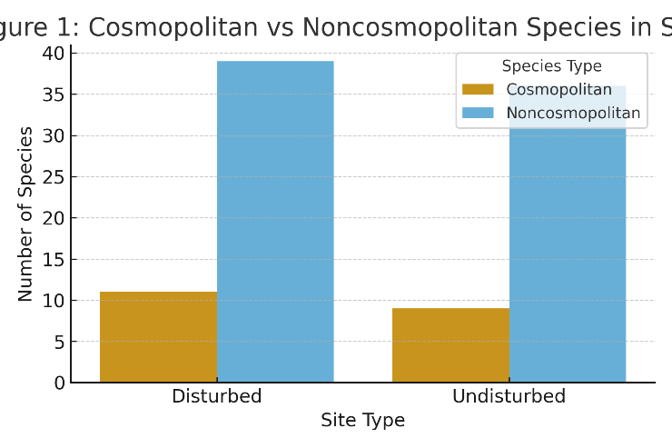
Figure. Cosmopolitan vs Noncosmopolitan Species in Springs of the Great Basin. 11 of 68 ostracod species (Darwinula stevensoni, Ilyocypris bradyi, I. gibba, Herpetocypris chevreuxi, H. reptans, Pseudocandona albicans, Cyclocypris ovum, Heterocypris salina, H. incongruens, Eucypris virens, Cypridopsis vidua) were classified as cosmopolitan. All other (57) species are considered noncosmopolitan. No ostracod species was found from 22 study sites. Eight cosmopolitan species against two noncosmopolitan species were found from total of 25 artificial habitats. More than 80% of these sites were dominated by cosmopolitan species.
 |  | disturbed | undisturbed | total
Tot.#ofspr. |  | 132 | 77 | 209
Tot.with cosmopolitan |  | 96 | 49 | 145
Tot.w/o cosmopolitan |  | 23 | 19 | 42
Tot.spr.w/o ostracods |  | 13 | 8 | 21
Tot.cosmopolitan spp |  | 11 | 8 | 19

Slide 16
Table: Correlations among environmental variables and species from the Great Basin. Notes: Strong correlation with % noncosmopolitans NS = not significant
Variable | Cosmopolitan Species | Noncosmopolitan Species | % Noncosmopolitans
Conductivity | Neg, sig (P<0.05) | Neg, sig (P<0.05) | Neg, sig (P<0.05)
pH | Pos, weak, NS | Neg, weak, sig | Neg, weak, sig
Water Temperature | Pos, weak, NS | Neg, weak, sig | Neg, weak, sig
Disturbance | Pos, weak, sig (P=0.0028) | Neg, weak, NS (P=0.06) | -
Cosmopolitan vs Noncosmopolitan | Pos, weak, sig (P=0.0118) | - | -

Slide 17
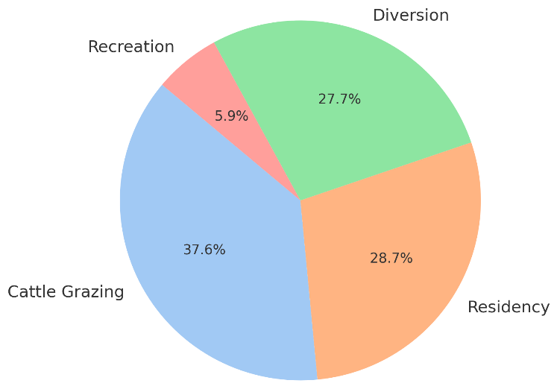
Figure. Percent distribution of disturbance types in the study area (e.g., mostly Nevada)
Total disturbance by humans (diversion + residency) = 57%, higher than cattle alone.

Slide 18
Hutchins et al (2025) reported that water management /use and climate change effects (drought and temperature extremes) were the most common threats in all sites.
Threat | Cave (3) | Edwards Aquifer phreatic zone (2) | Hyporheic zone (12) | Large karst spring (19) | Small karst spring (5) | Surface waters (1) | All Sites (42)
Housing & Urban areas | 0 | 0 | 25 | 0 | 20 | 100 | 13
Livestock & Farming | 33 | 0 | 17 | 32 | 40 | 0 | 31
Oil & Gas drilling | 0 | 0 | 25 | 5 | 0 | 0 | 5
Recreational activities | 0 | 0 | 17 | 5 | 0 | 0 | 4
Water management/use (Slight) | 33 | 100 | 0 | 21 | 20 | 0 | 20
Water management/use (Moderate) | 67 | 0 | 100 | 79 | 80 | 100 | 80
Invasive non-native species | 0 | 0 | 0 | 58 | 60 | 100 | 46
Domestic & urban wastewater | 0 | 00 | 33 | 32 | 40 | 100 | 38
Droughts (Slight) | 33 | 100 | 0 | 0 | 0 | 0 | 5
Droughts (Moderate) | 67 | 0 | 100 | 100 | 100 | 100 | 95
Temperature extremes | 33 | 0 | 100 | 5 | 80 | 100 | 56

Slide 19
Comparison of Disturbance and Threat Types
Disturbance / Threat Type | Factors effective on species (%) | Findings for the Great Basin | Emphasis in Texas Ostracod Study (2025) | Notes from Texas Study
Cattle Grazing | 38 | Highest disturbance across sites | Mentioned only indirectly (land use changes) | Not a dominant factor; less emphasized compared to pumping & climate
Residency / Settlement | 29 | Moderate | Urbanization, habitat modification cited as important localized threats | Moderate severity; affects shallow springs and karst outlets
Diversion / Water Management | 28 | Moderate | Aquifer pumping, springflow reduction, groundwater diversion are nearly universal | Identified as primary threat, high severity across all species
Recreation | 6 | Lowest disturbance | Minimal mention | Rarely highlighted; may affect specific spring sites
Climate Change | – | NA | Nearly universal threat (drought, temp. extremes) | Central driver of long-term risk; exacerbates pumping effects
Oil & Gas / Feral Hogs / Other Land Use | – | NA | Mentioned as site-specific threats | Regional relevance; not captured in the study

Slide 20
Previous studies provided supportive evidences:
Burkalova et al. (2011): Mussels were surveyed at 139 sites, distributed in 66 waterbodies, belonging to 11 major drainage basins of Texas.
Of the 46 Unionidae species currently present in Texas, 65% were classified as rare and very rare, including all state and regional endemics. Almost all endemics were found exclusively in streams and rivers, where diversity was almost double that of lentic waters. Man’s ongoing alteration of lotic with lentic waterbodies favors common species, and dramatically reduces habitat for endemics, contributing to homogenization of unionid fauna.
Sun et al. (2020): Working on the 249 research sites (springs) in the literature and Japan, they found that spring indicator invertebrates, Podocopida (Ostracoda) has 11% contribution. The information provided by the spring indicator taxa of an aquifer can reflect the contacts between the surface origin of the water and may be used as an indicator of groundwater and spring evaluation. Given the susceptibility of springs and groundwater to modification from land-use change and water abstraction, many species should be considered at risk, and urgent attention is required to incorporate biological indicators into an assessment of groundwater and spring management.

Slide 21
Conclusion
-Patterns of disturbance and species composition observed in the Great Basin spring systems align in part, but also contrast, with recent discoveries from Texas groundwater and spring habitats.
-In the Great Basin, anthropogenic disturbance was associated with a decline in local diversity, a significant but weak increase in cosmopolitan species, and a corresponding reduction in noncosmopolitan taxa, particularly in artificial habitats where cosmopolitans dominated more than 80% of sites. These findings suggest disturbance-driven homogenization of ostracod assemblages.
-In contrast, Texas aquifers and springs exhibit exceptional ostracod richness, with at least 118 nonmarine species recorded. At several spring complexes (e.g., Comal and San Marcos), multiple endemic groundwater specialists co-occur, highlighting Texas as a global hotspot of subterranean ostracod diversity.
-While Great Basin data emphasize biodiversity loss and cosmopolitan dominance under disturbance, the Texas record underscores the evolutionary potential and endemism of groundwater ostracods.
→Together, these regional perspectives suggest a unifying conservation message: springs and groundwater systems function as biodiversity reservoirs, but they are acutely sensitive to anthropogenic stress. Disturbance threatens to erode local diversity in the Great Basin and risks eliminating narrowly distributed endemics in Texas. The juxtaposition of homogenization in the north and endemism in the south thus reinforces the need for regionally tailored but urgently prioritized conservation strategies.
These findings from the Great Basin and Texas underscore the critical role of springs and groundwater systems as biodiversity reservoirs, while also emphasizing their sensitivity to disturbance and the need for targeted conservation strategies.

Slide 22
Three main points for your attention:
It is possible that differences in the numbers of ostracod species
(118 vs 80 spp) may be related
Sampling efforts in two region
Time of samplings
Size of area covered
Differences in the types of sampling sites
2) Low sampling density. More and extensive samplings should be done (this is also true for many states in the US)
3) Lack of identification of samples.
A MUST and VERY URGENT and IMPORTANT ISSUE !!!

Slide 23
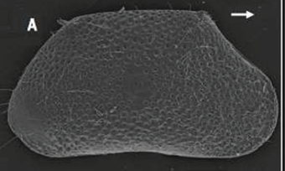
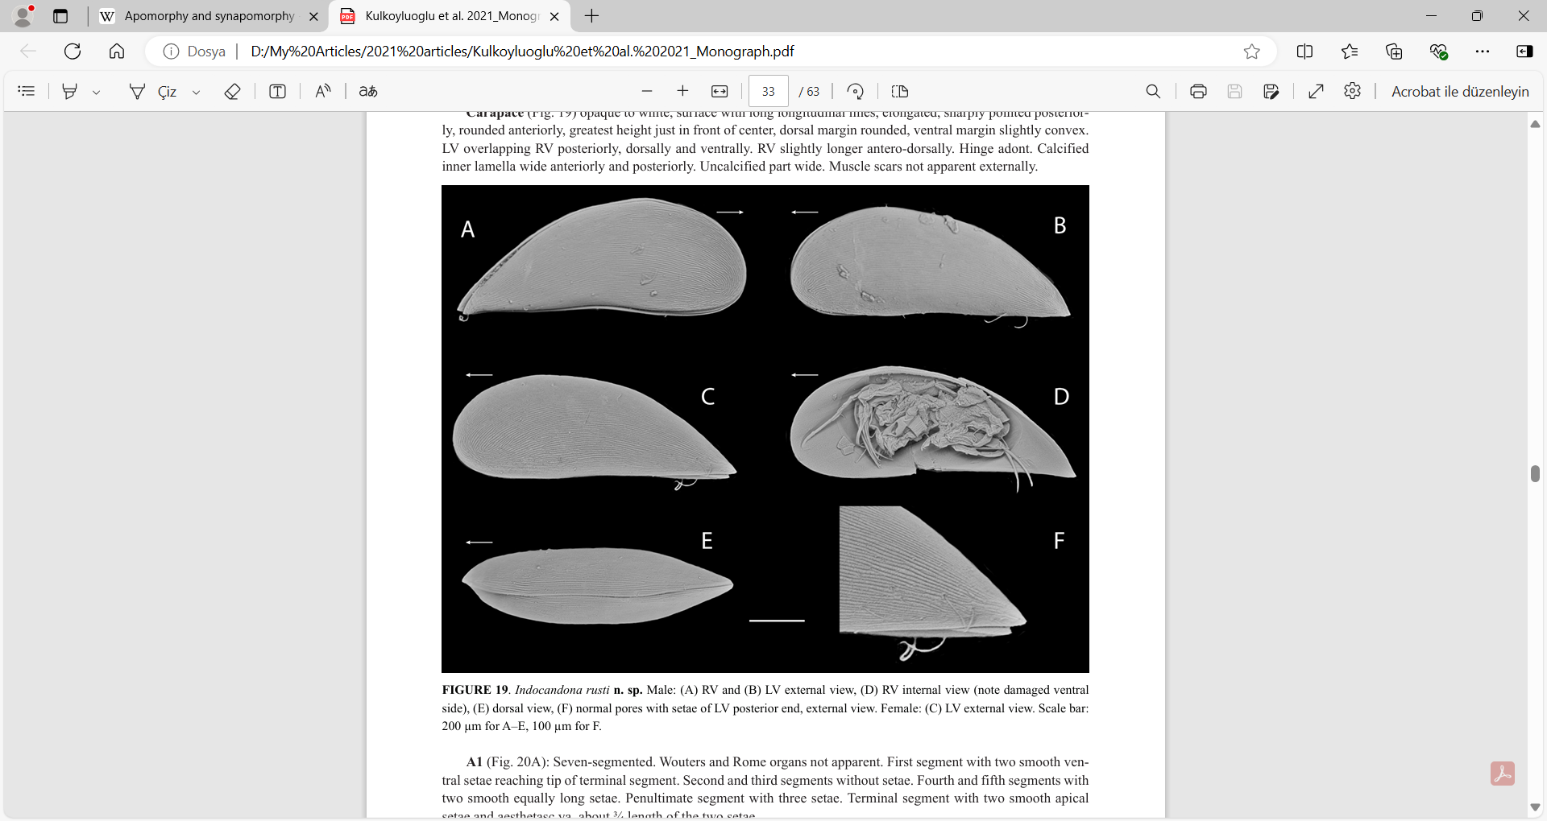
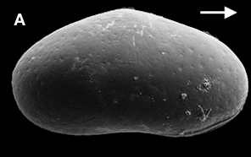
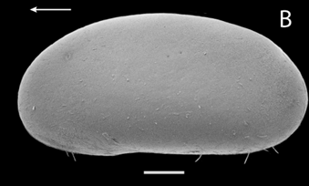
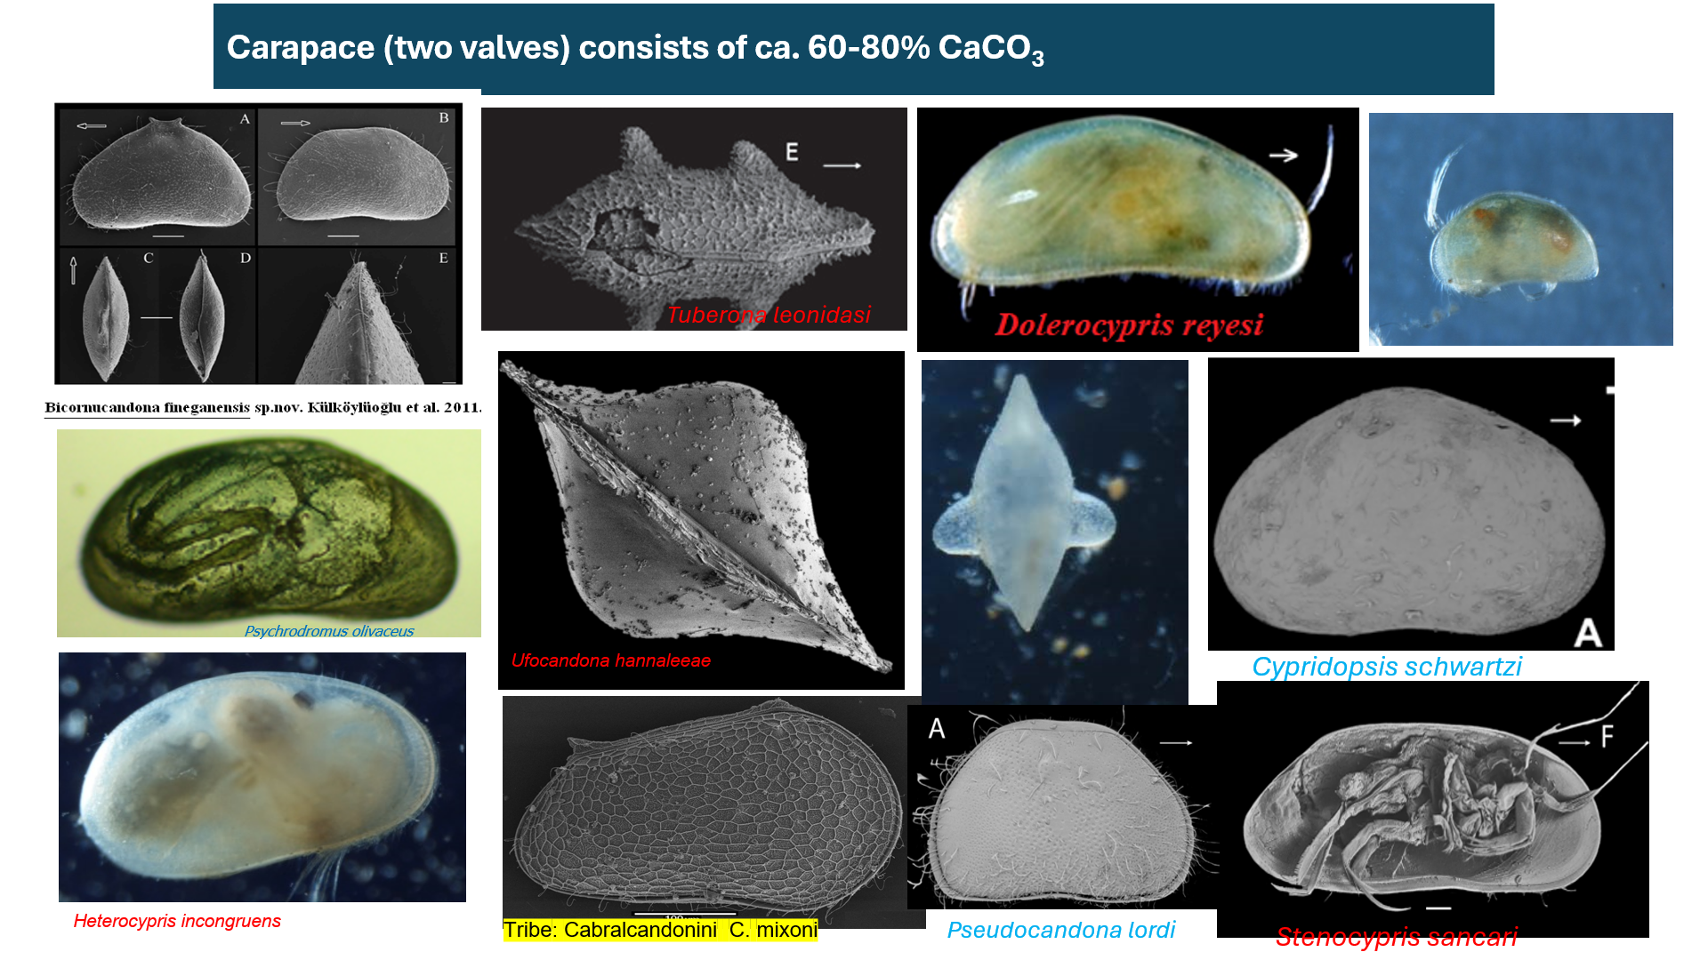
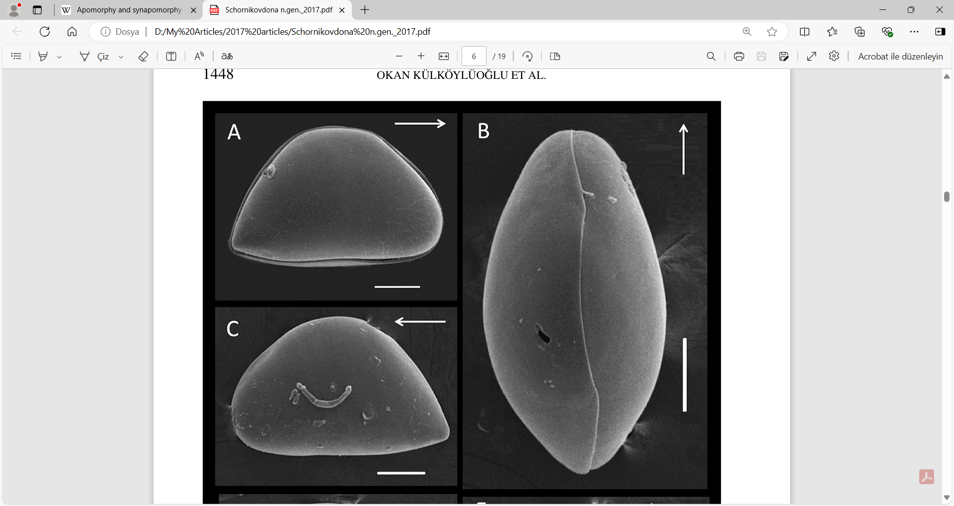
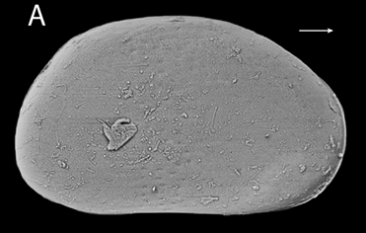
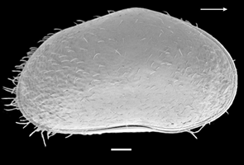
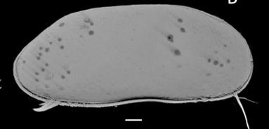
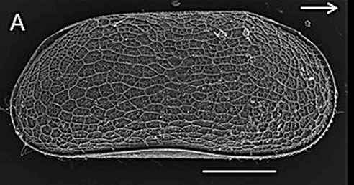
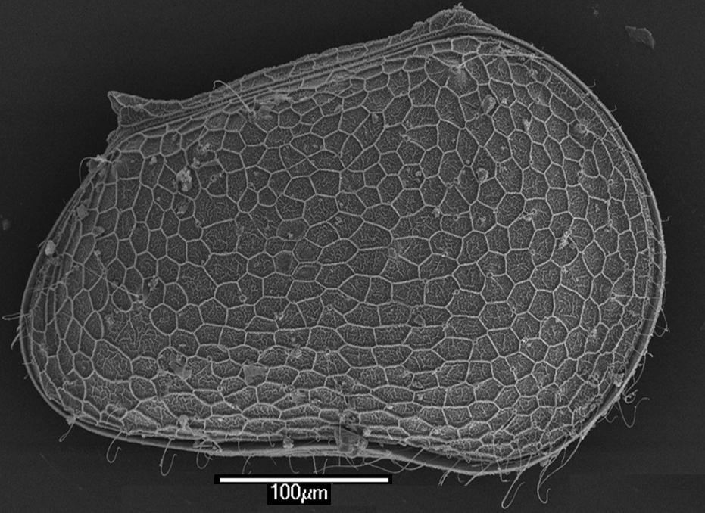
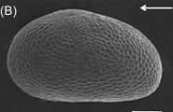
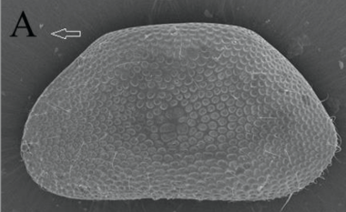
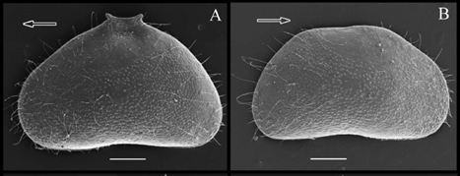
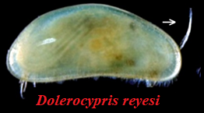
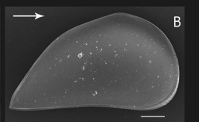
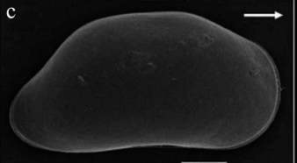
Thank you for listening

Slide 24
TGIF 2025 Program
9:00 - 9:10 | WELCOME REMARKS - CONFERENCE HOST: Liz Borda | Poster Presenter | Title | Co-Authors
 | Session 1 (Oral Presentation) - Moderator: Fernando Calderon Gutierrez | Evan Guerrero | Influence of the hyporheic zone on gene flow in invertebrates in the Edwards-Trinity Aquifer, Texas. | Dr. Kathryn Perez, Dr. Benjamin Schwartz, Dr. Benjamin Hutchins
9:10 -9:30 | Okan Külköylüoğlu, Ostracod diversity, disturbance, and conservation of springs and groundwater habitats in the Great Basin and Texas | Danielle Bragg | Spatiotemporal analysis of metazoan community from the subterranean estuaries of the Yucatan peninsula and Cozumel island through metagenomics | Dr. Elizabeth Borda, Dr. Fernando Calderon-Gutierrez
9:30 - 9:50 | Cecilia Fitzgerald-Cook, Detecting environmental DNA (eDNA) of a keystone crustacean in threatened Hawaiian wetlands. | Erika Frandsen | Relationships between benthic and hyporheic insect communities across environmental gradients in Texas rivers | Benjamin F. Schwartz,
9:50- 10:10 | Tyler Morgan, Gene flow at the microscale in three endangered animals |  |  | Benjamin T. Hutchins,
10:10-10:30 | Muntadher Mashan, Using genomic tools to enhance biodiversity assessments in karst subterranean estuaries |  |  | Weston H. Nowlin,
10:30-10:50 | Joseph Aubert, Insect diversity in the hyporheic zone of Texas rivers |  |  | Todd Swannack,
10:50-11:10 | Coffee Break |  |  | Miranda Sams,
 | Session 2 (Oral Presentation) - Moderator: Amelia Hunter |  |  | Kierra Determan,
11:10-11:30 | Gabrielle Vaughn, Population genetics and distribution of Typhlatya species |  |  | Kirby Wright,
11:30-11:50 | Ramon Villareal, Investigation of 2 potential new species of Cirolanides, a crustacean (Isopoda) found in the Edwards Aquifer. |  |  | Jessica Kittridge,
11:50-12:10 | Andrew Cannizzaro, Light shining into the darkness: phylogenetic analyses of a hypogean crustacean (Amphipoda: Parabogidiella) reveals unique diversity and structuring |  |  | Catherine Cline
12:10-12:30 | Photo Contest - Moderator: Bernard Mbithi | Connor Grizzle, Marco Rodriguez | Toward Speleogenomic Pipelines: Characterizing Biodiversity from Species to Communities | Marci Casias, Marco Rodriguez, Fernando Calderón-Gutiérrez & Elizabeth Borda
12:30- 1:40 | Lunch (Cafeteria) | Kamryn Richard | Work with Ozark Cave Fauna | Danté Fenolio
1:40 - 2:40 | Poster Session
 | Session 3 (Oral Presentation) - Moderator: Caroline Mierzejewski
2:40 - 3:00 | Katherine Bell, Conservation genetics of Stygobromus in Texas
3:00 - 3:20 | Ruben Tovar, Exploring the utility of diceCT in karst and aquifer taxa
3:20 - 3:40 | Pete Diaz, Salamander love rocks
3:40 - 4:00 | Ben Hutchins, The Aquifer Biodiversity Collection at the Edwards Aquifer Research and Data Center
4:00 - 4:15 | Student Awards and Photo Contest Winners - Moderator: Liz Borda
4:15 - 4:30 | CLOSING REMARKS - CONFERENCE HOST: Liz Borda
4:30 - ? | Burleson Yard Beer Garden?, Aquaduck Beer Garden?

