Slide 1
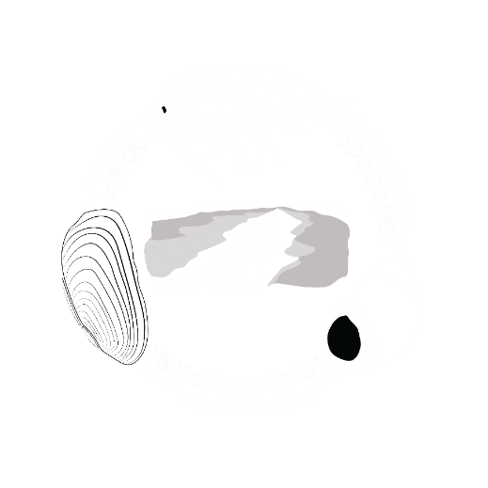

Light shining into the darkness: phylogenetic analyses of a hypogean crustacean (Amphipoda: Parabogidiella) reveals unique diversity and structuring.
Andrew G. Cannizzaro¹ & David J. Berg²
¹ Miami University, Department of Biology, Oxford, Ohio; ²Miami University, Department of Biology, Hamilton, Ohio

Slide 2
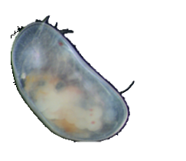
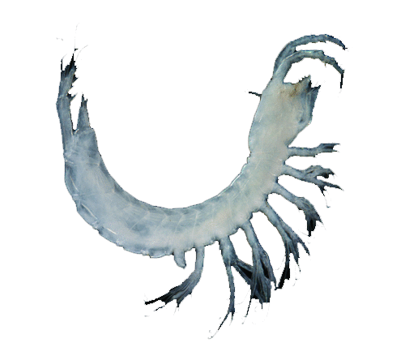
Groundwater Fauna
Astyanax mexicanus; Citron (CC)
Mexistenasellus floridanus
Macrocyclops sp.
Ostracoda sp.
Lockyerenella danschmidti; (Little & Camacho, 2016)
Procambarus orcinus ; © Keith A Crandall
Eurycea rathbuni; Joe N. Fries (CC)

Slide 3
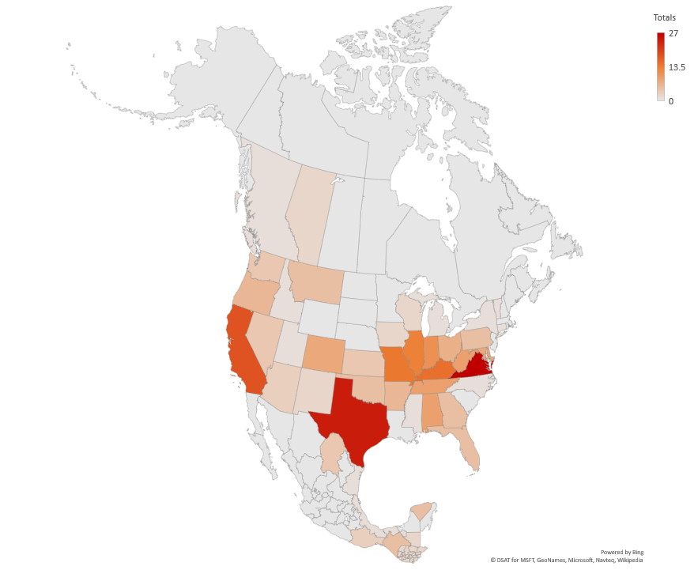
Total number of described groundwater amphipods from North America
Highest generic (and family-level) diversity in Texas. Hadziids and other unique families.
Highest specific diversity in Virginia, mostly Stygobromus spp.
Highest diversity found among the Crangonyctidae, 100+ spp.
14 spp.
13 spp.
15 spp.
18 spp.
27 spp.
25 spp.

Slide 4
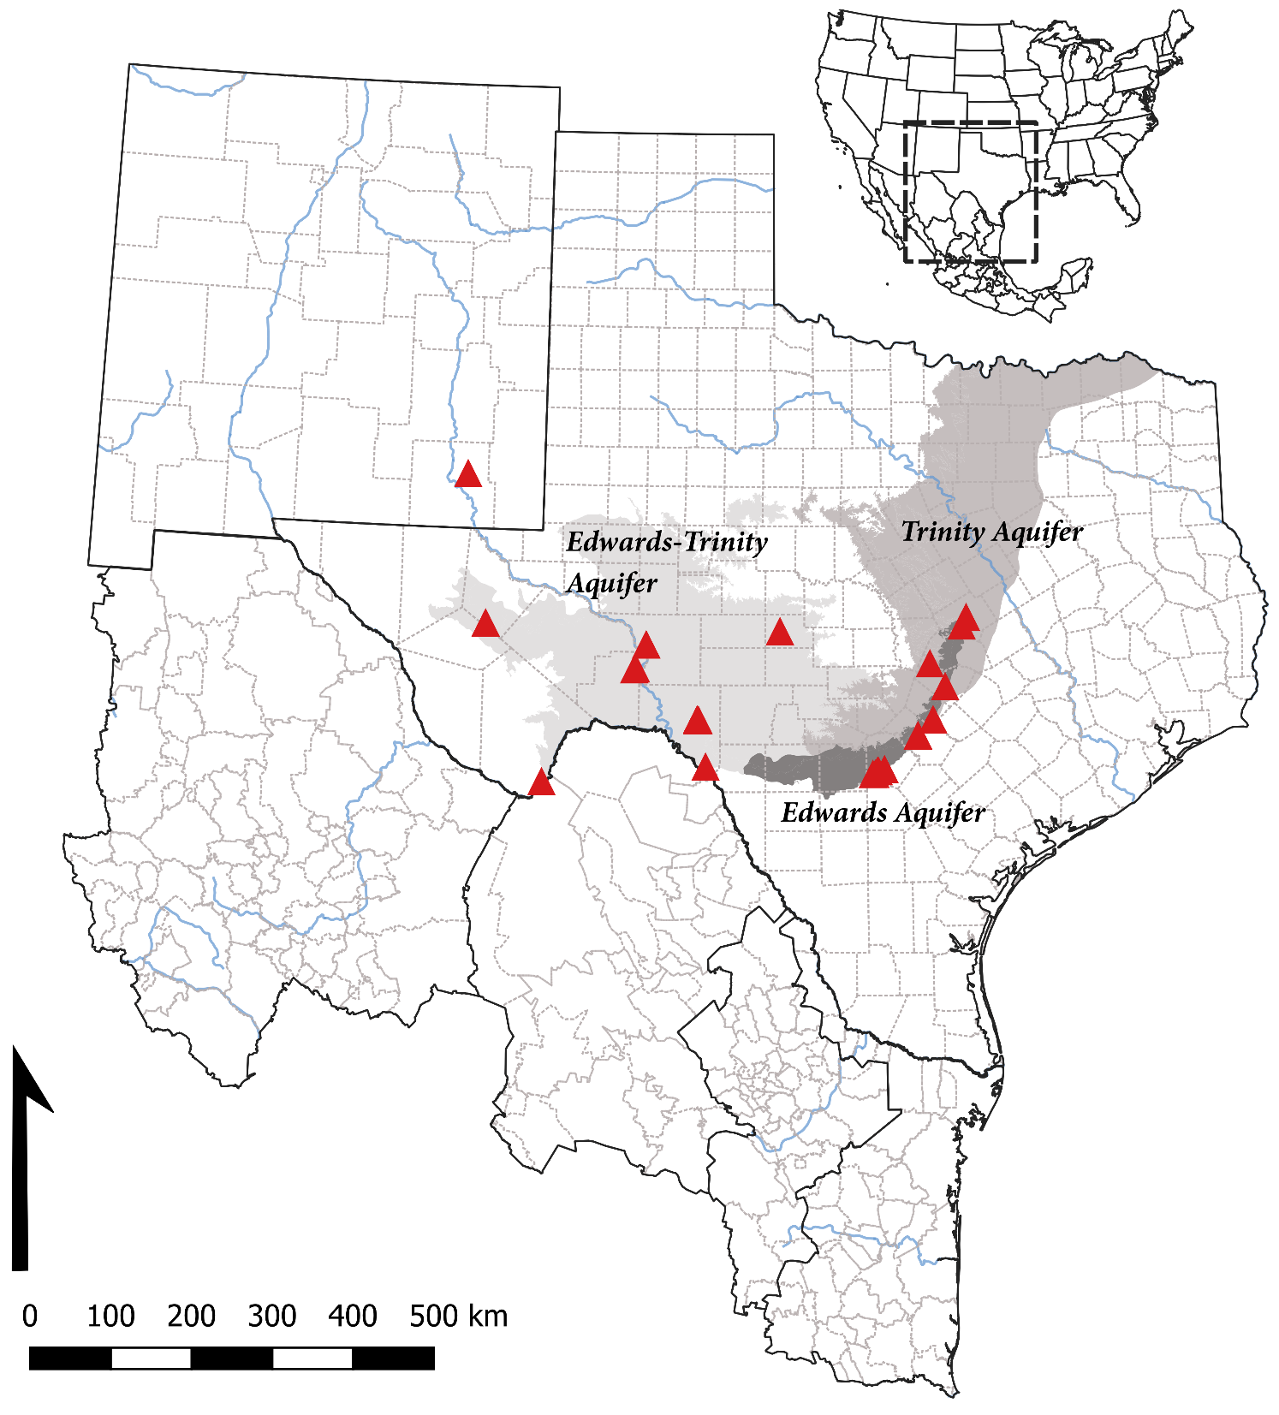

“Parabogidiella americana”
5 mm

Slide 5
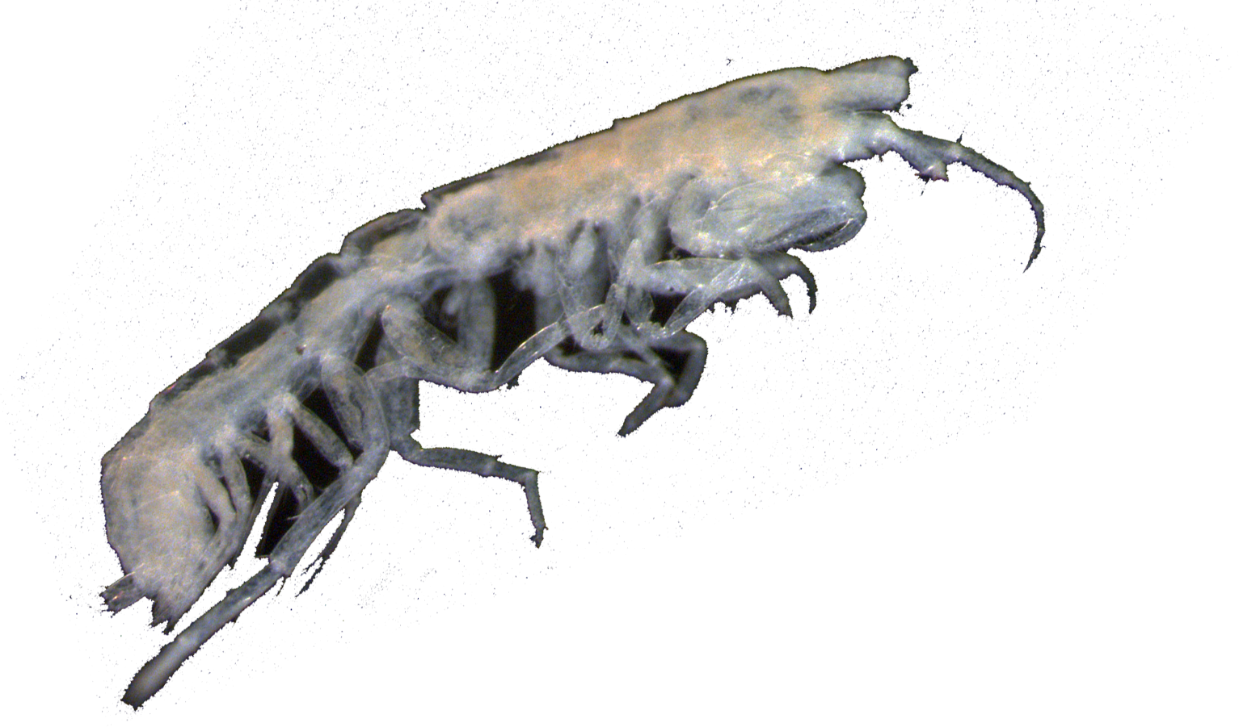


Objectives
(I) Investigate molecular diversity of the genus Parabogidiella.
(II) Identify species richness and distributions.
(III) Correlate species distribution to geology/hydrology.

Slide 6
Methods
Obtained individuals of Parabogidiella from 18 localities from the EARDC collection
DNA extracted and sequenced for three genes (18S/28S/16S)
Reconstructed phylogenies using Maximum Likelihood in IQTREE
Specimens cleared, stained, and dissected for morphology
Skylight Cave
San Solomon Spring
Anderson / Boiling Springs
Live Oak Creek
Caroline Spring / Ind. Creek
Barton Pool / Cold Springs
Finnegan Spring
Snake Spring
Blue Hole Spring
San Marcos Artesian Well
Comal Springs
Tornillo Creek
Tschirhart Well Aldridge Corp. Well

Slide 7

Anderson / Boiling Springs
Skylight Cave (New Mexico)
Caroline Spring
Caroline Spring
Inc. Simplexia
Tornillo Creek
San Solomon Springs
Independence Creek
Live Oak Creek
“Trans Pecos Clade”
“Basally-derived Clade”
San Marcos Artesian Well
Comal Springs
Snake Spring
Blue Hole Spring
Finnegan Spring
Barton Pool Spring
Diversion Spring
Cold Spring
Tschirhart Well
Aldrige Corp. Well
?
“Edwards Plateau Clade”
“Edwards Plateau Clade”
“Trans Pecos Clade”
=Simplexia?

Slide 8
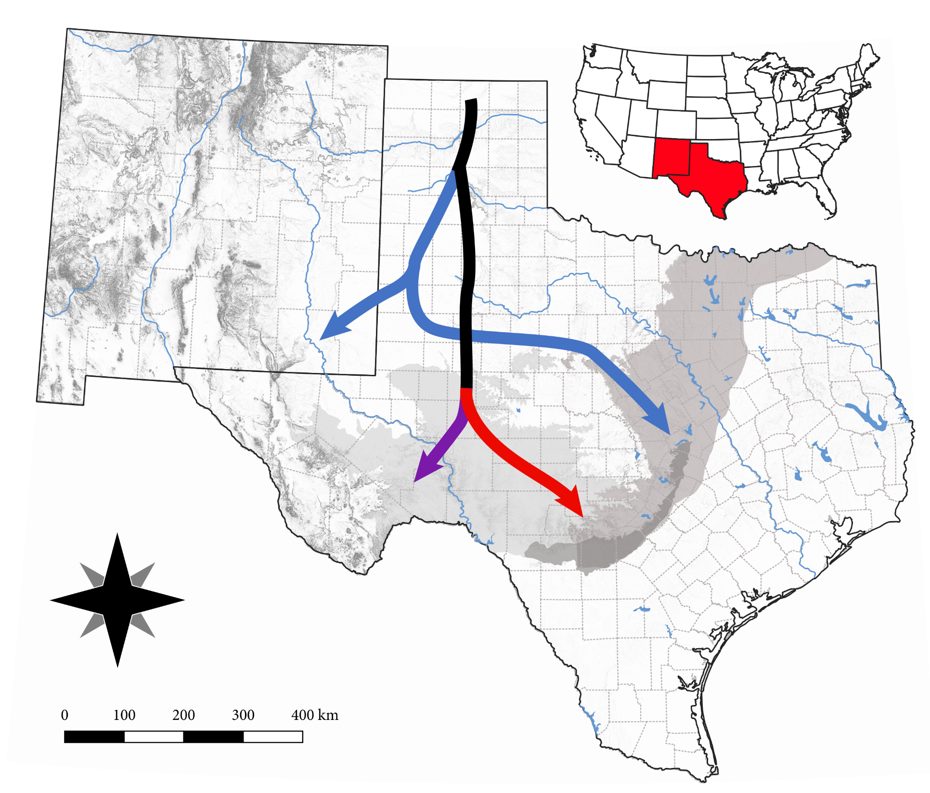
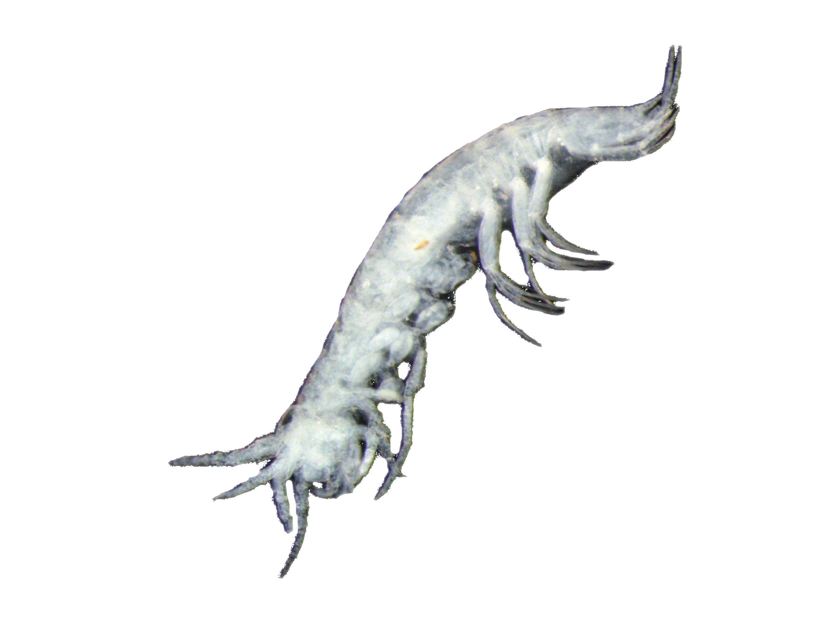
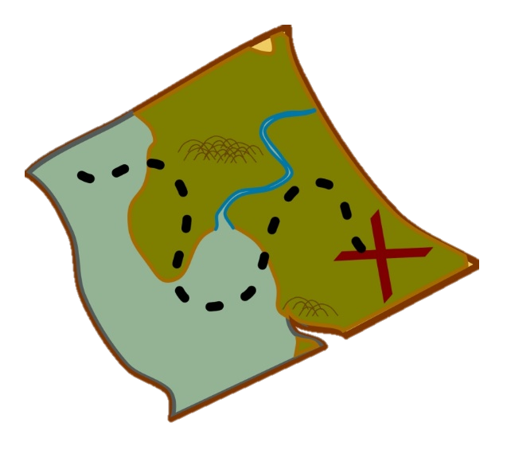
What happened?
(I) Lineage originates. Western Interior Seaway?
(II) Dispersal/divergence. Hyporheic vs aquifer?
?
(III) Divergence due to the Pecos River

Slide 9
Anderson Spring, (sp. 1)
Boiling Spring (sp. 1)
Skylight Cave, New Mexico (sp. 2)
Caroline Spring (sp. 3)
Caroline Spring (sp. 4)
Tornillo Creek (sp. 5)
Caroline Spring (Simplexia longicrus)
San Solomon Springs (sp. 6)
Caroline Spring (sp. 7)
Independence Creek (sp. 8)
Skylight Cave (sp. 2)
“Trans Pecos Clade”
Live Oak Creek (sp. 8)
Live Oak Creek (sp. 8)
Live Oak Creek (sp. 8)
San Marcos Artesian Well (sp. 9)
San Solomon Spring (sp. 6)
Live Oak Creek (sp. 8)
Anderson/Boiling Spring (sp. 1)
Tschirhart Well (sp. 10)
Caroline Sp. /Ind. Crk
(spp. 3-4, 7-8, S. longicrus)
Cold Spring (sp. 12)
Tschirhart Well (sp. 10)
5
Barton Pool Spring (sp. 14)
Tschirhart Well (sp. 10)
Finnegan Spring
Snake Spring
Blue Hole Spring
(sp. 11)
San Marcos Artesian Well (P. americana, sp. 9)
San Marcos Artesian Well (P. americana)
Comal Springs (sp. 13)
San Marcos Artesian Well (P. americana)
San Marcos Artesian Well (P. americana)
Tschirhart Well Aldridge Corp. Well
(spp. 10, 15)
“Edwards Plateau Clade”
Snake Spring (sp. 11)
Tornillo Creek
(sp. 5)
Finnegan Spring (sp. 11)
Blue Hole Spring (sp. 11)
Finnegan Spring (sp. 11)
Barton Pool/ Diversion Springs (sp. 12)
Comal Springs (sp. 13)
Cold Spring (sp. 14)
Tschirhart Well (sp. 15)

Slide 10
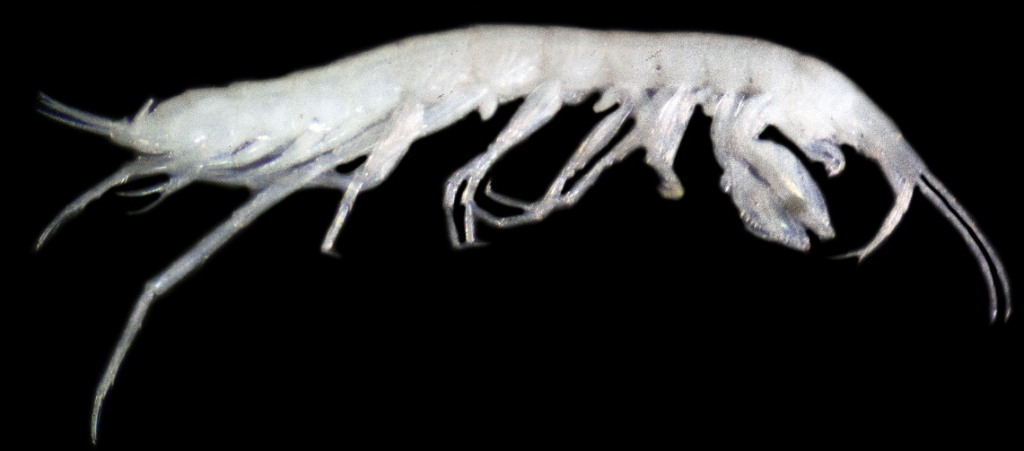
Not so cryptic diversity…
Live Oak Creek, Crockett County, TX
San Marcos Artesian Well, Hays County, TX
(non-type species)
San Marcos Artesian Well, Hays County, TX
(type)
Tschirhart Well, Bexar County, TX
San Solomon Springs, Reeves County, TX
Finnegan Spring, Val Verde County, TX
Skylight Cave, Eddy County, NM

Slide 11
Morphological Diversity (Gnathopods)
San Marcos Artesian Well, Bexar County, TX
(non-type species)
Tschirhart Well, Bexar County, TX
Skylight Cave, Eddy County, NM

Slide 12
Morphological Diversity (Uropods)
Live Oak Creek, Crockett County, TX
Finnegan Spring, Val Verde County, TX
Skylight Cave, Eddy County, NM
San Marcos Artesian Well, Bexar County, TX
(non-type species)
San Marcos Artesian Well, Bexar County, TX
(type)
Tschirhart Well, Bexar County, TX
Notes:
Uropods for burrowing? Or for Swimming?

Slide 13
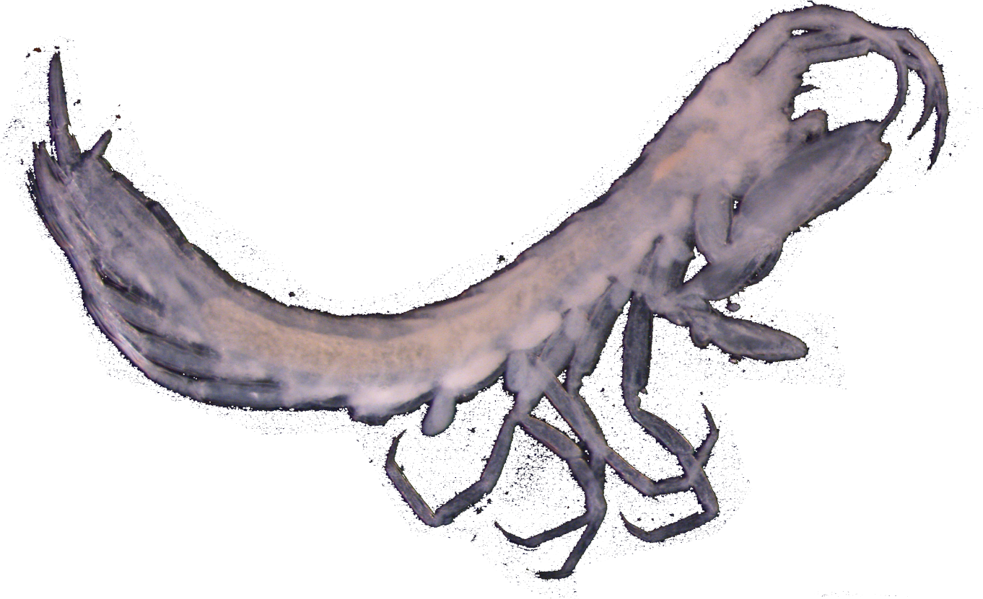
Future Work
?
Sequence additional populations? Artesiidae?
Time-calibrated phylogenies, ancestral area/state reconstruction.
Examine Bell County populations morphologically. Describe species.
?

Slide 14

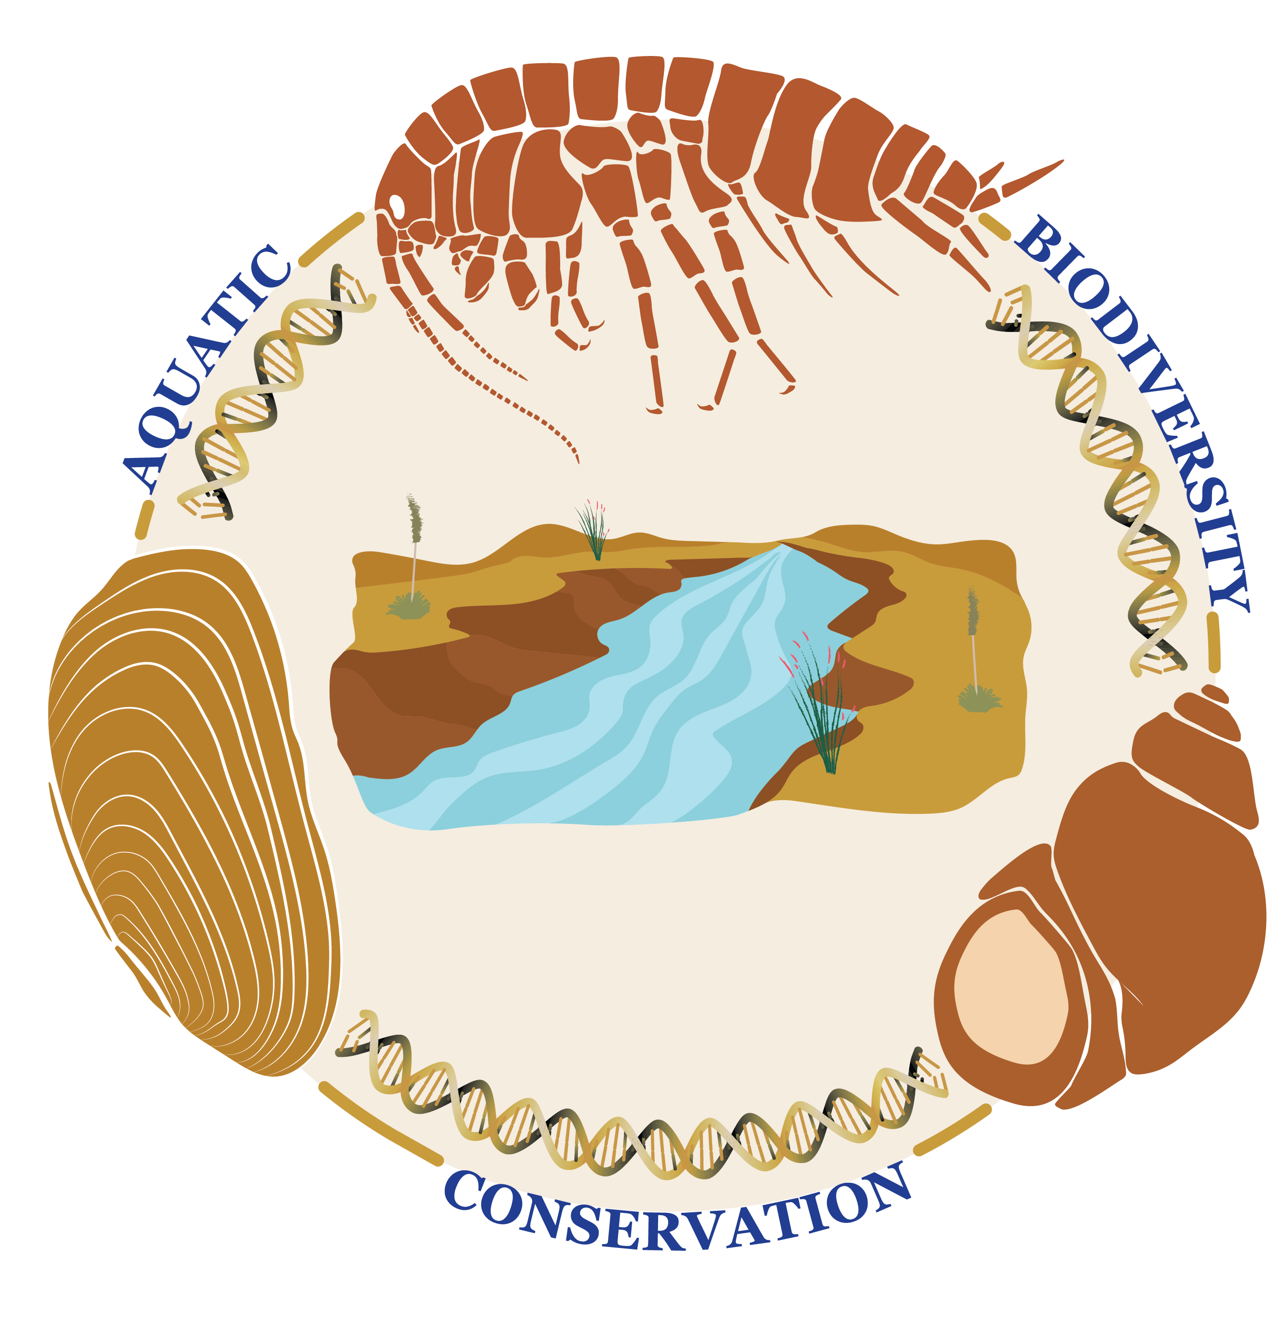

Acknowledgements
Thanks!
Benjamin Schwartz/Hutchins (EARDC)
Pete Diaz / Randy Gibson (USFWS)
B. Larsen, K. McDermid, P. Sprouse, A. Swink, V. Castillo III, A. Cottrell, W. Larsen, & W. Cantu

Slide 15
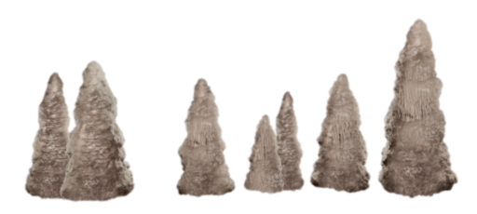
Thank you! – Questions?

