Slide 1
TXST AI Ready Office Hours
Responsible AI use & Recommended Resources
Alexa Hight, Assistant Director
Research & Data Services, University Libraries

Slide 2
Agenda
01 | Brief AI Basics on Choosing a Tool
02 | Considerations on Ethical AI Use
03 | Copyright Considerations
04 | Data Safety & Privacy
05 | Your Intellectual Property

Slide 3
AI Basics: Choosing an AI Tool
Types of AI: Not all AI works the same way. Understanding the differences helps you know what each type can and cannot do:
#1 Traditional AI (Narrow AI):
Designed to perform specific tasks like spam filtering, recommendation algorithms, or voice recognition
Follows predefined rules and patterns
Examples: Netflix recommendations, Siri/Alexa
Cannot perform tasks outside its specific programming
Notes:
While it may be common to associate AI with complex technology such as robotics and autonomous vehicles, AI is also used in many of the things we interact with on a daily basis. From mobile devices to online services, AI powers facial recognition, self-driving systems, predictive text messaging, voice assistants, email filters, navigation apps, and web-based search engines.
Ithaka S+R partnered with 19 US and Canadian institutions to track the rapidly evolving GenAI product marketplace for higher education, creating a publicly available Product Tracker with 100+ tools marketed specifically for teaching, learning, and research: GenAI Product Tracker

Slide 4
Machine learning & gen ai
#2 Machine Learning (ML)
AI systems that learn patterns from data without being explicitly programmed for every scenario
Improves performance over time with more data
Examples: fraud detection, image recognition, predictive analytics
Subset of AI focused on pattern recognition and prediction
#3 Generative AI (GenAI)
Creates new content (text, images, audio, video, code) based on patterns learned from training data
Responds to user prompts to generate human-like outputs
Examples: ChatGPT, Claude, Gemini, DALL-E, Midjourney, GitHub Copilot
Works through statistical prediction, not comprehension or fact-checking

Slide 5
Ethics and AI
There are lots of discussions around the ethical issues of artificial intelligence usage. There are a variety of issues that require careful considerations. Given this variety, it is difficult to say that there is one definitive way to ethically use AI tools.
There are five interrelated yet distinct categories:
Bias
Inaccuracies
Plagiarism/IP Infringement
Environmental Impact
User Safety

Slide 6
Bias
What is AI Bias?
Human biases in training data and algorithm design lead to skewed outputs with potentially harmful real-world consequences.
Where Bias Enters:
Training data (Wikipedia, books, web archives) reflects existing societal inequalities
Algorithms encode biased assumptions
Reinforcement learning from human feedback
Result: AI perpetuates and amplifies societal biases
Three Critical Areas of Bias:
Gender - Stereotyping (men = power/authority; women = appearance/nurturing)
Race & Western-Centricity - Models favor WEIRD societies; Islamic terrorism overrepresented despite guardrails
Neuronormativity & Ableism - Pressures conformity, silences diverse communication styles

Slide 7
Inaccuracies/hallucinations
What Generative AI Can Do:
Generate text, video, and images based on user input
What It Cannot Do:
Guarantee accuracy or appropriate representation of ideas
The Core Problem: "Hallucinations"
Outright fabrication of information
Incorrect contextualization of facts
Misinterpretation or inaccurate summarization of training data
Why This Happens:
LLMs prioritize coherence over accuracy by design—they produce fluent, convincing-sounding responses that may be false
Critical Safeguard:
All AI-generated outputs must be verified against authoritative sources, regardless of how confident or convincing the response appears
Notes:
Generative artificial intelligence can generate output, however, what GenAI cannot do is ensure that the output it has generated is an accurate or appropriate representation of the ideas it is demonstrating. In fact, generative AI is so prone to generating inaccurate information that a word has been coined to describe the experience: a "hallucination". Beyond outright fabrication, LLMs may also incorrectly contextualize, misinterpret, or inaccurately summarize information from their training data or retrieved sources. Author and cultural critic Naomi Klein observes that the term hallucination is a clever way to market product failures. It sounds better than saying the system makes factual mistakes or presents nonsense as facts. These frequencies errors are a demonstration of the AI functionality fallacy and a reminder that appearing knowledgeable isn’t the same as being factual.
While recent improvements, including web-access capabilities that allow models to retrieve real-time information, have reduced some hallucination risks, the fundamental architecture of LLMs means they prioritize coherence over accuracy. AI-generated outputs require verification against authoritative sources, regardless of how confident or convincing the response appears.

Slide 8
Academic integrities
Traditional Issues Persist:
Poor citation practices
Unclear guidelines and inconsistent instructor expectations
Heavy workloads and time pressure
New AI-Specific Challenges:
Attribution Complexity - Difficult to distinguish your original thinking from AI contributions, especially when AI helps develop ideas through conversation or identifies research themes
Unattributable Sources - AI trained on millions of uncredited copyrighted works and pirated content; outputs may reflect sources you cannot identify or properly credit
The Authorship Question - Is AI an author?
Some argue: Chat logs provide accountability; excluding AI is inconsistent with crediting human assistants
Others maintain: Authorship requires legal and ethical responsibility—something only humans can bear
Notes:
Plagiarism in the age of AI involves both traditional citation issues and new challenges around proper disclosure of AI use. With GenAI tools, distinguishing between original work and AI-assisted content becomes more complex. Students may plagiarize (intentionally or unintentionally) due to poor training in citation practices, heavy workloads, unclear guidelines, or inconsistent instructor expectations. Attribution presents unique challenges: when AI helps you develop ideas through conversation or identifies themes in your research, it's difficult to determine what constitutes your original thinking versus AI contribution. GenAI models are trained on millions of copyrighted works, pirated books, and web content without attribution to the original creators, meaning AI outputs may reflect ideas or patterns from sources you cannot identify or properly credit.
The question of whether AI can be an author remains debated. Some argue that AI can demonstrate a form of accountability through documented chat logs and that excluding AI as an author is inconsistent with how we credit human intermediaries or assistants (such as those who support disabled scholars). Others maintain that authorship requires the ability to take legal and ethical responsibility for work, which AI cannot do.

Slide 9
Academic integrities: Citation & Documentation Guidelines
Citation Guidelines: When using AI tools, always disclose and cite your usage following your discipline's style guide. Include the AI tool in both in-text citations and reference lists, along with a description of how it was used in your methods or acknowledgments section. The American Medical Association (AMA) is an exception, requiring disclosure only in methods or acknowledgments rather than as a cited author.
Documentation Guidelines: Best practices include documenting your process through saved chat logs and multiple drafts, verifying all AI-generated content before use, and remembering that AI outputs cannot be cited as authoritative sources without fact-checking. Google Docs and Word keep track of your version history, but you can show your process more clearly with an extension app that reports on time spent and copy/pastes and generates a video of the text’s evolution.
Notes:
Have any of you encountered publisher guidelines on AI use or how to disclose use, or have you implemented guidelines into your own courses?

Slide 10
Environmental impact
The impact of artificial intelligence, and more specifically, the data centers powering it, is a major concern for many people. The University of Chicago surveyed and found that 4 in 10 U.S. adults are “extremely” or "very" concerned about artificial intelligence’s environmental impact.
Water Consumption: There are two streams of water use behind AI queries: the on-site cooling of servers and water used by power plants to generate the electricity for data centers.
Energy Usage: While simple AI such as autocorrecting text messages can run on small personal devices, GenAI models that can generate new content require specialized Graphical Processing Units (GPUs) to run numerous calculations quickly.
Energy Resources: The computing power needed for GenAI requires energy sources, by either increasing the consumption of natural gas or demanding new sources such as renewable energy.
Notes:
To further complicate things, unlike Bitcoin or online shopping, AI can be used to reduce harmful environmental impacts that humans create. AI can “improve climate models, find more efficient ways to make digital tech, reduce waste in transport, and otherwise cut carbon and water use” . And although AI is only a part of data center usage, there is still a lack of transparency about what percentage is dedicated to AI. The increasing demand for energy and resources within the digital landscape will necessitate future disclosures to fully assess AI’s impact. Articles found in references present different perspectives of analyzing and addressing this environmental impact. Out of curiosity, what thoughts do you have on the environmental impact versus how AI can improve and make work more efficient?

Slide 11

User safety
As use of large language models, and particularly chatbots, increases among the general public, so do the different ways in which the chatbot is used. Without guardrails and guidelines on effective and safe use, users can develop harmful attitudes and relationships with AI chatbots.

Slide 12
Copyright status
Recent litigation involving AI companies has produced mixed rulings on whether training LLMs constitutes fair use. In 2025, district courts in both Bartz v. Anthropic and Kadrey v. Meta agreed that training LLMs on copyrighted books is transformative and qualifies as fair use. Some considerations from The Association of Research Libraries and the Authors Alliance regarding copyright law and AI litigation are as follows:
In terms of fair use, these cases involve commercial AI firms. Do we need an analysis of non-commercial players such as an academic and scientific researchers? Should the use of shadow libraries be treated differently for non-commercial entities that do not have the budget or resources?
Current lawsuits against AI firms and giant tech companies suggest that future licensing to access materials for AI training will only be obtainable by companies who can afford to purchase those permissions. Who should be able to participate and engage with this space?
The library and authorship communities are the very groups fair use is meant to protect, yet are caught in the middle of the fair use argument. How do we balance caring about authors, creators, and copyright holders with big tech companies driving the narrative around policy? Do we hold on to principles around fair use and freedom to research even if they align with AI firms during these litigations?
Do we need to counter big tech’s definition of open access with AI models? Should research communities advocate for true open access models by exercising more oversight and control responsible AI that can be reproduced?
Notes:
Recent copyright litigation involving AI companies has produced mixed rulings on whether training large language models constitutes fair use. In early 2025, district courts in both Bartz v. Anthropic and Kadrey v. Meta agreed that training LLMs on copyrighted books is highly transformative and qualifies as fair use, rejecting claims that authors deserve a new licensing market specifically for AI training. However, these rulings introduced the concept of 'market dilution,' where AI-generated content might indirectly harm creators (particularly emerging writers) by flooding the creative market, even without directly substituting original works.
The more contentious issue involves piracy: both Anthropic and Meta obtained books from shadow libraries like Library Genesis and stored them in internal repositories. Because Anthropic could not confirm which books were used for training versus stored for future use, the court ruled this storage cannot be presumed fair use and requires trial. As of September 2025, Anthropic announced a $1.5 billion settlement to resolve piracy claims, which has been delayed pending clarification of terms. These cases establish that while training on legally obtained materials may qualify as fair use, obtaining copyrighted works through piracy remains legally vulnerable and may require licensing agreements or settlements.
Some considerations from The Association of Research Libraries and the Authors Alliance (ARL, 2025) regarding copyright law and AI litigation are as follows:
In terms of fair use, these cases involve commercial AI firms (Meta, Anthropic, OpenAI). Do we need an analysis of non-commercial players such as a academic and scientific researchers? Should the use of shadow libraries be treated differently for non-commercial entities that do not have the budget or resources?
Current lawsuits against AI firms and giant tech companies suggest that future licensing to access materials for AI training will only be obtainable by companies who can afford to purchase those permissions. Who should be able to participate and engage with this space?
The library and authorship communities are the very groups fair use is meant to protect, yet are caught in the middle of the fair use argument. How do we balance caring about authors, creators, and copyright holders with big tech companies driving the narrative around policy? Do we hold on to principles around fair use and freedom to research even if they align with AI firms during these litigations?
Do we need to counter big tech’s definition of open access with AI models? Should research communities advocate for true open access models by exercising more oversight and control responsible AI that can be reproduced?
ARL: https://www.arl.org/event/unpacking-the-anthropic-and-meta-ai-copyright-decisions-for-authors-researchers-and-libraries/
Authors Alliance: https://www.authorsalliance.org/resources/generative-ai/

Slide 13
Data Safety & Privacy

Slide 14

Data Safety & Privacy
Data Protection & Privacy
Key Risks:
GenAI models may use your input for training depending on their data policies
Sensitive data (HIPAA, FERPA, PII) requires careful consideration
Always review vendor privacy policies before use
Best Practices:
Never enter personal, sensitive, or proprietary information
Use open-source models locally, private clouds, or VPCs for added security
Verify vendor transparency about data storage and training practices
Notes:
Personal Data Protection:
When using GenAI tools, it is important to understand how they are trained, as any input or prompt may be used tofurther train that AI depending on model-specific data privacy settings and policies. This gets especially tricky forHIPAA, FERPA, and any other personal identifiable information. Commercial GenAI models should provide transparentinformation on how your input is being used, and it is best practice to read the data storage and training policies tofamiliarize yourself with what you are agreeing to. Do not enter personal information, sensitive data, or proprietary data,and always consider that any information that is input into an LLM may have ethical, legal, or other safety concerns.
Privacy Concerns:
One solution to consider while working with personal information or sensitive data is installing an open-source modellocally on a personal machine. Ensuring that the model is run without access to the internet or connected to a server(e.g., firewalls) can provide an extra layer of security. You can also create personal or business accounts with AmazonBedrock, a full service that provides use of their Nova foundation AI models, customizable data techniques, and theability to build GenAI applications with secure data protection and privacy.
Another option for organizations and businesses is to work with a private cloud or a virtual network (VNet)/virtualprivate cloud (VPC). Private clouds offer dedicated working environments to a single organization, allowing for controlover security and infrastructure. VPCs are isolated working environments within a larger public cloud that offerscalability and enhanced security while minimizing the operational costs of a full-scale private cloud.

Slide 15


Intellectual Property
Intellectual Property & GenAI:
Uploading original research to GenAI can expose trade secrets and confidential data through breaches or model training
Many tools reuse prompts/uploads for training; your content may later appear in other users’ outputs
IP and copyright ownership of AI-assisted work is still legally unsettled
Free versions often have weaker privacy and data protections than enterprise or educational licenses
Best practices:
Do not upload unpublished research, proprietary data, or patentable ideas
Use enterprise/educational tools with strong data protection and no-training guarantees
Regularly review each platform’s data and training policies
Notes:
Faculty, staff, and students working with original data, research findings, unpublished manuscripts, grant proposals, or creative works on GenAI models may be compromising their intellectual property in several ways. First, there's the risk of data breaches where proprietary information could be exposed through security vulnerabilities. Second, many AI platforms use input data to further train their models, meaning your original ideas, research methods, or unpublished findings could be incorporated into the AI's training data and potentially reproduced in responses to other users. Third, the legal status of AI-assisted work remains uncertain: courts are still determining whether AI-generated or AI-assisted content is copyrightable, and if copyrightable, who owns it.
While some platforms allow users to opt out of training (such as OpenAI's ChatGPT settings or Anthropic's Claude), these policies vary by platform and change frequently. Additionally, some applications that have integrated AI features (like Microsoft 365 Copilot, Google Workspace AI, or writing assistants embedded in software) may make the option to prevent training more difficult to locate or may not offer opt-out at all. Free versions of AI tools typically have less stringent data protections than paid enterprise versions. For example, TXST students, faculty, and staff can access Microsoft Copilot 365 with enhanced data protection by using TXST credentials, which offers stronger safeguards than the free consumer version.
Best practices for protecting your intellectual property:
Never input unpublished research, proprietary data, patent applications, grant proposals, or confidential business information into GenAI tools
Review each platform's data usage and training policies before use (and check regularly for updates)
Use enterprise or educational versions with data protection agreements when available
Consider that anything you input could potentially become part of training data or be accessed by others
Save and document your own creative process independently to establish ownership and authorship of your work
Consult with Office of Technology Commercialization if working with potentially patentable research
Special consideration for instructors: Uploading student work to GenAI tools for grading assistance, feedback generation, or plagiarism detection raises ethical and legal concerns. Students retain copyright to their original work, and inputting their assignments into AI systems without explicit consent may violate their intellectual property rights and FERPA protections. Students may request that their work not be processed through AI detection tools or other GenAI systems. Instructors should obtain informed student consent before using AI tools to process student work, clearly explain how the tools will be used and what data protections are in place. When possible, use enterprise educational versions with strong data protection agreements and no-training guarantees, or avoid inputting identifiable student work altogether.

Slide 16
Other considerations and resources

Slide 17
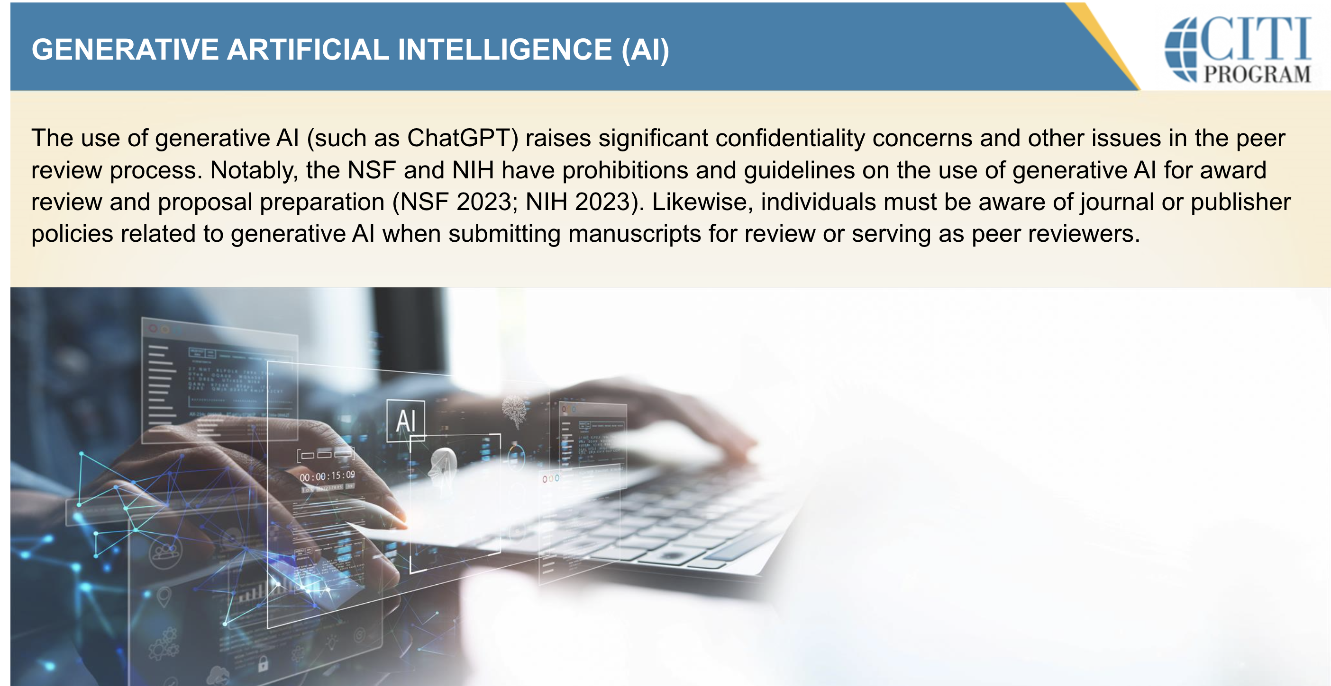
Check Grant funder guidelines/Policies
NSF Notice to research community: Use of generative artificial intelligence technology in the NSF merit review process:
NSF reviewers are prohibited from uploading any content from proposals, review information and related records to non-approved generative AI tools.
Proposers are encouraged to indicate in the project description the extent to which, if any, generative AI technology was used and how it was used to develop their proposal.
https://www.nsf.gov/news/notice-to-the-research-community-on-ai

Slide 18
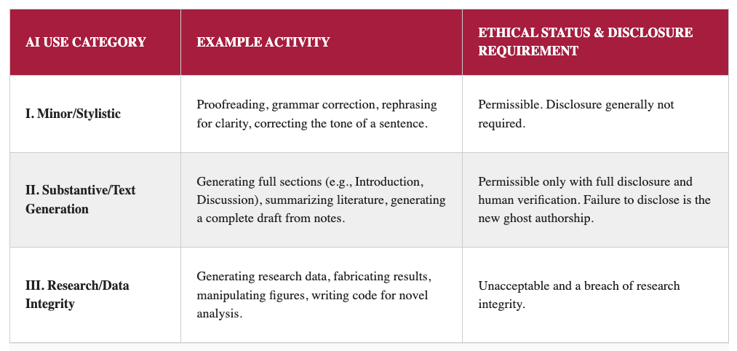
Check publisher policies/guidelines
Notes:
helpful framework informed by the Committee on Publication Ethics (COPE) position
Source: https://scholarlykitchen.sspnet.org/2026/01/22/guest-post-the-ghost-in-the-machine-why-generative-ai-is-a-crisis-of-authorship-not-just-a-tool/?informz=1&nbd=&nbd_source=informz

Slide 19
Resources
A 14-Year-Old Boy Killed Himself to Get Closer to a Chatbot. He Thought They Were In Love. - WSJ. (n.d.). Retrieved January 27, 2026, from https://www.wsj.com/tech/ai/a-14-year-old-boy-killed-himself-to-get-closer-to-a-chatbot-he-thought-they-were-in-love-691e9e96?mod=Searchresults&pos=19&page=1
About—GenAI: responsible use in research—LibGuides at Deakin University. (n.d.). Retrieved January 27, 2026, from https://deakin.libguides.com/generative-ai-research
AI and Copyright: What Authors and Libraries Need to Know about the Bartz v. Anthropic and Kadrey v. Meta Cases. (n.d.). Association of Research Libraries. Retrieved January 27, 2026, from https://www.arl.org/event/unpacking-the-anthropic-and-meta-ai-copyright-decisions-for-authors-researchers-and-libraries/
As Use of A.I. Soars, So Does the Energy and Water It Requires. (n.d.). Yale E360. Retrieved January 27, 2026, from https://e360.yale.edu/features/artificial-intelligence-climate-energy-emissions
Athaluri, S. A., Manthena, S. V., Kesapragada, V. S. R. K. M., Yarlagadda, V., Dave, T., & Duddumpudi, R. T. S. (n.d.). Exploring the Boundaries of Reality: Investigating the Phenomenon of Artificial Intelligence Hallucination in Scientific Writing Through ChatGPT References. Cureus, 15(4), e37432. https://doi.org/10.7759/cureus.37432
Buolamwini, J. (n.d.). Gender Shades: Intersectional Accuracy Disparities in Commercial Gender Classification. MIT Media Lab. Retrieved January 27, 2026, from https://www.media.mit.edu/publications/gender-shades-intersectional-accuracy-disparities-in-commercial-gender-classification/
Buolamwini, J. (with Popular Reading Collection. 2025). (2023). Unmasking AI: My mission to protect what is human in a world of machines (First edition). Random House.
Campellone, T. R., Flom, M., Montgomery, R. M., Bullard, L., Pirner, M. C., Pavez, A., Morales, M., Harper, D., Oddy, C., O’Connor, T., Daniels, J., Eaneff, S., Forman-Hoffman, V. L., Sackett, C., & Darcy, A. (2025). Safety and User Experience of a Generative Artificial Intelligence Digital Mental Health Intervention: Exploratory Randomized Controlled Trial. Journal of Medical Internet Research, 27(1), e67365. https://doi.org/10.2196/67365
Chicago Sun-Times response to May 18 special section—Chicago Sun-Times. (n.d.). Retrieved January 27, 2026, from https://chicago.suntimes.com/press-room/2025/05/20/chicago-sun-times-response-to-may-18-special-section

Slide 20
Resources
Duffy, C. (2025, May 22). Lawsuit claims discrimination by Workday’s hiring tech prevented people over 40 from getting hired | CNN Business. CNN. https://www.cnn.com/2025/05/22/tech/workday-ai-hiring-discrimination-lawsuit
Electricity 2024 – Analysis. (2024, January 24). IEA. https://www.iea.org/reports/electricity-2024
Explained: Generative AI’s environmental impact. (2025a, January 17). MIT News | Massachusetts Institute of Technology. https://news.mit.edu/2025/explained-generative-ai-environmental-impact-0117
Generative AI Has a Visual Plagiarism Problem—IEEE Spectrum. (n.d.). Retrieved January 27, 2026, from https://spectrum.ieee.org/midjourney-copyright
enerative Artificial Intelligence and Copyright Law. (n.d.). [Legislation]. Retrieved January 27, 2026, from https://www.congress.gov/crs-product/LSB10922
Hill, K. (2025, June 13). They Asked an A.I. Chatbot Questions. The Answers Sent Them Spiraling. The New York Times. https://www.nytimes.com/2025/06/13/technology/chatgpt-ai-chatbots-conspiracies.html
Huber, J., Anzengruber-Tanase, B., Schobesberger, M., Haslgrübler, M., Fischer-Schwarz, R., & Ferscha, A. (2025). Evaluating User Safety Aspects of AI-Based Systems in Industrial Occupational Safety: A Critical Review of Research Literature. International Journal of Environmental Research and Public Health, 22(5), 705. https://doi.org/10.3390/ijerph22050705
Isaac, M. (2025, June 4). Reddit Sues Anthropic, Accusing It of Illegally Using Data From Its Site. The New York Times. https://www.nytimes.com/2025/06/04/technology/reddit-anthropic-lawsuit-data.html
Jegham, N., Abdelatti, M., Koh, C. Y., Elmoubarki, L., & Hendawi, A. (2025). How Hungry is AI? Benchmarking Energy, Water, and Carbon Footprint of LLM Inference (arXiv:2505.09598). arXiv. https://doi.org/10.48550/arXiv.2505.09598

Slide 21
Resources
Kimball, S. (2024, May 5). AI could drive a natural gas boom as power companies face surging electricity demand. CNBC. https://www.cnbc.com/2024/05/05/ai-could-drive-natural-gas-boom-as-utilities-face-surging-electric-demand.html
Kovari, A. (2025). Ethical use of ChatGPT in education—Best practices to combat AI-induced plagiarism. Frontiers in Education, 9. https://doi.org/10.3389/feduc.2024.1465703
Kshetri, N. (2024). The Environmental Impact of Artificial Intelligence. IT Professional, 26(3), 9–13. https://doi.org/10.1109/MITP.2024.3399471
Lo, L. S. (2025, September 1). AI has a hidden water cost − here’s how to calculate yours. The Conversation. https://doi.org/10.64628/AAI.atken5eg6
Lo, L. S. (2026). The CARE approach for academic librarians: From search first to answer first with generative AI. The Journal of Academic Librarianship, 52(1), 103186. https://doi.org/10.1016/j.acalib.2025.103186
Macknick, J., Newmark, R., Heath, G., & Hallett, K. (2011). Review of Operational Water Consumption and Withdrawal Factors for Electricity Generating Technologies (NREL/TP-6A20-50900, 1009674; p. NREL/TP-6A20-50900, 1009674). https://doi.org/10.2172/1009674
Mazzi, F., & Fasciana, S. (2024). Video kills the radio star: Copyright and the human versus artificial creativity war. The Journal of World Intellectual Property, 27(3), 341–365. https://doi.org/10.1111/jwip.12304
Power BI Report. (n.d.). Retrieved January 27, 2026, from https://app.powerbi.com/view?r=eyJrIjoiZjVmOTI0MmMtY2U2Mi00ZTE2LTk2MGYtY2ZjNDMzODZkMjlmIiwidCI6IjQyNmQyYThkLTljY2QtNDI1NS04OTNkLTA2ODZhMzJjMTY4ZCIsImMiOjF9
Process Feedback: A learning-first alternative to AI detection. (n.d.). Retrieved January 27, 2026, from https://new.processfeedback.org/
Regulating Hidden AI Authorship—Virginia Law Review. (2025, March 7). https://virginialawreview.org/articles/regulating-hidden-ai-authorship/

Slide 22
Resources
Ritchie, H. (2024, November 17). What’s the impact of artificial intelligence on energy demand? [Substack newsletter]. By the Numbers. https://hannahritchie.substack.com/p/ai-energy-demand
Rosenberg, J. K., Scott. (2025, May 20). Sun-Times fallout: Fake book list raises red flags over AI. Axios. https://www.axios.com/local/chicago/2025/05/20/sun-times-fake-book-list-ai-summer-heat-index-newspaper-journalism
Smith, A. (n.d.). LibGuides: AI in the Library: Home. Retrieved January 27, 2026, from https://guides.ou.edu/c.php?g=1479087&p=11020735
Stewart, A. (n.d.). LibGuides: AI Literacy: Research and AI. Retrieved January 27, 2026, from https://guides.library.txstate.edu/c.php?g=1442381&p=10713719
Sun, Y., Sheng, D., Zhou, Z., & Wu, Y. (2024). AI hallucination: Towards a comprehensive classification of distorted information in artificial intelligence-generated content. Humanities and Social Sciences Communications, 11(1), 1278. https://doi.org/10.1057/s41599-024-03811-x
Sustainable Cloud Computing—Amazon Web Services. (n.d.). Amazon Web Services, Inc. Retrieved January 27, 2026, from https://aws.amazon.com/sustainability/
Sutera, P., Bhatia, R., Lin, T., Chang, L., Brown, A., & Jagsi, R. (2025). Generative AI in Medicine: Pioneering Progress or Perpetuating Historical Inaccuracies? Cross-Sectional Study Evaluating Implicit Bias. JMIR AI, 4, e56891–e56891. https://doi.org/10.2196/56891
Tan, E., & Chambers, D. (2025, July 14). Their Water Taps Ran Dry When Meta Built Next Door. The New York Times. https://www.nytimes.com/2025/07/14/technology/meta-data-center-water.html
van der Ven, H., Corry, D., Elnur, R., Provost, V. J., Syukron, M., & Tappauf, N. (2024). Does artificial intelligence bias perceptions of environmental challenges? Environmental Research Letters, 20(1), 014009. https://doi.org/10.1088/1748-9326/ad95a2

Slide 23
Resources
Water’s Value. (n.d.). US Water Alliance. Retrieved January 27, 2026, from https://uswateralliance.org/resources/waters-value/
What Americans think about the environmental impact of AI, according to a new poll. (n.d.). The Institute for Climate and Sustainable Growth. Retrieved January 27, 2026, from https://climate.uchicago.edu/news/what-americans-think-about-the-environmental-impact-of-ai-according-to-a-new-poll/
What is Amazon Bedrock? - Amazon Bedrock. (n.d.). Retrieved January 27, 2026, from https://docs.aws.amazon.com/bedrock/latest/userguide/what-is-bedrock.html
What is Amazon VPC? - Amazon Virtual Private Cloud. (n.d.). Retrieved January 27, 2026, from https://docs.aws.amazon.com/vpc/latest/userguide/what-is-amazon-vpc.html

