Slide 1
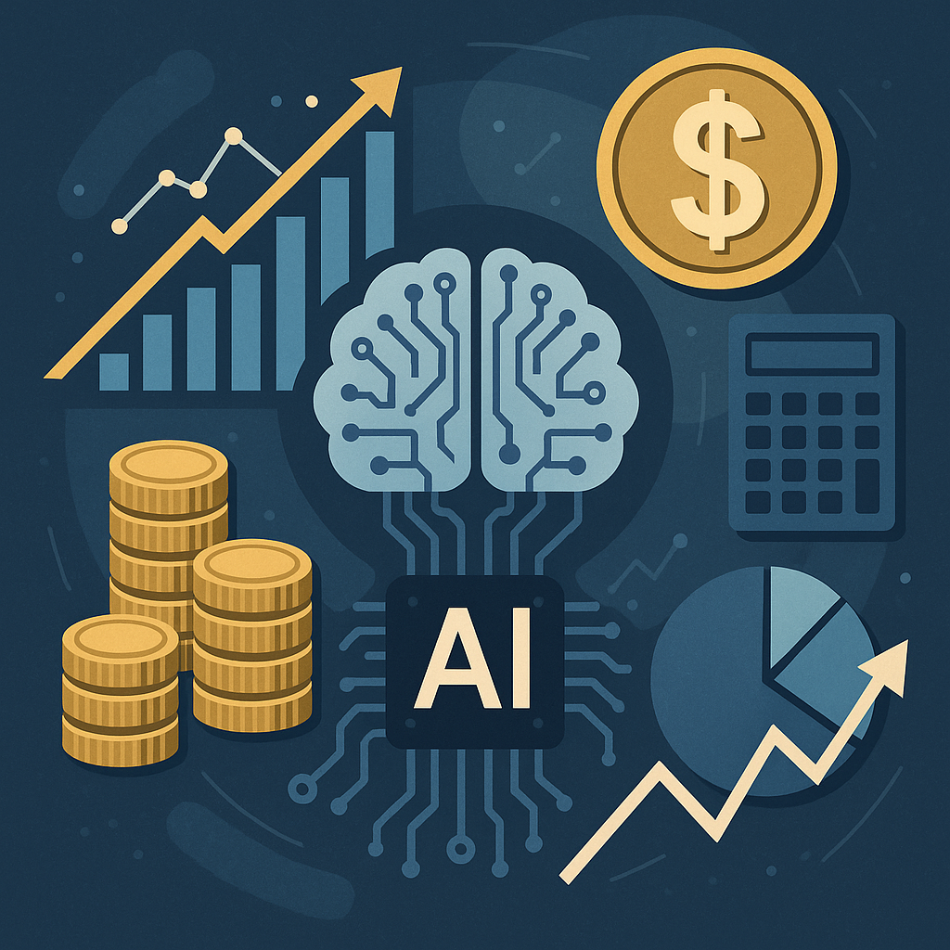
AI as a Teammate, Not a Tool: Helping Students Think Better in an AI World
Dr. Matthew Flynn
2026 AI in Teaching and Learning Symposium

Slide 2

Recent surveys indicate that between 85% and 92% of students use Artificial Intelligence (AI) for their studies.
“I’ll ask Chat”
not “I’ll Google it”
The default problem-solving workflow is changing.

Slide 3
What’s the big deal? Two Models for AI Interaction
Instrumental Help-Seeking
Using AI to build understanding
Clarify difficult concepts
Learn how to solve similar problems
Strengthen arguments or reasoning
Revise and refine thinking
Executive Help-Seeking
Using AI to obtain answers
Get quick and direct answers
Complete assignments with less effort
Succeed without working as hard
Finish faster
Students report seeking the most executive help from the internet and generative AI — and the least from instructors. (Aguilar et al., 2025)

Slide 4
AI as Teammate not a Tool
AI as a Teammate
Using AI to build understanding
Conversational prompting
Clarification of goals and context
Iterative refinement, working together
Evaluation and constructive criticisms
Goal: Improve Thinking and Productivity.
AI as a Tool
Using AI to obtain answers
One command – one answer
Minimal contextual understanding
No iteration on output – copy and paste
No critical thinking about output
Goal: Finish.
The difference is not access to AI.
The difference is how we position it in the learning process.

Slide 5

Jeremy Utley – Stanford University
“while research suggests AI makes people 25% faster, 12% more work, and 40% better quality, less than 10% of working professionals are deriving meaningful productivity gains from collaboration with AI”
The Performance Gap Is Not About Access — It’s About Use:
“whereas underperformers treat AI like a tool, outperformers treat AI like a teammate”

Slide 6
This Is Not The Future — It’s Now.
55%
77%
78%
Americans report regularly using AI.
Americans are estimated to be using AI-enabled products.
Businesses globally use AI in at least one function.

Slide 7

Job Market in 2026
“My view on this is like future people are just going to be so much more creative and are going to be freed up to do kinda crazy things” – Mark Zuckerberg, Facebook/Meta Founder CEO
“AI isn’t coming to take your job. Someone using AI is coming to take your job. The first thing everyone should do is learn to use AI so they can augment their own productivity” – Jensen Huang, CEO of NVIDIA

Slide 8

Prompting as a Skill
The quality of AI output reflects the quality of human thinking.
Garbage in, garbage out.
How can you be the best partner to AI?
1️⃣ Clear Objective
What problem are you solving?
2️⃣ Context
What information does the AI need?
3️⃣ Iteration & Evaluation
How do you test and refine the output?

Slide 9
1. Clear Objectives
Weak prompt:
Explain this regression.
Strong prompt:
Explain this linear regression to a first-year MBA student who understands correlation but not statistical modeling. Use one practical business example.
In the example, the strong prompt gives specific limits of understanding, context of audience, and a guidelines for specific output.
Imagine if your boss asked you to complete the same task, which prompt would make you more effective?
Specificity reduces ambiguity, and clarity improves reasoning.

Slide 10
2. Context of Use
AI, and people, cannot reason about information they do not have.
Weak prompt:
Write a paper on World War 2.
Strong prompt:
Write a paper on World War 2 with a specific focus on the Pacific campaign. Use the attached resources as a knowledge base, making specific references to them when appropriate. Begin with the U.S. entry to the conflict, trace major actions across the pacific, and end with the conclusion of the war. The final report should be 3 pages in length double spaced, and suitable for an audience of high school seniors.
Strong prompts provide full context for desired outputs. Like a human, AI cannot read your mind!
Context reduces hallucinations and improves the relevance of responses.

Slide 11
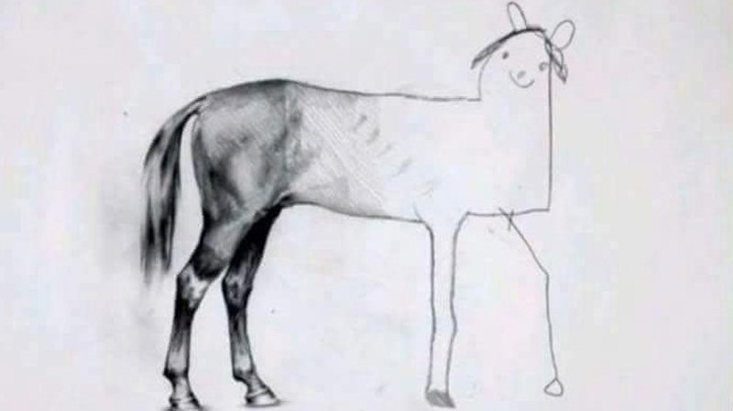
3. Iteration & Evaluation
The first output is a draft — not a finished product.
Prompt
Output

Slide 12
Iteration Transforms Output
Prompt → Output → Refine → Improve → Evaluate → Repeat
AI doesn’t give you new cognitive ability. But it does accelerate the feedback loop.

Slide 13
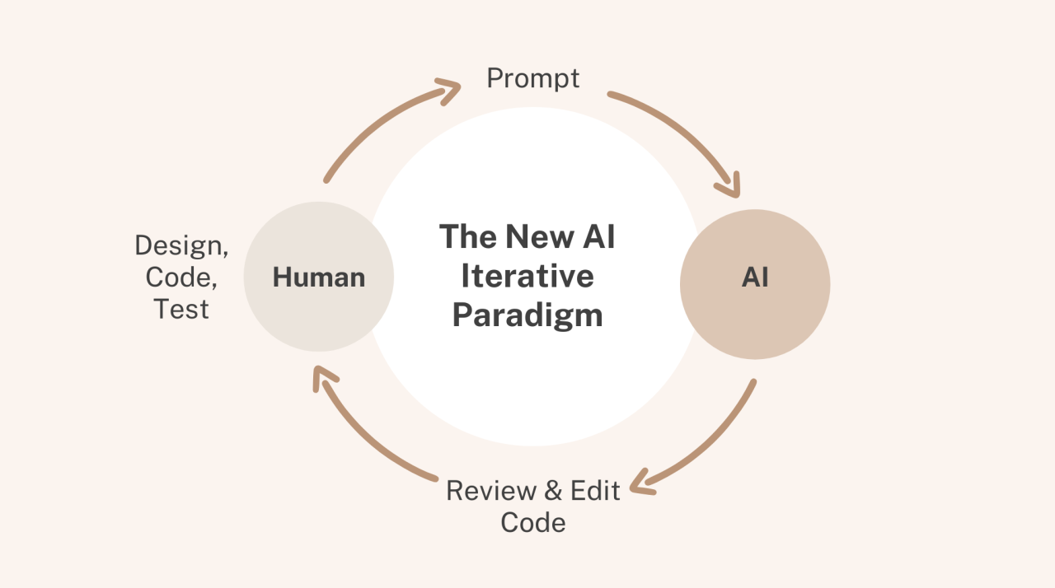

The Teammate Workflow
Start with a clear objective, what are you hoping to achieve from this work?
Give your teammate specific context, what would a teammate need to know to get started?
Define constraints and desired format
Share relevant feedback and friction points
ASK QUESTIONS! Ask the AI things you don’t understand and let the AI ask you to clarify things.
Prompt Iteration Output
🧠 Think of ChatGPT as a junior collaborator, not a search engine.
https://www.youtube.com/watch?v=wv779vmyPVY

Slide 14
Demo of Prompting Principles
Imagine I teach an environmental policy course, and I need some help in structuring my grading process for their final project.
How can I use AI to assist me with this task?
This demo provides an example of how we can more effectively prompt AI for better outputs:
GPT 5.2 Model
Fresh Chat with no memory for each prompt

Slide 15
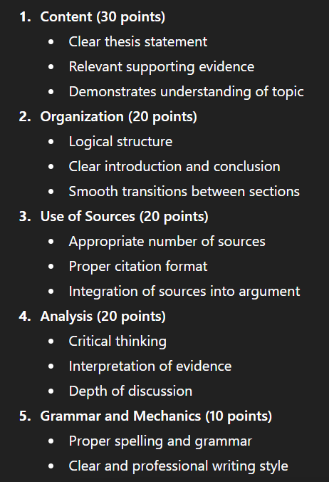
Weak Prompting
Generate a grading rubric for a research paper.
Generic 5-category rubric.
No weighting. No specificity. No alignment to learning goals.
Is this useful? Maybe.
Is this aligned to your course? Defintely not.

Slide 16
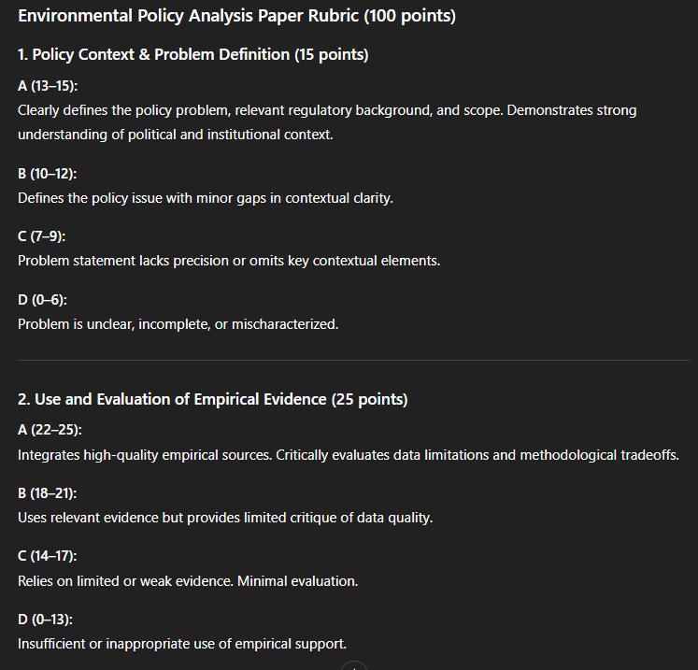
Strong Prompting
I teach a junior-level Environmental Policy course. Students are writing a 10-page policy analysis paper evaluating a proposed state-level climate regulation. Learning objectives include:
Evaluating empirical evidence
Applying cost-benefit reasoning
Integrating stakeholder perspectives
Writing persuasively for a policy audience
Create a grading rubric with weighted categories totaling 100 points. Include performance descriptors for A, B, C, D levels. Keep language clear enough to share with students.

Slide 17
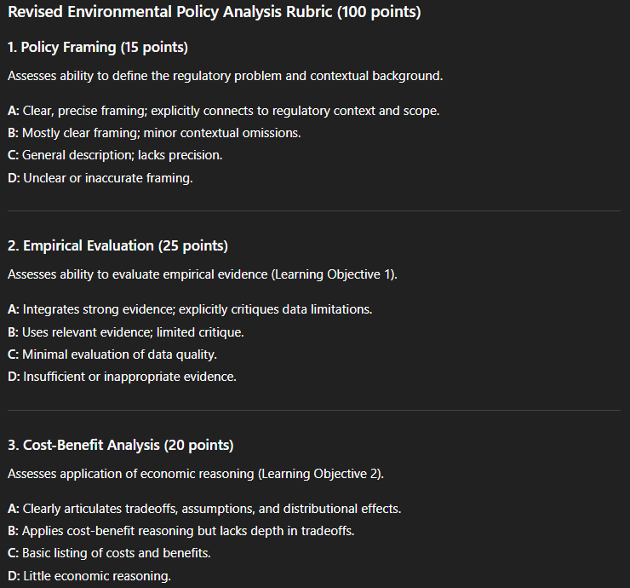
Iteration of Output
Revise this rubric to:
Reduce redundancy
Clarify differences between A and B levels
Make it more concise
Ensure criteria align directly to learning objectives
Successful use requires collaboration,
Where can GPT strengthen this iteration?
What additional questions can GPT ask of you to meaningfully contribute?
The intelligence is still human —the acceleration is AI.

Slide 18
Detection to Thoughtful Design.
The now dominant question in academia has been:
“How do we catch / prevent AI use?”
A more productive question is:
“How do we design assignments that make thinking visible?”
When process is visible and students feel encouraged, misuse becomes less attractive.

Slide 19

Design for Process
Traditional model:
Evaluate based on output
We could safely assume that output was a function of process
AI-era model:
Output does not always reflect process
In-person meetings
Abstract scenario applications
Requiring evidence of the learning process (drafts, reflections)

Slide 20
AI Literacy Is Not Technical — It’s Cognitive
Transparency→ Disclose AI use.
Reflection → Explain decisions.
Meta-Cognition → Evaluate outputs critically.
If the thinking process is graded, students must engage in thinking.

Slide 21
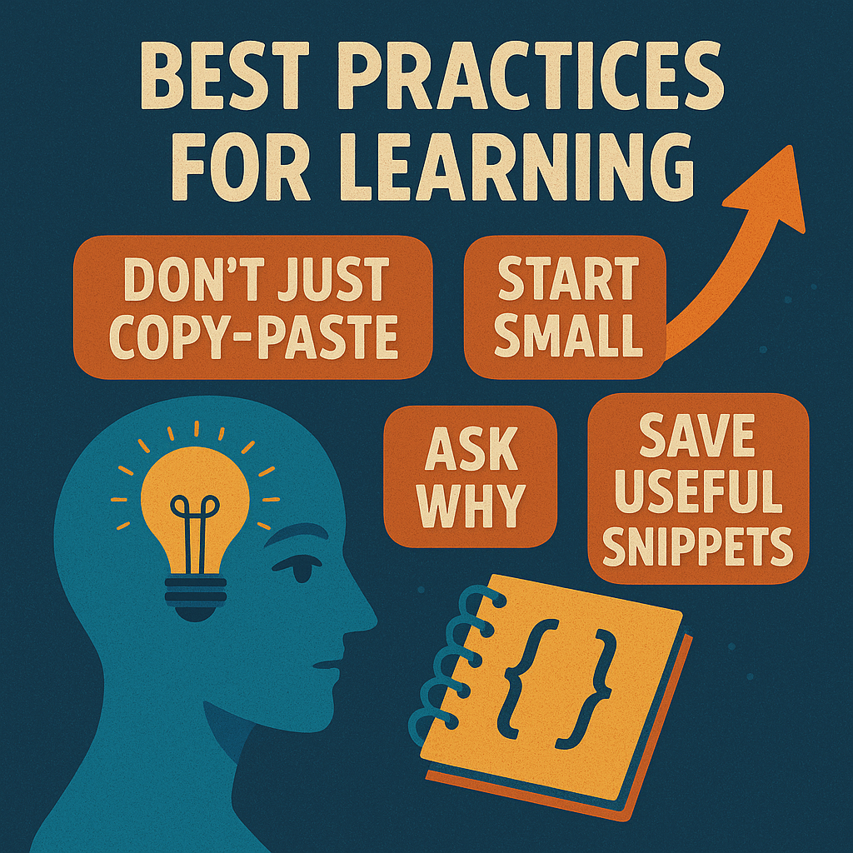
What Happens If We Don’t Adapt?
Students will use AI anyway.
Hidden use = shallow learning.
Designed use = deeper engagement.
Engage with AI as a teacher and teammate, not a tool!

Slide 22

When AI Use Undermines Learning
Using AI as a Replacement for Thinking,
If you make yourself replaceable, you will be replaced.
Using AI Without Understanding the Output
Students must stay engaged in the process to evaluate output.
Failing to Verify Assumptions or Appropriateness
Responsible use requires context.
Treating AI as Infallible
Just like you or I, AI makes mistakes, and it is important that we and our models learn from them together.

Slide 23
AI Is Not the Threat. Disengagement Is.
AI will not replace thinking.
But it will expose where thinking is absent.
AI accelerates production. Only reflection produces expertise.
Our role is not to prevent AI use — but to teach students how to think with it.
AI is a Teammate, not a Tool!

