Slide 1
AI in Teaching and Learning Symposium
Renzhi (Fred) Zhao, Assistant Professor,
Department of Information & Analytics

Slide 2
Slides
Suggest sub-topics
Elaboration of specific term (fact-check required)
Grammarly revision
Find related examples and cases (fact-check required)

Slide 3
Code Demo
Generate code demo for a sub-topic (be specific and test required)
Generate instruction reference between lines of code
Debug
Create in-class practices

Slide 4
Assignment and Exam Design
Clear understanding of the assignment scope
Create bullet points of requirements before delegation to AI:
Business context
Expected duration
Student level (e.g., intro in Python, advanced in statistics)
Student year (e.g., freshman, graduate students)
Student background (e.g., IS, marketing)

Slide 5
Last Notes
Fact check is paramount: Always double check the AI output, triple check if it is the core of our classes
Be as specific and directional as we can during prompting
Start with something before prompting
Iterated interaction with AI is important for great outputs
Sometimes web searching is still more efficient or effective

Slide 6
Thank you!
Fact check is paramount: Always double check the AI output, triple check if it is the core of your classes
Be as specific and directional as we can in prompt
Start with some prototypes before prompting
Iterated interaction with AI is important for great output
Sometimes web searching is still more efficient or effective

Slide 7
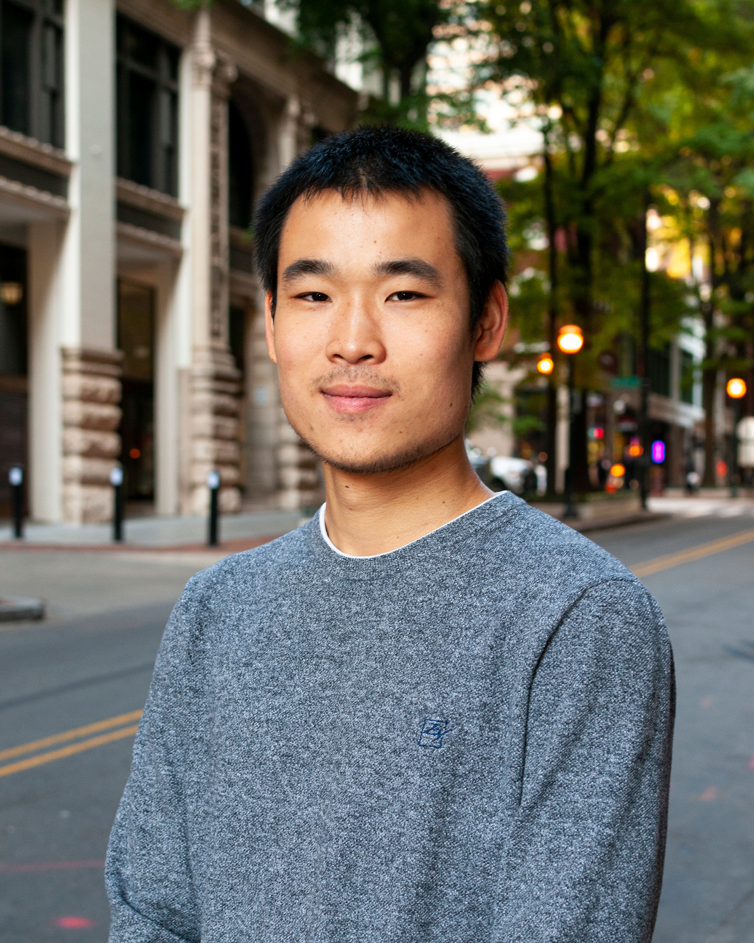

Renzhi (Fred) Zhao
fredzhao@txstate.edu
Thank you!

Slide 8
Any questions?

