Slide 1



Fundamentals of Generative AI
-Divya Gangwani
AI Engineer (CADS)
Texas State University

Slide 2
Overview of AI
There has been a lot of hype around AI now.
Everything you’ve been dealing with in the last few months around the topic of AI has to do with one specific thing: Generative AI.
You may have used many tools or applications that use generative AI, like image creation, generating graphics, or video in a few seconds.
Notes:
All this is possible with the help of generatiive AI. In the next few slides I’m going to talk about what is generative AI, what is its use and how does it work.

Slide 3
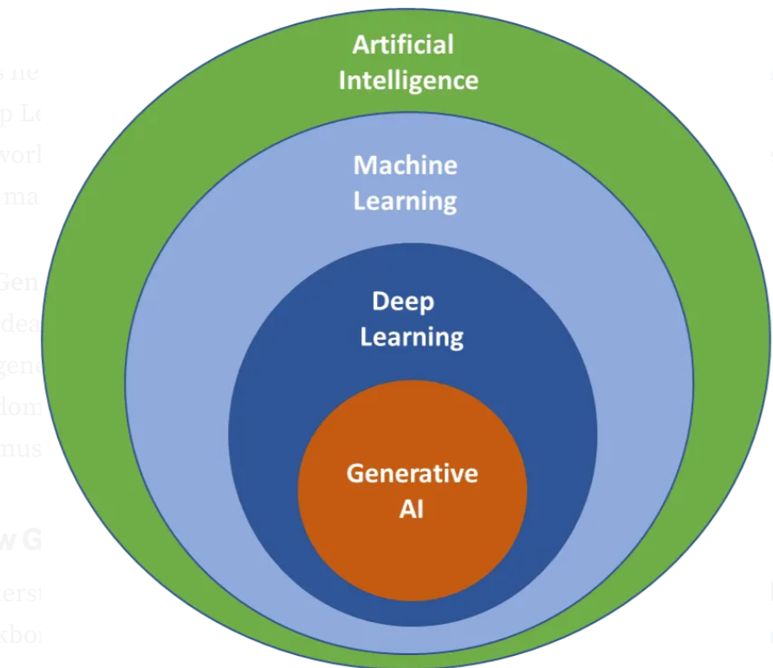
What is Generative AI
Most of you must be aware of the term AI. “Artificial Intelligence is a field of study that gives computers the ability to learn without being explicitly told or programmed”.
Generative AI is a subfield of AI that focuses on creating new content (ChatGPT, Perplexity), images, audio or synthetic data.

Slide 4


How Does Gen AI Work?
For faculty member: “You upload a rough syllabus outline and ask AI to draft weekly learning objectives — you still edit them, but it saves you time.”
For Students: “You paste a confusing paragraph from a textbook and ask AI to explain it in simpler language.”
For Staff: “You ask AI to rewrite an email announcement so it’s clearer and shorter.”

Slide 5
How Is It Different From Google?
Google finds information that already exists. Generative AI creates new text by predicting what should come next — like autocomplete on steroids.”
Google is like a librarian who points you to books.
Generative AI is like a knowledgeable assistant who reads the books and explains the answer to you in plain language
Notes:
It doesn’t know facts — it predicts language. Do you know why chat gpt makes mistakes – that because its predicting the word sequence and not understanding the context.

Slide 6
Generative AI models
Generative AI works because of powerful “foundation models” trained on enormous amounts of data. These models are the core engine of AI systems. By learning patterns from text, images, and other information, they can understand questions and create new, relevant responses instead of simply repeating stored facts.
Training Data → Model Training → Generative Models → New Content
Key Models:
GANs “Great at creating realistic images.”
VAEs “Good at learning patterns and variations.”
Transformer-based models “Best at language and text.”
Notes:
There are different families of generative models, each good at different things.

Slide 7

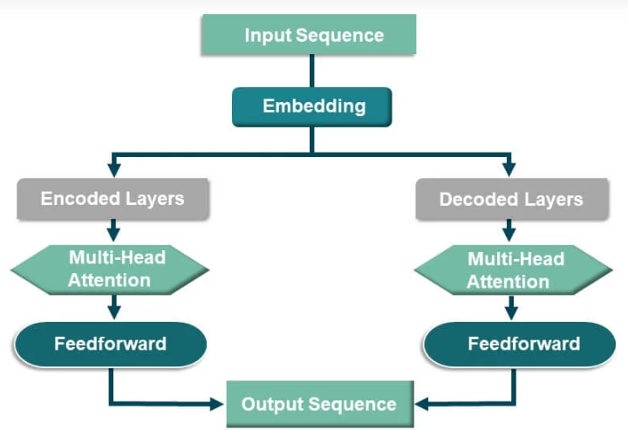

Transformer Models
The Transformer is a type of AI model that understands language by looking at how words relate to each other in a sentence, rather than reading them one by one. By learning these relationships, it can understand context and meaning, which is why it powers modern tools like ChatGPT.
GPT (Generative Pre‑trained Transformer) is a Transformer trained on massive text data to write, answer questions, and explain things.
Example: It understands that in “The bank by the river”, bank means something different than “I deposited money in the bank.”

Slide 8
Transformer Model
The most important part of the transformer model is its self-attention mechanism.
Think of it as the model deciding which word matters the most.
That is how it understands that “bank by the river” does not mean the “bank where you deposit the money”.

Slide 9
Applications & Impact of Generative AI
Healthcare: Generating medical images, summarizing patient records, and assisting doctors with diagnosis and treatment planning.
Education: Creating personalized study material, tutoring students, and automating grading and feedback.
Customer Support: Powering chatbots that answer questions, draft emails, and resolve issues 24/7.
Design & Media: Creating images, videos, music, and marketing content in seconds instead of weeks.
Why should you use Gen AI:
Higher productivity, lower cost, faster innovation, greater accessibility.

Slide 10
Closing Thoughts
If you remember one thing from today: Generative AI is a tool for drafting, summarizing, and explaining — not a replacement for human judgment.
What comes next :
Office hours are where we help you apply Generative AI to your own work — your tasks, your questions, your use cases.

Slide 11
Thank you ☺
Divya Gangwani

