Slide 1

Helping Students Connect Coursework to Careers Through AI-Assisted Text Analysis
Dr. Timothy M. Ponce
Assistant Professor of Technical and Professional Communication
Texas State University, San Marcos, Texas

Slide 2

Research Areas
Integration of Emerging Technology and Professional Communication
Pedagogy for AI Literacy
Job Documents and Job Hunting
in the Age of AI

Slide 3
The Familiar Questions
“What can I do with this major?”
“How do I know what employers are looking for?”
“Is my résumé good enough?”
Notes:
Ask the room:
How many of you have had a version of this conversation?
Let hands go up.

Slide 4
The Faculty Tension
Why This Conversation Feels Difficult
We are trained as scholars.
We are not hiring managers.
Industry expectations change quickly.
AI now mediates many hiring systems.

Slide 5
Hiring Is Already
AI-Mediated
Today’s Hiring Landscape
Many organizations use Applicant Tracking Systems (ATS) to screen and filter applicants (Lookadoo & Moore, 2024; Schellmann, 2024).
AI tools increasingly assist in ranking and evaluating candidates (Gelles-Watnick et al., 2023).
Hybrid human–AI review models are becoming more common in hiring processes (Chakraborty et al., 2024).
Students are aware of AI’s presence in hiring — and often express unease about it (Gelles-Watnick et al., 2023).

Slide 6
Reframing Our Employment Perspective
Instead of asking: “How do I teach résumé tricks? How do I help my students apply for jobs?”
We might ask: “What language patterns appear across job postings in this field?

Slide 7
What if we treated job descriptions as data?

Slide 8
Where are we going today?
1. Reframing Job Postings as Data
2. A Workflow Faculty Can Use
3. Mini Demonstration
4. Reflection and Moving Forward

Slide 9
1. Reframing Job Postings as Data

Slide 10

Instead of Starting With the Résumé…
What if we started with the
job postings?
What if job descriptions are not seen as individual documents but datasets?

Slide 11

Defining “Text as Data”
Ponce Definition:
Data is any collection of information that can be systematically recorded,
organized, and analyzed to extract meaning and insight.

Slide 12
Defining “Text as Data”
This includes:
Numbers
Words
Phrases
Repeated structures
  (Rajaraman et al., 2024)

Slide 13

Why This Framing
Helps Us As Faculty
If job postings are datasets, then:
  We are not guessing what
  employers want.
  We are analyzing patterns
  in language.
  We are helping students
  interpret evidence.
  We remain researchers and interpreters — not recruiters.

Slide 14
So, What Patterns Might We Find in This Data?
When We Analyze Job Postings at Scale, We Can Ask:
What skills appear most frequently?
What tools or certifications recur?
What verbs describe valued work?
How is responsibility framed?
How does tone shift by level?

Slide 15

This Is Familiar Work
Across disciplines, faculty already:
  Collect and examine data.
  Look for recurring patterns.
  Identify significant variables.
  Compare across cases.
  Interpret evidence to draw conclusions.
Job postings simply become our dataset, and AI can assist in identifying patterns at scale.

Slide 16
Section Summary
Job postings → Dataset
Recurring language → Evidence
AI → Pattern recognition tool
Faculty → Researchers and Critical interpreters
Students → Rhetorical decision-makers

Slide 17
2. A Workflow Faculty Can Use

Slide 18
A Six-Step Workflow or Class Activity
Gather job postings
Prepare the text
Ask structured questions
Identify recurring patterns*
Map findings to coursework
Reflect and refine
* Where AI comes into the picture

Slide 19
Step 1: Gather Relevant Job Postings
Students:
Identify roles aligned with their interests
Collect 20–50 postings
Focus on capturing responsibilities, skills, tools, and qualifications
Faculty role:
Help students define scope
Encourage variety across organizations

Slide 20
Step 2: Prepare the Text
Students:
Combine postings into
one document
Faculty role:
Help students define scope
Encourage variety across organizations
Clearly separate each posting
<job1>…</job1> <job2>…</job2>
Remove formatting inconsistencies

Slide 21
Step 3: Students Ask Structured Questions
Before using AI, students ask:
  What skills appear most frequently?
  What tools or certifications recur?
  What verbs describe valued work?
  What expectations are implied?
Later the AI assists in pattern identification. The key here is that inquiry precedes automation, and we know how to prompt inquiry.

Slide 22
Step 4: Use AI to Identify Patterns
Students:
Prompt: “Please analyze these job postings and identify the most commonly required skills, tools, and qualifications. Highlight recurring language patterns such as repeated action verbs.”
Faculty role:
Encourage comparison between human observations and AI output
Model skepticism and verification (Anders, 2024; Selber, 2024)

Slide 23
Step 5: Map Patterns to Coursework
Students:
Where have I developed these skills?
Faculty role:
Help students see connections they may overlook
Which assignments demonstrate
these tools?
What projects show evidence of these competencies?
What gaps should I address?
Translate disciplinary learning into employment language

Slide 24
Step 6: Reflect and Refine
Students:
Can provide current resume to AI and ask for skill gap analysis or mismatches in language
Faculty role:
Reinforce ownership/ voice
Craft plan for professional development.
Ensure no AI exaggeration in resume
Model ethical AI integration
Help students make professional development plan

Slide 25
Section Summary
What This Approach Achieves
What This Workflow Achieves…
  Reduces guesswork
  Grounds decisions in evidence
  Strengthens AI literacy
  Supports career readiness
  Preserves faculty identity

Slide 26
3. Mini Demonstration

Slide 27
Let’s Find Your Dataset
Go to a career website (e.g. LinkedIn Jobs) and search for entry level jobs your students might seek upon completion of their degree.
Copy and paste 5 of them into a word-processed document.
Add tags around them. <job1>…</job1> <job2>…</job2>

Slide 28
Human Pattern Observation First
Before Using AI: What Do We Notice?
What skills recur?
What tools are named?
What verbs stand out?

Slide 29
AI Pattern Output
Prompt: Please analyze these five job postings and identify the most commonly required skills, tools, and qualifications. Highlight recurring language patterns such as repeated action verbs.

Slide 30
Moving from Pattern to Interpretation
What do employers seem to value?
How are employers talking about entry level jobs?

Slide 31
Mapping to Coursework
Where might a student develop particular skills you identified?
Are there specific projects they could point to on their resume as examples of this skill in action?
Are there specific courses you would suggest a student take based on the data?
Are there terms you use in class that might not have a direct equivalent in a non-academic environment?

Slide 32
Before & After Resume Language
Before: Worked on group projects in XXX4321.
After: Collaborated with cross-functional team to analyze data and present insights using Excel and Google Analytics.
  Note: This is not exaggeration. It is alignment with recurring language from the posts.

Slide 33
Section Summary
So, What Just Happened?
We:
Collected postings
Observed patterns
Used AI to confirm and scale
Interpreted recurring competencies
Mapped them to coursework
Refined language responsibly

Slide 34
4. Reflection and Moving Forward

Slide 35
This Is Not About
Gaming the System
What This Approach Is Not
  It is not résumé keyword stuffing.
  It is not outsourcing thinking to AI.
  It is not replacing career centers.
  It is not turning faculty into hiring managers.

Slide 36

Critical AI Literacy in Practice
What Students Practice Through This Process
  Asking structured questions
  Comparing human observations
  with AI outputs
  Evaluating patterns for accuracy
  Identifying exaggeration or misalignment
  Making final rhetorical decisions
    (Selber, 2024; Kong et al., 2024)

Slide 37
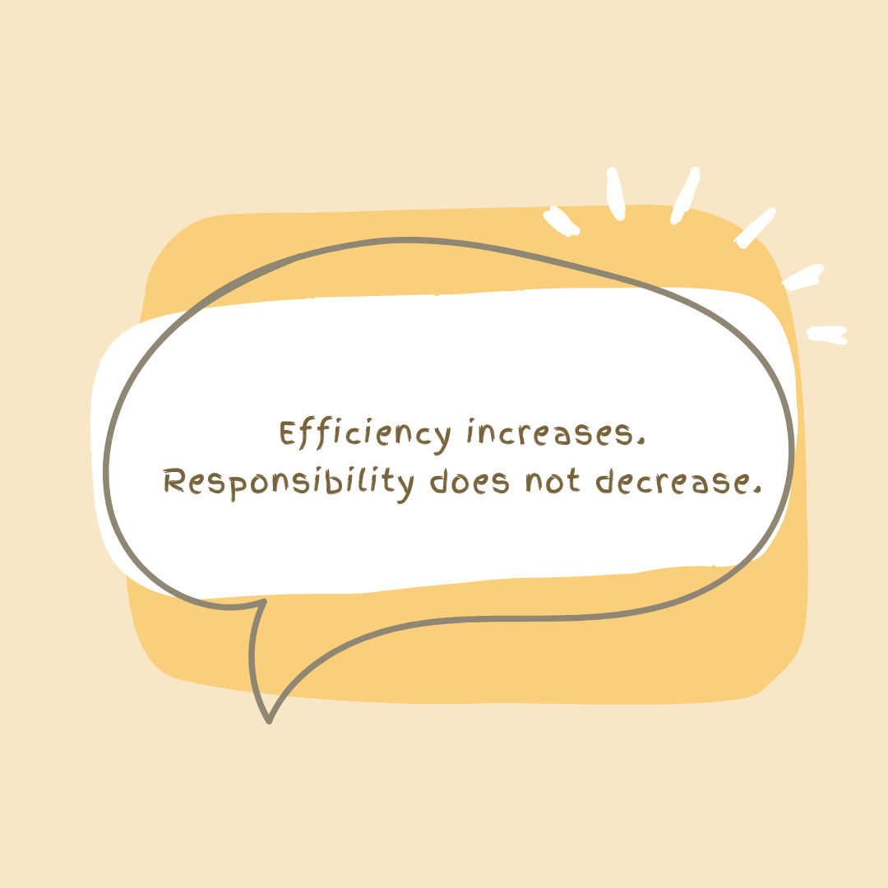
Preserving Human Oversight
Human-in-the-Loop Practice
  AI can:
  Identify patterns
  Suggest phrasing
  Scale analysis
  Students must:
  Verify accuracy
  Maintain authenticity
  Preserve voice
  Accept responsibility

Slide 38
Faculty Remain Researchers and Interpreters
We do not need to become:
  Career specialists
  AI engineers
We remain:
  Researchers
  Interpreters of evidence
  Translators of disciplinary learning
  Mentors in judgment

Slide 39
Why This Matters for Teaching and Learning
Why This Matters Now (More Than Ever)
  Public universities face career
  readiness pressure.
  Students feel uncertainty about
  AI-mediated hiring.
  Faculty relationships remain
  central to advising.

Slide 40

Q&A

Slide 41
References
Anders, A. (2024, April 4). Generative AI in professional communication [Substack newsletter]. Communicate / Innovate by Abram Anders. https://abramanders.substack.com/p/generative-ai-in-professional-communication
Canagasuriam, D., & Lukacik, E. (2024). ChatGPT, can you take my job interview? Examining artificial intelligence cheating in the asynchronous video interview. International Journal of Selection and Assessment. Advance online publication. https://doi.org/10.1111/ijsa.12491
Cardon, P., Fleischmann, C., Aritz, J., Logemann, M., & Heidewald, J. (2023). The challenges and opportunities of AI-assisted writing: Developing AI literacy for the AI age. Business and Professional Communication Quarterly, 86(3), 257–295. https://doi.org/10.1177/23294906231176517
Chakraborty, I., Chiong, K., Dover, H., & Sudhir, K. (2024). Can AI and AI-hybrids detect persuasion skills? Salesforce hiring with conversational video interviews. Marketing Science. Advance online publication. https://doi.org/10.1287/mksc.2023.0149
Gelles-Watnick, L., Anderson, M., McClain, C., Vogels, E. A., & Rainie, L. (2023, April 20). AI in hiring and evaluating workers: What Americans think. Pew Research Center. https://www.pewresearch.org/internet/2023/04/20/ai-in-hiring-and-evaluating-workers-what-americans-think/

Slide 42
References (Continued)
Kong, S.-C., Korte, S.-M., Burton, S., Keskitalo, P., Turunen, T., Smith, D., Wang, L., Lee, J. C.-K., & Beaton, M. C. (2024). Artificial intelligence (AI) literacy – An argument for AI literacy in education. Innovations in Education and Teaching International, 1–7. Advance online publication. https://doi.org/10.1080/14703297.2024.2332744
Lookadoo, K., & Moore, S. (2024). Is your résumé/textbook up-to-date? An audit of AI ATS résumé instruction. Business and Professional Communication Quarterly. Advance online publication. https://doi.org/10.1177/23294906231223101
Luscombe, A., Dick, K., & Walby, K. (2022). Algorithmic thinking in the public interest: Navigating technical, legal, and ethical hurdles to web scraping in the social sciences. Quality & Quantity, 56(3), 1023–1044. https://doi.org/10.1007/s11135-021-01164-0
Malin, C., Kupfer, C., Fleiß, J., Kubicek, B., & Thalmann, S. (2023). In the AI of the beholder—A qualitative study of HR professionals’ beliefs about AI-based chatbots and decision support in candidate pre-selection. Administrative Sciences, 13(11), 231. https://doi.org/10.3390/admsci13110231
Ponce, T. M. (2024). AI résumé writing: How prompt confidence shapes output and AI literacies. Business and Professional Communication Quarterly. Advance online publication. https://doi.org/10.1177/23294906241273317
Quick, C. (2012). From the workplace to academia: Nontraditional students and the relevance of workplace experience in technical writing pedagogy. Technical Communication Quarterly, 21(3), 230–250. https://doi.org/10.1080/10572252.2012.666639

Slide 43
References (Continued)
Racelis, J. V. (2024). Mas Marunong Kang Mag-English (You’re better at English-ing): Professional ventriloquy and the ideologies of “professionalism.” Technical Communication Quarterly, 33(3), 258–269.
Rajaraman, N., Jiao, J., & Ramchandran, K. (2024). Toward a theory of tokenization in LLMs (arXiv:2404.08335). arXiv. http://arxiv.org/abs/2404.08335
Read, S., & Michaud, M. (2018). Hidden in plain sight: Findings from a survey on the multi-major professional writing course. Technical Communication Quarterly, 27(3), 227–248. https://doi.org/10.1080/10572252.2018.1479590
Randazzo, C. (2016). Where do they go? Students’ sources of résumé advice, and implications for critically reimagining the résumé assignment. Technical Communication Quarterly, 25(4), 278–297. https://doi.org/10.1080/10572252.2016.1221142
Randazzo, C. (2024). The exclusionary potential of “professionalism” in hiring situations. Technical Communication Quarterly, 33(3), 270–284. https://doi.org/10.1080/10572252.2024.2340432
Schellmann, H. (2024). The algorithm: How AI decides who gets hired, monitored, promoted, and fired and why we need to fight back now. Hachette Books.

Slide 44
References (Continued)
Selber, S. (2024). An AI manifesto for technical communication programs. In E. Crane (Ed.), Proceedings of the Teaching Tech Comm and AI Symposium 2024. TechneForge. https://techneforge.com/proceedings-ai-symposium-2024/
Selfe, C. L. (1988). Computers in the classroom: The humanization of computers—Forget technology, remember literacy. The English Journal, 77(6), 69–71. https://www.jstor.org/stable/818623
Tham, J., Howard, T., & Verhulsdonck, G. (2022). Extending design thinking, content strategy, and artificial intelligence into technical communication and user experience design programs: Further pedagogical implications. Journal of Technical Writing and Communication, 52(4), 428–459. https://doi.org/10.1177/00472816211072533

