Slide 1
The Office of Research Development

Slide 2

What do we do?
Build Research Capacity: Trainings & initiatives that help faculty apply for and receive external funding
Proposal Development: Help faculty develop competitive proposals for external funders through writing assistance and strategic alignment
Grant Writing (aka Narrative Co-Development)
Assist with non-technical narrative aspects of external funding proposals
Align and highlight project strengths with funder missions
Strengthen narrative and non-narrative documents
Project Management
Coordinate multi-PI, multi-institution proposals
Meeting facilitation, proposal checklists, templates, and resource facilitation
Help faculty develop calibrated research plans and strategies

Slide 3
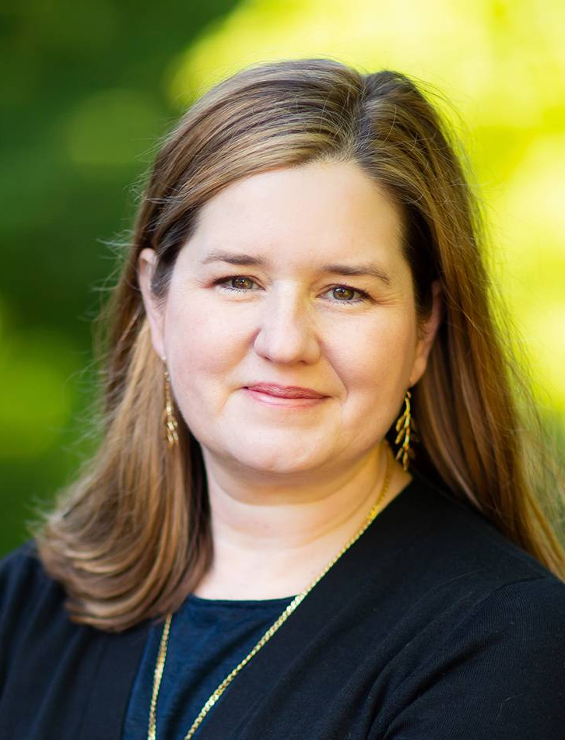
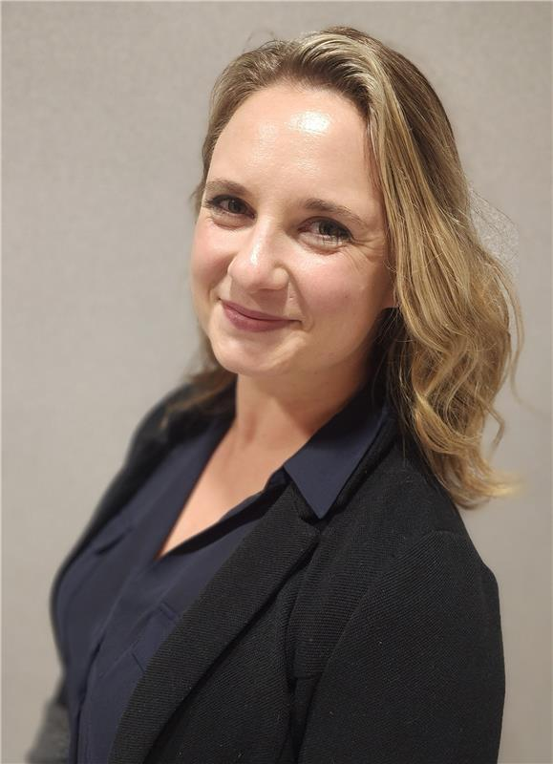
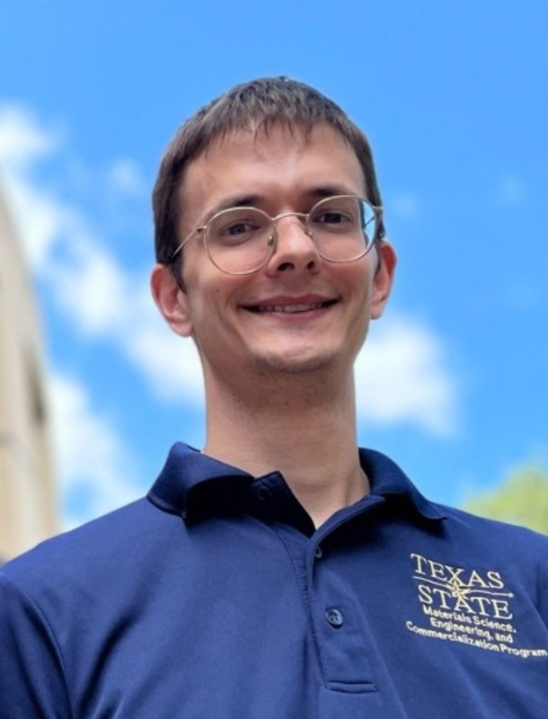
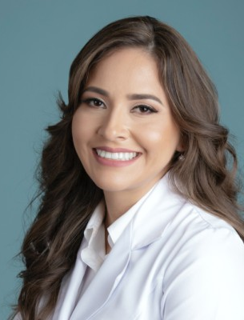
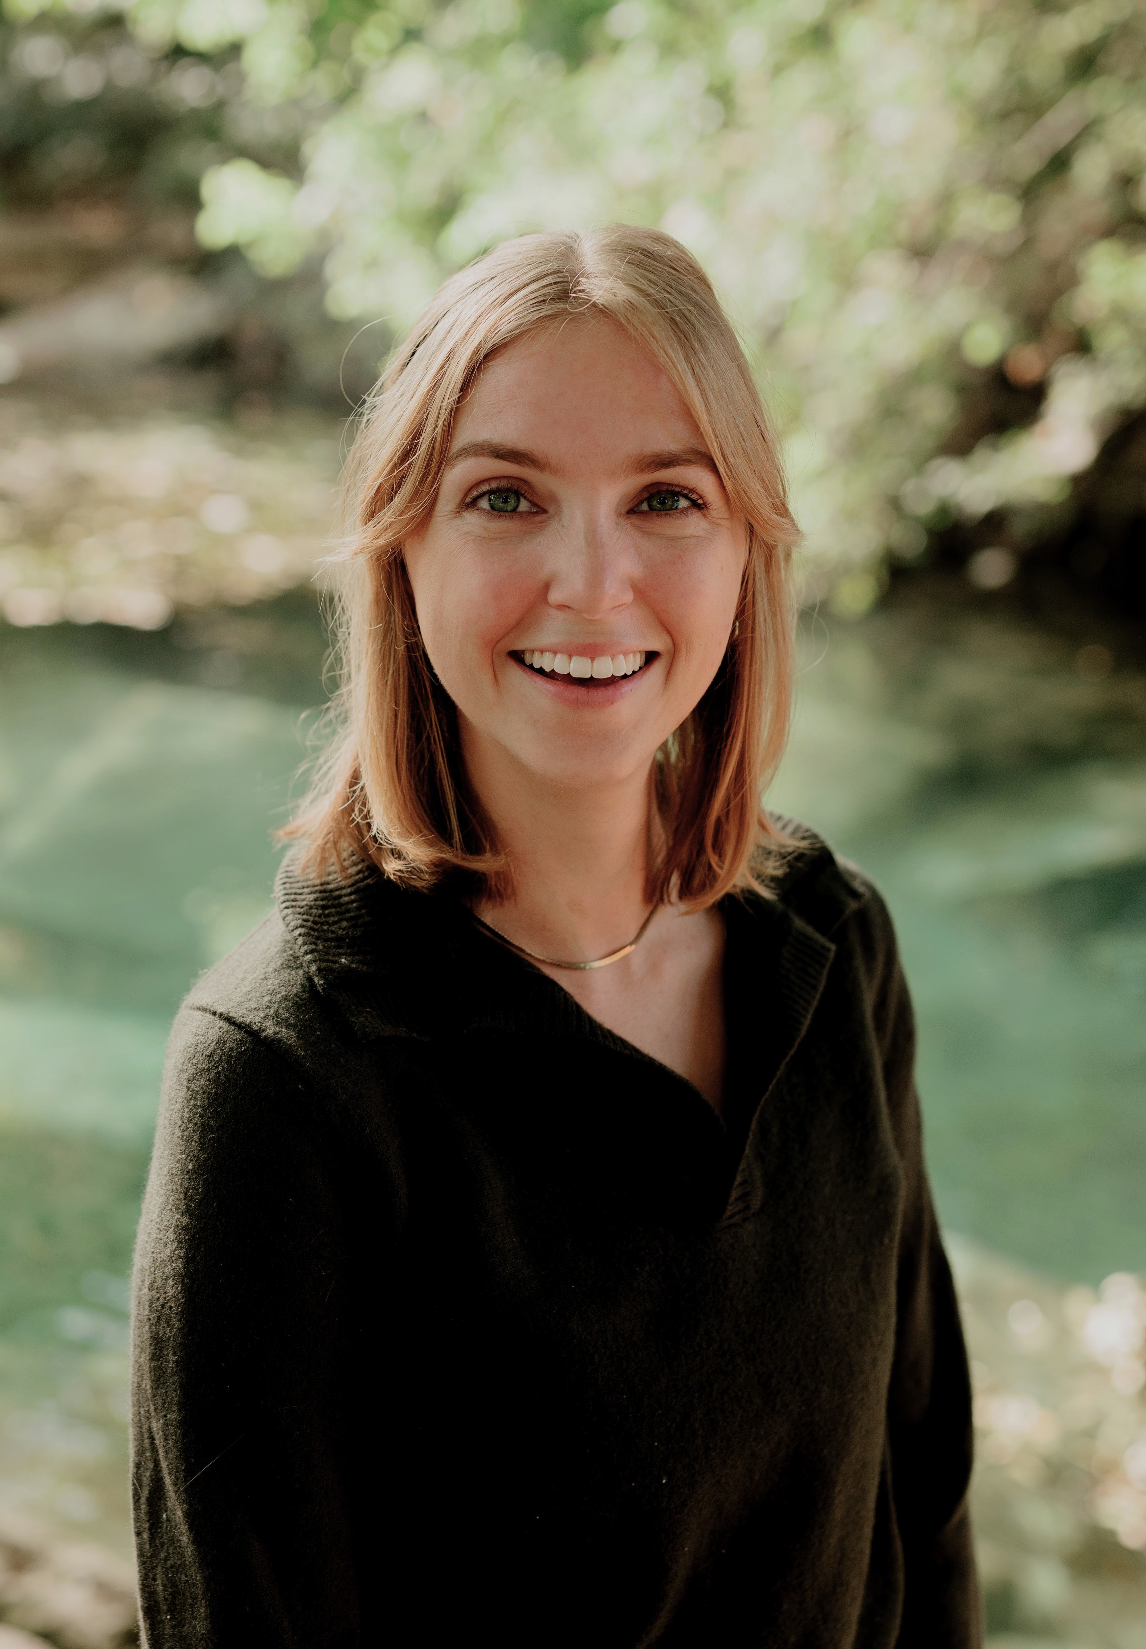
The Team
Dr. Jennifer Speed
Rachel Bomberger, M.S.
Dr. Sam Kimmel
Dr. Evelyn Frias-Toral
Lauren Chappell, M.S.
Assistant Vice President for Research Development
Creative and Technical Writer
Project Manager
Science Writer
Program Support Specialist

