Slide 1
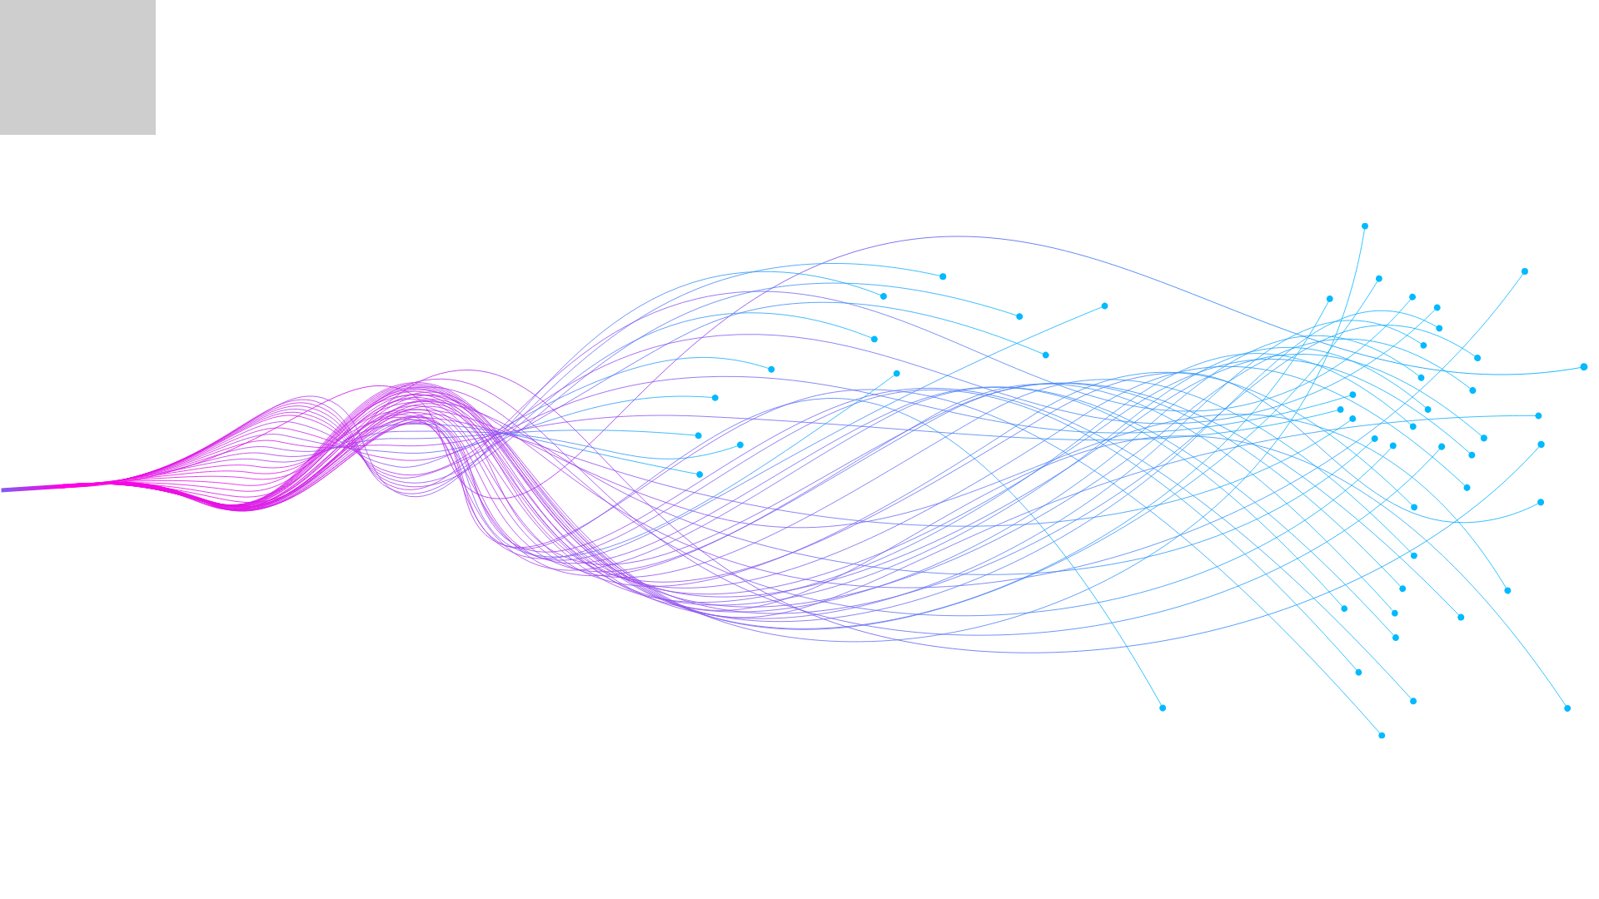
Scaling Experiential Learning with AI: Using AI-powered Simulations in Professional Sales Education

Slide 2
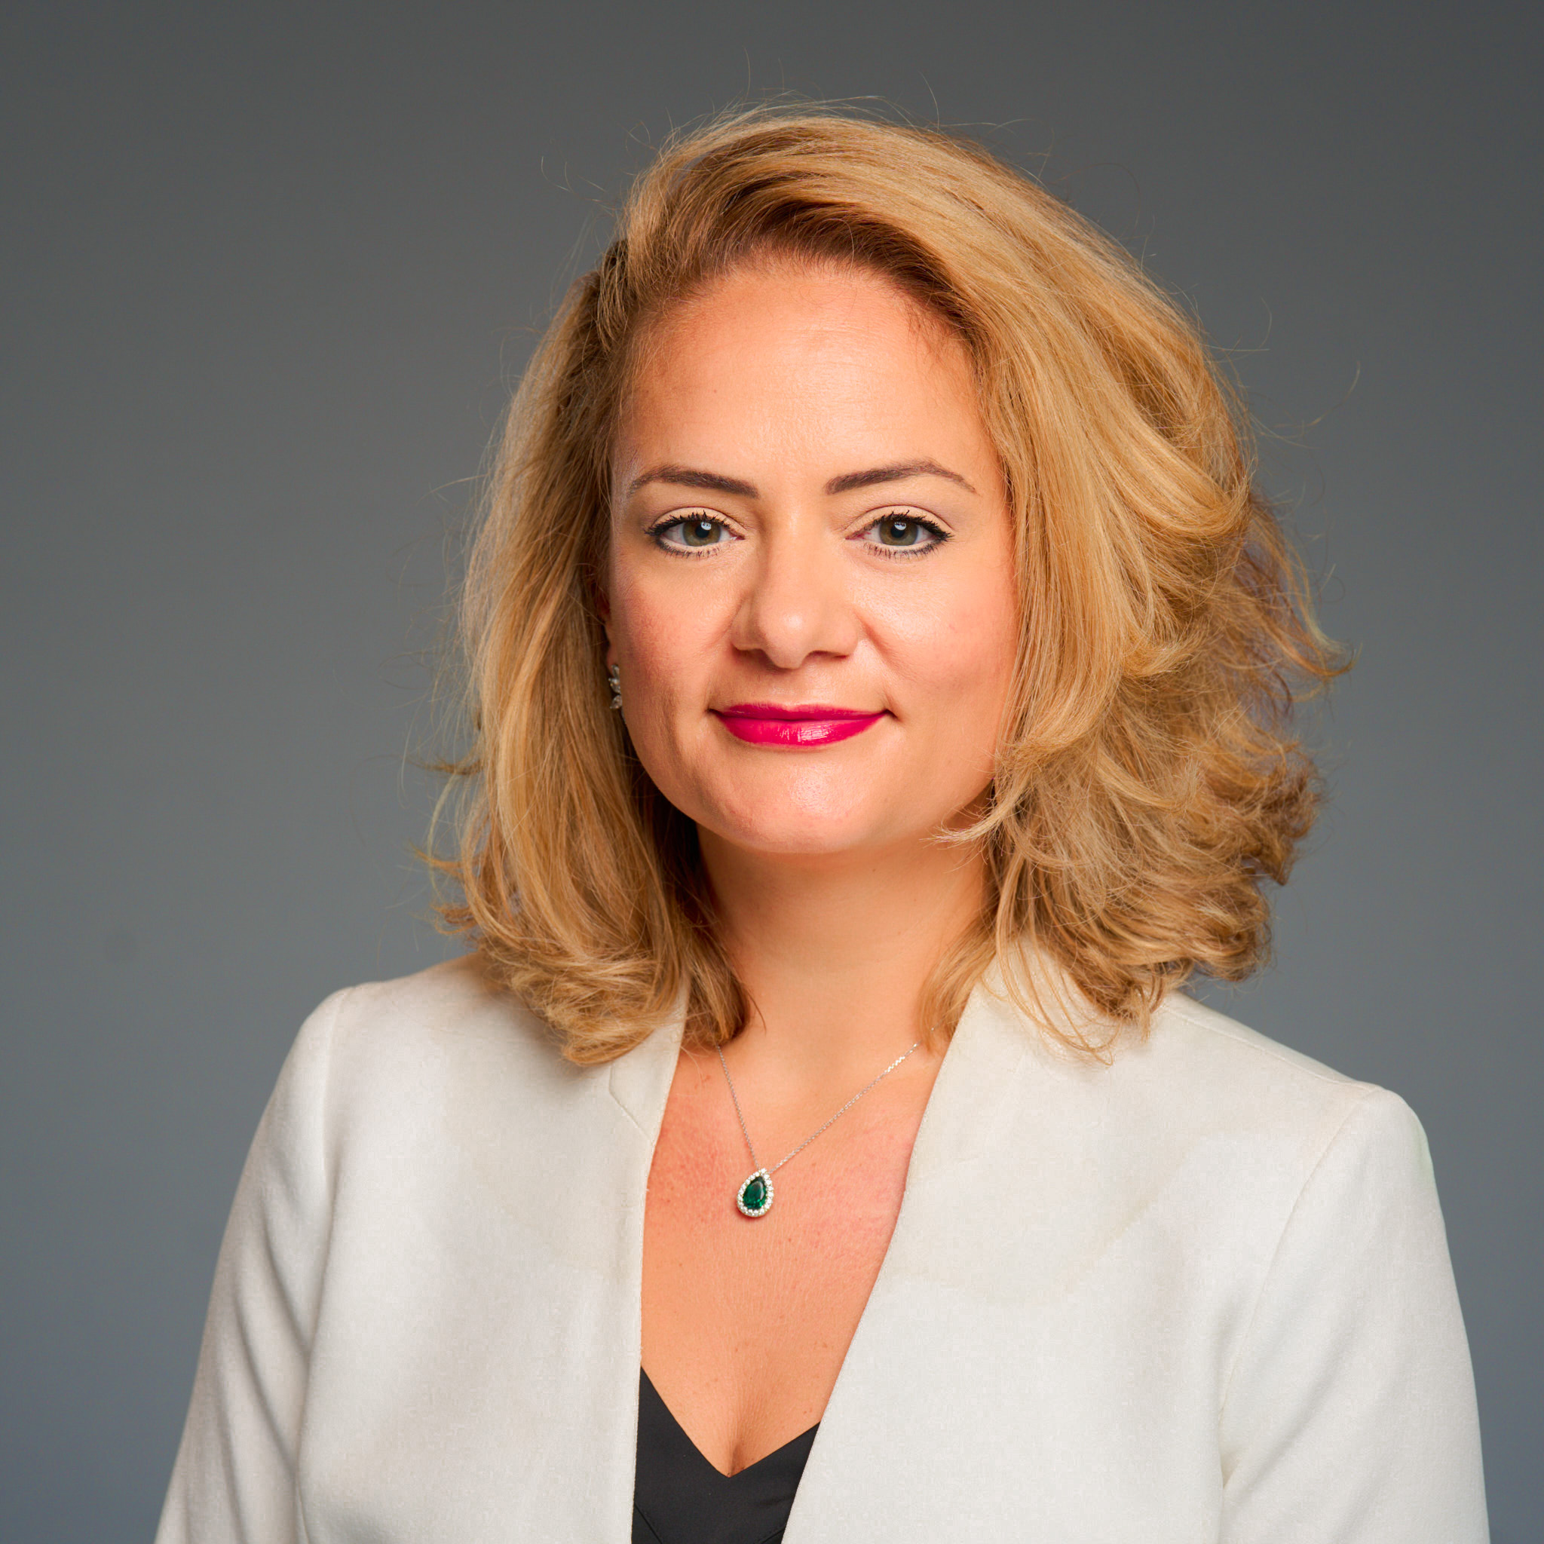
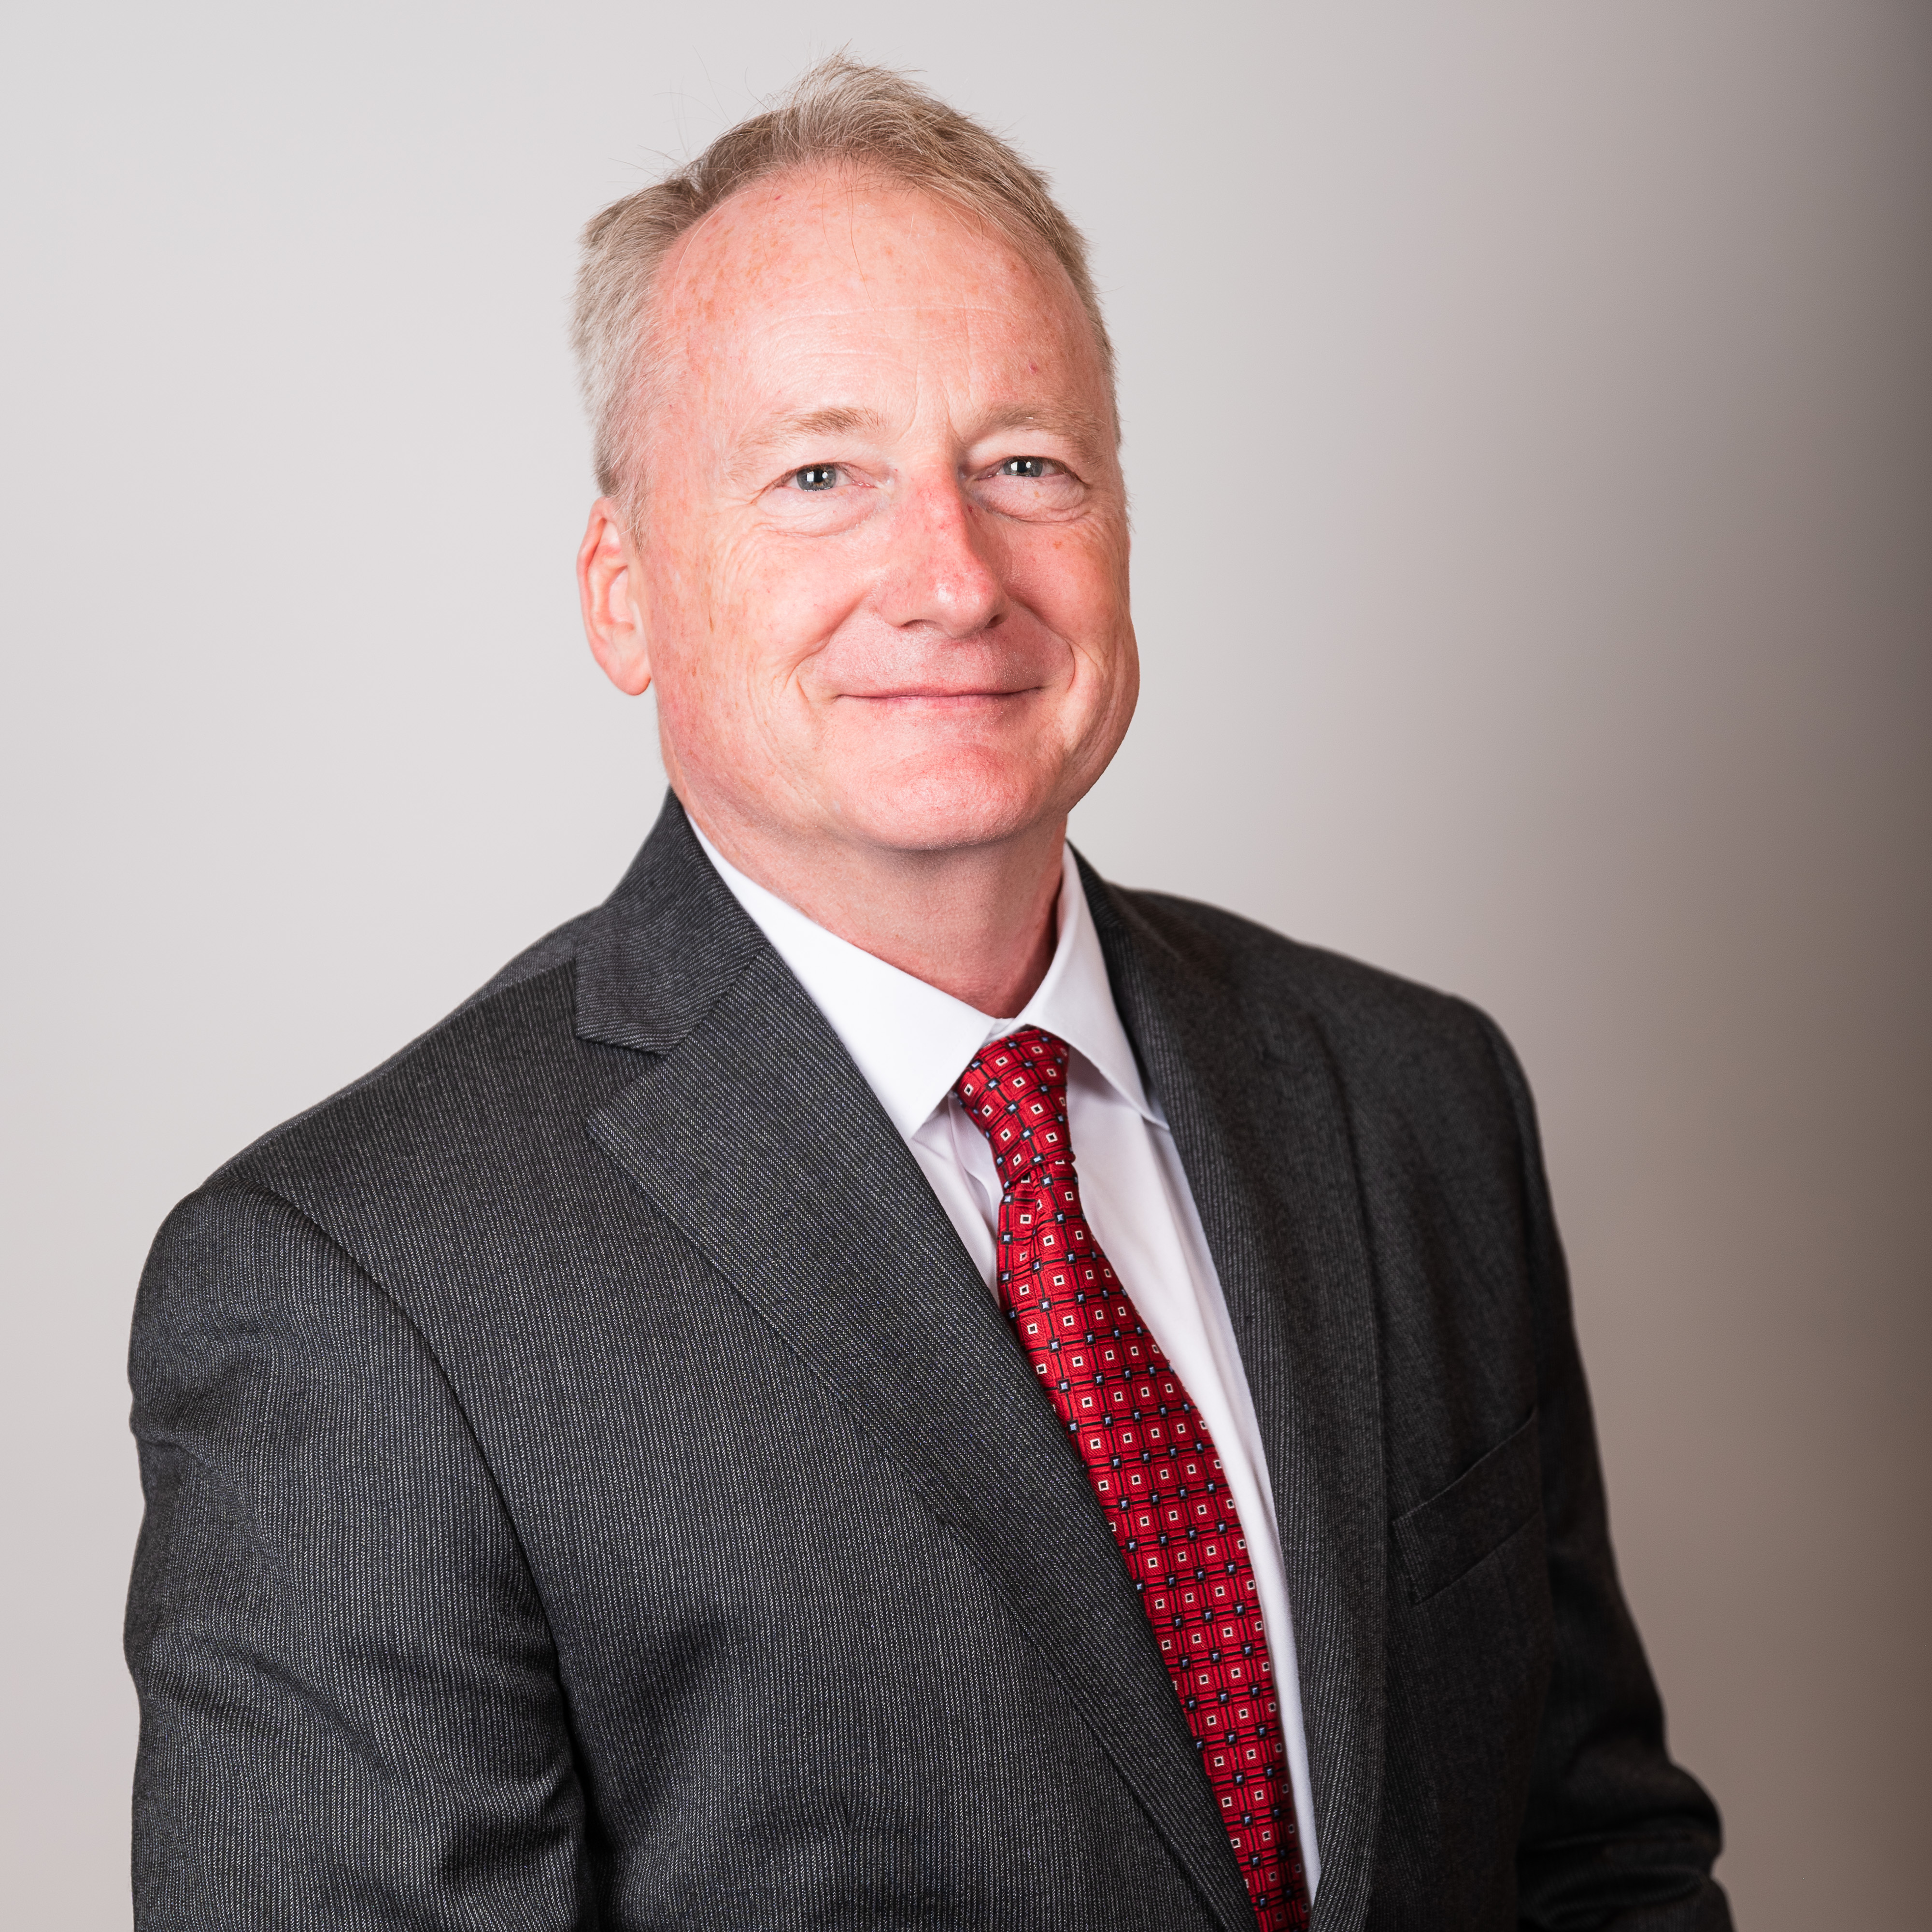
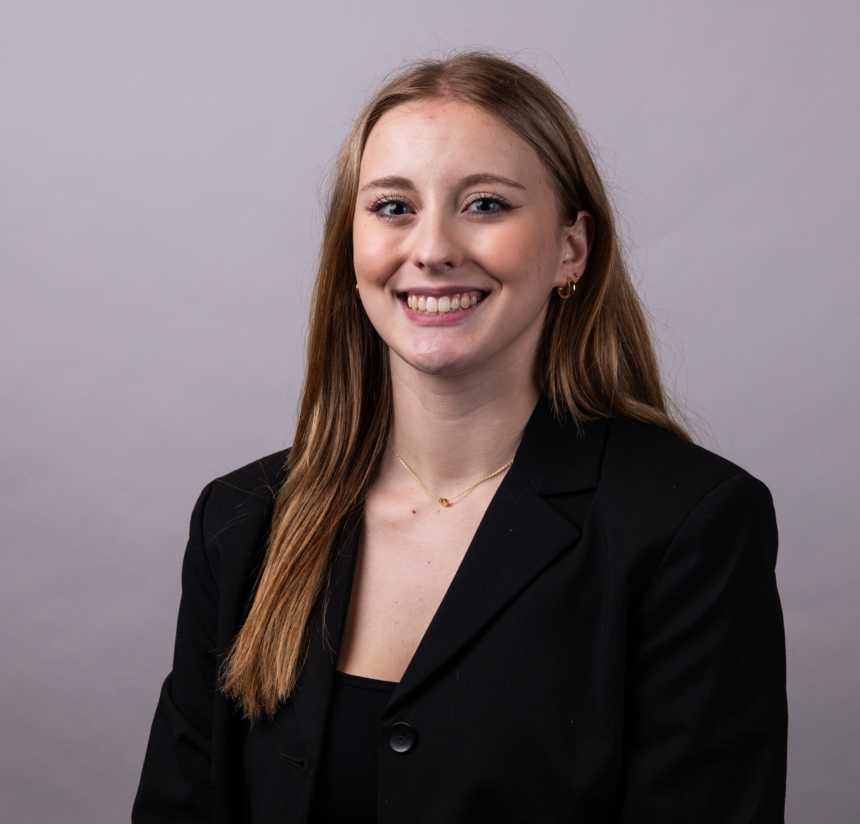

THE CENTER FOR PROFESSIONAL SALES
AT The McCoy COLLEGE OF BUSINESS
Dr. Linda Alkire
Director
Center for Professional Sales
Dr. Derrek Schartz
Asst. Director
Center for Professional Sales
Ms. Riley Singleton
Graduate Assistant
Center for Professional Sales

Slide 3

SECOND NATURE: AI SOFTWARE
https://txst.yuja.com/V/Video?v=15464829&node=66991126&a=43759230

Slide 4




SIMILAR AI PLATFORMS

Slide 5





SECOND NATURE: Industries SERVED
Sales
Insurance
Technology
Telco
Banking
Education

Slide 6
TRADITIONAL SALES TRAINING
Limited classroom time
Experiential learning is effective but difficult to scale.
Coaching-intensive disciplines face instructor capacity limits.
Uneven peer participation
Restricted access to opportunities

Slide 7
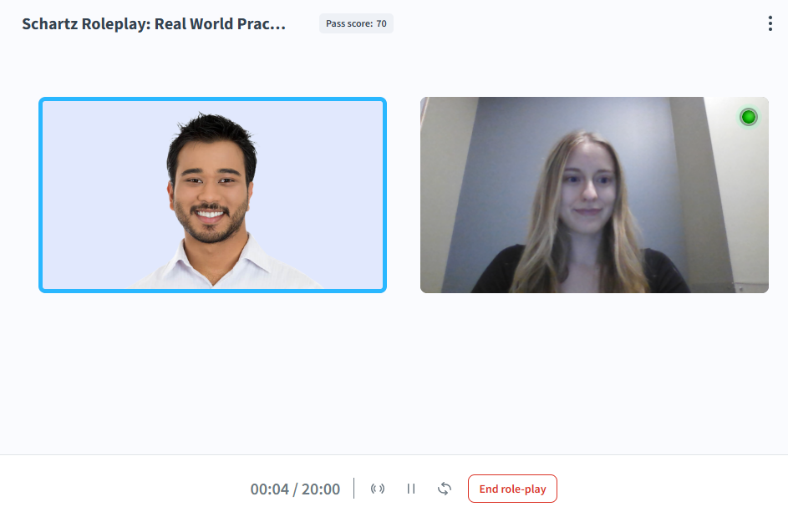
HOW WE USE SECOND NATURE:
Realistic sales conversations
Executive presentation feedback
Sales competition preparation
Developing elevator pitches
Interview practices

Slide 8
AI-Enabled Experiential Learning Cycle​​
Practice (AI simulation)
Immediate feedback
Reflection
Instructor coaching
Improved performance
In-Class Presentation
Instructor coaching

Slide 9
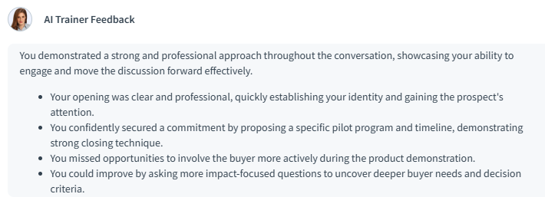
HOW SECOND NATURE AMPLIFIES LEARNING:
Standardizes practice
Individualized learning
Frees classroom time for:
Deeper discussion
Coaching
Reflection

Slide 10
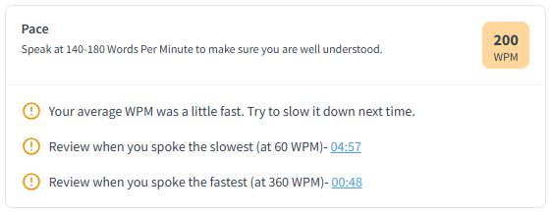
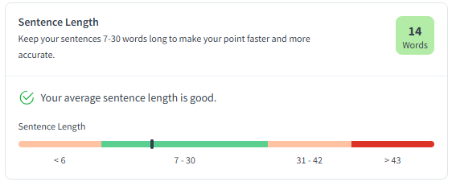
WHAT MAKES SECOND NATURE UNIQUE?
Human-Centered Capabilities
Analyzes emotional intelligence
Demonstrates active listening
Adapts to responses quickly
Delivers immediate and effective feedback

Slide 11
“AI Does Not Replace Faculty, It Repositions Them”
Evaluator
Content delivery
Grading
Skill Development
Mentoring
Coach

Slide 12
BENEFITs TO OUR SALES STUDENTS:
Refines sales skills
Builds confidence in various scenarios
Low-risk environment
Unlimited practice
Immediate feedback
Workforce readiness

Slide 13
HOW ELSE SECOND NATURE CAN BE USED:
Communication focused disciplines
Decision making
Emotional intelligence
Interpersonal skill development
Practice complex interactions
Workforce training

Slide 14
KEY Takeaways:
Analyze instructional limitations of traditional sales training
Apply AI-driven simulations to support human-centered capabilities
Design practical approaches to integrate AI into sales and other disciplines

Slide 15

THANK YOU
Dr. Linda Alkire
Director for the Center for Professional Sales
linda.alkire@txstate.edu
Dr. Derrek Schartz
Asst. Director for the Center for Professional Sales
sve21@txstate.edu
Ms. Riley Singleton
Graduate Asst. for the Center for Professional Sales
qie8@txstate.edu

