Slide 1

AI as Assistant and Data Analyst
Cultivating and Measuring Student AI-Resilience in Capstone Writing
Mica Rutschke, DHA, MSOT, CLVT, CTIS
Ripsimé K. Bledsoe, Ph.D.
March 4 2026
TXST AI in Teaching & Learning Symposium

Slide 2
Session Roadmap
Two Stories in One Session
Part 1: AI as Assistant (Pedagogy)
How we taught OT doctoral students to use AI ethically in capstone research writing
Part 2: AI as Analyst (Methodology)
How we used AI to analyze massive qualitative data efficiently
You'll Leave With:
A framework for AI-integrated writing assignments
A replicable workflow for analyzing student reflections
Broader applications for your use

Slide 3
The Problems & Our Approach
Generative AI Has Destabilized Academic Writing
The Risks:
"Cognitive offloading" – students bypass critical thinking
Loss of voice and ownership
Academic integrity concerns
The Reality:
Banning AI is impractical
Students need to learn professional/discipline specific use
Educators lack tested integration models within their own domains/disciplines
Our Challenge: How do we teach WITH AI rather than against it?

Slide 4
The Problems & Our Approach
Guided Research and Writing Difficult
Challenges students face:
Synthesize large bodies of evidence
Write professionally for clinical/academic audiences
Demonstrate sound reasoning through writing
Self regulate and stay motivated
Not rely too much or too little LLMs

Slide 5
The AI-Resilience Framework
Moving from Policing to Pedagogy
AI-Resilient Design Principles (Digital Education Council, 2025):
Structural, not discursive change (Corbin et al., 2025)
Focus on process over product (assessment)
Validate learning through human-led checkpoints
Require traceable development (logs, drafts, iteration)
Core Philosophy: AI as Assistant, not Author

Slide 6
Study Design & Context
Exploratory Case Study
OTD Capstone Research Course
Participants: 11 doctoral occupational therapy students
Activities:
Pre-test survey (baseline confidence: writing, research, AI comfort)
AI Use Logs (structured documentation of AI interactions)
Post-test survey (confidence + open-ended reflections)
Classroom: Mini rehearsals, AI assisted search tools, Digital article organizers
Intervention: Structured "AI as Assistant" protocol with required AI Use Logs

Slide 7
Research Questions
How did students' self-efficacy in writing and research change after the AI-integrated intervention?
How did students operationalize "AI as Assistant" in practice? (patterns of use, decision-making, critical evaluation)
To what extent did AI-resilient course design (process focus + in-class validation) influence demonstrated understanding?

Slide 8
AI as Assistant
The Pedagogical Intervention

Slide 9
Preparation – Beyond Syllabus Statements
Structured, Principle-Driven Integration
Core Instructional Principles:
Preserve your voice – AI supports, does not replace
Verify with trusted sources (faculty, peer-reviewed literature)
Identify weaknesses, gaps, bias in AI output
Document your decisions (AI Use Logs required)
In-Class Activities:
Guided prompting sessions (e.g., mission/vision statements)
Iterative revision cycles with faculty feedback
Oral validation of understanding (mini-rehearsals)
Human First --> Guided AI

Slide 10
Baseline-Where Students Started
Mixed Readiness & Cautious Curiosity
Pre-Test Confidence (1–4 scale):
Independent research: M = 2.80
Graduate writing: M = 2.80
Presenting research: M = 2.90
Comfort using AI: M = 2.60 (lowest)
Key Patterns:
Wide spectrum of writing self-efficacy (still building independence)
Interested in AI but uncertain how to use it appropriately
Fear of misuse; lack of clear policies

Slide 11
Process – What Students Actually Did
Key Patterns (Logs):
Cognitive Work:
Learning (understanding structure, content)
Anchoring (organizing initial thoughts)
Reframing (revising ideas based on AI feedback, adapting to limitations)
Generating (translate ideas into outcomes, tools)
Quality Control:
Verification (checking facts, citations, bias)
Humanizing (maintaining voice, ownership)
Ownership (active revision, rejection of "AI-like" wording, selective)
Support Functions:
Managing Cognitive Load (reducing overwhelm)
Grounding (aligning to site/context)
Refining (condensing, reweighting, matching needs)

Slide 12
Process – Key Patterns
Students Were Active, Not Passive
Quotes:
"The AI process helped my thinking as it put my ideas all together... It helped me gather and organize my thoughts."
"I liked what AI generated... but I preferred the beginning that I wrote independently."
“The first output AI gave me did not really include caregivers… I asked it to include extra information…
"AI helped with condensing my idea into what I was trying to voice out."
Pattern: Iterative refinement + sustained ownership

Slide 13
Process – Key Patterns
Students Resisted "Cognitive Offloading"
Key Finding: Students were highly aware of maintaining their humanity in writing.
"Yes, I felt that this summary was organized... One thing I was weary of is that it included information not stated in my outline."
"I feel my capstone is mine… All I had to do was put all my components… so it helped me with the writing aspect.”
Exception: Students accepted AI output when:
They felt less confident in writing ability, OR
Their own prewriting/prompts were thorough
Implication: Scaffolding matters for vulnerable learners

Slide 14
Outcome – Where Students Ended
High Confidence & Unanimous Value
Post-Test Confidence (1–4 scale):
AI-supported research: M = 3.67
Deep understanding with AI: M = 3.67
Graduate writing (AI-assisted): M = 3.78
Helpfulness of AI modules: M = 4.00 (100%)
Value of human-led activities: M = 4.00 (100%)
Shift: From cautious (2.6–2.9) → confident integration (3.67–4.0)

Slide 15
Outcome – Key Patterns
Post-Test (open-ended)
Enhanced clarity & organization "AI helped provide more clarity to my thoughts and organized them better."
Increased confidence "Overall I am more confident in using AI for my writing."
Skill acquisition "I learned how to use it correctly and appropriately for grad school."
Critical oversight "There were some instances where I had to correct AI, but overall, I think it's a great tool if utilized correctly."
Reduced cognitive load "AI significantly helped reduce stress and cognitive load."
Maintained ownership "I would go back and individualize even more."

Slide 16
Key Takeaway
AI-Resilient Design Works
When AI integration includes:
✅ Human-led instruction (principles, validation)
✅ Process documentation (logs as assessment)
✅ Iterative revision expectations
✅ Explicit norms (voice, verification)
Students:
Maintain ownership & voice
Build writing self-efficacy
Use AI critically, not passively
Experience reduced overwhelm in complex synthesis tasks

Slide 17
AI as analyst
The Methodological Innovation

Slide 18
The Qualitative Research Challenge
Qualitative Data Analysis:
The Problem:
Coding is time-prohibitive
Hard to scale up
Difficult to triangulate
The Question: Can we use AI to analyze student learning without sacrificing rigor?

Slide 19
Adapted AI-Assisted Workflow
Accessible Innovation for Faculty Use with Built-In Validation
Original (Katz et al. (2024):
Python/vector embedding, computational NLP/LLM analysis (teaching evaluations at Virginia Tech)
Powerful but inaccessible to most faculty
Our Adaptation:
LLM (ChatGPT) based workflow
Hybrid validation: parallel manual coding by researchers
Multi-Layered Triangulation
Human-AI comparison (manual coding + LLM)
Three temporal codebooks (Baseline → Process → Outcome)
Three data sources (pre-survey, logs, post-survey)
Convergence across all sources = confidence in findings
→ For larger samples: batch manual coding + LLM comparison
Notes:
We adapted Katz's computational approach to make it accessible—using ChatGPT instead of Python—but validated it through parallel manual coding. The LLM did well but missed some nuance, which is expected and actually similar to how different human coders surface different insights. For larger samples, we recommend a hybrid: a few researchers batch-code manually, then compare with the LLM. That's still way faster than traditional coding.
Most importantly, we built in three layers of triangulation: comparing human and AI codes, developing three temporal codebooks, and using three different data sources. The fact that themes converged across all of these gives us confidence in the findings—and that's a strength of case study methodology

Slide 20
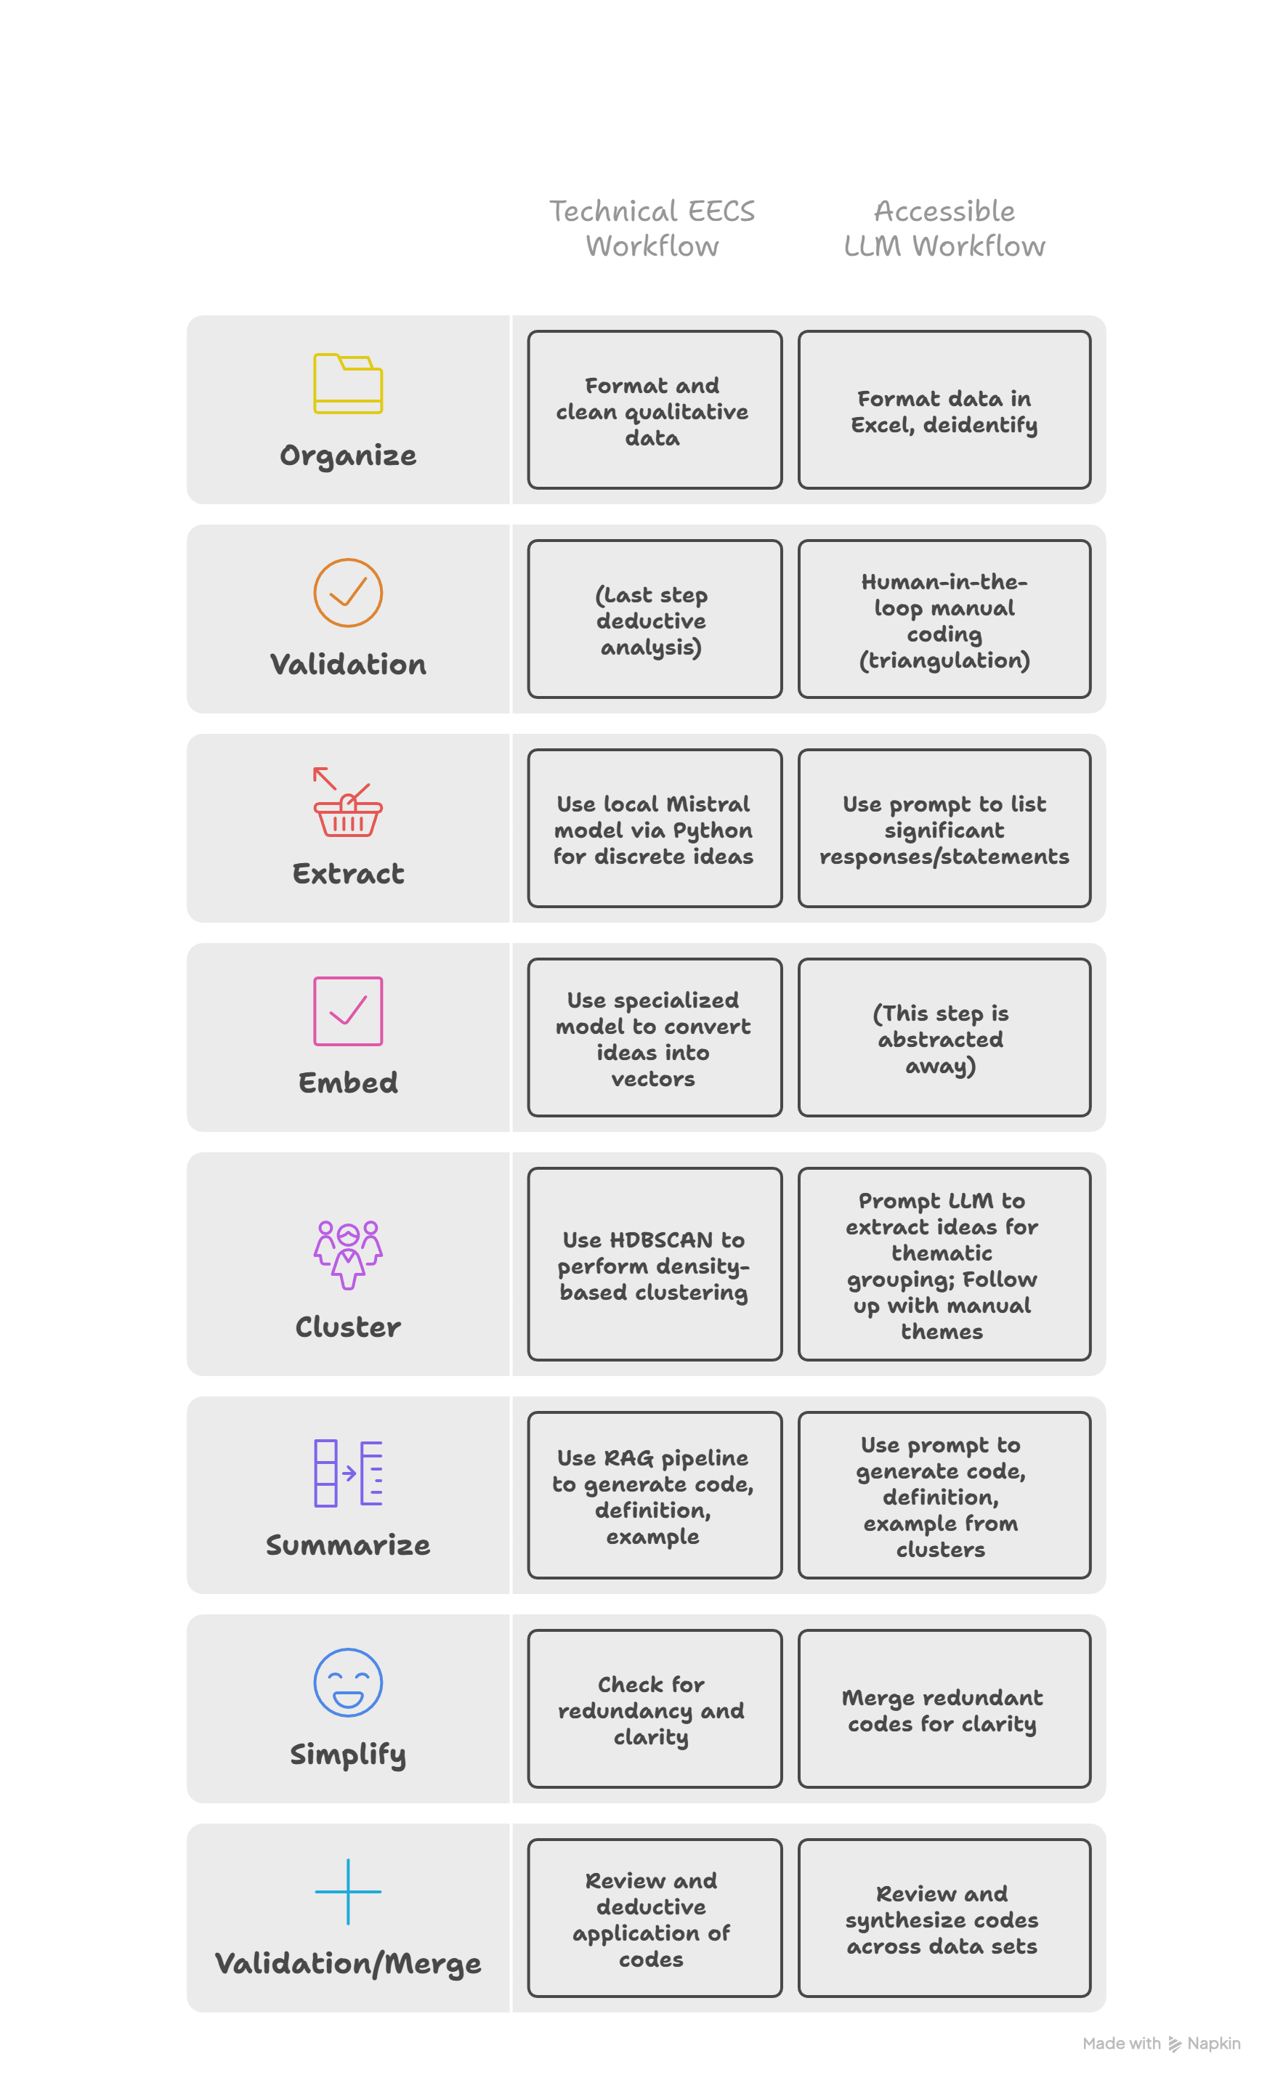
Technical EECS Workflow vs. Accessible LLM Workflow
Adapted from: Katz et al. (2024) – AI analysis of teaching evaluations ​

Slide 21
Baseline Analysis (Pre-Test)
Extract Initial Perceptions
Summarize into Baseline Codebook
Gather all responses and use a prompt to collect initial perceptions
Cluster Initial Perceptions
Create a formal codebook entry for each cluster using a prompt
Group similar themes into clusters using a prompt

Slide 22
In-Semester Data Analysis (Logs)
Manual Analysis
Cluster Actions and Strategies
Researchers review and identify key themes
Extract Actions and Strategies
Actions and strategies are clustered into groups
Summarize into Process Codebook
Log entries are processed to extract actions and strategies
Clusters are summarized into a formal codebook

Slide 23
Outcome Data Analysis (Post-Test)
Extract Final Perceptions
Summarize into Outcome Codebook
Gather all post-test responses
Cluster Final Perceptions
Create a codebook summarizing the clusters
Group similar perceptions together

Slide 24
Prompt Structure & Progression
How We Talked to ChatGPT
Framework: Structured, persona-based, task-specific prompting
"You are a qualitative research assistant ..."
Attitudes/confidence/anxieties/perceptions
Actions taken
Strategies used
Challenges encountered
"Aha" moments
Evolving thinking
Structured 3-Phase Analysis
Significant statements → Thematic clusters → Codebook (definitions + quotes)

Slide 25
Cross Codebook Synthesis
Tracing Learning Trajectories
Compared three validated codebooks side-by-side (temporal + data course triangulation)
Trace evolution of themes over time:
Which anxieties dissipated?
How did strategies transform?
What new considerations emerged?
Convergence: Iterative refinement, ownership, verification, reduced load, confidence, self efficacy
Scalable: Codebook can be applied to future cohorts to test transferability and refine framework over time

Slide 26
Key Takeaway
AI as Analyst is Feasible & Rigorous
Benefits:
✅ Reduces time for qualitative coding
✅ Accessible to faculty without advanced qualitative training
✅ Maintains rigor through human validation
✅ Scalable to course evaluations, surveys, TL projects
Requirements:
Structured prompts (role, goal, context)
Staged analysis (not one-shot, temporal)
Human review (triangulation, spot-checking, batch analysis)
Transparent reporting

Slide 27
Transferability
You Can Use These Methods
AI as Assistant Pedagogy:
Any discipline with research/writing (STEM, History, Business)
"AI Use Logs" = universal process assessment
Adaptable to lab reports, proposals, literature reviews
AI as Analyst Methodology:
Course evaluations
Student reflections
Open-ended survey responses
Departmental feedback
Any text-based qualitative data
Democratizes access to research for time-constrained faculty

Slide 28
Limitations & Future Directions
Limitations:
Small sample (n = 11)
Self-report data (perceptions, not writing quality measures)
Likert items not validated instruments
Single course context (OT capstone)
Future Research:
Rubric-scored writing analysis
Apply codebook to future capstone cohorts
Multi-site, multi-discipline replication
Develop quantitative survey based on codebook patterns
Differential effects for lower-confidence/ELL students

Slide 29
Implications for Practice
For Educators:
AI integration works when structurally designed
Process documentation meaningfully shifts assessment
Human instruction remains maximally valued
Reduced cognitive load may support persistence in high self-regulation tasks
For Researchers:
AI-assisted qualitative analysis is viable for learning outcomes
Temporal codebooks capture learning trajectories
Transparency + validation = rigor
Qualitative research as a more practical and valuable tool
For Institutions:
Need constructive AI policies (not just bans)
Faculty development on AI pedagogy + research

Slide 30
Three Things to Remember
AI-Resilience = Structural Design Process over product; validation over honor codes
Students Can Use AI Critically When principles are taught, voice is preserved, verification required
AI Can Accelerate Qualitative Research With human-in-the-loop validation, rigor is maintained

Slide 31
Contact & Questions
Questions?
Contact: Mica Rutschke: Rutschke@uiwtx.edu
Ripsimé K. Bledsoe: rkbledso@uiwtx.edu

