Slide 1

Preparing Students for an AI-Transformed Economy
AI in Teaching & Learning Symposium – March 5, 2026
Strategic Advisory Services

Slide 2


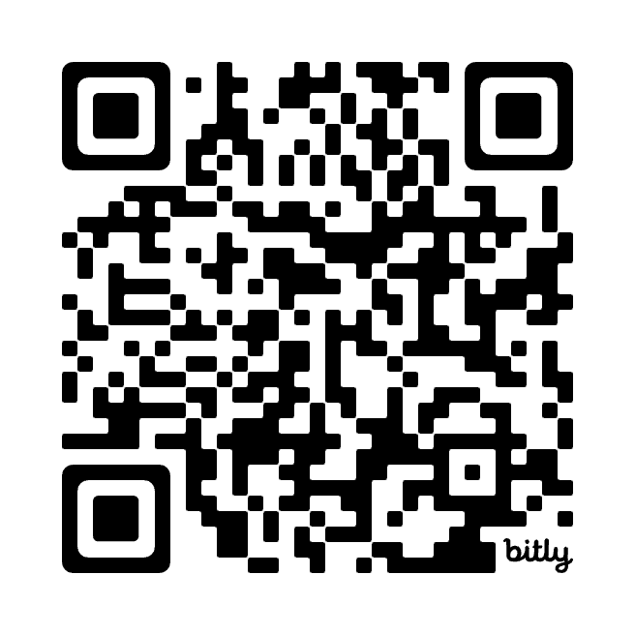
Joining You Today…
Jon Rice
Director,
EAB Research Advisory Services
JRice@eab.com
LinkedIn:
linkedin.com/in/jonfrice

Slide 4




Faculty & Staff Have Vastly Different Takes on AI
Four AI Personas Found Across Campus – Which do you identify with?
Stubborn Skeptic
Passive Observer
Curious Examiner
AI Champion
“AI is just the latest overhyped piece of technology.”
"AI is a pedagogical issue. Faculty and staff should play around with it but that doesn't make it a priority."
“I am exploring AI applications, but I’m not sure what problems it helps me solve yet.”
”AI will transform every part of higher education and my work.”
Source: EAB interviews and analysis.

Slide 5
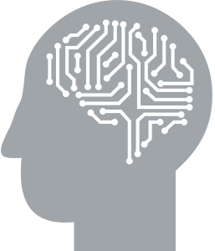


A Generation Shaped by Socially Disruptive Technology
A Contracting Labor Market for New Grads
A (R)evolutionary Advance in Artificial Intelligence

Slide 6
A Generation Shaped by Socially Disruptive Technology
Gen Z:
Born 1997-2012
(13-29 years old in 2026)
Notes:
Not to say that we’re not all affected by an AI-transformed economy – but we know that it’s having a particular effect on the current Generation who are coming through our campuses

Slide 7








A Generation Shaped by Socially Disruptive Technology
Key Observations:
Delayed markers of adulthood
Social isolation, particularly amongst young men
Declining extroversion and conscientiousness
Growing political polarization
Growing reliance on parasocial substitutes (i.e. AI companions)
Economic pessimism driven by rising costs of living
A silver lining – Positive early results from school phone bans
Gen Z:
Born 1997-2012
(13-29 years old in 2026)
Source: EAB interviews and analysis.
Notes:
Broad brushstrokes here…

Slide 8
A Contracting Labor Market for New Grads

Slide 9





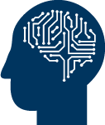
2. A Contracting Labor Market for New Grads
Key Observations
The college wage premium remains at a near all-time high
Unemployment rates for recent grads now look similar to those of non-college workers
College grads make up a growing share of long-term (6+ months) unemployed workers
More than half of college grads start their career underemployed¹—and 73% remain so 10 years later
Economic growth continues to climb but job openings are falling
Early indicators suggest AI is disproportionately impacting entry-level jobs in the knowledge sector
Gen Z Meets the Labor Market
In an occupation that does not require a bachelor’s degree or for which the majority of workers do not have a bachelor’s degree.
Source: Burning Glass Institute, Talent Disrupted; Federal Reserve Bank of New York, Is College Still Worth It?; Hosseini, Seyed M. and Lichtinger, Guy, Generative AI as Seniority-Biased Technological Change; New York Fed, The Labor Market for Recent College Grads; New York Times, The Newest Face of Long-Term Unemployment?; St. Louis Fed, Job Openings and S&P 500; EAB interviews and analysis.
Notes:
Supplemental Notes:
This is an optional summary slide that can be used to more quickly cover key points from the labor market/economy section of Front #3.
See individual Front #3 slides for more scripting/context.

Slide 10

No Time to Wait and See
AI’s Disruption Already Visible at the Entry Level
-7.7%
Average Number of Total, Junior, and Senior Workers (Normalized to 0 in January 2015) at 285,000 U.S. Firms¹
Decline in junior headcount across firms that adopted AI (Jan 2023 - Jun 2024)
-40%
Decline in junior hires in wholesale and retail trade per quarter at firms that adopted AI (compared to non-adopters)
ChatGPT launch
Junior workers from mid-tier schools face greater AI disruption than those from elites or less selective schools
2015
2016
2017
2018
2019
2020
2021
2022
2023
2024
2025
Harvard University researchers’ analysis of LinkedIn resumes and job postings data; n=62 million workers across 285,000 U.S. firms.
Source: Hosseini, Seyed M. and Lichtinger, Guy, Generative AI as Seniority-Biased Technological Change; EAB interviews and analysis.
Notes:
We’ve seen recent studies that start to look at the canaries in the coalmine effect around early career hiring, showing signs that AI is already impacting junior workers.
One study from Harvard analyzed 2015 to 2025 employment data using job openings on LinkedIn.
They found a divergence in the number of junior and senior workers in late 2022, which is around ChatGPT’s launch. As you can see from the chart here, the number of junior workers across firms declined while the number of senior workers continued to grow.
In firms that adopted AI, junior headcount declined by nearly 8% between January 2023 and June 2024, with a larger decline in sectors with high AI exposure. For example, in wholesale and retail trade, companies that adopted AI hired 40% fewer junior workers per quarter than those that did not adopt AI.
The study also found a slight difference depending on the selectivity of the school a candidate comes from, with folks from mid-tier schools most impacted.
Another interesting point from the study is that the employment reductions were largely from reduced hiring, not layoffs.
So, we’re starting to see a shift in talent strategy, with firms hiring fewer workers in roles with higher AI exposure and where AI can automate most tasks...
Supplemental Notes:
Data background and definitions:
This is from a Harvard study on AI’s impact on young workers, published in August 2025. The researchers analyzed LinkedIn resume and job postings data from Revio Labs between 2015 and 2025. The dataset included over 245M job postings from 285K U.S. firms, representing 62M workers. The study compares employment trends between younger and more senior workers among AI adopters and non-AI adopters.
Junior workers are folks in entry-level positions. Senior workers represent workers outside of entry-level (e.g., manager-level, senior executives).
Companies that adopted AI are those that posted at least one role dedicated to implementing, operating, or working with AI systems (e.g., prompt engineer).
Researchers identified 10,599 AI adopters (~3.7% of their sample). AI adopters were larger firms, averaging 498 employees and 27 new hires per quarter. Non adopters average 101 employees and five new hires per quarter.
Some people might say these declines are driven by broader company or industry trends (e.g., economic uncertainty) and not just AI. But the study controlled for these shocks by comparing juniors and seniors within the same firm at the same time to isolate the impact of AI.
Key takeaways:
The study’s core argument is that AI is seniority-biased—employment for junior workers declined starting in 2023 while senior employment kept rising.
Junior and senior employment grew at similar rates until mid-2022 with a slight decline in both employment during COVID. Starting in 2023, senior employment kept rising while junior employment declined. Junior employment hasn’t grown since.
The 7.7% decline in junior headcount is primarily driven by reductions in hiring rather than layoffs. At the same time, promotions of existing juniors into more senior roles increased across AI adopters. This could be an early sign of firms starting to become more diamond-shaped than pyramids.
AI’s impact on junior employment is uneven. The largest reduction occurred in wholesale and retail trade where adopting firms hired 40% fewer juniors than firms that did not adopt AI. Information, professional services, and finance also hired fewer juniors. No significant reductions in senior hiring across industries.
Junior workers from mid-tier schools were more impacted by AI. Junior workers from elite and less selective schools were also impacted but at a smaller scale. The researchers provide two explanations for this:
Elite graduates are costly but more productive and produce higher quality work, discouraging companies to reduce hiring aggressively despite GenAI adoption.
Grads from less selective schools are cheaper (typically earning half the salary of an elite grad), shielding them from displacement.
Mid-tier graduates combine moderate cost with moderate productivity.

Slide 11
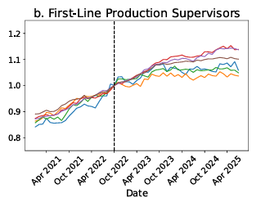
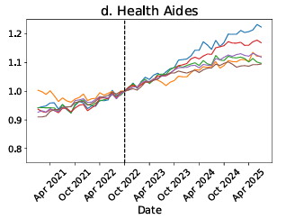
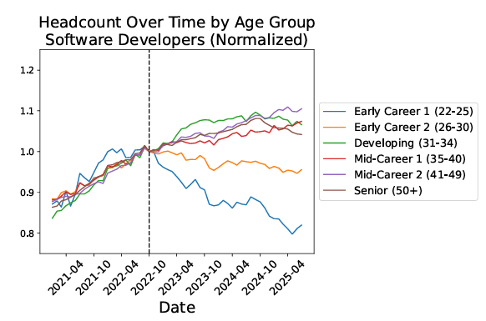
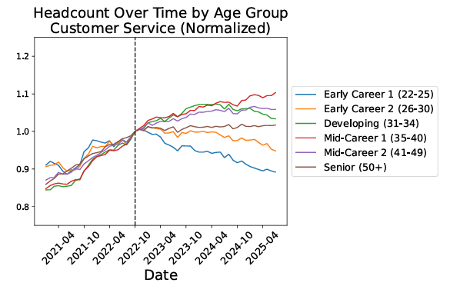
Not All Early Career Workers Equally Impacted
Declines Concentrated in Occupations With High AI Exposure
Early Career 1 (22-25)
First-Line Production Supervisors
Health Aides
1.2
1.2
1.1
1.1
Early Career 2 (26-30)
Low AI Exposure
1.0
1.0
0.9
0.9
Developing
(31-34)
0.8
0.8
Apr 2021
April 2025
Apr 2021
April 2025
Software Developers
Customer Service Representatives
Mid-Career 1
(35-40)
1.2
1.2
1.1
1.1
Mid-Career 2
(41-49)
High AI Exposure
1.0
1.0
0.9
0.9
0.8
0.8
Senior
(50+)
Apr 2021
April 2025
Apr 2021
April 2025
Source: Brynjolfsson et al., Canaries in the Coal Mine? Six Facts about the Recent Employment Effects of Artificial Intelligence; EAB interviews and analysis.
Notes:
And we see this more clearly in a similar study by Erik Brynjolfsson at Stanford looking at changes in employment by AI exposure.
These charts can be complicated to look at but the basic point is we’re seeing employment declines concentrated in early-career roles with high AI exposure.
The dotted line on the charts represents ChatGPT’s launch in November 2022.
For high AI exposure occupations like software developers and customer service representatives, we’re seeing significant declines in early career employment since ChatGPT’s launch.
But in less-exposed occupations, like Health Aides, employment has been stable or growing.
This study also found that how AI gets used in these occupations matters. Early career employment stays above average in augmented roles, whether they’re highly exposed to AI or not. But in roles where AI is used to automate tasks, early career employment rises in low-exposure roles but declines significantly in high-exposure roles.
What’s interesting from these two studies is that AI is impacting work differently than past technologies. Historically, older workers would face greater risks as it may be harder for them to learn new technologies. But with AI, were seeing a reverse effect with older workers facing less impact as they possess more of the skills that AI can’t replicate yet.
And the roles with high AI exposure and facing greater risks of disruption are those that we traditionally categorized as “safe” jobs that provide stronger job security and higher ROI.
And we’ll talk more about that in this next section…
Supplemental Notes:
Data background
This data is from Stanford working paper published in August 2025. Researchers analyzed monthly payroll records from ADP which cover 3.5 to 5 million workers between 2021 and 2025.
To measure AI exposure, researchers combined two approaches: 1) a previous study’s ratings of how well GPT-4 can perform each occupation’s tasks and 2) Anthropic Economic Index’ analysis of Claude usage, which maps each usage to a specific occupation.
Like in the Harvard study, the researchers compared workers of different ages and AI exposure within the same firms at the same time to control for company-wide or external shocks.
Key takeaways
Employment for early career workers in less-exposed occupations has been stable or growing between late 2022 and April 2025.
For first-line production supervisor, employment grew but at a slower pace compared to older workers.
Notably, for health aides, employment for early career workers is growing much faster than for older workers.
In contrast, employment for early career workers in occupations with high AI exposure declined by 13%. Between late 2022 and 2025, employment for software developers aged 22-25 declined by nearly 20%.
AI’s impact on employment depends on whether AI is used for automation or augmentation.
In occupations where AI augments work, exposure matters less. Entry-level employment stays above average in both highly and least AI exposed roles.
In occupations where AI automates work, employment rises in low-exposure roles but declines in high-exposure roles, with 22-25-year-olds facing greater disruption.
Automation is when AI directly executes a task with minimal human involvement, like asking AI to write a document. Augmentation is when AI enhances human capabilities through collaboration, like using AI for brainstorming or to learn a new topic.

Slide 12
A (R)evolutionary Advance in Artificial Intelligence
Notes:
Let’s shift to talk more about AI specifically. In the next few slides, we’ll go over how AI has evolved in recent years, what this means for our students, and how we can respond to these changes.

Slide 13




AI Threatens to Exacerbate Labor Market Mismatch
Impact is Faster, Broader, and Deeper than Prior Tech Shifts
Past Tech Innovations
Generative AI
Electricity primarily transformed manufacturing and agriculture
Internet and PC reshaped clerical, professional services, and sales
Impacts all industries, with higher exposure in knowledge sectors
Lower-wage and entry-level workers most at risk
Scope of Influence
Electricity reduced reliance on physical labor
PC/Internet displaced 3.5M workers, mainly in clerical roles
Directly mimics higher-order cognitive functions
Projected to impact 90% of jobs by 2032, leading to 12M job shifts
Nature of Disruption
Electricity expanded to rural areas through community co-ops
PC/Internet spread via consumer demand before firms adopted
Executive mandates and enterprise policies are driving adoption
Embedded AI in core software reduces need for individual uptake
Altitude of Adoption
Electricity reached 50% adoption in 42 years, PC in 20 years
Reached 50% adoption in less than three years
Pace of Adoption
1) Gallup survey of employed U.S. Adults in Q2 2025, N=19,043.
Source: Bond, Trends in Artificial Intelligence; Cognizant and Oxford Economics, New Work, New World; Gallup, AI Use at Work Has Nearly Doubled in Two Years; McKinsey & Company, Generative AI and the Future of Work in America and What Can History Teach Us About Technology and Jobs?; EAB interviews and analysis.
Notes:
Let’s start with why AI might feel different from past technological innovations.
We’ve compared AI to major technological shifts in different eras like electricity from the Second Industrial Revolution and PC and Internet in the late 90s and early 2000s.
AI’s impact is faster, broader, and deeper than anything we’ve seen before.
Unlike past technologies that impacted a few sectors, AI is projected to impact nearly every sector, with greater impacts in knowledge sectors.
AI can mimic higher-order cognitive functions, unlike past technologies that often automated physical and routine tasks, giving workers more time for creativity, value creation, and analytical tasks.
AI adoption is driven from the top-down. You’ve probably seen recent headlines of CEOs speaking about reducing their headcount. Some firms like Shopify now require teams to show that AI can’t do the job before asking for more headcount.
The pace of adoption is unprecedented, reaching 50% adoption in less than three years.
Supplemental Notes:
The goal of this slide is to show how AI’s impact and disruption is faster unlike anything we’ve seen before. We do this by comparing AI with past tech innovations that transformed work in two different eras. Electricity is from the Second Industrial Revolution (~late 1800s to early 1900s) and PC and the internet are from the information revolution (1970s to 2000s)
When it comes to AI adoption, there are studies, like a more recent MIT report, that show that 95% of firms adopted AI are seeing zero returns on their investment. But what we want to focus on here is that AI is already changing how executives think about their workforce even if they aren’t seeing any returns yet.
Executives are not waiting for people to adapt. Instead, they’re quietly changing their talent mix, slowing backfills, and they may be more willing to replace entire workers with AI than past technologies.
Electricity: “launched” in 1879 with the invention of the lightbulb.
Scope of influence: Massive productivity gains in manufacturing and agriculture.
In manufacturing, firms with access to electricity were 10% more productive than firms without electricity. Electricity allowed manufacturing firms to rely more on machines which worked faster and at higher quality than human workers (source:).
In agriculture, electricity first led to contraction as more people moved out of rural areas to work in factories. However, once electricity reached rural areas, it boosted productivity and allowed farmers to be more efficient by using machines to automate some farm work, making up for the decline in workers
Nature of disruption: Electricity displaced many low and mid-skill jobs by enabling faster, higher-quality machine work and routinizing tasks via assembly lines. However, overtime, electricity created more jobs than it replaced, including more specialized roles like engineers and managerial roles.
Altitude of adoption: In the 1930s, 90% of rural homes and farms lacked electricity because private utilities refused to build costly lines in low-population areas. Rural residents organized their own member-owned, not-for-profit co-ops to finance, build, and manage powerlines. The Federal Government created the Rural Electrification Act (REA) in 1935 which helped finance rural co-ops. By the mid-1950s, co-ops brought electricity to over 90% of farms and rural household.
Pace of adoption: Electricity reached 50% household adoption in 42 years. NY was the first city with electricity in 1882. In 1925, half of all homes in the US had power. Most of these homes were in urban areas, it took another decade for electricity to reach rural households.
PC and Internet: PC was invented in 1981, internet in the early 90s
Scope of Influence + Nature of disruption:
Personal computers displaced 3.5M workers since 1980, mainly jobs in typewriter manufacturing, secretarial work, and bookkeeping. For example, between 1990 and 2015, accounting jobs declined by ~900K as firms moved from physical books to accounting software and secretarial jobs declined by 1.4M.
However, computers also created ~19M new jobs across industries, like software engineers and graphic designers.
Altitude of Adoption: Individuals adopted PCs and the internet much faster than companies. PC ownership reached 50% of households by 1998, while workplace use was less than 50%. Similarly, 50% of US adults used the internet by 2000 but only 42% used it at work.
Pace of Adoption: It took 20 years for 50% of US households to own personal computers
AI
Scope of Influence:
In some industries like healthcare and social assistance/services, AI is more likely to augment work by automating routine tasks, freeing time for human-centered roles like patient care. In knowledge sectors, AI may replace both routine and cognitive tasks, increasing automation risks.
AI will also impact workers at all levels, including CEOs, but lower-wage and entry-level jobs are more vulnerable. We’re already seeing reduced entry-level hiring in occupations with high AI exposure (e.g., software developers, customer service reps).
Nature of Disruption:
AI will impact 90% of jobs by 2032. 52% of these jobs will have at least 25% of tasks automated. Only ~10% of jobs will have little impact (i.e., less than 5% of tasks automated).
12M occupational transitions in the US by 2032. 80% of the 12M people needing to transition will be people in lower-wage jobs like office support, customer service and sales, production, and food service occupations.
Occupational transition/job shift definition: when someone is involuntarily displaced by a job from automation and unable to get a new job in the same occupation because demand has declined.
Altitude of Adoption: Many executives are already planning to prioritize AI and reduce their headcount. For example, CEOs and Shopify and Fiver told teams to prove that AI can’t do the work before asking for more headcount. Amazon’s CEO issued a memo to staff that they’ll need fewer people in coming years, JP Morgan’s CEO of consumer and community business told investors they’ll reduce their operation headcount by 10%
Pace of Adoption: 50% adoption in less than 3 years, meaning that half of all US households regularly use AI tools in their daily lives, including ChatGPT, AI assistants, smart home devices with AI capabilities. ChatGPT reached 1M users within one day.

Slide 14



AI’s Transformative Opportunities in Higher Ed
Incorporating AI into the Curriculum
to Match Societal, Workplace Changes
Provide 24/7, Personalized Student
Support with One-Stop Conversational AI
Supercharge Faculty and Staff Productivity
to Pursue More Strategic Tasks
Maximize Enrollment and Advancement Yield
with Hyper-Personalized Content Generation
Transcend Historical Bounds of Innovation in
Research by Using AI to Expand Human Capabilities
Source: EAB interviews and analysis.

Slide 15
Know Your Enemy
Informed Skepticism
Critical Engagement with AI is the First Step to Reducing Unethical Use
Engaging with AI doesn’t equal adoption…AI literacy isn’t advocating for a specific position about AI—far from it. Rather, it aims to inform users and equip them with knowledge while removing the hype around these tools that are often marketed as magic to our students.
Marc Watkins
Assistant Director of Academic Innovation, University of Mississippi
Know what tasks generative AI does well…and what it’s really bad at
Get familiar with ethical AI use and the risks of using AI tools
Understand what makes it easy for students to use AI unethically
“Future-proof” classroom assignments and assessments
Sources: Mark Watkins, Engaging With AI Isn't Adopting AI; EAB interviews and analysis.
Notes:
Critical engagement with AI is essential because higher education needs to avoid the ethical pitfalls. We don’t want to create haves and have-nots; we don’t want to foster rampant misuse of AI tools; and we certainly don’t want to uncritically accept that AI automatically makes everything better.
Marc Watkins at Ole Miss has been writing for a long time that AI literacy isn’t positional: it doesn’t say “everyone should use AI”. Engagement does not equal adoption.
The checklist of items on the right should look a lot like the six questions that define AI literacy. That’s on purpose. We’re saying faculty can and should be AI literate and still be AI skeptics. And if for you that means you stop at “AI proofing” assignments and assessments, that still does a lot more to reduce misuse than sticking with the same assignments we’ve always used.
More on that in a moment, but first, I want to highlight some of the ways we see AI literacy training showing up.

Slide 16



What A Difference 7 Years Makes
Whiplash As Companies Flip from Retraining to Layoffs
2019
2026
Amazon to Retrain a Third of
Its U.S. Workforce
Amazon Is on the Cusp of Using More Robots Than Humans in Its Warehouses
Accenture says it retrained 300K workers in 4 years
Accenture to Double AI Workforce Three Months After Mass Layoffs
“Amazon’s promise to upgrade the skills of its workforce… represents one of the largest corporate retraining initiatives on record.”
of employers would downsize their workforce due to AI
41%
Source: C. Cutter (2019), “Amazon to retrain a third of its U.S. workforce”; R. O’Donnell (2019), “Accenture says it retrained 300K workers in 4 years”; S. Herrera (2025), “Amazon is on the cusp of using more robots than humans in its warehouses”; J. Levine (2023), “Accenture to double AI workforce three months after mass layoffs.”

Slide 17
Some Historically “Safe” Majors Under Pressure
Top and Bottom Five Bachelor’s Programs by Change in Completions, 2010-2024
Registered Nursing
6.1%
Unemployment rate for computer science majors
-28%
Drop in US computer programmer employment from 2023 to 2025
Computer Science
Computer & Information Science
Psychology
Sports/
Kinesiology
0.2%
Recent growth in enrollment (Spring 2024 to Spring 2025)
Liberal Arts and Sciences
Teacher Education, Specific Subjects
Accounting
History
English
Source: Federal Reserve Bank of New York, Labor Market Outcomes; NSC, Current Term Enrollment Estimates (Spring 2025); NYT, Goodbye, $165,000 Tech Jobs. Student Coders Seek Work at Chipotle.; The Atlantic, The Computer-Science Bubble Is Bursting; The Washington Post, More than a quarter of computer-programming jobs just vanished; EAB analysis of IPEDS data.
Notes:
So our assumptions about AI not impacting “human” tasks are being upended—and that of course has ripple effects on our academic programs.
Let’s overlay some of these trends in AI advances with completions data from IPEDS between 2010 and 2024.
On the left are the historically fastest growing fields according to IPEDS two-digit categories. Registered nursing is number one, which won’t surprise many of you.
But what was one of the safest STEM fields for the last 30 years? Computer science. Now there are still a lot of completions over the last 15 years, but the data on the right shows emerging vulnerabilities in this field.
Computer science majors have a higher unemployment rate at 6.1%. Plus, we’ve seen a significant drop in software development and computer programming jobs in the last two years and flatlining enrollment growth in this field in the past year.

Slide 18
Some Historically “Safe” Majors Under Pressure
Top and Bottom Five Bachelor’s Programs by Change in Completions, 2010-2024
Registered Nursing
Potential for a Liberal Arts Revival…
Associated with critical thinking, ethics, creativity, and discernment
Untethered to rapidly expiring technical skills
Computer Science
Computer & Information Science
…But It Isn’t Guaranteed
Sports/
Kinesiology
Curriculum often focused on discipline and content, not translatable skills
Psychology
Lower earnings and lack of workforce integration deter prospective students
Liberal Arts and Sciences
Teacher Education, Specific Subjects
Accounting
History
English
Source: Federal Reserve Bank of New York, Labor Market Outcomes; NSC, Current Term Enrollment Estimates (Spring 2025); NYT, Goodbye, $165,000 Tech Jobs. Student Coders Seek Work at Chipotle.; The Atlantic, The Computer-Science Bubble Is Bursting; The Washington Post, More than a quarter of computer-programming jobs just vanished; EAB analysis of IPEDS data.
Notes:
On the other hand, when we look at the fastest shrinking programs, many are in the liberal arts. Again, probably not to surprising for this group.
But there’s been a lot of rhetoric around the potential for a resurgence of the liberal arts in the era of AI, precisely because skills like critical thinking, ethics, and creativity will be at a premium. They’re the things that AI isn’t as good at, and they aren’t tethered to an app or coding language that could disappear in the next year.
That’s certainly a possibility—but it’s not guaranteed, for many reasons.
First, many of our humanities and liberal arts degrees are associated with those outcomes but focused on content rather than building the translatable skills our students need to live and work in a robotic future.
Second, these fields are associated with lower earnings and lack of workforce integration that deter students from choosing these paths.
.

Slide 19



The Old Career Ladder
Executive
Mid-Level
Entry-Level
Abundant, accessible starter jobs
Accessible with minimal professional experience or polish
Progression assumed—time and loyalty yield advancement
Employers expect to train and socialize junior hires
Source: EAB interviews and analysis.
Notes:
[Transition] So taking this altogether, what does AI mean for the future of work, especially at the entry-level?
Historically, this is what the career ladder looked like at most organizations.
A large number of entry-level employees, a medium number of mid-level managers, and a small group of executives.
The social contract was that if you majored in sociology, psychology, or business, there’d always be a place for you at a knowledge company, like EAB. Maybe you wouldn’t add immediate value to the company, but they’d invest in you and you’d have the opportunity to rise up the career ladder.

Slide 20


From Pyramid to Diamond
Executive-Level
Mid-Level
Entry-Level
Generalist Staff
Technical Staff
Entry points are scarce, tightly gated, and reserved for already-skilled candidates
Employers demand more polished, experienced hires from day one
First jobs feel less like “learning roles” and more like immediate proving grounds
Source: EAB interviews and analysis.
Notes:
And what that could lead to is a more diamond-shaped organizational structure where entry-points are scarce and tightly gated, reserved for a select folks. For example, those with personal connections in the organization.
In this new world, employers would likely reserve these positions for more polished, experienced candidates from day one.
First jobs would become less like training roles, with employers instead expecting workers to demonstrate immediate value.
Our challenge today is: how do we get our graduates into this diamond? What will it look like from a curricular perspective? What experiences do we need to give them?

Slide 21
How can higher ed respond and remain relevant?
Notes:
Given all these changes, let’s end with what we can do to prepare students for the future of work.

Slide 22
Key Responsibility to Non-Expert GenAI Users
Levels of AI Knowledge by Future Workforce Demand
Skills Needed
University Implication
~5%
Large language model design: building new GenAI models
API manipulation: the use of application program interfaces to have AI models interact with one another
Training already exists in Computer Science department
of knowledge-sector jobs will be advanced level
~25%
Model fine-tuning ability: Able to select and adjust the right models for the company
Cross-team collaboration: Oversee integration into workstreams and employee training.
Option to provide additional coursework for students who want to become AI leaders in their field
of knowledge-sector
jobs will be
intermediate level
~70%
AI Literacy: Understanding GenAI’s abilities and limitations as the technology evolves
Emotional Intelligence: Human-to-human interaction to complement GenAI
Ensure all students have these skills; opportunity to provide training for field-specific uses
of knowledge-sector jobs will be basic level
Source: EAB interviews and analysis.
Notes:
It is important to note that higher ed already has been leading in GenAI for some time. About 5% of workers will need to be very advanced users of GenAI. The types of people who would be able to build a large language model, for example. The deep technical expertise needed for these sorts of jobs is likely not the purview of the PCO unit, but these programs probably already exist at your institution in your computer science or engineering departments. They have also likely been producing workers who are skilled in GenAI development for some time.
But this isn’t a story about computer science programs. One of the most important implications of GenAI is that everyone, not just advanced users, needs to know its strengths and weaknesses, and needs to develop familiarity with the technology through experience using it in different contexts.
So let’s look at this other 95% of workers. These are not students who need computer science programs – they are students who need to learn about GenAI within lots of other kinds of programs – the programs you offer in the PCO unit. About 25% of workers will need to be intermediate users of GenAI. They’ll need to understand GenAI well enough to fine-tune a model to work better in a specific context, or to choose the right tools for particular tasks. And to train colleagues and provide leadership on how to use GenAI in their workplace. These types of workers need moderate levels of technical knowledge as well as additional learning around how to make connections between the technical side of the house and the business decisions made about technical tools. These folks would benefit from things like an AI specialization in an MBA, or other contextualized technical leadership training.
And finally, the largest set of knowledge economy workers are the 70% who will need to have basic GenAI skills. They’ll need to understand what GenAI can, and can’t, do, and to keep that understanding up to date as the technology evolves. And they’ll need new soft skills as they spend more of their time on human-to-human interactions once GenAI begins to take over some of their more routine tasks. The greatest opportunity for PCO units here is to provide students with opportunities to learn GenAI basics and to understand how GenAI may be applied in their specific field.

Slide 23




More Than One Degree, One Technology
New Offerings for General Users Are A Helpful Starting Place
But Broader Leadership and Strategy Needed
Generative AI for Business Transformation
Online 16-week bootcamp
More than just technical learning
AI content already exists in computer science departments, but students need cross-disciplinary skills for GenAI.
Generative AI for Productivity
Online 2.5-month certificate
More than just one field
All fields will need to use GenAI as it reshapes the makeup of the economy.
Generative AI for Business
Online two-week professional ed. course
More than just a set of skills
Students need both concrete GenAI skills useful today and the ability to learn new ones as the technology evolves.
Generative AI and Business Transformation
On-campus four-day executive ed. program
“In the year 2000, if you had an internet degree, if there was such a thing, it would have looked great… you could have gotten a job anywhere. Now, it wouldn’t be as applicable. The same could be true for a degree in AI.”
Kerem Koca, CEO, BlueCloud
Source: Purdue University, West Lafayette, IN; Cornell University, Ithaca, NY; The University of Chicago, Chicago, IL, The University of Pennsylvania, Philadelphia, PA; Colleges are touting AI degree programs, CNBC. Here’s how to decide if it’s worth the cost; EAB interviews and analysis.
Notes:
So, how should higher ed serve these 95% of learners who aren’t experts but will be using GenAI quite often?
Well, one option is to offer short programs specifically focused on training up workers to be successful with GenAI in their particular environments. As you can see here on the left, many high resource institutions have already started moving in this space.
What’s notable here is the range of program types we’re seeing schools experimenting with. Among these and other examples you’ll see throughout our presentation, we see degrees, specializations, certificates, bootcamps, executive education programs, microcredentials and badges … any way we see adults being educated, we see that format in a program about GenAI.
These programs are great if you are able to offer them at your institution. But if you are not a high resource shop that can quickly stand up programs, you don’t need to fret, because the shelf-life for these programs is likely not incredibly long. The quote at the bottom really sums up one important way to think about programs in GenAI. Put yourself back 25 years ago. The internet was emerging, and we were all thinking about the massive changes it was going to bring to everything we did (and still not really understanding just how much would really change). If you had stood up a master’s degree in the internet in 2000, what would that have done for your students in that moment? Would it have made them highly marketable, or would employers not have been looking for that type of credential at all? And perhaps equally importantly, how laughable would a master’s degree in the internet seem today?
So, if we create programs in Generative AI for non-advanced users, there will likely be positive impact from these programs now, but what happens 3 years from now when GenAI is deeply embedded into all fields and has very specific field-applications for different jobs?
On the right, we’ve highlighted several ways in which Generative AI, because it is different in kind than many of the technological changes we’ve faced before, requires a response that is both less and more intensive than standing up a new program. It’s critical to know that, first of all, teaching about GenAI is about much more than teaching technical skills. As we’ll discuss much more across the presentation, the user of Generative AI needs a range of cross-disciplinary skills to really engage these tools in the real world.
Second, GenAI is going to impact nearly every academic field and industry. So, it’s not just about adding some GenAI components or specializations to a handful of disciplines. It’s about thinking of GenAI as a component of EVERY program in your portfolio in some way.
And finally, equipping students with what they need to engage with GenAI is about more than teaching a specific set of skills. Skills used for engaging with GenAI effectively change rapidly as the technology changes. As workplaces find new ways to use the tool. And as everyday users learn the basics.

Slide 24
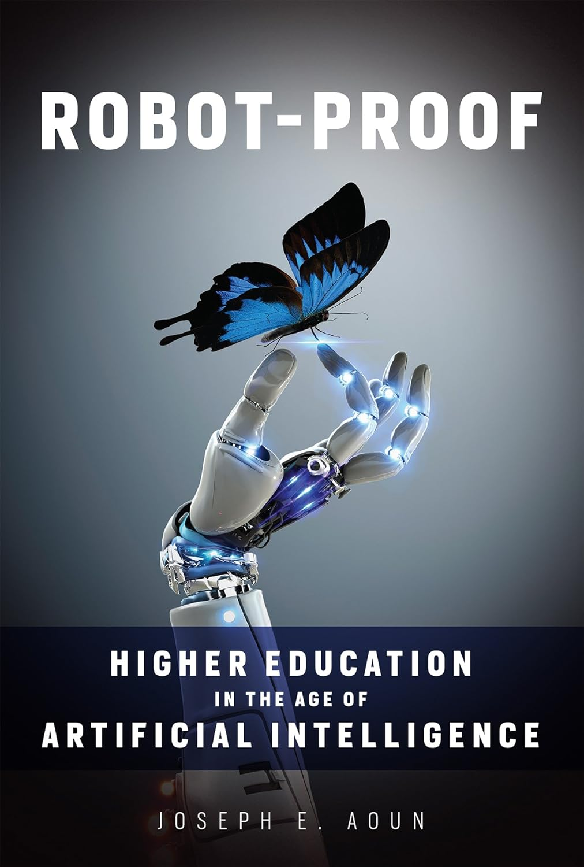

Towards a “Robot-Proof” Graduate
Years Before AI Took Center Stage, Joseph Aoun Sketched the Playbook
Humanics Curriculum
Integrate tech, data, and human literacies across the curriculum
Prioritize cultivating literacies and competencies over content delivery
Increase interdisciplinary, applied, project-based learning in classroom
Experiential Learning
Connect classroom learning with practical, real-world experiences
Expand co-ops and internships, recognize co-curriculars as learning
Provide a secondary transcript to document applied learning
Lifelong Learning Mindset
2017
Offer reskilling to help grads thrive amid ongoing tech changes
Support alumni with lifelong access to learning and career services
Instead of educating college students for jobs that are about to disappear under the rising tide of technology, twenty-first-century universities should liberate them from outdated career models and give them ownership of their own futures.”
Source: Joseph E. Aoun, Robot-Proof; EAB interviews and analysis.
Notes:
As for what higher ed’s visions should be in, say, 2030, we can go back to Joseph Aoun’s book Robot Proof, which he wrote in 2017.
If you aren’t familiar, Aoun was the president at Northeastern University—a school that has certainly punched above its weight and been at the forefront especially in terms of education-work integration.
In his book, Aoun suggests three pillars of where higher ed should focus.
First, we need to shift toward what he calls a humanics curriculum which integrates tech, data, and human literacies across the curriculum. Now some of this is reframing, it doesn’t mean that every faculty member at Northeastern has turned over and undone all their curriculum. They had to go through slow and painful reform just like you have to. But this is helpful reframing of the kinds of literacies you need to equip students with and to organize the curriculum around.
Second is experiential learning, which is a buzzword and not differentiated anymore. But employers increasingly value students that show applied, relevant, real-world learning and application. We’re seeing more schools already investing in things like curricular or co-curricular transcripts that capture some of these things that aren’t just grades.
Third, the idea of unbundling the four-year bachelor’s degree and spreading learning over time. The four-year model was built around a traditional industrial model that is very different from the work life that Gen Zs and Gen Alphas will face.
Supplemental Notes:
In 2024, Joseph Aoun published a second edition of Robot-Proof to focus specifically on AI, while the first edition focused on machines and automation more broadly. However, his main arguments haven’t changed.
We created a short podcast summary of Robot Proof using NotebookLM here: https://eab.app.box.com/file/1998612938085.
Humanics curriculum:
Tech literacy: Not just learning how to use AI tools but how they operate, how they’re used across industries, and how algorithms work. Since coding is AI’s language, Aoun argues it’s important for students to learn basic coding to effectively communicate with AI systems.
Data literacy: The ability to discern between truth and hallucinations, between human-made and AI-generated outputs, and the ability to interpret data insightfully and explaining their “why.” This is a change from the first edition which only focused on data interpretation.
Human literacy: Mastering nine distinct skills that AI can’t replicate. He groups these skills into three categories: core, catalytic, and creative
Core capacities: critical thinking, problem-solving, communication and collaboration, and cultural agility
Catalytic capacities/divergent thinking: initiative and self-reliance, comfort with risk, and flexibility and adaptability.
Creative capacities: opportunity recognition (seeing problems as opportunities to create solutions), creative innovation, and future orientation
Note: These nine capacities are from the 2024 edition. In the 2017 edition, Aoun only mentions four key capacities: systems thinking, cultural agility, entrepreneurship, and critical thinking.
How do you teach humanics?
Aoun argues that most curricula and pedagogy still overly focus on filling students’ minds with information when we should be focusing on cultivating competencies and skills.
Humanics requires expanding our pedagogical toolbox and integrating these literacies through innovative, interdisciplinary approaches rather than teaching them in silos.
For example, instead of only teaching tech literacy in computer science courses, universities can integrate tech and human skills in a coastal sustainability course where students use urban planning data to solve key sustainability problems.
Courses should focus less on lectures and more on project-based, applied learning.
Example of humanics at Northeastern: Combined Majors – interdisciplinary programs that combine two disciplines and courses (Like a CS + X). However, the combined majors don’t always guarantee that students will learn all three literacies. For example, a student could choose a combined major in Art and Sociology which may not equip them with key tech literacies.
Experiential learning:
Aoun defines experiential learning as any learning outside the classroom, including co-ops and internships, co-curriculars, and research.
Experiential learning makes students robot-proof by immersing them in real-world contexts that exercise judgement, common sense, and sensory awareness, all of which AI struggles with. Experiential learning also builds “muscle memory” in human qualities like initiative, adaptability, and cultural agility.
Experiential learning at Northeastern: 96% of students that participated in a co-op get a job or are in grad school within 9 months of graduating, 58% are offered a job from a co-op employer.
Secondary transcript: Northeastern used to have an app called SAIL that documented experiential learning, but it doesn’t exist anymore. However, more institutions are beginning to offer secondary transcripts. Brandeis is the most recent example – grads will have a second transcript that documents microcredentials and applied learning as part of their reinventing the liberal arts initiative. See here: https://www.brandeis.edu/plan/second-transcript.html
Lifelong Learning Mindset: The bachelor’s degree or a graduate degree is not the end of a person’s education. As AI continues to transform work, workers will need to keep reskilling and upskilling, requiring institutions to become an engine for continuous learning. What institutions need to do:
Serve both those who are long on time but short on experiences (i.e., recent graduates) and those who are short on time but long on experiences (i.e., seasoned professionals).
Cultivate a growth mindset among undergraduate students and teach them the importance of continuous learning.
To make sure alumni come back to their alma mater when they need to upskill/reskill, universities should redefine alumni relationships from transactional (e.g., seeking donations) to more nurturing and supportive (e.g., giving them access to career services, tuition discounts).
What lifelong learning should look like:
Personalized based on employer and student needs – offerings must be industry-relevant. Employers should have input on curricula.
Accessibility – ensuring alumni and lifelong learners can access programs from different locations. Either through online/hybrid models or multiple campuses.
There are some 2025 realities that may make a robot-proof education model more challenging to adopt.
Humanics: Interdisciplinary models are difficult to launch and scale. Many institutions encounter challenges like unclear market demand, departmental silos, misaligned faculty incentives, and high curricular development costs.
Internships: In our research we found that employers now place more weight on internships and co-op experience than research and co-curriculars. Also, employers prefer internship experiences in a relevant industry and not just any internship experience. We also predict that internships will become scarcer as employers increasingly use AI to automate routine tasks, which typically interns would perform.
Lifelong learning: Upskilling needs are evolving faster than ever, and institutions may not be able to keep up. Additionally, a saturated credentials market can make it harder for universities to stand out.

Slide 25



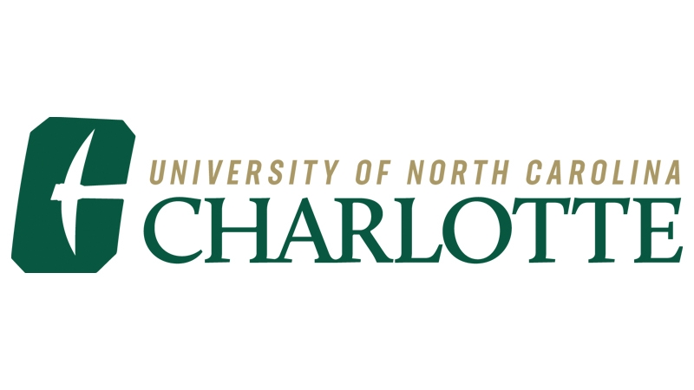



Multiple Ways to Get Started
GenAI Success Doesn’t Require Becoming an AI University
GenAI Petting Zoos
Wesleyan hosts an event for students to experiment with different tools
“Plug and Play” Module
UNT’s PCO unit built GenAI learning modules faculty can easily integrate into courses
B.S., AI in Business
ASU offers a major that teaches applications of AI in specific business contexts
Individual Initiatives
New Curriculum
Large Institutional Investment
Faculty Training
UNC Charlotte holds events where faculty who use GenAI present their practices to their peers
Applied Certificate
Northeastern offers a certificate that teaches students to use AI as a complement to any academic field
Full Integration
University of Florida infuses AI into all curriculum and styles itself an “AI University” preparing society for the fourth industrial revolution
Source: Wesleyan University, Middletown, CT; University of North Texas, Denton, TX; Arizona State University, Tempe, AZ; University of North Carolina at Charlotte, Charlotte, NC; Northeastern University, Boston, MA; The University of Florida, Gainesville, FL; EAB interviews and analysis.
Notes:
DISCUSSION: (let folks respond about how viable these approaches seem at their institutions, any categories that are missing, etc.)
So, we’ve said it’s not too late to act. Many schools have missed opportunities as they tried to wait out the hype cycle, and in the meantime, alternative providers have snapped up some early opportunities. But the good news of multiple hype cycles of GenAI means many more opportunities are yet to come, and there are some ways higher ed is uniquely positioned to add value to students’ learning about GenAI.
The other good news I’d like to add here is that there are many WAYS to get started. For so many institutions, dealing with financial pressures, declining enrollments, legislative interventions, and everything else, it can feel daunting to imagine taking on GenAI too. But grappling with GenAI is not optional – every institution needs to understand and begin to act in this space.
But that does not mean that every institution needs to act in the same way or on the same scale. On this slide, we’ve shared a few examples of ways different institutions are investing in GenAI. On the left, we have types of activities that the PCO unit could implement on its own, like the GenAI Petting Zoos Wesleyan University runs to help students experiment with different tools. Or the training sessions at UNC Charlotte where faculty using GenAI share their practices and tips with their peers.
Other institutions might be more like those in the middle of this graphic – ready to implement GenAI content into curriculum in some way. University of North Texas does this with centrally developed learning modules on GenAI that can be adopted by faculty across the institution. While other institutions are creating full programs on the topic, like Northeastern’s Applied AI Certificate or ASU Online’s degree in AI uses in business.
Very few institutions will want to invest in an institution-wide AI strategy as the University of Florida did. UF’s model is an exciting one and any institution can learn from its practices. But don’t be overwhelmed by the sense that it’s impossible to enter the market unless you can do it at UF’s scale.
DISCUSSION: (let folks respond about how viable these approaches seem at their institutions, any categories that are missing, etc.)

Slide 26

How to Know When to Delegate
Knowing What Is a Human Task and What Is a Delegated Task
Automation: when GenAI can perform a task completely without human intervention
Augmentation: when GenAI works in conjunction with humans to amplify human skills
Tasks Likely to Be Automated
Tasks Likely to Be Augmented
Data Scientist
Data entry and checking
Basic coding tasks
Healthcare Admin
Appointment scheduling
Billing and coding
Data Scientist
Data decision making
Results analysis
Healthcare Admin
Patient care coordination
Regulatory compliance
GenAI Exposure and Automation/Augmentation Potential,
By Estimated Percentage of Tasks
Healthcare Admin
Source: “Jobs of Tomorrow,” World Economic Forum, September 2023; EAB interviews and analysis.
Notes:
As workers learn how to use GenAI, their jobs will change. They’ll delegate tasks to GenAI where it is strong, and continue to complete those tasks themselves where it is not. So some elements of their jobs will go away, some will be enhanced by GenAI, and some won’t change at all. It’s important to keep the nuances of these three possibilities in mind as we anticipate how jobs will change, because often, we think of the impact of GenAI on jobs as all-or-nothing. It’s all about jobs being “taken” by AI. But it’s actually not that simple. And understanding these nuances requires us to think about two ways AI can affect a job – through AUTOMATION (AI doing the task for you) and through AUGMENTATION (the human uses AI to improve or speed up the work).
Let’s look in a little more detail at what these different types of changes mean for a couple of specific job fields. We’ll use the job of a data analyst and the job of a healthcare administrator as examples. These are good examples because they show different types of impact by GenAI, and also because they are both fields you probably have programs in right now – programs whose curriculum you might need to rethink in light of these coming changes to the nature of the work you’re preparing those students for. What’s interesting, as we play out the effects of automation and augmentation on different jobs, is how different those impacts looks in different fields and different roles.
Take a look at the bar graphs along the bottom. First, the role of a Data Scientist, in the top bar. In this role, about 35% of the work will be able to be automated away by AI. This is things like data entry and basic coding. More than half of the job will be augmented by AI – or in other words, more than half the job will now entail the employee working with AI to improve their work. And about 10% of the job won’t be affected by AI – things like presenting to a client, say, are things the human still does on their own.
In contrast, look at the impact of AI on the role of a Healthcare Administrator. About 20% of the role can be automated away by AI – think of things here like billing and coding, or appointment scheduling. Another 30% of the job will be able to be augmented by AI – here, the tools could help the health care administrator get faster and better at sourcing possible treatment plans, or drafting documents for regulatory compliance. But fully half the job of a healthcare administrator is work that AI can’t even help with – supervising staff and interacting directly with patients, for example.
So comparing these two roles, the work of a data scientist post-implementation of AI looks nothing like what it was before AI. Only 10% of the role is unchanged. But the role of a healthcare administrator, while significantly changed, is still about half the same as it was before. And as a result, how much we need to change curriculum in the programs preparing students for these jobs really differs.

Slide 27









Automation and Augmentation in the Real World
Normally, Analytical Tasks Dominate a Financial Analyst’s Workday
But When AI Automates These Tasks, Analysts Take on New Responsibilities
9:00
9:00
Compiles multiple financial statements for analysis
Reviews news for relevant information
11:30
11:30
Shows data to manager who identifies several inconsistencies
Meets with client to discuss financial needs
1:00
1:00
Fixes errors, standardizes data and detects any outliers
AI collects financial statements and automatically conducts analysis
3:00
Identifies best models for analysis
3:00
Develops takeaways from AI analysis
4:30
4:30
Uses SAS to complete calculations
Presents findings to stakeholders
Source: EAB interviews and analysis.
Notes:
Let’s make this kind of impact even more concrete with a bit of a day-in-the-life for one type of worker. Here, we’ve illustrated what the job of a financial analyst might look like today, and then what their day might look like after they’ve implemented GenAI to automate or augment parts of their work.
On the left, the typical day of a financial analyst before GenAI. Most of the day was spent at a desk in Excel and coding platforms. They were deep in the data, actually conducting the analysis and fixing data problems. Now, GenAI can do a lot of that (and soon, it will be able to do even more as the technology advances). So as firms implement these tools, the financial analyst’s job becomes more like the day on the right. GenAI will take most of that analysis off their plates, freeing up their time to interact with clients, work with their team on setting strategy, and present to stakeholders.
So again, we have to ask the question of curriculum. A program today preparing students to be financial analysts is likely very heavy on data skills, software skills, analytical skills, and that prepares students well for what these jobs have looked like to date. But does that program prepare students for the job on the right? Are they spending time learning public speaking, client interactions, strategic planning, and other business skills that are suddenly taking up most of their day?

Slide 28
Critical Question
How will GenAI automation and augmentation impact the skills in my discipline?
Notes:
Given all these changes, let’s end with what we can do to prepare students for the future of work.

Slide 29
Some Fields Need New Skills, Others New Tech
AI Exposure and AI Complementarity Scores for Select Fields
Some Augmentation Potential
Changes from Augmentation Only
Changes from Automation and Augmentation
No Automation Potential
AI Exposure: How relevant GenAI will be to the work of a particular field
AI Complementarity: The degree to which AI will augment rather than automate tasks
Source: Pizzinelli, C., Panton, A., Tavares, M., Cazzaniga, M., & Li, L., “Labor Market Exposure to AI: Cross-Country Differences and Distributional Implications,” IMF, October 26, 2023; Felten, E., Raj, M., & Seamans, R., “Occupational, industry, and geographic exposure to artificial intelligence: A novel dataset and its potential uses,” Strategic Management Journal, April 28, 2021; Eloundou et al., “GPTs are GPTs: An Early Look at the Labor Market Impact Potential of Large Language Models,” arXiv, March 17, 2023; EAB interviews and analysis.
Notes:
So there are lots of things to consider about how we should change our curricula to prepare students for jobs changed by AI. But all those things also beg the question: how we are going to get all that done? And so we need to prioritize. We can’t revise every program at once, so how can you decide which programs urgently need revision, and which can wait longer? That’s what we’ll dig into here.
There’s a lot going on on this slide, so let me take a minute to walk you through what you’re seeing here and go through some definitions. In this 2x2 matrix, we’ve plotted the likely impact of GenAI on a variety of fields. Using data from the International Monetary Fund, we have plotted how these fields will be affected along two axes.
Let’s start with defining those axes.
First, along the horizontal, we map level of AI exposure for this field. This concept measures how relevant GenAI is to the work of that field (for example, it’s much more relevant to the field of healthcare administration than it is to the field of childcare). GenAI is less relevant to the work of fields plotted further to the left, more relevant as you move toward the right.
But examining AI exposure is not enough information to understand HOW a field will be affected by GenAI, so we also have the vertical axis here representing what’s called AI complementarity. AI complementarity tells us whether the things AI can do with regard to a particular role are mostly automation, or mostly augmentation, or a mix of both. Fields plotted toward the bottom of the vertical are more likely to experience some degree automation, while those plotted toward the top are more likely to experience augmentation.
With these definitions in mind, we can see how the impact on a number of sample fields plays out across four categories of change, represented in quadrants. Starting on bottom left, we have fields that are minimally exposed to GenAI – meaning the work is not really very relevant to the types of tasks GenAI can do – and also low in AI complementarity – meaning there is little in that field to be automated or augmented. Fields in this quadrant, like fine art or acting, are likely to see little impact on their work due to GenAI.
Moving up to the top left quadrant, we see fields that are still not very exposed to GenAI – again, their work just isn’t that relevant to what GenAI can do well – but experiencing a higher level of complementarity. These fields may see some peripheral changes in their work as GenAI can provide some augmentation to increase efficiency or enhance the quality of some output.
On the top right, we see roles that are highly exposed to AI and experience high levels of complementarity. Fields in this category, like speech pathology, will see GenAI help them in their work but won’t see GenAI automate many tasks that are core to the role.
And finally, on the bottom right, we see fields that are highly exposed to AI, their work very relevant to the tasks AI can do, but not as complementary. This means that these fields, like roles in finance and insurance, are very likely to see the core skills for their field change due to GenAI, with a mix of both automated and augmented tasks.

Slide 30
How to Prioritize GenAI Investments
Some Augmentation Potential
Changes from Augmentation Only
Peripheral Opportunity for Use
Supporting Skills Exposed
Teach students how GenAI can support administrative tasks
E.g., for physical therapy, use GenAI to help with patient scheduling; key therapy practices won’t change
Teach students how GenAI could support tangential responsibilities
E.g., for speech pathology, GenAI can help design treatment plans; key treatment methods won’t change
Investment Priority
No Automation Potential
Changes from Automation and Augmentation
Little to No Opportunity for Use
Core Skills Exposed
Teach GenAI basics like email editing; few field-specific¹ uses available
E.g., for acting, using GenAI to
find auditions
Teach students how to use field-specific GenAI tools while spending more time on human tasks
E.g., for finance, more time communicating briefings, engaging clients, etc.
Uses for GenAI where the tech will be able to automate or augment a task that is, at least in some way, unique to the work of that field
Source: Pizzinelli, C., Panton, A., Tavares, M., Cazzaniga, M., & Li, L., “Labor Market Exposure to AI: Cross-Country Differences and Distributional Implications,” IMF, October 26, 2023; Felten, E., Raj, M., & Seamans, R., “Occupational, industry, and geographic exposure to artificial intelligence: A novel dataset and its potential uses,” Strategic Management Journal, April 28, 2021; Eloundou et al., “GPTs are GPTs: An Early Look at the Labor Market Impact Potential of Large Language Models,” arXiv, March 17, 2023; EAB interviews and analysis.
Notes:
So, that’s all very interesting, but what does it mean for what you should DO as an academic leader? What do these changes imply for the programs and curriculum you need to offer in relation to these changing fields? We’ve laid that out on this slide, with specific actions to take for fields in each of the four quadrants we just discussed.
Before we look at those implications, I need to throw one other definition at you. The difference between field-specific uses and general uses for GenAI. Field-specific uses for GenAI are cases where GenAI will be able to automate or augment a task that is, at least in some way, unique to the work of that field. So, for a radiologist, for example, that would mean that GenAI would help them analyze X-ray results. A non-field specific use would be using GenAI to help edit an email. That is something everyone in every field will use GenAI to do.
Now if we look at roles in the bottom right quadrant, the core skills of the profession are exposed to GenAI – some of them may be automated and some augmented, but either way, knowing how to use GenAI will be crucial for field-specific tasks in this category. We recommend that PCO units prioritize investment in these fields because everyone in the field will need to learn new skills. This will include both learning GenAI skills, and learning skills for new tasks that can be added to their plates once GenAI frees up some of their time. Think back to the finance example we looked at earlier. Financial analysts had to learn to use GenAI in field-specific ways, such as knowing how to use it to analyze financial data. But they also started to spend their time on much more client interaction, and needed to learn additional communication skills to do so.
For those on the top right, supporting skills will be exposed. The speech pathology example is a helpful one here. In that role, GenAI will be helpful in making treatment plans and might save some time for professionals, but it won’t really transform the role. And these tasks will be easy to learn – workers likely just need a basic training in GenAI use and ethics and that is all. So these fields are a lower priority for PCO units to revise curriculum.
For the fields on the top left, GenAI will have some field-specific applications, but not many – for example, in early childhood education, teachers may use a GenAI tool that links to past curriculum plans to assist in curriculum development. Again, curriculum revision in these fields would be a lower priority, as basic uses of these tools can be gained with simple training available through alternative providers or a company’s L&D office.
And fields on the bottom left, there is the least applicability of GenAI and thus the lowest priority for any curriculum changes.

Slide 31
A Different Story in Each Discipline
Faculty Must Determine Where Their Discipline Lands on the Grid
AI Impact on Disciplines vis-à-vis How Much Curricula vs. Pedagogy Must Evolve
Computer Science
Business
Marketing
Graphic Design
Machine learning rapidly becoming a core skill
Communication
Medicine
AI automation knowledge necessary for grads entering workforce
Biology
Philosophy
How much what we teach will change
New assignment design needed to address AI impact on academic integrity
Law
Social Work
English Composition
Forestry
History
English Literature
Foreign Languages
How much how we teach will change
Source: EAB interviews and analysis.
Notes:
Now, pivoting back to higher ed. Defining AI skills will ultimately vary by discipline, and will ultimately be up to the faculty. We need to determine how much curriculum—what we teach—needs to change, and how much pedagogy—how we teach—needs to change. That will vary from one discipline to the next.
Here, we wanted to capture those changes in a conceptual graphic. Let me orient you to the axes and then talk through a few disciplines. With a nod to similar graphics created by organizations like the IMF, this focuses on faculty-specific questions. On the x-axis, how much how we teach needs to change in response to AI. From low on the left to high on the right. On the y-axis, how much what we teach needs to change, again from low in the bottom left to high as you move up. With various disciplines landing at different points on the graph.
[Click to animate: computer science callout.] For example, in a field like computer science, we’d expect a lot of change to what needs to be taught. Machine learning and AI are shifting from futuristic trends to core skill areas within the field. Programs will likely want to adopt more curriculum focused on AI development.
[Click to animate: English Lit callout.] In a field like English Lit, it’s really the pedagogy we’ll expect to change a great deal. If AI can complete a traditional assignment for you—we need new paradigms for how to demonstrate true learning.
[Click to animate: Comms callout.] In a field like Communication? It’s both. Workers in the field will need to know how to use AI tools to automate simple tasks. So faculty would likely want to assign work where students replicate this kind of automation; all the while, teaching students how and why it works.
This chart isn’t quantitative (though it does roughly echo the IMF’s analysis of how jobs will change with AI) and isn’t meant to be definitive. You and your faculty might plot them differently. In fact, you should. This is faculty’s domain. The point is understanding and distinguishing between these two axes of curricula and pedagogy.

Slide 32
Critical Question
In my discipline, do we need to change what we teach, how we teach, or both?
Notes:
Given all these changes, let’s end with what we can do to prepare students for the future of work.

Slide 33
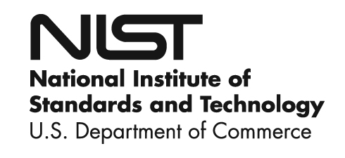

Experts Through Experience
Experiential Learning Allows Students to Uncover New Applications of GenAI
Lower Lift
Higher Lift
Explore New Use Cases Through Classroom Assignments
Encourage Innovation Through Extracurricular Competition
Identified specific projects where students would use GenAI
Required students to use GenAI to automate away part of their future job
Asked students to reflect on how GenAI would impact their field (examples include use in HR and marketing)
Hosts challenges where students of all disciplines tackle core societal issues, utilizing GenAI within their solutions
Current challenges focus on autonomous wildfire detection, school safety, and mental health monitoring
Fortune 100 companies use xFoundry as a pipeline to hire graduates with GenAI experience
>85
Students involved within the program’s first year
“[Students] became experts in using AI for their field…they also tended to think that the leaders of the organizations they were joining did not yet see the full significance of AI.”
Students learn from tech leaders at organizations such as:
—Ethan Mollick, Professor, Wharton School of Business
Source: xFoundry; Mollick, E., “Strategies for an Accelerating Future,” One Useful Thing, February 2024; EAB interviews and analysis.
Notes:
Even once you’ve made some decisions about which programs you are going to revise most urgently, you probably have some questions left. How do you engage an already overburdened institution and faculty in this work? How do you ensure that what you build is not immediately out of date in this rapidly changing space? So let’s spend the last bit of our time together talking about agile, lighter-lift ways to build GenAI into curriculum.
On the left, an approach used by Ethan Mollick, a GenAI expert from Wharton. (By the way, if you don’t know Mollick’s work, you should! Check out his blog “One Useful Thing.”) Mollick gives his students an assignment to figure out how GenAI can automate away a part of their future jobs. In completing this project, Mollick’s students have found all sorts of new applications for GenAI in fields like HR and finance. As you can see in the quote on the bottom, students typically realize that GenAI will be much more impactful for their fields than they initially imagined. And to conduct this project, Mollick doesn’t have to have all the answers or build a bunch of new curriculum – he just needed to create the problem and let the students loose. He can learn along with them.
On the right, an example of teaching these skills through a cocurricular innovation challenge. Xfoundry is a company that partners with University of Maryland to hold competitions for students to engage in experiential learning and solve real world problems with GenAI. For example, this year students are working on a project to use GenAI to improve school safety outcomes, and next year, they will be working on using GenAI to improve student mental health. In the past, they have worked on projects that use GenAI to detect wildfires and to improve nutrition literacy for low-income populations. They have engaged more than 85 students in their challenges so far and told us that they have seen a lot of interest from employers and students in this work. Starting this fall, they are hosting a larger competition where some students will “win,” and then pitch their work to companies. Now, this is a higher lift, but what’s key here is that it enables your students to begin exploring these tools in meaningful, very applied ways without having to wait on your faculty to reskill or your curriculum to be updated.

Slide 34


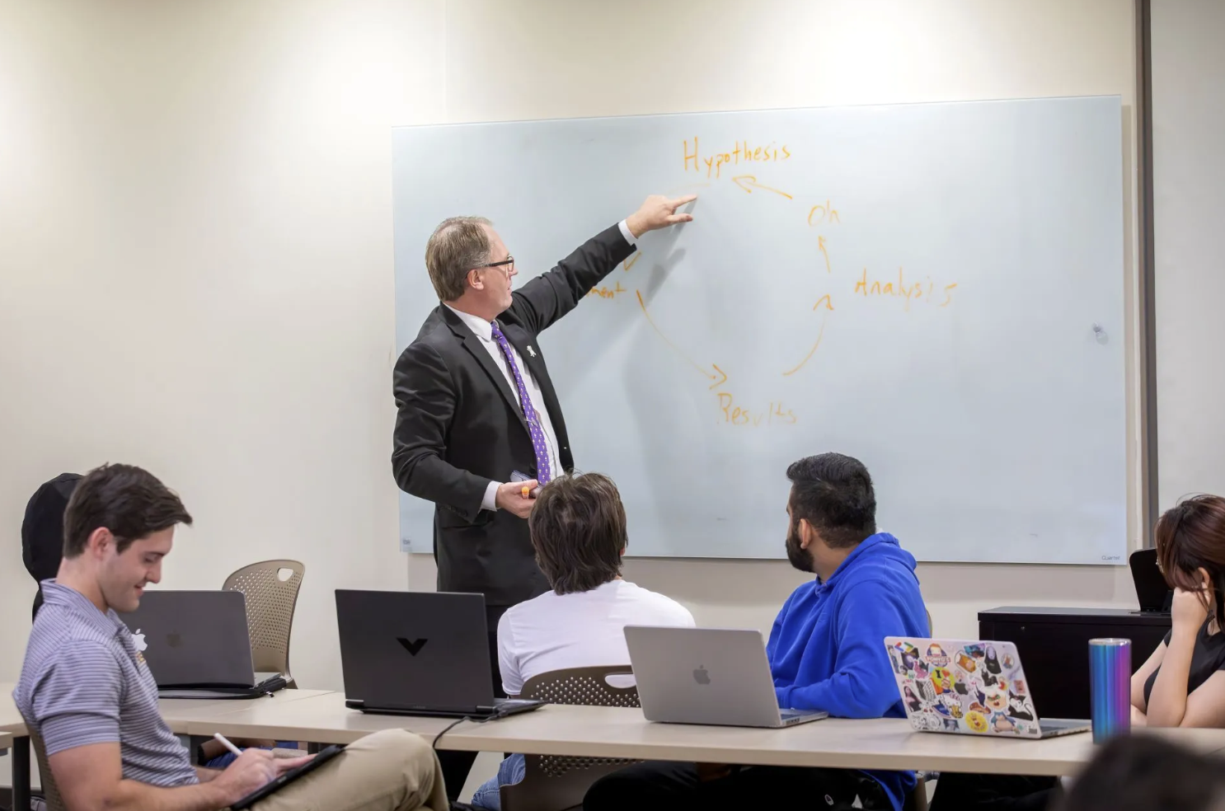


Invite Employers to Class
Honors 3035: Large Language Model Development and Deployment for Real-World Applications
Course Teaches Students Key Skills for GenAI Future
Project-Based
Consists of multiple projects, some provided directly from companies
Taught by both practitioners and faculty
Team-Based
Students are split into teams, reinforcing the communication skills needed in the GenAI economy
Local Economy Focus Projects tackle problems relevant to local employers
Deep GenAI Familiarity
With little technical background, students learn how to manipulate LLMs to achieve desired goals
Louisiana State University.
Graduates Prepared to Shape GenAI Uptake
Course completers have gone on to work at companies such as:
20-30 students from a range of disciplines
Source: Louisiana State University, Baton Rouge, LA; 2024: an AI Odyssey- LSU Integrates Artificial Intelligence Into 40 Spring Courses, Nov 8, 2023; EAB interviews and analysis.
Notes:
Here’s another light-lift approach to adding GenAI content into curriculum.
LSU’s provost developed an honors course which brings students from different disciplines into a project-based environment where they work in teams to solve problems with GenAI. They source these problems from employers, and even invite the employers into class as guest speakers.
The class has been extremely successful in early iterations – there is a waitlist for employers who want to be involved, and students who completed the class have gone on to work at places like SpaceX and Microsoft in GenAI-specific roles. One of the students was hired for a GenAI role that normally would have required 8+ years of experience, but the employer looked at the syllabus of the LSU course and decided that the student had enough experience to forego that requirement.
And again, I want to emphasize – this course of course requires a lift in terms of finding and coordinating with employers, and it’s not scalable to large numbers of classes, but it does provide a way to engage students with advanced thinking and experiences on this topic before faculty are up to speed or curriculum is fully revised. It allows faculty to learn this field alongside their students.

Slide 35





Faculty as the Fulcrum
Curriculum Design
Pedagogy
Embed AI fluency into disciplinary content
Keep syllabi current with evolving tools, industries, and employer needs
Balance AI/tech fluency with distinctly human differentiators in every course
Mirror workplace ambiguity in projects
Design activities and assignments where AI is a co-worker
Incorporate relational intelligence practices in the classroom
Professional AI Use
Employer & Career Integration
Use AI transparently in teaching prep and grading
Narrate AI-related judgement and risk management
Demonstrate professional norms for responsible AI use
18 Future-Ready Faculty Success Behaviors
Stay current on discipline-specific career pathways
Build ongoing feedback loops with employers and alumni
Ensure capstones and assignments include external validation
Assessment
Continuous Learning
Grade the process, not just the final product
Equip students with verifiable evidence of career readiness
Assess relational and professional skills with the same weight as technical ability
Engage in continuous reskilling cycles
Collaborate with colleagues across disciplines on innovative approaches
Contribute to institution-wide efforts by sharing AI lessons and failures
Source: EAB interviews and analysis.
Notes:
We’ve talked about our vision for higher ed’s role in preparing students for the future of work. Let’s end with a practical slide.
Here, we’ve outlined 18 behaviors that faculty can demonstrate next term to start building and integrating some of these concepts into their courses—from relationship development to skills articulation and assessment to pedagogical changes.
And an important part of this is getting up to speed with AI themselves, which is difficult to do considering how fast AI is changing. One training is not going to be enough. A more meaningful approach would be to encourage faculty to spend 30 minutes a day or a couple hours a week experimenting with AI tools to stay updated on these new literacies.
Overall, AI is going to continue to change labor market trends and we’ve got to stay on top of this, going back to our faculty and nudging them to think more broadly about what their graduates will step into and how they can best support them.

Slide 36
From Conversation to Change
Questions to Answer on GenAI in the Curriculum
Are the skills taught in my discipline going to be automated or augmented by Gen AI?
Do we need to change what we teach, how we teach, or both?
What curricula or content might we need to update given that possible impact of GenAI?
What can each of us do—regardless of our role—to help Texas State have continued success in an AI-transformed economy?
Notes:
.

Slide 37
Your GenAI Integration Cheat Sheets
Resources for Teaching with AI
Libraries of Ready-Made AI Assignments
Resources for Designing “AI-Resistant” Assignments
AI Pedagogy Project Assignments (MetaLAB (at) Harvard):
Growing collection of AI assignments from instructors around the world
Generative AI-Resistant Assignments
(University of Central Florida):
Instructions for how to design assignments that make cheating with GenAI more difficult
AI Assignment Library
(University of North Dakota):
Collection of AI assignments built by expert UND faculty
Designing Assignments to Limit AI Usage
(North Carolina State University):
Library of instructions and workshops for how to design projects with GenAI in mind
TextGenEd
(WAC¹ Clearinghouse):
Peer-reviewed library of faculty-submitted assignments designed to promote AI literacy
AI Assessment Scale GPT (ChatGPT)
(Furze Smith Consulting):
Chatbot designed to help instructors
build assignments with varying levels of
AI integration
ChatGPT Assignments to Use in Your Classroom Today
(University of Central Florida):
Book of 60 practical uses for AI in learning, with pre-written prompts to assist with each use case
AI Writing Instructional Designer (ChatGPT)
(Abram Anders):
Chatbot designed to help writing teachers integrate AI into their assignments
Writing Across the Curriculum.
Source: EAB interviews and analysis.
Notes:
The tools to support genAI integration don’t stop there. We figured it was most helpful to give you a resource list as a take-home, with links you can click once you receive the slides.
Two categories here: libraries of ready-made assignments and prompts from faculty you can adopt. Tried and tested. Sometimes with commentary on what worked well and what they’d change. These are for your AI-integrated or AI-first assignments.
And resources for designing “AI-resistant” assignments or limiting AI use. Again, real examples from real classrooms. Including a couple that incorporate ChatGPT.
We welcome you to explore these on your own.

