Slide 1




Slide 2

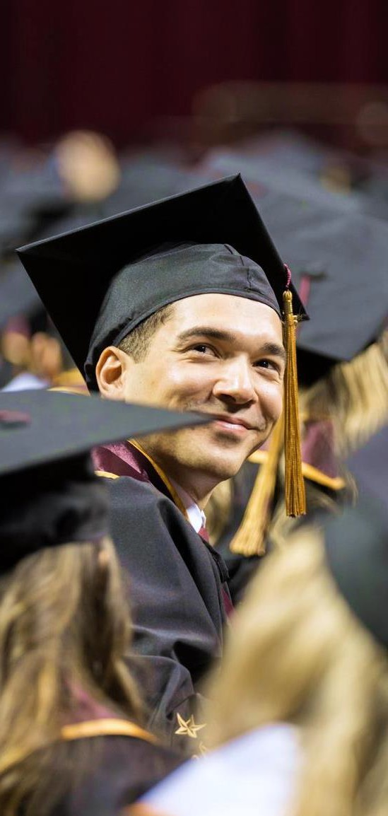
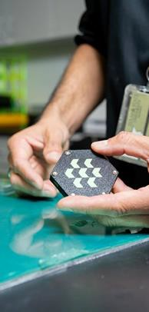

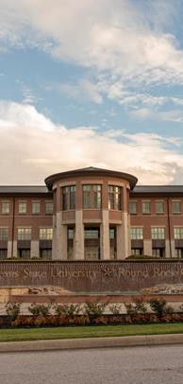
















H O P E S & A S P I R A T I O N S H I G H
Elevate student success
Run to R1
Increase enrollment
Grow the Round Rock Campus
Become an employer of choice

Slide 3



+65%
2,918
2,224
2,083
2,063
students served in two years
1,783
1,813
2.7K+
undergraduate applications for fall 2026
Fall 2020
Fall 2021
Fall 2022
Fall 2023
Fall 2024
Fall 2025

Slide 4
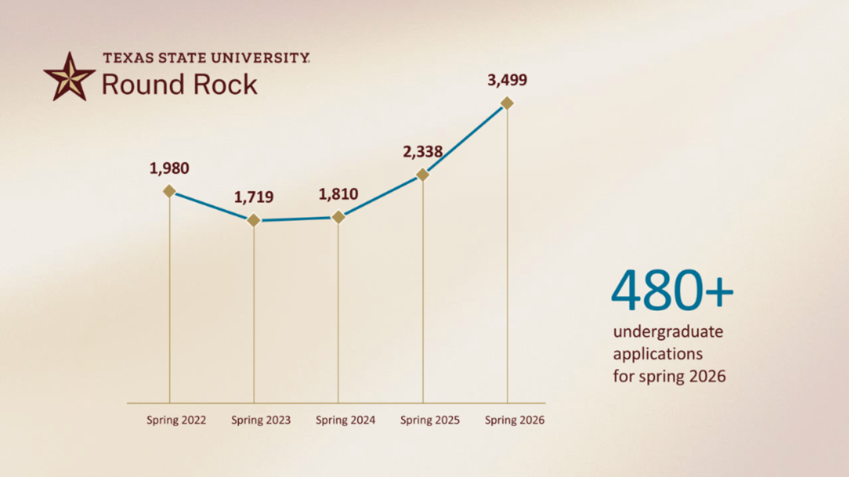

Slide 5


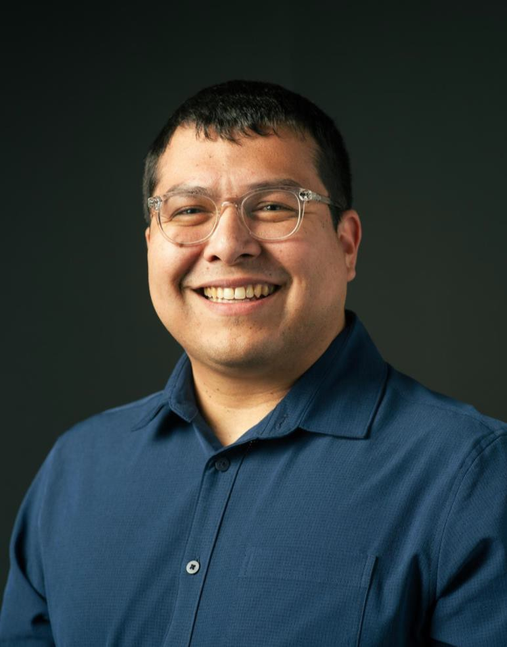
“ No matter the role I’ve been in — from financial aid to administration — I always return to the same question: How can we make their college experience better?
Their success is what inspires me each
day.”
C A T A R I N O J . B E C E R R A J R .
Ad min istra tive Assista nt I I I,
O ff ice of th e Vice President , Rou nd Rock C am pu s

Slide 6


Academic Programs at the RR campus
2 D O C T O R A L P R O G R A M S
11 M A S T E R ’ S P R O G R A M S
20 B A C H E L O R ’ S P R O G R A M S
Enrolling Freshmen and transfer students

Slide 7

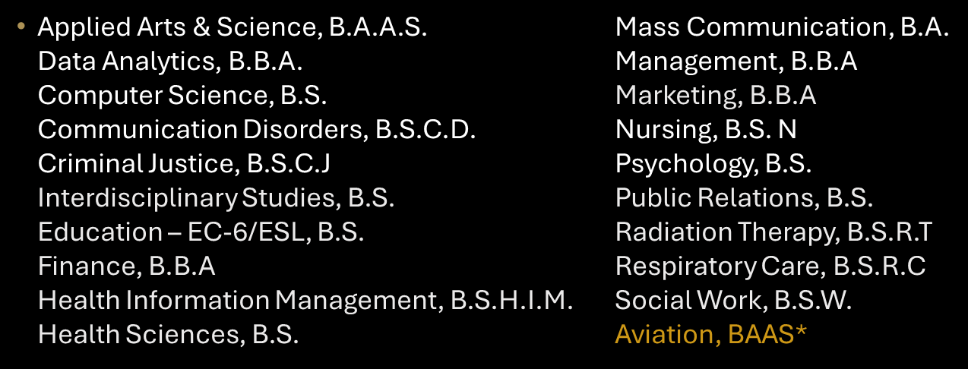
Undergraduate Programs

Slide 8
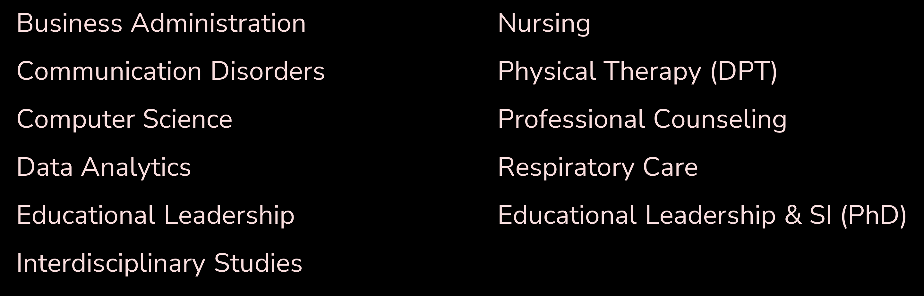
Graduate Programs

Slide 9
Student Success Initiatives
Holistic Student Support
Engagement & The Bobcat Experience
Academic Support Expansion
Strategic partnerships with various divisions/units across TXST to reduce barriers to support
Enhanced opportunities for student veteran support
Hand-raise feature in Navigate will direct students to adequate support
Orientation to TXST Round Rock
Co-curricular programs & community building
Supporting student organization & leadership development
Implementation of Tutoring Services, Success Coaching, Acadeum Support Lab and a new Peer Mentor Program
Academic advising workshops and outreach programs
Early Academic Progress check-ins with Faculty
Health & Wellbeing
Career Readiness & Experiential Learning
Community Impact
Enhanced programming through Student Health Center & Counseling Center
Intramural & group fitness opportunities
Formalized partnerships for shadowing & employment opportunities
Field trips & career events
Service Projects & Volunteerism
Civic Engagement Opportunities
Community Outreach Events – The BIG Event, Trunk or Treat, Wellness Fair, Discover TXST

Slide 10
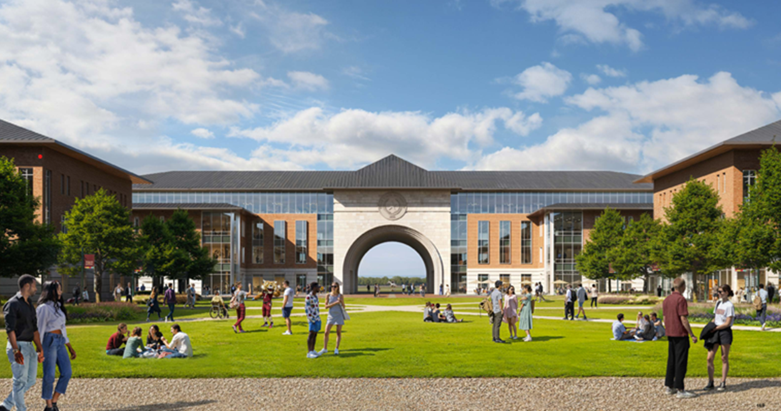
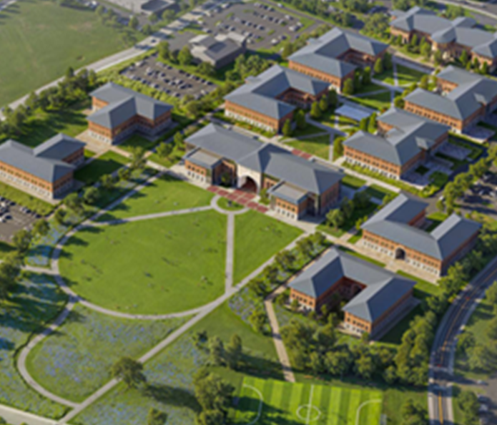
RR Campus
Looking to the future

Slide 11


SAVE THE DATE
State of Texas State Round Rock edition – April 24th

Slide 12


