Slide 1
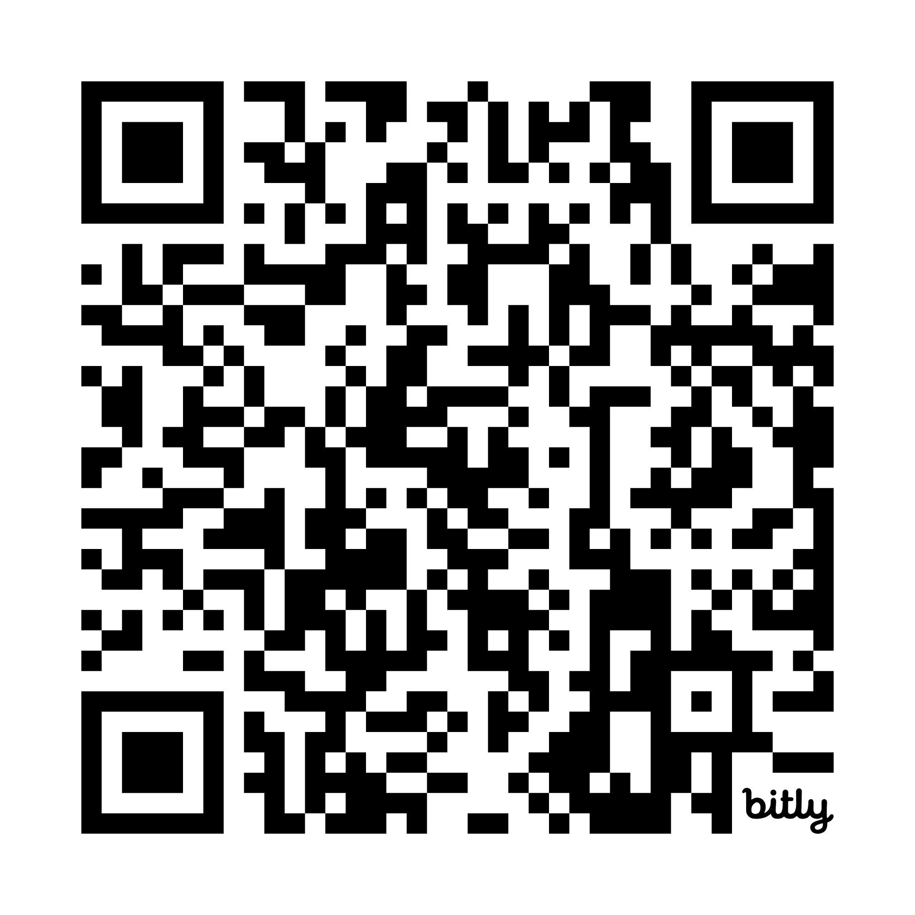
AI for Educators: Streamlining Content with NotebookLM & Canva Magic
Jennifer King, Ed.D.
Assistant Professor of Instruction for the Department of Organization, Workforce, and Leadership Studies
https://bit.ly/NotebookLM_Canva

Slide 2
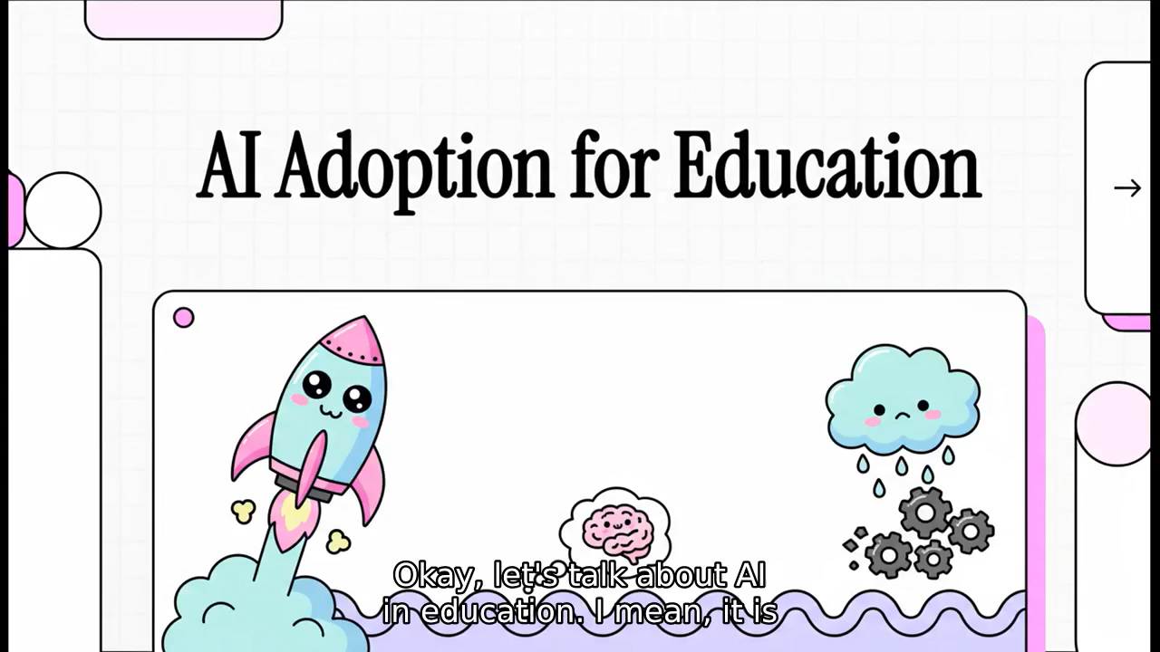
Part 1: NotebookLM
Notes:
Demo what a slideshow looks like from a peer-reviewed article upload. Notebook LM will only give back the information you give it, so there is no hallucinations from this AI tool. You can quickly create flashcards, quizzes, podcasts, video/slideshows, and others.

Slide 3
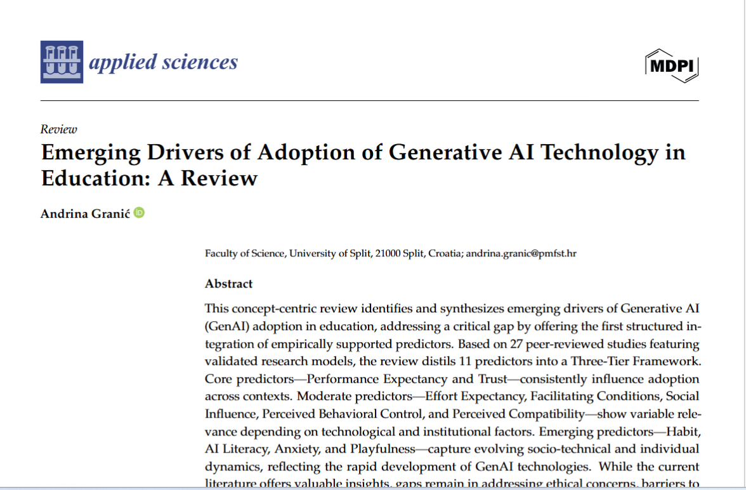
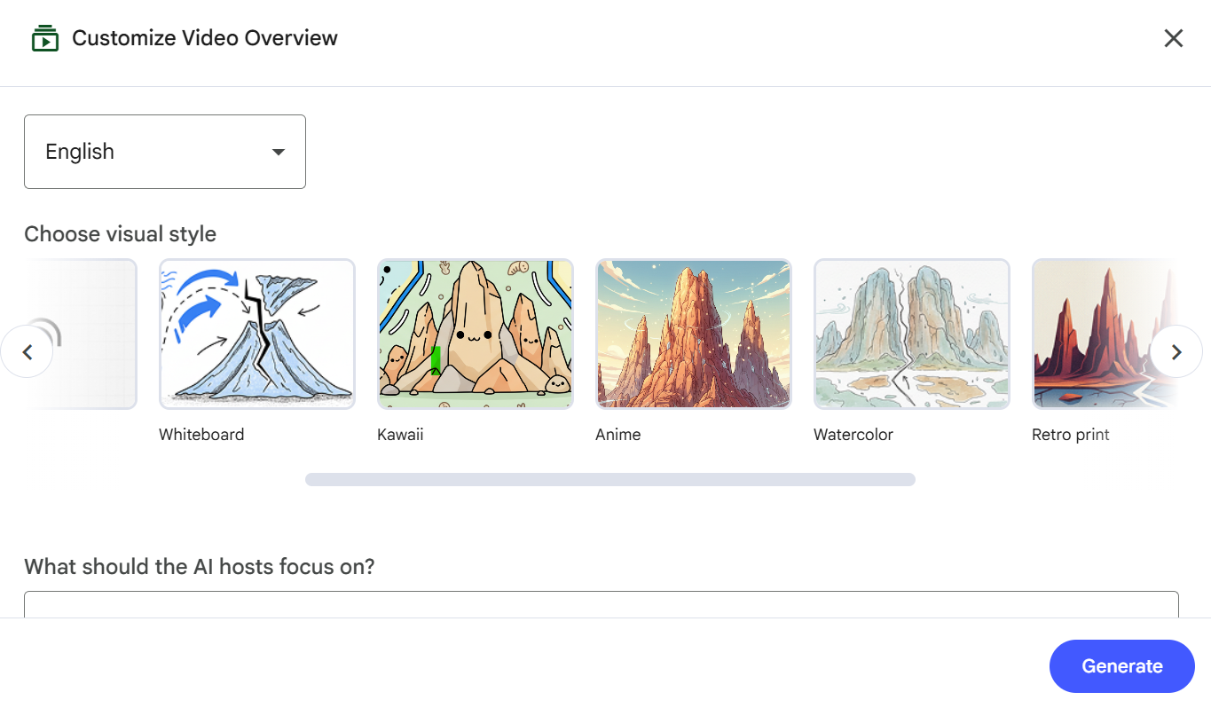
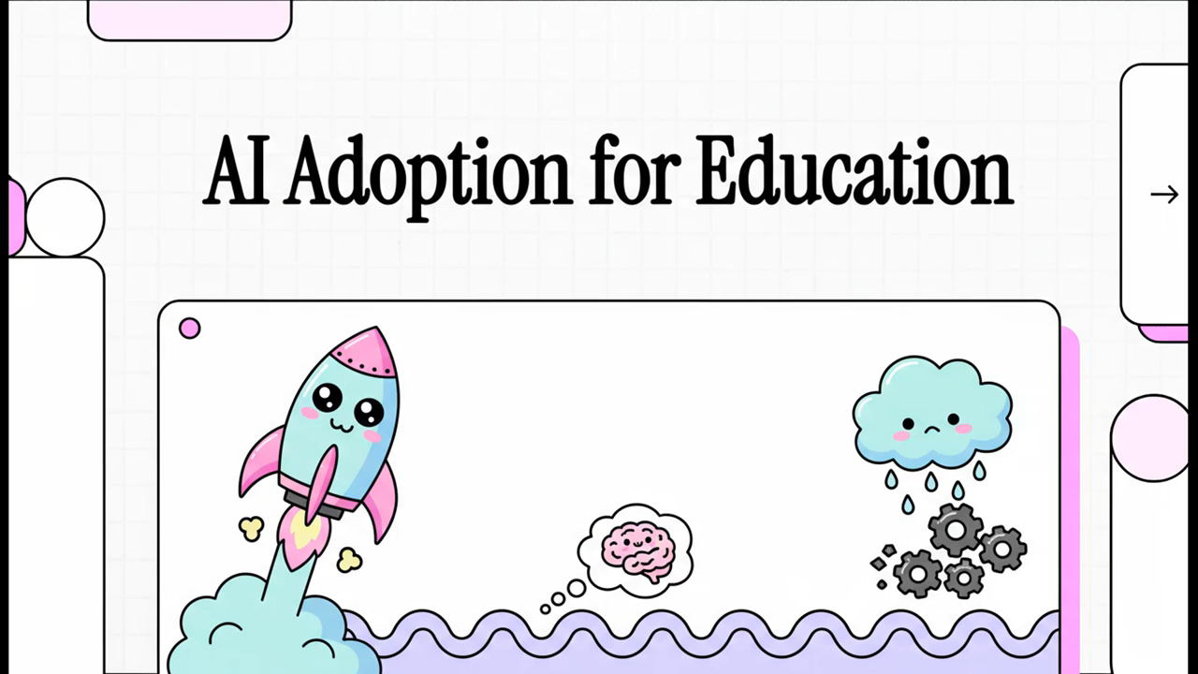
NotebookLM
Demo Guided Practice
📹 Creating a Video with Transcript and Subtitles
1️⃣ Upload a Document
Open NotebookLM.
Upload your source document (PDF, Google Doc, etc.).
Review the generated summary or notes if needed.
2️⃣ Create a Video
Use NotebookLM’s video generation feature (if enabled for your account).
Follow prompts to generate the video based on your uploaded document.

Slide 4
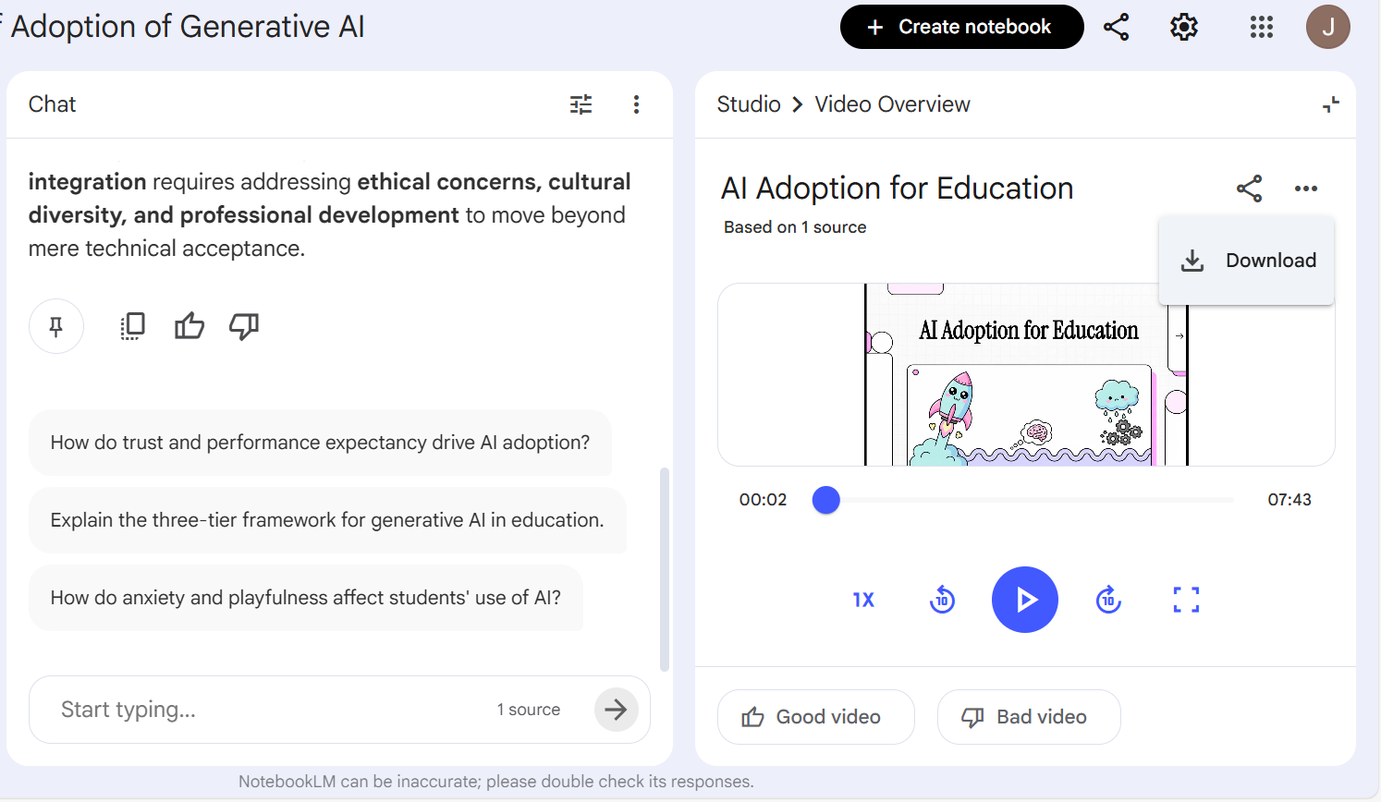
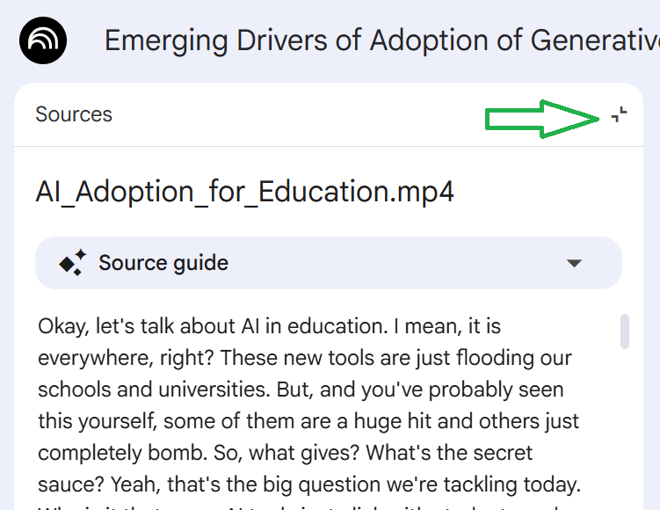
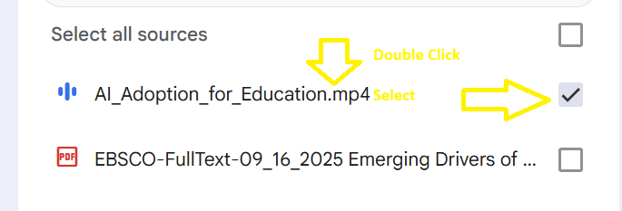
4️⃣ Upload the MP4 Back into NotebookLM
Upload the newly created video file into NotebookLM.
NotebookLM will generate a transcript from the video.
3️⃣ Download as an MP4
Once the video is generated, select Download.
Save the file as an MP4 to your computer.

Slide 5
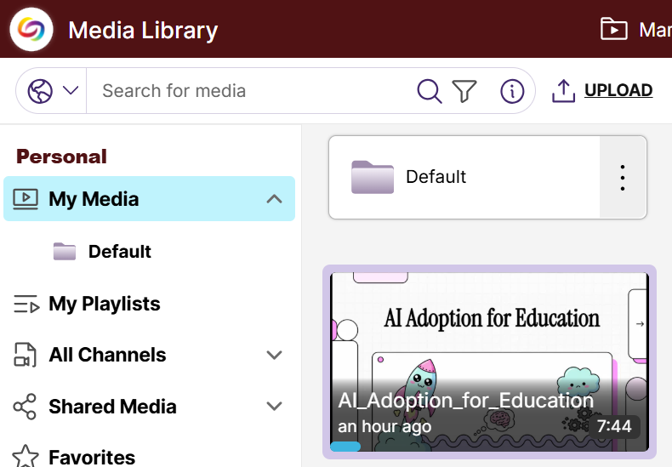
YuJa Video! https://txst.yuja.com/Login
Upload the Video into YuJa for Subtitles
Log into YuJa.
Upload the MP4 file.
Enable auto-captioning to generate subtitles.
Review and edit captions for accuracy.
Publish the captioned version.
Direct Link: https://txst.yuja.com/V/Video?v=15480737&a=63172547

Slide 6
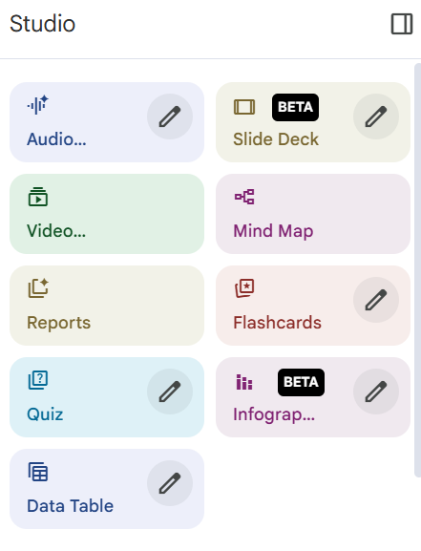
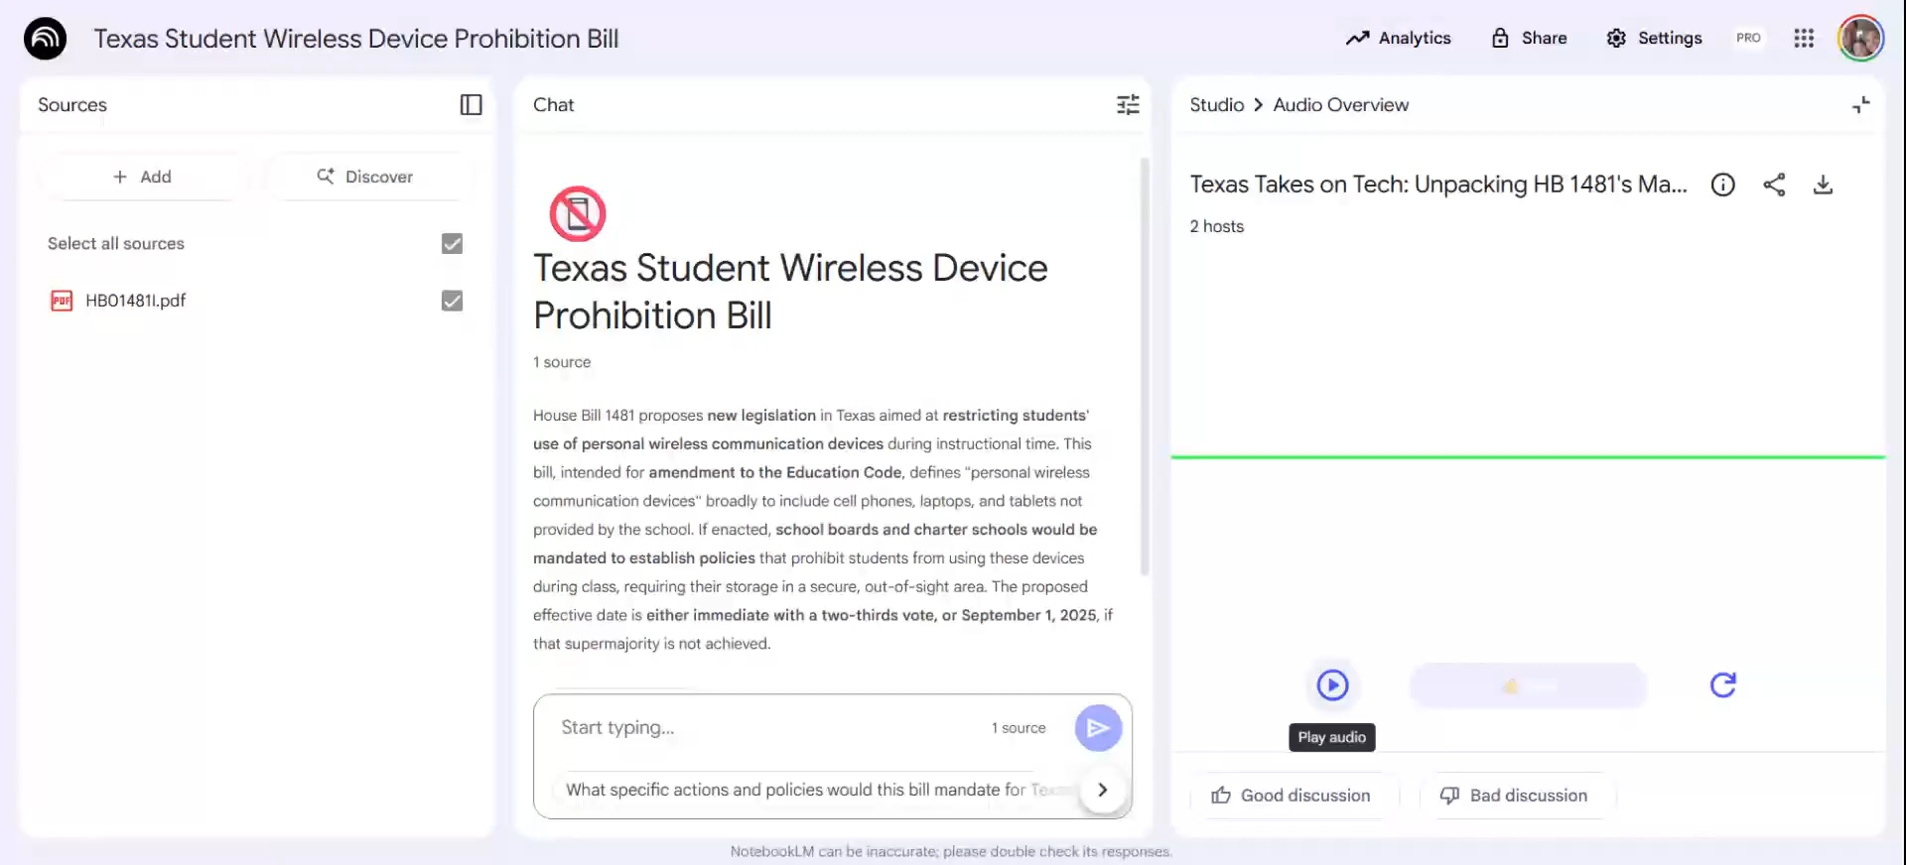
NotebookLM
Possible benefits for instructors and learners:
  Accessibility
  Study Guides
  Multilingual learners
  Faster prep
  Engagement
  Comprehension
  Etc.

Slide 7
Part 2:
Canva AI
“How many of you have spent more than 30 minutes formatting a Canvas page?”

Slide 8
Demo & Guided Creation
1. Demonstrate: Canva AI - Canva
  Magic Design or Magic Write
  Generate a header image for a Canvas page
  Create a simple, clean instructional page visual
  Show before/after comparison
Possible Benefits:
  Reducing cognitive load
  Visual consistency
  Professional polish without design stress (once the original is created)

Slide 9
Canva Ai & TXST
May need to request Canva for Faculty & Staff: https://brand.txst.edu/resources/templates/canva.html
Canva FAQ:
https://brand.txst.edu/resources/templates/canva/faq.html

Slide 10
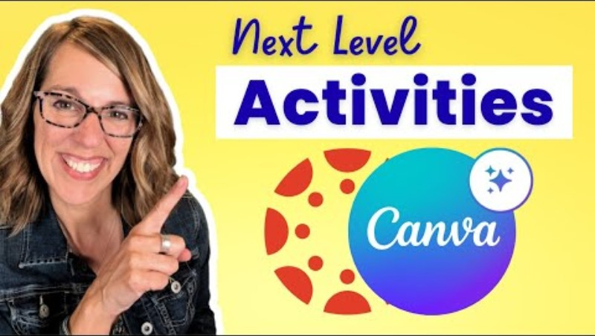
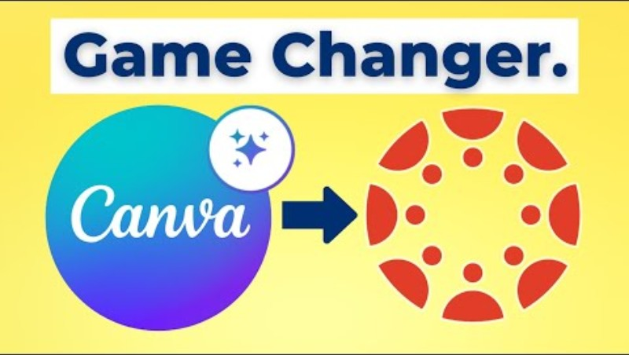
Canva Instructional Videos
✅ Simplify content creation for faculty
✅ Make courses more visually engaging
✅ Enable students to express understanding creatively
✅ Allow assignments and grading to stay within Canvas’ workflow
✅ Support collaboration and digital literacy
Notes:
Canva-Based Assignments
You can design or select a Canva template and assign it to students as:
Editable Canva assignments
Project-based design tasks
Reflective visual assessments

Slide 11
Embed Code
Course banners
Module icons or buttons
Thematic headers
Visual navigation aids

Slide 12

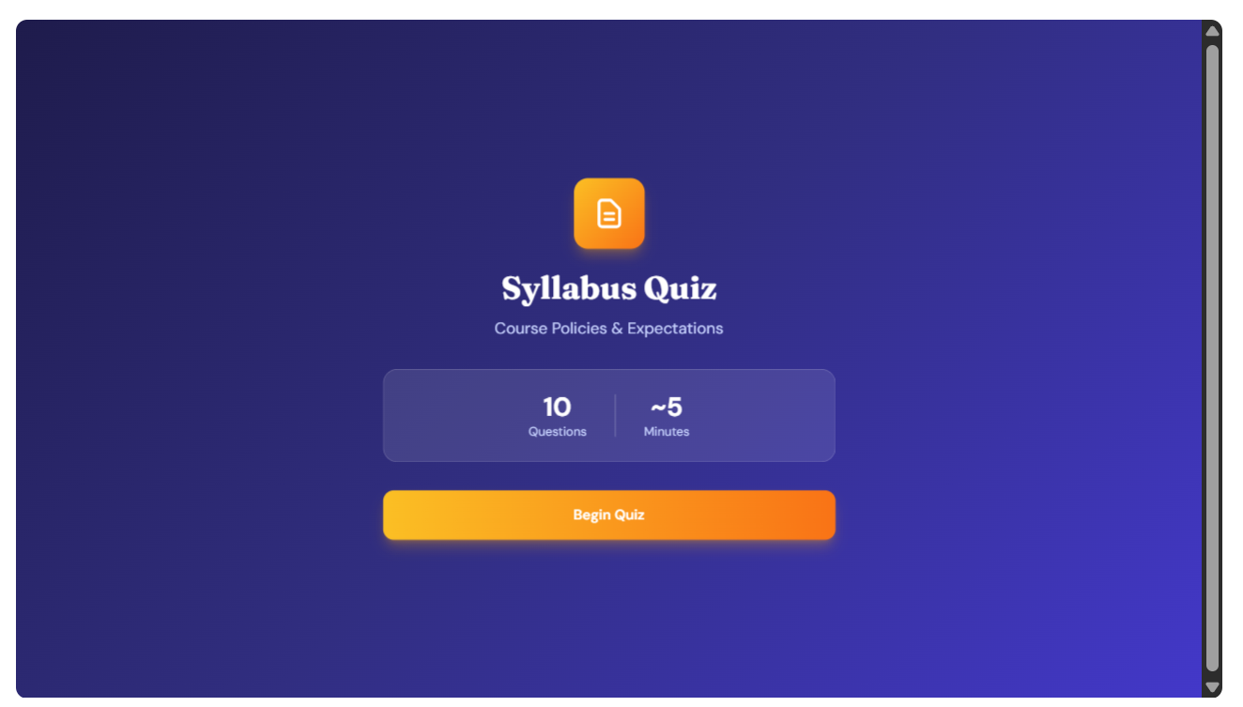


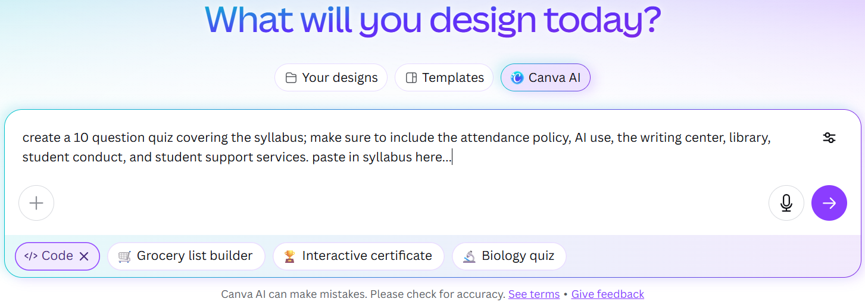
Directions to embed code into Canvas
Log in to both Canva and Canvas
Go to the Canva ai tab on the left
Select in the box on the bottom (if you don’t see that option, select expand in the box on the right)
Describe your creation (ex. Create a 10-question quiz over my syllabus & paste syllabus) and click submit

Slide 13
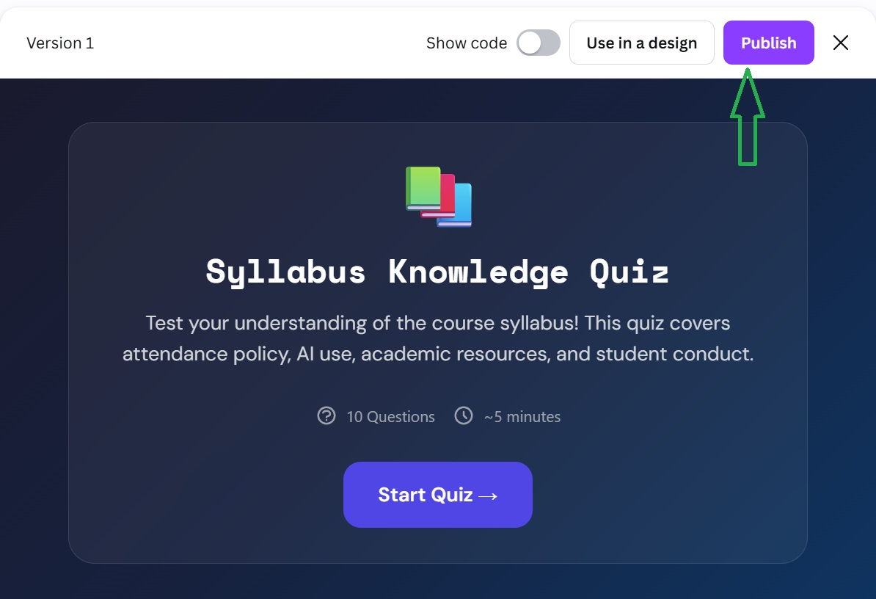

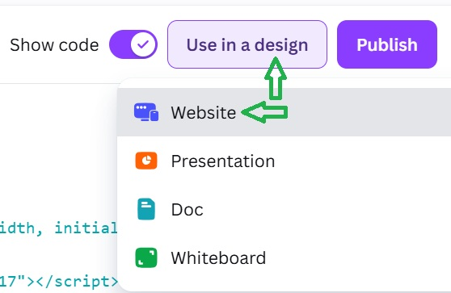
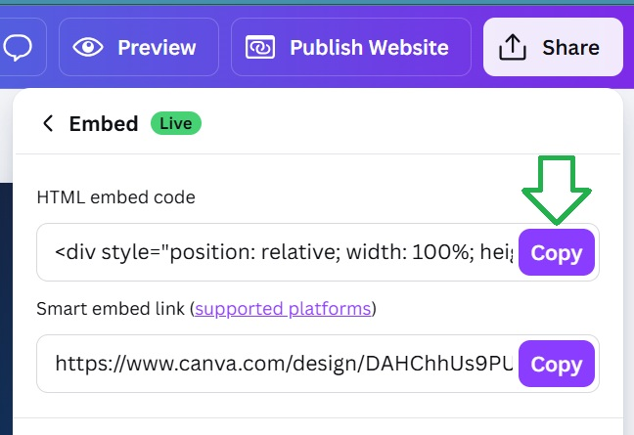
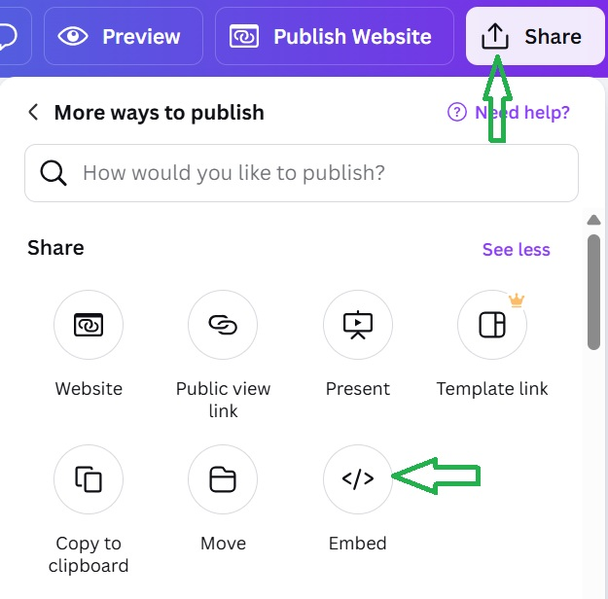
Directions continued…
Test quiz or edit
When satisfied, select publish
Click the “X”
Select Use in a Design and Website
Select Share and Embed (see all to view more options)
Copy embed code

Slide 14
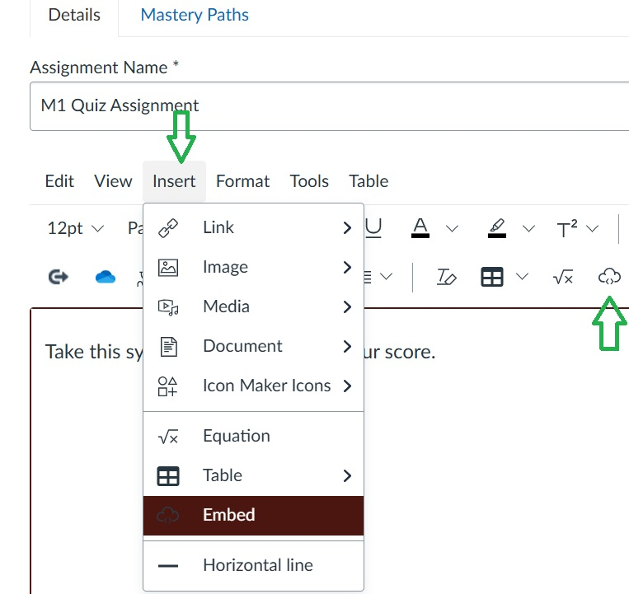
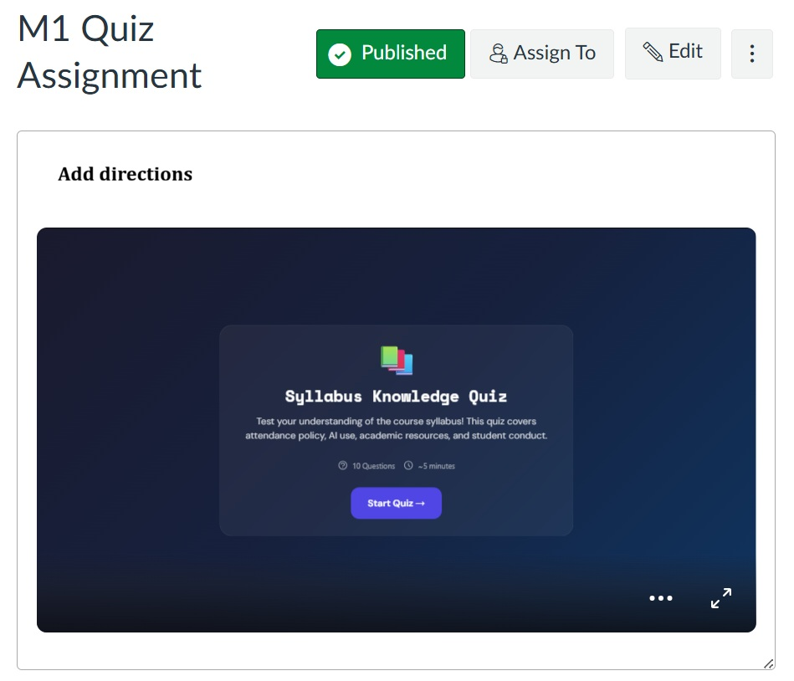
How to embed in a Canvas course
Open your Canvas course
Page
Assignment
Announcement
Etc.
Insert your embed code (two options to embed)
It is ready to use!
Edit in Canva automatically updates in your Canvas course (and any course with the embed code)

Slide 15
Thank you!
Jennifer King jk1369@txstate.edu
Q&A Time!

Slide 16
