Slide 1
Beyond Prompt Engineering: Guiding Non-Technical Students to Architect AI Solutions
Presenter: Dr. Ju Long, Steve Gregg, Sr. Excellence Professor
Department of Information Systems and Analytics
Co-Presenter: Matt Douglas, MBA Candidate
McCoy College of Business
Texas State University

Slide 2
“I Built This!”

Slide 3
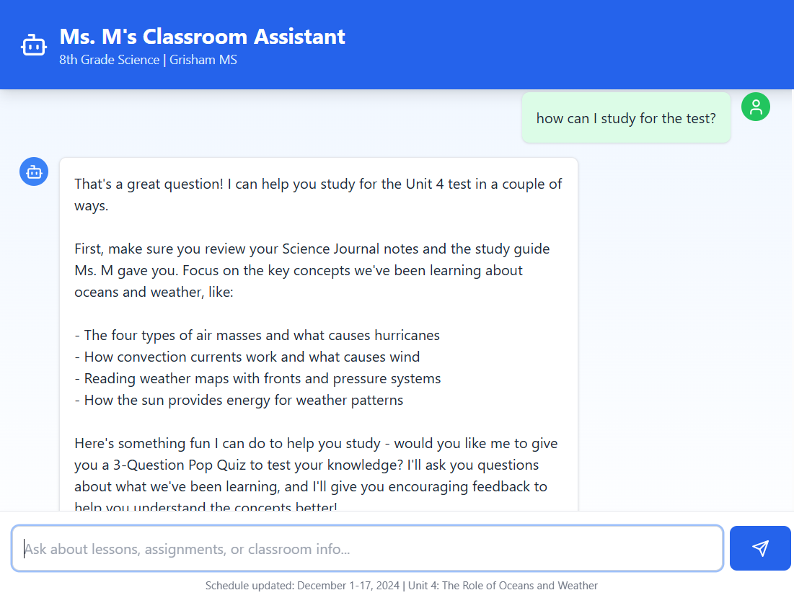
By Angela Marraudino

Slide 4
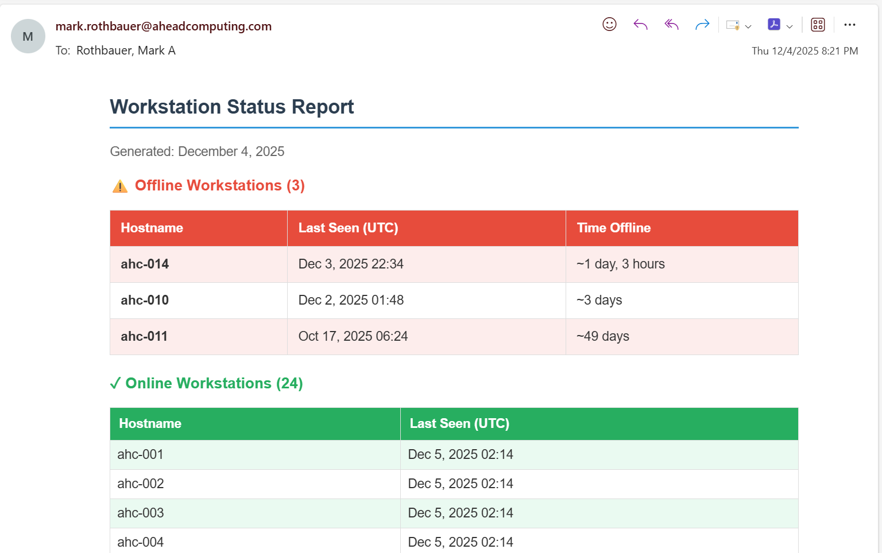
Company Hardware Status MCP in Claude Desktop
By Mark Rothbauer

Slide 5
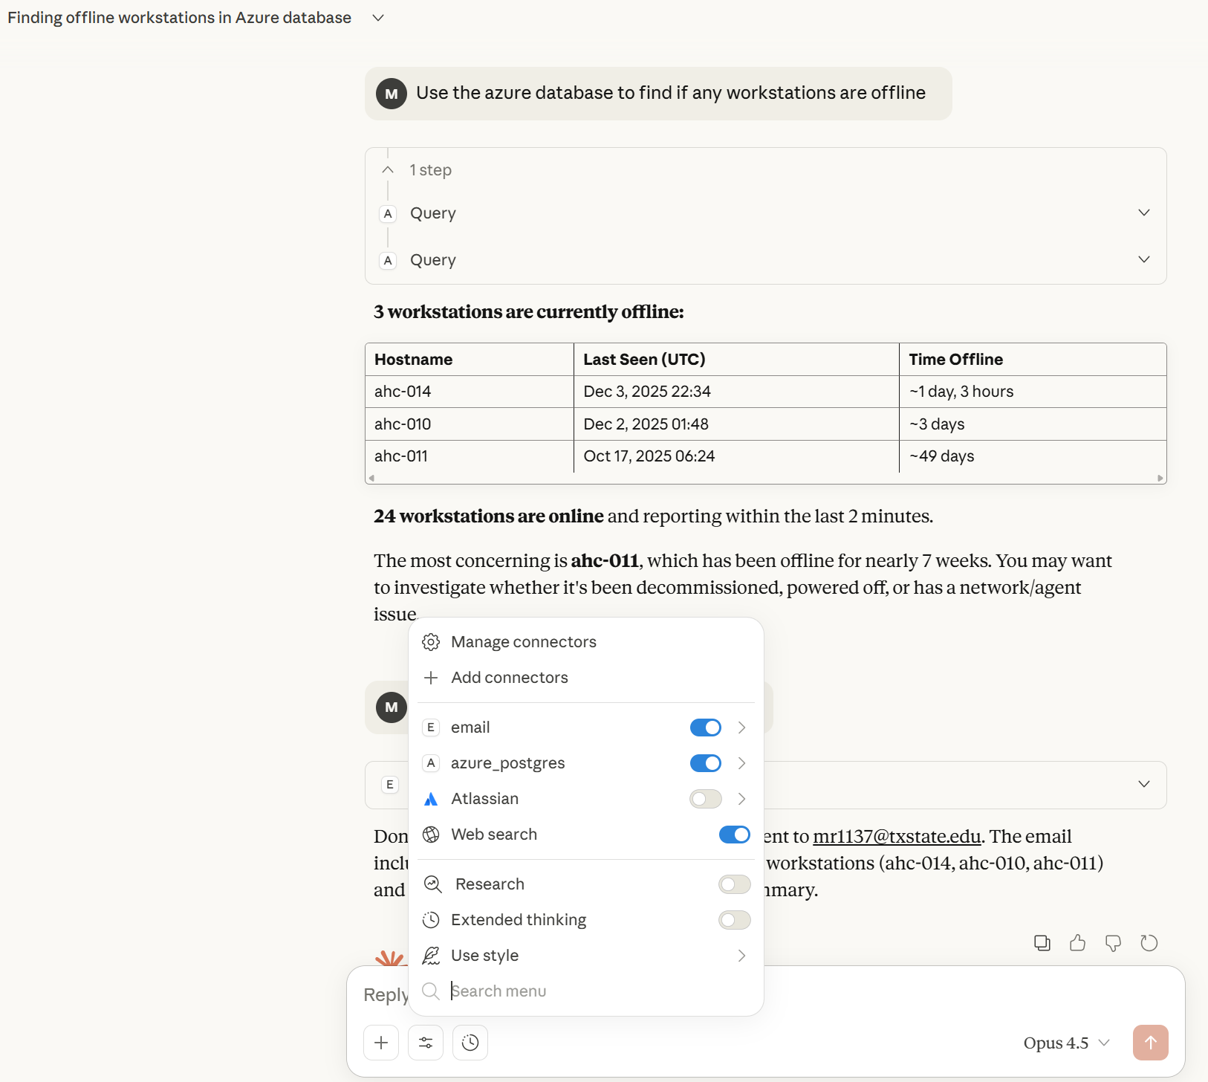

Slide 6
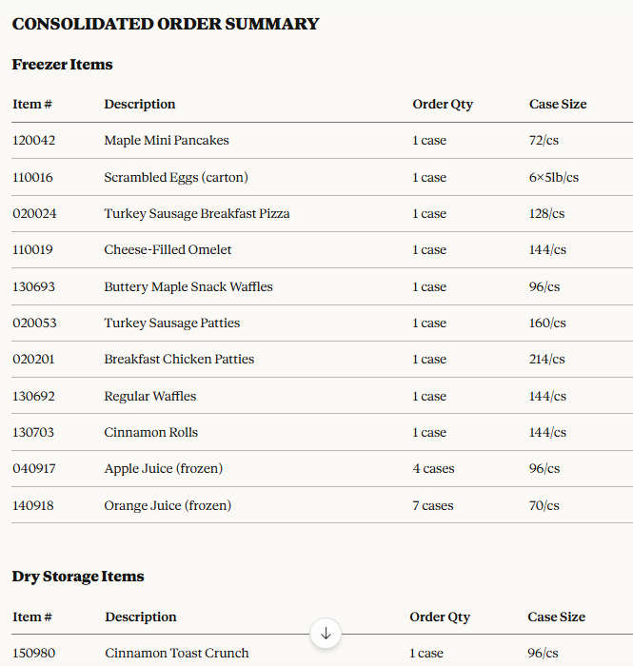
Smart Food Ordering in Child Nutrition
By Andrea Benavides

Slide 7
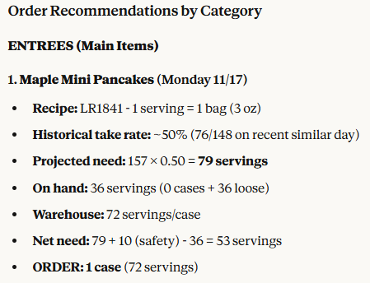
Smart Food Ordering in Child Nutrition

Slide 8
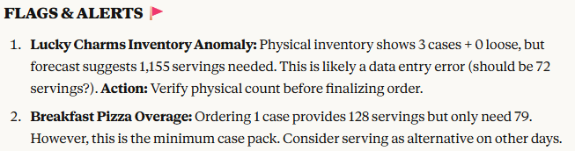
Smart Food Ordering in Child Nutrition

Slide 9
The "Why" – The Shift in AI Education

Slide 10
The Problem: Students are learning to chat with AI, but industry needs them to build with it.
The Goal: Moving from “Prompt Engineering” to “Build AI Agents”
The Context: 60 Online MBA students, zero coding background, 8 weeks.

Slide 11
“Everyone Can Be An AI Builder.”

Slide 12
“A Perfect Job Needs A Perfect Tool” -Confucius

Slide 13
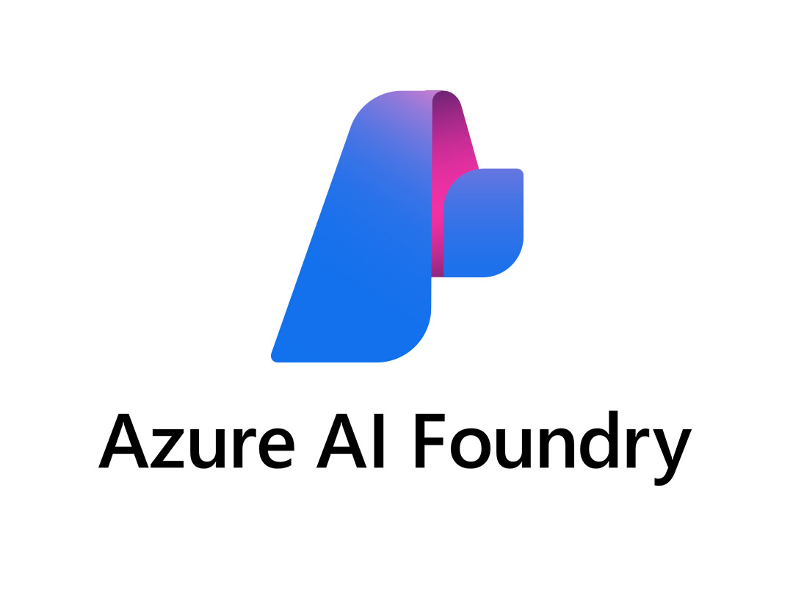
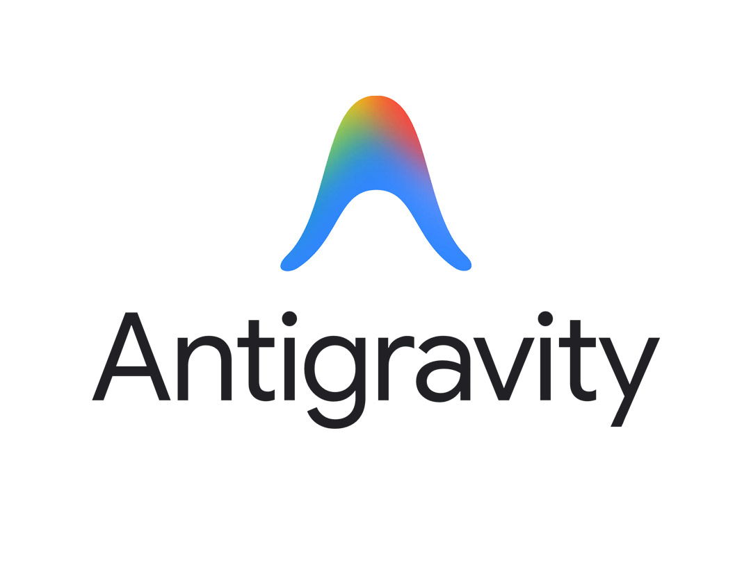
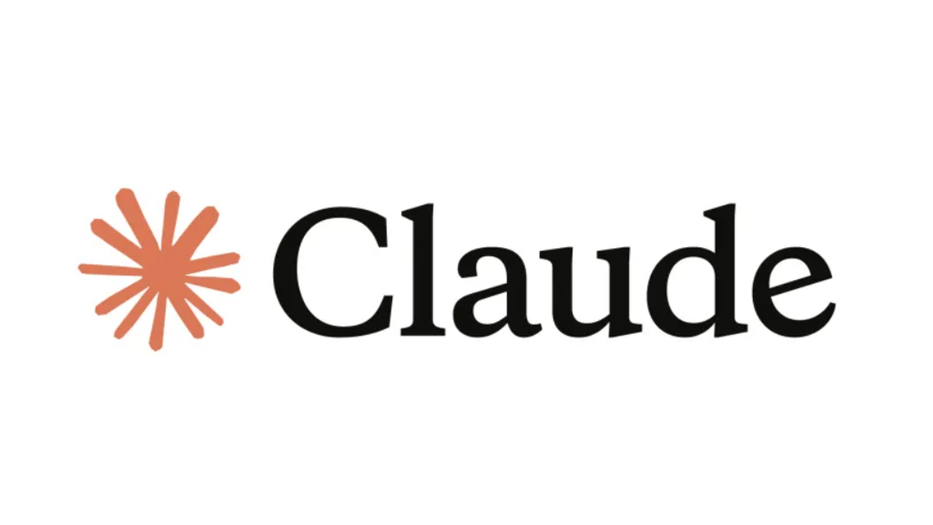

The Toolset:
Microsoft AI Foundry
Criteria: Chat based. No-Code, Low-Code
No Coding Background Needed
With Knowledge Base.
Google Antigravity
Claude
Google Gemini

Slide 14
Learning Workflow

Slide 15
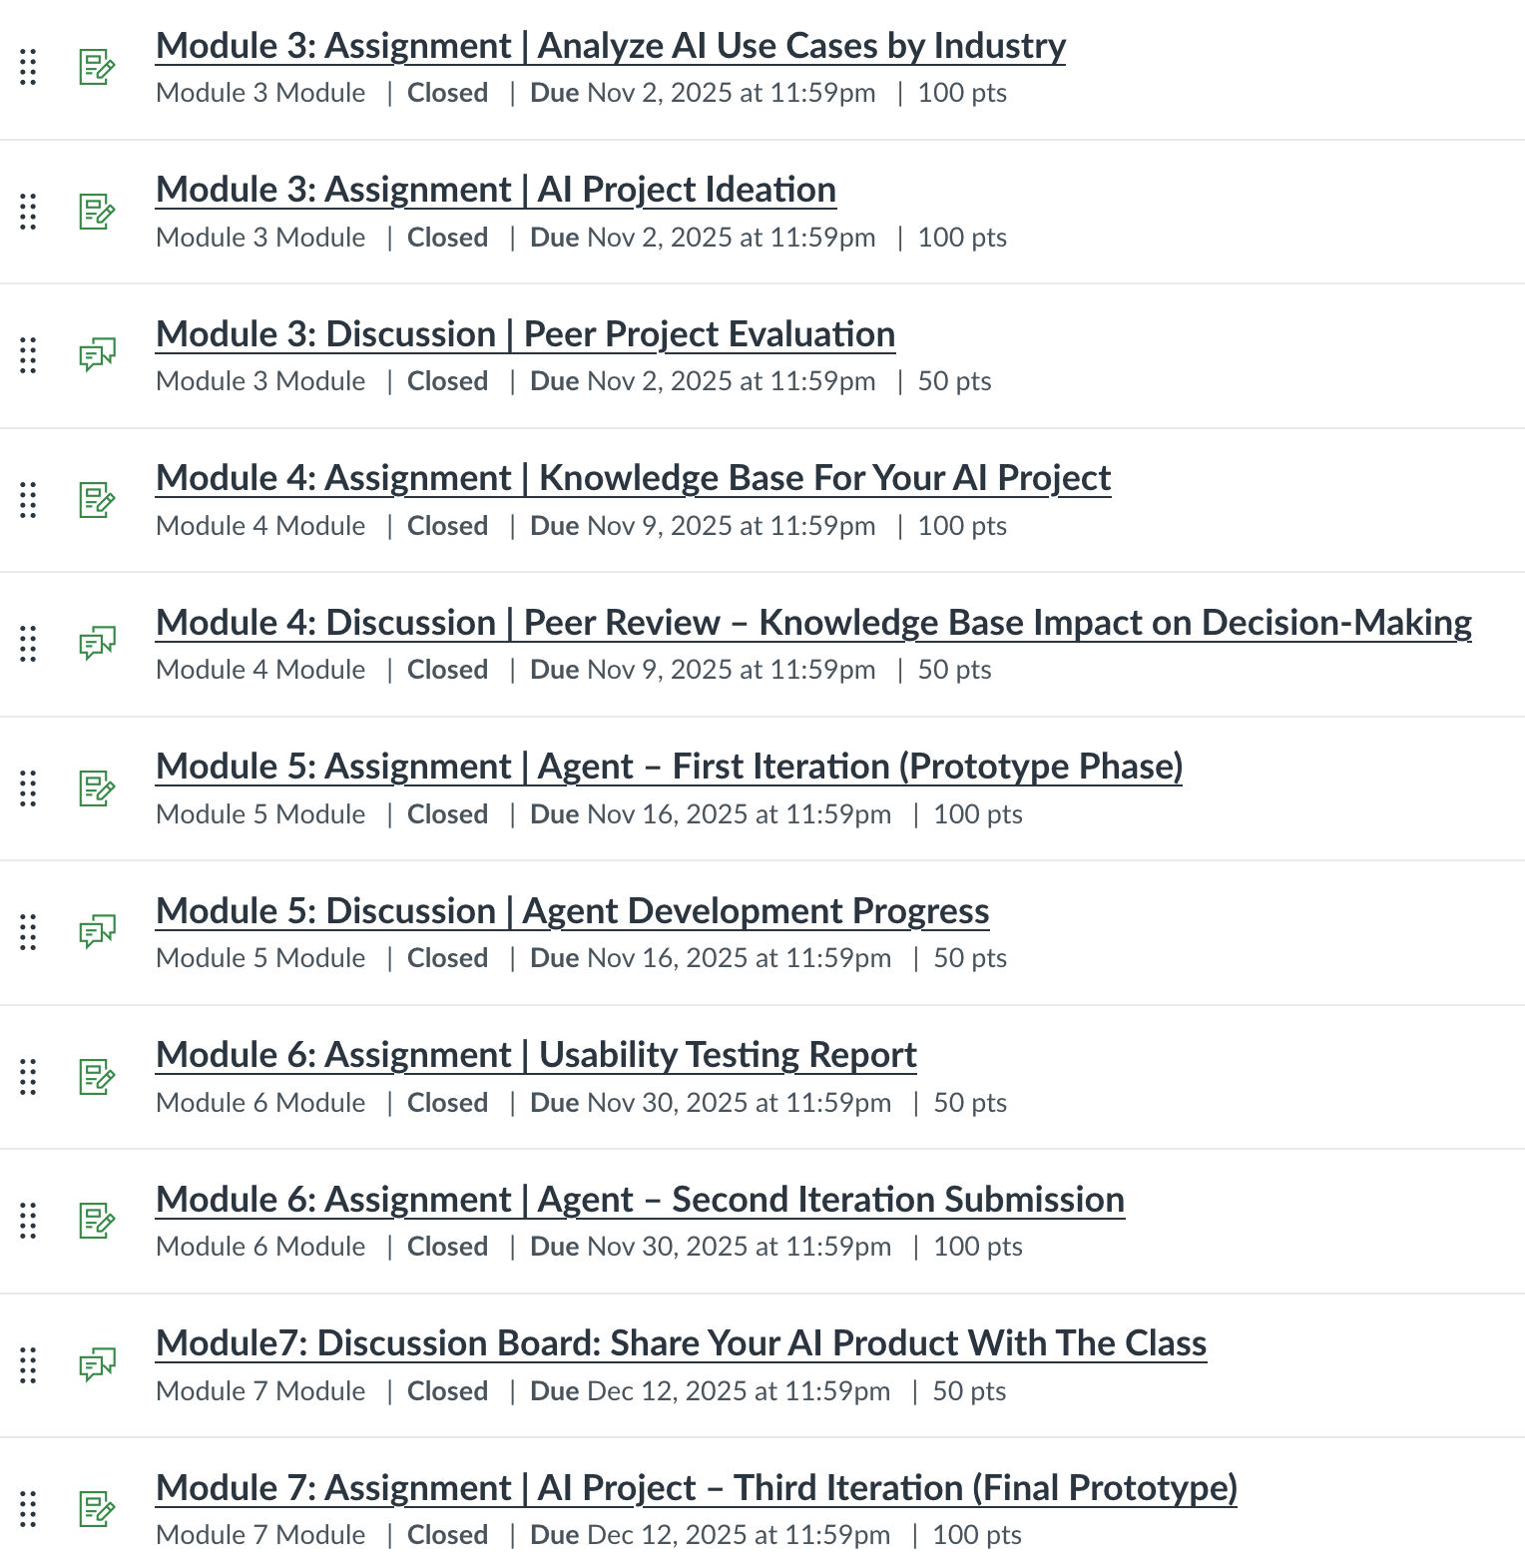

Slide 16
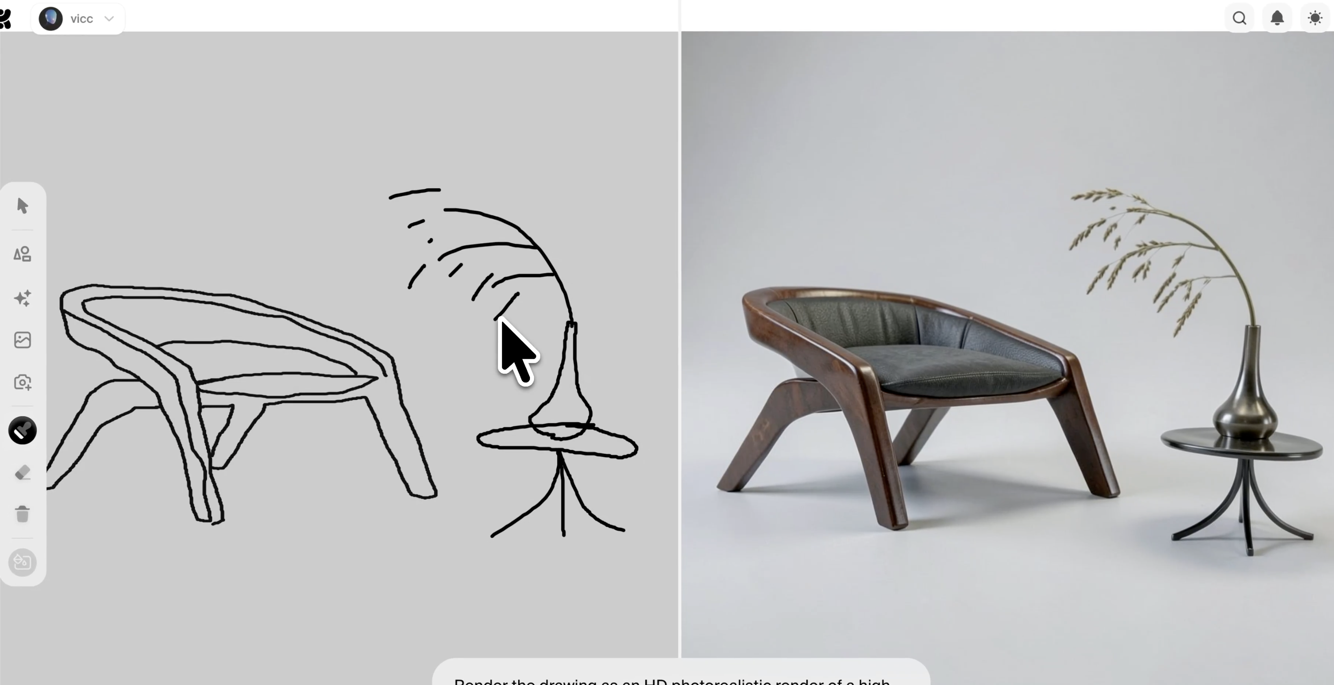
What to build is essential

Slide 17
Pedagogical Framework: The "Triangle of Support"
Peer Collaboration: share progress, receive and give feedbacks
Instructor Guidance: step by step recorded tutorial videos
AI-Assisted Troubleshooting

Slide 18

Fail Fast
Common Hurdles:
Data quality
Data availability
Hallucination
The Strategy:
Iteration
Knowledge base
human in the loop

Slide 19
Scalability: AI Building Across Disciplines It’s Not Just Business: The logic is universal.
Engineering
Healthcare
Semiconductor Material Management
Processing intake form
Education
Key Insight:
Custom tutoring agents
Everyone can build an AI Agent

Slide 20
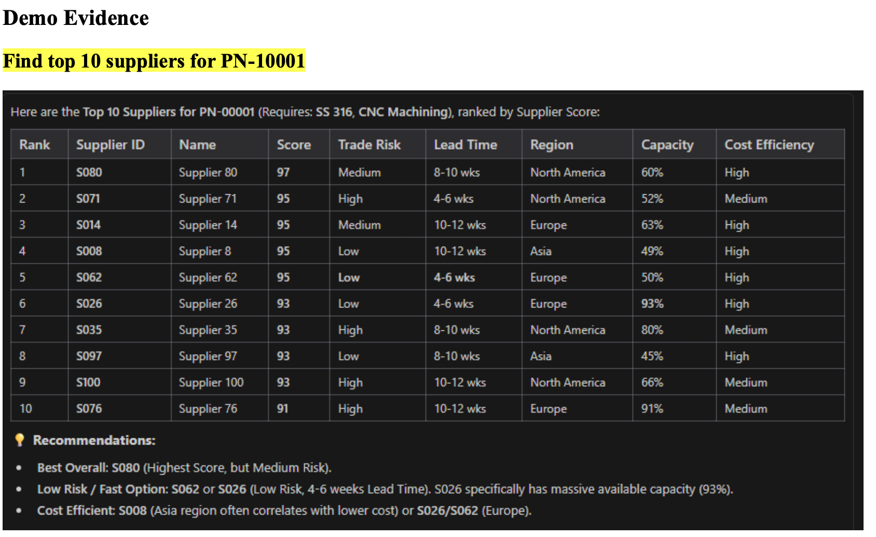
Supplier Matching Agent for Semiconductor Equipment Supply Chains
By Brian Griffitts

Slide 21
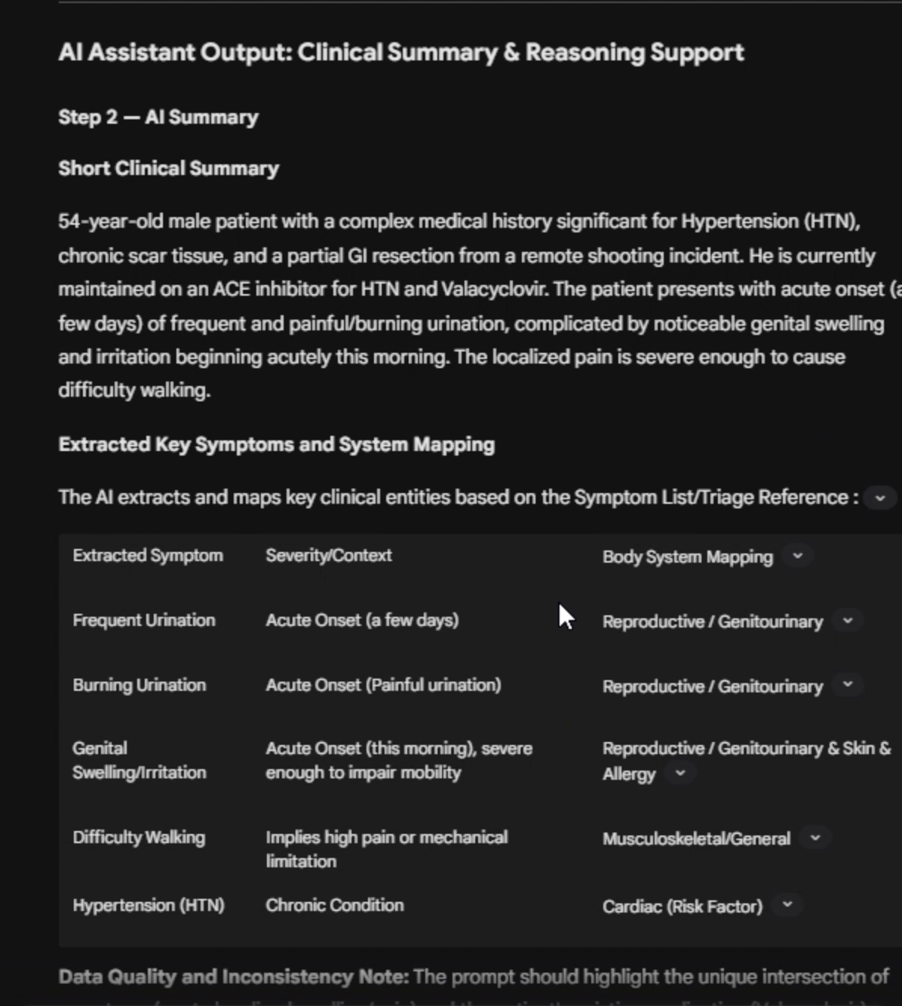
Patient Intake
By Kyra Ramirez

Slide 22
A student’s perspective
Matt Douglas, MBA Candidate, McCoy College of Business

Slide 23
ISAN 5318- Student perspective
Purpose
Educate students on the aspects and uses of AI in multiple workspaces
Method
Discussion boards and lectures from Dr. Long on AI, leading into producing an AI Agent.
Project
Using one of multiple platforms, build an AI Agent that will perform one work task you currently do, while maintaining human oversight.
Key Takeaway
The best way to develop an agent is to tinker and fine tune it in the workshop/playground.

Slide 24
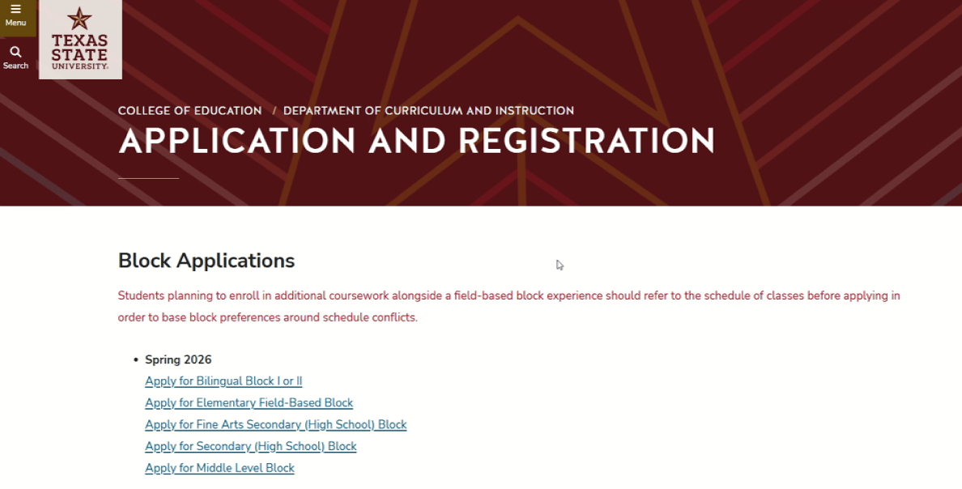
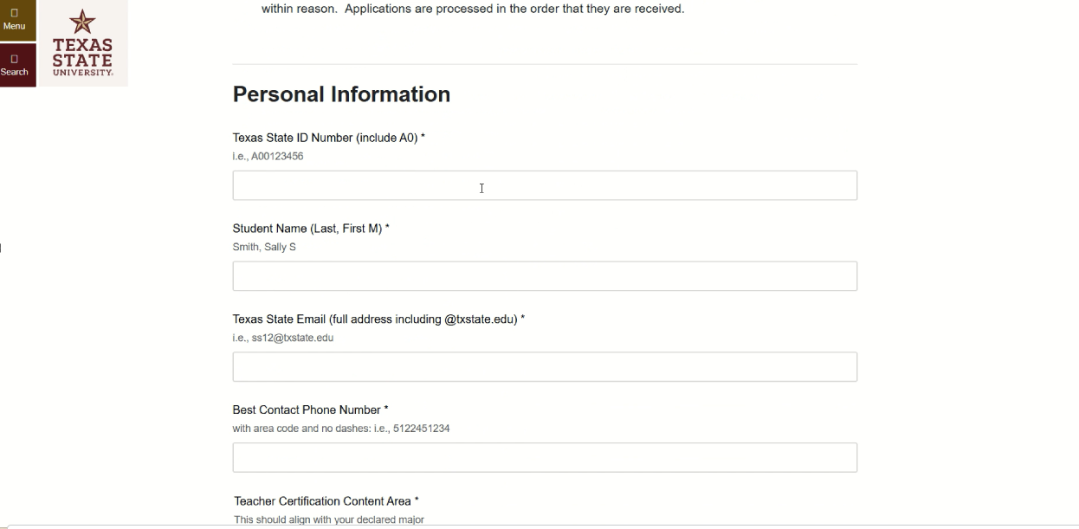
My Project
Applications are completed by the students on the blocks website as dynamic forms
Each application is manually reviewed by either an advisor or COE admin
Excel spreadsheets are used to track the applications in steps:
Application received
Evaluation
Overrides for classes input manually into Banner or-
Emailing the student to explain what they lack for placement
Managing placement to ensure classes are not overfilled or under filled
By Matt Douglas

Slide 25
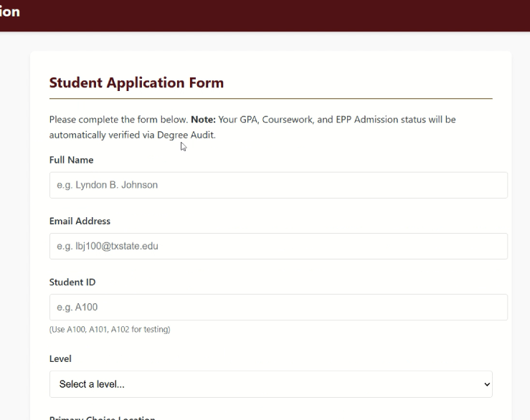
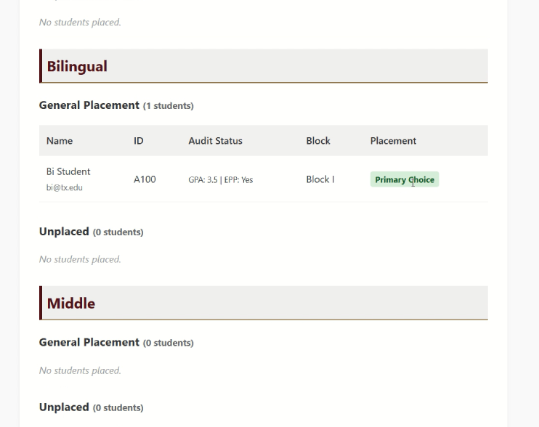
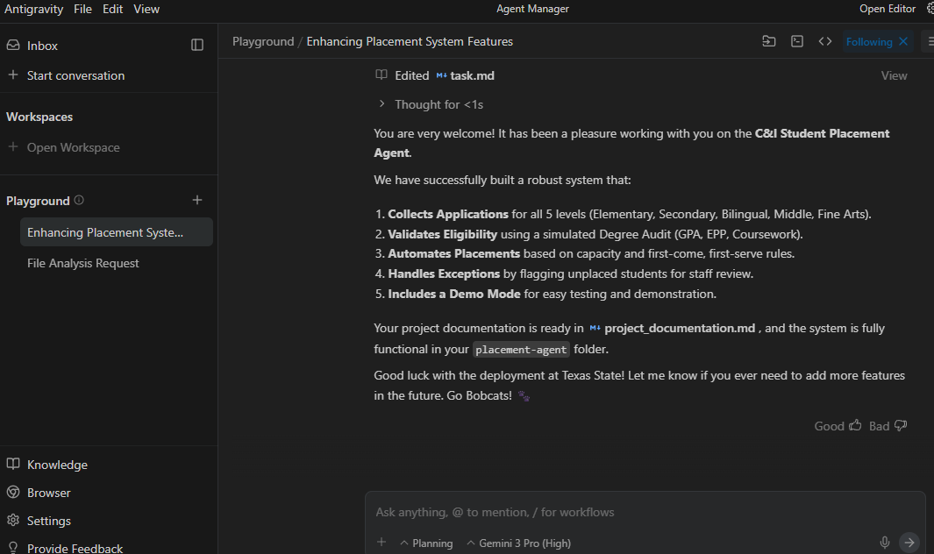
My Project
Students apply in a nearly identical platform, but no dynamic forms needed
The agent will receive and evaluate the student’s information to make sure they meet the criteria
If they don’t meet requirements, they list them under “Unplaced”
Placed students are matched to their schools and placed by their preferences
Overrides are completed in the background
Human oversight is managed by all correspondence to students, including placement emails
By Matt Douglas

Slide 26
Thank you very much!
Questions and Answers
Contact: julong@txstate.edu

