Slide 1

AI as a Learning Partner: Supporting Conceptual Application, Ethical Use, and Team Engagement
Dr. Peg Richmond
Dr. David Cameron
TXST AI Symposium 2026
Photo by Carlos Gil on Unsplash

Slide 2




Who We Are
Dr. Peg Richmond
Dr. David Cameron
Assistant Professor of Instruction
Department of Management
Associate Professor of Instruction
Department of Management
Notes:
Both with a background in industry, encompassing strategic management, business communications, consulting, entrepreneurship, etc.
Writing intensive classes
Experiential learning

Slide 3

Our Agenda
Meeting Sophia: An AI-Facilitated Discussion Platform
The Undergraduate Experience
The Graduate Experience
Photo by Suzy Hazelwood: https://www.pexels.com/photo/notebook-1226398/

Slide 4






Incorporating AI into the Writing Process
AI-assisted brainstorming
Idea pitch.
The AI-assisted writing process
Ethical use
Platform comparisons
Evaluating AI output
Analyzing reports & presentations for AI-use, accuracy & credibility
AI-Assisted research.
Traditional research methods.
Proposal DRAFT.
DRAFT peer review.
Notes:
In the Spring of 2024, probably read 500+ written assignments, the majority of which were written entirely or partially by AI. It was that experience that led me to begin to incorporate AI into all of my writing intensive classes. Over time, I have defined a scaffolded assignment series in my Business Communications class and have a very clear policy in my other classes.
In addition, we have in-class discussions related to how AI fits into the writing process, ethical use, how platforms compare, what is and is not credible and accurate.
Initially, student perceived guided use as a free-for-all. And, I am still not able to see the students’ critical thinking as students unable to ’show their work’ in using AI info as they create their own work.

Slide 5

Drawbacks of AI Assignments
Continued submission of raw AI output
Unable to assess individual comprehension / application / performance
Continuing (S)He said / (S)He said issues
Student reluctance to objectively evaluate peers
Student requests for increased instructor oversight / involvement
Photo by Andre Hunter on Unsplash
Notes:
Initially, student perceived guided use as a free-for-all. And, I am still not able to see the students’ critical thinking as students unable to ’show their work’ in using AI info as they create their own work.
And, without visibility into team dynamics, these are some of the issues with which my students and I struggle.

Slide 6
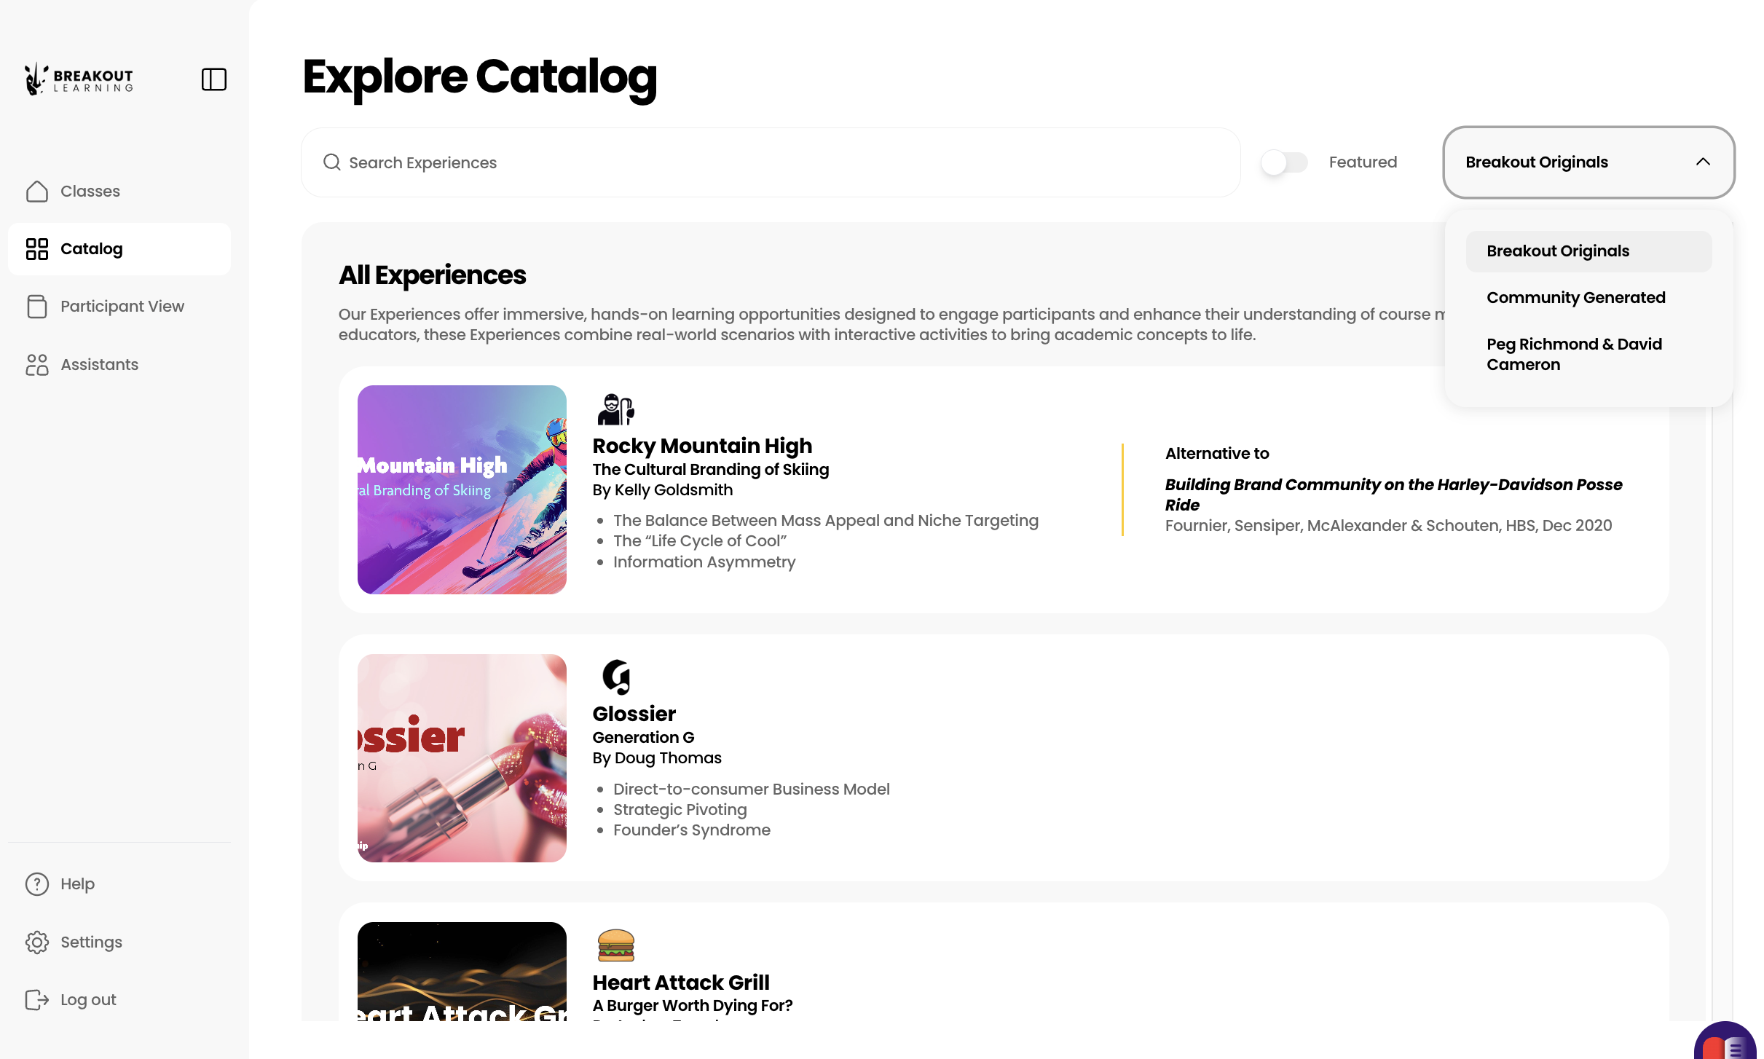
Meet Breakout Learning and Sophia
Content Options
Notes:
At this point, we were invited to a demonstration of Breakout Learning’s AI-facilitated discussion platform. The discussions are facilitated by Sophia, the platform avatar. Within each class, an instructor can include between 1 and 12 modules, which come from a catalog of already developed discussion topics or can be created with the assistance of the company’s instructional designer.
This slide shows on the landing page the various catalogs from which instructors can select. In this case, we work with BL to create out own and acess it here.

Slide 7

How It Works
Our Development Process with Sophia
Simple. Flexible. Gets easier every time.
The Process — Every Time
Outline
Curriculum / Assignments discussed with Breakout. General outline generated and reviewed.
Dossier Review
Dossier is built by Instructional Designer. Pre-work, quiz questions and exhibits planned.
Module Launch
Modules moved into production. Go live after instructor approval and can be assigned to a class..
1
2
3
What Comes In Changes How The Work Gets Distributed
Discussion questions come in ready
Small adjustments get made and the module gets built.
Fast and simple. Effort was upfront.
A syllabus and readings come in
Questions get written and shaped through feedback.
Effort is spread across the review.
Both paths work. Both get to the same place.
Notes:
The design process for Sophia follows three consistent steps for every instructor: submit content, review the discussion modules the Breakout team builds, and approve them for release to students. Those steps never change. What changes is what happens inside each one, and that depends entirely on what the instructor brings to the table.
On one end of the spectrum, an instructor arrives with their content and their own discussion questions already written. In that case, alignment is essentially immediate. The Breakout team takes those questions, makes minor adjustments to optimize them for the platform if necessary, and builds the module. The review process is lightweight — mostly confirmation that everything looks right. The instructor's effort was front-loaded in the form of their own intellectual work, and the collaboration is efficient because of it.
On the other end, an instructor comes with content but no questions. That's completely fine and honestly pretty common — it's education, and not everyone has their discussion strategy mapped out in advance. The minimum we need to get started is a syllabus with weeks, topics, and readings. Learning objectives help more. Key concepts help even more. The more context an instructor can provide, the fewer cycles it takes to get there. But we will get there regardless. In this case the Breakout team does more generative work upfront, and the instructor's effort is distributed across the review process — reacting, refining, and shaping the questions through iteration until they reflect exactly what the instructor wants students to engage with.
The important thing to communicate is that neither path is a compromise. Both arrive at the same destination. The collaboration is just front-loaded in one case and distributed across the review cycle in the other. The process is designed to meet instructors where they are.

Slide 8
The Undergraduate Experience

Slide 9
Undergraduate Experience
Courses: Business Communications & Business Plan Development, Spring 2026
Writing Intensive
Experiential
Creative Opportunity Identification / Validation / Persuasion
Objective: Increasing Concept Comprehension, Student Confidence, & Team Dynamics Insight
Semester-long writing assignment series
Self-formed student teams, 4-6 junior & senior business students
Coupled with individual chapter quizzes, professional development activities, public speaking

Slide 10

Course Set-up
Overview
Learning Objectives
Rubrics
Reasoned Position & Evidence
Critical Thinking: Competitive Advantage Alignment
Critical Thinking: IDE vs. SME Fit
Critical Thinking: Validation Method Fit
Peer Engagement
Notes:
This is a section of my business development class:
Picture is on the landing page and includes an overview, learning objecitves and rubrics.
Three of the Rubrics are tied specifically to the 3 general discussion questions in each module.
Rubrics – 3 Critical Thinking Modules line up with the 3 discussions.

Slide 11
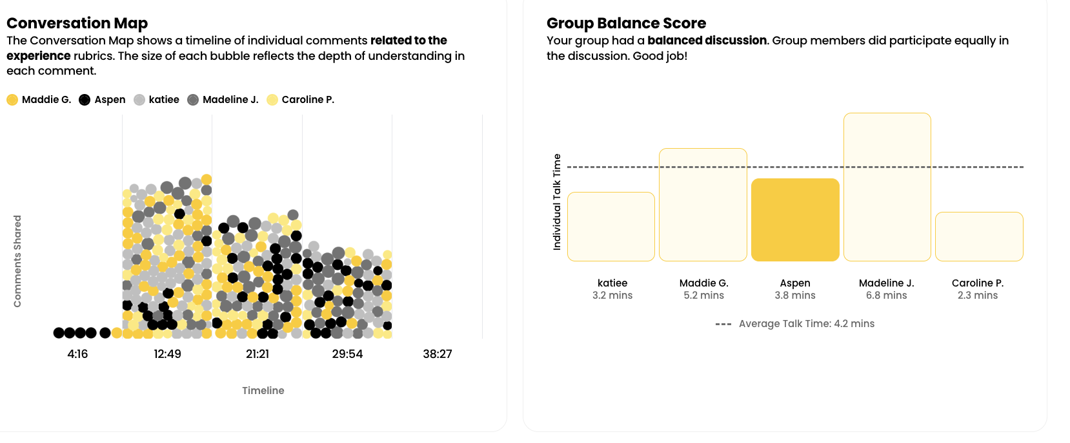
Session Overview
Notes:
Drilling down into a single team or group in a specific assignment, the instructor can see the conversation map, indicating by color and size of dot, who spoke and when.
The group balance score indicates whether a single student, in this case, the highlighted one, spoke more than or less than the team average.

Slide 12
Assessment Criteria
Exemplary: Actively builds on peers' ideas using specific references by name or direct quote, engages in meaningful exchanges, and helps facilitate the discussion.
Proficient: References specific peer contributions by name or quote and builds on them, engages in response patterns through back-and-forth interaction, and extends the discussion.
Developing: Shows partial engagement by referencing peers or using agreement/disagreement markers, asking follow-up questions, or participating when prompted.
Beginning: Shows minimal acknowledgment of peers through brief references, simple response tokens (like "mm-hmm" or "right"), or basic participation when prompted.
No Evidence: No peer interactions, references to others' contributions, or collaborative language appear in the response.
Notes:
Exemplary (Blooms = Synthesis / Evaluation)
Proficient (Blooms = Analysis)
Developing (Blooms = Application)
Beginning (Blooms = Comprehension)
No Evidence
On a scale of 0-4

Slide 13
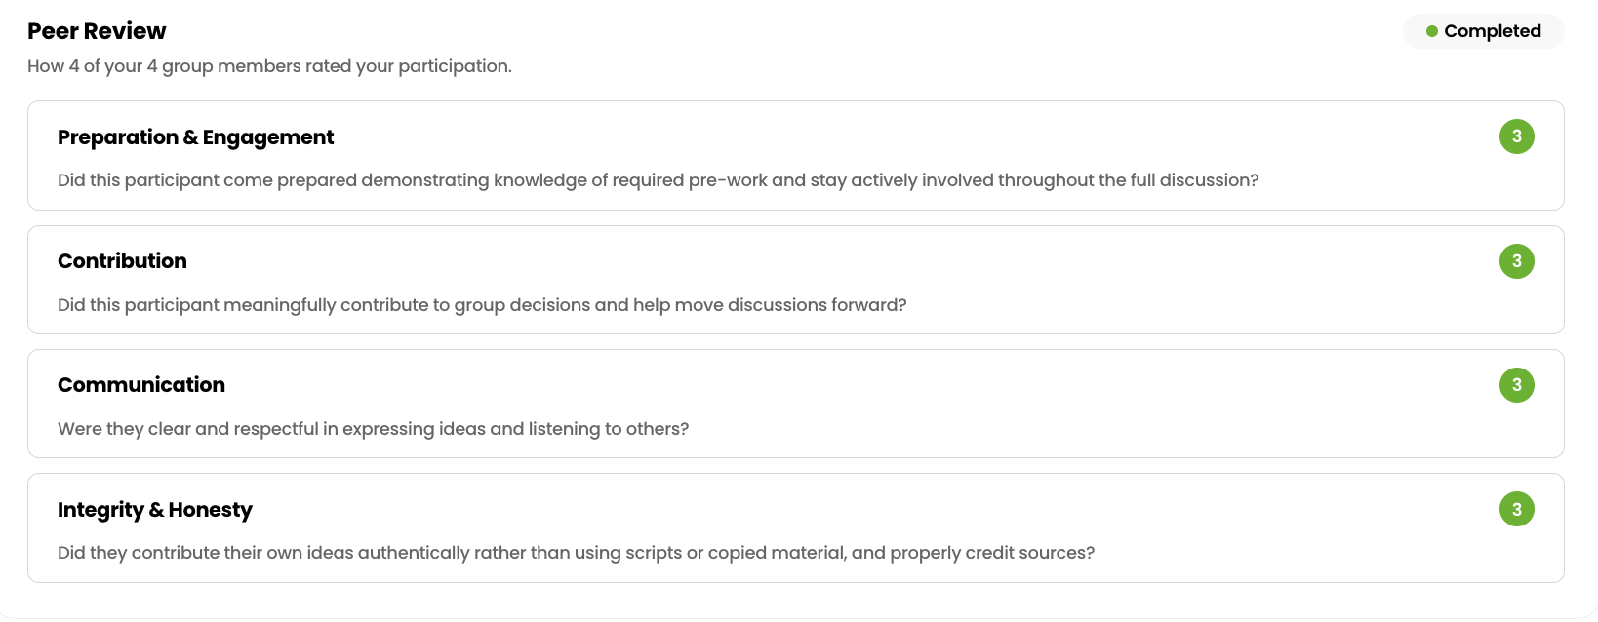
Optional Peer Review
Needs Support
Exceeds Expectations
Met Expectations
Not Applicable
Notes:
Optional peer review. I did employ it to allow students to have a way to indicate a team member is disengaged without direct confrontation. Difficult conversation are likely beyond their abilities at this stage and are a lesson of the course.
In this particular case, the student is appropriately engaged.

Slide 14
It gets faster after the first module
Module 1
Most time
Both sides are learning: The instructor and the Breakout Learning ID team are calibrating to understand expectations.
Modules 2+
Less than half the time
The working relationship is set. Things move fast. Many
instructors start bringing their own questions.
Sophia is not a separate thing that needs to be configured
When the discussion questions are finalized, she is already set up. She takes each question and breaks it into clear tasks for students —
telling them exactly what a complete answer looks like.
"What are the ethical responsibilities of educators
using AI, and how should that shape course design?"
Three clear tasks students can actually act on
The Design Work Gets Done. Sophia Comes With It.
Notes:
Something happens after the first module or two that's worth naming explicitly. The early modules are where both sides are learning — the instructor is developing an intuition for how Breakout discussion questions work, what they look like on the platform, and how students experience them. The Breakout team is learning the instructor's course, their voice, their expectations, and the specific intellectual terrain of their discipline. That mutual calibration takes some time, and it's normal for the first module to involve more back and forth than subsequent ones.
Once that calibration happens, things move significantly faster. The consistent experience is that subsequent modules take less than half the time the first one did. And importantly, the first one often doesn't take as long as instructors expect going in.
The other thing that happens over time is that instructors start contributing more upstream. After seeing how a few modules work — how the questions are structured, what makes a good discussion prompt on the platform, how students respond — many instructors develop enough of an intuition that they can bring their own questions with confidence. What started as a heavier review process gradually shifts toward the faster, more front-loaded path described in slide one. The collaboration matures, and the tool becomes easier to use the more you use it.
This is worth highlighting for an academic audience because it reframes the onboarding investment. The first module isn't just producing a discussion — it's building the working relationship and the shared vocabulary that makes everything after it faster. Instructors never have to think about Sophia as a separate task or a separate customization process. She is the output of the question design work, not an additional layer on top of it. Once the discussion questions are finalized — whether the instructor wrote them or developed them collaboratively with the Breakout team — Sophia is essentially ready. There is no additional AI setup, no prompting, no configuration that falls to the instructor.
What Sophia actually does is straightforward and worth demystifying. She takes each discussion question and breaks it into discrete tasks that guide students to fully answer everything the question is asking. She's not interpreting the question from general knowledge or improvising based on what she thinks the course is about. She's working from the specific materials developed with the instructor — the questions, the learning objectives, the exhibit content, the discussion architecture. That context is what makes her guidance feel accurate and course-specific rather than generic.
The logic is simple: a well-written discussion question often contains multiple implicit asks. Sophia makes those asks explicit so students know exactly what they need to do to fully satisfy the prompt. Each task is a student-facing question of no more than 150 characters, followed by a specific requirement that tells students what a complete answer looks like.
The result is that a significant AI facilitation capability comes along for free with the design work the instructor was already doing. They customize the questions. Sophia comes with that.
Before: "What are the ethical responsibilities of educators when using AI tools in the classroom, and how should those responsibilities shape course design and assessment?"
After:
What ethical responsibilities do educators have when using AI in the classroom? Require participants to identify at least two specific obligations and ground them in the course materials.
How should those responsibilities influence how a course is designed? Require participants to connect at least one ethical consideration to a concrete course design decision.
How should they shape assessment specifically? Require participants to take a position on at least one assessment practice and explain their reasoning.
The before/after makes the point without any explanation needed. The question didn't change — it was just unpacked. That's what Sophia does, and it happens automatically once the design work is done.

Slide 15

Early Insights from Beta Use
Spring 2026
7 Classes
3 undergraduate
3 graduate
1 graduate (not yet started)
Students
66 undergraduates
44 graduates (current)
10 graduates (future)
Photo by Anastasiia Ornarin on Unsplash
Notes:
We want to remind you this is early insight.

Slide 16
Undergraduate Comprehension Gains

Slide 17
Undergraduate Confidence Gains

Slide 18

Undergraduate Perceptions & Concerns re Breakout Learning Experience
Disliked:
“Vague,” “repetitive” prompts
AI as the sole assessment tool
Being recorded or monitored, expressed privacy concerns
Lack of self-directed discussions
Liked:
More practical, less theoretical activity
Forward progress on their team project
Clear expectations or frameworks
Support for research rigor
Building professionally relevant skills

Slide 19
The Graduate Experience

Slide 20
Graduate Comprehension Gains
Notes:
These comprehension and confidence gains reported here are based on self reports collected in each module through a pre- and post-survey

Slide 21
Graduate Confidence Gains

Slide 22
Incorporating an AI Learning Tool into MBA Capstone Course
Course: MBA Capstone with live consulting projects, Spring 2026 Beta
Applied Strategic Analysis & Soft Skills development - external business partners
Section Focus: Online, Accelerated 8-week course (A01)
The Problem: remote, asynchronous nature of online courses
Objective: Increase student engagement
Remote team assignments, 4-5 seasoned students
Enter Sophia, AI-assisted team discussions
Occasional direct faculty contact

Slide 23

Sophia – a new breed of AI tool
A customized AI Assisted Learning application (Breakout Learning)
Structured questions/context
Student led discussions
Detailed Sophia assessment/feedback
Six sessions
Roughly, 1 hour per session ***
Sandbox/toys
[Teams and Clients)

Slide 24

AI facilitated team discussion
Engagement ➔ learning
Social/emotional
Cognitive / understanding
Active learning (modified ICAP framework)
Student Feedback (Sophia)
Peer engagement
Dialogue contribution
Talk time
Sophia
A virtual team meeting with Sophia

Slide 25
Engagement assessment, A01
AI-Powered Scoring
Talk time
Contribution rubric
Peer Engagement: How the student built on and responded to peer’s ideas in discussion.
Reasoned Position and Evidence: How well the student constructed logical arguments with claims, supporting evidence, …
Critical Thinking: The cognitive complexity the student demonstrated in relation to the learning objectives

Slide 26
Sophia – Engagement/feedback
A Student’s Feedback (0-4 metric)
Peer Engagement (3): Facilitated group direction and checked for alignment. To improve, she could….
Insight vs. Observation (4): Evaluated the value-added of different analyses, questioning …
Reasoned Position & Evidence (3): Articulated a clear stance on executive presentation… Could improve by providing more multi-step, theory-backed arguments
Active learning/feedback loop appears to be working

Slide 27
Sophia – Student Experience mid-point Survey
Survey results
Comparison: A01 vs 251 sections
A01(OMBA) positive & enthusiastic
.251 (hybrid) more critical but constructive
Sophia is perceived as a positive, more so in A01

Slide 28

Sophia - Student Comments
“Forces us to engage and look from different perspectives than we normally would.”
‘Students valued that Sophia forces participation and creates team accountability.’
"Sophia helps me feel more confident in understanding the course material.”
& similar comments on improving the app heard previously
Students watching instructor in a classroom

Slide 29

Sophia, - Takeaways
Results are encouraging
AI dialogue/feedback stimulated engagement in a team environment
Stronger affinity
OMBA >> Hybrid
Data interesting, but early
Plan continued use

Slide 30

Improvements Feedback
More instructive feedback
More adaptive avatar
More discussion related to the student projects, not theory
More actual “case” examples
Photo by AbsolutVision on Unsplash
Notes:
Repeated request for:
Step-by-step guidance
Applied “tips and tricks”
Automation workflows
Clear instruction on how companies use AI responsibly

Slide 31


Q&A
Photo by IGOR LUNGU on Unsplash
We welcome the opportunity to share more. Feel free to contact us with questions or for more information.
Peg Richmond
(512) 408-6155
pr22@txtate.edu
David Cameron
(512) 638-1782
dc50@txtate.edu

Slide 32
Appendices

Slide 33

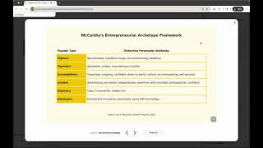
How Sophia Works
Follow Sophia’s verbal instructions and the prompts you see on screen.
Speak your responses out loud — don’t type in the chat. Sophia will listen and respond to you directly.
Find a quiet space for the best experience.
Be patient with timing — Sophia may take a moment to reply or respond quickly, just like people do in real life. Just be your authentic self, and respond like you would in a conversation with your peers.
Stay on topic — Sophia will guide you through the lesson material and won’t answer unrelated questions.
The Solo Experience: meet “Sophia”
If your instructor enables solo mode, you will have the option to go through the Breakout Learning experience alone, instead of in a group. If you fly solo, you’ll be joined in your Breakout room and guided by Sophia, your AI-learning companion.

