Slide 1
Short Videos, Smart Support
AI-Guided OER Lessons for Fully Online Courses
OER Micro-Video
4-Step Lesson
AI “Micro-Tutor”
Dr. Moira Di Mauro-Jackson • Texas State University
AI in Teaching & Learning Symposium • Wed, March 4, 2026 • 2:30–3:15 PM • LBJSC 316
World Languages & Literatures (College of Liberal Arts)
Notes:
[Sources]
- Internal: “AI in Teaching and Learning Symposium Proposal #06-235-910” (uploaded PDF), pages 2–5.
[/Sources]

Slide 2
Why asynchronous students stall (even after a video)
Context
The common pattern
What they need instead
• Students watch a clip… then pause.
• Confusion turns into avoidance.
• Questions arrive late (“I’m lost”).
• Practice happens too late (or not at all).
Result: the video is “content,” not a learning path.
A predictable, low-friction rhythm:
1) a 1-minute warm-up,
2) a tiny checkpoint,
3) a short practice task,
4) a quick reflection…
…plus optional “micro-tutor” support that gives
*clues*, not answers.
Goal: structure + support (without adding cost)
End Result: Turn OER video into a guided micro-lesson
Notes:
XXXXXX
[Sources]
- Internal proposal PDF, pp. 3–5 (problem framing and session rationale).
[/Sources]

Slide 3

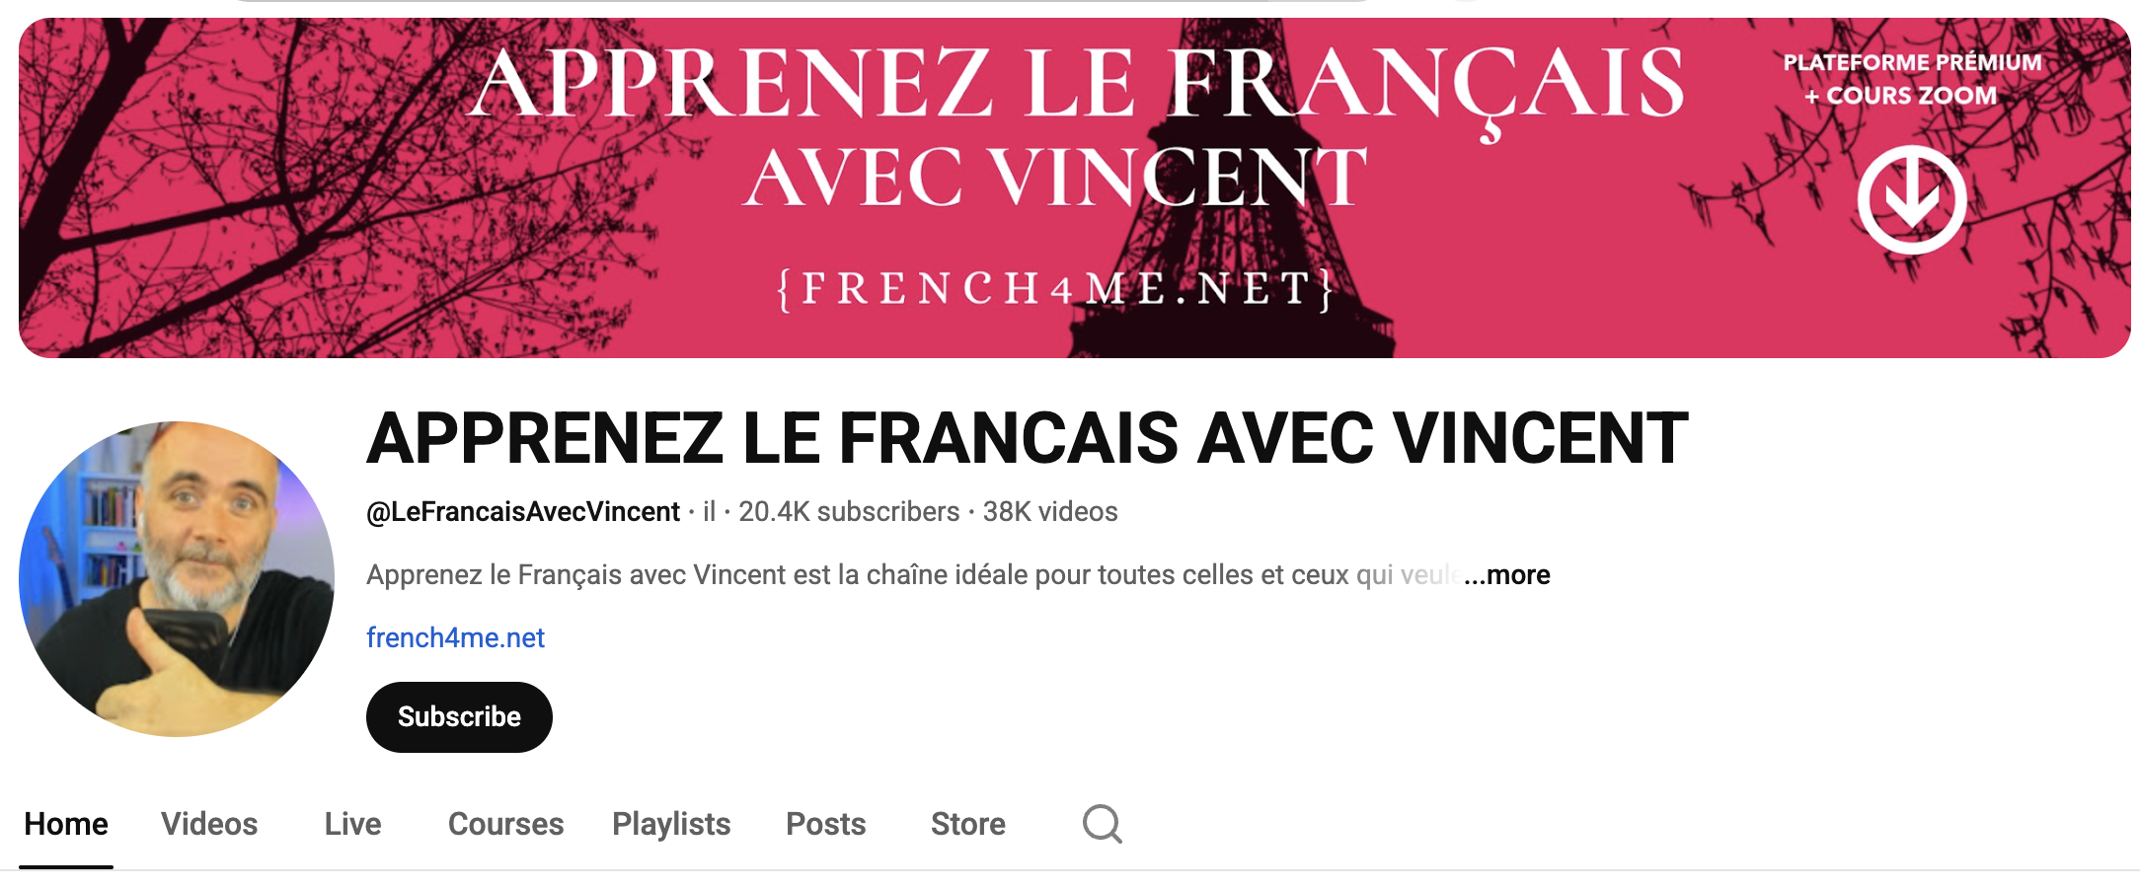
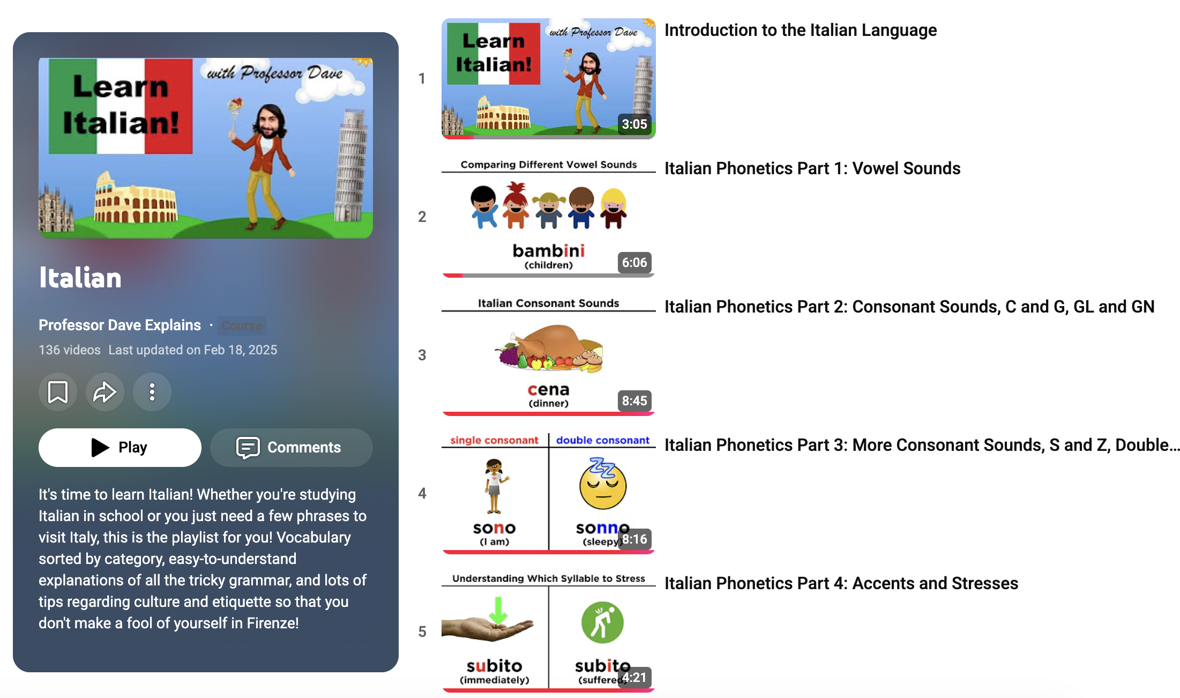

What are
OER (Open Educational Resources)
and
how do they differ from Open Access,
Library-Licensed and Affordable Course Content?
Definition

Slide 4
The simple, repeatable model
Overview
Turn any short OER video into a guided micro-lesson:
1
BEFORE
2
DURING
1-minute warm-up tied to the week’s goal
(activate prior knowledge; set purpose)
Pause-and-check note + one-question gate
(confirm understanding; keep momentum)
3
AFTER
4
WRAP-UP
Short practice with an open resource or model
(listen/read → model → create)
One-sentence reflection + optional AI hint box
(“Ask for a clue, not a solution”)
AI “micro-tutor” (optional) — scoped support
Allowed: hints, rephrasing, quick checks • Not allowed: doing the task for the student
Notes:
[Sources]
- Internal proposal PDF, pp. 2–4 (four-step model + AI micro-tutor scope).
[/Sources]

Slide 5

Step 1 — BEFORE (1 minute)
Build momentum
Warm-up question (tiny, targeted)
Make it feel collaborative
Purpose: connect the video to the week’s learning goal.
Keep it quick: one prompt, one response.
Examples:
• “What do you already know about ___?”
• “Pick the best definition of ___.”
• “Predict: what will the video explain?”
Optional add-ons that work even online:
• quick poll (1 click)
• “post one sentence” discussion
• pair-share in comments (2 replies)
Design principle: *start is easy.*
Instructor time: ~2 minutes to build, big payoff
Notes:
[Sources]
- Internal proposal PDF, pp. 2–4 (Before step and outcomes).
[/Sources]

Slide 6
Step 2 — DURING (pause + check)
Keep students engaged
Pause-and-check note
One-question gate (LMS checkpoint)
Add one instruction right under the video:
“Pause at 1:45 and write one example.”
Why it works:
• forces active listening
• lowers cognitive load
• creates a micro-success
Immediately after the video:
• 1 multiple choice OR
• 1 short answer (one sentence)
Use it to detect “stuck points” early
(without grading a whole quiz).
Tip: keep the gate low-stakes (completion or 1 – 5 points). It’s a signal, not a punishment.
Notes:
[Sources]
- Internal proposal PDF, pp. 2–4 (During step: pause-and-check + one-question gate).
[/Sources]

Slide 7

Step 3 — AFTER (practice)
From input to output
The practice recipe
Examples across disciplines
• Biology: lab demo → 3-step practice questions
• History: artifact clip → sourcing grid
• Math: worked example → parallel problem
• Nursing: procedure video → SBAR note
Same structure, different content.
Use an open resource or model:
1) Listen / read (with transcript)
2) Notice a feature (highlight, match, sort)
3) Create a short output (2–5 minutes)
Keep it bite-sized so students actually do it.
OER example: “Professor Dave” grammar clips + Italian Conversations (audio+transcript)
Notes:
[Sources]
- Internal proposal PDF, pp. 2–4 (After step + transferability examples).
- Italian Conversations (audio + transcript): OnlineItalianClub page.
URL: https://onlineitalianclub.com/italian-conversations/
[/Sources]

Slide 8

Step 4 — WRAP-UP (reflection + optional AI)
Close the loop
One-sentence reflection
Optional AI “micro-tutor” box
Purpose: metacognition + accountability.
Prompts (choose one):
• “One thing I can do now is…”
• “The hardest part was… because…”
• “My next step is…”
Grading: completion or very small rubric.
Ask for a clue, not a solution.
Try prompts like:
• “Give an additional hint about step 2.”
• “Rephrase the question in simpler words.”
• “Check sentences for errors.”
Avoid:
• “Do this for me.”
• “Write my answer.”
Notes:
[Sources]
- Internal proposal PDF, pp. 2–4 (Wrap-up step + “Ask for a clue, not a solution” framing).
[/Sources]

Slide 9
AI guardrails that protect learning (and integrity)
Practical policy
ALLOWED
NOT ALLOWED
• Rephrase instructions
• Give a hint (1 step)
• Provide vocabulary
• Check for one error
• Offer an example *format*
(not the student’s answer)
• Explain “why” something is wrong
• Generate the full answer
• Translate/solve the whole task
• Write the student’s paragraph
• Complete graded work
• Create citations/sources
the student didn’t consult
• Anything that replaces learning
Copy/paste: “AI may be used for hints and rephrasing only. Full solutions are not permitted.”
Notes:
[Sources]
- Internal proposal PDF, pp. 2–4 (AI micro-tutor scope + allowed/not allowed framing).
[/Sources]

Slide 10
Equity & access (built in, not bolted on)
Design checklist
Low-bandwidth friendly
Why it matters
• short videos (or audio + transcript)
• captions + transcript always
• printable page version
• screen-reader-friendly structure
• flexible windows (when possible)
Students differ in:
• time, work schedules, caregiving
• bandwidth/device access
• disability accommodations
• confidence asking for help
This model supports all of the above
without increasing cost.
Notes:
[Sources]
- Internal proposal PDF, pp. 2, 4–5 (accessibility + equity strategies).
[/Sources]

Slide 11
Evaluate impact (without new tools)
Iterate quickly
Look at 3 simple indicators
What I saw in my courses
1) Video/page views (who started?)
2) Checkpoint results (where they stall)
3) Late/missing patterns (when they drift)
Then make 2 small tweaks:
• tighten the warm-up prompt
• shorten the practice task
• move the checkpoint earlier
• more on-time starts
• clearer student questions
• fewer “I’m lost” emails
while grades stayed aligned
with authentic performance.
Notes:
[Sources]
- Internal proposal PDF, pp. 2, 4–5 (analytics indicators + reported impact).
[/Sources]

Slide 12
Try it now ( 5 - 10 minutes ): build one micro-lesson
Interactive
Work solo or in pairs: pick ANY short video you already use (or want to use).
Your micro-lesson checklist
Prompt starters (steal these)
BEFORE: write 1 warm-up question
DURING: add 1 pause-and-check note
DURING: add 1 checkpoint question
AFTER: design 1 short practice task
WRAP: choose 1 reflection prompt
Optional: AI hint box + guardrails
Warm-up:
“In one sentence, what is ___?”
Checkpoint:
“Which option matches ___?”
Practice:
“Create 2 examples of ___.”
Reflection:
“One thing I can do now is…”
AI hint: “Give me a clue about step 3.”
After 10 minutes: you’ll have a one-unit pilot plan ready to deploy
Notes:
[Sources]
- Internal proposal PDF, pp. 3–4 (session outcomes: draft a one-unit pilot plan).
[/Sources]

Slide 13
Takeaways (you can use tomorrow)
Copy/paste Canvas module
AI micro-tutor prompt
Equity + access checklist
Before → During → After → Wrap-up
Works in any LMS.
Hints + rephrasing only
(“Ask for a clue, not a solution”).
Captions, transcripts, printable pages,
low-bandwidth options.
Q&A • If you’d like the template, I can share it after the session.
Dr. Moira Di Mauro-Jackson • md11@txstate.edu Grazie Mille/Merci
Notes:
[Sources]
- Internal proposal PDF, pp. 2–5 (takeaways and session outcomes).
[/Sources]

