Slide 1


From Prompt Engineering to Prompt Literacy:
Practical Strategies for Teaching Ethical and Effective AI Use
April Joy Miles
Texas State University
AI in Teaching & Learning Symposium

Slide 2

Why this Conversation Matters
AI is already embedded in student workflows
Policies vary widely across courses
Faculty uncertainty is high
Students are navigating inconsistent expectations

Slide 3
The Current Framing Problem
Many conversations focus on:
Very few focus on:
Cognitive development
Metacognition
Ethical reasoning
Student agency
Detection
Prohibition
Productivity
Efficiency

Slide 4
Prompting as Technical Skill
Prompt Engineering
“Write a 500-word essay about the causes of the French Revolution with citations.”
Optimize output
Task completion
Efficiency-driven
Technical precision

Slide 5
Prompting as Critical Practice
Prompt Literacy
“Help me understand the main causes of the French Revolution. Explain it like I’m preparing for a class discussion.”
Clarify purpose
Reflective
Rhetorical
Ethical

Slide 6
The Pedagogical Shift
Prompt Engineering asks:
“How do I get the best answer?”
Prompt Literacy asks:
“What am I trying to learn?”
“How does this influence my thinking?”
“What responsibility do I hold in this exchange?”

Slide 7
Theoretical Grounding
This framework is grounded in:
Constructionism (Papert)
Critical Pedagogy (Freire)
Ethics of Care (Noddings)
Emerging scholarship on AI literacy

Slide 8
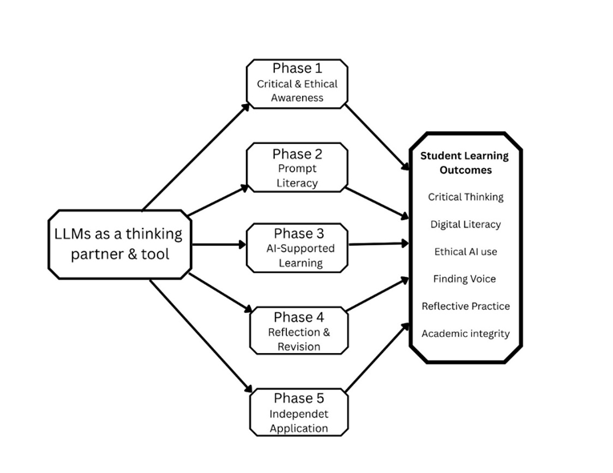
The Instructional Model for LLM-Supported Learning

Slide 9
Phase 1: Critical & Ethical Awareness
What are LLMs?
Where do biases exist?
What are the risks?
What responsibilities do students hold?

Slide 10
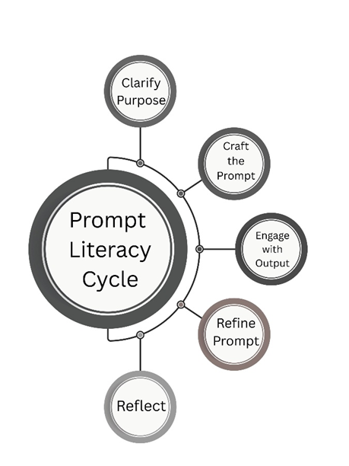
Phase 2: Prompt Literacy
Clarify Purpose
Craft
Engage
Refine
Reflect

Slide 11
Modeling Matters
Faculty should:
Think aloud while prompting
Show draft comparison
Revise publicly
Normalize uncertainty

Slide 12
Phase 3: AI-Supported Learning
Use AI to:
Not to:
Brainstorm
Outline
Generate alternative perspectives
Critique drafts
Replace original thinking

Slide 13
Phase 4: Reflection & Revision
Students analyze:
What did AI contribute?
What did I change?
Where did I disagree?
How did my thinking evolve?

Slide 14
Phase 5: Independent Ethical Application
Students develop:
Personal AI use policies
Field-specific case studies
Professional judgment

Slide 15
Syllabus Design Matters
Instead of:
Consider including:
AI use prohibited
When AI is appropriate
When it is not
Disclosure expectations
Alignment with learning goals

Slide 16

Sample Language
"In this course, generative AI may be used for brainstorming and revision support. Students must disclose AI assistance and remain responsible for accuracy, originality, and intellectual ownership."

Slide 17
What Faculty Gain
Reduced policing
Clear expectations
Deeper student reflection
Ethical transparency
Stronger academic integrity

Slide 18
If We Don’t Teach This
Students will:
Optimize for efficiency
Hide use
Develop shallow dependency
Experience inconsistent standards

Slide 19
The Larger Question
Are we preparing students to:
Avoid AI?
Or
Lead responsibly in AI-mediated environments?

Slide 20
AI cannot think. Yet it can shape how students think. What we do with that is the work.

Slide 21
THANK YOU
Questions?

