Slide 1
Designing Structured AI Use in Coursework: Lessons from a Graduate Geography Seminar on Global Climate Change
Yanan Li, Injeong Jo, & Yihong Yuan
Department of Geography and Environmental Studies
March 4, 2026
2026 AI in Teaching and Learning Symposium

Slide 2
Session Outline
Motivation
Course context
Coursework design
3-stage framework
Learning benefits
Practical strategies / Transferability
Q & A
Notes:
Frame this as practical and classroom-ready.

Slide 3
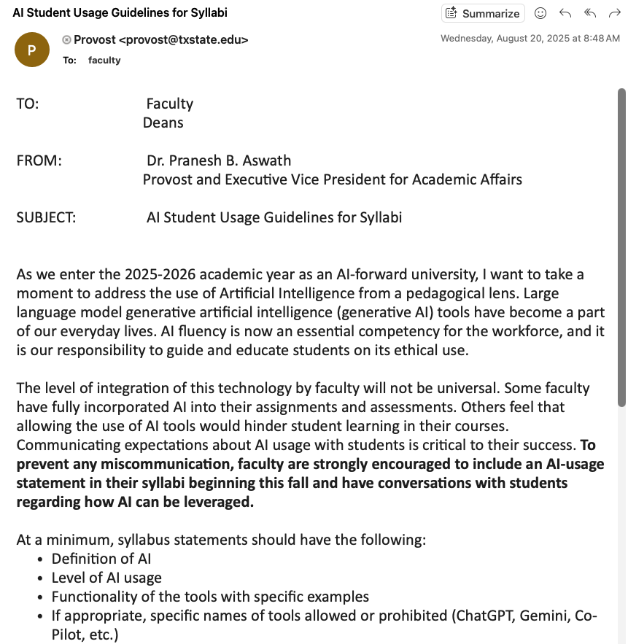
Motivation
University’s AI Policy
Proliferation of GenAI is changing
the education landscape
Why structured AI Use?
Some students already use AI
Risks:
Overreliance
AI’s hallucinations
Cognitive offloading
Opportunity:
Guided critical engagement
Responsible use
Notes:
Motivation
How can the field embrace the change GenAI brings without compromising authentic geography learning experiences while still encouraging innovation?
GenAI’s Influence on Education
Proliferation of GenAI is changing the education landscape
Growing concerns surrounding GenAI’s capacity to: misinform, spread disinformation, and perpetuate biases
Some use, some not – fairness
Opportunity: through structured and guided AI use, AI can be an efficient and effective tool for learning.
Therefore, Emphasize design over prohibition.

Slide 4
Course Context
GEO 5316/7337 Graduate Seminar: Global Climate Change
10 graduate students enrolled in Fall 2025
Class meets weekly, for ~3 hours
Course content: climate science, climate impacts, and human responses
Course Structure
Other activities:
Guest lectures
Career talk
Project discussion
Presentations
Peer evaluation
… …
Within classroom
Outside classroom
Announcements / “house keeping”
Lecture
Class discussion
Assigned readings
Homework:
Excel
Reflection writing

Slide 5
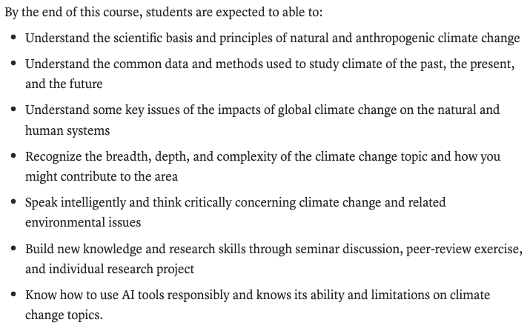
Course Learning Goals
Notes:
Build habits for responsible, critical use of AI in scientific reading and communication.

Slide 6

Three-Stage AI Integration Framework
Stage 1: Structured Comparison
Stage 2: Semi-structured
Stage 3: Autonomous Use
Human vs AI answers
Given questions
Strict template
Strict prompt
Accuracy scoring and justification
Reflection:
Comparison
AI’ strength and weakness
AI assisted learning
Given guiding questions
AI use documentation
Verification methods
other learning methods
Reflection:
AI usefulness
Fact-checking
Full freedom in final project
Individual project on
Literature Review
Research
Climate Fiction
Deliverables
Presentation
Paper
AI use documentation; transparent reporting
HW1 – HW6
HW7 – HW10
Final Project
Notes:
Structure shapes behavior
Reflection builds metacognition
Documentation increases accountability

Slide 7
Stage 1 – Structured Comparison
Student Workflow:
1) Carefully read the assigned material.
2) Produce your Human Answer to each question first (no AI).
3) Run Closed‑book queries to each AI (same or equivalent prompts across models).
4) Run Open‑book queries supplying the material (upload PDF or provide website).
5) Enter all answers in Excel; score each AI answer 1–10 with a short justification.
6) Write the 2‑page reflection to the fixed questions.
Submit both Excel and Word documents on Canvas.
Notes:
Students write answers first
Then compare with AI output
Score accuracy and justify
Do not overwrite your human answer after seeing AI outputs; treat your human answer as a baseline.

Slide 8
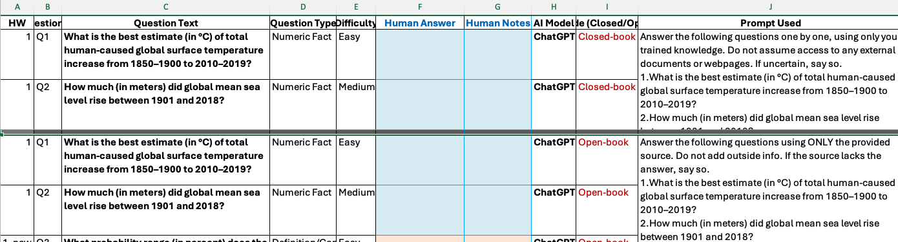
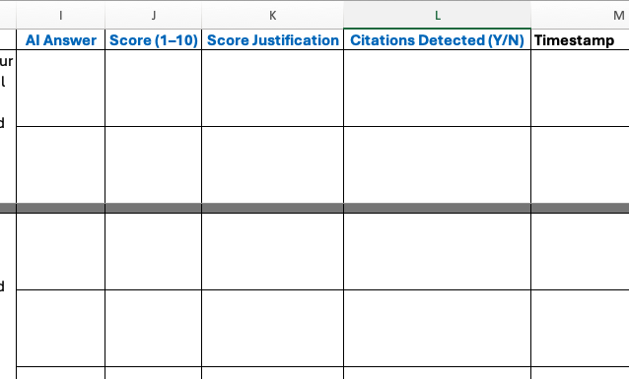
Stage 1 – Weekly Deliverables (2 items)
Excel sheet (template provided): your human answer + AI answers, scores (1–10) and short justifications.
Reflection (MS Word, ~2 pages, double‑spaced): respond to 3 fixed questions about the week’s experience.
Blue columns: for student’s entries
Notes:
The Excel is the structured dataset; the Word doc captures qualitative insights.

Slide 9
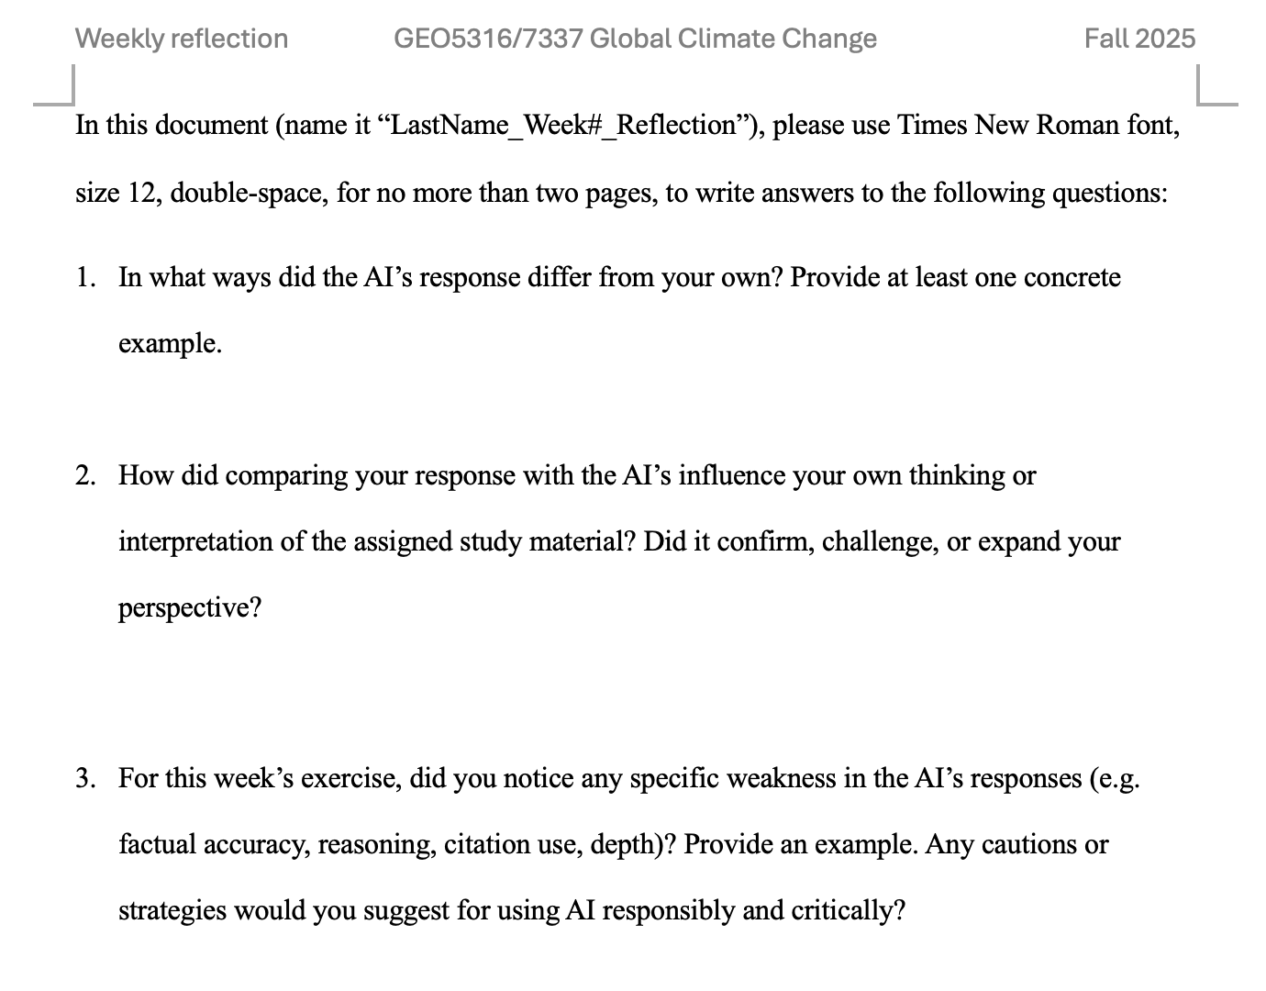
Excel sheet (template provided): your human answer + AI answers, scores (1–10) and short justifications.
Reflection (MS Word, ~2 pages, double‑spaced): respond to 3 fixed questions about the week’s experience.

Slide 10
AI Modes: Closed‑book vs Open‑book
Stage 1 – Strict AI Use
Closed‑book: The model does not receive the reading material. Ask the question plainly; no excerpts.
Open‑book: Provide the material (upload/attach text or paste excerpt) and ask the same question.
Notes:
No collaboration on answers; your human answer must precede AI runs.
Follow the exact prompt template for closed vs open modes.

Slide 11
Stage 2 – Semi-structured AI Assisted Learning
For weeks of HW7–HW10: “Each week, a PhD student will lead a lecture on a selected climate change topic. To prepare, you will complete a homework assignment before the lecture, using both the assigned readings, AI tools, and other methods to explore 5 guiding questions related to the topic.”
Defining “semi-structured” method:
Learning Geography
The guiding questions are generic and helpful for others to learn the topic, but the answers can’t be derived from the assigned readings.
AI Use
AI was mentioned as one of the tools they can use to help find answers to the guiding questions. Students are encouraged to use other methods (their traditional ways of learning a new concept). Document how AI was used.
Notes:
Explain the instruction to the PhD students. Then explain the difference from Stage 1. Simply put, from stage 1 to stage 2, the focus shifts from “Is AI right or wrong?” to “How can AI support my learning?”
In regard with the use of AI, for HW1-6, students obtain AI-generated answers using a strict prompt given by me, and they directly compare human vs. AI answers. The goal was to help students get familiar with AI tools, learn how AI performs/fails. For HW 7-10, AI was mentioned …. There is no comparison, instead only the answers they come up with to the guiding questions, and the documentation of how they used AI (see the semi-structured Excel template). Basically, students have freedom in how they use AI.
3–5 topical questions
2) AI required but flexible: You are required to use one or more AI tools (e.g., ChatGPT, Gemini, Copilot, Perplexity, Grok) to assist your learning—not to replace it. Use AI to clarify complex ideas, check facts, identify examples, or improve your writing. AI should be treated as a scholarly assistant, not an authority. You are fully responsible for the accuracy and integrity of your work.
3) For any use of AI tools, you must document using the provided Excel template.
Must document prompts + verification

Slide 12
Stage 2 – Semi-structured AI Assisted Learning
1) Carefully read the assigned material.
2) Use AI in your learning to answer the topical questions.
3) Document any use of AI tools using provided Excel template.
4) Write the 2‑page reflection to the fixed questions.
5) Submit both Excel and Word documents on Canvas.
Student
Workflow:
Notes:
AI expected
Flexible usage
Mandatory verification
Written reflection

Slide 13
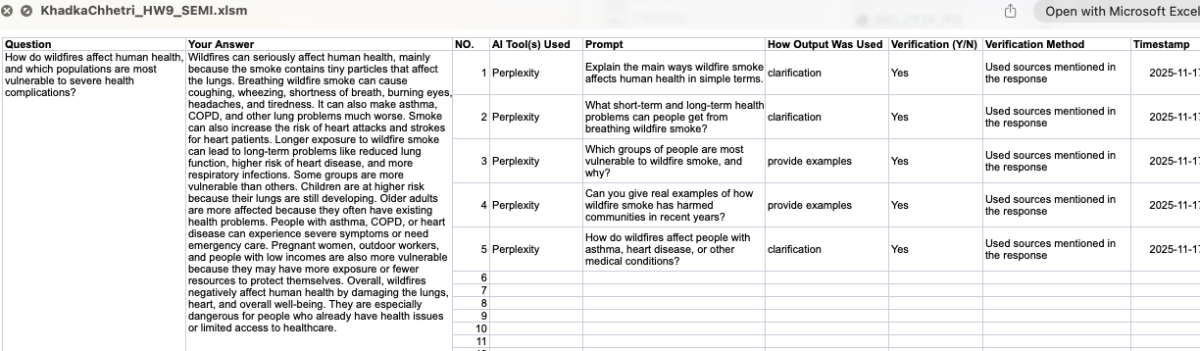
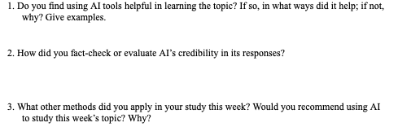
Stage 2 – Assignment Example
Excel: enter answers / document AI use / verification
Reflection.doc

Slide 14
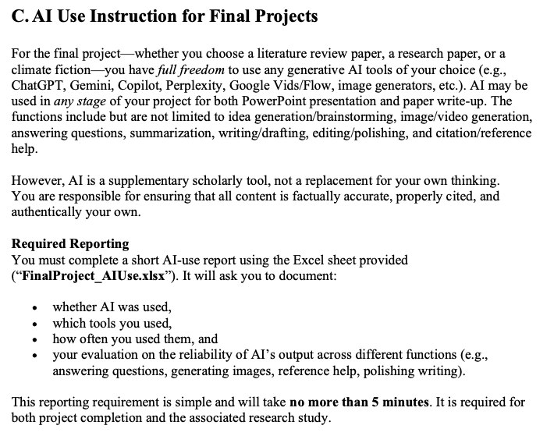
Stage 3 – Autonomous AI Use
Independent final project
Full freedom
Mandatory documentation
Notes:
Transfer skills to authentic work.

Slide 15
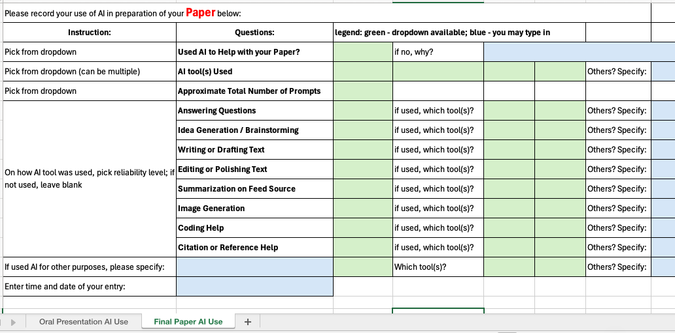
Stage 3 – AI Documentation
Tool used / Prompt summary / How output used / Verification / Trust level
Notes:
Emphasize transparency over restriction.
Tool used
Prompt summary
How output used
Verification Y/N
Trust level
Screenshot of Excel doc

Slide 16
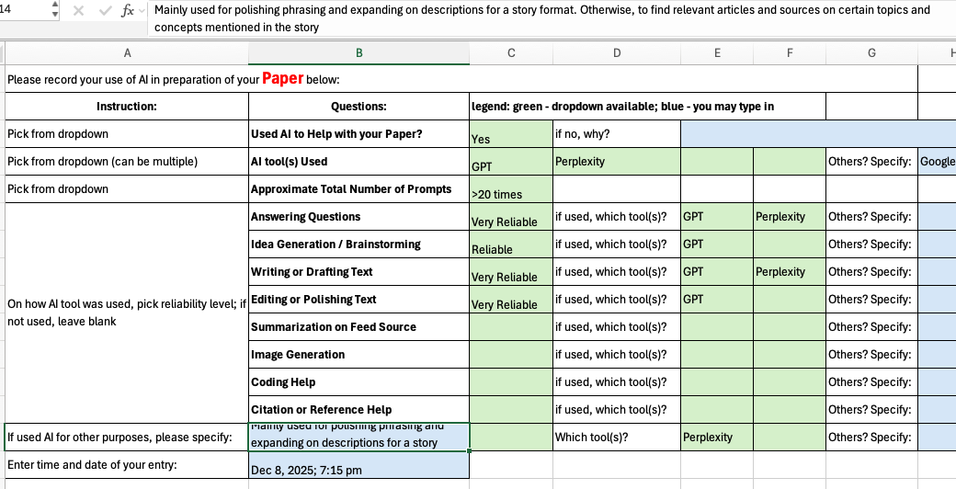
Stage 3 – Final Project showcase
Notes:
Example of AI use in final project

Slide 17


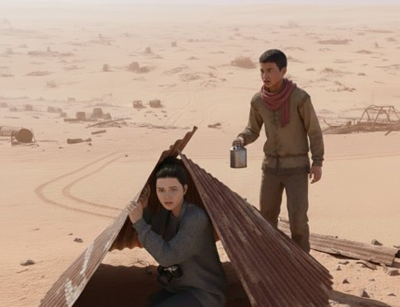
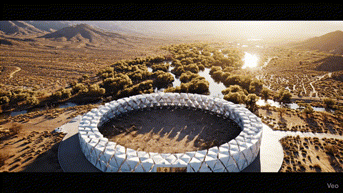
Final project example: A student wrote a fictional story about a future Earth where a climate-controlled dome, Eden-31, shelters a privileged elite from a world destroyed by global warming. A girl, Kya, escaped the dome to find a legendary natural sunset, but only found the brutal reality of climate injustice…
Eden-31

Slide 18
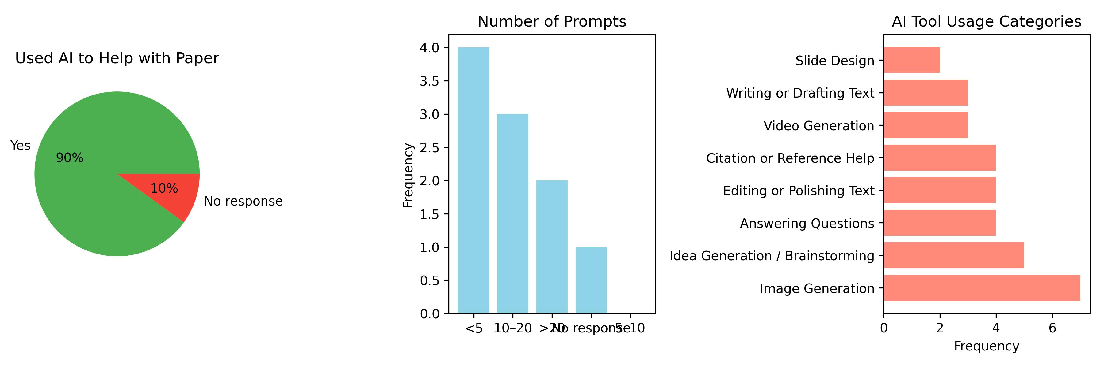
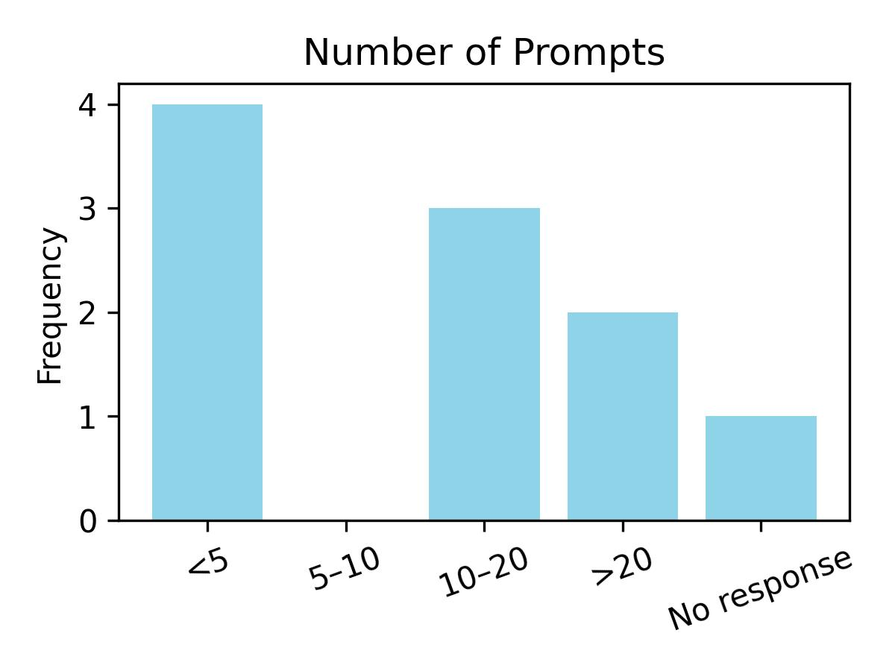
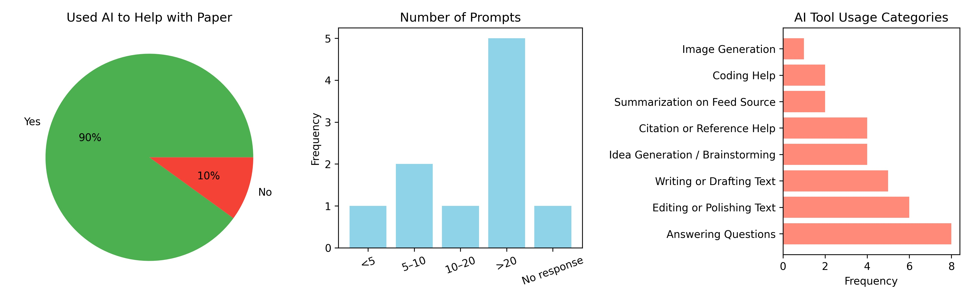
Stage 3 – AI use statistics (n = 10)
For Final Project presentation:
Used AI to help with presentation?
For Final Project paper:
Used AI to help with paper?
Notes:
“I did not use AI to help me write my paper because I have wanted to write my own science fiction story ever since I joined the Creative Writing club in my Junior year as an undergraduate. Concepts within the paper come from my preexisting knowledge on climate and concepts explored in various works of fiction and nonfiction which I have read/watched.”

Slide 19
Improved Learning Results:
Students learn better because of this design:
Learning Experience
AI Experience
Learning Benefits
AI helped clarify concepts and expand understanding
Improved writing flow
Provided examples and summaries
Observed Strength
Clarification
Synthesis
Language support
Visualization
…
Growing Awareness
Recognized hallucinations
Less blind trust
More intentional prompting
Observed Weakness
Inaccurate facts
Fabricated citations
Violation of prompts
Long thinking time for images/videos
…
Notes:
students actually learn better as a result of this design (for example, scientific reading, fact-checking habits, writing clarity, and epistemic judgment (knowing when not to trust AI)).
Learning benefits: Highlight geography concept learning.
Attitudes about AI: Show evolution across semester.
Weakness: overconfidence
Discuss need for verification.

Slide 20
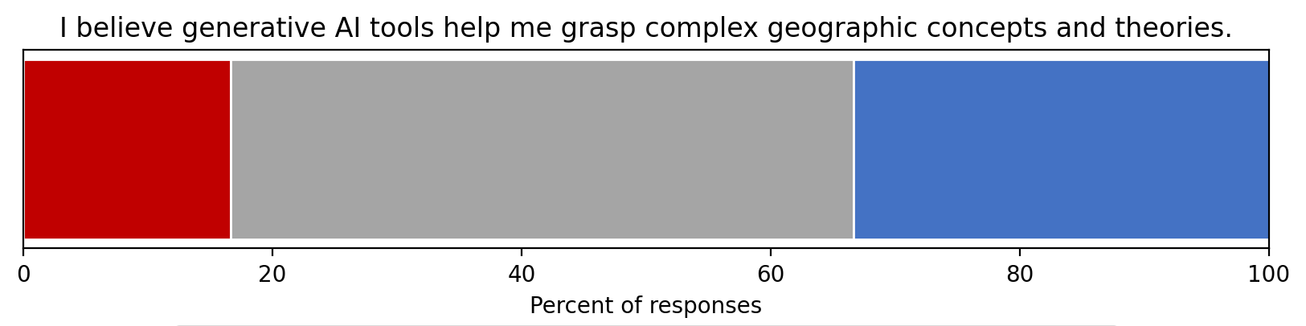
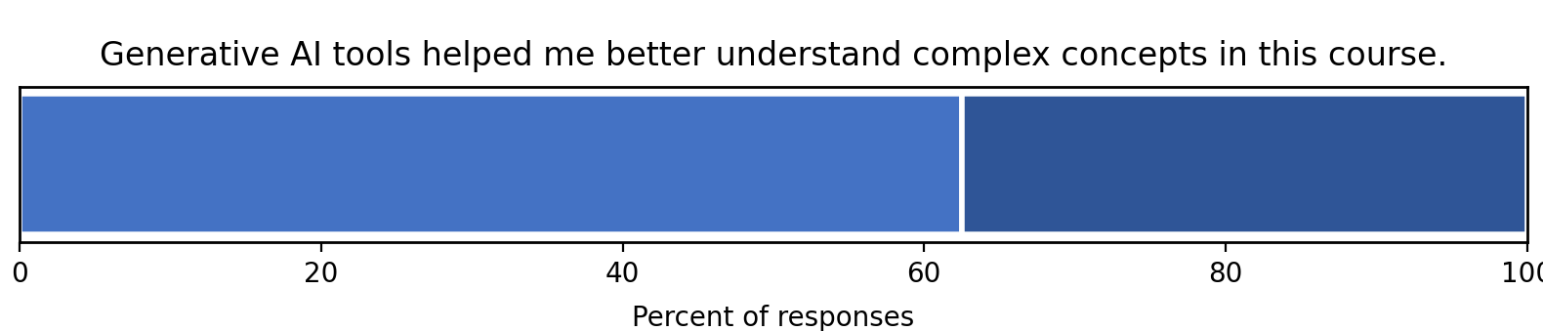
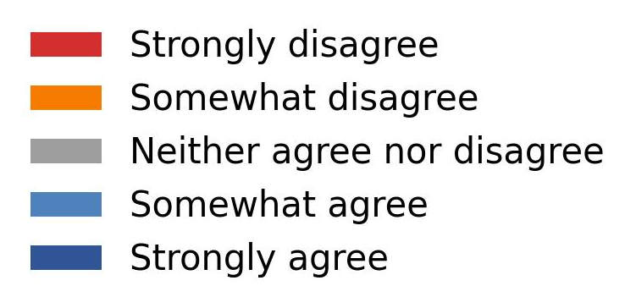
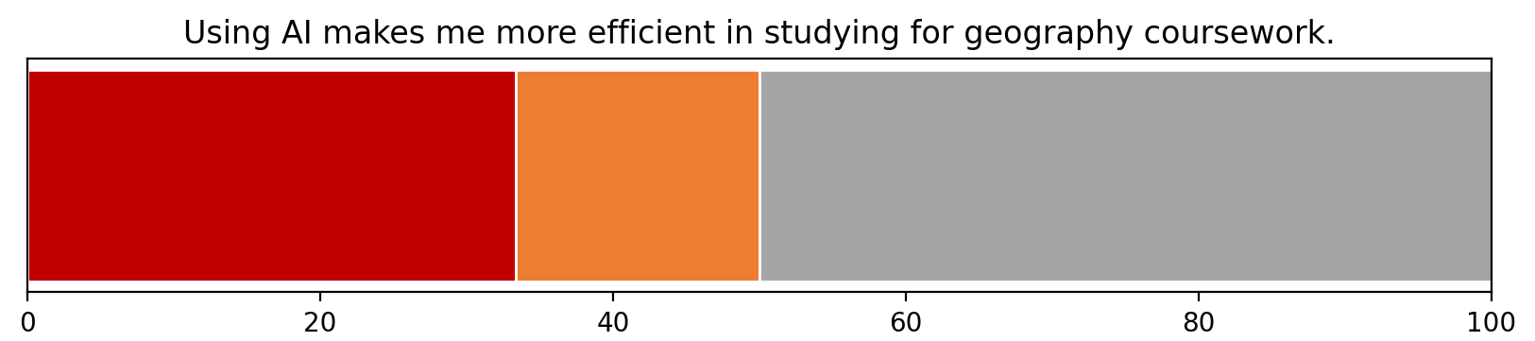
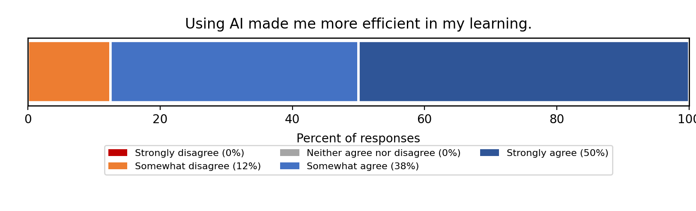
Students’ Perceptions: pre- and post-class
Pre-survey
Post-survey
Pre-survey
Post-survey
Notes:
Attitudes about AI: Show evolution across semester.

Slide 21
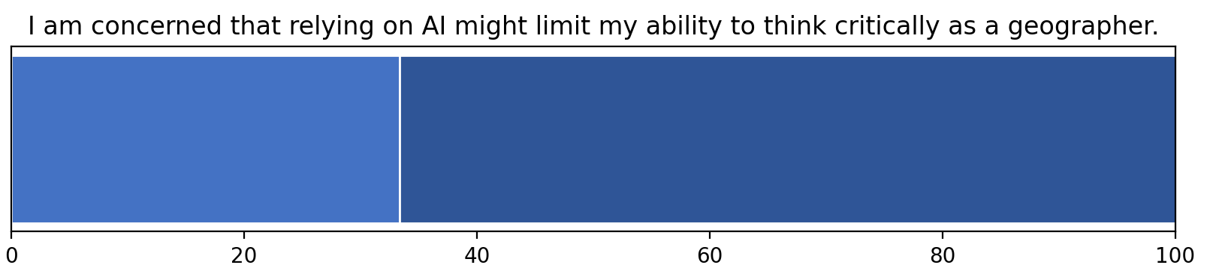
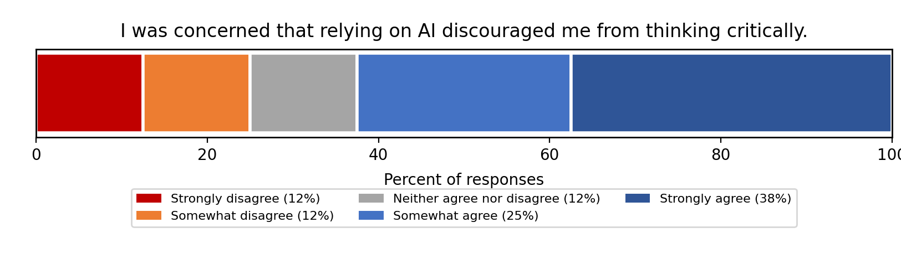
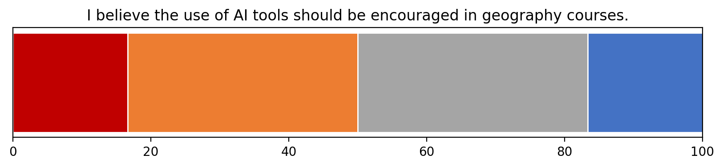
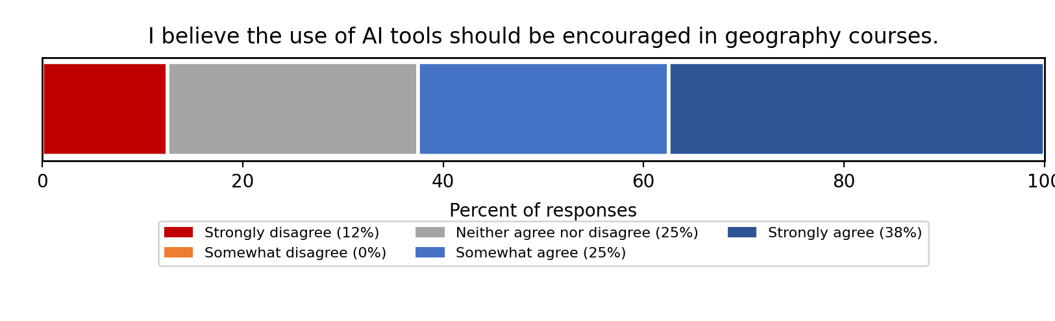
Students’ Perceptions: pre- and post-class
Pre-survey
Post-survey
Pre-survey
Post-survey
Notes:
Attitudes about AI: Show evolution across semester.

Slide 22
Practical Strategies / Transferability
Familiarity with AI tools
Begin with strict use; provide details
Make AI visible with an open mind
Transparency
Prompt records
Trust level rating
Fact-check
Require external source check
Ask: how do you know this is correct?
Clear responsibility
Metacognition
Ask students
How did AI change your thinking?
Where was it wrong?
Would you trust it again?
Start Constrained
Require Documentation
Embed Verification
Build Reflection
Notes:
Encourage scaffolded rollout.
2. Transparency normalizes ethical use
Model epistemic responsibility.
Reflection drives metacognition.

Slide 23
Accessibility
Works in humanities, STEM, social sciences
Design > technology
No advanced AI expertise needed
Minimal Technical Barrier
Use tools you and/or students already access
Focus on pedagogy
Adapt structure to class size

Slide 24
Limitations and Concerns
Small graduate cohort
Single-course case study
Future scaling needed
Large amount of preparation
Rapid changes in AI technologies
AI literacy is a workforce skill
Students need critical habits
Higher Education must lead responsibly
But it matters, because
Notes:
Position framework as solution.
Academic integrity
Loss of rigor
Equity in access
Why This Matters Now
Connect to broader institutional mission.
AI literacy is workforce skill
Students need critical habits
Higher ed must lead responsibly

Slide 25

Key Takeaways
Design AI use intentionally
AI supports disciplinary learning
Teach the importance of responsible, reflective, and critical AI use
Shift from control to autonomy
THANK YOU!
Questions & Discussion
*The use of students coursework data has been approved by IRB project (#10358).
Notes:
Know the verification importance, have confidence and critical awareness of AI’s strengths and limitaitons
Advancing AI literacy
Embracing GenAI use while being mindful of the challenges and opportunities it presents is essential

