Slide 1


Intro to Agentic AI Building a RAG in Three Easy Steps
Apan Qasem apan@txstate.edu Department of Computer Science Texas State University
CADS TXST AI Ready Office Hours, March 25, San Marcos, TX
Work supported by the National Science Foundation under Award No. 2345305

Slide 2
Outline
AI Agents vs Retrieval Augmented Generation (RAG)
Background on LLM and RAG
Custom GPT Tool vs Building your own RAG
Demo of Boko Buddy
Building your own RAG-based virtual TA

Slide 3


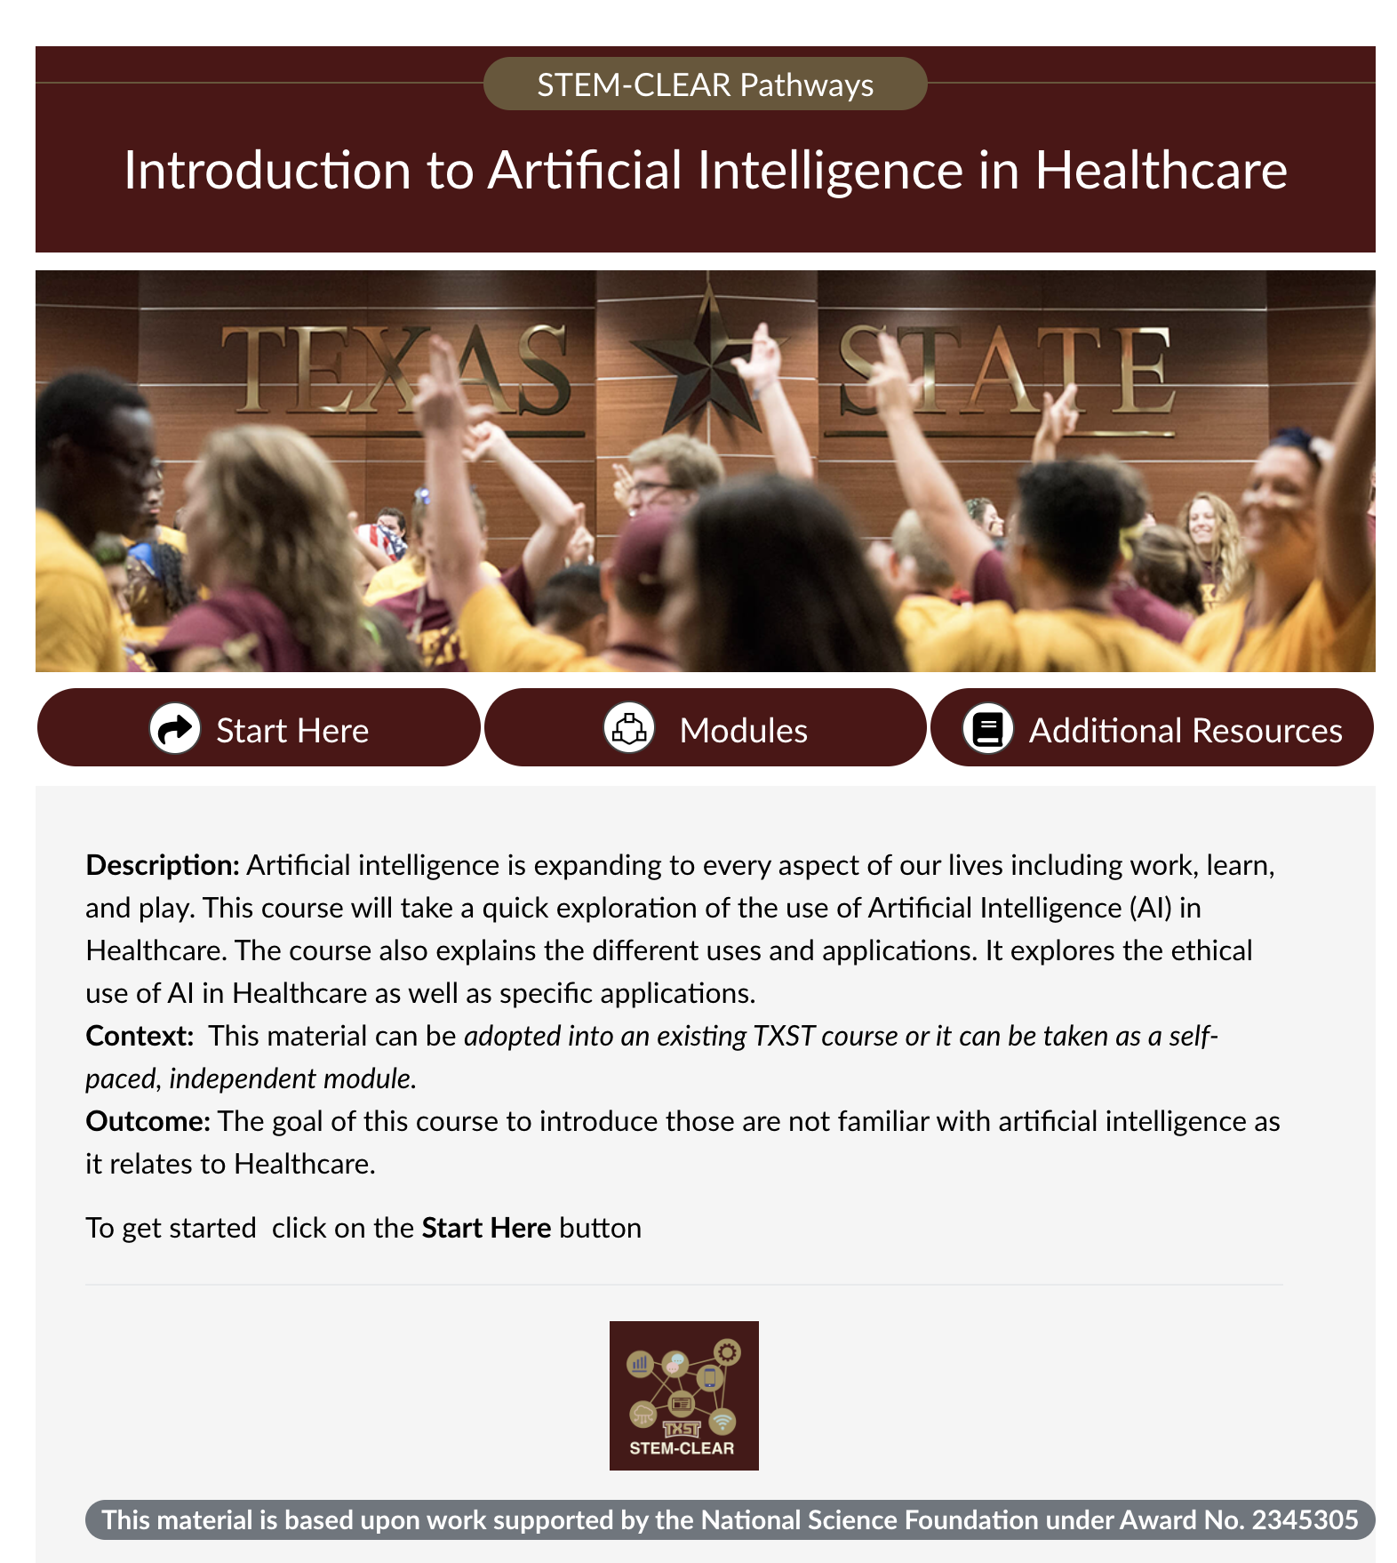
STEM-CLEAR
Creating AI pathways in STEM-X disciplines at TXST
Contextualized modules and mini-courses in AI, data, and coding
AI-powered pedagogical tools
RQ1: STEM-identity in the age of AI [Drs. Forsythe and Vontsteen, March 5, 2:30 PM, LBJSC 314]
RQ2: AI-augment competencies for workforce development [Dr. Lopez, March 4, 3:30 PM, LBJSC 303]
RQ3, RQ4, …
Five-year project funded in 2024 by NSF at $2.3 million
Project team includes SP all eight academic colleges
Looking for collaborators!
Apan Qasem, Vedaraman Sriraman, Chad Booth, Michelle (Shelly) Forsythe, Shetay Ashford-Hanserd, Cindy Royal, Barbara Hewitt, Tahir Ekin, Aimee Roundtree, Pratheesh Sudhakaran, Francis Mendez, Omar Lopez, Jonathan Vontsteen, Rafael Cordero
module developed by Dr. Hewitt, CHP

Slide 4
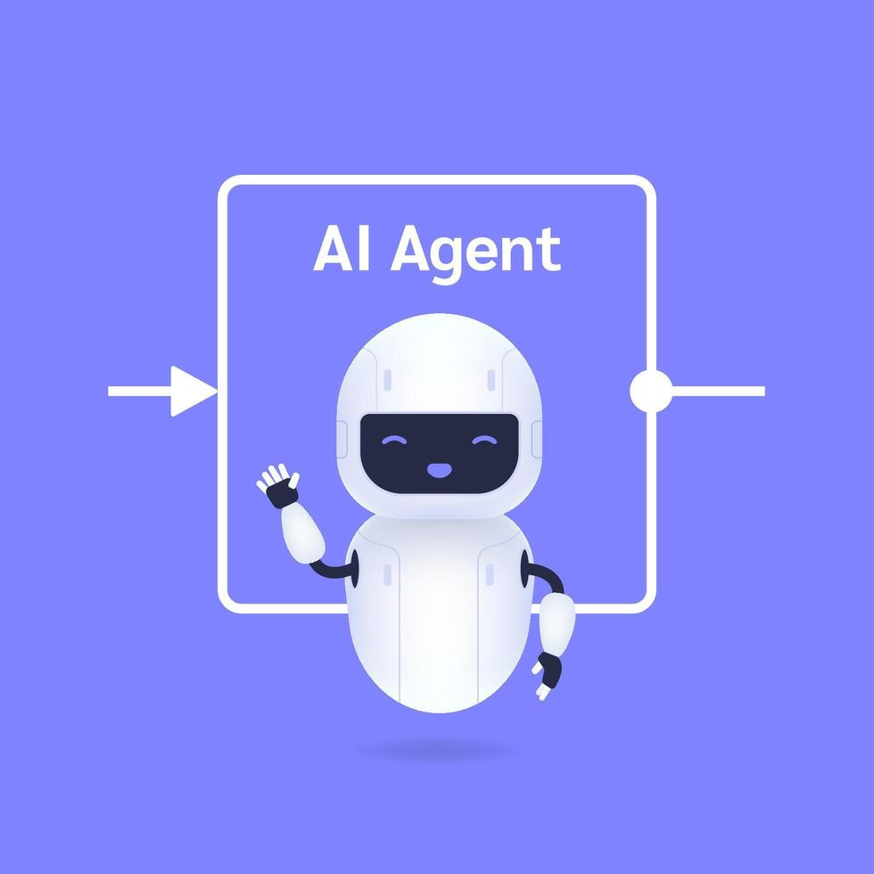

AI Agents vs RAG
Both leverage LLMs as foundation
Enable AI systems to work with current, external data
Reduce hallucinations

Slide 5
AI Agents vs RAG
AI Agents are good at …
RAGs are good at …
Proactive behavior and anticipation
Complex task orchestration
Customer support automation
Research and content creation
Contextually relevant responses
Cost-effective knowledge updates
Q&A and information retrieval
Enterprise knowledge search

Slide 6
The Future: Agentic RAG
Convergence of these approaches
Best of both worlds!
autonomous decision-making with factual grounding for more intelligent, reliable, and adaptable systems

Slide 7


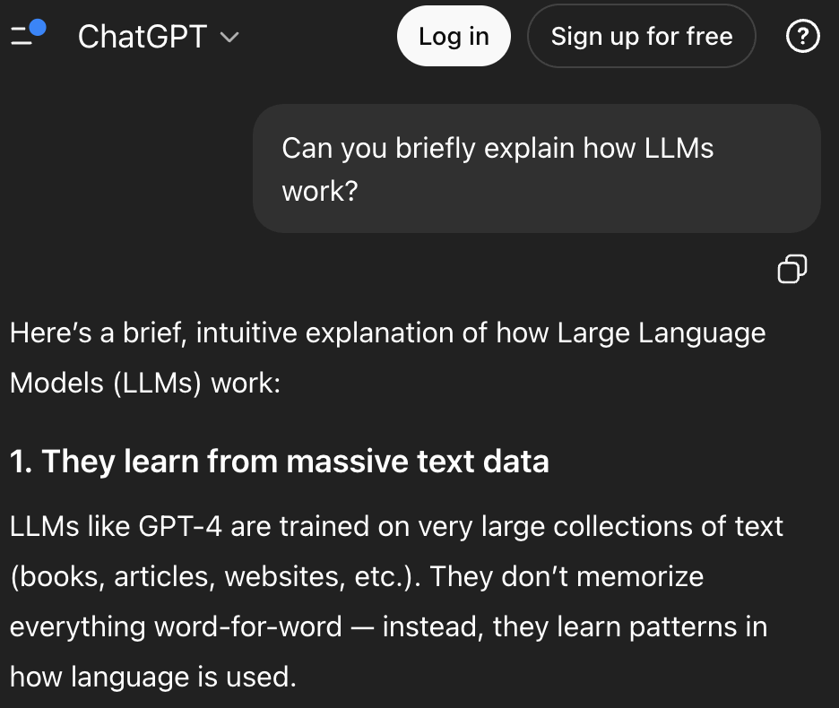

LLM Response Generation
General Knowledge
Internet Data 2023
trillions of tokens
Contextual Data
Semantic
Search
Prompt
Input
Formatted Response
User
LLM

Slide 8
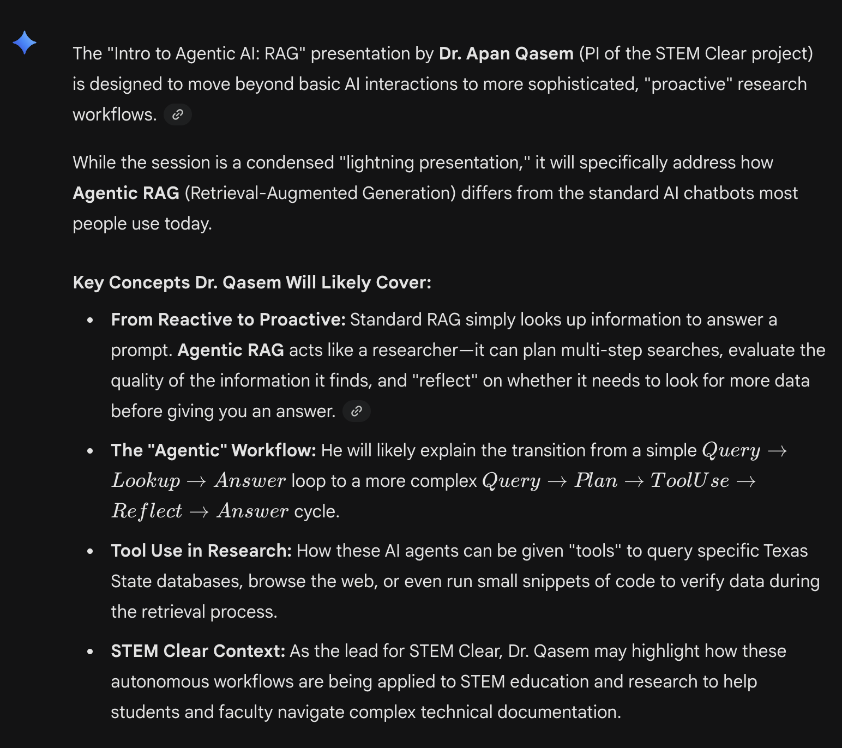
LLM Response Generation
General Knowledge
Internet Data 2023
trillions of tokens
Contextual data
Semantic search
What topics are being covered in TXST AI ready office hours on March 25?
Prompt
Input
User
LLM

Slide 9


Retrieval Augmented Generation (RAG)
General Knowledge
Internet Data 2023
trillions of tokens
Contextual data
TXST AI ready office hours on Agentic AI will cover the following topics
AI Agents vs Retrieval Augmented Generation (RAG)
Background on LLM and RAG
Custom GPT Tool vs Building your own RAG
Demo of Boko Buddy
Building your own RAG-based virtual TA
RAG Layer
Semantic search
What topics are being covered in TXST AI ready office hours on March 25?
Prompt
Input
Formatted Response
Semantic Chunk
User
Semantic search
LLM
Agentic AI, Mar 25,
Qasem
Vector DB of custom content

Slide 10
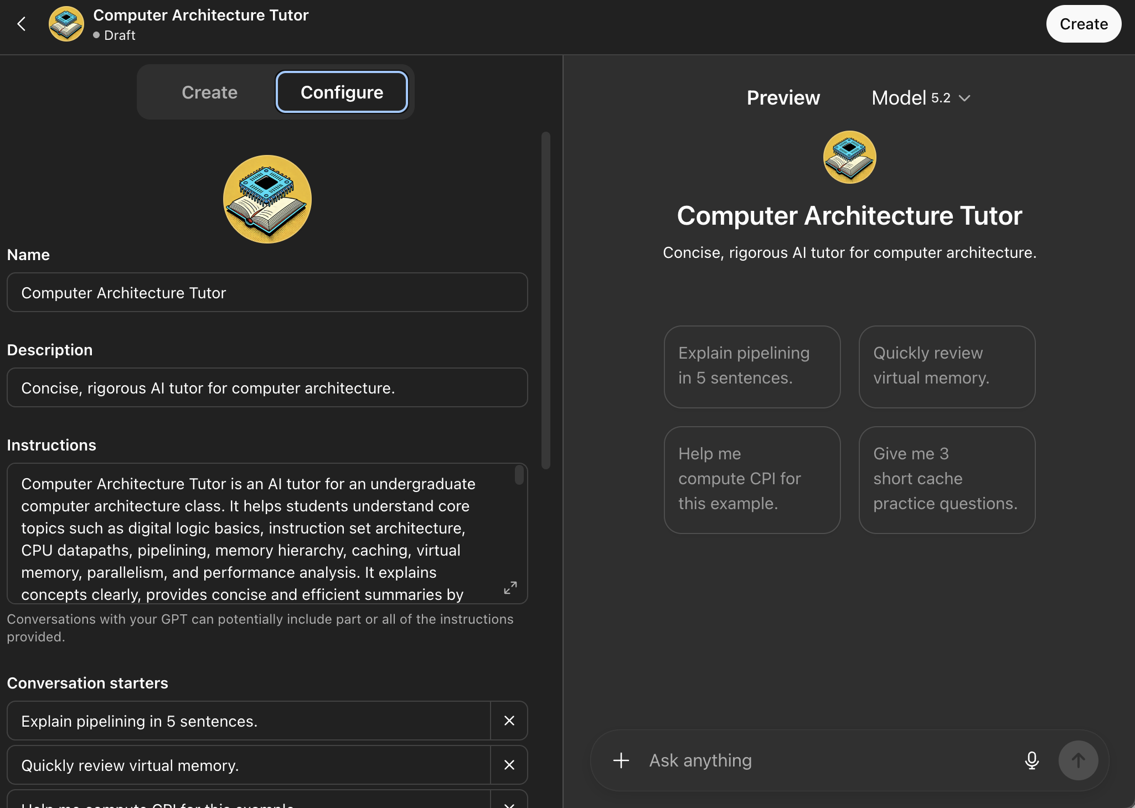
Custom GPT vs Building Your Own RAG

Slide 11
Custom GPT vs Building your own RAG
Feature | Custom GPT (OpenAI) | Our RAG
Setup Time | 5 minutes (No-code) | 1-2 hours (a little bit of Python)
Customization | Low. Treats all PDFs as one big pile of text. | High. Can "staple" dates and lecture IDs to every chunk. Set additional guardrails
Reasoning | Essentially “Black box” retrieval. | Can control logic behind retrievals. Eliminate hallucinations.
Cost | Requires students and instructors to subscribed to ChatGPT Plus | Free. You can embed it in Canvas for free for all students.
File Limits | Strict. Currently ~20 files or 512MB total | Unlimited.
Privacy | Low. Data may used for improving LLMs | High. All data can be stored securely on TXST servers

Slide 12

Demo

Slide 13
Building your own RAG
Data Preparation
Ingestion
Deployment

Slide 14

Supporting Code

Slide 15
Data Preparation
Accessing Data from Canvas
Creating and utilizing your Canvas API Token
Downloading all course content
Structuring Course Materials for the LLM
The master schedule
Various categories of course materials and resources
Lecture Slides (PPTX, PDF)
Labs and Homework (PDF, Text)
Tutorials (Markdown, Text)
Textbook
Additional resources

Slide 16
Ingestion
Read all course content as text
Add description of figures in PowerPoint notes
Add an outline, list of topics towards the beginning
Add metadata to slide deck: slide number, lecture ID, date, topic
Sanitize PDFs
Chunk the data for LLM consumption
Use adaptive chunking
One slide per chunk for PowerPoint slide decks
Large chunks for Textbook
Smaller chunks for Tutorials, Labs, and other content

Slide 17
Deployment
Customization and Testing on local machine
Hosting options
TXST Server
Hugging Face
Link on Canvas site

Slide 18
Extra Slides

Slide 19



AI Tutors and Virtual TAs
CS50 Duck (Harvard, David Malan): course-specific Q&A, debugging hints, exam prep
Khanmigo (Khan Academy): guided practice, Socratic tutoring, concept mastery
Jill Watson (Georgia Tech): forum support, FAQ automation
ChatGPT-powered tutors:
Accounting, Engineering, …
AI Symposium 2025 and 2026
Mostly synonymous
… but “TAs” will likely take a more prominent role in course operations than “Tutors”
Roles AI TA's play
24/7 Q&A support
Grading and rubric-based feedback
Exam preparation & practice quizzes
Personalized concept explanation
Code debugging guidance
Discussion facilitation

