Slide 1
Building Emergency Coordinator Program

Slide 2
Agenda
The Building Emergency Coordinator (BEC) Program
BEC Roles and Responsibilities
BEC Activities, Information and Resources
Texas State University (TXST) Emergency Notification

Slide 3
What is the BEC Program?
The BEC Program’s purpose is to create and maintain safeguards, security, and emergency management which are essential to ensure that Texas State University to mitigates risk, continue to perform its mission in the event of a natural or man-made disaster or extraordinary events that could disrupt normal operations.
This readiness program is vital to protecting the lives and health of Texas State University’s faculty, staff, students, and associates; minimizing damage to and loss of university property and assets; and restoring normal operations as rapidly as possible.
BECs Serve as an extension of Emergency Management in the prevention, protection, mitigation, response, and recovery phases of an emergency.

Slide 4
Duties
Meet with and inform employees of your role and provide them with preparedness and safety information.
Inform the emergency management team should you need to be removed or replaced as BEC for your department or building.
Create and maintain a building emergency plan for your building and share it with your department members.
Establish designated check-in methods for during emergencies

Slide 5
Roles & Responsibilities
Emergency Role
Liaison Role
Planning Role

Slide 6
Planning Role
Risk Assessment:
  Identify building-specific risks (fire hazards, chemical storage, labs, high-traffic areas, etc.)
  If unsure about what in the office may be a risk BECs can request a risk assessment walkthrough with the emergency management team.
Communication and Coordination:
  Serve as information disseminators for the building in their purview as a means to assist in the distribution of safety information to the occupants of their building and ensure safety procedures are posted throughout the building.
  Educate your buildings occupants on safety procedures and evacuation routes.

Slide 7
Liaison Responsibilities
Occupants of the building:
Provide clear instructions during emergencies
Share status updates when possible
Reassure and keep people calm to reduce panic
Emergency Responders:
Identify yourself as BEC
Provide a quick briefing
Share building information
Emergency Management:
Communicate building status updates as they happen
Pass along occupant needs
Serve as the single POC to reduce confusion

Slide 8
Emergency Role
During an emergency BECs serve as a bridge between building occupants and first responders. While the BEC serves as the primary POC for building-related emergencies for buildings with multiple BECs you may not be the POC.
After calling 911 or during an alarm activation begin to direct occupants to follow the correct procedure:
  Evacuate
  Shelter-in-place
  Lockdown
Direct occupants to towards safe exits or shelter areas
When emergency responders arrive be available as the POC but do not prevent them from doing their job
Remember you are not a first responder never put yourself in harms way

Slide 9
Building Emergency Action Plan
What is a BEAP?
  A document that prepares the building occupants for possible emergency situations.
Who creates the plan?
  The Building Emergency Coordinator (BEC) should coordinate the completion of the checklist and development of the BEAP with their department leadership.
Reviews of the plan:
  The emergency manager will review the BEAP and provide comments for plan improvement
  All BEAPs should be reviewed and revised, if needed, on an annual basis.
  Once a plan is created and reviewed the BEC representatives should then educate their personnel on the BEAP, focusing on specific building evacuation routes, sheltering areas inside the building, access and functional needs provisions, and outside evacuation assembly areas.

Slide 10

Training
The Emergency Management staff will facilitate training opportunities for all BEC members. BEC members are strongly encouraged to register for these training sessions and may request specific courses through the Emergency Management staff to further enhance their skills and knowledge. These trainings are not mandatory however, we encourage all members to participate when possible.
Initial Training:
  Review the BEC program PowerPoint and fact sheet
Formal Training:
  First Aid CPR & AED, Stop the Bleed, Skywarn, CRASE, and Active Shooter

Slide 11

Emergency Procedures

Slide 12
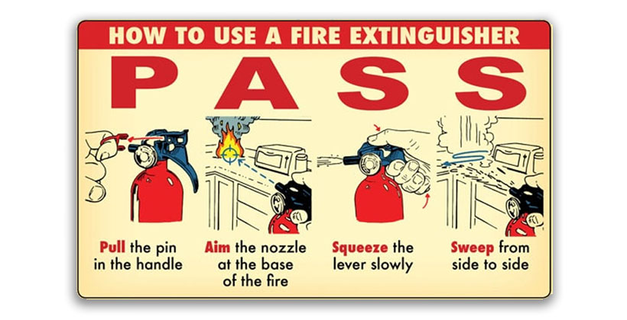
Fire
Activate the fire alarm using the manual pull station if the alarm is not already active.
Evacuate the building and notify all building occupants.
Do not use the elevators.
Have a plan to evacuate persons with disabilities.
Move to the rally point, PLEASE do not reenter the building until notified by emergency personnel.

Slide 13
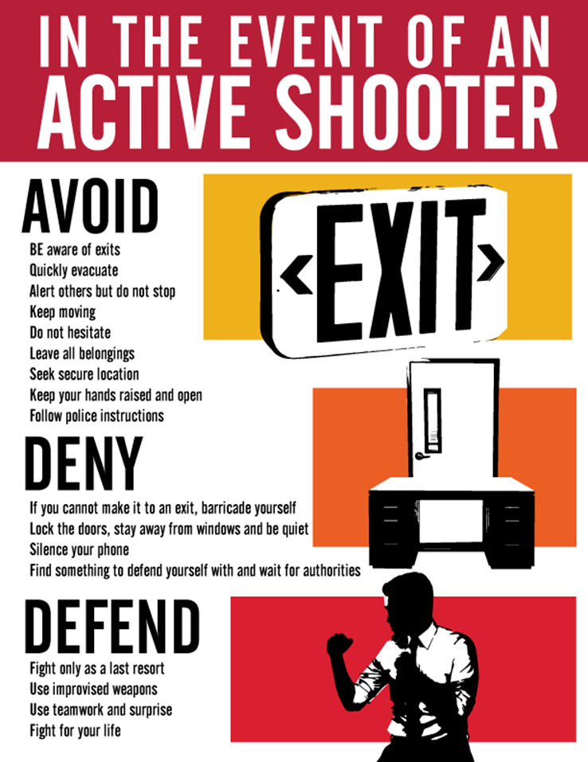
Active Shooter
During an active shooter situation BECs role is to guide, coordinate, and communicate
Do not put yourself at unnecessary risk you are to follow Avoid, Deny, Defend protocols like everyone else.
If you must remain inside of the building attempt to remain calm and account for the people you have in the room with you if possible.
If it is safe to do so call 911 or dispatch at (512)245-2805 and alert them of any information you have (what room you are hiding in, how many people are there, if you have any information on the shooter)

Slide 14
Medical Emergencies
Immediately dial 911
  Provide type of injury or medical condition
  Give the exact location of the injured person. You may be asked to stay on the line until medical services arrives
Provide first aid or medical assistance if required and within your capability.
If the person is unconscious and not breathing begin CPR, if trained to do so.
Remain with the injured person until Emergency Medical Service (EMS) arrives

Slide 15
Threats
In the event of a Bomb Threat
  Do not handle the items.
  Gather as much information as possible from the caller.
    If possible, location, type, description
  Dial 911
  Follow the direction of law enforcement.
In the event of a Suspicious Package
  Do not handle the items.
  Get as much information as possible from the caller about the package.
    If possible, location, type, description
  Dial 911
    Do not use any electronic device near the package.
  Follow the direction of law enforcement.
  Evacuate the area surrounding the package and await instructions from UPD.

Slide 16
Swatting
If you receive a threat immediately notify law enforcement they will assess the situation and provide guidance regarding facility lockdown, search, and/or evacuation.
Only relay verified instructions/information given by emergency personnel and encourage calm behavior to prevent panic.
Swatting is a malicious act that can involve placing false emergency calls to emergency responders, often reporting a (false) severe, ongoing crisis at a specific location. The goal of swatting is to provoke a significant law enforcement response, creating chaos and potentially resulting in violence.
Remember even if you suspect that a call is false always treat the incident as a genuine threat
If an evacuation is ordered guide occupants to safety assembly areas. If lockdown is ordered lock doors, turn off lights, move away from doors and remain calm.
If possible, stay in contact with emergency management or law enforcement to provide situational updates from your building.

Slide 17
Power Outage or Utility Failure
Report and power outage or utility failure the university police department (512-245-2805)
If there is a possible danger to building occupants, exit the building and 911.
Notify emergency personnel of persons with disabilities, who are in the building.
If there are any individuals trapped in an elevator.
The TXST administration will decide on the status of classes based on the situation.

Slide 18
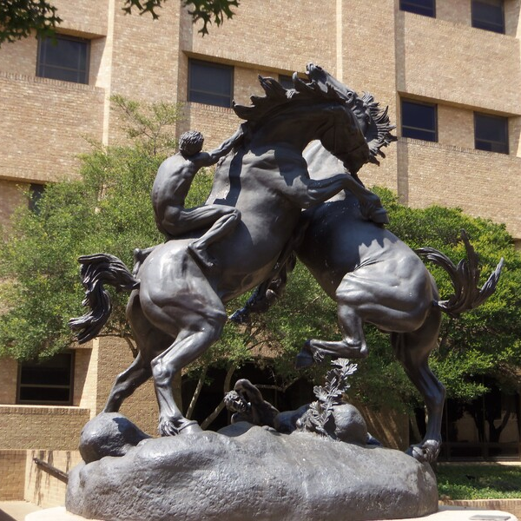
Expressive Activities
Who may assemble: Only students enrolled at, and employees of, Texas State have the right to peacefully assemble in the common outdoor areas of Texas State campuses for expressive activities.
Non-affiliated individuals: Individuals not affiliated with Texas State may only assemble peacefully in area designated as a traditional public forum by Texas State unless invited, sponsored, and approved by the university.
Time Parameters: Only permitted between 8:00 AM and 10:00 PM.
Date Parameters: During the last two weeks of a semester or term anyone engaging in expressive activity is not permitted to materially and substantially disrupt the functioning of the institution
Identification Requirements: Individuals must present valid ID and proof of status at the university upon request by law enforcement or university official
https://studentinvolvement.txst.edu/freedomofexpression.html

Slide 19
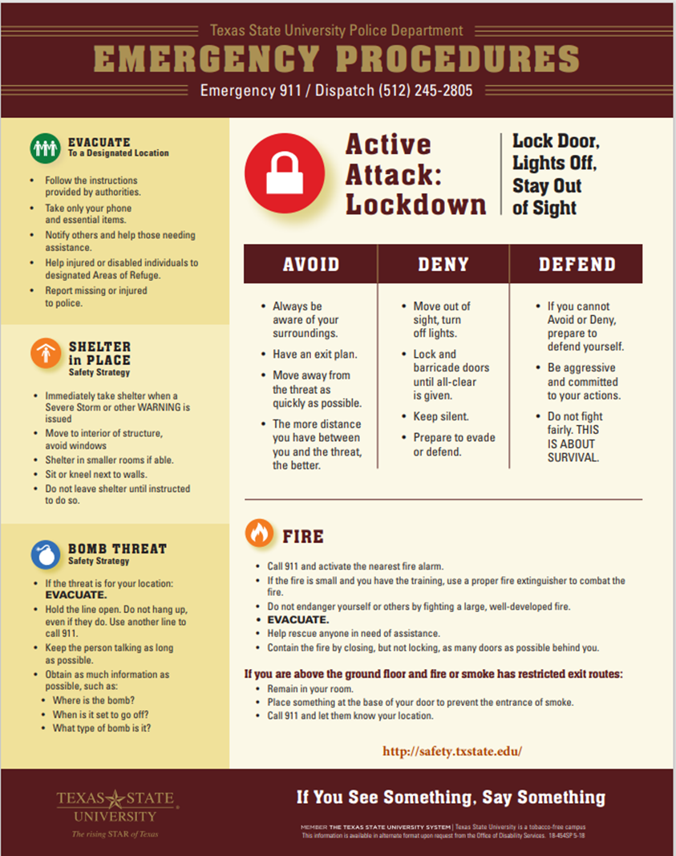
TXST Emergency Procedures Poster
This poster should be placed in visible locations throughout your building, classrooms, hallways, and high foot traffic areas.
If you do not have this poster, please contact the Emergency Management staff and we will bring you a posture to place in your departments and buildings.

Slide 20
Severe Weather Notification
Monitor Severe Weather:
  Use the National Weather Service (NWS) for updates.
  For local forecast by enter: 78666 (Austin/San Antonio, TX)
  Forecasters can be reached 24/7 at 800-292-5508 if you have any questions.
  https://www.weather.gov/ewx
Difference between Weather Watches and Warnings:
  Watch means hazardous weather is possible
  Warning means hazardous weather is occurring, and posses a risk to life and property

Slide 21
TXST Emergency Notification
TXState Alerts:
  The TXState Alert system is an emergency notification system that uses email and text messages to notify the university community about potentially dangerous situations:
    To get text message alerts, you must opt in to the system. The service is free, but note that depending on your texting plan you may be responsible for additional charges from your provider.
    All users with a @txstate.edu email address are automatically registered to receive email alerts.
TXST Closures:
  Weather related TXST closure decisions are made by the TXST President or their designee.
  TXST closure means the suspension of normal activities however, essential services such as EHSREM, UPD, Facilities, and others may continue to operate

Slide 22
EHSREM Contact Information
Dr. Wendy McCoy
Director, EHSREM
email: wendy.mccoy@txstate.edu
phone: 512.245.3616
Karla Munoz-Rivera
Emergency Manager
email: mwn25@txstate.edu
phone: 512.245.6804
Madison Covington
Emergency Management Specialist
email: madison.covington@txstate.edu
phone: 512.408.8405
512.245.3616
EmergencyManagement@txstate.edu
Emergency Management Staff
Co-located at UPD
1321Academy St, Pecan Building
San Marcos, Texas 78666

