Slide 1


Research 101
Notes:
1

Slide 2

Research and the Scientific Method
OVERVIEW OF LESSON 1
Credible Tools of Research
Different Types of Research
Recap of Types of Research
Quantitative vs. Qualitative Research
Importance of Research
Notes:
2

Slide 3

What is Research?
1. Research question(s)
2. Data collection
3. Documentation of the information/data
4. Analysis of that information/data
Notes:
Research is a process of scientific inquiry or investigation that involves the Scientific Method
Conducting research includes four key things:
Research questions. Youre trying to understand the way something works, or why something is happening, or possible solutions to problems you care about.
Data collection. Collecting information from experiments, previous research, surveys, these are all necessary for research
Documentation. To report your findings, you have to compile all your work into a project, paper, a poster, or some kind of documentation that explains your research.
Analysis of data. This is where you look at your results and determine what they mean, Are they good or bad? Give an example
3

Slide 4


What does research in agriculture look like?
Notes:
4

Slide 5


What is the purpose
of research?
Test how true/valid a hypothesis is
Assemble data
& findings
Generate questions for future research
Notes:
Start by asking the question to your students: what is the purpose of research? Then click the icons
Remember, a hypothesis is a prediction that we create based on something we see or learn or experience, and our logic.
Explain the word valid, validity can be similar to reliability, logic, soundness, etc.
5

Slide 6




What research is NOT:
  Watching TikTok about wood carving, then making an informational video about it
  Finding a book at the library about raising pigs
  Reading a book about the moon then writing an essay about it
Notes:
Ask them to give you examples of what may not really be research
For example:
If you go to the library and read about black holes, you did not conduct research. “Information discovery” and “reference skills” are not the same as research.
If you read a book and write an essay about it, you did not conduct research. Though you collected information, organized it, included supporting statements and references, this is not true research. What is lacking is the interpretation of data. You must draw conclusions from the facts
6

Slide 7

How to conduct research using…
The Scientific Method
Notes:
7

Slide 8




The Scientific Method
A method of discovering knowledge/information based on making predictions (hypotheses), testing them, and developing theories that best explain the data.
Steps of the scientific method are:
1. Make an observation that describes a problem!
2. Create a hypothesis about it
3. Test the hypothesis
4. Make conclusions and refine your hypothesis
Notes:
The scientific method is one of the most popular research methods. Explain the definition, then go through the steps of the scientific method. Important to mention that inductive and deductive logic is needed to come up with research designs and conclusions.
8

Slide 9

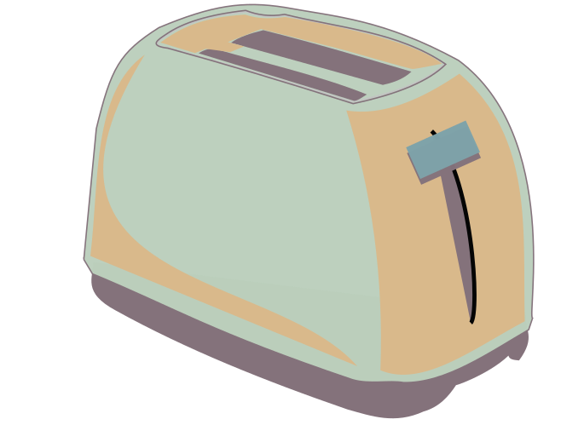



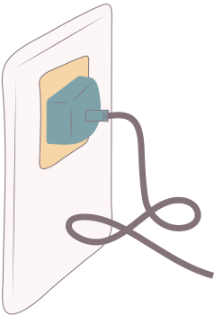

An Example of The Scientific Method
Step 1-
Observation: my toaster doesn’t work.
Step 2-
Question: Is something wrong with my electrical outlet?
Step 3-
Hypothesis: If something is wrong with the outlet, my coffeemaker also won’t work when plugged into it.
Step 4-
Prediction: If my coffeemaker doesn’t work, then my outlet must be broken.
Step 5-
Experiment: I plug my coffeemaker into the outlet.
Step 6-
Result: My coffeemaker works!
Conclusion: My electrical outlet works, but my toaster still doesn’t work.
Step 7-
Refine the results: My toaster is broken.
Notes:
This is just an illustration that may be helpful in understanding the process of the scientific method
9

Slide 10
Summary of Part 1:
  What research is and isn’t
  The Scientific Method
See you in part 2!
Notes:
End of Day 1
Ask them if they remember the four basic steps of the Scientific method.
Ask them if they can name some tools for doing research
Ask them to name a type of research.
21

Slide 11

Tools for research
Research tools help us to :
  find information
  collect data
Always use credible and reliable sources
Notes:
10

Slide 12

Class Discussion:
Can you think of any tools that you could use to find information for scientific research?
Notes:
Ask the class to think of some tools that researchers may use.
The next few slides will provide examples so don’t spend too long, maybe 2-5 minutes talking with them.
11

Slide 13

The Library
The library has many research resources such as:
  archival documents
  books
  Librarians
  scientific journals
  internet access
Notes:
Librarians are great resources as they often have knowledge that we may not! Librarians can also help you find credible sources
You won’t usually be looking at archival documents, but you will most certainly be looking at scientific journals and using the internet.
12

Slide 14

Internet Sources
  Scientific articles & journals
  .gov, .org, .edu are credible sites
  Videos and interviews
  Connect with other researchers
Notes:
There are many ways that the internet can be a tool for researchers.
This is where we publish and find our scientific journals and articles. These are going to be your most credible sources because they are almost always peer-reviewed. Explain peer-reviewed.
It’s important that researchers only use and create credible information, that way no false information is spread or leads to the harm of others.
13

Slide 15

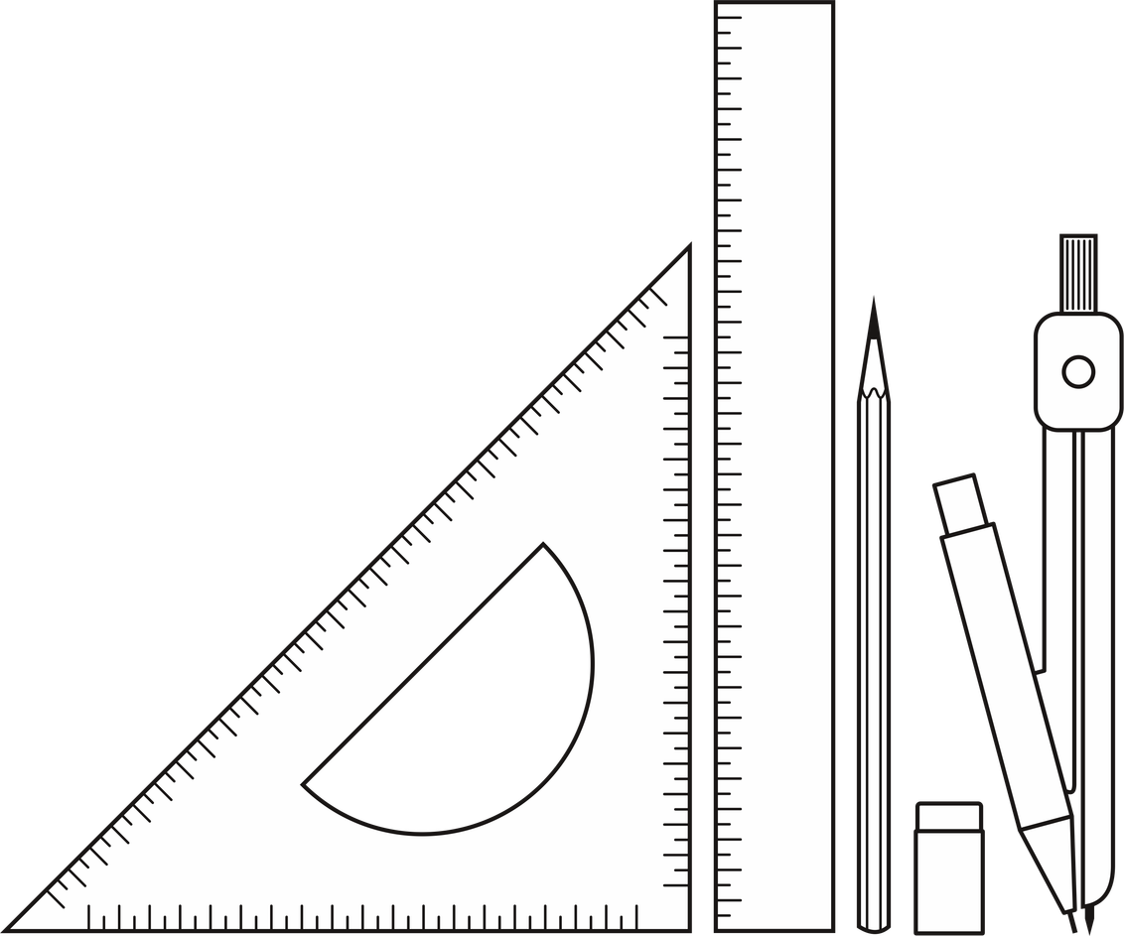
Measurements and Calculations
Measuring directly will give you accurate results.
Notes:
All researchers conduct measurements or calculations of some sorts. When you google Italian restaurants near you, you may look at the Yelp reviews and compare who has the higher rating. This is a calculation and measurement !
14

Slide 16





The Different Areas of Research
Notes:
So we know where to find information, now lets talk about the different types of research. These are all common in agriculture, but can be used for different disciplines and study areas as well!
15

Slide 17

Type 1:
Laboratory Research
  Research carried out in a controlled indoor setting (like a lab) where variables can be carefully manipulated and measured.
  Example: Testing the effect of different pH levels on plant seed germination in a lab.
Notes:
Lab research is also popular in ag. It is used to develop new forms of feed, medicines, and plant or animal-derived products for humans
16

Slide 18
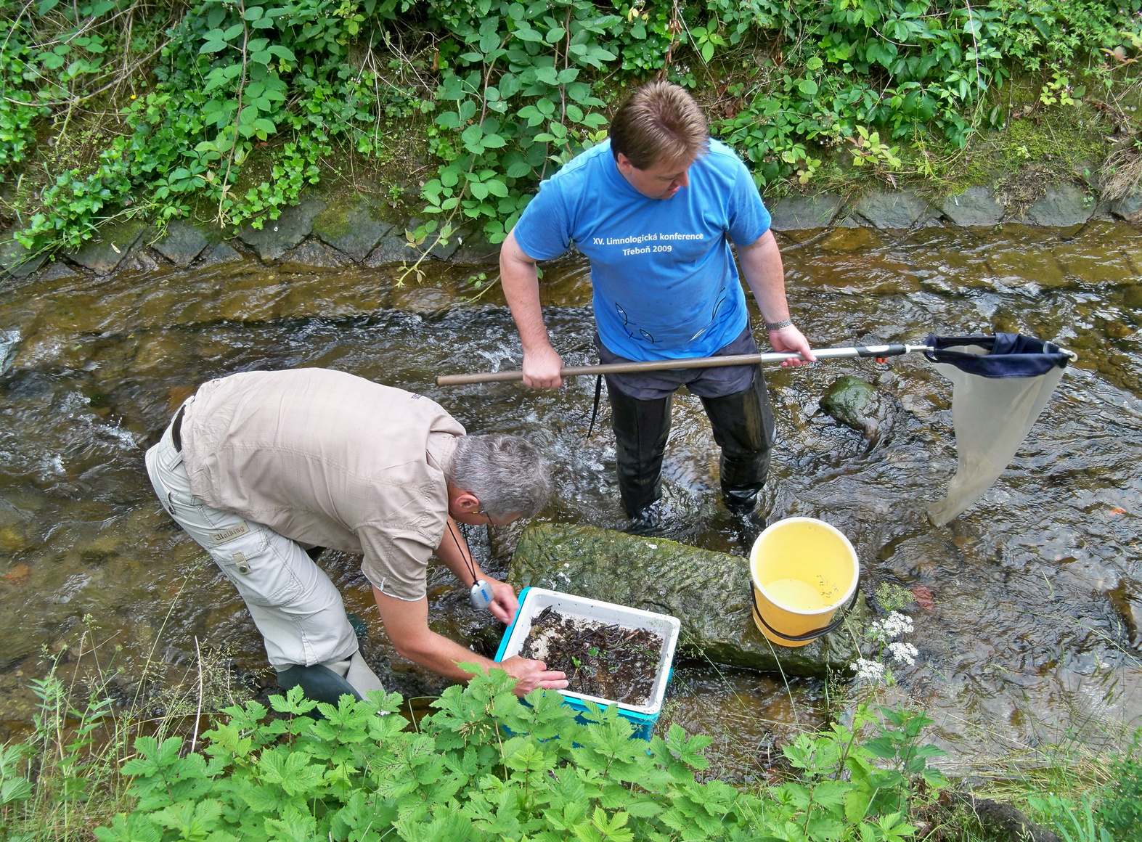
Type 2:
Field Research
  Research conducted in a natural or real-world environment where conditions are not controlled by the researcher.
  Example: Observing crop growth patterns directly in farmers’ fields.
Notes:
Field research is very hands on and time consuming. It is very common in agriculture and biology, especially wildlife biology
17

Slide 19

Type 3:
Experimental Research
  Involves a hypothesis, a variable manipulated by the researcher, and a variable that they can measure and compare.
  Usually conducted in a controlled environment.
  Ex: Giving one group of students extra tutoring to see how it affects test performance compared to a “control” or baseline group that does not receive extra tutoring.
Notes:
18

Slide 20

Type 4:
Survey Research
  A study that uses surveys to determine things about a specific population.
  People answer the survey questions and responses are collected for data analysis and interpretation.
  Ex: Surveying AG teachers to ask about the biggest challenges they face to educate the new generation.
Notes:
Survey research is often used in all kinds of research. Whenever you rate an app on your iPhone, youre participating in survey research.
19

Slide 21

Type 5:
Policy Research
  Investigates the effects of current government or social policies or predict potential effects of proposed policies
  Policy researchers often work within government agencies
  Ex: A researcher investigating farmers’ water rights will research previous water laws and policies.
Notes:
Policy research is really common in agriculture.
For instance, water rights policies are developed after researchers gather all of the current information.
Around the world, hunger and food insecurity are researched to influence policies and programs that can help with these issues.
Advocacy LDE
20

Slide 22

What’s next?
we will:
  Recap the types of research
  Study Qualitative vs Quantitative
  Find out why research is important
Notes:
22

Slide 23
Research can be categorized as:
Qualitative or Quantitative
Notes:
Now that we know about the different research methods, lets look at the two different types of research. We’ll talk about each one individually and then go through some examples to make sure we all understand.
23

Slide 24

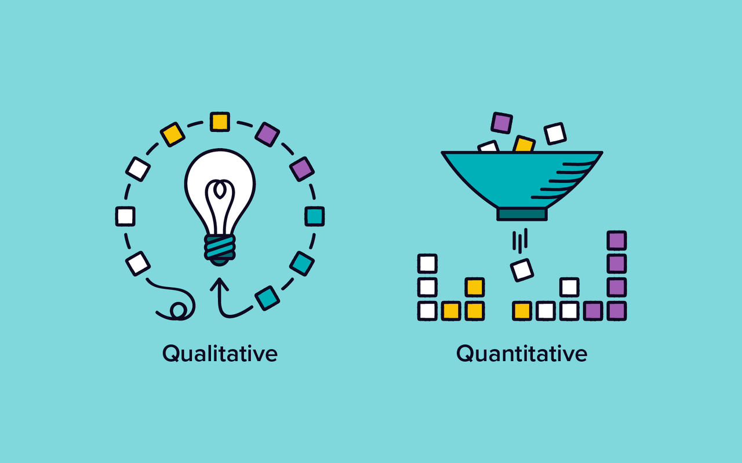
Quantitative Research
  Doing qualitative research is also called interpretive research
  Not only about “what” people think but also “why” they think so
  Qualitative research uses open-ended responses from participants
Notes:
Self explanatory
24

Slide 25



Qualitative Research
  Involves collecting and analyzing non-numerical data
    Verbal responses, text, video, or audio
  Meant to understand concepts, opinions, or experiences
  Can also be used with nearly any type of research including:
    Survey research
    Policy research
    Field research
Notes:
26

Slide 26

STUDENT ACTIVITY
Identify whether these 4 following research studies are qualitative or quantitative!
Notes:
Let the students guess
Have them raise their hands for which one they think it is.
If any of them disagree, ask them why they believe it is one or the other.
28

Slide 27


  Researchers conduct a focus group consisting of 10 participants
  They ask questions about grocery shopping habits, whether the participants like meat products, and why the participants usually buy those specific groceries
  The researchers determine the shopping habits and motivations of public consumers.
Qualitative or Quantitative?
Notes:
Qualitative
30

Slide 28


  Researchers collect samples of rainwater in five different counties
  They compare the measurements and determine that two of the counties received more than 10 inches of rainwater, and the other three received less than 3 inches of rainwater
Qualitative or Quantitative?
Notes:
quantitative
32

Slide 29




  Researchers provide participants with a sample of three different sodas
  Soda 1 has 500mg of sugar, Soda 2 has 250mg of sugar, and Soda 3 has no sugar
  Researchers ask the participants to taste each soda, they ask the participants which soda tastes better, which they would be most likely to buy, and which soda tasted the worst
Qualitative or Quantitative?
Notes:
qualitative
31

Slide 30


  Researchers collect 30 samples of a native species of beetle
  Researchers measure all the beetles’ body lengths, antenna lengths, and leg lengths
  They determine that beetles in this area have an average body length of 3.72 inches, an average antenna length of 0.75 inches, and an average leg length of 1.09 inches
Qualitative or Quantitative?
Notes:
quantitative
29

Slide 31
Why is it important to do
GOOD research?
Notes:
33

Slide 32

Importance of Good Research
Research is a way to understand issues & increase public awareness about them
    Can you think of any issues the public is aware of, thanks to research?
    Covid-19 cases
    Mental health
    Social media
Notes:
Ask the students and discuss what they say. Then pull up the bullet points.
34

Slide 33
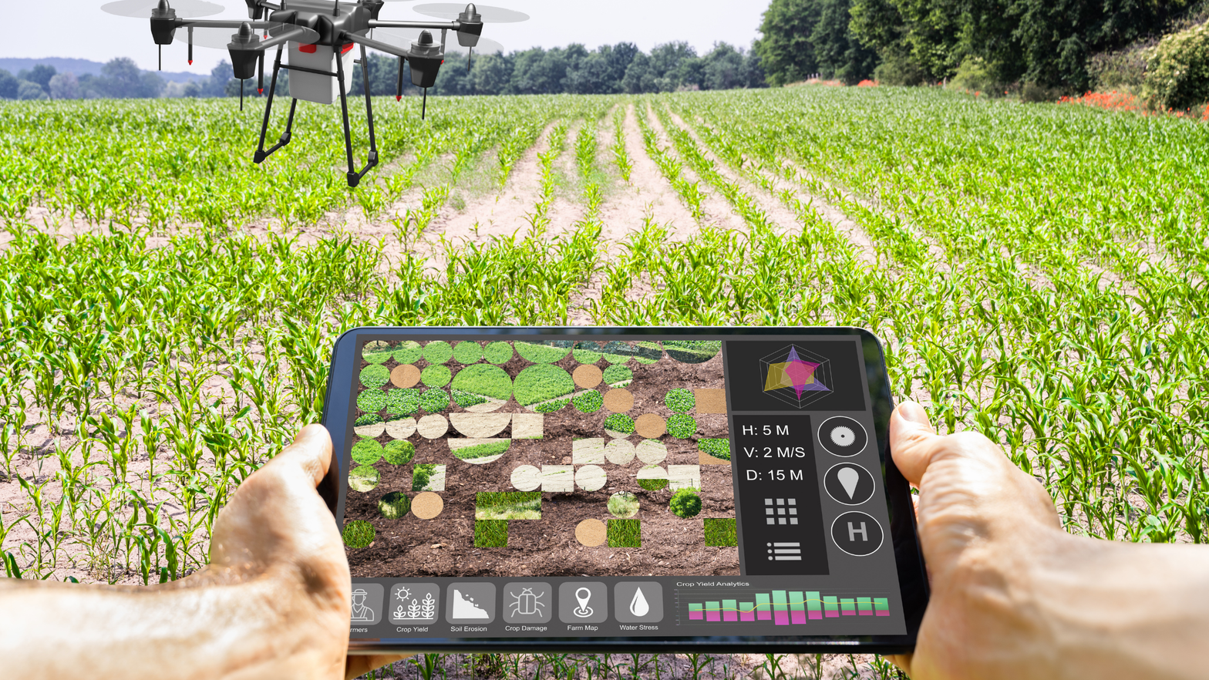
Importance of Research
Good research helps businesses and organizations to succeed and reach their economic potential
  Are there any business-related innovations you can think of?
  Precision agriculture
  Crop/cattle monitoring with drones
  Genetic engineering
  Lowering environmental impact of agriculture
Notes:
Again, Ask the students and discuss what they say. Then pull up the bullet points.
35

Slide 34

Importance of Research
  Allows us to make evidence-based decisions that are justified with data and facts
  Helps us find, gauge, and utilize opportunities
  Promotes a confidence and passion for reading, writing, analyzing, and sharing valuable information with the public
Notes:
36

Slide 35


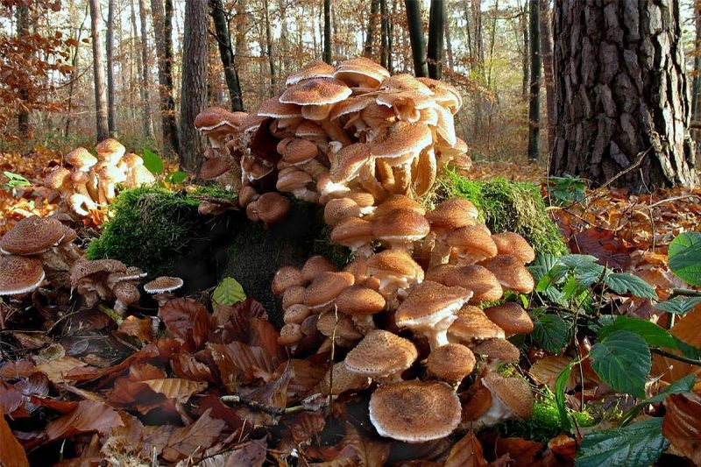
Popular Myths Debunked by Research:
Myth: The largest living organism is the blue whale.
  The largest living organism on planet earth is the humongous honey fungus in the Oregon Blue Mountains.
  This single organism has thousands of mushroom fruiting bodies roughly 2.4 miles across.
  Research found that it's spreading. On the bright side, the mushrooms are edible. Bon appetit!
Notes:
37

Slide 36
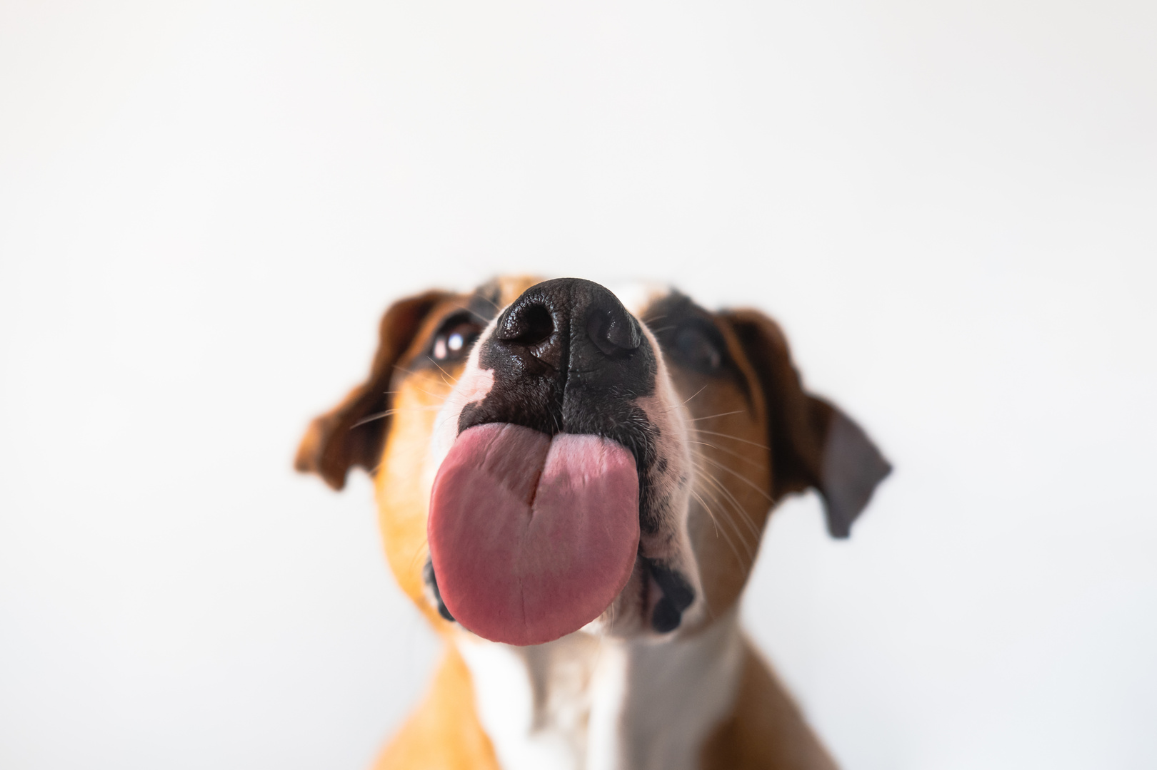


Popular Myths Debunked by Research:
Myth: Dog mouths are cleaner than human mouths.
  Dog mouths are no cleaner and are, in fact, much dirtier than human mouths.
  Dog mouths are teeming with bacteria because they eat and lick all sorts of gross things like garbage, carcasses, and, of course, poop.
  A dog's mouth functions as its hands, its washcloth, its toilet paper and so on. Dog mouths are very dirty.
Notes:
38

Slide 37

Current Quantitative Research in Agriculture
Notes:
Kayra is feeding Black Soldier Fly Larvae. This is high in protein and can be used as chicken and cattle feed.
39

Slide 38
Current Qualitative Research in Agriculture
Notes:
Rhett is making the students self-grade their welds, then having the CWI and instructor come grade them. He found that on average, females are a lot harder on themselves than the males are. The males usually score themselves higher. Maybe this is because females are less confident when welding.
Annalisa sent out surveys to residents in san marcos, asking them all about how much water they use every month, what they use the water for, and how people wash their laundry to determine how efficient and sustainable people really are.
40

Slide 39
Summary
Research is a careful and detailed study into a specific problem, concern, or issue using the scientific method
Research involves the collection of data, documentation of critical information, and analysis of that data/information
Quantitative methods use numbers and statistics to measure and analyze data. They help answer questions like “how much,” “how many,” or “how often.”
Qualitative methods use words, observations, and descriptions to understand people’s experiences, opinions, or behaviors. They help answer questions like “why” or “how.”
Notes:
Worksheet: Create a qualitative and quantitative study. Why is is qual vs quantitative.
42

Slide 40


Lesson 1: COMPLETE
Now...
  Complete the Qualitative/Quantitative Research Worksheet
  Next time we’ll learn about how to develop a research project
Notes:
43

