Slide 1


DEVELOPING YOUR
RESEARCH PROJECT

Slide 2
Overview
1. Research design
2. Data collection and methods
3. Choosing methods to answer your research questions
4. Research validity

Slide 3


What is a
Research Design?
The research design provides the overall structure for the research
the procedures
the data collected
and data analyses
Simply put, research design is planning!
Notes:
To answer any research question, you need to have a research design.
The design will create the overall structure of your experiment, data collection, and data analyses/reporting

Slide 4

Why your Research Design is Important
A good research design will
1. Keep the researcher on track
2. Explain how the researcher collects data
3. Outline every detail of the project
Notes:
When you create a research plan, you want to make sure it is specific and valid enough to accurately and thoroughly answer your research question

Slide 5
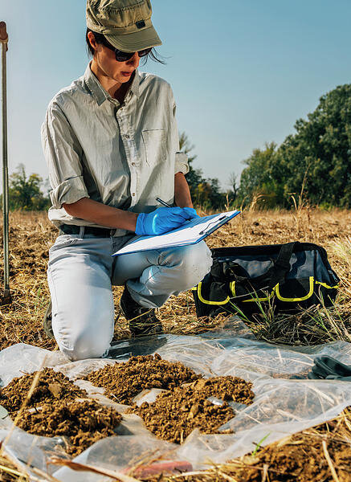
Planning a General Approach
Imagine you’re a researcher. You must be diverse to investigate anything with good research.
As a researcher, you can’t limit your thinking to one area
You must be flexible and work within all sorts of areas
For example: A soil scientist will need to know about soil components, but they also need to have people skills, knowledge of chemistry, and data collection skills
Notes:
When you create a research plan, you want to make sure it is thorough enough to cover all aspects of the research topic. You can't plan a plant experiment and ignore variables like light and water.
Ask the class if they can think of another type of researcher that would need to know information from different areas.

Slide 6
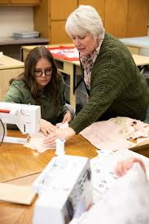
More Ways of Planning a General Approach
You specialize in child development. You must be willing to offer guidance on child-rearing practices, early childhood education, and development milestones.
Someone in this field needs to be observant, the ability to observe children's behavior and development closely to their progress and identifying any development delays or challenges
Communication is a strong skill to have, it can be vital for effectively interacting with children, parents, and educators.
For example: A child development specialist might work in a school, assessing children’s developmental milestones and creating individualized education plans
Notes:
When you create a research plan, you want to make sure it is thorough enough to cover all aspects of the research topic. You can't plan a plant experiment and ignore variables like light and water.
Ask the class if they can think of another type of researcher that would need to know information from different areas.

Slide 7

Steps to Planning a (General) Research Design
Identify the problem or question
Review any existing literature or findings
Set your research question(s)
Select the study procedures and design
Select the sample design
Collect the data
Process and analyze the data
Write the research report
I want to see if growing cover crops in my field will increase soil biodiversity
Current studies show that cover crops can benefit soil health
Will adding more cover crops to a plot of barley increase soil health?
I design how and what I will plant, irrigation and harvesting schedule, etc.
I create a random design where some plots have cover crops and some don’t
At the end of the trial, I take soil samples from the plots to test for for biodiversity factors
Compare the soil test results from the different plots
Report whether the cover crop plots were more, less, or the same biodiversity
Notes:
Walk through these steps slowly and give examples to make sure they’re understanding the process. Highlight the need to do literature research, use googlescholar. Set your research question, etc. These are all very important.
Go through the example and mention more detail than is provided. Especially step 4, you also need to mention data collection design

Slide 8
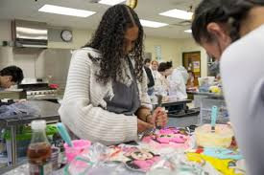

Steps to Planning a (FCS) Research Design
Identify the problem or question
Review any existing literature or findings
Set your research question(s)
Select the study procedures and design
Select the sample design
Collect the data
Process and analyze the data
Write the research report
How can I effectively educate families about making informed decisions that promote their health, well-being, and financial stability?
Family Consumer Scientists can use existing literature to identify best practices and gaps for effective family education.
How do clear research questions improve my study in Family Consumer Sciences?
Define research objectives to choose the best methodology and data collection tools.
Choose a sample design based on research goals and target population.
Collect data using the chosen methods and tools to ensure accurate and relevant information.
Process and analyze the data to extract meaningful insights and identify trends.
Write the research report to present findings, interpretations, and conclusions in a clear and structured manner.
Notes:
Walk through these steps slowly and give examples to make sure they’re understanding the process. Highlight the need to do literature research, use googlescholar. Set your research question, etc. These are all very important.
Go through the example and mention more detail than is provided. Especially step 4, you also need to mention data collection design

Slide 9
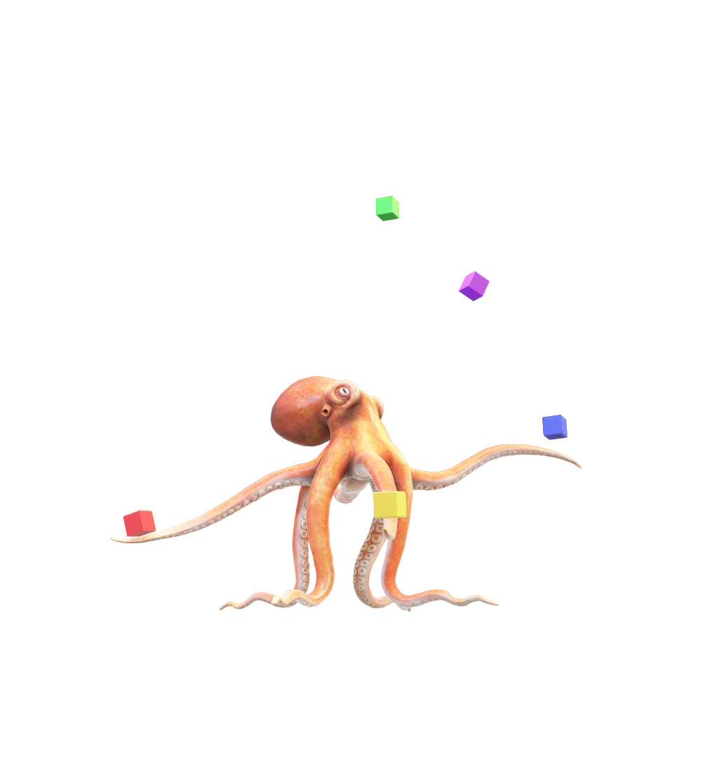
Student Activity
Get out a blank sheet of paper
  We’re going to create a research design throughout this lesson, so don’t lose this sheet!
2. Create a section on your paper titled
“Research Problem”
  Write down a potential research problem, state your research question
  This can be any research problem that you’re interested in
Notes:
This can be a question related to agriculture, or the research topic you came up with from the last class.
Give the students about 5-10 minutes to do this, since they don’t know much about the research methods yet, you may offer a little help.
But not too much, we’ll come back to it. This doesn’t have to be specific, just a general idea of how they might answer the question

Slide 10

Looking at Existing Literature
Research that has already been done
Can help you plan your design
It’s important to only use information from credible sources
  Google Scholar
  Science.gov
  Educational Resources Information Center
Some resources might give false or bad information
  Wikipedia
  Twitter
Notes:
Research that has already been done can help you plan your research design.

Slide 11
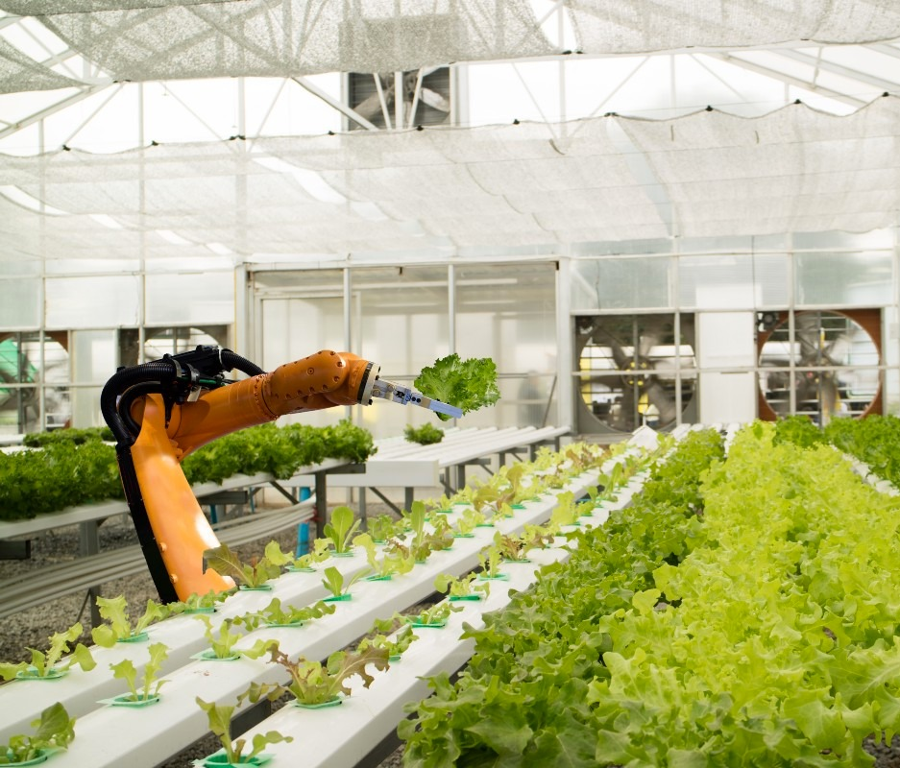

Research Methods
There are many different types of research methods
Important ones in agriculture include:
Observation
Experiments
Surveys
Field research
Notes:
These are just a few of many types of research.
Some of these are qualitative and some of these are quantitative research methods.
Field research: Research where data is collected outside of the lab, classroom, and library! The approaches of field research can vary depending on the discipline.
Experimental research: A study where participants are randomly assigned to groups that undergo different treatments or interventions. After the treatment, the researcher looks at the effects and compares it to the other groups’ effects.
Survey research: A study that uses surveys to determine things about a specific population. For example, the US census is a survey study. People’s answers the to survey questions get collected for data analysis and interpretation.

Slide 12
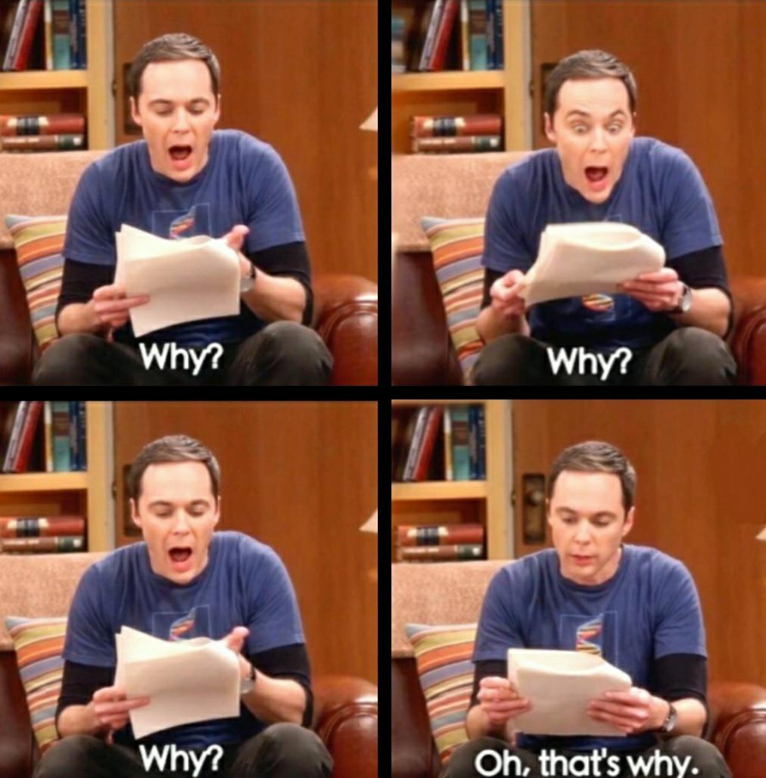
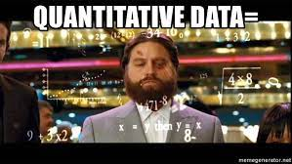
Quantitative & Qualitative
Research Methods
We want to focus on two main types of research
Both are very important in all fields of research, but they’re suitable for different types of data
Quantitative
Qualitative
Notes:
Can anyone guess what types of research I'm talking about?

Slide 13
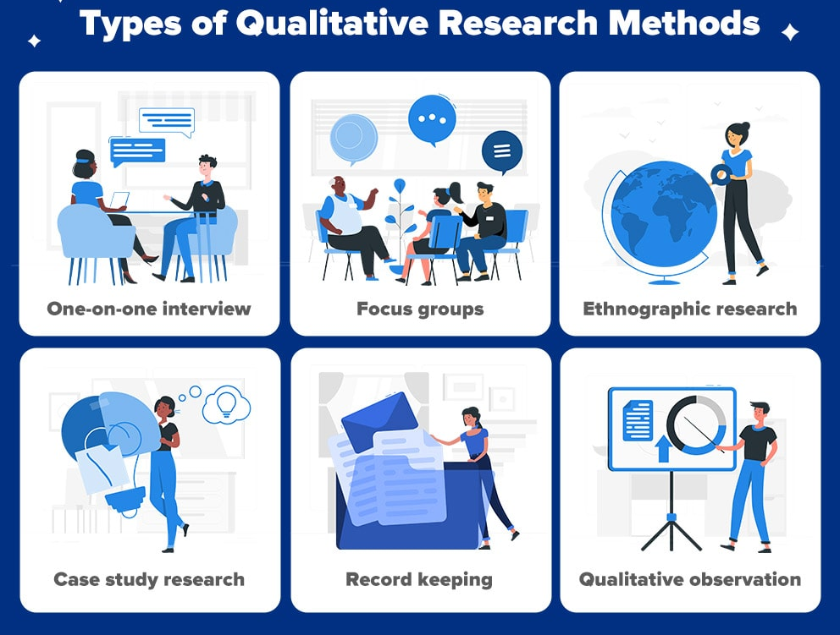
Qualitative
Research Methods
Doing qualitative research is also called interpretive research
Not only about “what” people think but also “why” they think so
Qualitative research uses open-ended responses from participants
Notes:
Don’t spend too much time on qualitative. Try to think of an example that relates it back to agriculture.
Results are usually words, quotes, or illustrations

Slide 14

Qualitative
Questions
Do you feel stressed or excited about taking a test?
When do you usually play videogames and why at that time?
What is your favorite carnival ride and why?
Notes:
Don’t spend too much time on qualitative. Try to think of an example that relates it back to agriculture.
Results are usually words, quotes, or illustrations

Slide 15
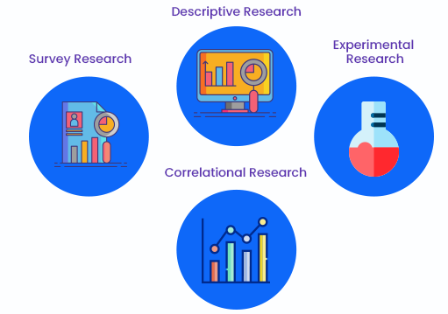
Quantitative
Research Methods
It is focused, has established procedures, and the researcher takes a more detached view
The data are numerical and usually represent a large population
Quantitative research helps find trends, averages, and numerical information
Notes:
Again, think of an agricultural example.
Collected samples of grasshoppers to compare their average wingspan

Slide 16

Quantitative
Questions
How many pets do you own and how many of them are female?
When you grocery shop, how many different fruits do you normally buy?
If the price of coffee drops, how much do Starbucks sales change?
Notes:
Again, think of an agricultural example.
Collected samples of grasshoppers to compare their average wingspan

Slide 17
Student Activity
1. On your sheet of paper, create another section on your paper titled “Research Design”
  Write down the research method you might use to answer your research question
  Explain whether you’re using quantitative or qualitative methods
Notes:
This can be a question related to agriculture, or the research topic you came up with from the last class.
Give the students about 5-10 minutes to do this, since they don’t know much about the research methods yet, you may offer a little help.
But not too much, we’ll come back to it. This doesn’t have to be specific, just a general idea of how they might answer the question

Slide 18
End Day 1!
1. Research design (Day 1)
2. Data collection and methods (Day 1)
3. Choosing data collection methods to answer your research questions (Day 2)
4. Research validity (Day 2)

Slide 19
Overview
1. Research design
2. Data collection and methods
3. Choosing methods to answer your research questions
4. Research validity
Notes:
These are the

Slide 20
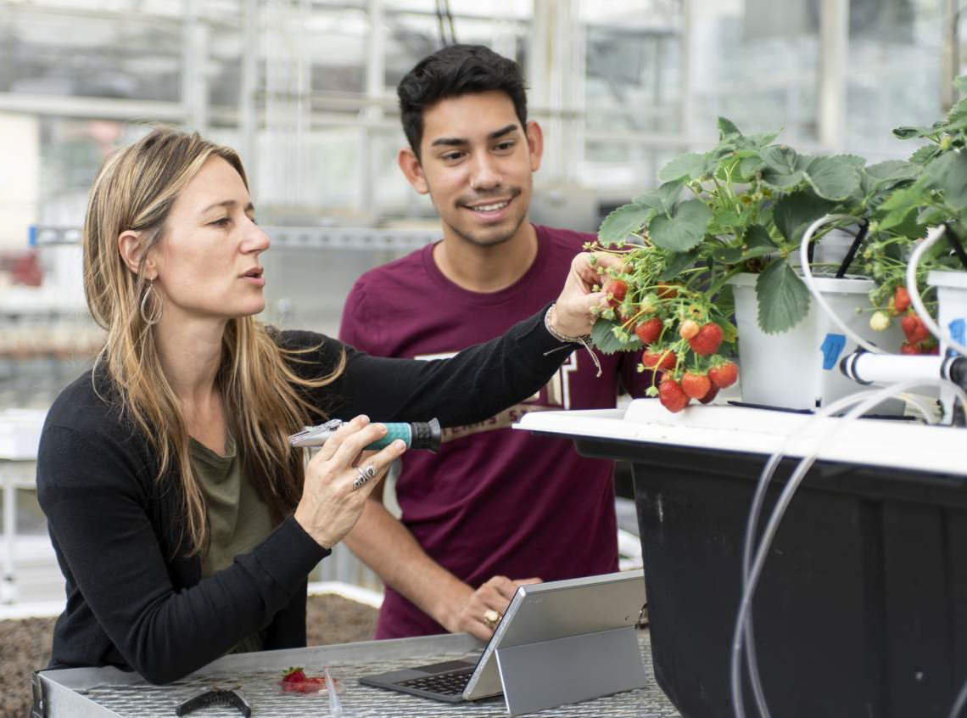
Planning for Data Collection
Before you plan your data collection, ask yourself a few questions:
  What kind of data are needed for the research?
  Where are the data located?
  Who/How will the data be collected?
  What data will be considered acceptable data?
  How will the data be interpreted?
Notes:
More detail on the next slide
Walk through these questions, maybe give a couple examples. Say something like, “lets talk a little bit more about data, since research deals with all different kinds of data. Its important to be specific about the data you’re dealing with”

Slide 21

What is Data?
Once we have a research question in mind, we need to start thinking about data!
Data is information
  individual facts, statistics, numbers
One important thing about data is that they are rarely permanent
  Because of this, it’s important to do research that finds the most recent and accurate data
Notes:
Now talk about data. Research is based around data so this is a very important section.
Data may be accurate for only a very short time
Tomorrow, next week, next year—what we thought we had “discovered” about something may have changed in some way
New information, technology, and skills are constantly being developed. This changes the way we understand things, including data.
It’s important to do research that finds the most recent and accurate data

Slide 22
What is Data Collection?
A process of gathering and analyzing specific information
It is important to note that data collection falls under two broad categories: Primary and secondary data collection!
Data collection can be done in the library, on the internet, in the field, nearly anywhere
Notes:
The vocab isn’t that advanced, but just make sure they understand what ”volatile” and “evaporation/expiration” mean regarding data.
Primary data is:
Collected directly from the data source without going through any existing, alternative sources.
Secondary data is:
Data that has been collected in the past by someone
It focuses on finding out all there is to a particular subject matter.
Data is collected to be further used to test hypotheses

Slide 23
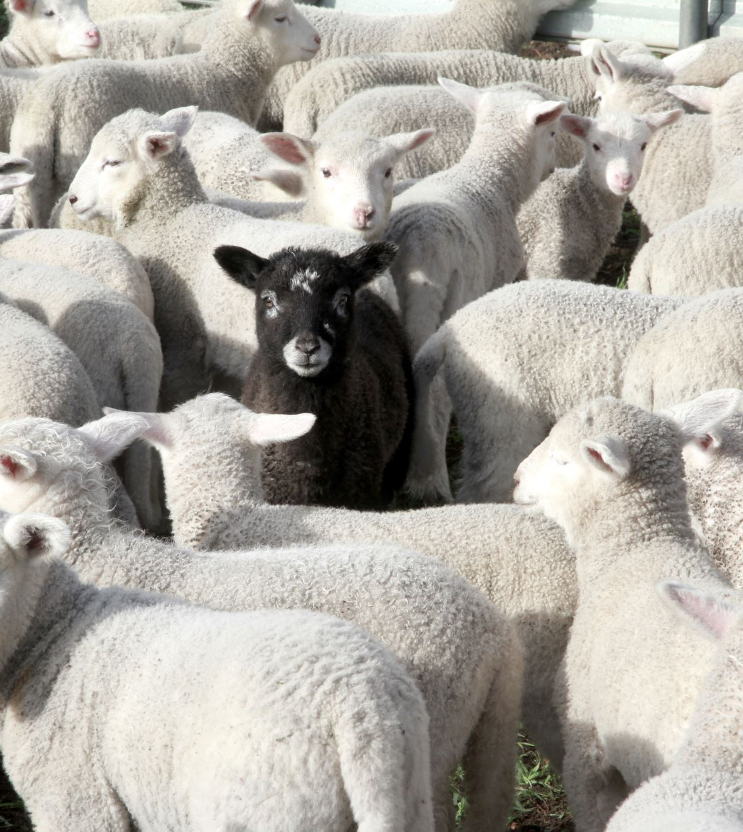
Data Collection in Agriculture
Let’s walk through an example where we answer these questions:
A college student conducting research wants to see if adding Black Soldier Fly larvae (high in protein) to sheep feed will increase the sheep’s bodyweight gain.
Notes:
This is just a few examples, there are many more.

Slide 24
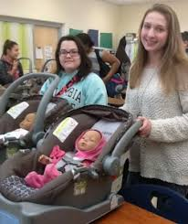
Data Collection in FCS
Let’s walk through an example where we answer these questions:
How does incorporating high-protein plant-based ingredients into a family meal plan affect the overall health and nutritional intake of family members?
Notes:
This is just a few examples, there are many more.

Slide 25
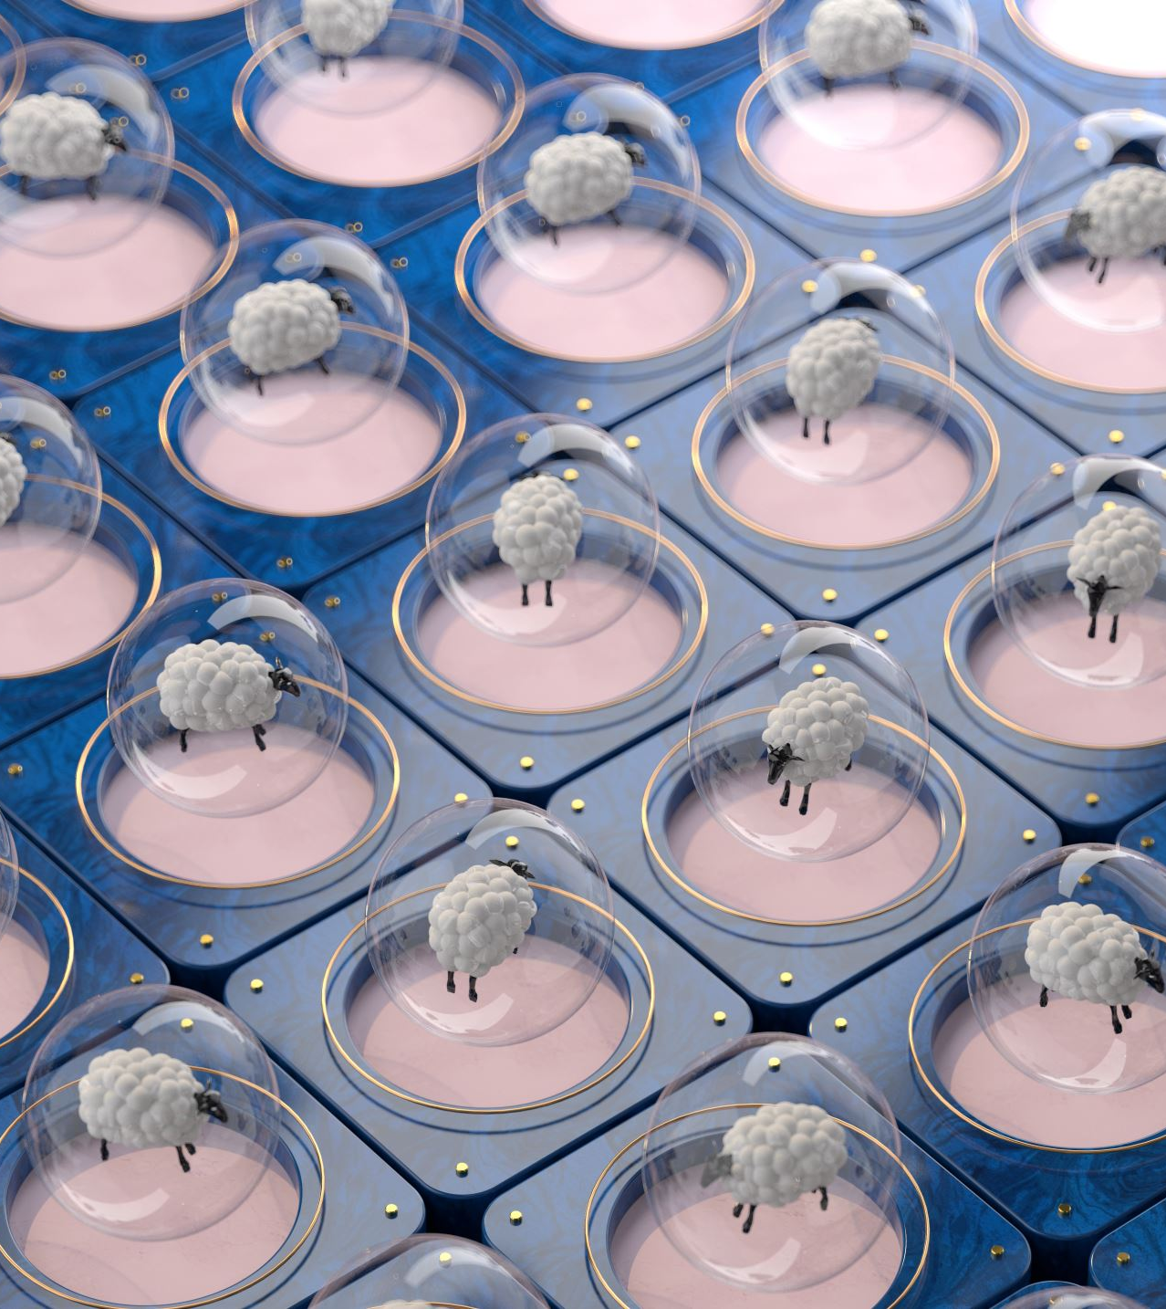
What kind of data are needed for the research?
Individual sheep bodyweight
Amount of fly larva added to the feed
Amount of feed consumed
Percentage of fly larvae to add to feed, etc.
Notes:
These are just some examples, there are other factors they can look at. Again when youre thinking about what data to collect, you want to keep your research question in mind.

Slide 26
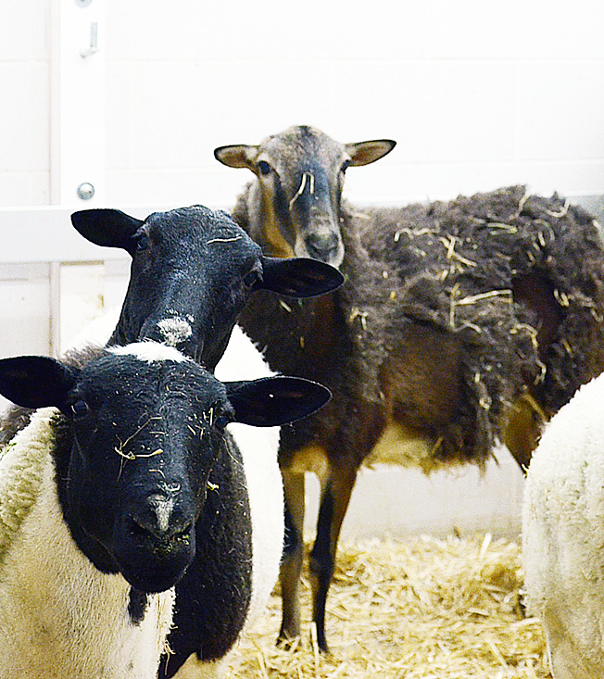
Where are existing data located?
Online resources
  .edu, .gov, .org
Previous research articles
  Peer-reviewed and published
Sheep farmers, etc.
Notes:
When looking at online resources, we want to use reliable ones like .gov, .edu, or peer-reviewed journals and articles that have been published.

Slide 27
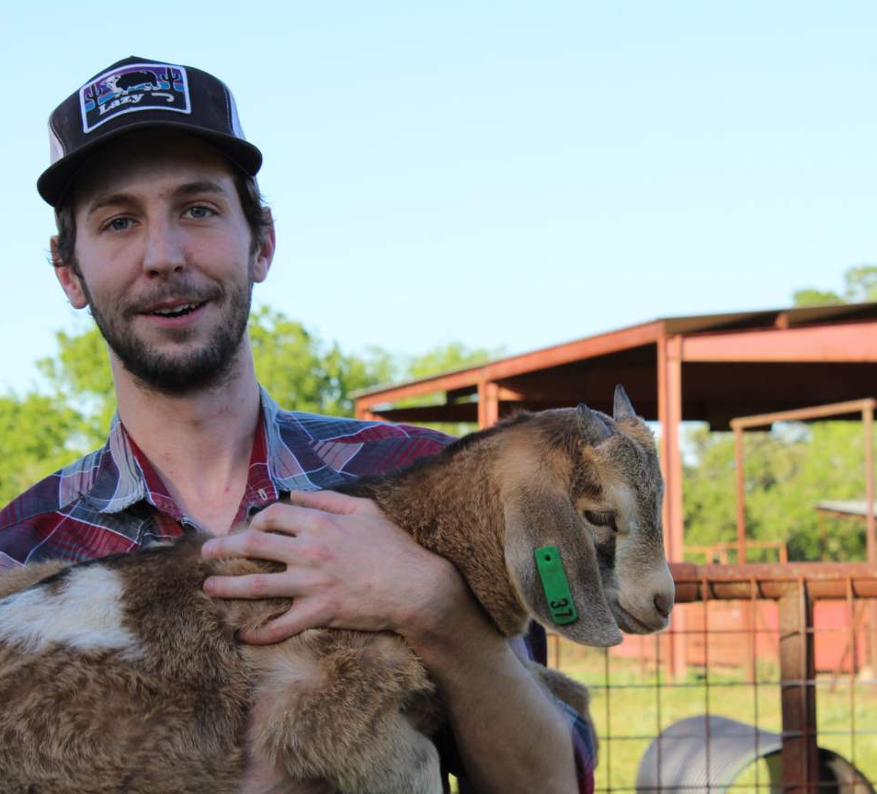
How will the data be collected?
Measuring the volume of feed consumed by the sheep every day
Measuring fly larva portions of the feed
Weighing the sheep before and after the trial period

Slide 28
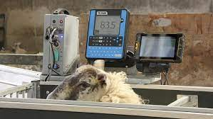
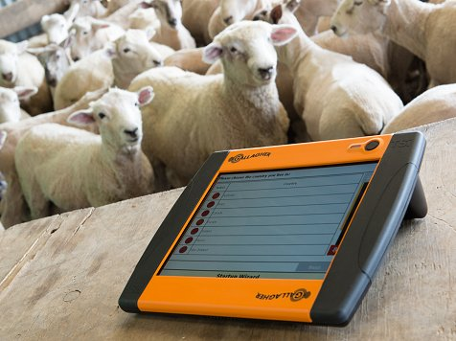
What data will be acceptable and how will you interpret it?
Weight of sheep that consumed at least a predetermined level of feed during the experiment, etc.
If the sheep see a faster bodyweight gain from the fly-larva-enhanced feed, then new forms of feed may be able to use fly larva. If the feed does not work, it may not be an option.
Notes:
We don’t want to use just any data. In order to report accurate data, we need to collect accurate data that answers our research question.

Slide 29
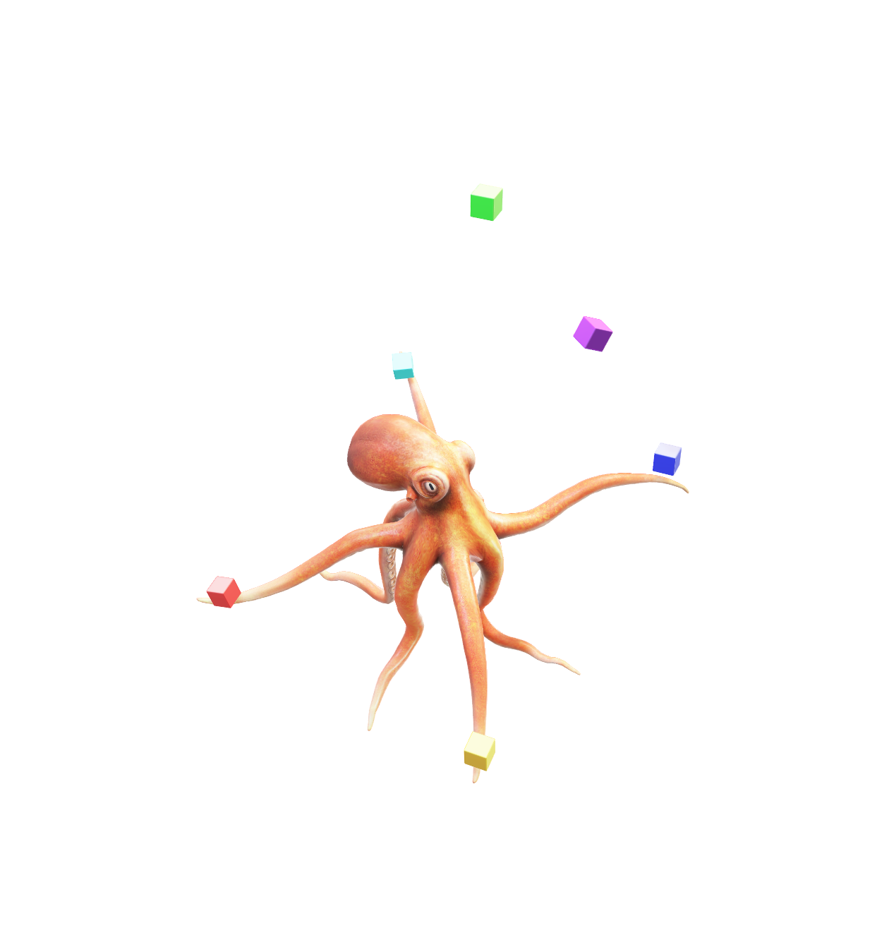
Student Activity
On the same sheet of paper from earlier, create a new section titled “Data Collection”
2. Think about which data you would need to collect and analyze for your research problem
  How will you collect it? Where will you find it?
  Write down what data you are collecting, what data you are analyzing, how you are going to analyze it
Notes:
Give them 10 minutes or so.
Data collection can come in many forms. Surveys, field tests, etc.
They can analyze it by comparing samples, comparing to past results, etc.

Slide 30
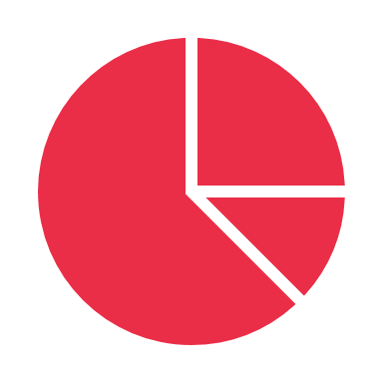

What comes after data collection?
Once you determine your method of data collection, you must make sure it is
  Reliable and
  Credible
Research design and methods are appropriate for the problem/ question
Results are accurate and trustworthy
The researcher’s interpretations of the data are plausible

Slide 31
How to Enhance the Credibility of your Research
Triangulation – In triangulation, multiple sources of data are collected with the hope they will all come together to support a specific hypothesis, theory, or conclusion.
Tracy reads three different scientific articles about the polar ice caps melting. They all show the same results, that global warming from climate change is causing the ice to melt.
Notes:
These are just some of the ways to increase the credibility of your research results, there are many more. Make sure they understand before you move on.

Slide 32
How to Enhance the Credibility of your Research
A controlled lab study – Research conducted in lab settings can be performed by researchers that can control the environment conditions, measurements, and experimental treatments.
Henry grows all the plants for his trial in the greenhouse so precipitation, wind, temperature, and humidity can all be controlled, minimizing variability. This allows the plants to all receive the same experimental variables.
Notes:
These are just some of the ways to increase the credibility of your research results, there are many more. Make sure they understand before you move on.

Slide 33
How to Enhance the Credibility of your Research
Respondent validation – In respondent validation, a researcher takes conclusions back to the participants in a study and asks “Do you agree with my conclusions? Do they make sense based on your own experiences?”
Before Allison sends out her research survey, she creates a small group of people that represent her target population and asks them to take her survey as a trial run. Based off their responses, she can determine if her survey questions are valid.
Notes:
These are just some of the ways to increase the credibility of your research results, there are many more. Make sure they understand before you move on.

Slide 34
How to Enhance the Credibility of your Research
Follow-up studies – In some research, follow up studies are designed and performed to specifically eliminate any alternative research conclusions from the original study.
Jared is concerned that his research could be flawed, so he conducts a follow up study where he replicates the research again. Replicating the study allows him to confirm his results or realize they were wrong.
Notes:
These are just some of the ways to increase the credibility of your research results, there are many more. Make sure they understand before you move on.

Slide 35
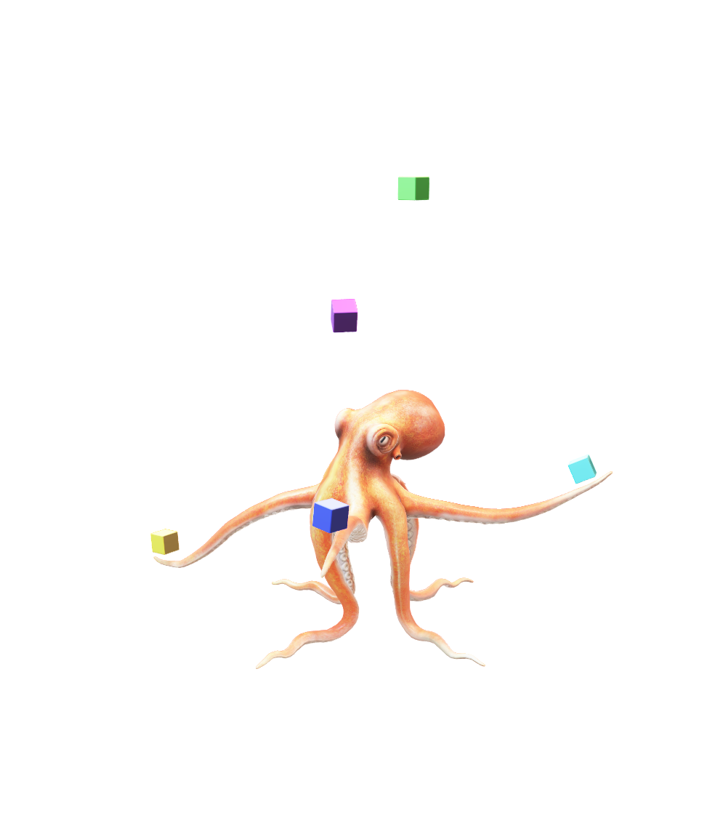
Student Activity
On the same sheet of paper from earlier, create a new section titled “Research Credibility”
Explain how you will ensure your data is trustworthy
  Who will have access to it?
3. Explain how you would make your research report reliable
You might cross-reference with other researchers
You might do a follow-up study
Notes:
Give them about 5 minutes. This will give them time to explain how they will make sure they collect the right data, and how they will make sure their report is credible/reliable

Slide 36
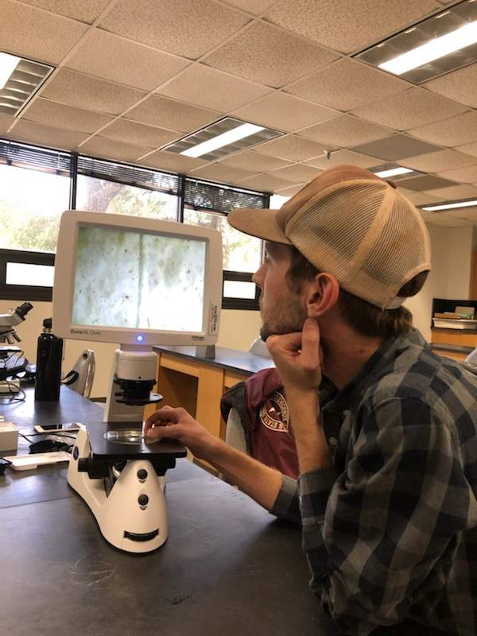
Overview of our Research Project Lesson
First, we identified our research problem and looked at the existing literature that relates to our research topic
After that we narrowed down our research question(s) and determine which design we wanted to use
Next, we collected the data, and made sure our results were reliable and credible
Our next lesson we will discuss how to analyze your data and write a research report!

Slide 37
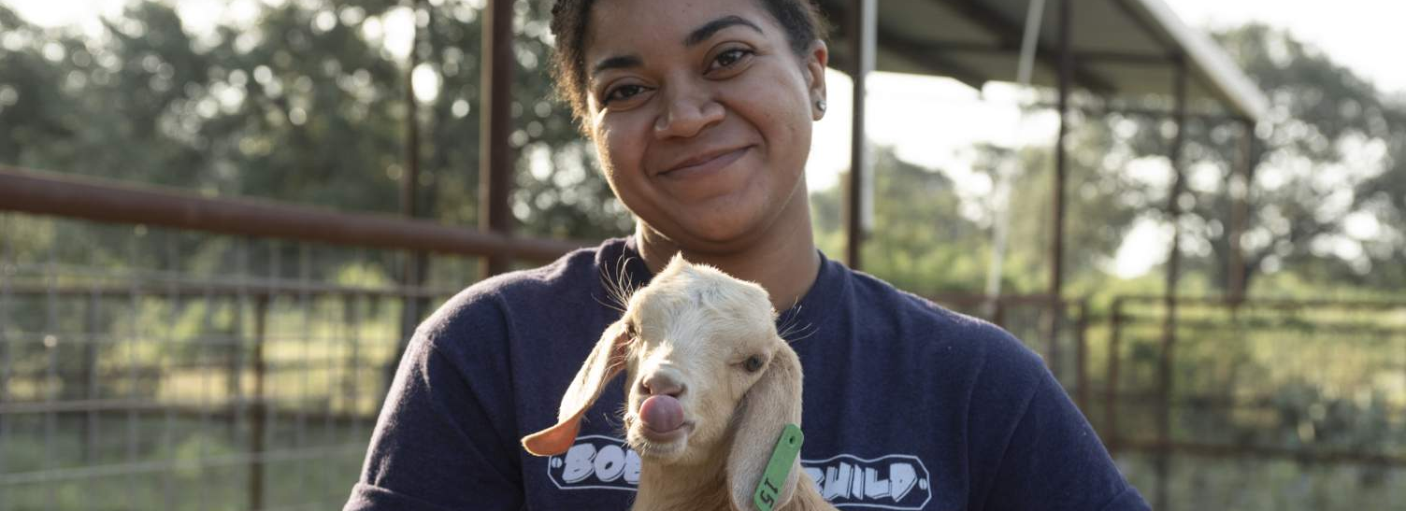
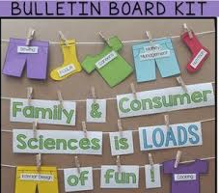
Remember,
All projects are completed one step at a time!

Slide 38
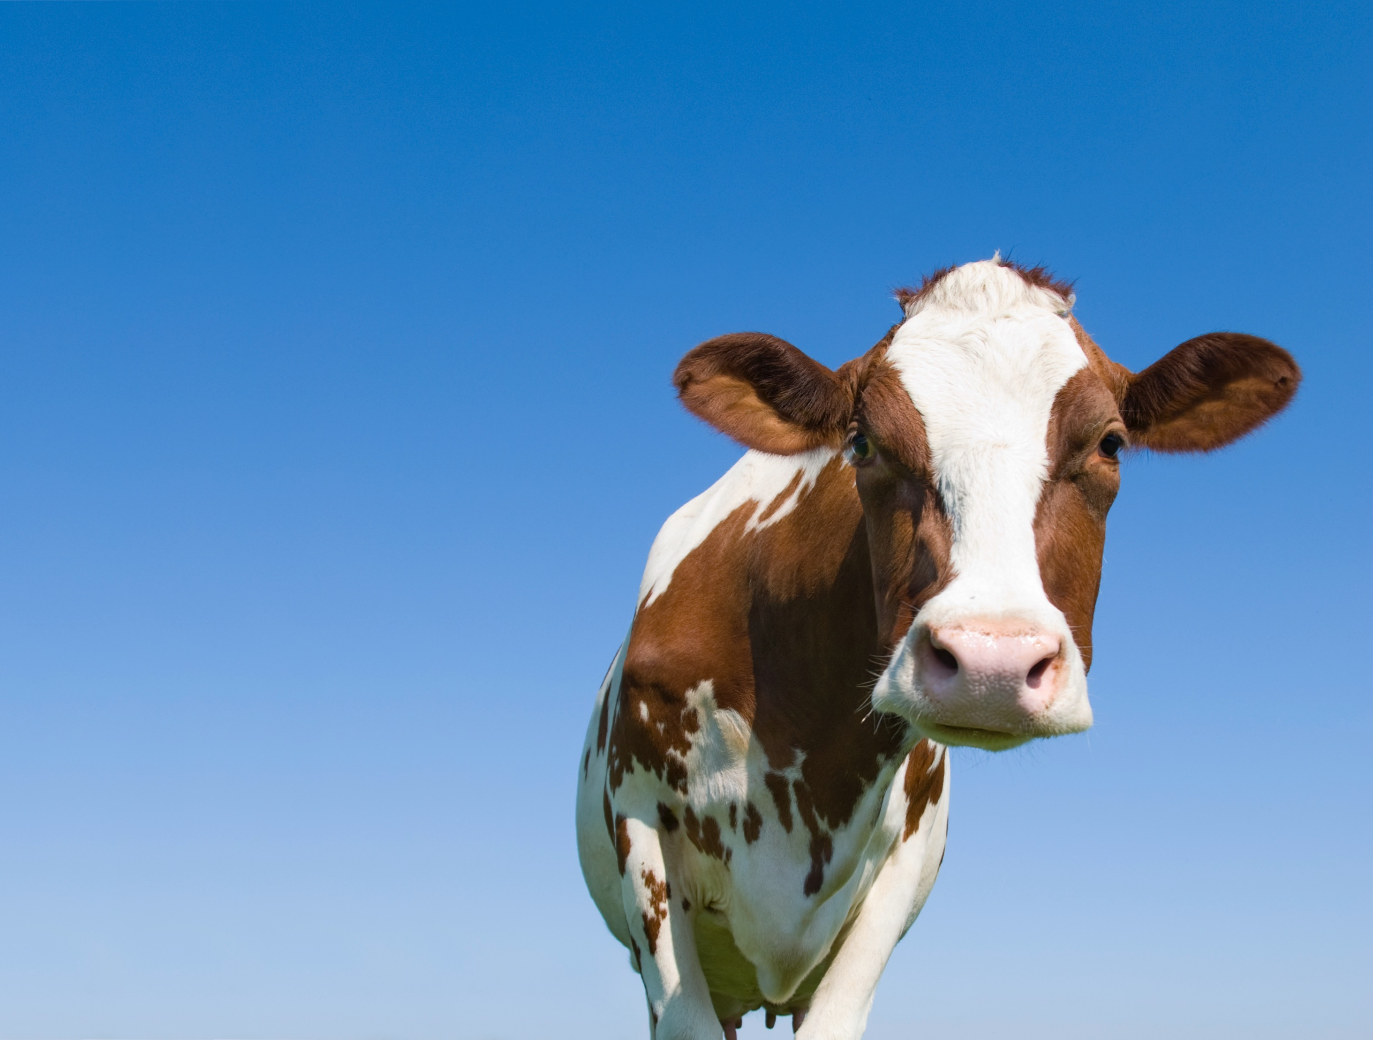
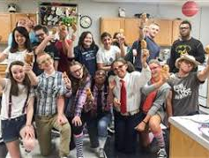
Have a great day!
HAVE A GREAT DAY!!!

