Slide 1



Analyzing Data &
Preparing a Research Project
Notes:
1

Slide 2

OVERVIEW
  Tools to organize data
  Interpreting your results
  Creating a research report
Notes:
This is what we will cover in todays’ lesson
Day 1: How to organize and interpret your data
Day 2: Creating your report
2

Slide 3
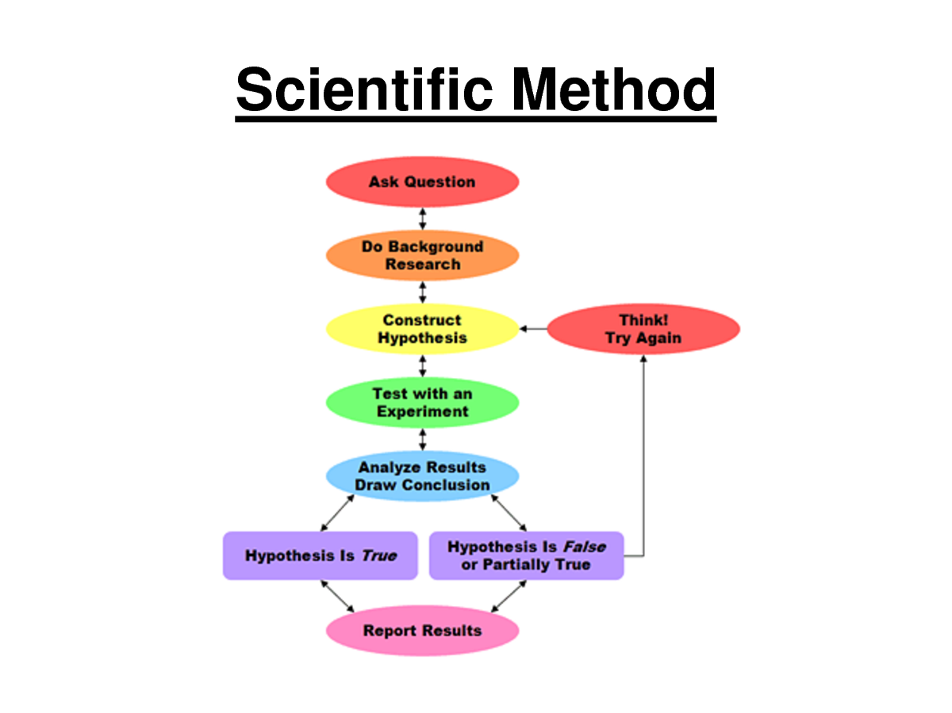
Recap!
  We learned how to use the scientific method
  Different types of research methods
    Experimental, field, policy, etc.
  Data and the different collection methods
    Survey, measurements, interviews, etc.
  How to make sure our data and research is credible
Notes:
3

Slide 4
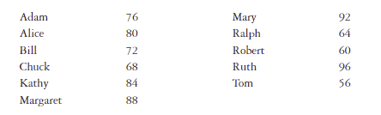
Organizing Your Data
  Before you analyze your data, it’s helpful to organize it into productive ways
  For example, lets look at a hypothetical data set
  Imagine these are test scores from Dr. Duke’s students in the Intro to Research in Ag class

Slide 5


How can we organize this data?
  When you organize your data, its easier to
    Understand what the results mean
    Identify trends
    Find patterns
    Find correlations
If we take the data, and lay it out horizontally with the gender, we might notice something:
    The lowest score is from a boy
    The highest score is from a girl

Slide 6
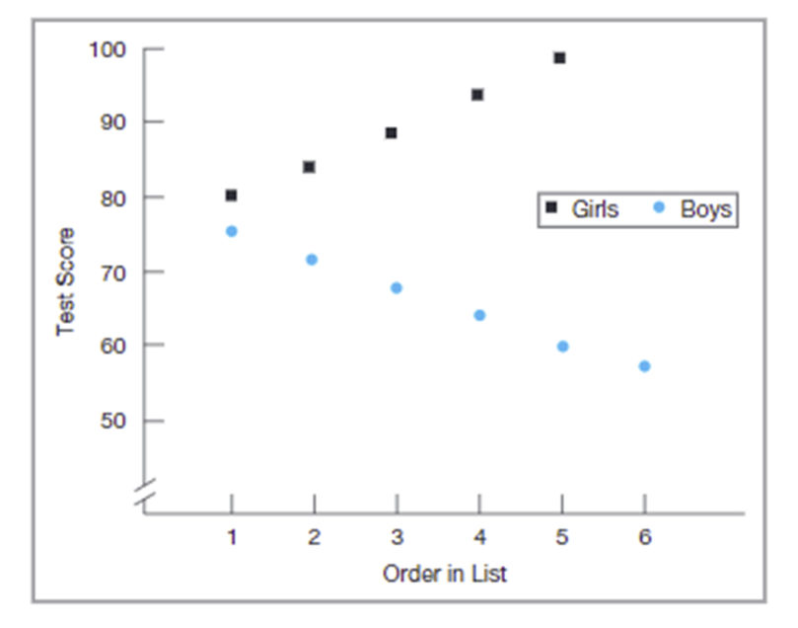
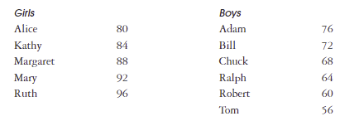
How can we organize this data?
  If we separate the data into 2 tables alphabetically by name, it will look like this…
  If we make a scatterplot of the boy scores and the girl scores, it will look like this…
Notes:
There are many different ways to organize your data. It’s important to organize it in whatever way is going to help you find the trends and patterns of your data so you can start thinking about what your data actually means.
6

Slide 7




Tools for
Organizing Data
  Excel spreadsheets
  Bar charts
  Pie charts
  Graphs
  Tables
  Graphical images
Notes:
It is important to choose the correct tools that work best for your specific dataset. This will help your audience to better be able to interpret your results, and make them more meaningful
7

Slide 8
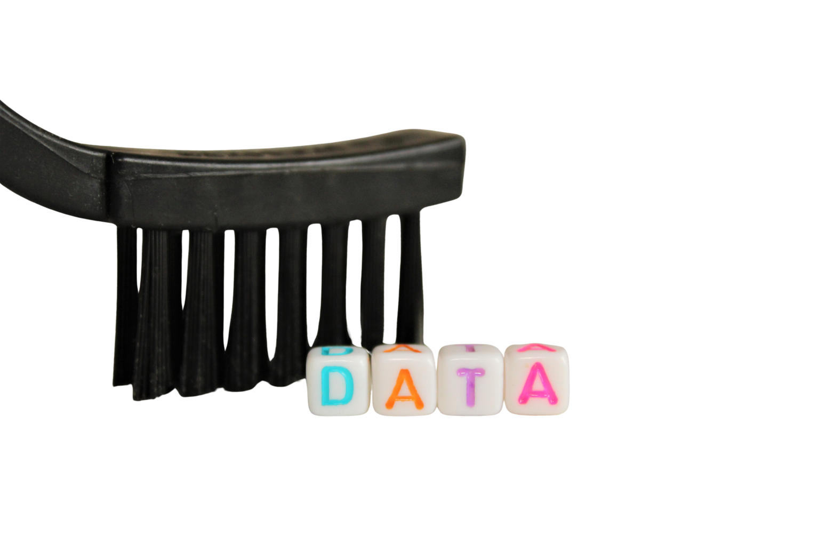
INTERPRETING YOUR DATA
1. Cleaning
  when you collect a lot of information, sometimes you collect duplicates or badly formatted data
  before you analyze, make sure your data is clean of formatting errors or duplicates so you do not analyze incorrect data
Notes:
To properly analyze your research data, you must go through 3 steps.
Clean: Once you have the necessary data it is time to clean it and leave it ready for analysis. Not all the data you collect will be useful, when collecting big amounts of information in different formats it is very likely that you will find yourself with duplicate or badly formatted data. To avoid this, before you start working with your data you need to make sure to erase any white spaces, duplicate records, or formatting errors. This way you avoid hurting your analysis with incorrect data.
Analyze: With the help of various techniques such as statistical analysis, regressions, neural networks, text analysis, and more, you can start analyzing and manipulating your data to extract relevant conclusions. At this stage, you find trends, correlations, variations, and patterns that can help you answer the questions you first thought of in the identify stage. Various technologies in the market assists researchers and average business users with the management of their data. Some of them include business intelligence and visualization software, predictive analytics, data mining, among others.
Interpret: Last but not least you have one of the most important steps: it is time to interpret your results. This stage is where the researcher comes up with courses of action based on the findings. For example, here you would understand if your clients prefer packaging that is red or green, plastic or paper, etc. Additionally, at this stage, you can also find some limitations and work on them.
8

Slide 9
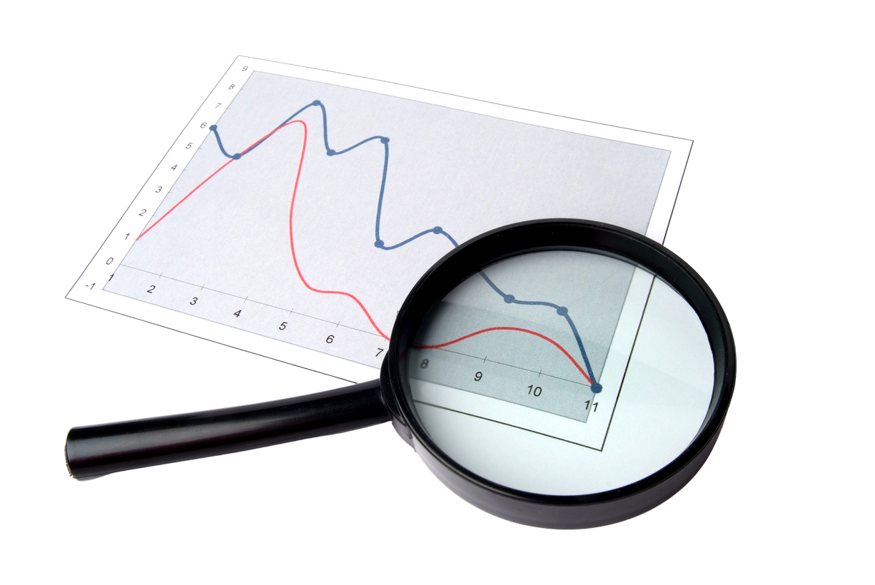
INTERPRETING YOUR DATA
2. Analyzing
  by using statistical analyses, regressions, text analyses, etc., you can start manipulating your data.
  at this stage, you will find trends, variations, and patterns
Notes:
To properly analyze your research data, you must go through 3 steps.
Clean: Once you have the necessary data it is time to clean it and leave it ready for analysis. Not all the data you collect will be useful, when collecting big amounts of information in different formats it is very likely that you will find yourself with duplicate or badly formatted data. To avoid this, before you start working with your data you need to make sure to erase any white spaces, duplicate records, or formatting errors. This way you avoid hurting your analysis with incorrect data.
Analyze: With the help of various techniques such as statistical analysis, regressions, neural networks, text analysis, and more, you can start analyzing and manipulating your data to extract relevant conclusions. At this stage, you find trends, correlations, variations, and patterns that can help you answer the questions you first thought of in the identify stage. Various technologies in the market assists researchers and average business users with the management of their data. Some of them include business intelligence and visualization software, predictive analytics, data mining, among others.
Interpret: Last but not least you have one of the most important steps: it is time to interpret your results. This stage is where the researcher comes up with courses of action based on the findings. For example, here you would understand if your clients prefer packaging that is red or green, plastic or paper, etc. Additionally, at this stage, you can also find some limitations and work on them.
8

Slide 10

INTERPRETING YOUR DATA
3. Interpreting
  lastly, look at the patterns/findings from your research and determine your course of action
  at this stage, you may also find limitations in your research
Notes:
To properly analyze your research data, you must go through 3 steps.
Clean: Once you have the necessary data it is time to clean it and leave it ready for analysis. Not all the data you collect will be useful, when collecting big amounts of information in different formats it is very likely that you will find yourself with duplicate or badly formatted data. To avoid this, before you start working with your data you need to make sure to erase any white spaces, duplicate records, or formatting errors. This way you avoid hurting your analysis with incorrect data.
Analyze: With the help of various techniques such as statistical analysis, regressions, neural networks, text analysis, and more, you can start analyzing and manipulating your data to extract relevant conclusions. At this stage, you find trends, correlations, variations, and patterns that can help you answer the questions you first thought of in the identify stage. Various technologies in the market assists researchers and average business users with the management of their data. Some of them include business intelligence and visualization software, predictive analytics, data mining, among others.
Interpret: Last but not least you have one of the most important steps: it is time to interpret your results. This stage is where the researcher comes up with courses of action based on the findings. For example, here you would understand if your clients prefer packaging that is red or green, plastic or paper, etc. Additionally, at this stage, you can also find some limitations and work on them.
8

Slide 11

TYPES OF DATA ANALYSIS
  Descriptive analysis -
  what happened
  Diagnostic analysis -
  why it happened
  Predictive analysis -
  what will happen
Notes:
There are many methods of data analysis. We’ll talk about a few of the most common ones.
Within these types of data analysis, you can use different anaylsis methods like regression analysis, factor analysis, neural networks, data mining, decision trees, etc.
Descriptive analysis - What happened.
The descriptive analysis method is the starting point to any analytic reflection, and it aims to answer the question of what happened? It does this by ordering, manipulating, and interpreting raw data from various sources to turn it into valuable insights for your organization.
Performing descriptive analysis is essential, as it allows us to present our insights in a meaningful way. Although it is relevant to mention that this analysis on its own will not allow you to predict future outcomes or tell you the answer to questions like why something happened, it will leave your data organized and ready to conduct further investigations.
Diagnostic analysis - Why it happened.
Diagnostic data analytics empowers analysts and executives by helping them gain a firm contextual understanding of why something happened. If you know why something happened as well as how it happened, you will be able to pinpoint the exact ways of tackling the issue or challenge.
Designed to provide direct and actionable answers to specific questions, this is one of the world’s most important methods in research, among its other key organizational functions such as retail analytics, e.g.
Predictive analysis - What will happen.
The predictive method allows you to look into the future to answer the question: what will happen? In order to do this, it uses the results of the previously mentioned descriptive, exploratory, and diagnostic analysis, in addition to machine learning (ML) and artificial intelligence (AI). Like this, you can uncover future trends, potential problems or inefficiencies, connections, and casualties in your data.
With predictive analysis, you can unfold and develop initiatives that will not only enhance your various operational processes but also help you gain an all-important edge on the competition. If you understand why a trend, pattern, or event happened through data, you will be able to develop an informed projection of how things may unfold in particular areas of the business.
9

Slide 12
LET’S ANALYZE AN EXAMPLE DATA SET
The table shows the final welding exam scores for the two groups of students.
Student Scores Group 1 (Live and VR) | Student Score Group 2 (Live)
Katy - 95 | Will - 58
Jerry - 86 | Darren - 62
Quint - 97 | Fiona - 49
Julie - 80 | Gabriela - 80
Felix - 91 | Larry - 55
Suzy - 89 | Nolan - 65
The students in Dr. Anderson’s welding class are taking their final welding exam. Half of the class trained using the live + VR welding machine and the other half only used the live welding machine.
Notes:
There are many methods of data analysis. We’ll talk about a few of the most common ones.
Within these types of data analysis, you can use different anaylsis methods like regression analysis, factor analysis, neural networks, data mining, decision trees, etc.
Descriptive analysis - What happened.
The descriptive analysis method is the starting point to any analytic reflection, and it aims to answer the question of what happened? It does this by ordering, manipulating, and interpreting raw data from various sources to turn it into valuable insights for your organization.
Performing descriptive analysis is essential, as it allows us to present our insights in a meaningful way. Although it is relevant to mention that this analysis on its own will not allow you to predict future outcomes or tell you the answer to questions like why something happened, it will leave your data organized and ready to conduct further investigations.
Diagnostic analysis - Why it happened.
Diagnostic data analytics empowers analysts and executives by helping them gain a firm contextual understanding of why something happened. If you know why something happened as well as how it happened, you will be able to pinpoint the exact ways of tackling the issue or challenge.
Designed to provide direct and actionable answers to specific questions, this is one of the world’s most important methods in research, among its other key organizational functions such as retail analytics, e.g.
Predictive analysis - What will happen.
The predictive method allows you to look into the future to answer the question: what will happen? In order to do this, it uses the results of the previously mentioned descriptive, exploratory, and diagnostic analysis, in addition to machine learning (ML) and artificial intelligence (AI). Like this, you can uncover future trends, potential problems or inefficiencies, connections, and casualties in your data.
With predictive analysis, you can unfold and develop initiatives that will not only enhance your various operational processes but also help you gain an all-important edge on the competition. If you understand why a trend, pattern, or event happened through data, you will be able to develop an informed projection of how things may unfold in particular areas of the business.
9

Slide 13
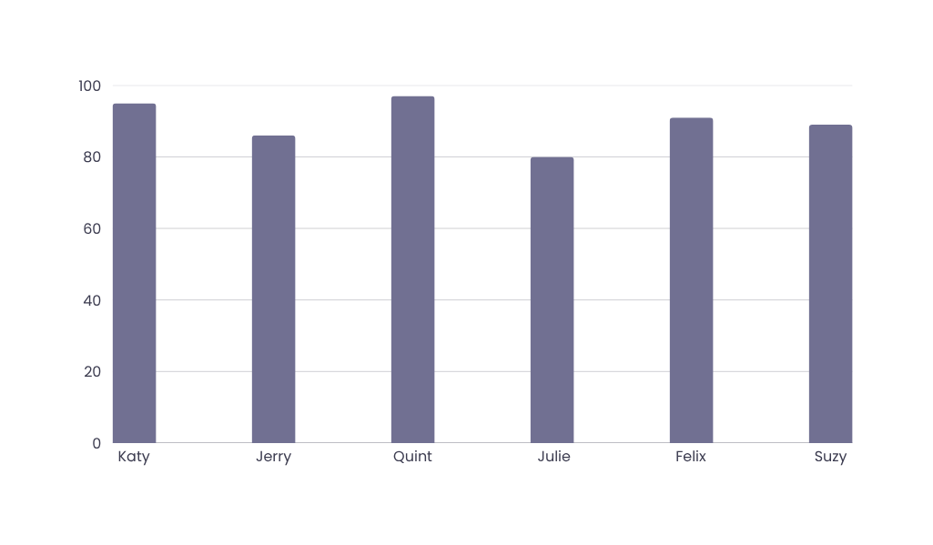
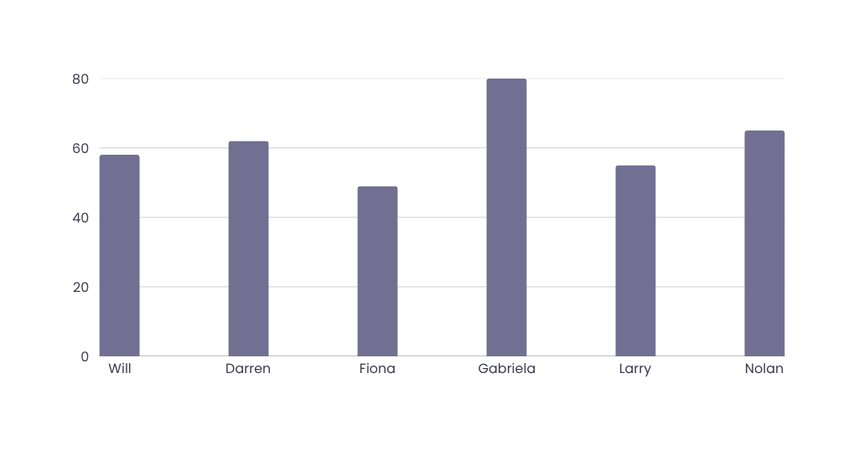
ANALYZING AN EXAMPLE DATA SET
  WE CAN ORGANIZE THE DATA INTO A CHART OR GRAPH TO HELP US VISUALIZE THE DIFFERENCE BETWEEN THE GROUP’S SCORES
  WE CAN THEN IDENTIFY TRENDS AND DRAW CONCLUSIONS FROM THE RESEARCH
Notes:
We can see that the students in group 2 had much lower test scores.
11

Slide 14

WHAT CAN WE FIND FROM THIS DATA?
  We can see that the students in Group 1 (live + VR training) had generally higher exam scores than the students in Group 2 (only live training)
  What can we conclude from this?
    Maybe the live + VR training combo is better for training students
    Maybe the live training more challenging for students
    Maybe the live training students had less experience
      We should have collected this data to know for sure!
    When interpreting your research data, you cannot make assumptions, you can only make statements that the data supports
EVIDENCE-BASED CONCLUSIONS
Notes:
All of these things are things you have to consider when thinking about your research results. You can only make conclusions that are supported by the results.
12

Slide 15

Recap!
  How to organize your data
  Tools to organize them
  Interpreting your results

Slide 16

Creating your research report
Notes:
The components to a good research report are:
Explanation of the Research Problem or Question​
Description of Study Design and Data-Collection Methods​
Presentation of the Data and Their Analyses​
Interpretations of the Data​
Identification of Possible Weaknesses of the Study​
Summary and Connections to a Broader Context
15

Slide 17

Essential Elements of a Research Report
  Introduction
  Methodology
  Data and Findings
  Conclusions
  References

Slide 18

INTRODUCTION
The introduction is where you explain:
    Your research problem
    History behind it
    Related research and literature
    Introduce your research question

Slide 19

METHODOLOGY
In your Methodology section, you explain:
  All research protocols & procedures
  How you designed the study
  How you collected the data
  Who were your participants, and were you get approved by a review committee

Slide 20

DATA & FINDINGS
In your Findings section, you explain:
  What method you used to analyze your data and information
  The trends, averages, patterns in your data
  What these trends and patterns mean (interpretations)

Slide 21

CONCLUSIONS
Your conclusion section will wrap up your research report! A good conclusion will:
  Summarize your research report and findings
  Identify the possible weaknesses of the study
  Explain what the findings mean to a broader group or society

Slide 22

REFERENCES
  The last section of your research report is the Reference or Works Cited
  This section is where you list the literature and articles you mentioned throughout the report
  Reference lists will show the
    Author, Title, Year Published, Publisher, etc.
  Different teachers/publishers will require different styles of citation
    APA, Chicago, MLA, AMA

Slide 23

When writing your research report, it is important to maintain academic integrity
Academic integrity includes:
  Crediting the words and ideas of other people ​
  Maintaining confidentiality and protecting participants’ right to privacy ​
  Identifying any biases in your sample selection​
  Describing the limitations of your assessment strategies​
  Providing a complete report of your findings, including findings that may not support your predictions​

Slide 24
WHAT DOES A COMPLETE RESEARCH REPORT
LOOK LIKE?
  Introduction (1-2 pages)
  Methods (1-3 pages)
  Results (2 pages)
  Conclusions (1 page)
  References/Works Cited (2+ pages)
Introduce the research topic and problem, previous literature, etc.
Explain what your research design was, data collection method, etc.
Explain your data analysis and what you found, trends, averages, etc.
Interpret the results, wrap up the report, come to conclusions, mention weaknesses.
Cite all authors and articles that were mentioned in the report.
Notes:
These are all just rough estimates of lengths. Obviously some reports with be longer than others depending on their experiment, their results, and how much they decide to discuss in the conclusions.
23

Slide 25



Lesson Summary
Before today, we learned how to formulate a research question, a research design, and how to collect different data.
Today, we learned how to organize our data, different data organization tools, and how to interpret results.
We also learned how to create a research report, a skill you will use often in school and your research career.

Slide 26

Lesson 3 Complete!!

