Slide 1
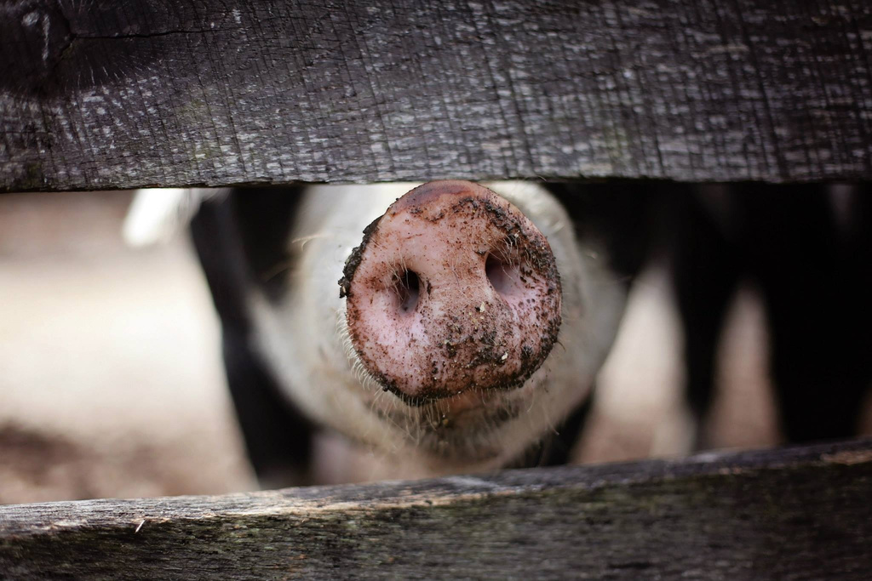
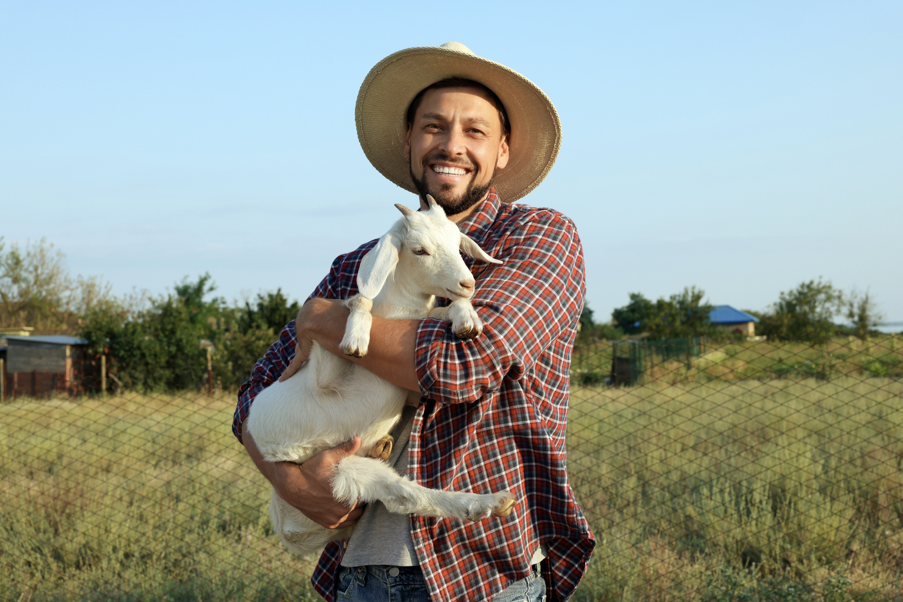
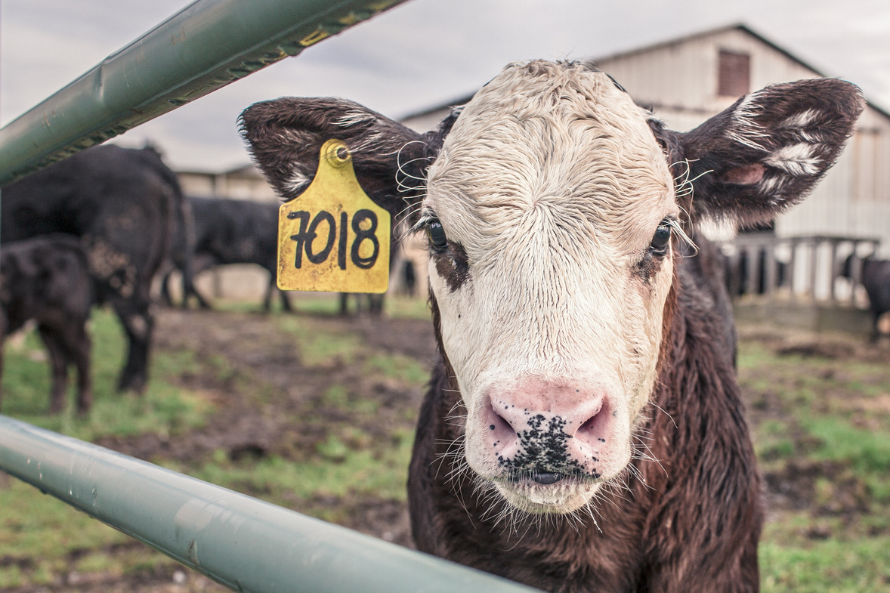

Ethics & Integrity in Research
Notes:
1

Slide 2

GENERAL OVERVIEW
  What are research ethics & integrity?
  Research ethics committees
  How to be an ethical researcher
  Research misconduct, the consequences, and how to avoid it!
Notes:
Will also be covering several examples, some activities, and a video
2

Slide 3


What are Research Ethics & Integrity?
  Research ethics and research integrity are overlapping themes that are usually talked about together.
  Research ethics and integrity practices make sure that research:
  Is conducted with the highest standards
  Is performed with the minimal risk of harmful outcomes or consequences
Notes:
Make sure you pose this question to the class. Ask them “what are ethics? What is integrity?”. Wait and see what they say, discuss society’s understanding of ethics and how it could apply to research. THEN load the text box.
3

Slide 4

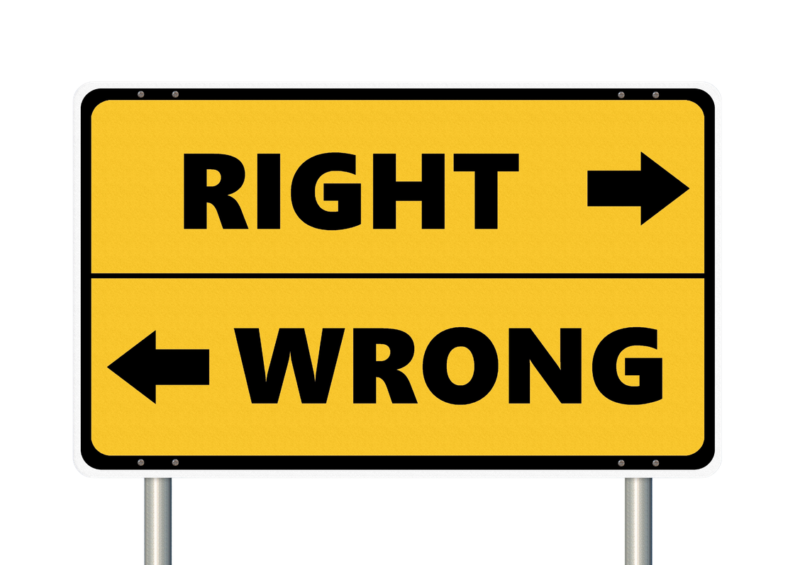
  Research ethics: doing research with responsibility, particularly towards participants, colleagues, employers, funders and society.
  Research integrity: doing research in ways that ensure confidence in the results, the researchers, and the research community.
Definition of Research Ethics & Integrity
Notes:
The two concepts are distinct, but they affect each other.
For example, mistakes from poor data management not only undermine the confidence in the research (a breach of integrity) but are also a lack of responsibility towards participants & funders (a breach of ethics)
4

Slide 5
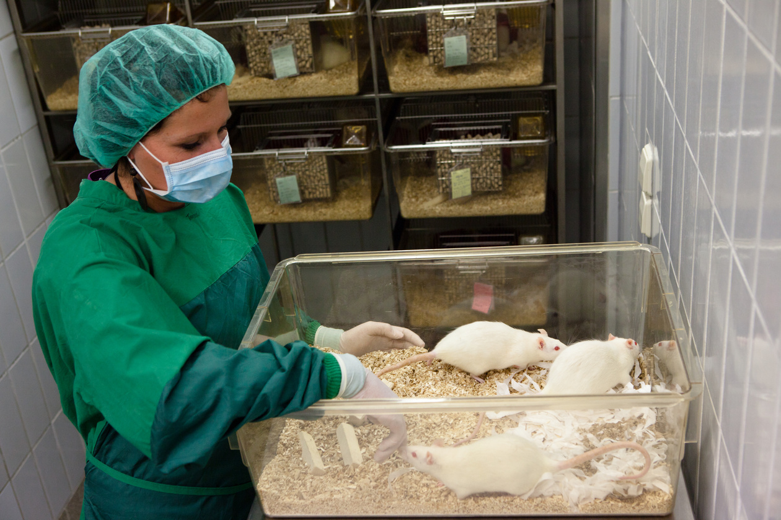
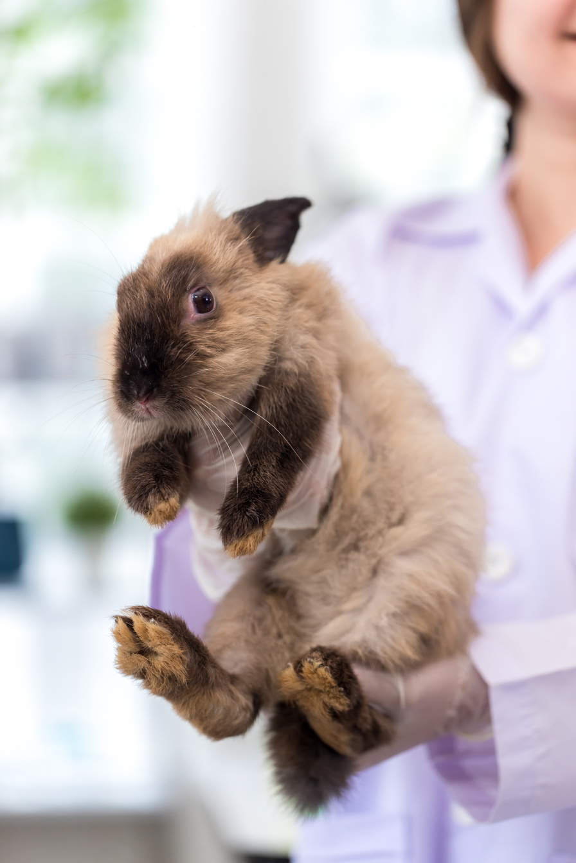

Why are they Important?
  Research ethics help to create safe, reliable experimental designs
  Research ethics and integrity principles are used as guidelines for situations in research
    Academic scandal
    Scientific misconduct
    Research regulations
Notes:
Research ethics help to create safe, reliable experimental designs for different types of research, usually involving human and animal experimentation
Research ethics and integrity principles are used as guidelines for situations like academic scandal, scientific misconduct, and research regulation
Why else might ethics in research be important? Ask the students before moving on to the next slides.
5

Slide 6
CLASS DISCUSSION
1
2
3
As a class, come up with a research question.
This can be about any type of topic or research!
Then create a general research design.
How would you try to answer this question or test the hypothesis?
Now come up with 2 ways that there could be a breach in the ethics or integrity of the research.

Slide 7




What are Ethical Risks
to Consider in Research?
  As a researcher, you must be aware of potential risks to a participants’
    Wellbeing
    Autonomy
    Justice
  If your project involves any potential risks, you will need to think about how to address them.
Notes:
Wellbeing is understood as their health and welfare,
Autonomy is their freedom and ability to make their own decisions.
Justice is fairness, treating them equally and fair.
7

Slide 8



What are Ethical Risks to Consider in Research?
Some questions are:
  Will any of the participants be vulnerable?
  How will you show that any participants have agreed to take part?
  Are you collecting personal data?
Notes:
As you read these questions, make sure you give examples of ethical research considerations regarding the question
Will any of the participants be classed as vulnerable? For example:
Are any of them under 16 years of age?
Unable to communicate in the language?
Members of a stigmatized or marginalized social group?
Have a relationship with the researcher (either personally or professionally)?
How will you show that any participants have agreed to take part?
Will they be able to give informed consent individually?
Will consent need to be obtained from parents or guardians?
Will the purpose of your research be concealed from participants at the outset?
Are you collecting personal data, either face to face or online? If so,
How will you obtain the consent of participants?
How will this be securely stored and maintained?
How will this data be used?
With whom will it be shared?
How and when will it be disposed of?
8

Slide 9
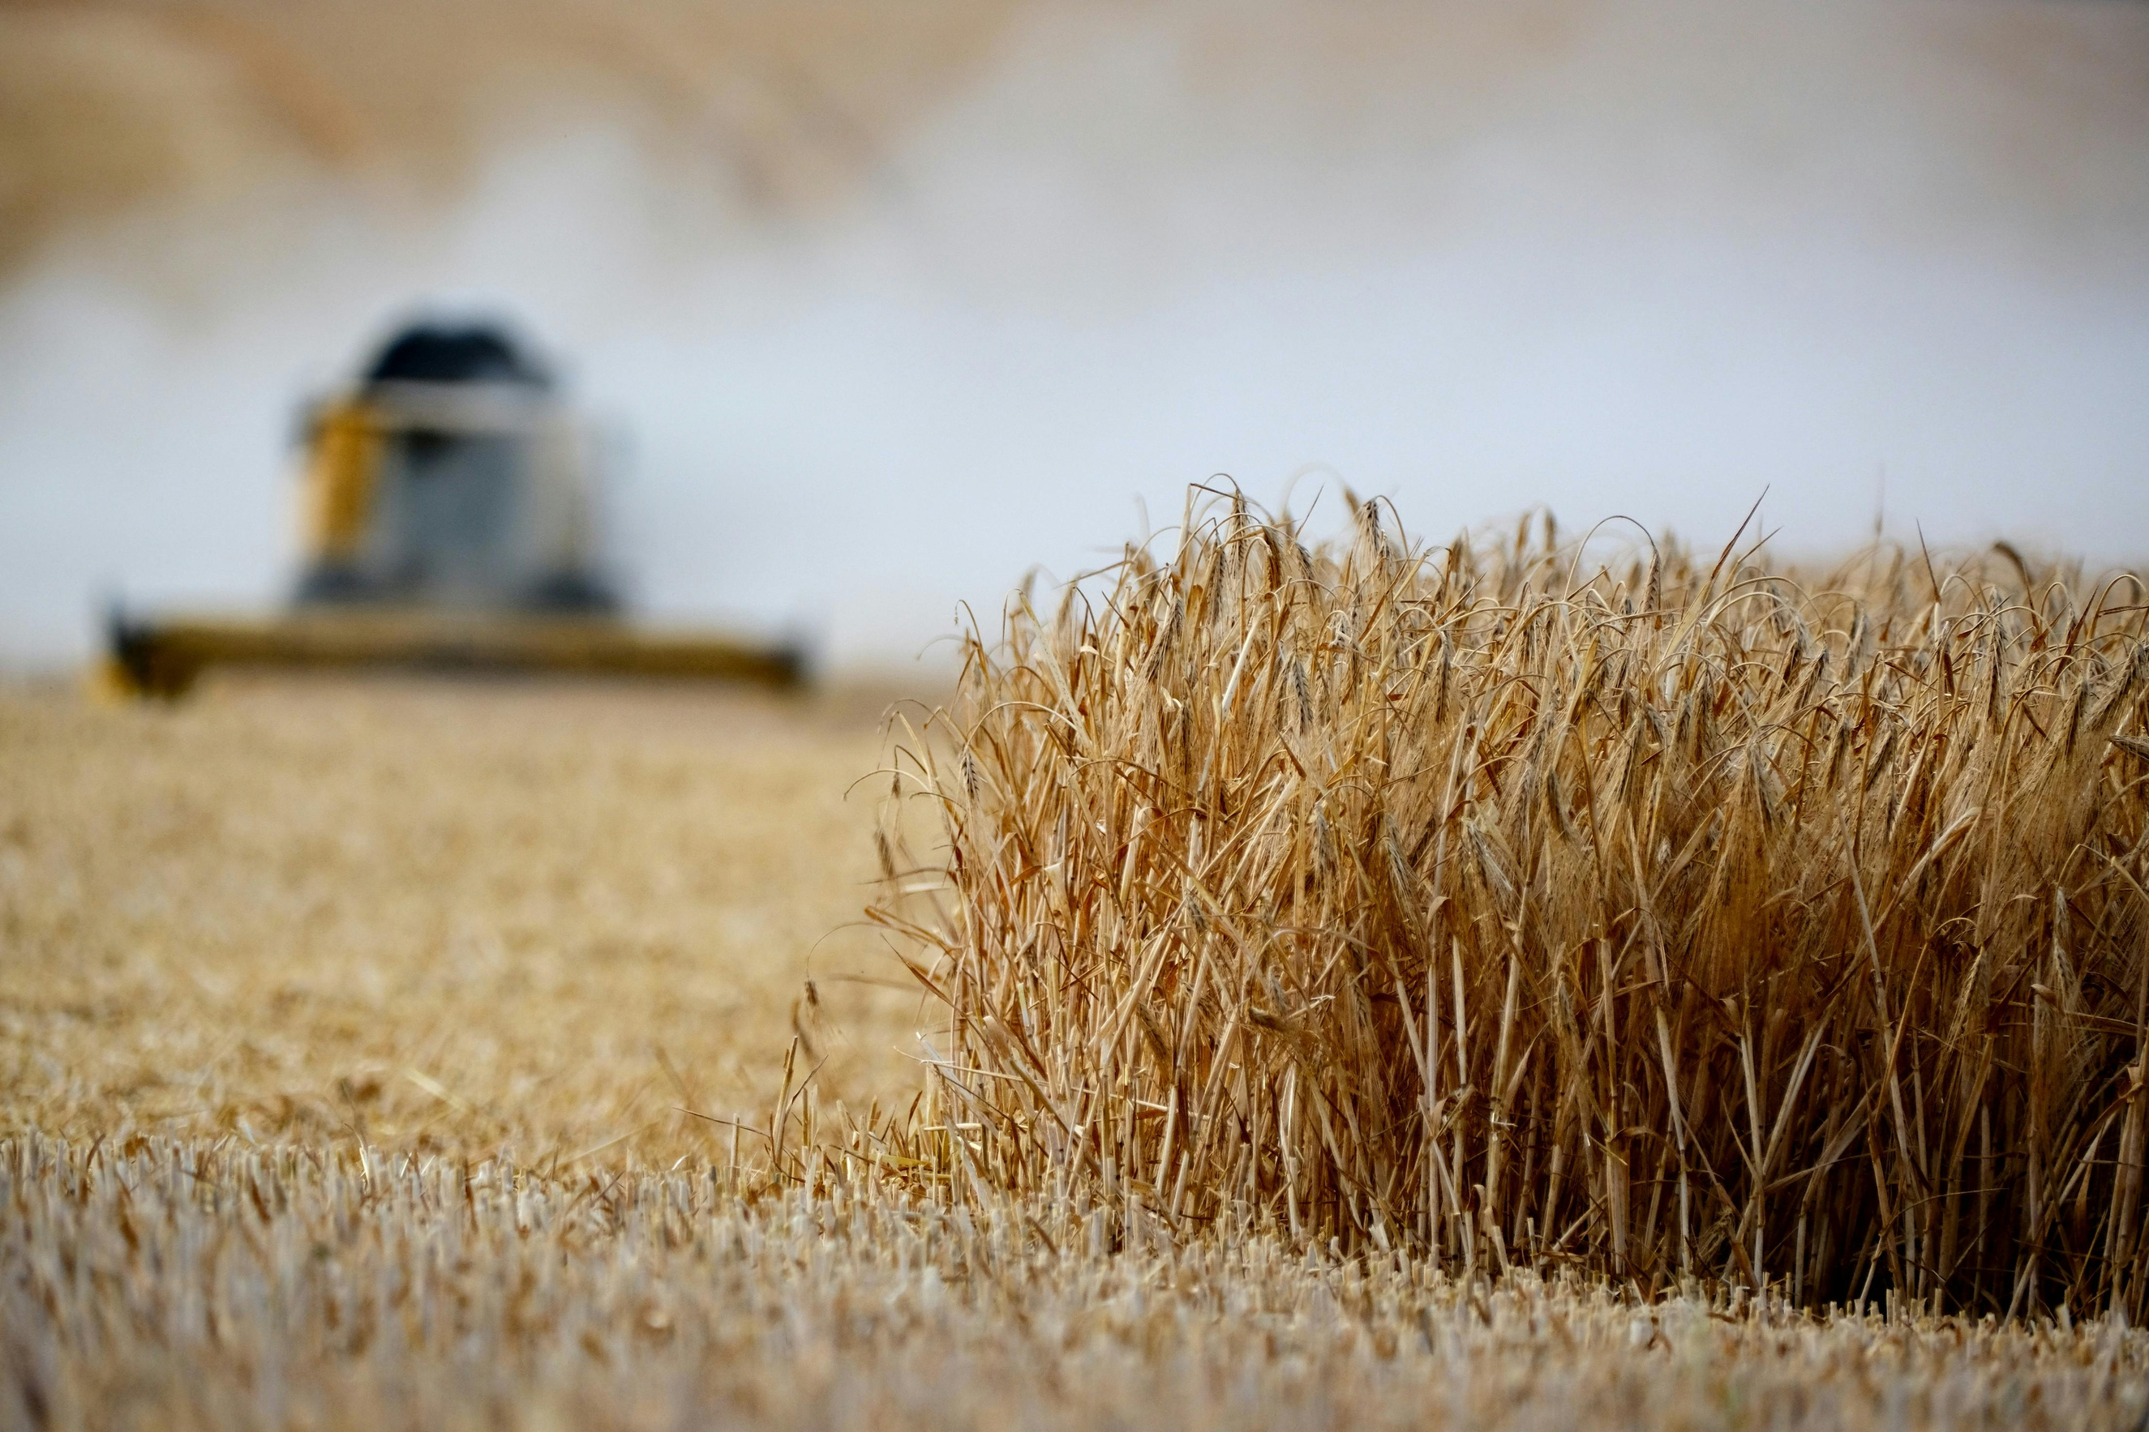
RESEARCH ETHICS IN AGRICULTURE
Four main aspects of agricultural research are incredibly important when it comes to ethics.
These four aspects are
  People in the food industry
  Public citizens
  Farm animals (food supply)
  The living environment

Slide 10

RESEARCH ETHICS IN AGRICULTURE
Ethics in agricultural research means making choices that are fair, safe, and respectful to people, animals, and the environment.
Four main areas of focus:
  Consumers and Producers
    Families make smart food choices.
    Farmers ensure food safety and quality.
  Community Engagement
    Encourages healthy eating and supports local food programs.
  Farm Animals and the Environment
    Promotes animal care and eco-friendly farming practices.
  Nutrition and Wellness
    Highlights the importance of balanced diets and healthy lifestyles

Slide 11
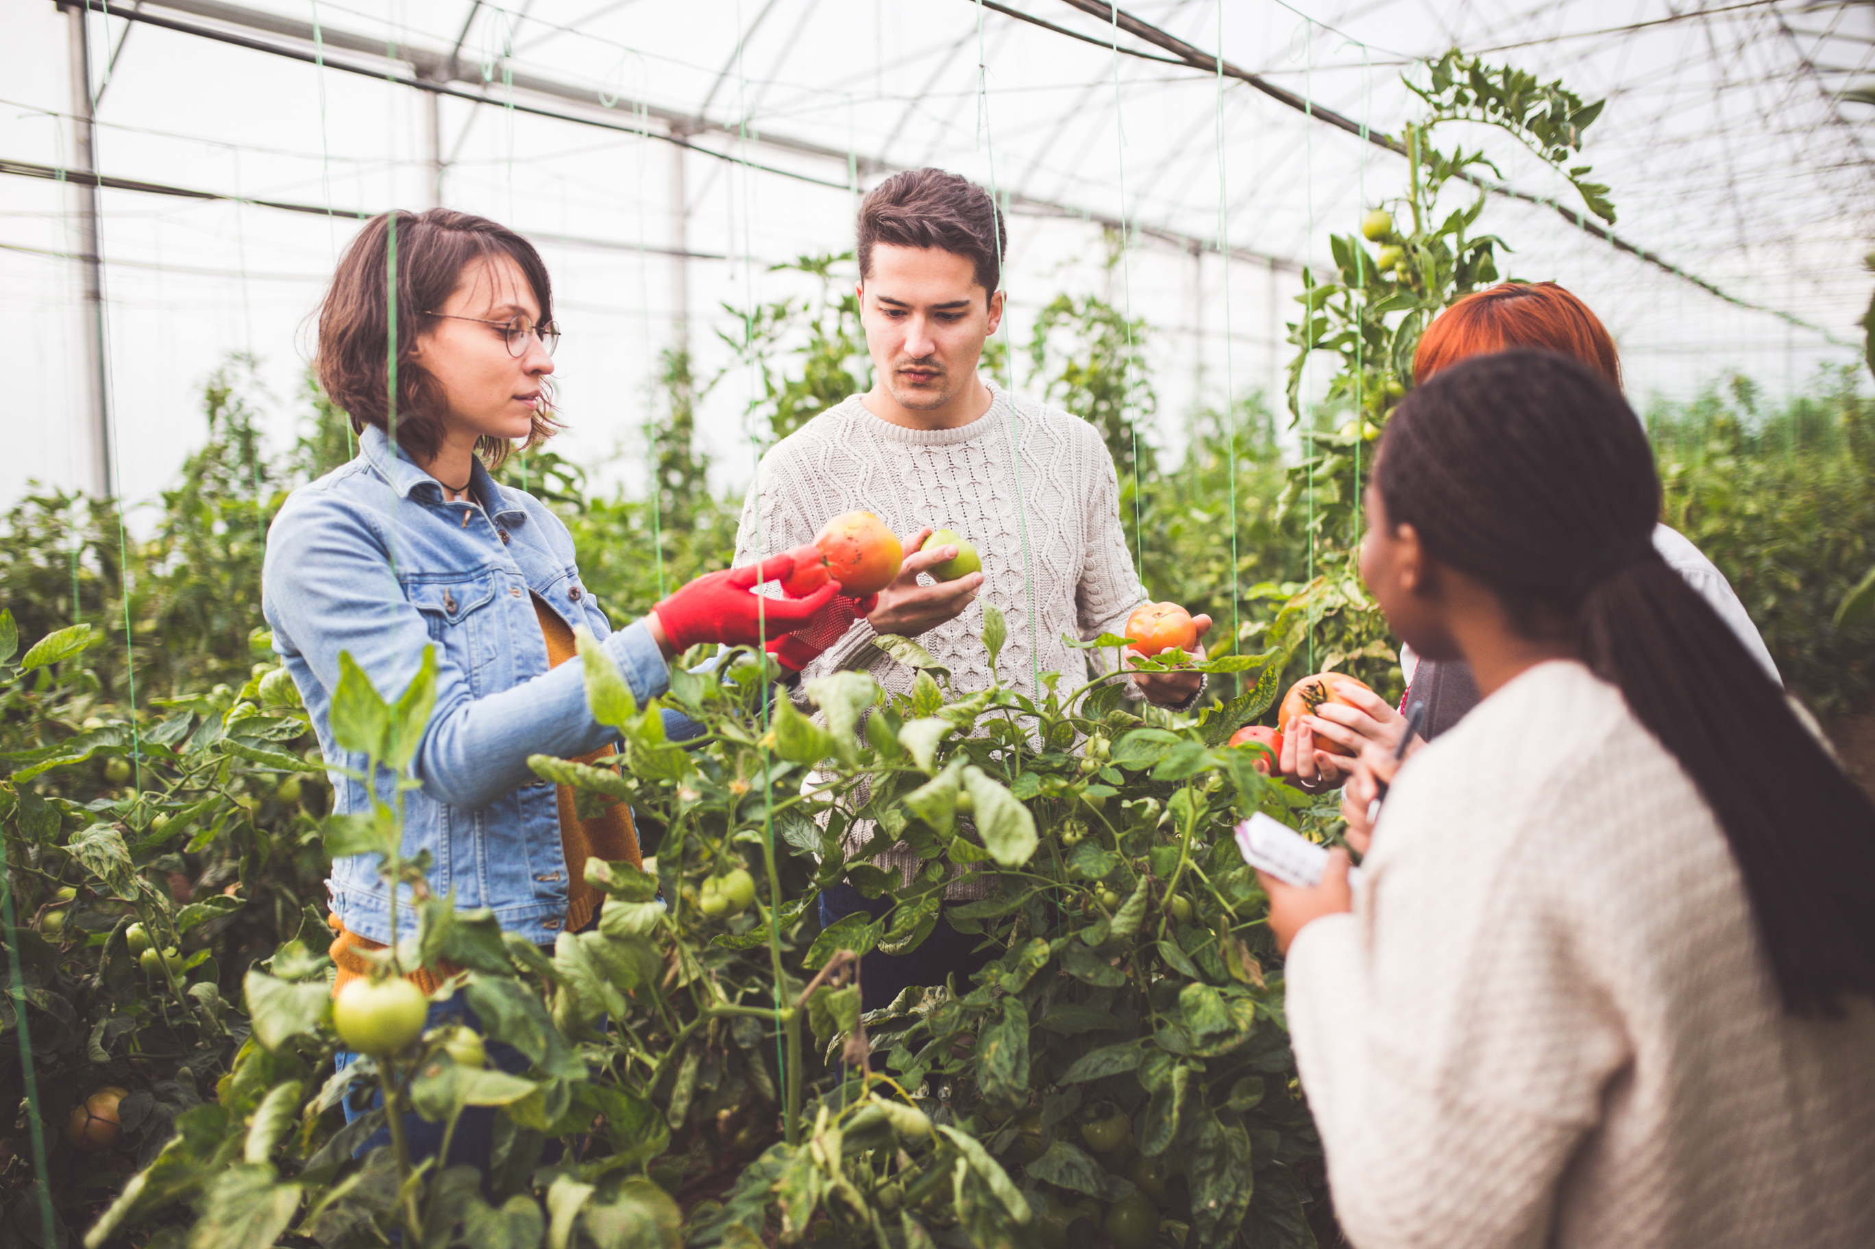
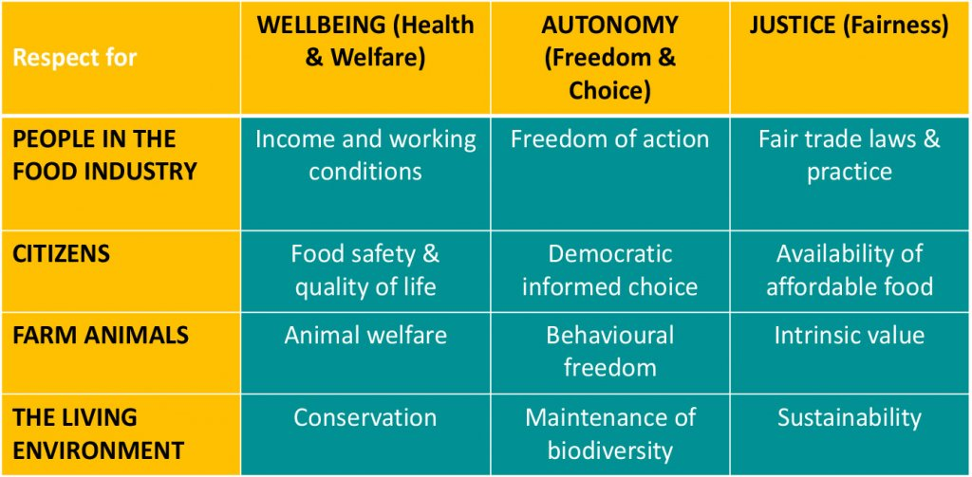
Research Ethics in Agriculture
Notes:
This table shows the different factors of ethics that
11

Slide 12
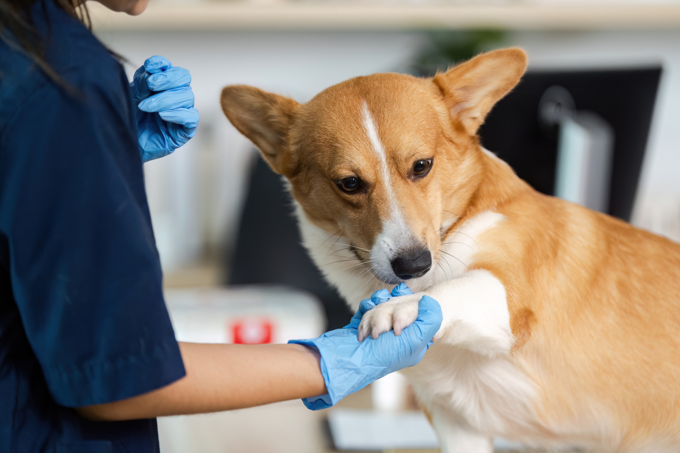
  Food Safety
  Treatment of Animals
  Chemical Use
Discussion:
Examples of Agricultural
Ethical Issues
Notes:
These are some examples.
Food Safety: Producers taking shortcuts or using questionable additives makes food unsafe. Recalls are common, especially with produce, and food recalls are up by 10% since 2013.
Treatment of Animals: Many have a difficult time seeing this as an actual ethics issue facing the agricultural industry. If animals are just being used as a food source, why treat them well? But this also includes using steroids and hormones to boost growth and production. Unethical treatment leads to lower quality products, meaning it’s worth investing to treat animals better.
Chemical Use: The use of pesticides and other chemicals has been an ongoing debate. Farmers want to use chemicals to reduce pests and increase production. However, those same chemicals have been known to cause health issues. Plus, pesticides are killing off native species and decreasing biodiversity.
12

Slide 13
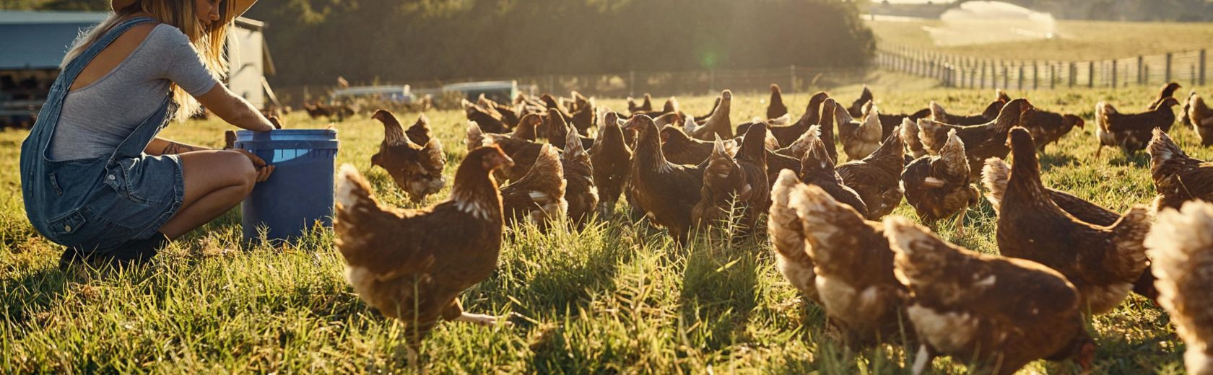
Ethical Research Practices
  Data management
  Authorship
  Human and animal welfare
Notes:
To make sure we are practicing ethical research, there are three main considerations we must take.
- Authorship – always give due credit to authors, and never plagiarize another author’s work
- Data Management – data from research involving private information should always be documented and stored in secure locations
- Human & Animal Welfare – researchers must always treat human and animal subjects humanely, and ensure that human subjects are informed of their study participation (informed consent)
Its important to note these are just some of the core practices. We are wanting to highlight the human and animal welfare, leading into the next slides.
13

Slide 14
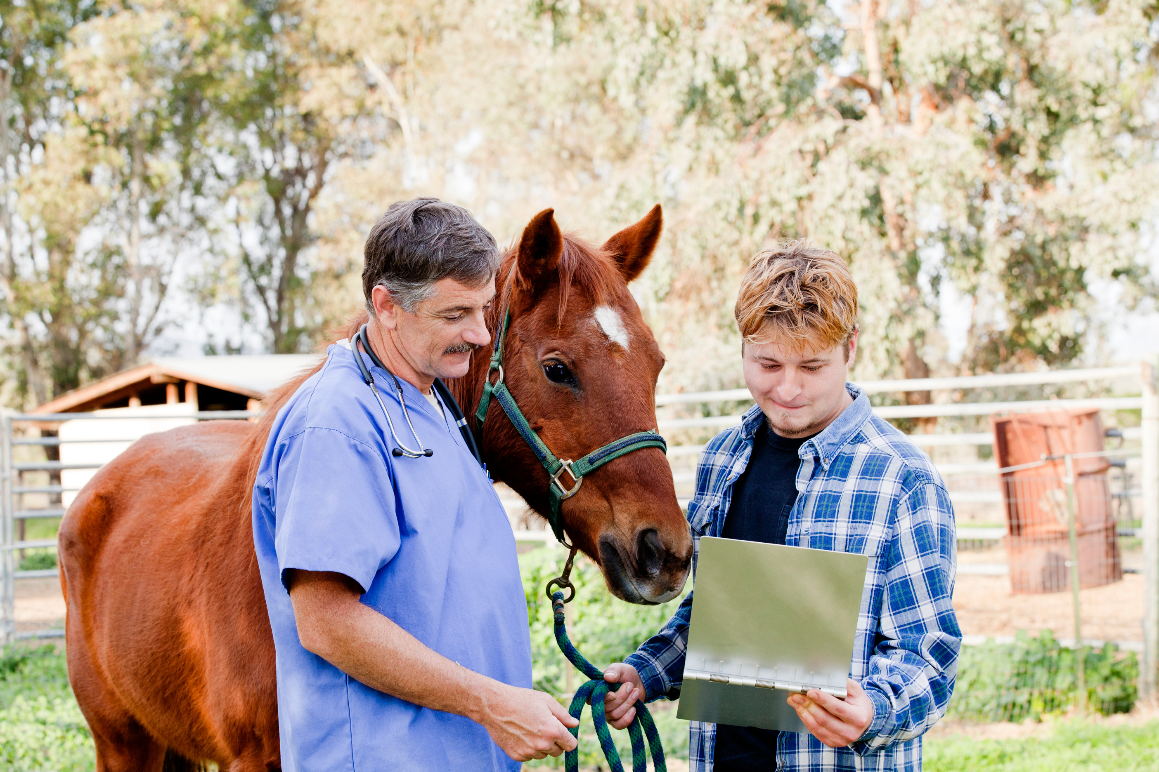
Ethical Research Practices
When conducting human or animal research, certain precautions have to be taken to make sure there are no serious risks.
Here’s a video that talks more about it.
Notes:
To make sure we are practicing ethical research, there are three main considerations we must take.
- Authorship – always give due credit to authors, and never plagiarize another author’s work
- Data Management – data from research involving private information should always be documented and stored in secure locations
- Human & Animal Welfare – researchers must always treat human and animal subjects humanely, and ensure that human subjects are informed of their study participation (informed consent)
Its important to note these are just some of the core practices. We are wanting to highlight the human and animal welfare, leading into the next slides.
14

Slide 15

Human Research:
Informed Consent
  Research with humans requires informed consent
  Informed consent: permission granted in the knowledge of the possible consequences
Notes:
Informed consent is normally given by a participant or patient, to a doctor or researcher. The patient gives consent that they are aware of the potential risks and affects of whatever treatment they will undergo.
One common practice is to give participants an informed consent form that describes the nature of the research project, as well as the nature of participation in it
15

Slide 16
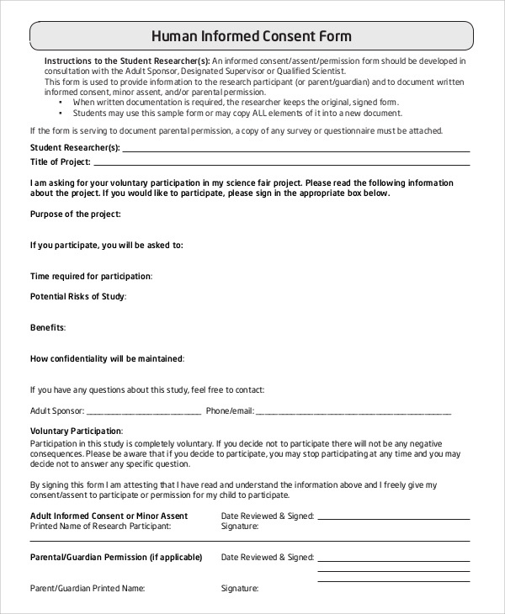
Informed Consent Forms
Informed consent forms contain:
  Disclosure of information
  Competency of the participant (or surrogate) to make a decision
  Voluntary nature of the decision
  Documentation of the consent
Notes:
Walk them through the form, explain any terms they may not understand.
Other elements include:
Research project title and purpose
Researcher names
Project benefits to participants and scientific community
Explanation of how data will be managed
16

Slide 17



Research Ethics Review Committees:
IRB, IACUC, and IBC
Notes:
So, who created the need for these informed consent forms?
Who makes sure that researchers are doing these forms and conducting research ethically?
That’s where research ethics review committees come in!
We’re gonna talk about three different ones.
17

Slide 18

Institutional Review Board (IRB)
  IRB reviews the paperwork and procedures of a researcher’s project before the researcher is allowed to do it.
  IRB members have professional experience to provide scientific and ethical review.
  An IRB has 5 members and must have:
    at least 1 scientist member
    at least 1 member whose specialty
    is nonscientific
Notes:
In the US, Canada, and some of the EU, any college, university, or research institution must have an institutional review board (IRB) that scrutinizes all proposals for conducting human research under the supervision of the institution.
Research proposals must be submitted to and accepted by the IRB before any data are collected for the project.
An IRB consists of at least five members of varying backgrounds.
IRB members should have the professional experience to provide appropriate scientific and ethical review.
An IRB must have at least one scientist member and at least one member whose primary concerns are nonscientific.
Why do you think this is the case?
18

Slide 19
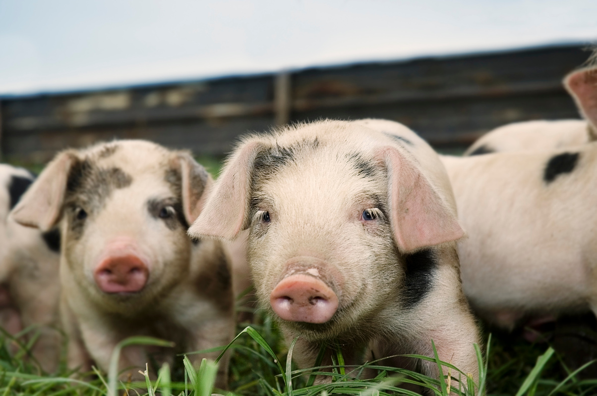
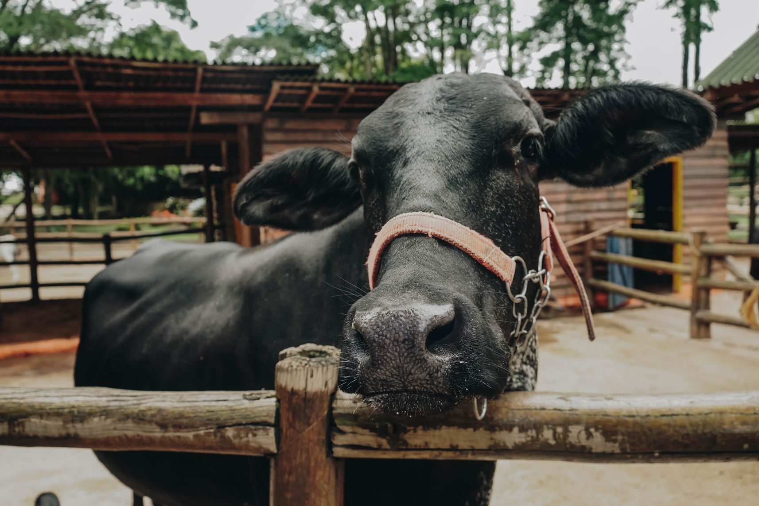
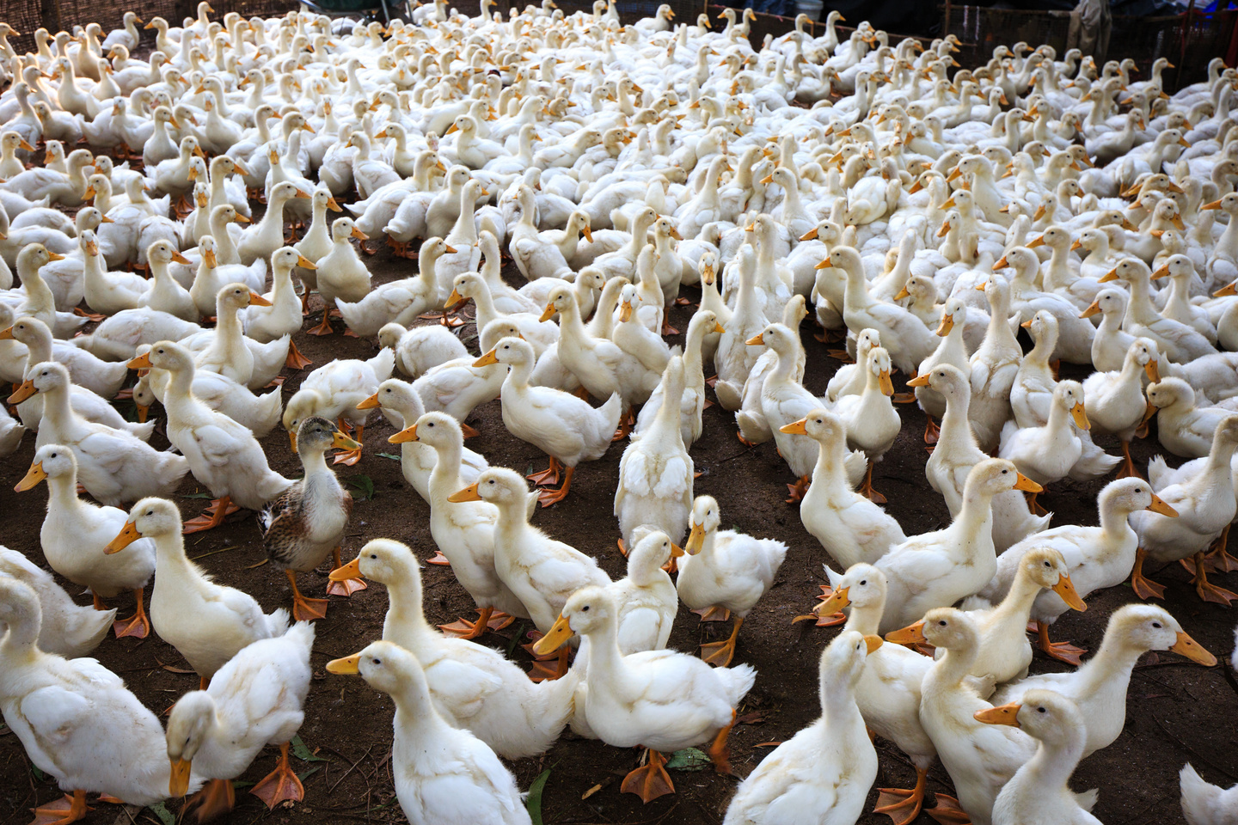
Institutional Animal Care & Use Committee (IACUC)
  IACUC reviews the animal use protocols and purposes that researchers intend to use.
    research that may cause suffering, distress, or death to animals must be described/justified to IACUC
    IACUC also has 5 members
      At least 1 veterinarian,
      1 animal research scientist,
      1 member who is nonscientific,
      and 1 member who is not affiliated
      with the institution
Notes:
Researchers must submit their animal use protocols to their institution’s IACUC for approval
IACUC reviews the animal use protocols and purposes that researchers intend to use.
Any research that may potentially cause suffering, distress, or death to animals must be described and justified to IACUC.
The researcher must minimize or prevent suffering or death to the extent that it is possible to do so.
IACUC consist of at least 5 members and includes:
one veterinarian with training/experience in laboratory animal science and medicine, who has direct authority and responsibility for activities involving animals at the institution
one practicing scientist experienced in research with animals
one member whose primary concerns are in a nonscientific area (ethicist, lawyer, clergymember)
one member who is not affiliated with the institution other than as a member of the IACUC
One researchers are approved, they may begin their research study
19

Slide 20
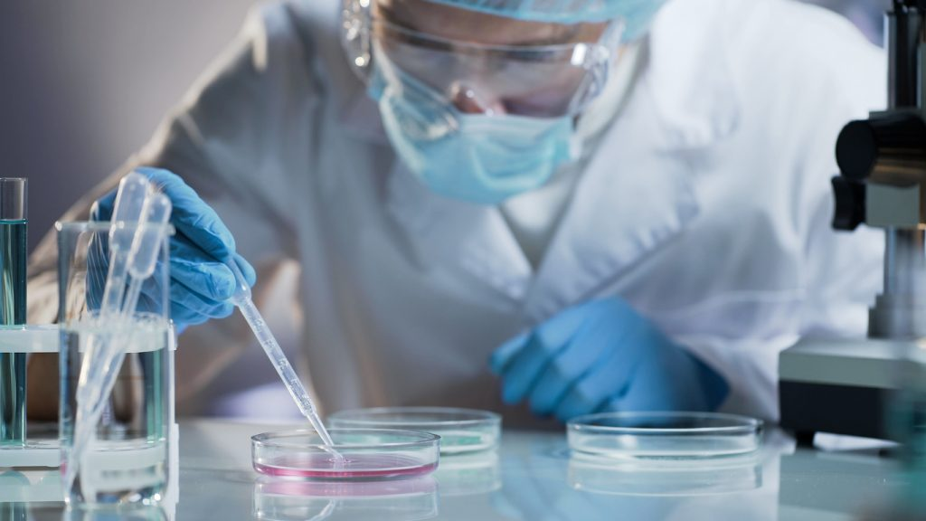
Institutional Biosafety Committee (IBC)
  The IBC must review and approve all research involving hazardous biological materials, including:
  Recombinant DNA
  Select agents and toxins
  Human or zoonotic pathogens
  IBCs consist of many members, all experts or specialists in various fields like:
    Infectious disease
    Safety services
    Public health
    Biology
Notes:
The IBC must review and approve all research and teaching projects involving hazardous biological materials, including:
Recombinant DNA (as defined by institution guidelines and including transgenic animals and plants)
Select agents and toxins, specified by the institution
Some human or zoonotic pathogens
Strict Animal and Plant Pathogens that are either reportable or non-indigenous to the area of the institution
Like IRB and IACUC, the IBC functions to review research proposals and protocol involving potentially dangerous aspects.
IBCs consist of many members, all experts or specialists in various fields like:
Infectious disease
Safety services
Public health
Biology
IBC members may be Doctors, consultants, or community members invested in the biosafety of research.
20

Slide 21

IACUC
Protection of
Animal Welfare
IBC
Plant &
Biosafety Oversight
IRB
Protection of
Human Subjects
HUMAN
SAFETY
ANIMAL
SAFETY
Notes:
Walk them through the similarities between the different review boards/committees
They are all interconnected and deal with similar ethical issues. These three boards help to make sure that agriculture research and other animal/human research is done in an ethical and humane way.
21

Slide 22


CLASS DISCUSSION:
Take a look at the headlines below, and decide which review board (IRB, IACUC, or IBC) must have given permission for these research experiments.
  “Woman Cured of HIV After Human Umbilical Cord Blood Transplant”
  “In a First, a Robot Performs Laparoscopic Surgery on Pig Without Human Help”
  “Doctors Transplant Gene-Modified Pig Kidneys Into Brain-Dead Patient”
  “New species of corn developed using genome manipulation will allow farmers to use less water and fertilizer while maintaining crop yields”
Notes:
IRB
IRB and IACUC
IRB and IACUC and maybe IBC
IBC
PS all of these are true
22

Slide 23
WHAT’S NEXT?
  What are research ethics & integrity?
    Ethics in agriculture
  Research ethics committees
  How to be an ethical researcher
  Research misconduct, the consequences, and how to avoid it!
Notes:
Will also be covering several examples, some activities, and a video
24

Slide 24
WHAT WE’VE LEARNED SO FAR...
What we learned about research ethics:
  Help us do research safely and responsibly
  Remind us that research can have risks
To avoid these risks, researchers must:
  Keep data organized and accurate
  Give proper credit to authors and contributors
  Protect people and animals involved in research
Committees that check research ethics:
  IRB: Human subjects
  IACUC: Animal research
  IBC: Biological safety
Notes:
Risks can be towards humans, animals, the environment.
There are many aspects to being an ethical researcher, but the three key factors are authorship, data management, and human/animal welfare. Expand on those a little.
So we’ve talked about how review committees help us to be good researchers, lets talk about what we personally can do and what happens when we fail to be an ethical researcher.
25

Slide 25

  Good research practices are based on fundamental principles of research integrity
  They guide researchers in their work and help them with the ethical challenges they face in research
How to be an Ethical Researcher
Notes:
Mention that these review committees are largely guided by fundamental principles of research ethics and integrity.
26

Slide 26
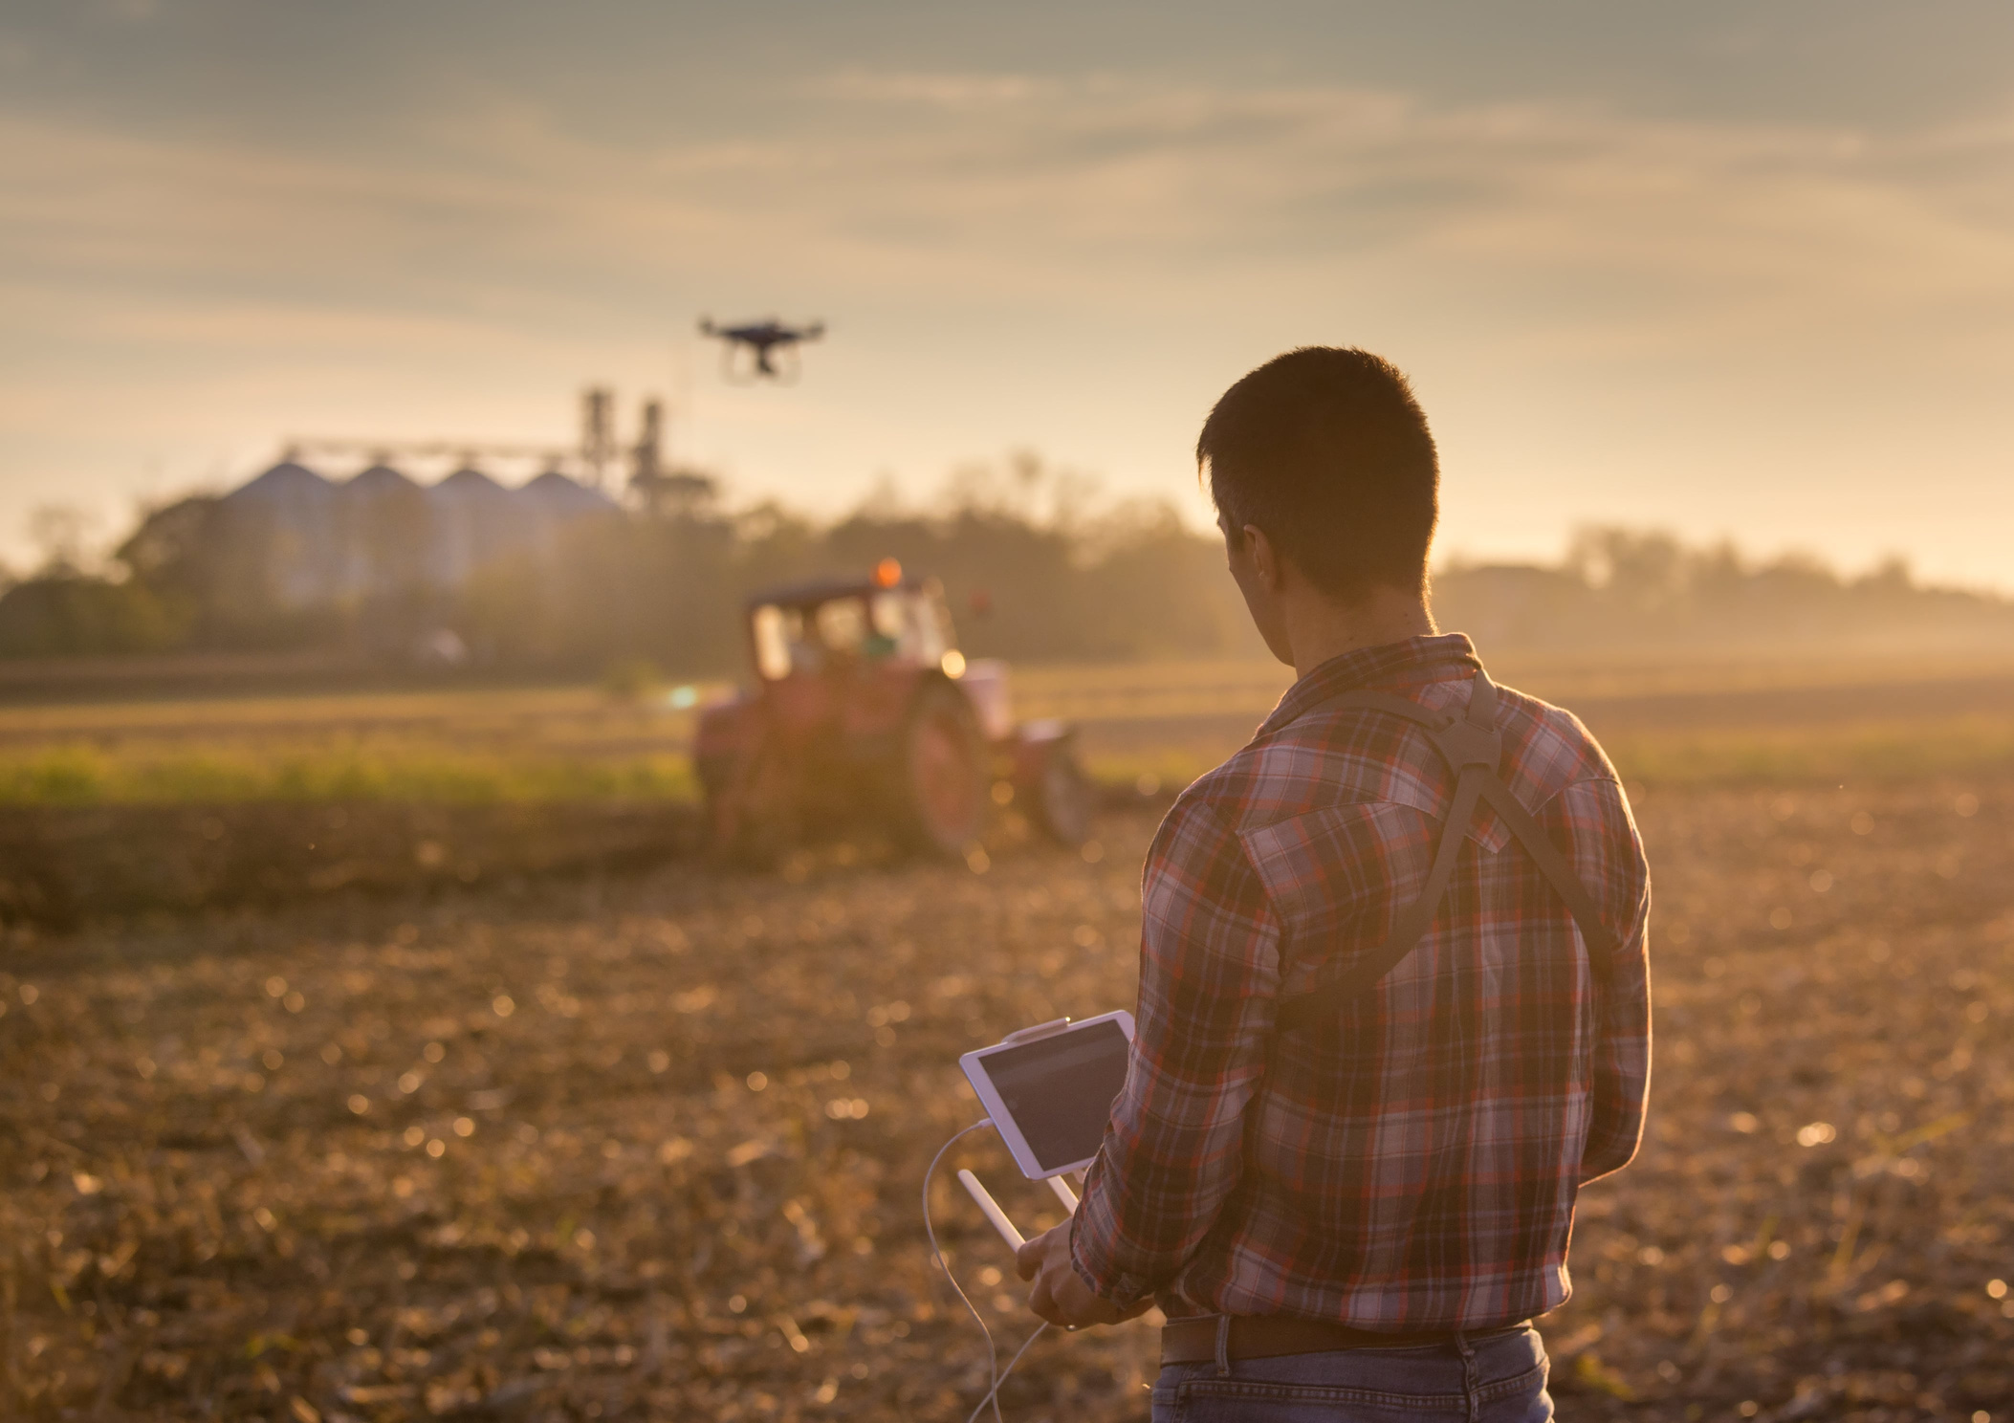
PRINCIPLES OF RESEARCH INTEGRITY
  Reliability in ensuring the quality of research
  Honesty in reporting research in a transparent, fair, and unbiased way
  Respect for colleagues, research participants, society, ecosystems, cultural heritage and the environment
  Accountability for the research, for its management, training, supervision, and for its wider impacts
Notes:
Principles of research integrity include:
Reliability in ensuring the quality of research, reflected in the design, the methodology, the analysis and the use of resources
Honesty in developing, undertaking, reviewing, reporting and communicating research in a transparent, fair, full and unbiased way
Respect for colleagues, research participants, society, ecosystems, cultural heritage and the environment
Accountability for the research from idea to publication, for its management and organization, for training, supervision and mentoring, and for its wider impacts
27

Slide 27
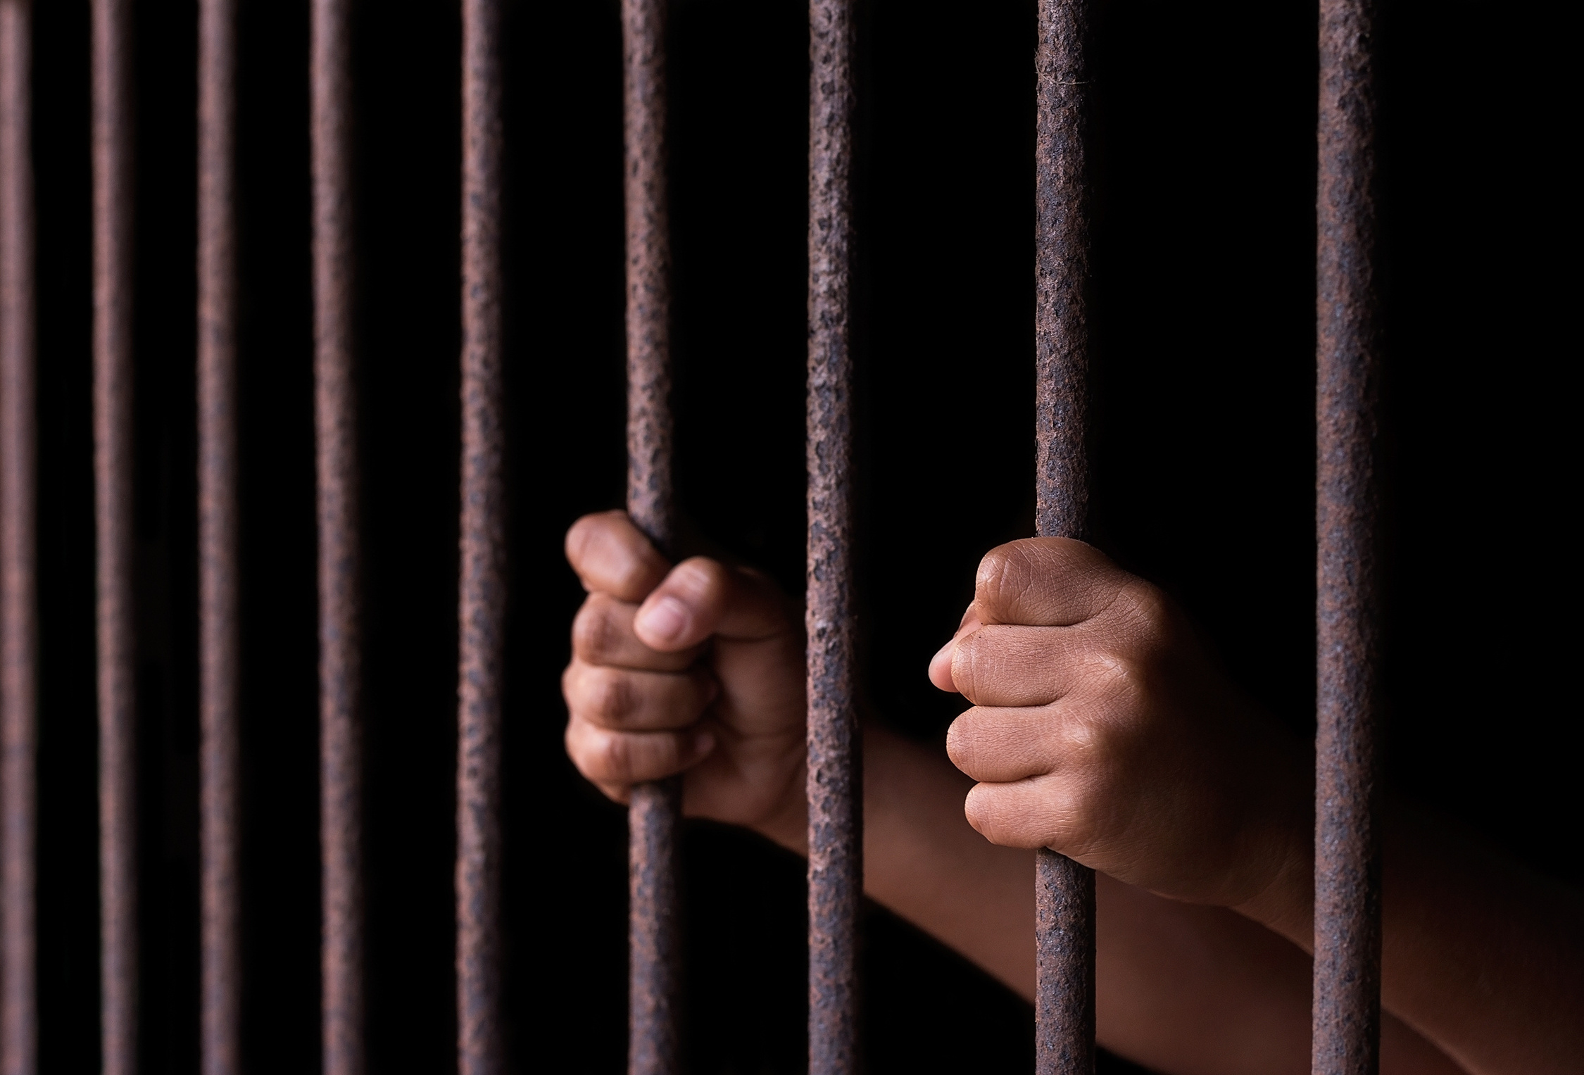
RESEARCH MISCONDUCT
  Research misconduct is defined as fabrication, falsification, or plagiarism in performing research or reporting results.
  Research misconduct is taken very seriously and should be avoided in all its forms.
Notes:
If research principles are not followed, they can lead to research misconduct.
If you are participating in research misconduct, you are not being an ethical researcher. And we’re not talking about making a simple mistake like entering the wrong data number, we’re talking about completely falsifying and making up your research results.
28

Slide 28

Fabrication, Falsification, & Plagiarism
Fabrication: making up data or results and recording or reporting them.
Falsification: Manipulating research materials, equipment, or processes, or changing or omitting data such that the research is not accurately represented.
Plagiarism: The appropriation of another person's ideas, processes, results, or words without giving appropriate credit.
Notes:
Ask them if they can think of any examples before moving to the next slide.
29

Slide 29
CLASS ACTIVITY:
MATCH THE RESEARCH MISCONDUCT
Decide whether the examples below are fabrication, falsification, or plagiarism.
Example 1. A surveyor notices that their data is proving his hypothesis wrong. They decide to not include the data in their paper so that the work looks more favorable to their sponsors.
Example 2. In order to meet recruitment pressure and expectations, a coordinator completed enrollment forms using faked names and information. They submit the forms to their boss at the deadline.
Example 3. Two researchers are working on a project together and they both put effort into writing the research paper. After the paper is written, one of the researchers publishes the paper, but only with themselves as the author.
Notes:
Key: Example 1 is falsification. Example 2 is fabrication. Example 3 is plagiarism.
30

Slide 30

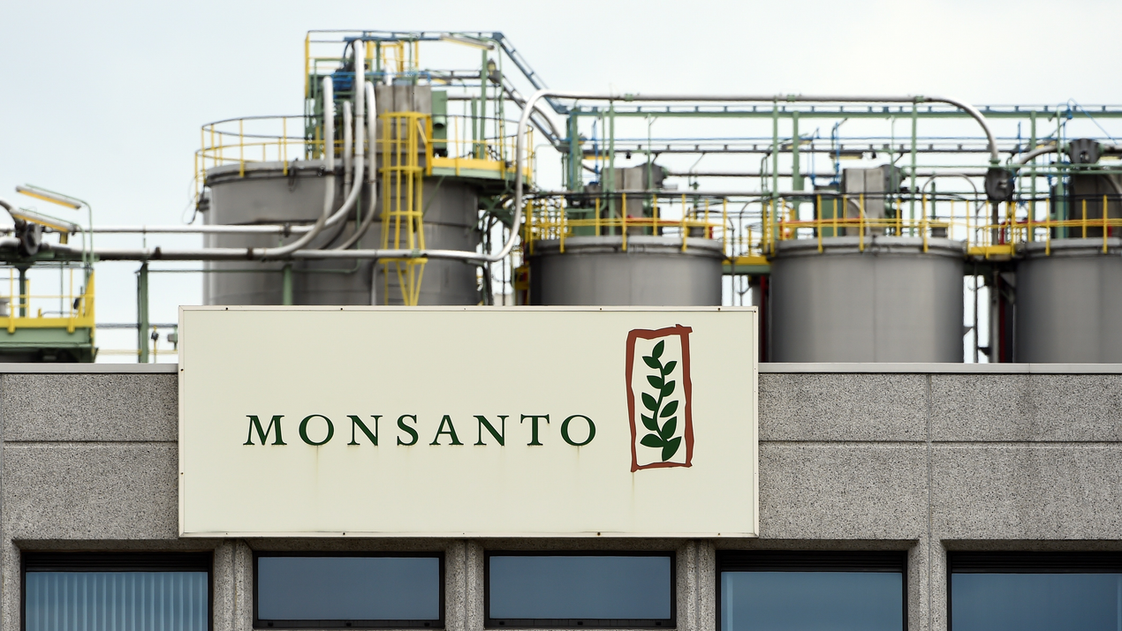
EXAMPLE OF AGRICULTURAL RESEARCH MISCONDUCT: MONSANTO
Ghost writing: writing a document under someone elses name.
  Monsanto engaged in ghostwriting and other types of research misconduct to make it harder to regulate its most profitable products.
  Although public-science organizations have sanctions to punish research misconduct, private-science organizations do not. At Monsanto, they were allowing research misconduct.
  Journal editors who peer-reviewed the Monsanto documents were also unethical
    They did not disclose their conflict of interest
  Scientific misconduct by private firms threatens the public’s trust and integrity of public science.
Notes:
Large corporations that cheat the system make it hard for public science and people trust in science to flourish.
Lying and cheating is never the right way to increase profits. It also indirectly hurts a lot of people.
There are even more scandals about their seeds and pesticides being toxic and cancer-causing.
31

Slide 31
SUMMARIZING RESEARCH ETHICS
  Research ethics and integrity ensure research is conducted with the highest standards and the minimal risk of harm
  There are ethical risks when designing a research experiment, therefore scientists must address these and get approval from review boards (IACUC, IRB, IBC)
  Failure to follow research ethics properly can lead to research misconduct, resulting in serious consequences.
  Researchers engaging in misconduct may lose funding, research/facility privileges, their job, and respect/trust within the industry and academic community.
Notes:
Spend some time on each of these points to really make sure they understand the concepts.
32

Slide 32

The end!

