Slide 1


TXST Office of Veterans Affairs
New Student Orientation
2026

Slide 2

VA BENEFITS: THE BASICS (DON’T MISS THIS!)
Submit a request for benefits every semester
Check your TXSTATE.EDU E-MAIL DAILY
YOU do NOT need to be registered to submit a Certification Request
Deadlines = Everything
  -Priority Processing
  -Payment Deadlines
Submit online and track STATUS anytime

Slide 3
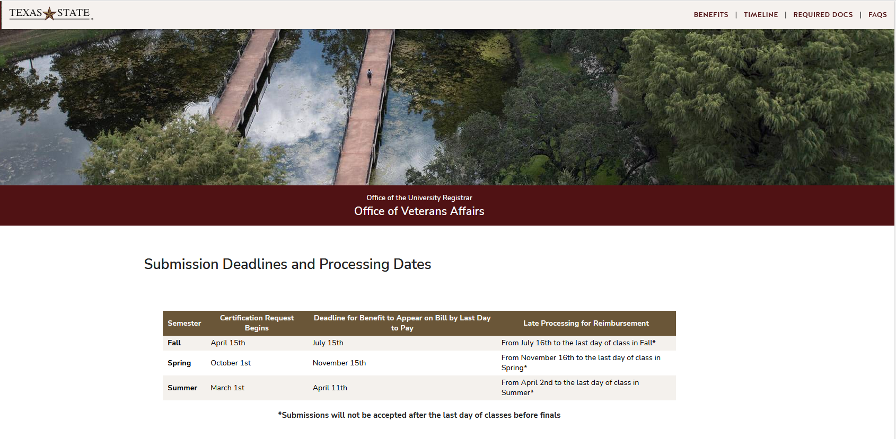
DEADLINES

Slide 4

NetID and Texas State Email:​
NetID = access to all Texas State Systems
TXST, used to login to ALL Texas State
Systems (Ex: zzz99)
Texas State Email = official communication channel
NetID
zzz99@txstate.edu
Texas State Email

Slide 5
FERPA (Family Educational Rights & Privacy Act)
Academic Records/Transcripts Financial Aid Records
Admission Records Student Financial Records
By federal law, we can only talk to the parent if there is a FERPA release in our system
DO NOT
Log in to the student’s accounts
Sign documents as the student
Impersonate the student on the phone
THIS IS FEDERAL LAW, WE TAKE FRAUD SERIOUSLY

Slide 6
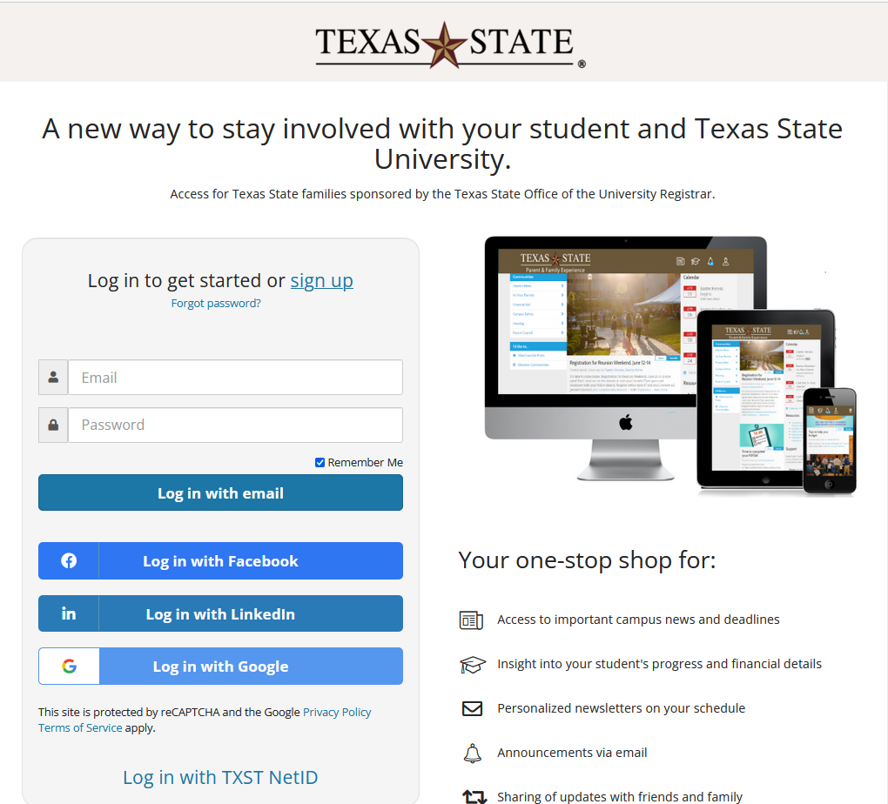
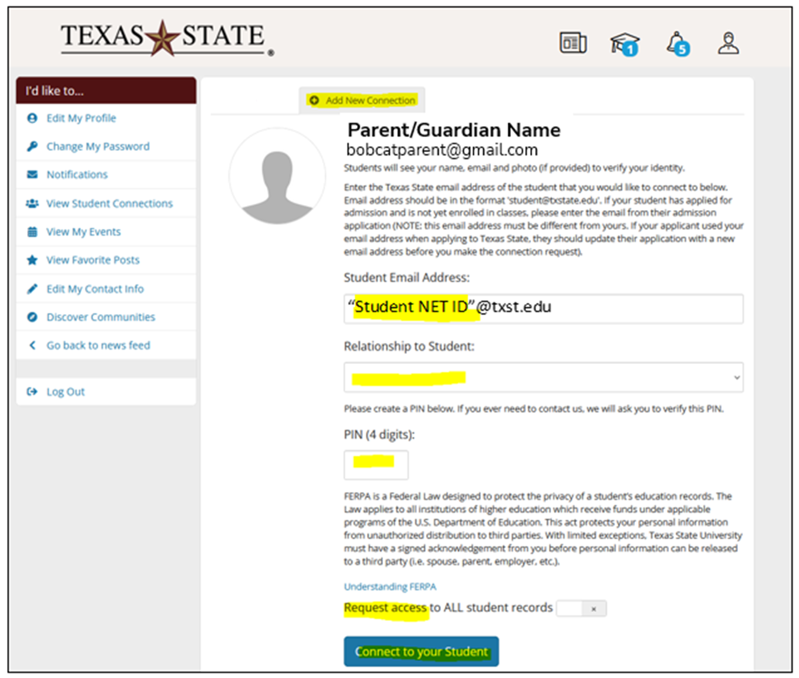
Bobcat Family Portal https://txstate.campusesp.com/users/sign_in
Parent signs up/logs in
Requests Access
Designate a PIN
Wait for student to accept
Once student grants permission it will take 24 hrs to be reflected in the system University-wide.

Slide 7
Residency
Admissions Office Determines Residency Status for Tuition Purposes
Initial residency classification is determined by your application answers.
Check your General Student Record on CATSWEB to see your residency status.
If you believe you have been misclassified, contact the residency officer IMMEDIATELY.
www.admissions.txstate.edu/pay-for-college/residency.html
Tuition waivers exist for qualified active-duty members, veterans, and military dependents to pay in-state tuition.
The Student must be a Texas Resident in order to use Hazlewood

Slide 8

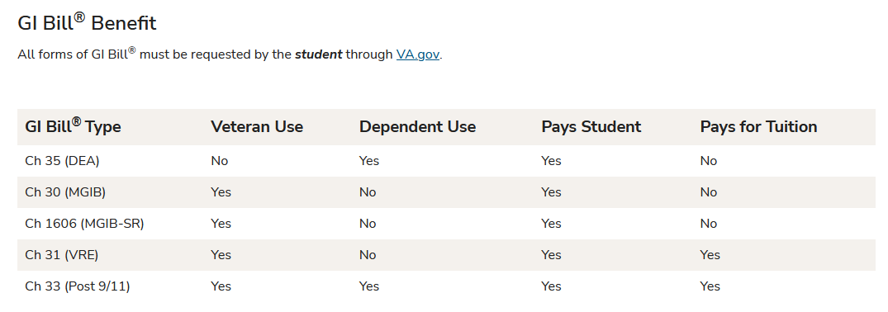
FEDERAL BENEFITS
Veteran Benefit Administration (VBA)
Must apply for Certificate of Eligibility at VA.GOV
Must upload COE via VA Portal to process the benefit
(Pays Student = STIPEND)

Slide 9

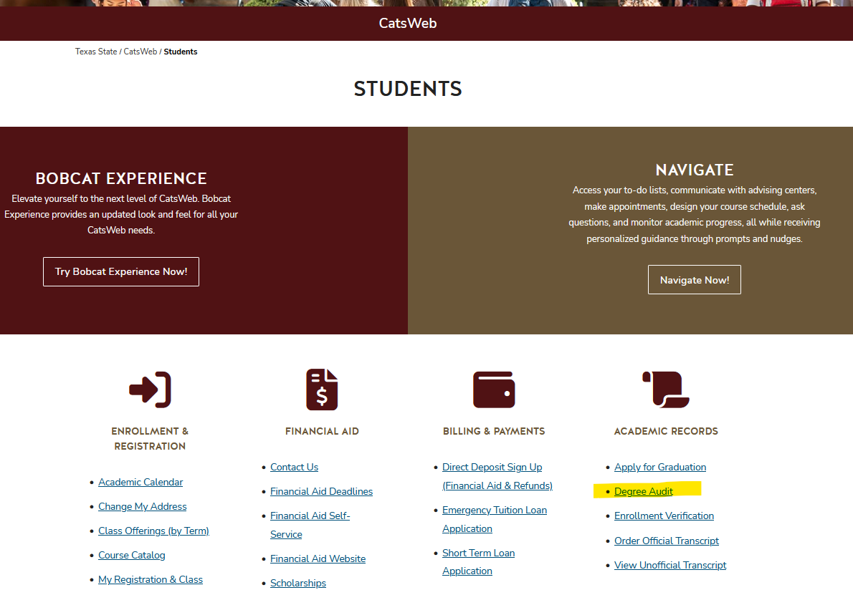
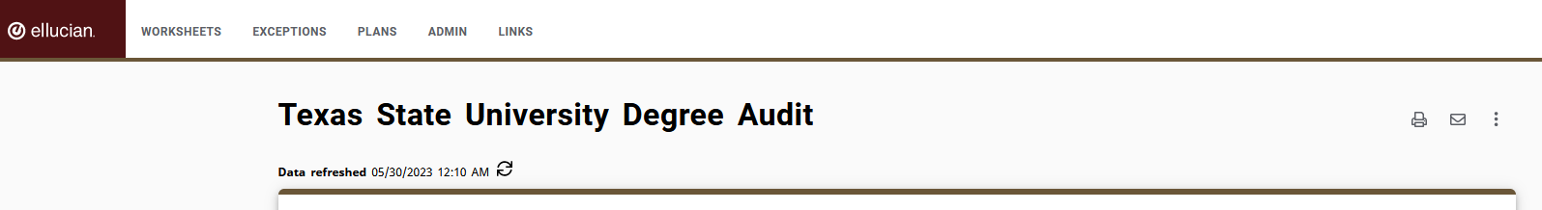
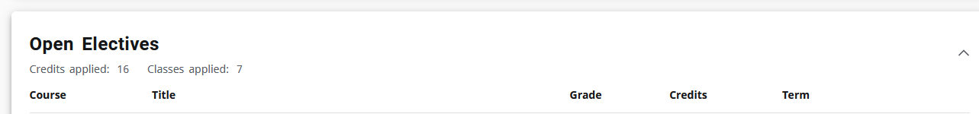
FEDERAL BENEFITS
Veteran Benefit Administration (VBA)
Federal veteran education benefits will only pay for courses required to earn your degree of study.
Contact your academic advisor to request to have a course re-classified to fit within your degree plan.
You can always view “Open Electives” shown on Degree Audit via CatsWeb

Slide 10
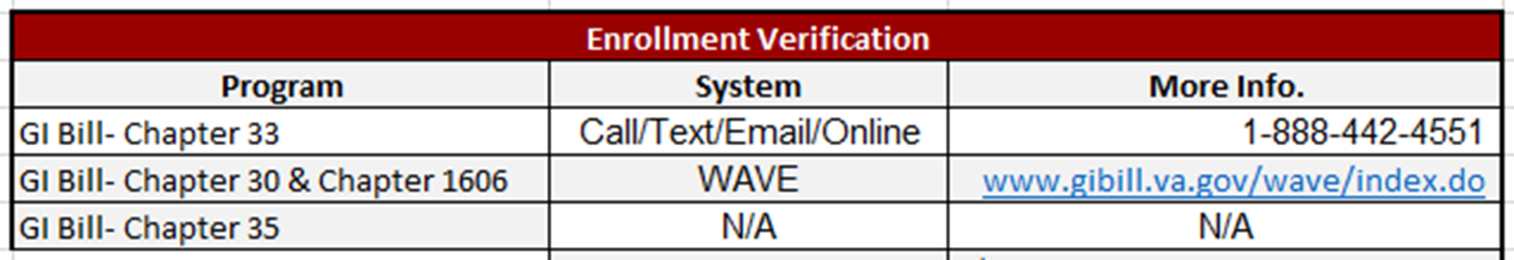
How Do I Get Paid?
Tuition and Fees
Stipends
We review COE, check enrollment, and certify the courses required for your degree of study
We calculate how much the VBA will cover and sent that amount to Student Business Services
In 48 hrs of being approved, students can see the amounts covered on the bill
We review COE, check enrollment, and certify the courses required for your degree of study
You will get paid on the 1st of the month for your enrollment during the previous month
Nothing will be paid directly to Texas State by VBA for ANY Texas State charges (i.e. housing, meal plans, books, etc….)
Verify Enrollment Monthly:

Slide 11

HAZLEWOOD OVERVIEW:
Was the Veteran a resident of Texas and/or designate Texas as either Home of Record or Place of Entry at time of enlistment?
Serve at least 181 days on Active Duty
Character of Service either Honorable or General-Under Honorable Conditions
Have no federal, tuition-paying veteran education benefit(s)
150 Hours of Tuition & Fees, WAIVED
YES: LEGACY
YES, AND Veteran Disability rating = 100%
150 hours of exempted tuition & most fees
Be 25 yrs or younger on 1st day of semester
150 hours is shared by Veteran and Dependent(s)
No two people may use the Exemption during the same semester
150 hours of exempted tuition & most fees
No Age Limit
The Veteran and each of their eligible Dependents get their own 150 hrs
Minimum TXST GPA of 2.00 (UG) 3.00 (GR)
Does NOT cover study abroad, correspondence, extension courses, or $90 Student Service Fee

Slide 12
Schedule Changes and Veteran Education Benefits
In General:
FOLLOW THE REFUND POLICY DATES FOR TXST Posted by One Stop
https://onestop.txst.edu/cost-payments/refund.html
Hazlewood:
Hazlewood hours Used- Enrollment at Census.
GI Bill®:
Email us immediately for ANY changes you make.
If you drop classes after the Census date, you will be charged.
GI Bill® will incur a debt with the school
Any debt to the VBA for housing or book stipend is owed to them.
Dropping with a W does not mean you will not be charged.
University Withdrawal:
Called to Active Duty?
-Give us a copy of your orders (before you leave if possible).
Mitigating Circumstances?
-Must provide documents

Slide 13
Can I Receive Hazlewood + GI Together
No
Yes
Maybe
Chapter 1606
Chapter 30
Chapter 35
Chapter 31
Chapter 33 @100%
Chapter 33
Either will cover tuition &
you cannot waive tuition more than once
-Hazlewood for tuition & fees
-GI for monthly stipend
If you have <100% of Chapter 33 then yes

Slide 14
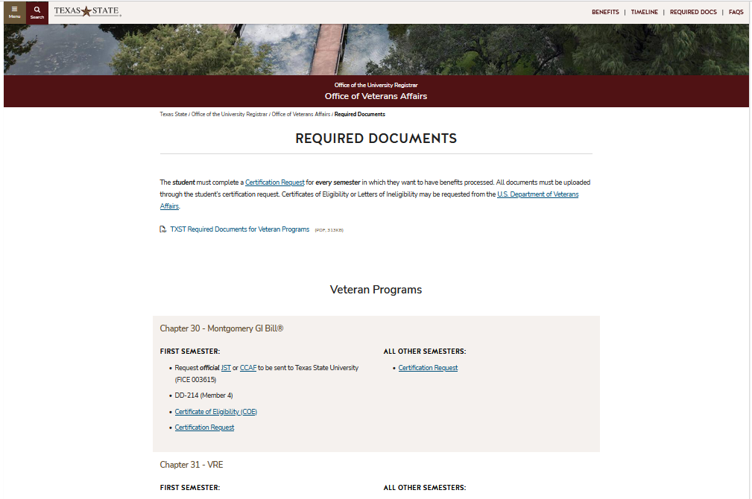
What Does TXST Need From Me?
Submit Certification Request & Upload Required Docs
Check Your Bobcat Mail & Login VA Portal to check status
Check your Bill
BOOKMARK THIS PAGE

Slide 15
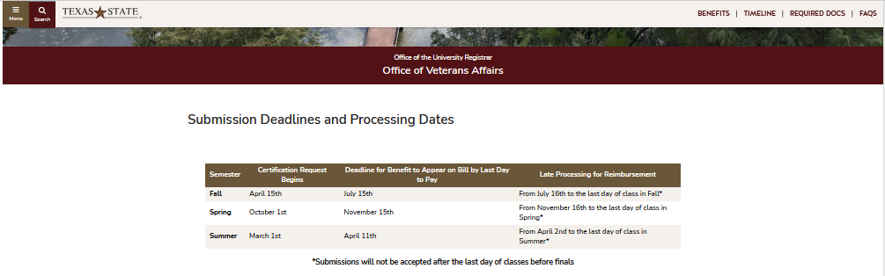
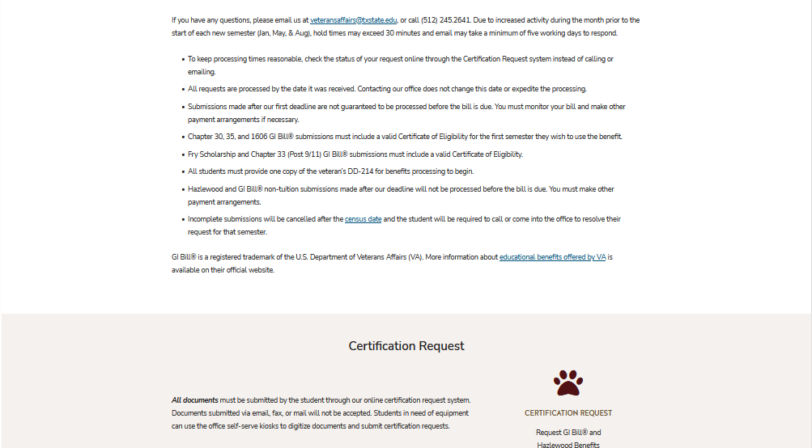
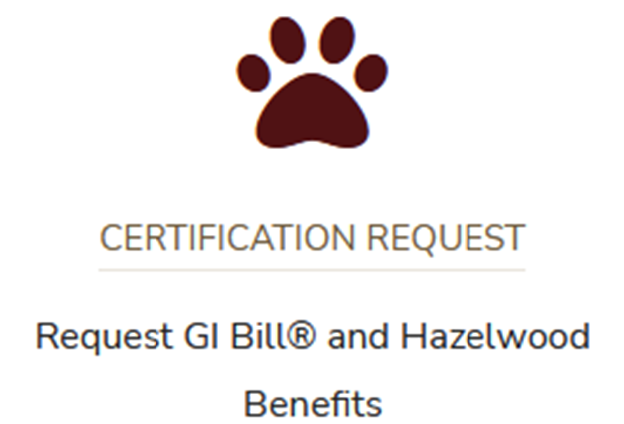
VA Portal
Start semester request
Check on status
Required Documents Lists
Check your Bill
FAQ
va.txst.edu

Slide 16
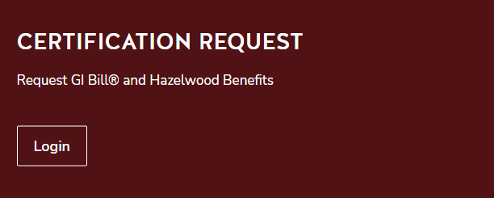
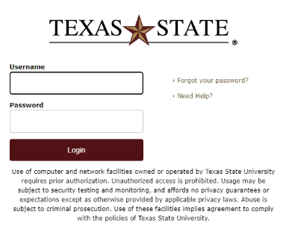
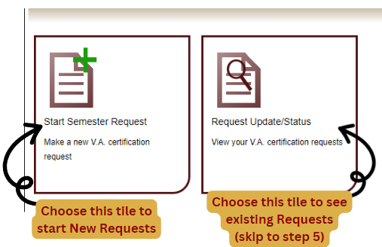
Certification Request
You MUST put in a request for certification every semester
You will receive a computer-generated email every time the status of your request changes
Once reviewed, a status will be assigned and a specific message with further instructions will be included in the status email.
ONLY notifies your Texas State email.

Slide 17
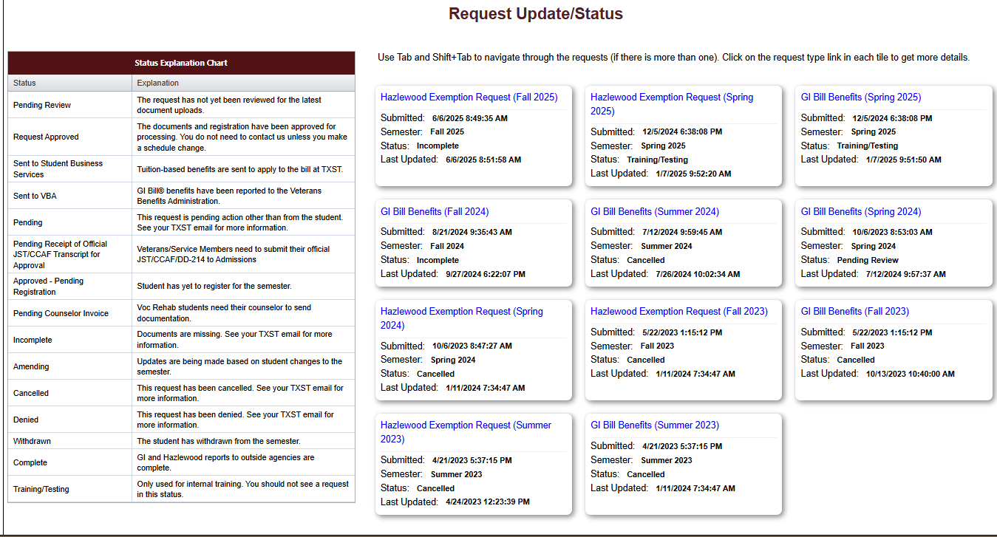
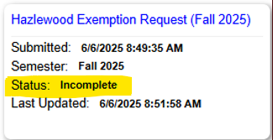
Certification Request
This is a reference chart These are your requests

Slide 18
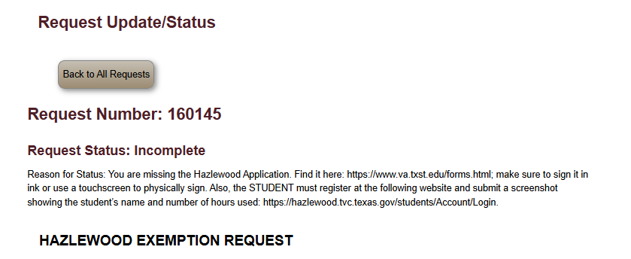
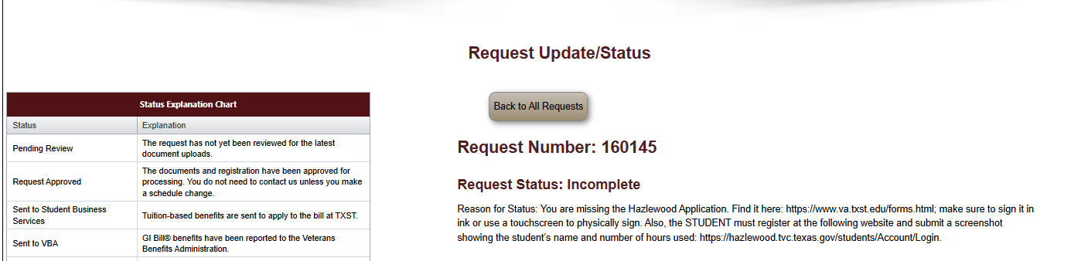
Certification Request

Slide 19

VA Work Study
Enrolled ¾ time or more
Using Federal Benefit
Minimum Wage
TAX FREE!
Real World Experience (Paid Internship)
Email us for an interview- VETERANSAFFAIRS@TXSTATE.EDU

Slide 20
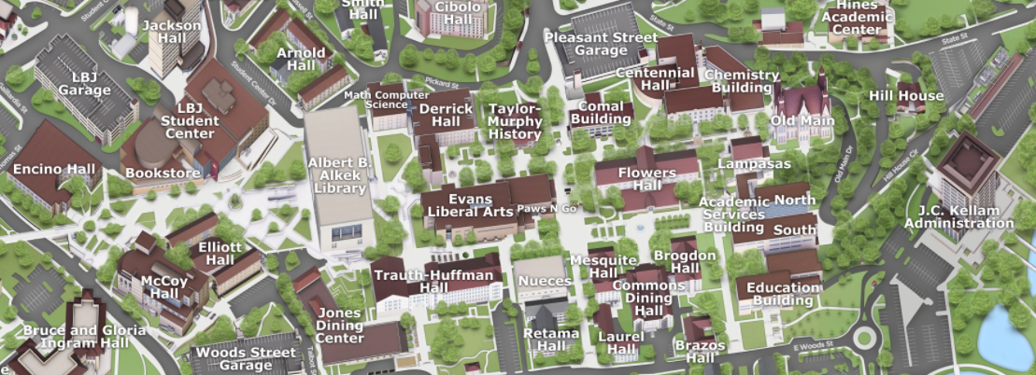
Office of Veterans Affairs
NSO
San Marcos Campus
JC Kellam, Rm 640
601 University Drive
San Marcos, Texas 78666
NSO

Slide 21
Contact Us
Office of Veterans Affairs
512-245-2641
va.txst.edu
ROTC
Army: 512-245-3232
Air Force: 512-245-2182
Veterans Benefits Administration
888-442-4551
va.gov
Veterans Alliance (VATS)
512-245-2278
Vet Academic Success Center (VASC)
512-245-6192
Tx Vet Commission (TVC)
512-463-6564
tvc.texas.gov

Slide 22
VA BENEFIT PROCESSING-Need to Know
Submit request each semester you would like to use benefit
CHECK YOUR TXSTATE.EDU E-MAIL
YOU do NOT need to be registered to submit a Certification Request
Due Dates MATTER, so don’t miss deadlines!
  -Priority Processing
  -Payment Deadlines

Slide 23

Questions?

