Slide 1
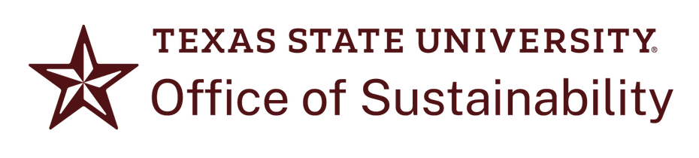
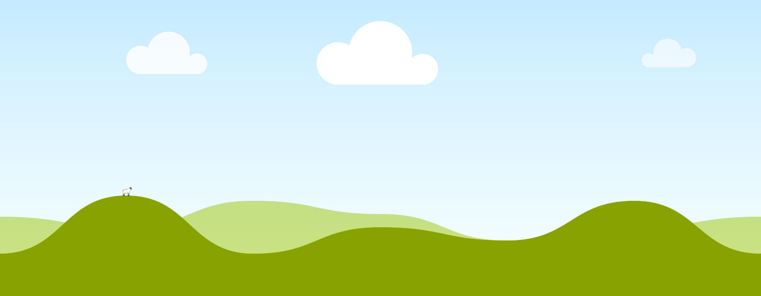
Sustainability 101
An Introduction to Sustainable Living for First Year Bobcats

Slide 2
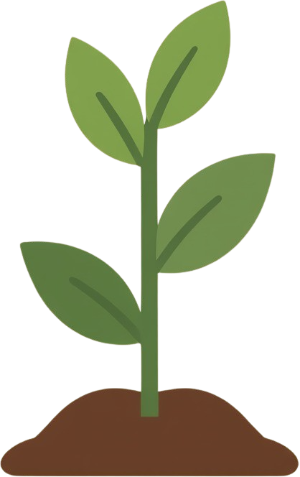
What is Sustainability?
Sustainability is the ability to provide resources for current and future populations while protecting the environment and enhancing economic stability. Principles of sustainability can be used both as a policy goal for institutions and governments, and as a lifestyle and value system for individuals.
The Triple Bottom Line
is a framework that outlines the three pillars of sustainability. Together, these pillars form a balanced approach for sustainability initiatives that consider human and environmental needs.
People
Planet
Profit
This bottom line pertains to consideration for societal needs, particularly related to accessibility, fair labor practices, and community wellbeing. Prioritizing the welfare of people is an important dimension of social sustainability.
The environmental bottom line of sustainability focuses on the needs of the nonhuman world, including ecological systems and habitats. This bottom line recognizes the dependence of all human needs on the stability of natural processes.
The final bottom line centers economic productivity, and prioritizes the growth and viability of economic systems that specifically benefit the other two dimensions of sustainability. In this context, profit describes value generated to support the needs of humans and the environment.

Slide 3

What does sustainability look like for Bobcats?
From the moment they set foot on campus, all Bobcats have the opportunity to become stewards, or caretakers, of the TXST and San Marcos community. The act of caring for your community, resources, and personal wellbeing is called stewardship.
Local Stewardship and Service
Self-stewardship
At TXST, we uphold the three pillars of sustainability by working towards stewardship in five main areas:
Native Habitat Protection
Waste Reduction
Water Conservation

Slide 4
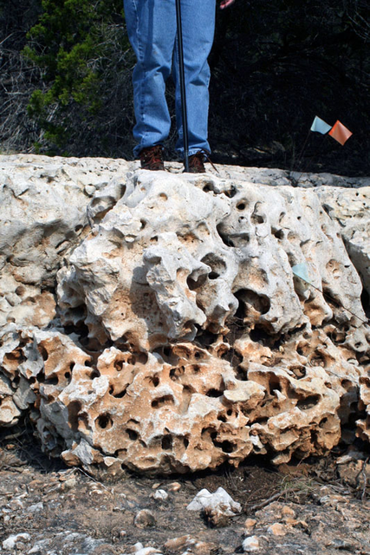
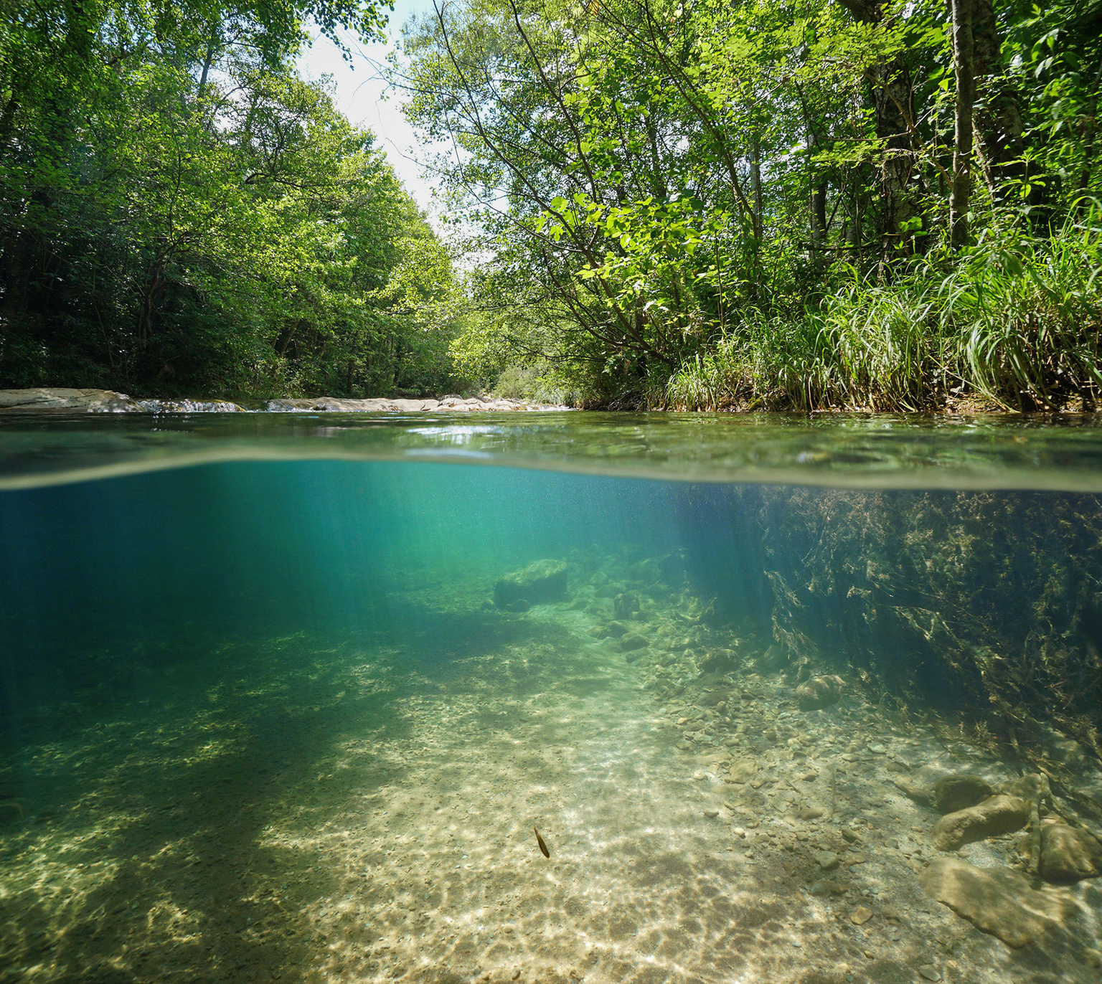
Water Conservation
All water on Texas State University campus comes from the Edwards Aquifer, an underground reservoir that provides water for roughly 2 million people across a region that includes the I-35 corridor and Texas Hill Country. The Edwards Aquifer is also the source of the San Marcos River, and many other Central Texas rivers.
Conserving our most important resource is our collective responsibility. To help ensure water is flowing through our rivers and aquifer for years to come, be sure to:
SAVE
water during daily activities like showering, brushing your teeth, and doing laundry.
REPORT
spills, leaks, and maintenance issues with water infrastructure you see around campus.
Learn more about water science and conservation in Central Texas from the Edwards Aquifer Authority!
VOLUNTEER
with university or local organizations involved in water stewardship.

Slide 5
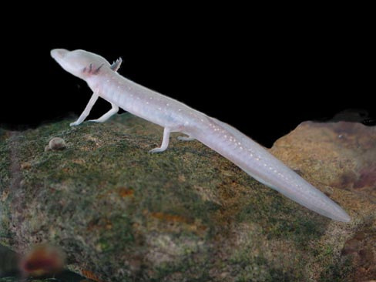
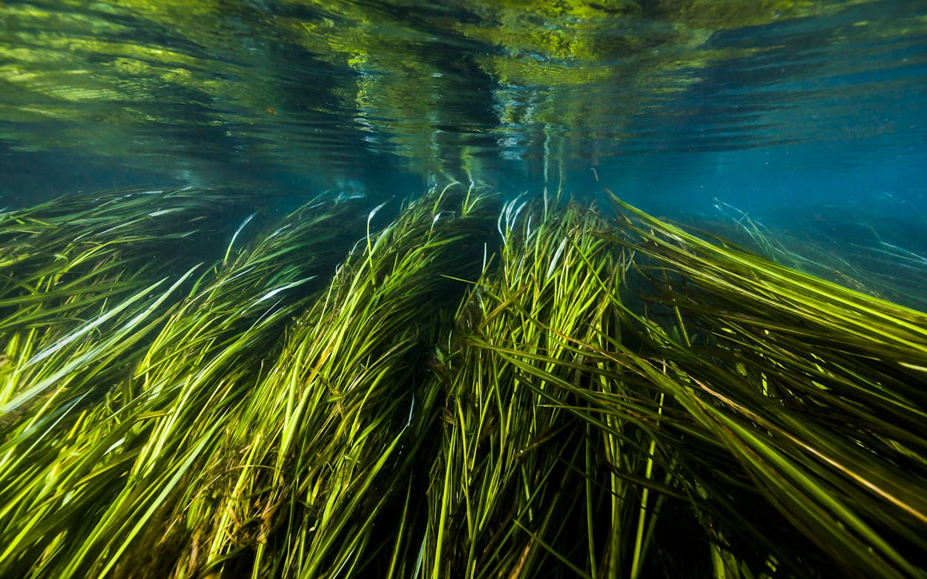
Habitat Protection
In addition to being a home for the Bobcat community, Texas State University campus also includes the part of the San Marcos River that is home to 5 native species found nowhere
else on Earth, including the endangered Texas Blind Salamander and Texas Wild Rice.
Texas Blind Salamander
Eurycea rathbuni
Native plant and animal life plays an important role in maintaining the balance of the unique river ecosystem that TXST students are lucky to enjoy. To help prevent the degradation of outdoor recreation areas and preserve wildlife populations, be sure to:
DISPOSE
of all waste in outdoor areas properly, and pick up any litter you see or may have produced.
RESPECT
wild plants and animals by giving them space and staying within approved outdoor access areas.
FOLLOW
all posted signage in riverside parks. Signs are there to keep you safe and habitats healthy!
Texas Wild Rice
Zizania texana

Slide 6
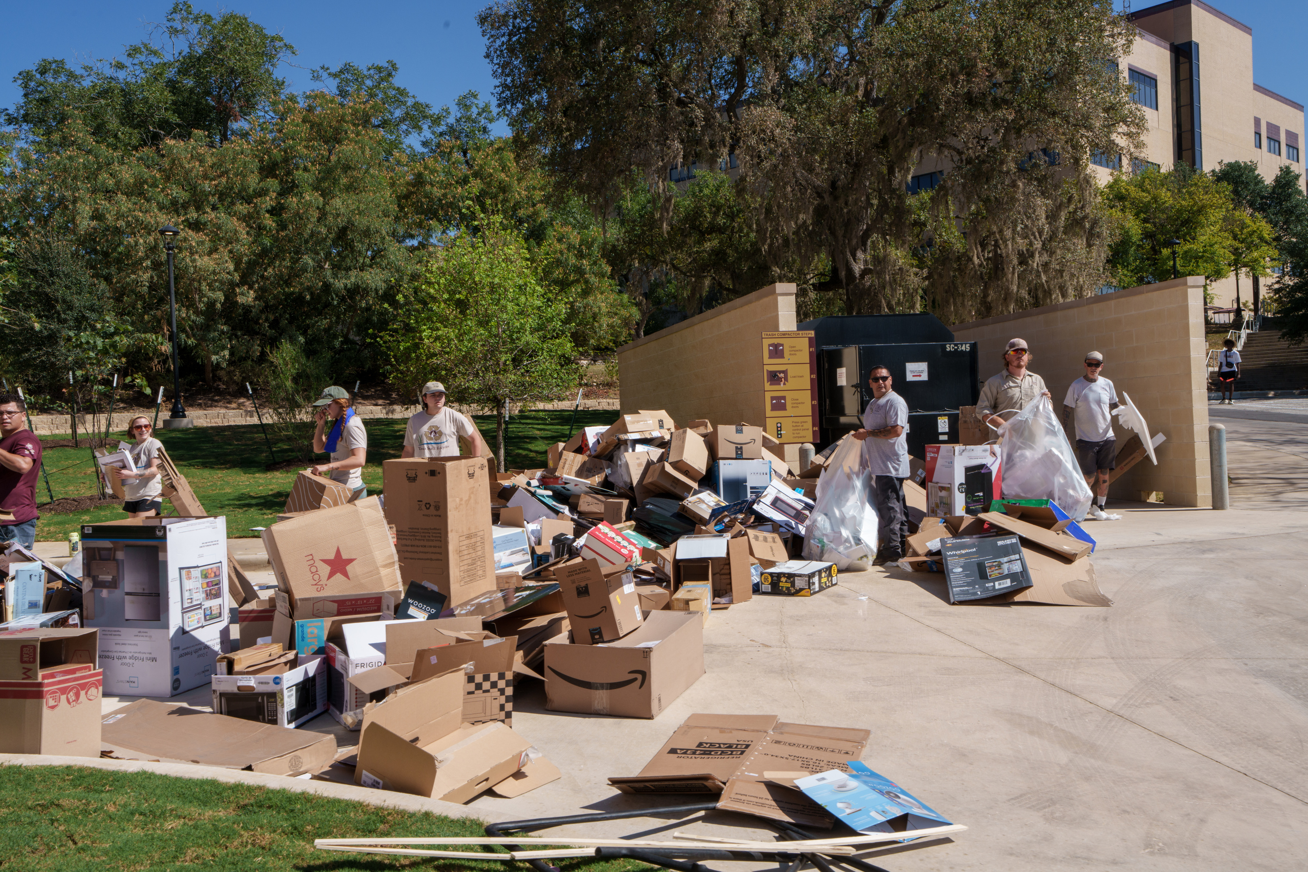
Waste Reduction
In one of the fastest growing counties in the country, it is more important than ever to reduce the amount of waste heading to Texas landfills, which have a collective remaining lifespan of about 50 years.
Keeping material out of the garbage isn’t just better for the planet- it also promotes the circular economy by continuously maintaining the value of items and lengthening their useful life. You can become a steward of sustainable materials management by learning to:
REDUCE
the amount of items you buy to limit waste produced as a byproduct of spoilage or packaging.
REUSE
items in different ways before throwing them in the trash. Upcycling cis friendly for your budget and the environment!
REFUSE
purchasing items that are “trendy,” disposable, or hard to
repair. Opt for items that you see yourself using as long as possible.
TIP: Check out the TXST Recycling Guide for a full list of accepted materials!
RECYCLE
whenever possible. Whether it’s paper, plastic, or batteries, make sure recycling is sorted properly to avoid safety hazards and waste contamination.

Slide 7
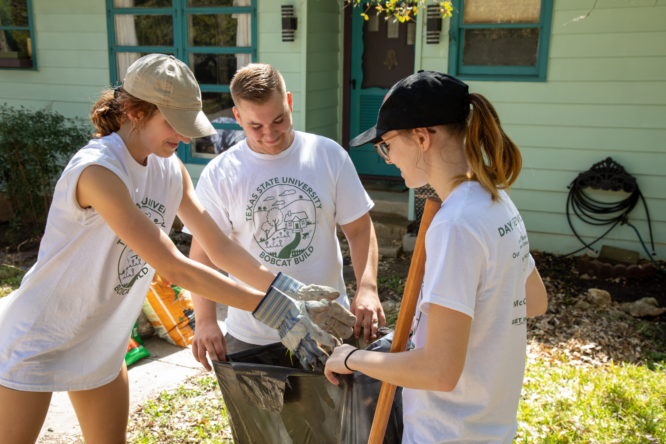
Local Stewardship & Service
As easy as it can be to get caught up in campus life, it is important to remember the way TXST is connected to the San Marcos community, and vice versa.
Being interested in and respectful to a city you just moved to is a good habit to cultivate no matter where life takes you. You can practice becoming an involved and informed local by:
EXPLORE
public third places outside of campus to meet new people and get integrated into local culture.
SHOP
at local stores and restaurants to keep money in the regional economy and support local artisans and businessowners.
CONTRIBUTE
time to helping local organizations providing vital community services, and get involved in local volunteering opportunities for causes important to you.
LEARN
about resources available to residents through local government to stay connected as a San Martian.

Slide 8
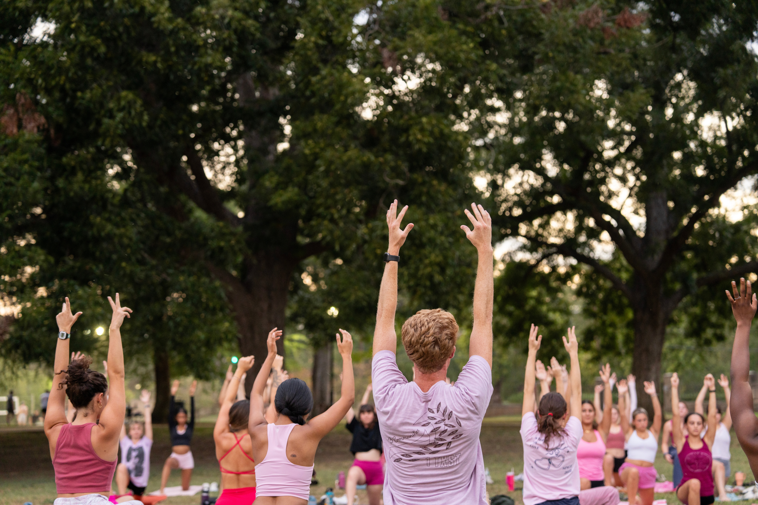
TIP: For a full list of health resources available to Bobcats, visit the Counseling Center or the Student Health Center.
Self Stewardship
During the hustle and bustle of your first year in college, it is important to make self care a priority in addition to your academic responsibilities. Remember that it is impossible to our from an empty cup, and other areas of sustainable living are not possible to uphold if you cannot sustain your own wellbeing. To achieve a holistic stewardship of the self, be sure to:
TAKE BREAKS
from work and electronic devices regularly to maintain energy levels and avoid burnout.
CONNECT
with people of similar interests by joining student organizations and building your community.
GET OUTSIDE
during your free time! Whether taking a walk or swimming in the river, connecting with nature has numerous benefits for your mental and physical health.
REACH OUT
if you are in need! Some struggles can only be solved with help from health professionals or friends and family. Remember that you are never alone!

Slide 9

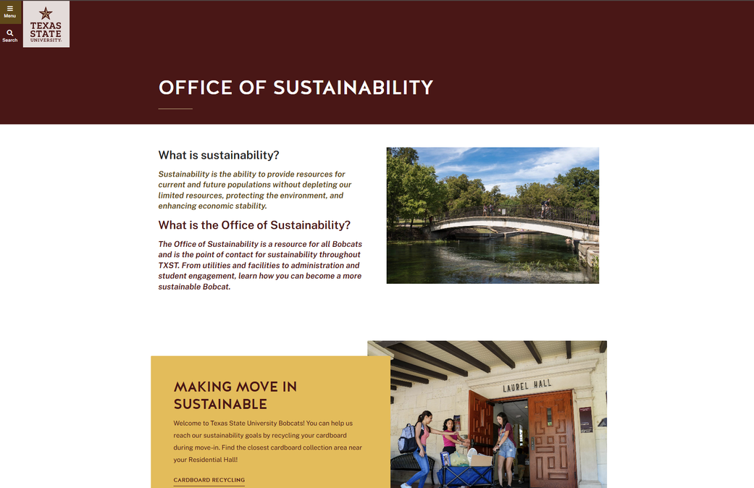
Get Involved!
Interested in one or all areas of sustainable stewardship? Have an idea on how to make campus more sustainable, but don’t know how to get it off the ground? The TXST Office of Sustainability is your go-to resource for all things related to resource conservation, sustainability research, and eco-friendly outreach on campus.
Services provided by the Office of Sustainability include...
  Sustainability Workshops
  Volunteer Opportunities
  Special Events
  Internships and Fellowships
  Sustainability Project Funding
  Industry Networking and Connections
...and more!
Email us at sustainability@txstate.edu or visit our website at sustainability.txst.edu.
Notes:
5

Slide 10

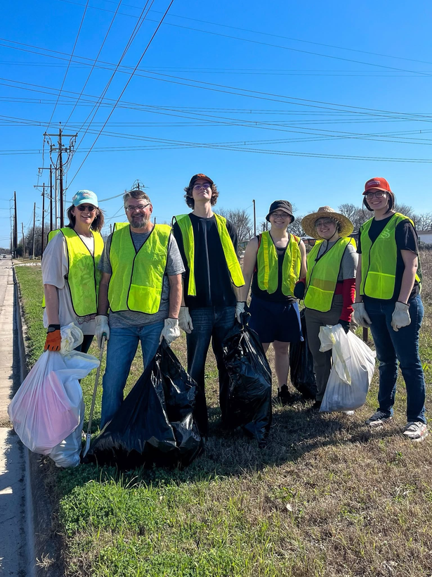
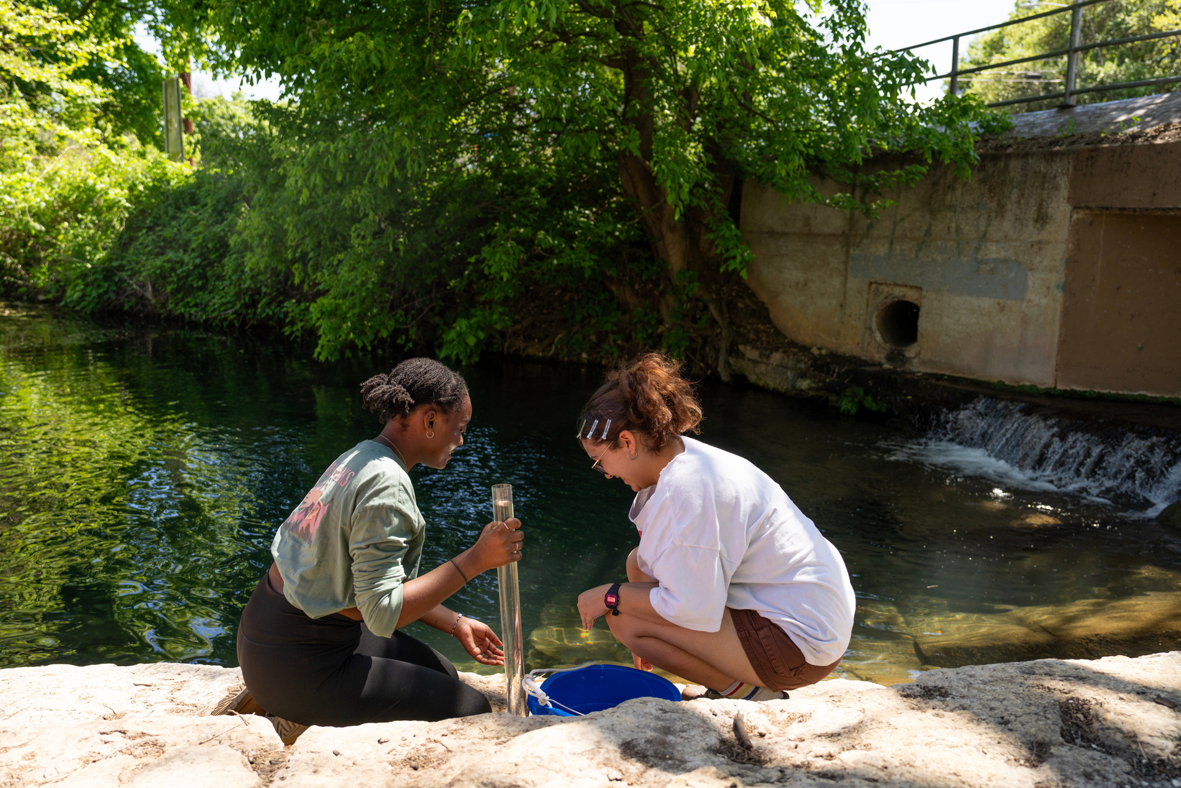
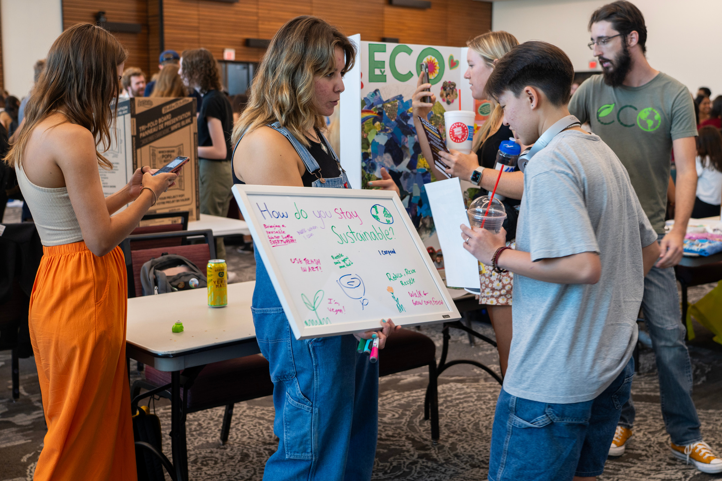
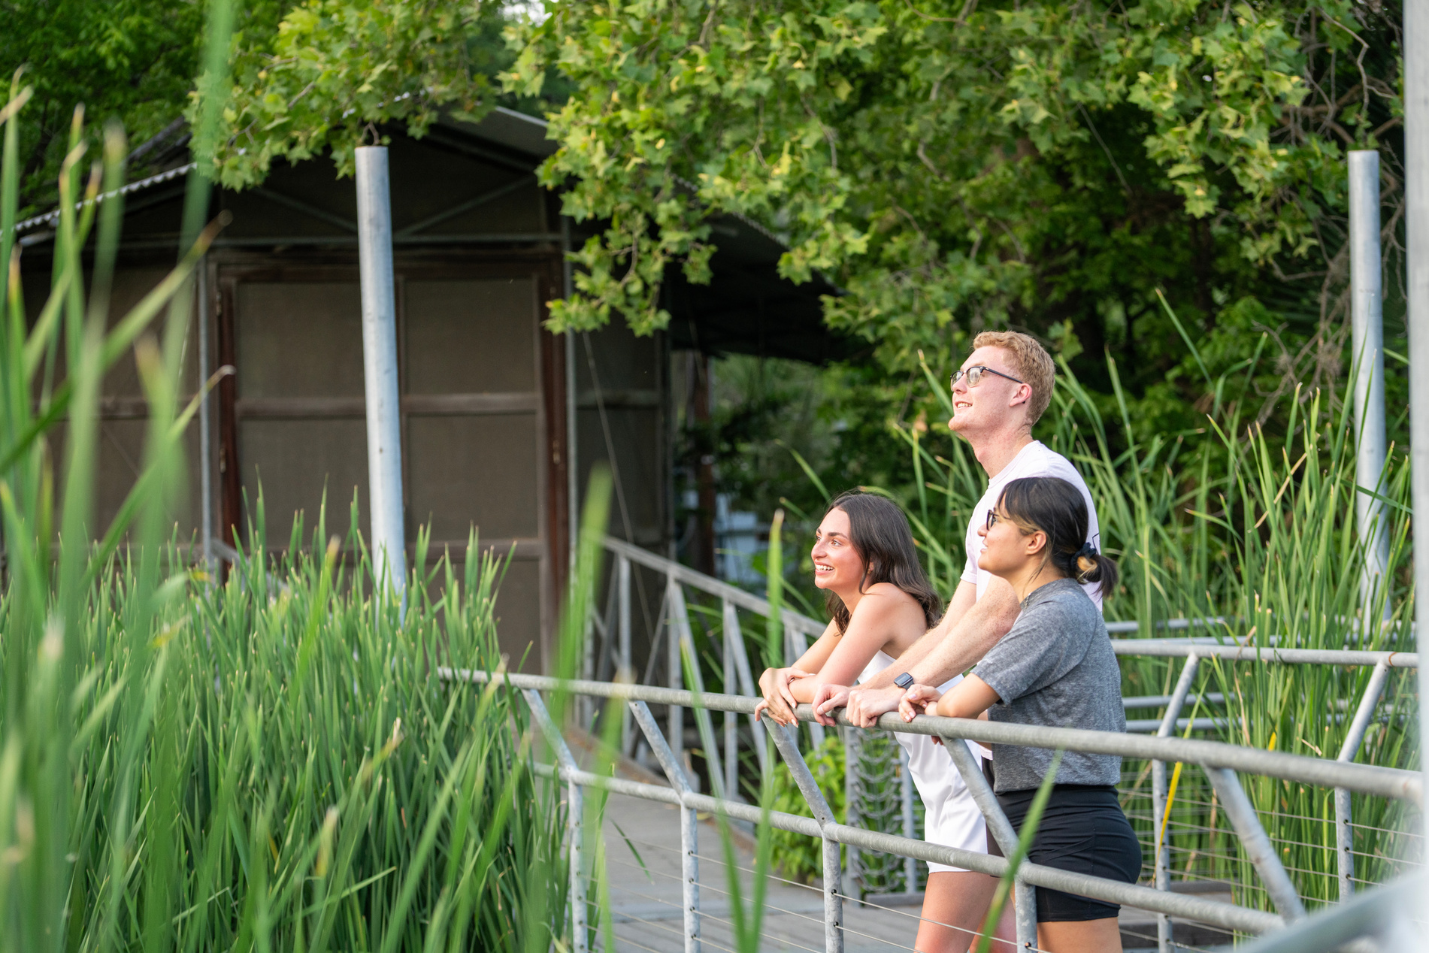
Eat ‘Em Up, Cats!
At TXST, sustainability is a project powered by the everyday actions and habits of Bobcat students, staff, and faculty. The path to stewardship is one that we are all walking together.
Welcome home, and welcome to the team!

