Slide 1




Self Stewardship
Mental Health, Self Care, and Wellness Strategies for First Year Bobcats

Slide 2
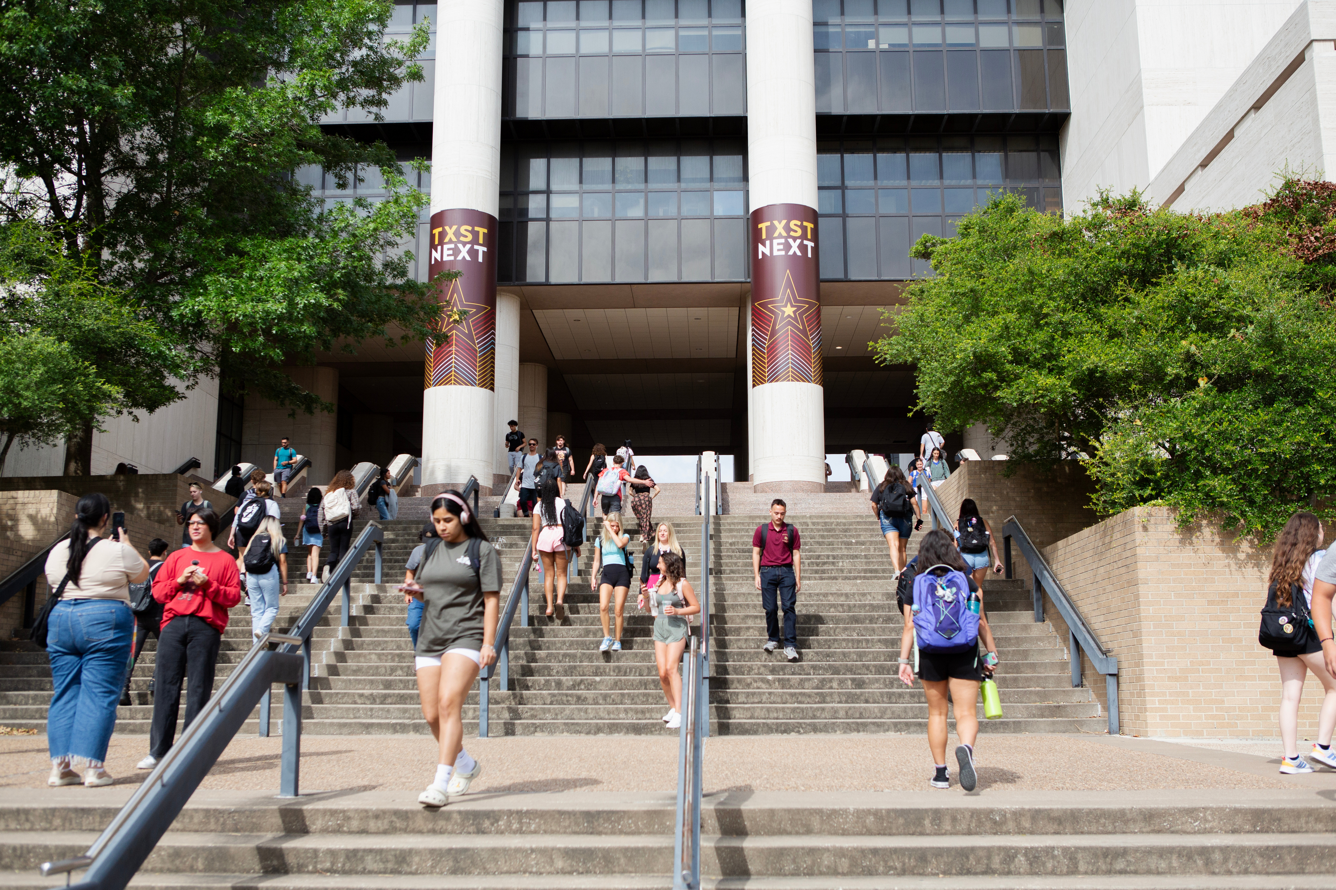
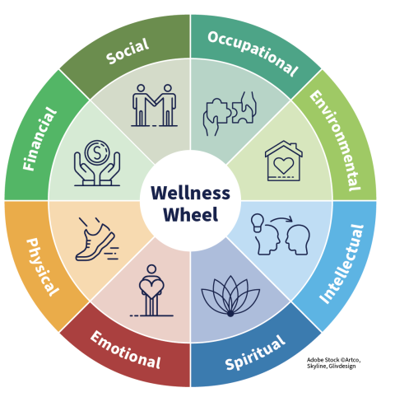
Filling Your Cup
An often overlooked part of sustainable living is self-stewardship, or maintenance of the self. As much as stewardship is about caring for your environment, natural resources, native habitats, and community, it is impossible to do these things while neglecting your own mental and physical needs. Caring for your body and mind goes hand-in-hand with caring for the world around you.
Dimensions of Wellness
The journey to wellness is one that must incorporate multiple aspects of health and wellbeing. The most effective kind of self care strategies are
those that are holistic, meaning that they target not just one but multiple or even all dimensions of wellness.
The Wellness Wheel* is a tool used by public health experts and educators to help patients assess their overall health. This visual model is helpful to begin thinking about your health strengths, and what areas of your health may need more attention.
*information from SAMHSA

Slide 3

The Student Struggle
Your first year of college is a time of big changes that can cause both excitement and stress. Navigating the challenges associated with taking difficult classes, living alone, and adapting to a new social environment can often result in the worsening of existing mental health struggles and the emergence of new ones.
While it may seem at some points like you are the only person experiencing your struggles, it is good to remember that you are not alone!
In 2020-2021, more than
60%
Practice Makes Perfect
The best way to prepare for any potential changes in the status of your mental health as a new college student is to practice habits that will sustain your wellbeing through challenging times.
In the same way it is good to practice healthy eating and exercise, self stewardship is developed over time by finding the strategies that work for your lifestyle, schedule, and interests. The following are a series of tips and tricks to make stewarding your Self easier in your first year as a Bobcat!
of US college students surveyed at 373 campuses met criteria for having one or more mental health issues.*
*Lipson et al. 2022

Slide 4
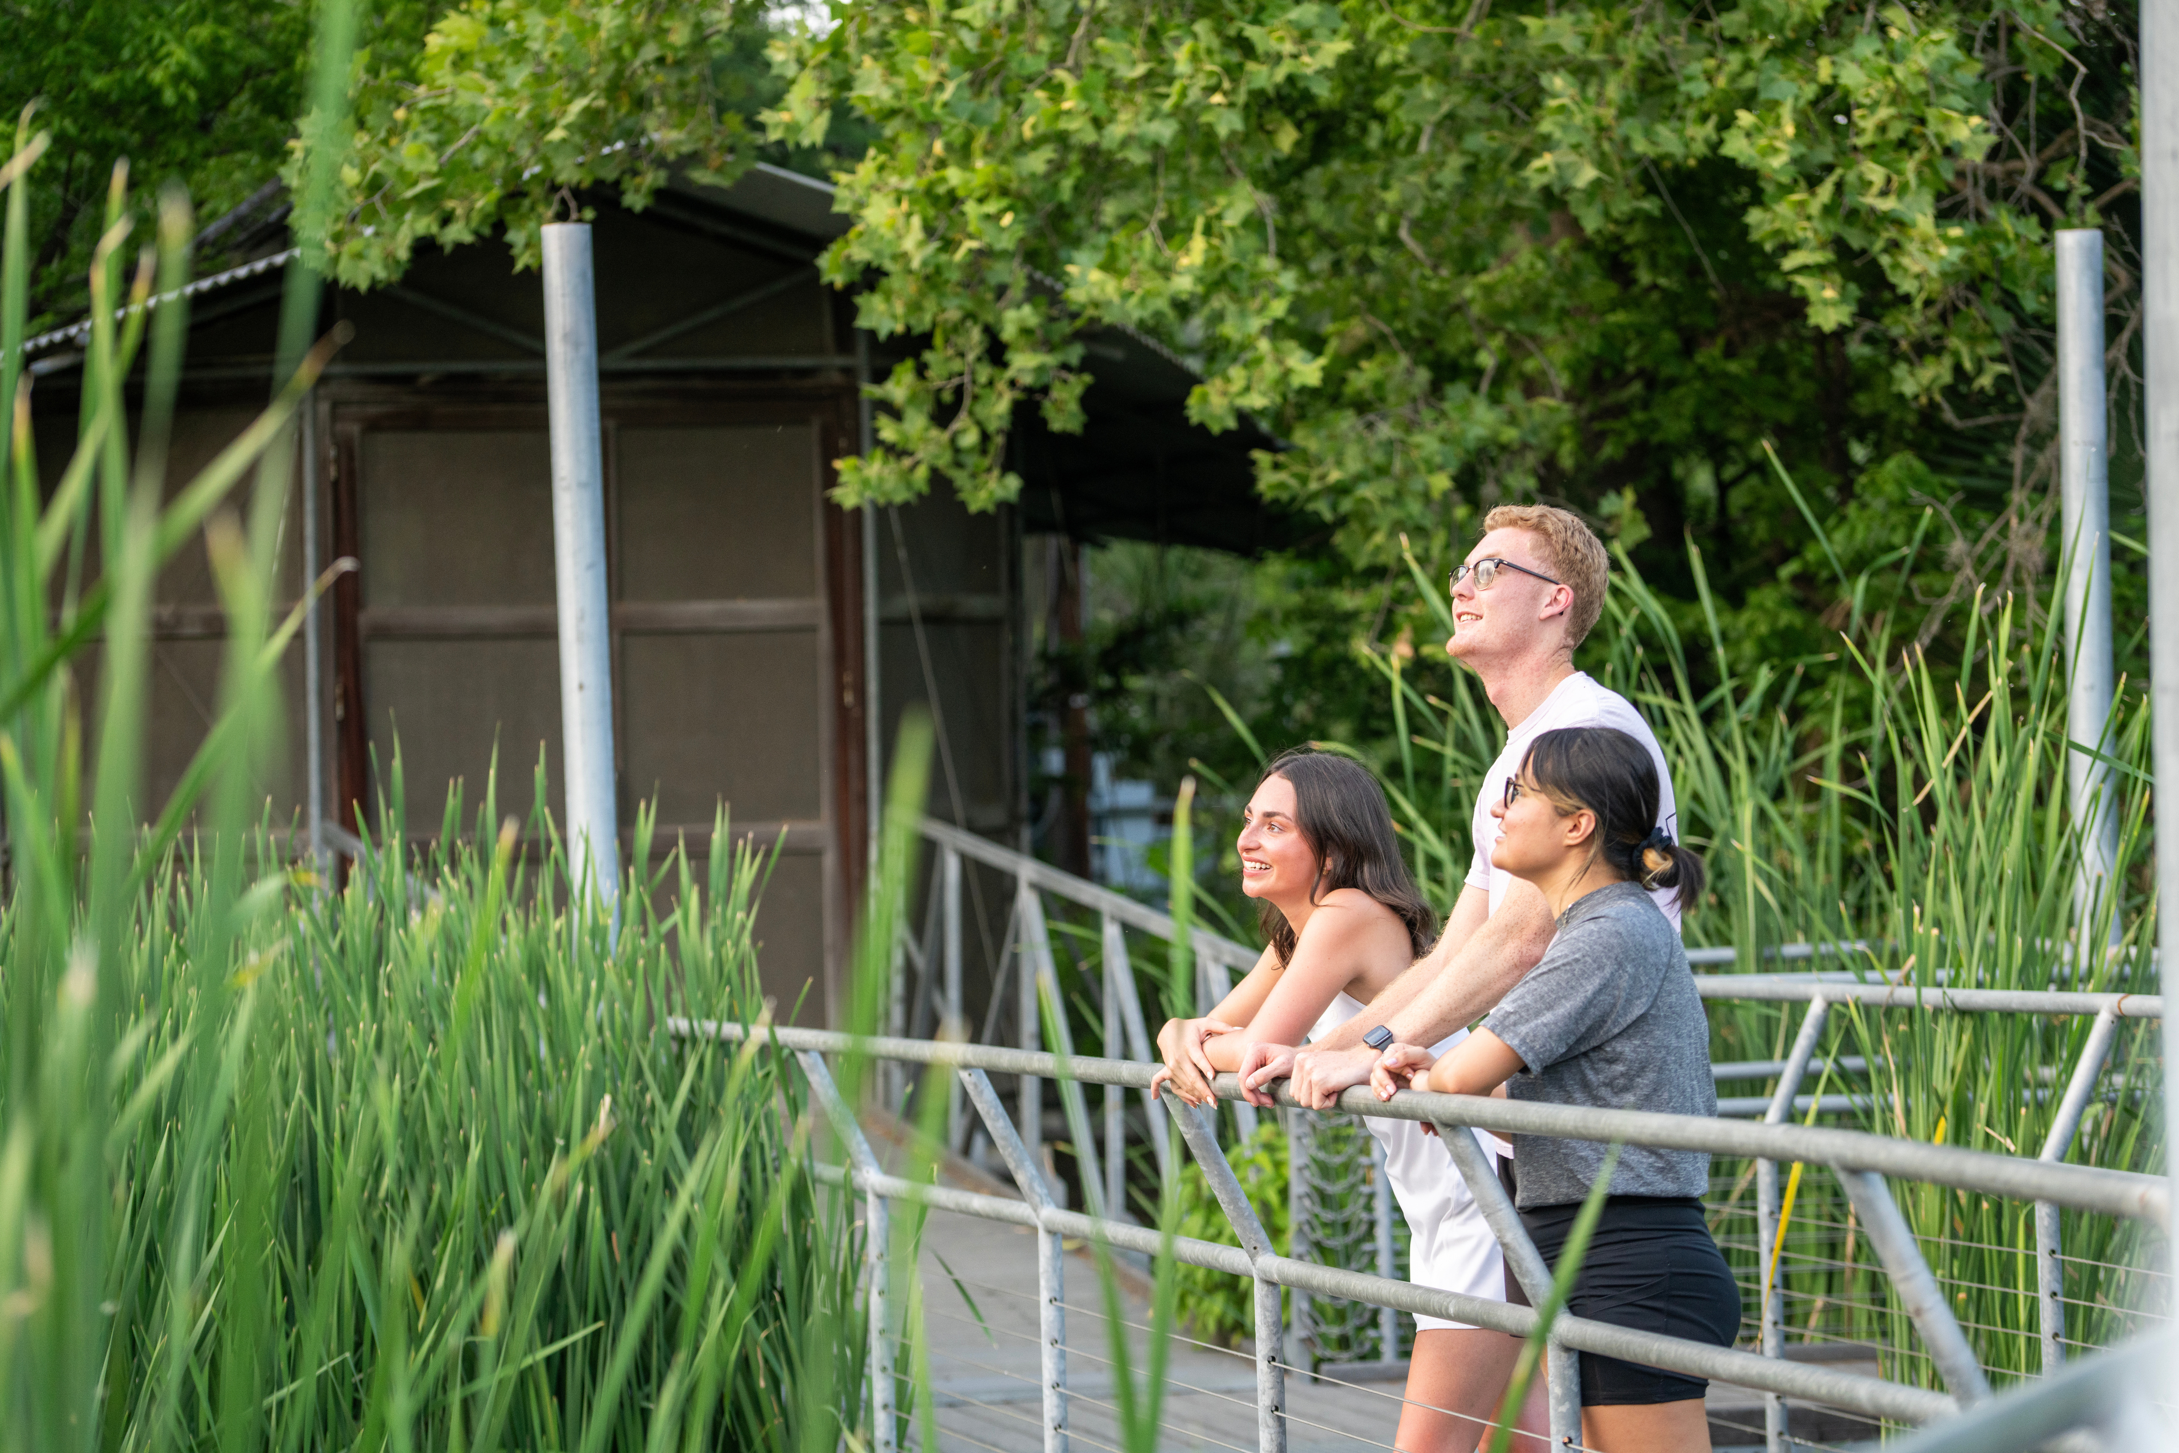
Tip 1
Disconnect
With new classes and new responsibilities, it can be easy to lose yourself in the pressures of university life. Yet amid the hustle and bustle, taking regular breaks is essential to maintain your health and quality of life. Give yourself grace and remember that it’s okay to disconnect from your work in order to recharge.
Do Not Disturb
Did you know?
According to one study, researchers found that average total screentime for university students exceeded 8 hours a day!*
Taking breaks from devices in particular is an important component of rest and relaxation. While it may be tempting to turn to screens for easy entertainment during your free time, constant digital stimulation can worsen stress, lower sleep quality, and cut down on time that could be spent developing other healthier habits.
It isn’t enough to simply take breaks from schoolwork,
it is also necessary to be intentional about how you spend
this valuable recovery time. A mindful break can work wonders for your brain, and make you feel more energetic and prepared whenever you get back on the wagon.
*Kumban et al. 2025
Notes:
5

Slide 5
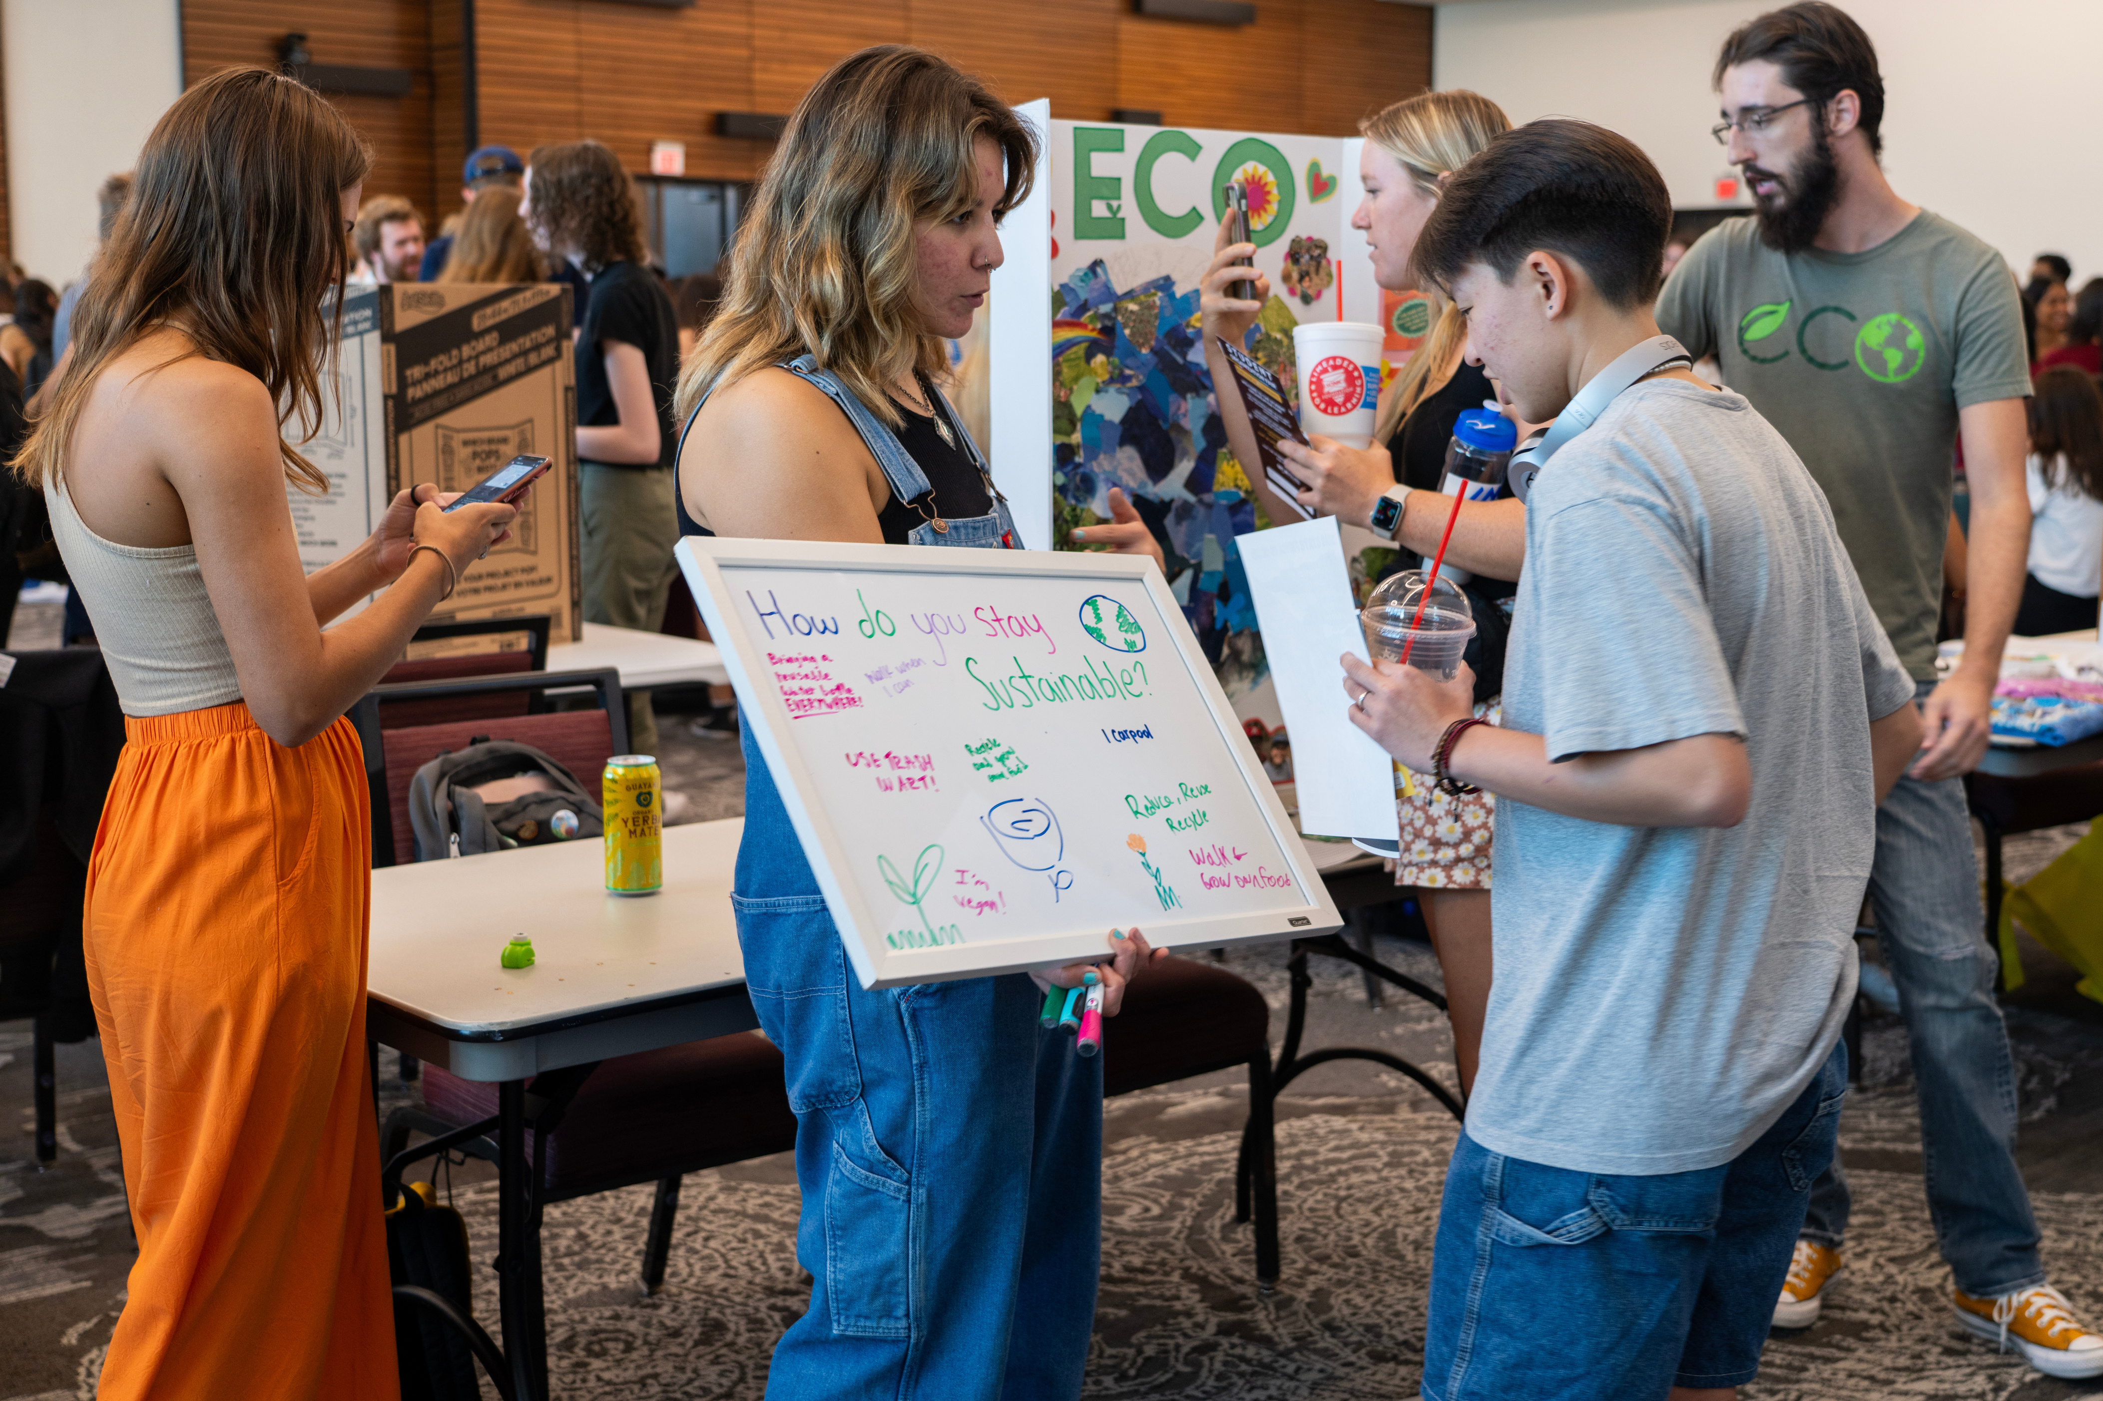
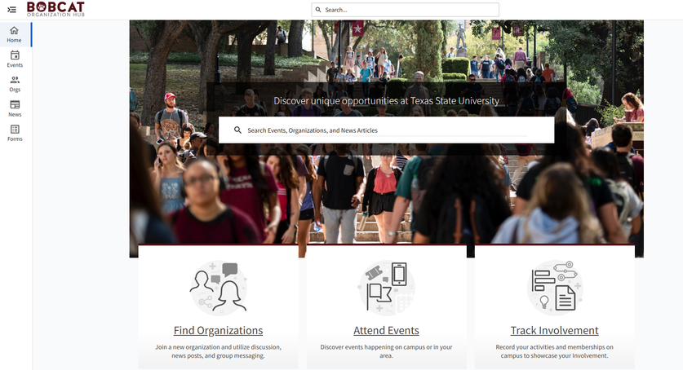
Find Your Community
Tip 2
The university experience is better spent alongside friends who share similar interests, hobbies, and passions. Making an effort to expose yourself to environments where you can form bonds with other Bobcats will not only help combat feelings of loneliness in a new city, but is also an excellent way to kickstart potential career networks and lifelong friendships.
An easy way to meet other Bobcats is to join a student organization. Keep up with TXST Student Involvement for the dates of the Student Organization Fair, a semesterly event that takes place in the LBJ Student Center Ballroom.
The Bobcat Organization Hub webpage is a useful site to help you find student organization events, meetings, and volunteer opportunities. For more information about joining clubs and organizations, email Student Involvement at getinvolved@txstate.edu.

Slide 6

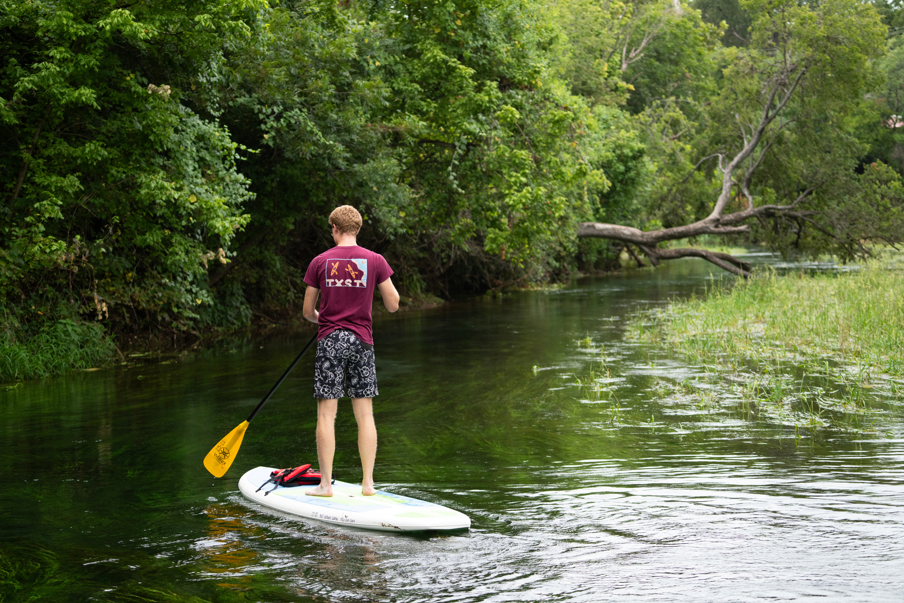
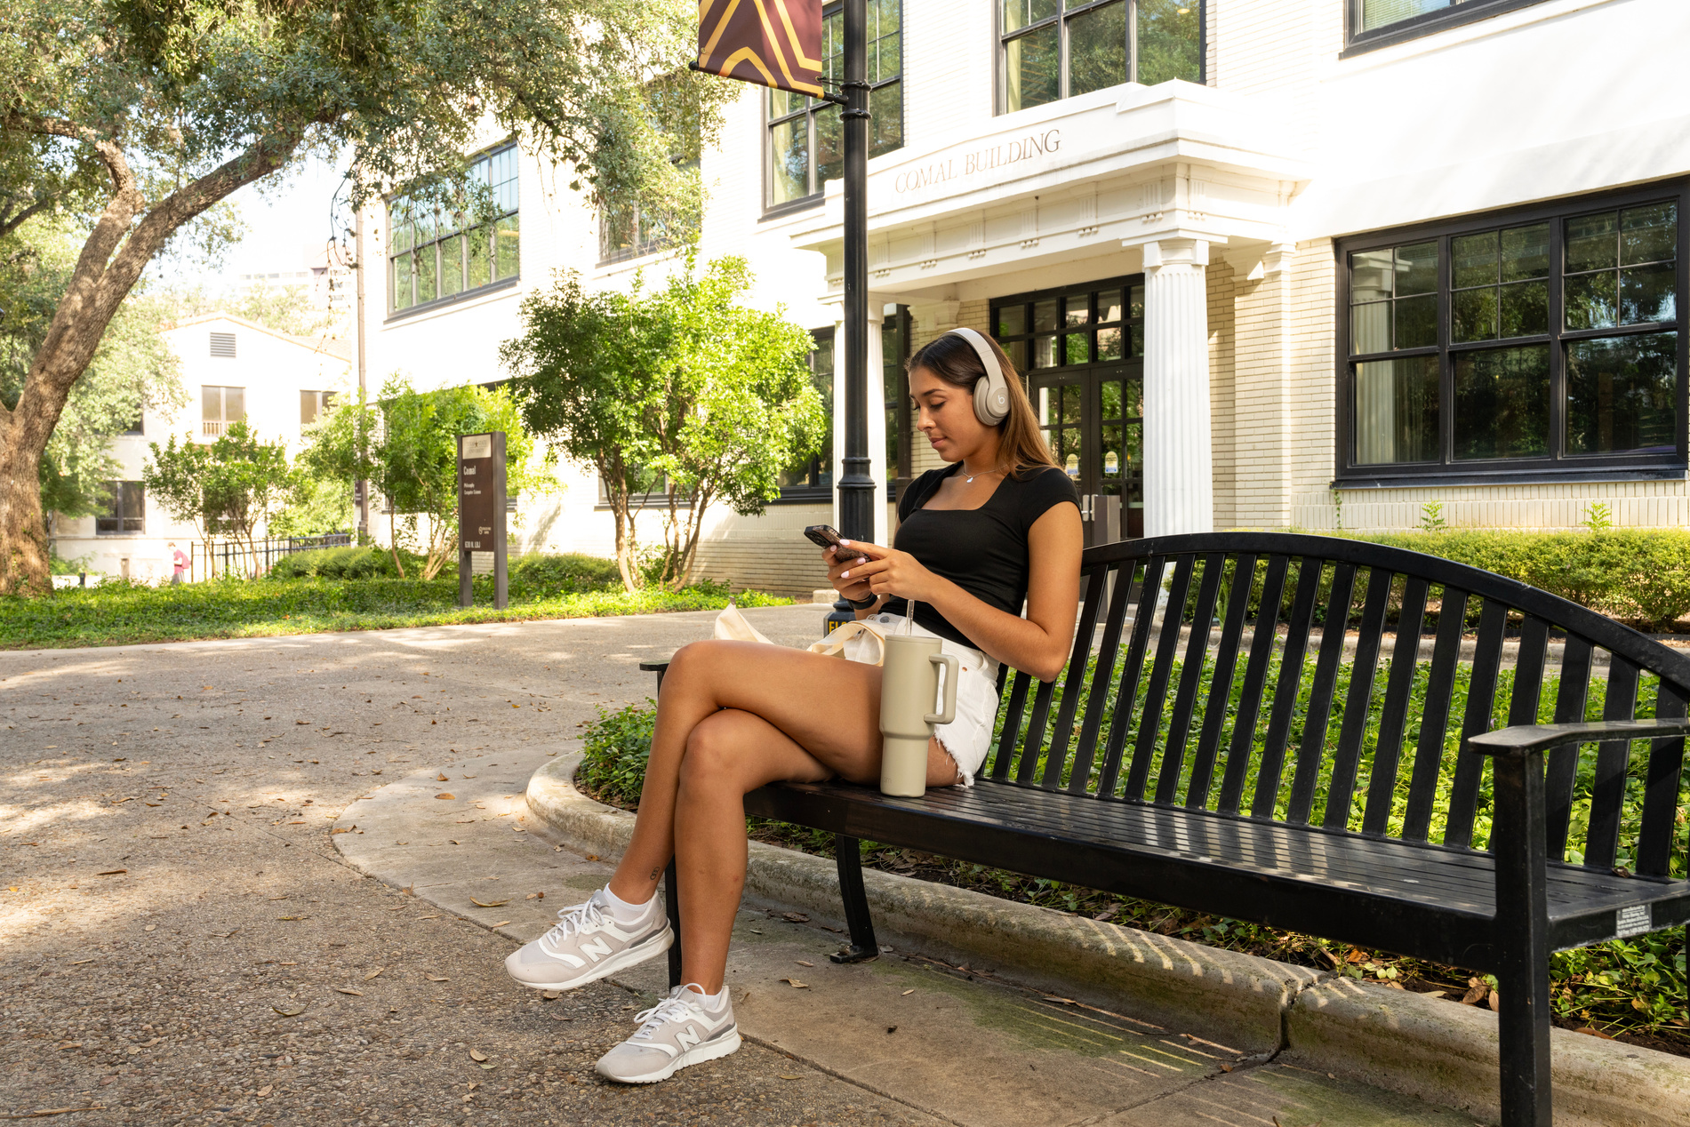
Tip 3
Get Outside
Incorporating nature into your everyday routine is a fun and easy way to boost your mood, improve your physical health, and introduce you to what may become your next hobby. Luckily, TXST is an official Campus Nature Rx institution, meaning that it is committed to providing Bobcats with nature-based wellbeing initiatives and opportunities to connect with the outdoors- all you have to do is step outside!
Outdoor Habits
Sometimes getting more time in nature is as simple as changing the location for activities you would already otherwise be doing. The following are some suggestions to maximize your time by turning daily tasks into opportunities to touch grass.
  Walk or bike to class
  Have picnics
  Study outside
When weather permits, opt to walk or bike around campus instead of taking the bus or driving to get a little blood pumping before sitting down for class!
Turn lunchtime into a fun outdoor break by finding a table or comfy spot to eat outside between classes.
Whether you grab a friend or go solo, studying and doing other coursework outside is a great opportunity to take a break from fluorescent lights and get some fresh air.
Notes:
5

Slide 7


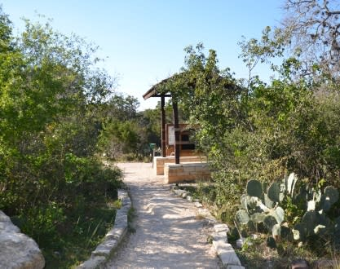
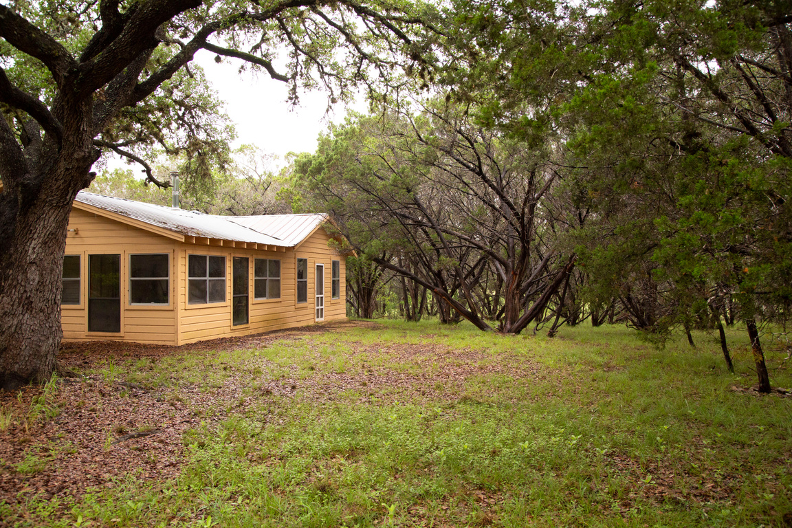
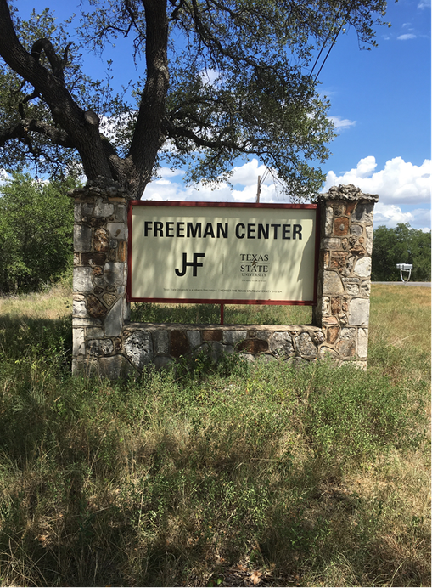
Tip 3
Outdoor Locations
Want to get outside, but don’t know where to start? Check out these outdoor amenities on and around Texas State campus to begin your outdoor experiences and participate in seasonal programming!
Meadows Center
Sewell Park
City Natural Areas
Watercraft rentals, picnicking, swimming, & more!
Hiking and wildlife viewing
for Water and the Environment
Freeman Center*
Glass bottom
boat tours,
wetland boardwalk, aquarium, & more!
Camping, geocacheing, fishing, & more!
University Camp
Hands-on agricultural and anthropological research
*Freeman Center is an active research facility and can only be accessed by students involved in ongoing research projects or class activities.
Notes:
5

Slide 8
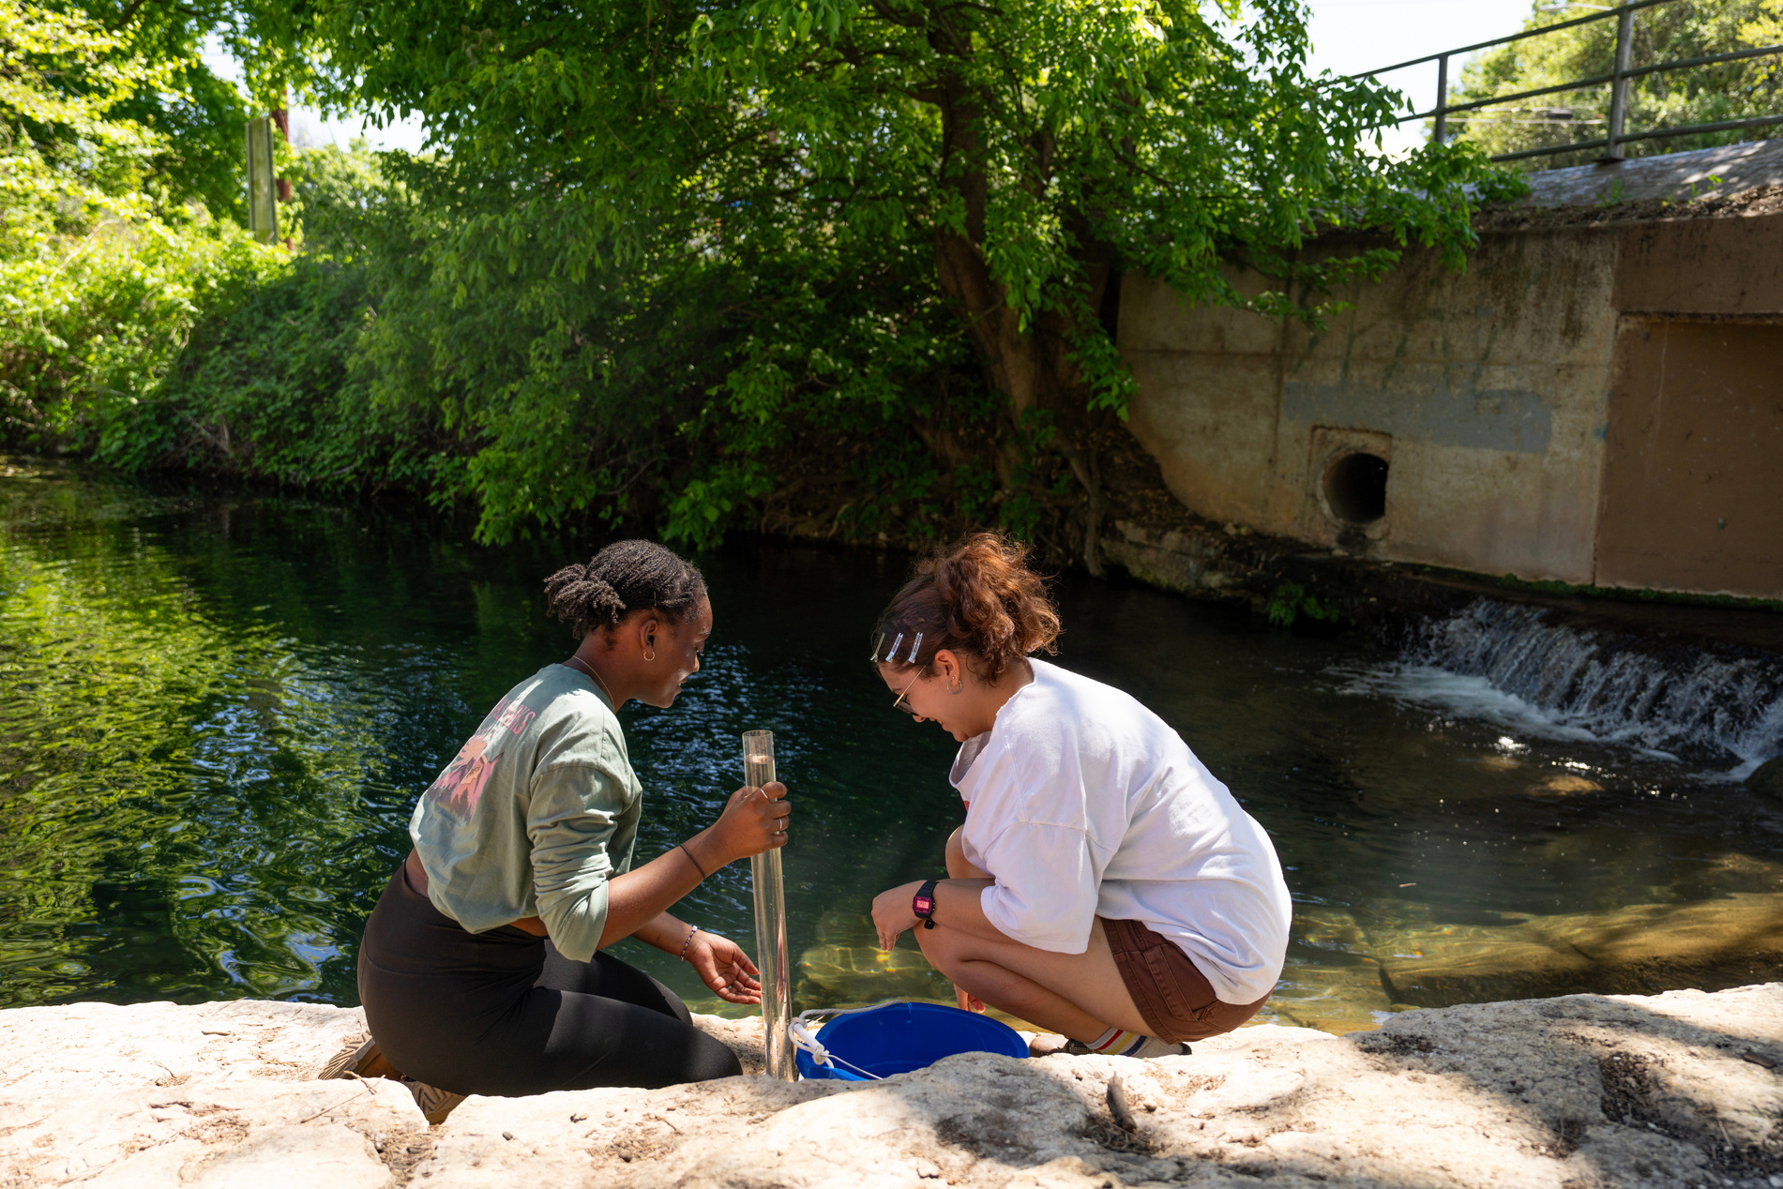

Tip 3
Outdoor Courses
Many academic departments offer courses that include outdoor labs, service learning opportunities, or field trips. Check the course catalog for the following departments to register for one or a few!
  Department of Geography and Environmental Studies
  Department of Agricultural Sciences
  Department of Anthropology
  Department of Biology
  Department of Health and Human Performance
  School of Social Work
Outdoor Events
Every year, a variety of events take geared towards connecting students with the San Marcos community and natural environment take place on TXST campus. Keep an eye out for dates of the following events as the year progresses to participate.
  August - First Float
  October - Sacred Springs Powwow
  March - Bobcat Build’s Big Event
  April - Earth Day Festival
For more more information and advice on how to integrate nature into your life as a Bobcat, visit the Campus Nature Rx webpage or email
Dr. Christine Norton in the School of Social Work.
Notes:
5

Slide 9

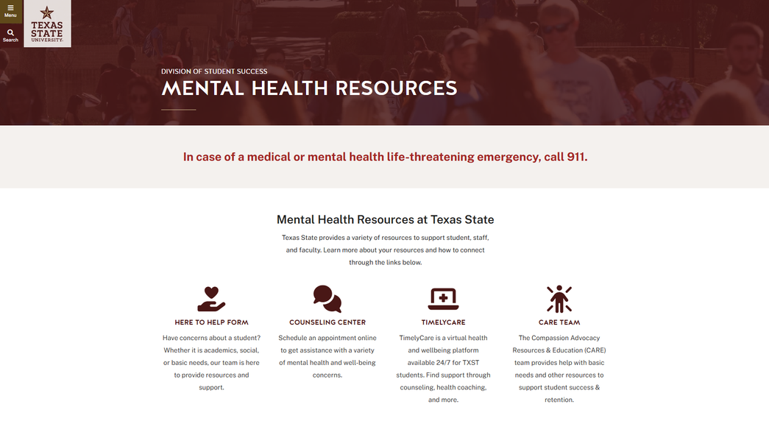
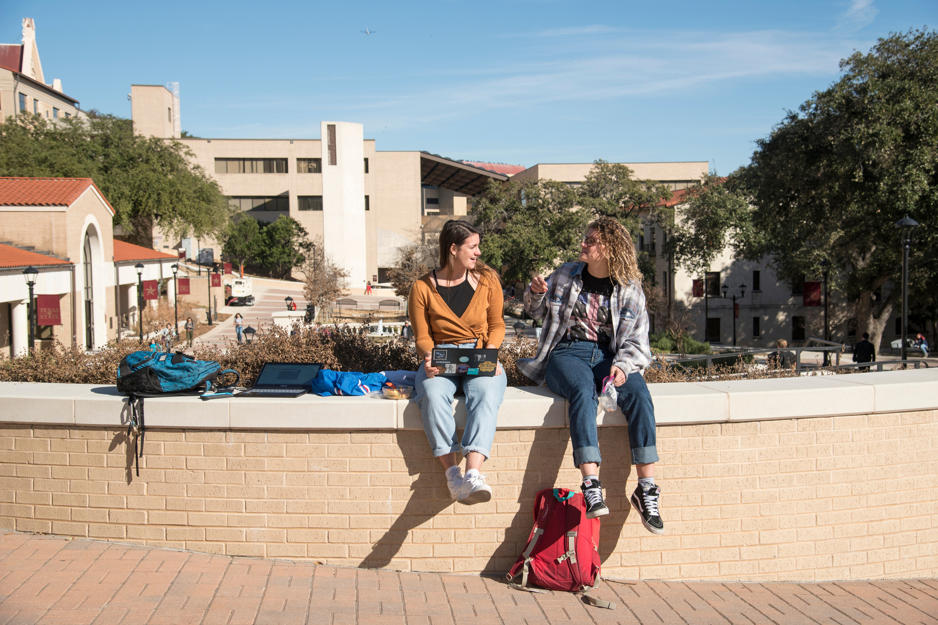
Tip 4
Ask for Help
While many mental health struggles can be addressed with lifestyle and habit changes, it is often useful and sometimes necessary to seek professional help for certain conditions. At Texas State, Bobcats have access to a variety of mental health resources offered through the TXST Counseling Center and the Student Health Center on-campus clinic.
Strength in Numbers
Even though it can be hard to reach out, remember that there is no shame in admitting you may need a helping hand. Getting the care you need may be daunting at first, but taking the first step is worth the effort for your health and wellbeing. You shouldn’t have to do this all on your own- we are all stronger together!
Find out about the various mental health resources available to Bobcats by visiting the Division of Student Success webpage, or by calling the Counseling Center at 512.245.2208.
Notes:
5

Slide 10

No Bobcat is an Island
Your first year of college may be a whirlwind of ups and downs, but prioritizing all dimensions of your wellbeing is the key to success in your academic and personal life. As you find yourself committed to your courses, student organizations, and work schedule, be sure to also commit some time to self care and maintenance.
Struggles associated with mental health and wellness are extremely common, especially during tumultuous life changes. Having patience with yourself and compassion for your peers experiencing similar challenges can make a world of difference. Remember- self stewardship is a journey we are all on together!

