Slide 1

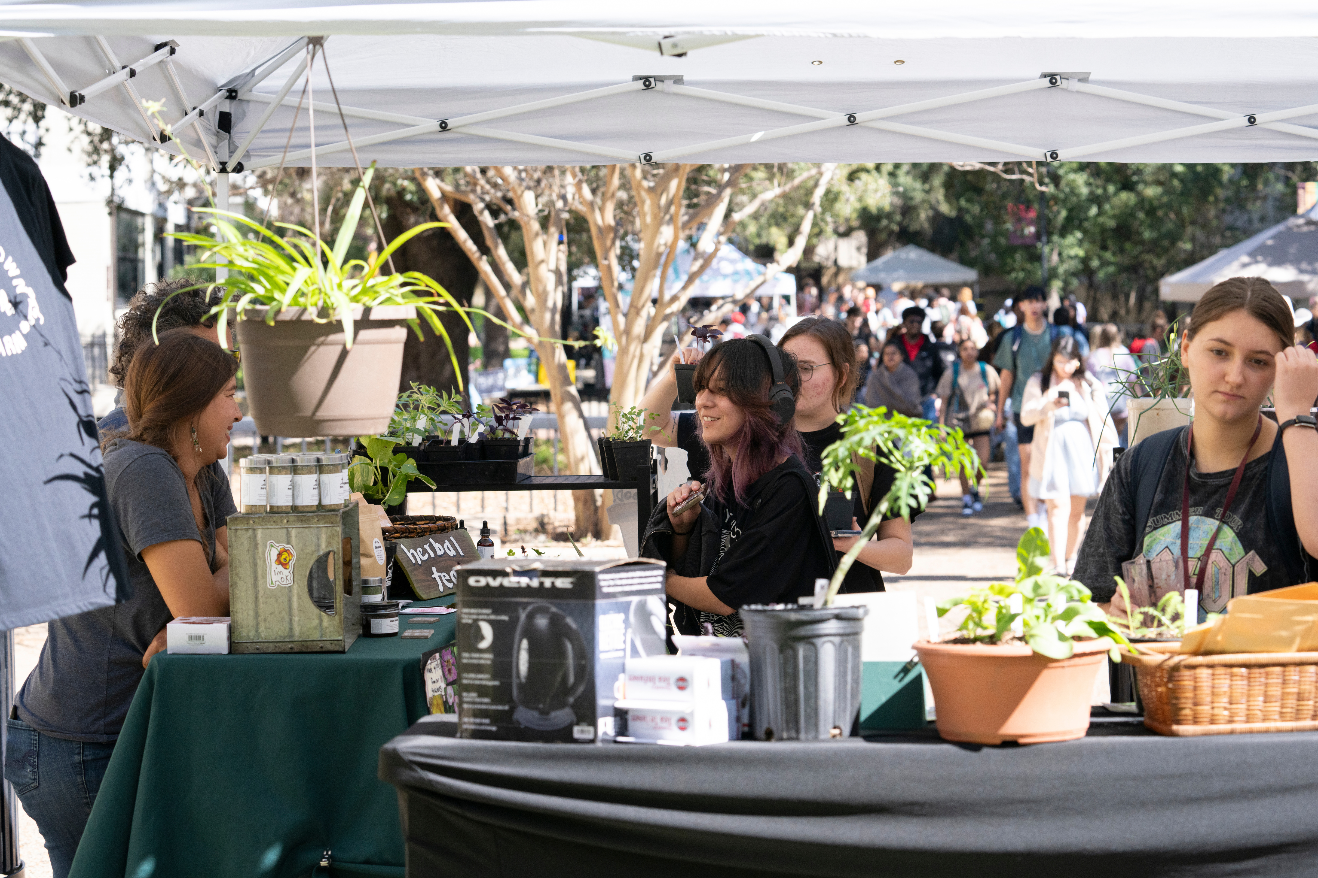

Go Local, Go San Marcos
Growing Community Roots as a First Year Bobcat

Slide 2
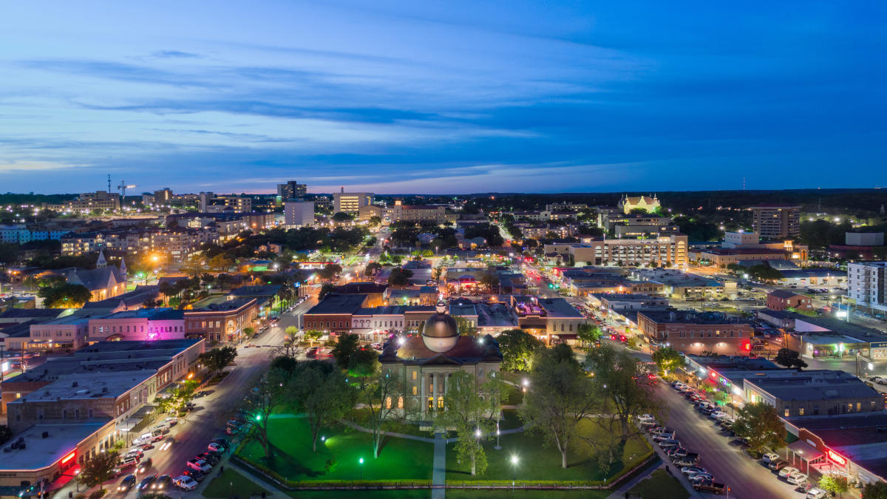
Knowing Where You Stand
Moving to a new city is a scary, exciting, and busy time in a person’s life. Integrating oneself into a new community can be intimidating, but developing connections to the places you inhabit is a valuable lifelong practice no matter where you find yourself living.
Why is it important to become “a good local?”
As a TXST student living on campus, it is sometimes easy to forget that in addition to being a Bobcat, you are also a part of the greater Central Texas community. Over the next four years, you will share resources, amenities, and public space with thousands of non-student neighbors both on and off campus. Getting to know the city and being aware of your impact on other residents is an important part of
becoming a steward to this new environment.
College is not only about practicing the skills associated with your career field, but about
acquiring knowledge to become an active and informed citizen. Learning how to give back to the San Marcos community and how to access the resources available to you as a San Martian will make your time at TXST easier and more fulfilling.
Notes:
7

Slide 3
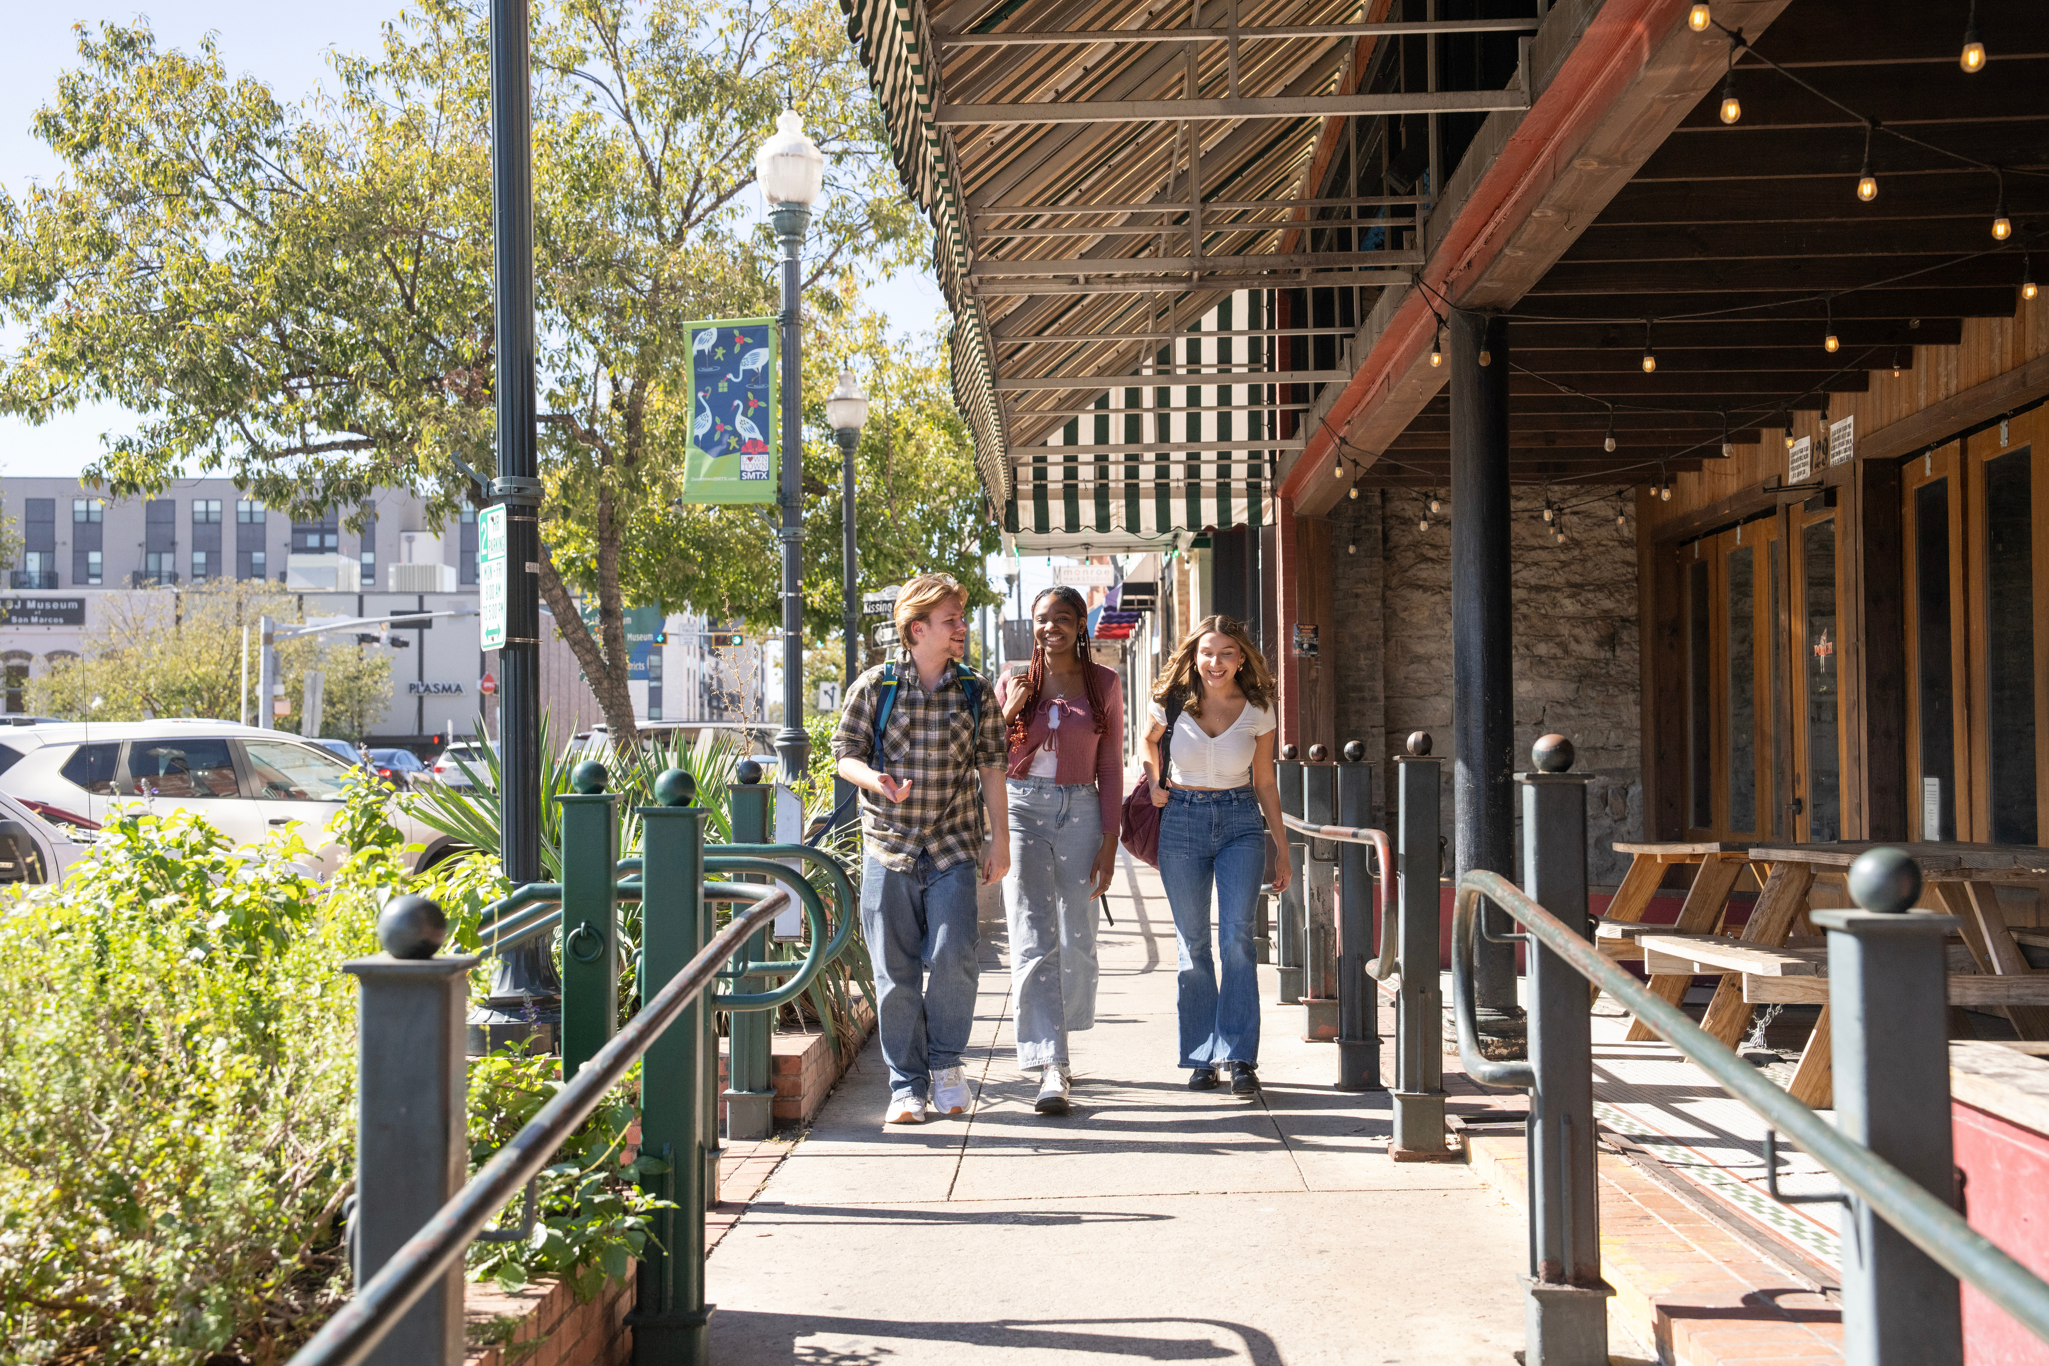
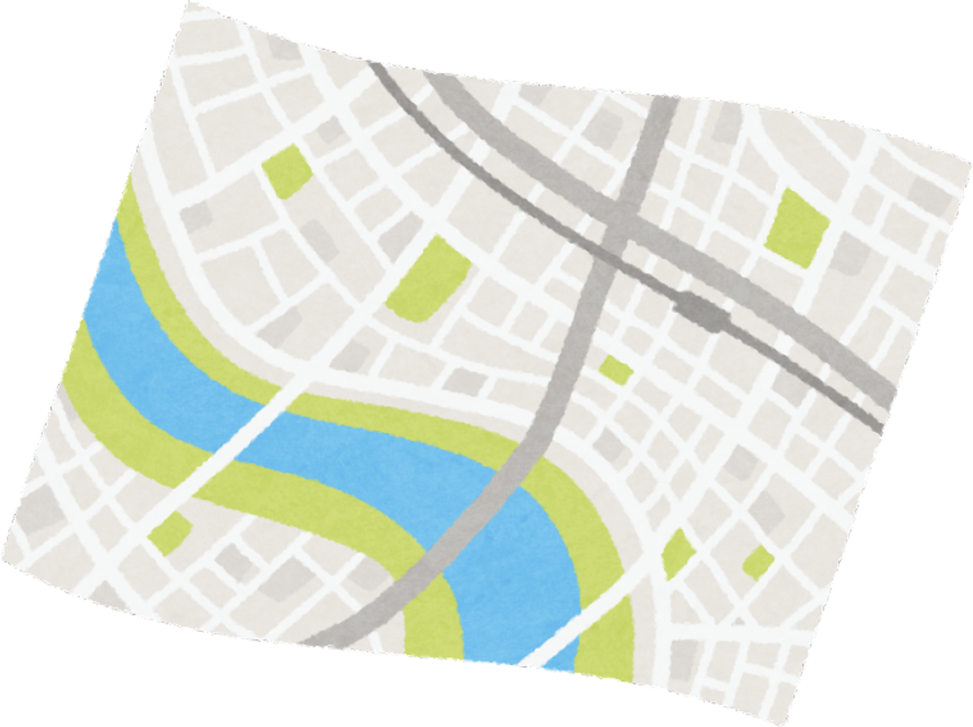
Stepping Outside
The first step to familiarizing yourself with a new location is often the one you take out your own front door! Getting to know San Marcos begins by exploring its streets, businesses, parks, and outdoor areas. Finding and frequenting these locations where you can have fun and interact with neighbors will help to both orient yourself geographically in your new home and discover new ways to spend time outside of school.
Finding a Third Place
A third place is a setting outside of the home (the first place) and work or school (the second place) where people can go to relax and socialize. Cafes, bookstores, music venues, and restaurants are all popular kinds of third places, but they can also be free locations like libraries and parks.
Third places are important because they help us form identities and interests outside of our professional lives, and provide a space to connect with friends and strangers.
Think, Pair, Share:
What is your favorite place to spend free time? Is it a first, second, or third place?

Slide 4
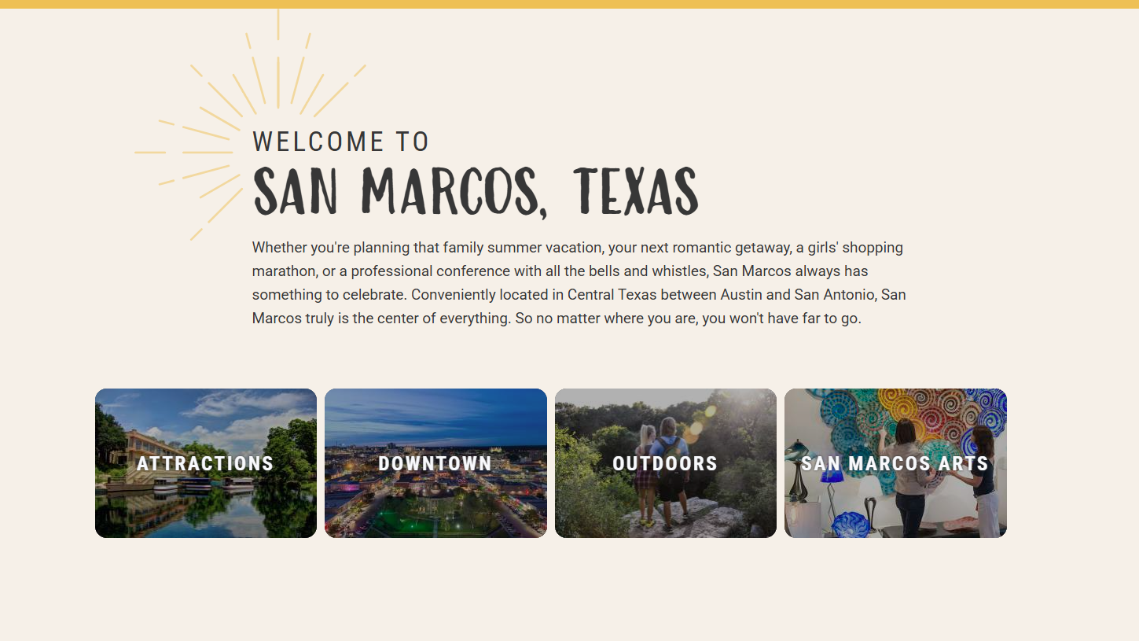
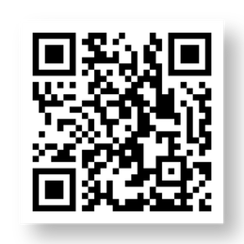
Exploring San Marcos
San Marcos is abundant with third places catered to different personalities and interests. You can learn more about things to do in town and narrow down activities that seem appealing by browsing the official
Visit San Marcos blog, which is updated regularly with information about upcoming events and local highlights. Social media is also a great place to look for ideas on how to spend your time free time out on the town.

Slide 5

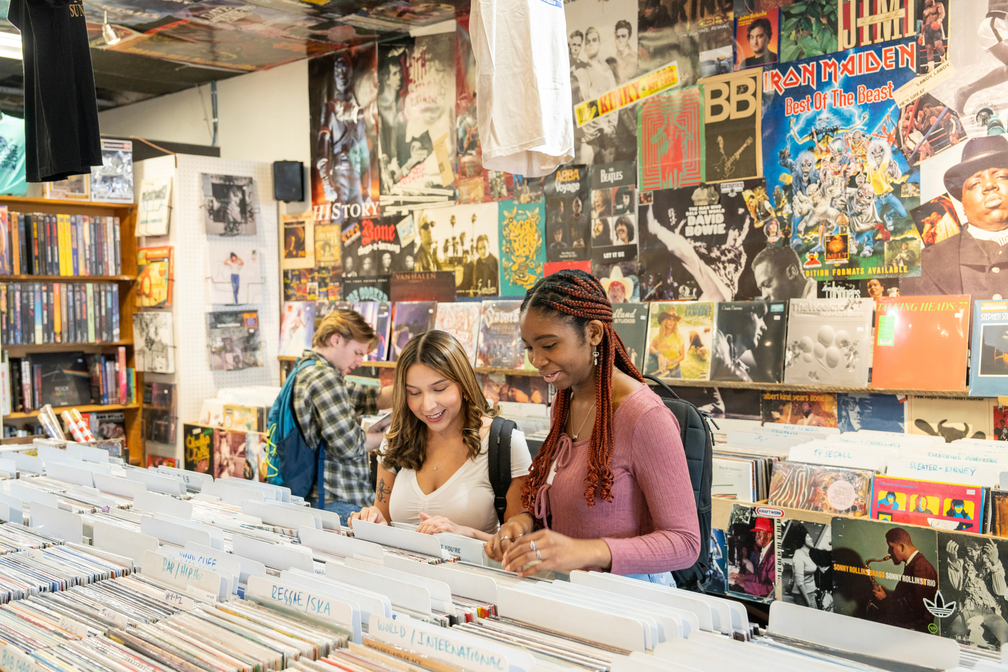
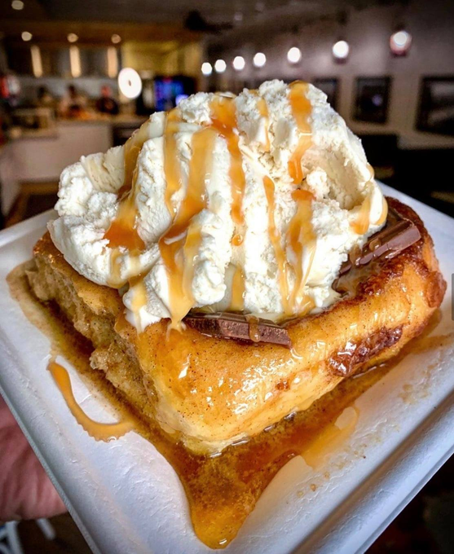
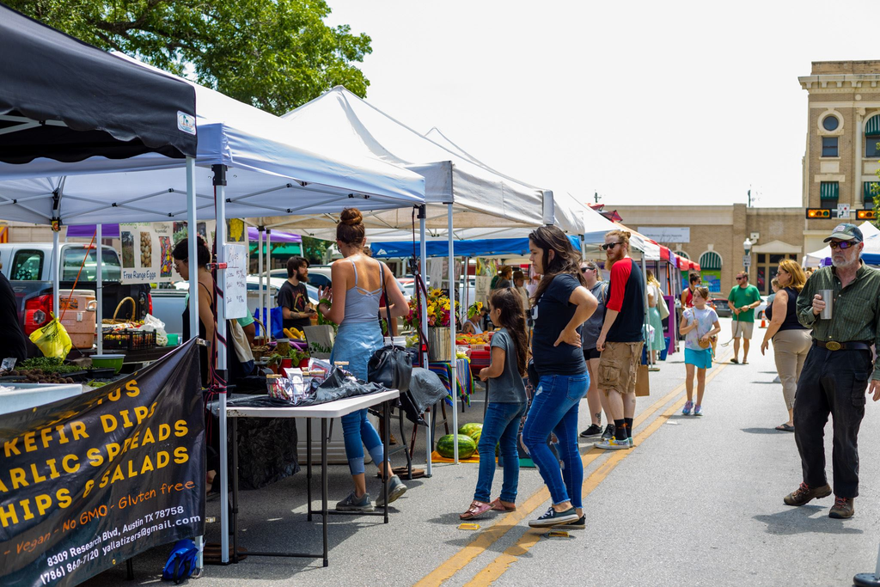
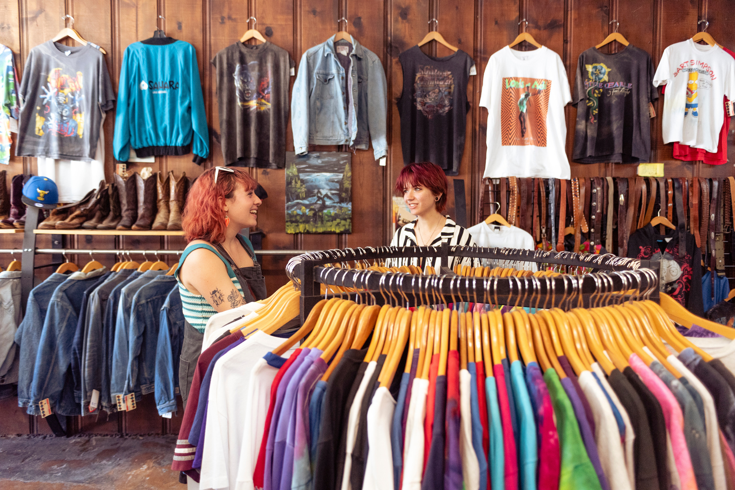
Sundance Records
Shopping Local...
Where are Bobcats buying?
One of the best and easiest ways to connect to your new community is by becoming a patron of local establishments. Choosing to shop local not only integrates you into city culture, but also provides numerous benefits to businesses, consumers, and ecosystems.
Gil’s Broiler & Manske Rolls
...for the Earth
San Marcos
Farmers Market
Because local businesses operate from within city centers, they are typically able to make more local purchases and thus require less transportation to get products to consumers.
By cutting vehicle delivery miles and buying materials from other nearby producers, local businesses generate fewer emissions and less waste in their production process. When you buy from local stores and restaurants, you are also reducing your own carbon footprint by traveling shorter distances for goods and services.
Vagabond Vintage
Notes:
5

Slide 6
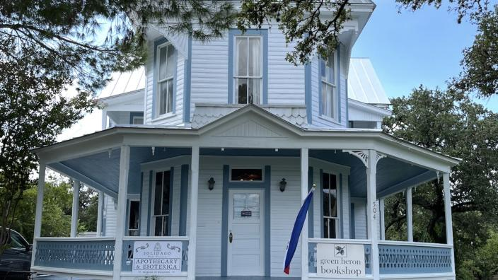
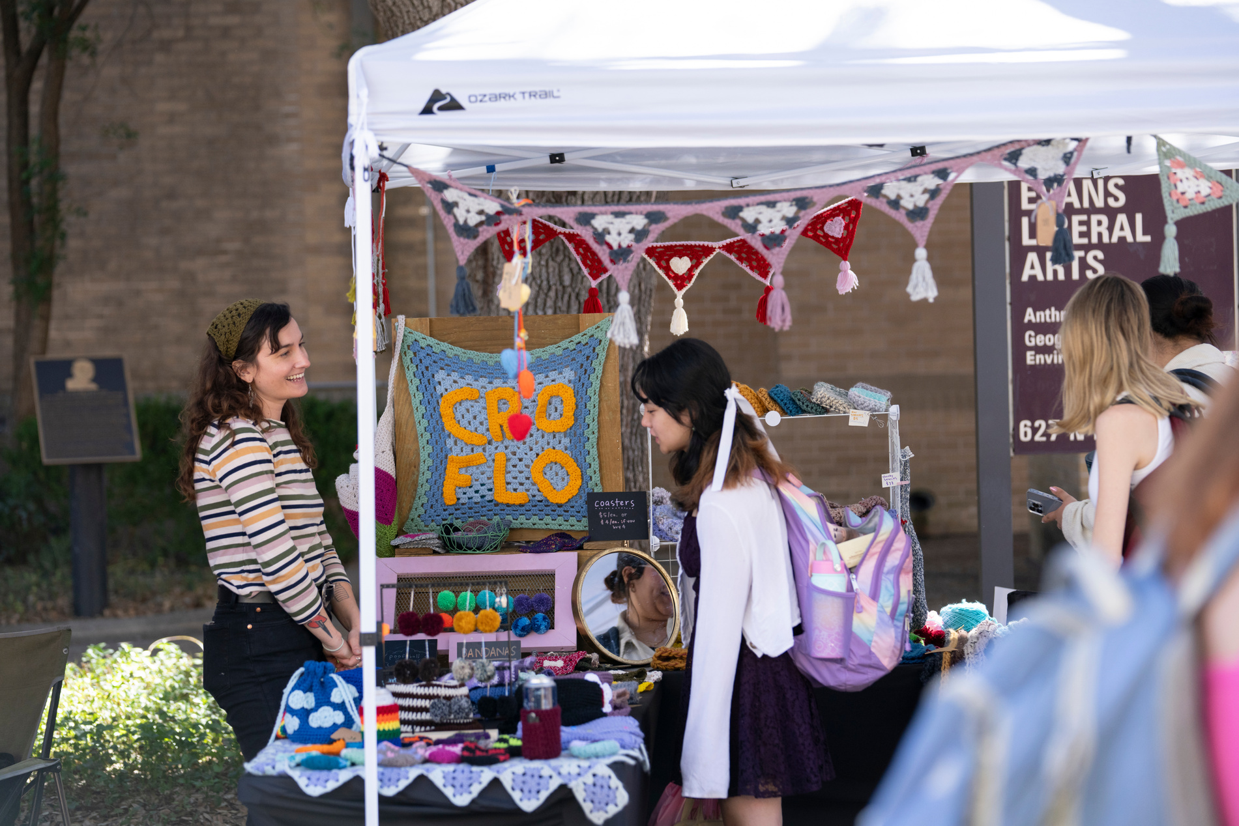
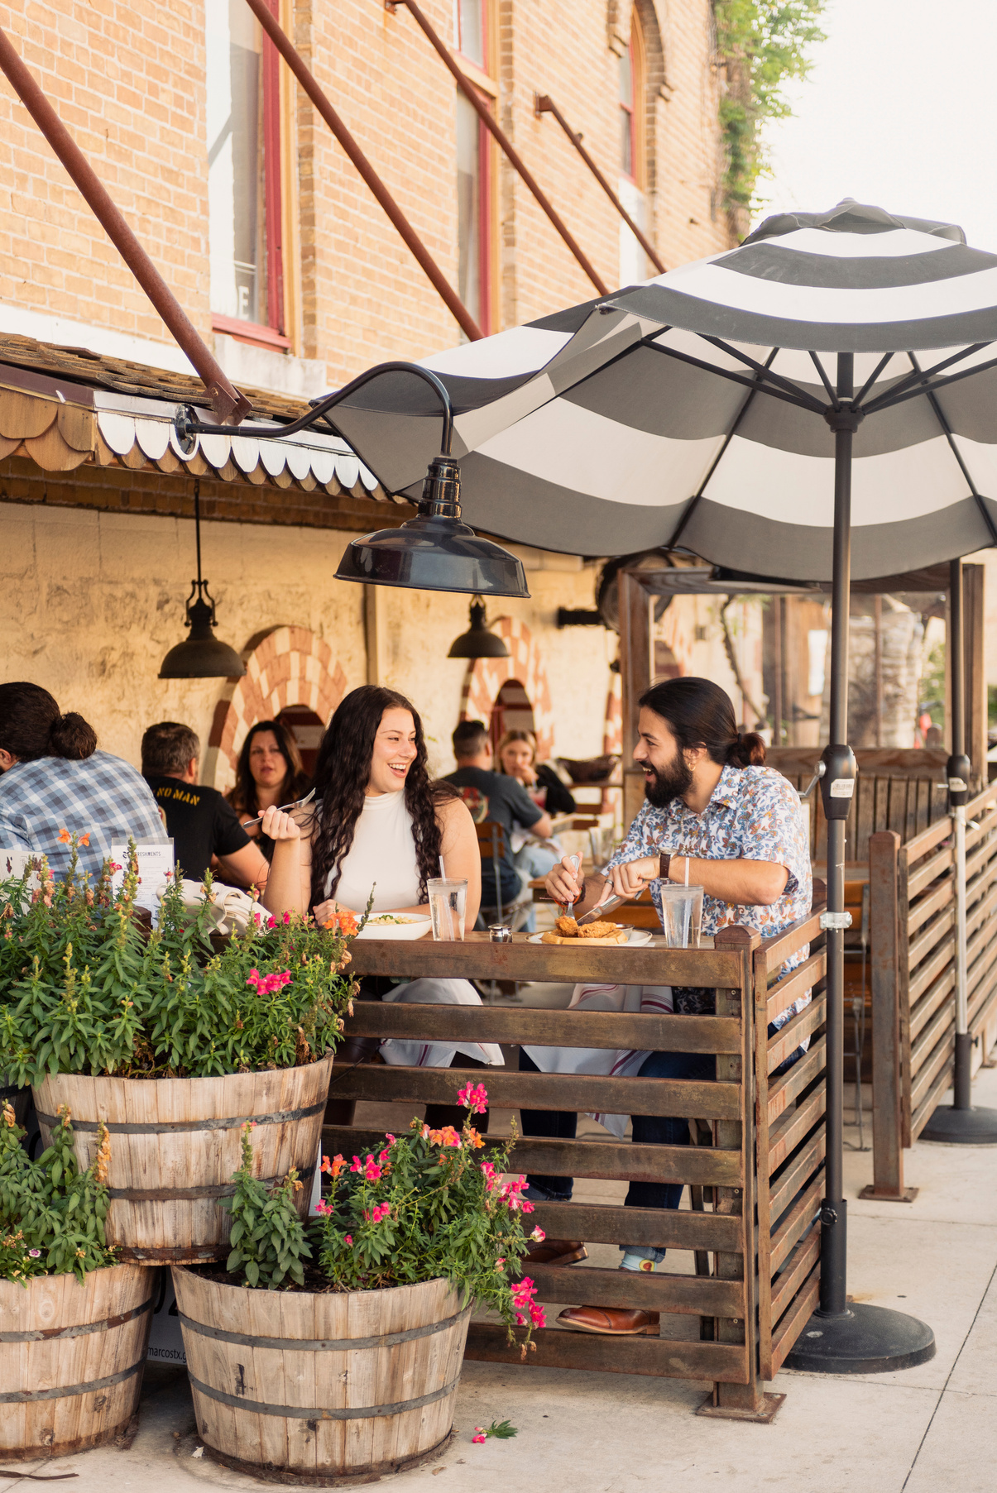
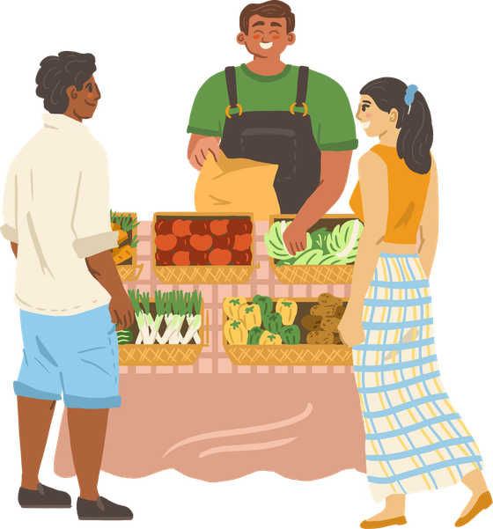
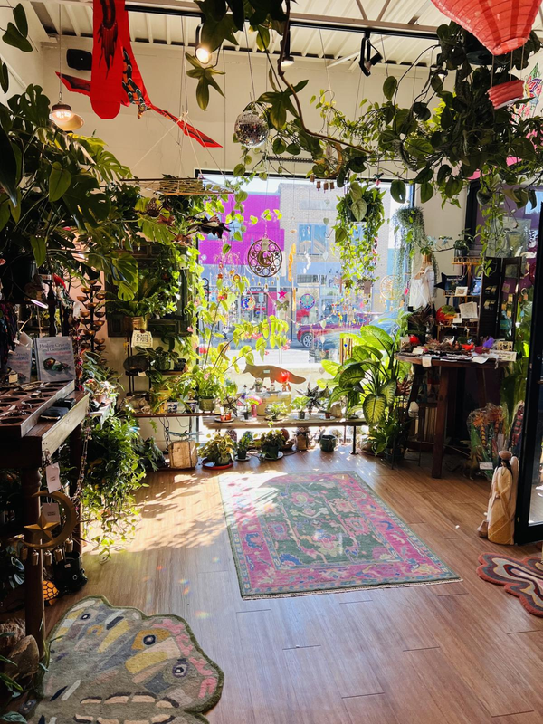
Green Heron Bookshop
...and for the Economy
Where are Bobcats buying?
Buying from local businesses also keeps money flowing within local economies. The Local Multiplier Effect describes what happens when dollars spent at local businesses remain in a regional economy, generating more local wealth, charitable donations, and jobs.*
Quad Market Days
Even though it may not be realistic to stop buying from big box stores entirely, opting for a local choice whenever you are able to still benefits the environment and keeps dollars in the city!
The Root Cellar Cafe
*Information from American Independent Business Alliance
Daughter of the Wild
Notes:
5

Slide 7
Where is your dollar going?
shareholder profits
national marketing
leaving local economy →
corporate payroll
nonlocal supplies (imports)
52.9% of every dollar
you spend at independent retailers goes back into the regional economy,
recirculating as wages, donations, local tax revenue, and purchases from local suppliers.
chain retailers
local supplies
wages
local taxes
In comparison, only
13.6% of every dollar spent at big box chains stays in local economies.*
local donations
local
businesses
← returning to local economy
*Data from Civic Economics
Notes:
5

Slide 8
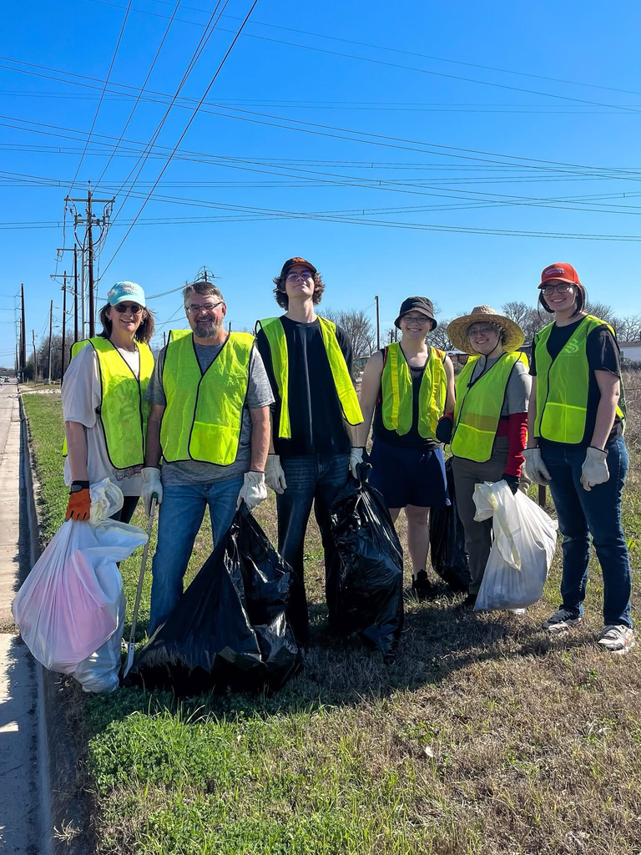

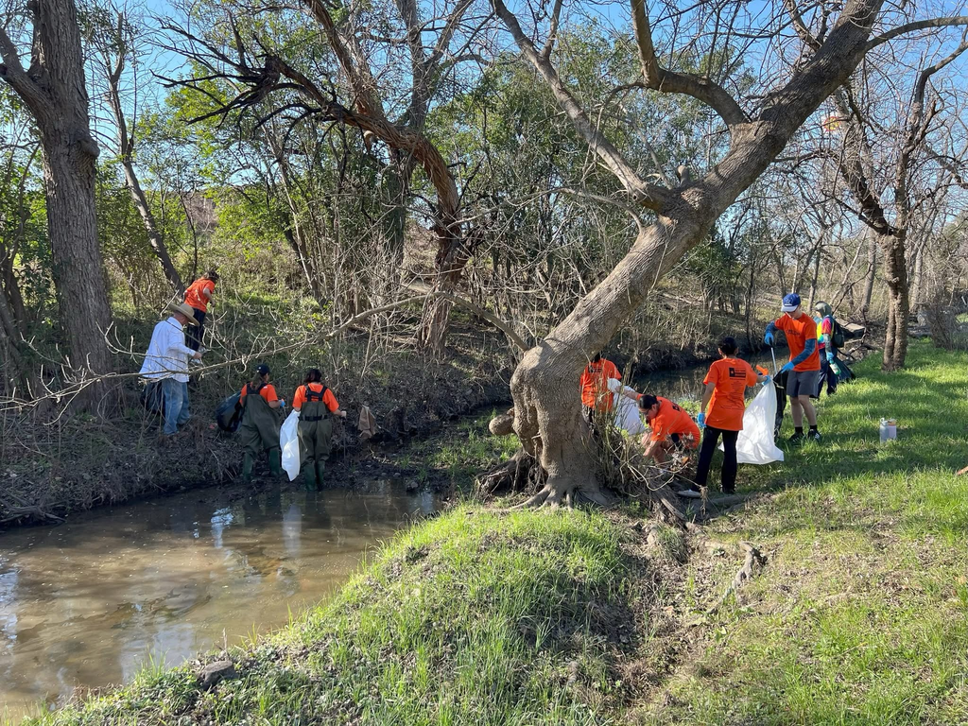


Building the Village
When you’re not perusing a local shop or eating at a family-owned restaurant, volunteering is another great way to give back and get involved in the San Marcos community. Each year, Bobcats have the opportunity to participate in a variety of different volunteer events where they can make a positive impact on people and the environment.
Both Texas State University and
the City of San Marcos host regular and seasonal river clean up days that any member
of the public can participate in.
In October and March, San Martians come
together to pick up litter around the San Marcos
River and its watershed during the Fall River
Clean Up and Great Texas River Clean Up.
To participate in these important local
traditions, learn more from the City of San Marcos’ River Clean Ups webpage, or follow the Keep San Marcos Beautiful campaign on Facebook or Instagram.

Slide 9
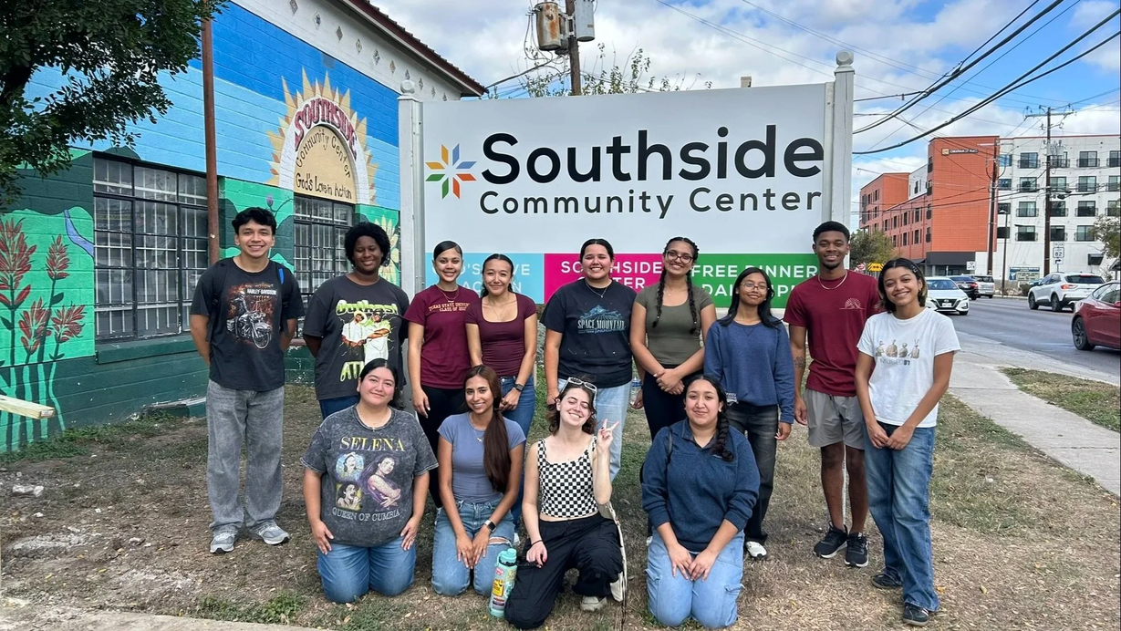
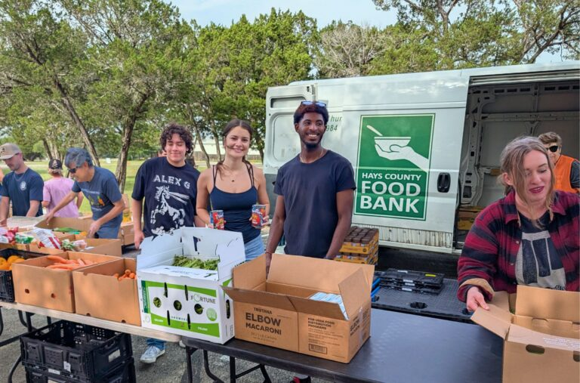
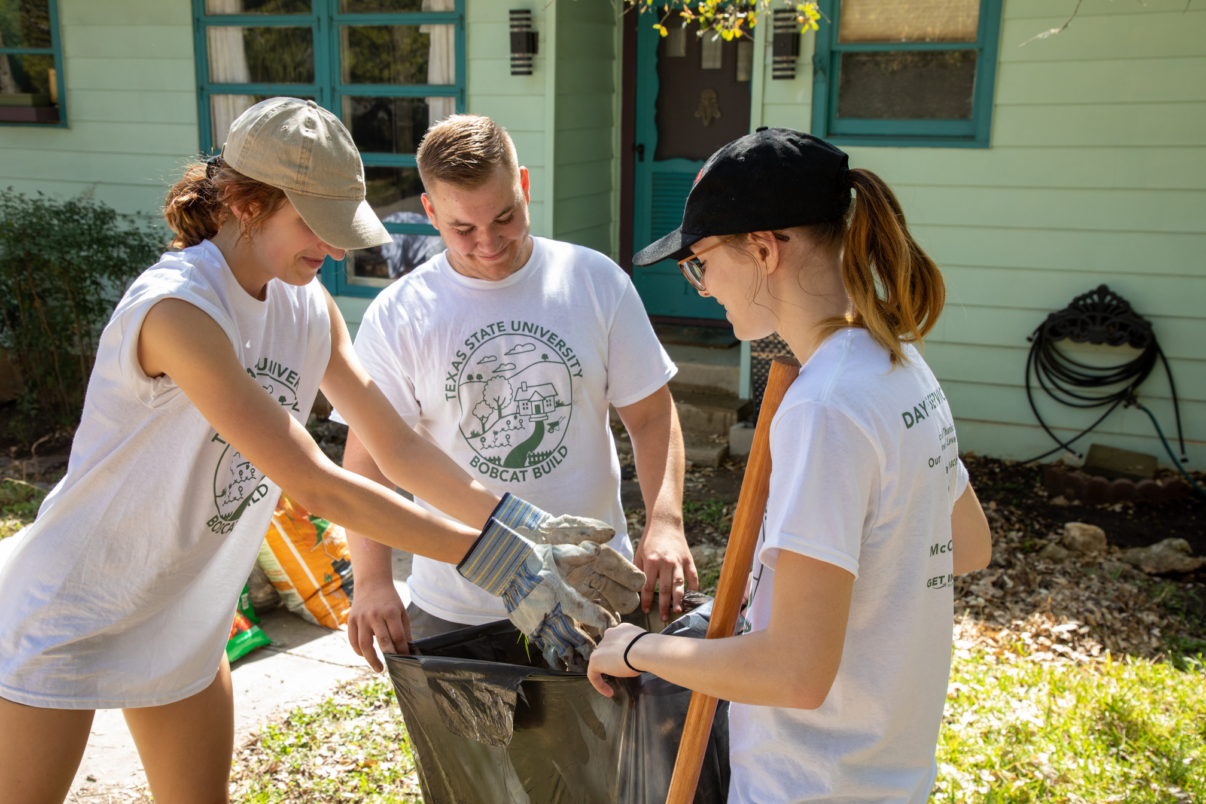
Volunteers are always needed at Southside Community Center, which serves as a shelter and resource distribution site for San Martians experiencing homelessness. Bobcats can volunteer to serve meals, clean, and organize donations.
The Hays County Food Bank feeds hundreds of Hays County families and individuals experiencing food insecurity, operating with help from volunteers who cook meals, transport food items, and organize items for distribution.
Every Spring, TXST hosts Bobcat Build’s Big Event, a day of service where students can donate their time to various community projects across the city. Bobcats have an opportunity to join as individuals or as a member of a participating student organization.
These events and organizations are just some of the volunteer opportunities that Bobcats can participate in as new residents of San Marcos!
Notes:
7

Slide 10
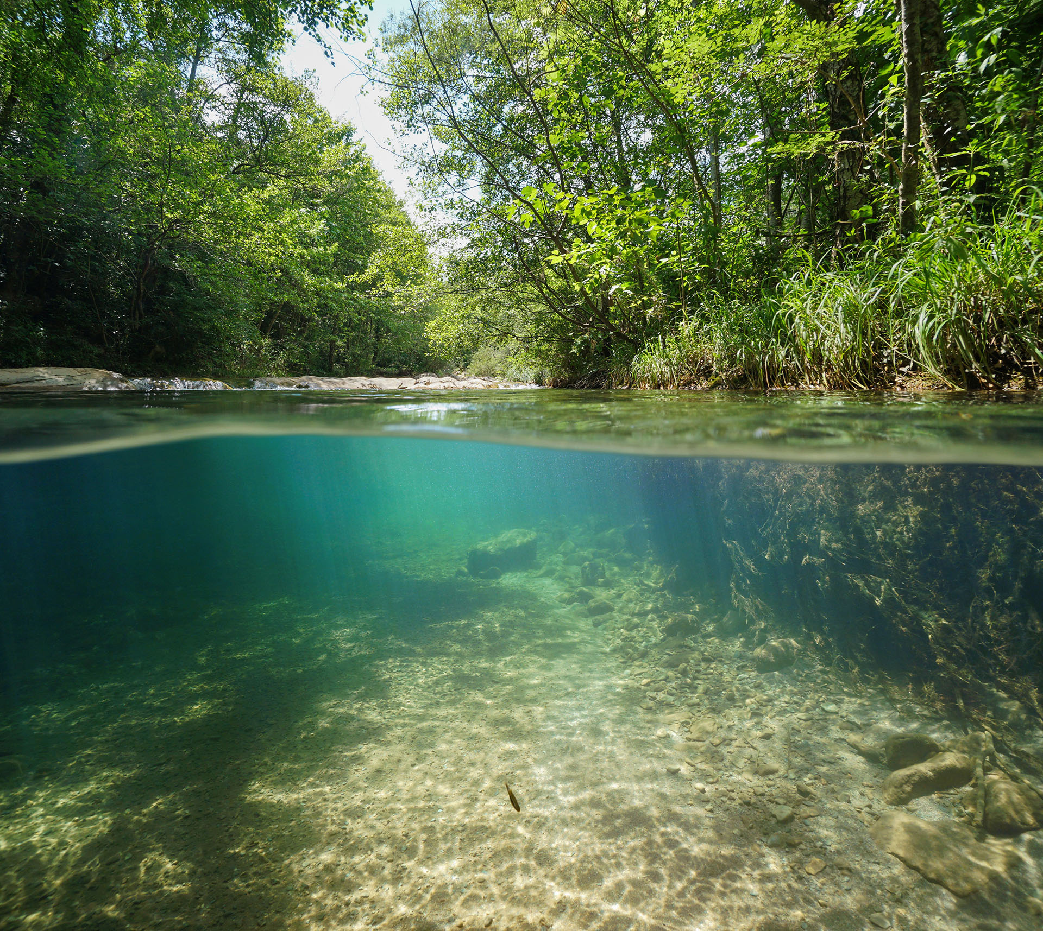
Local Services and Resources
In addition to the resources available on campus to TXST students, Bobcats also have access to a variety of services and amenities provided by Hays County and the City of San Marcos. As you settle into your home, be sure to learn not just what you can do for your city, but what your city can do for you!
PARKS
LIBRARY
ACTIVITY CENTER
VOTING
BUS ROUTES
Whether you like riverside picnics or hikes through hill country, San Marcos parks and natural areas have something for every Bobcat to enjoy. Plan your next outdoor outing using this map that displays all San Marcos parks and nature trails.
In addition to Alkek Library, Bobcats also have access to books and services offered at the San Marcos Public Library on East Hopkins St. Students can get a library card for free using their Residence Hall address.
Looking to go for a swim, host an event, or join an exercise class? The San Marcos Activity Center has a variety of amenities and resources available for members. Located close to campus, the SMAC is the “Center of it All!”
If traveling home to vote is inconvenient or impossible, Bobcats can register to vote in San Marcos using their Residence Hall address at the Hays County Elections Office, located in the Hays County Government Center on Stagecoach Trail.
Along with the Bobcat Shuttle, students can ride the San Marcos bus for free, which runs on 8 routes that service all parts of the city. The Capitol Area Rural Transportation System (CARTS) bus also offers routes to out-of-town destinations for a small fee.
Notes:
7

Slide 11
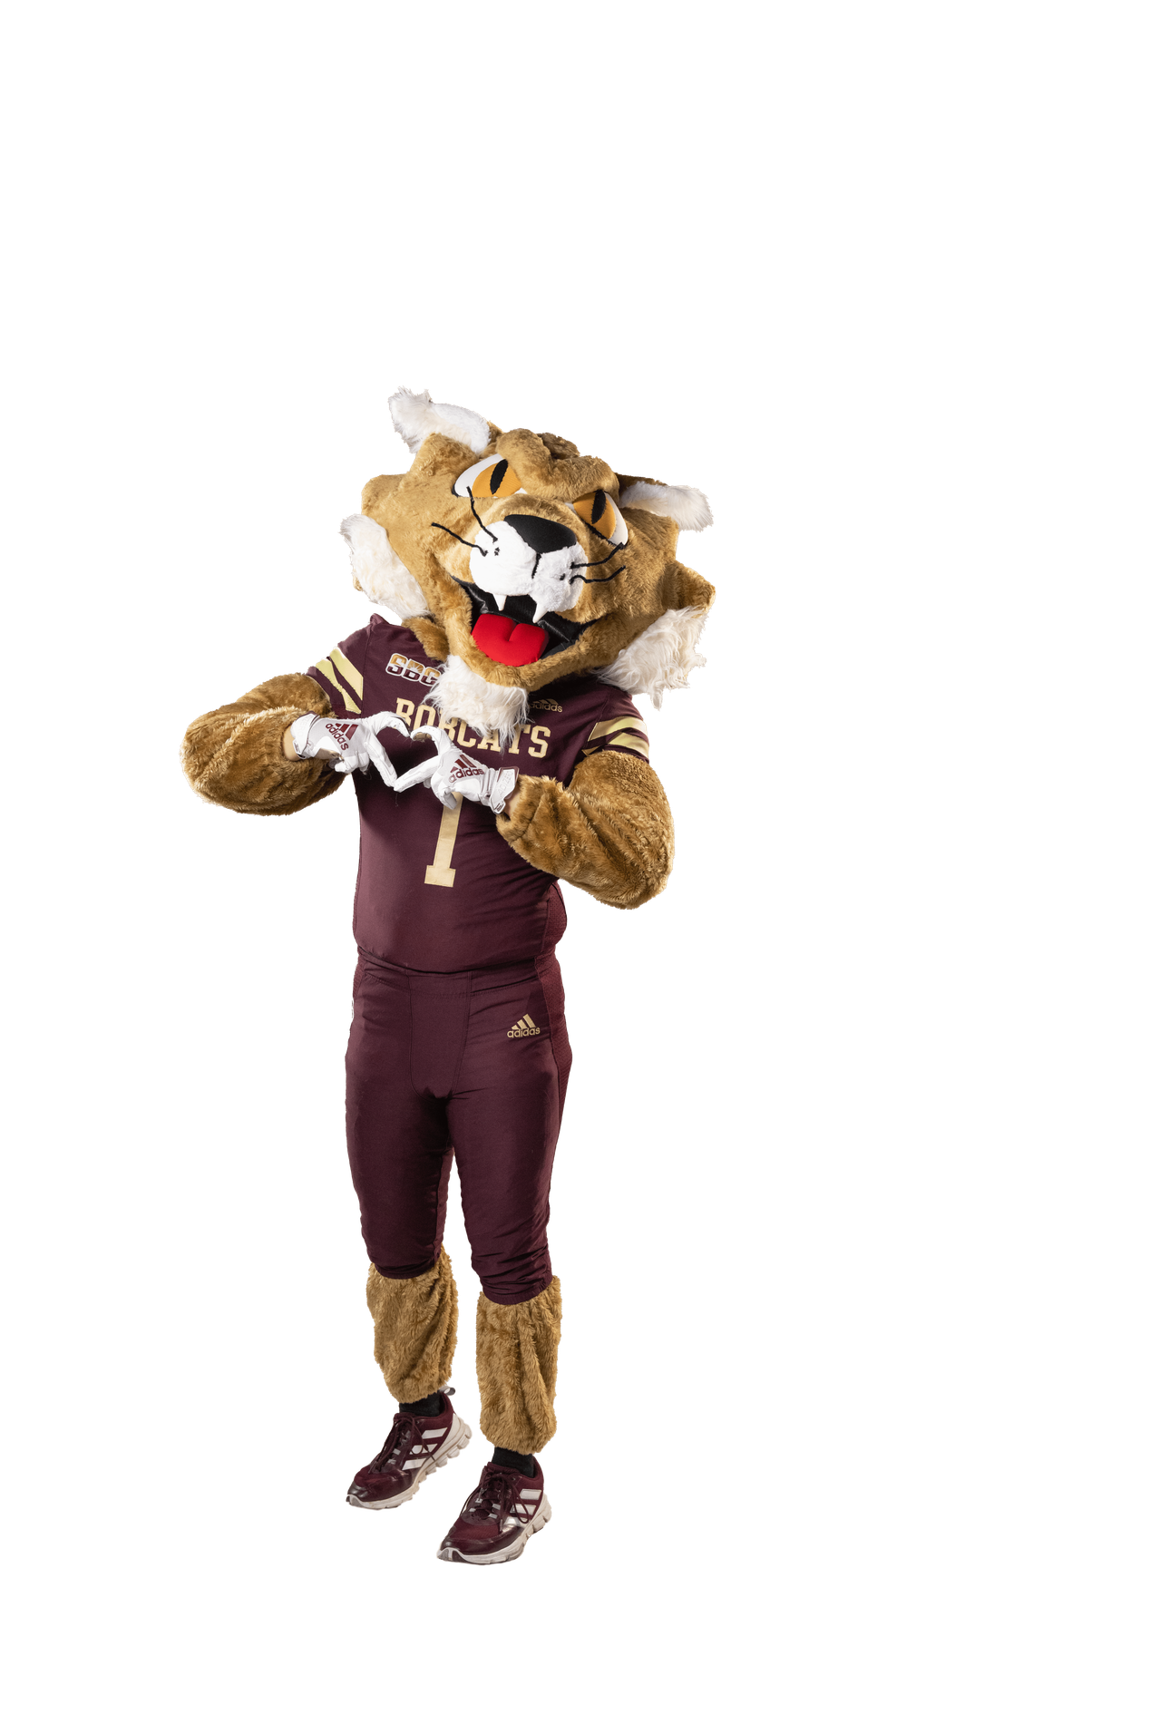
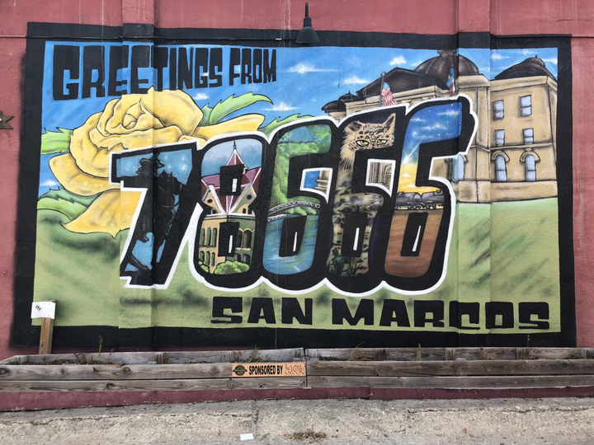
Welcome Home, Bobcats!
San Marcos is more than just a college town, and you are more than just a college student! Being a Bobcat means that your community can be found both in your classes and Residence Halls as well as in the public third places throughout the city.
No matter where you live or how long you stay there, forging connections to local people and environments is the foundation for stewardship and happiness.
Remember- a plant can’t grow without first setting down roots!

