Slide 1

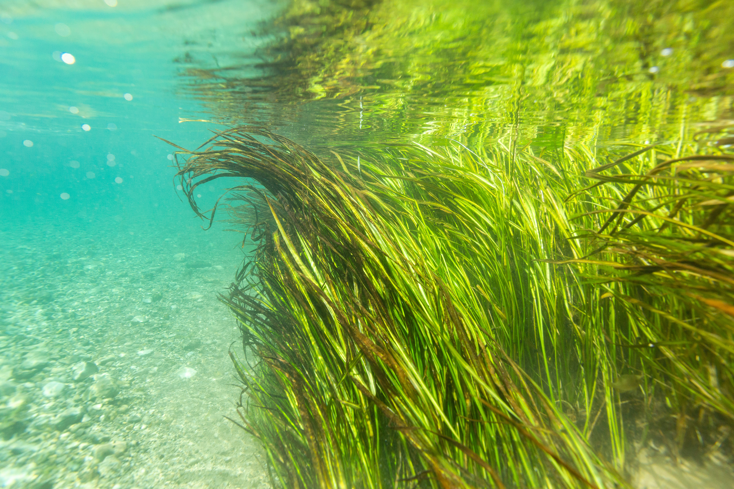

Our Habitat, Our Home
Endangered, Threatened, and Endemic Species of the Edwards Aquifer

Slide 2
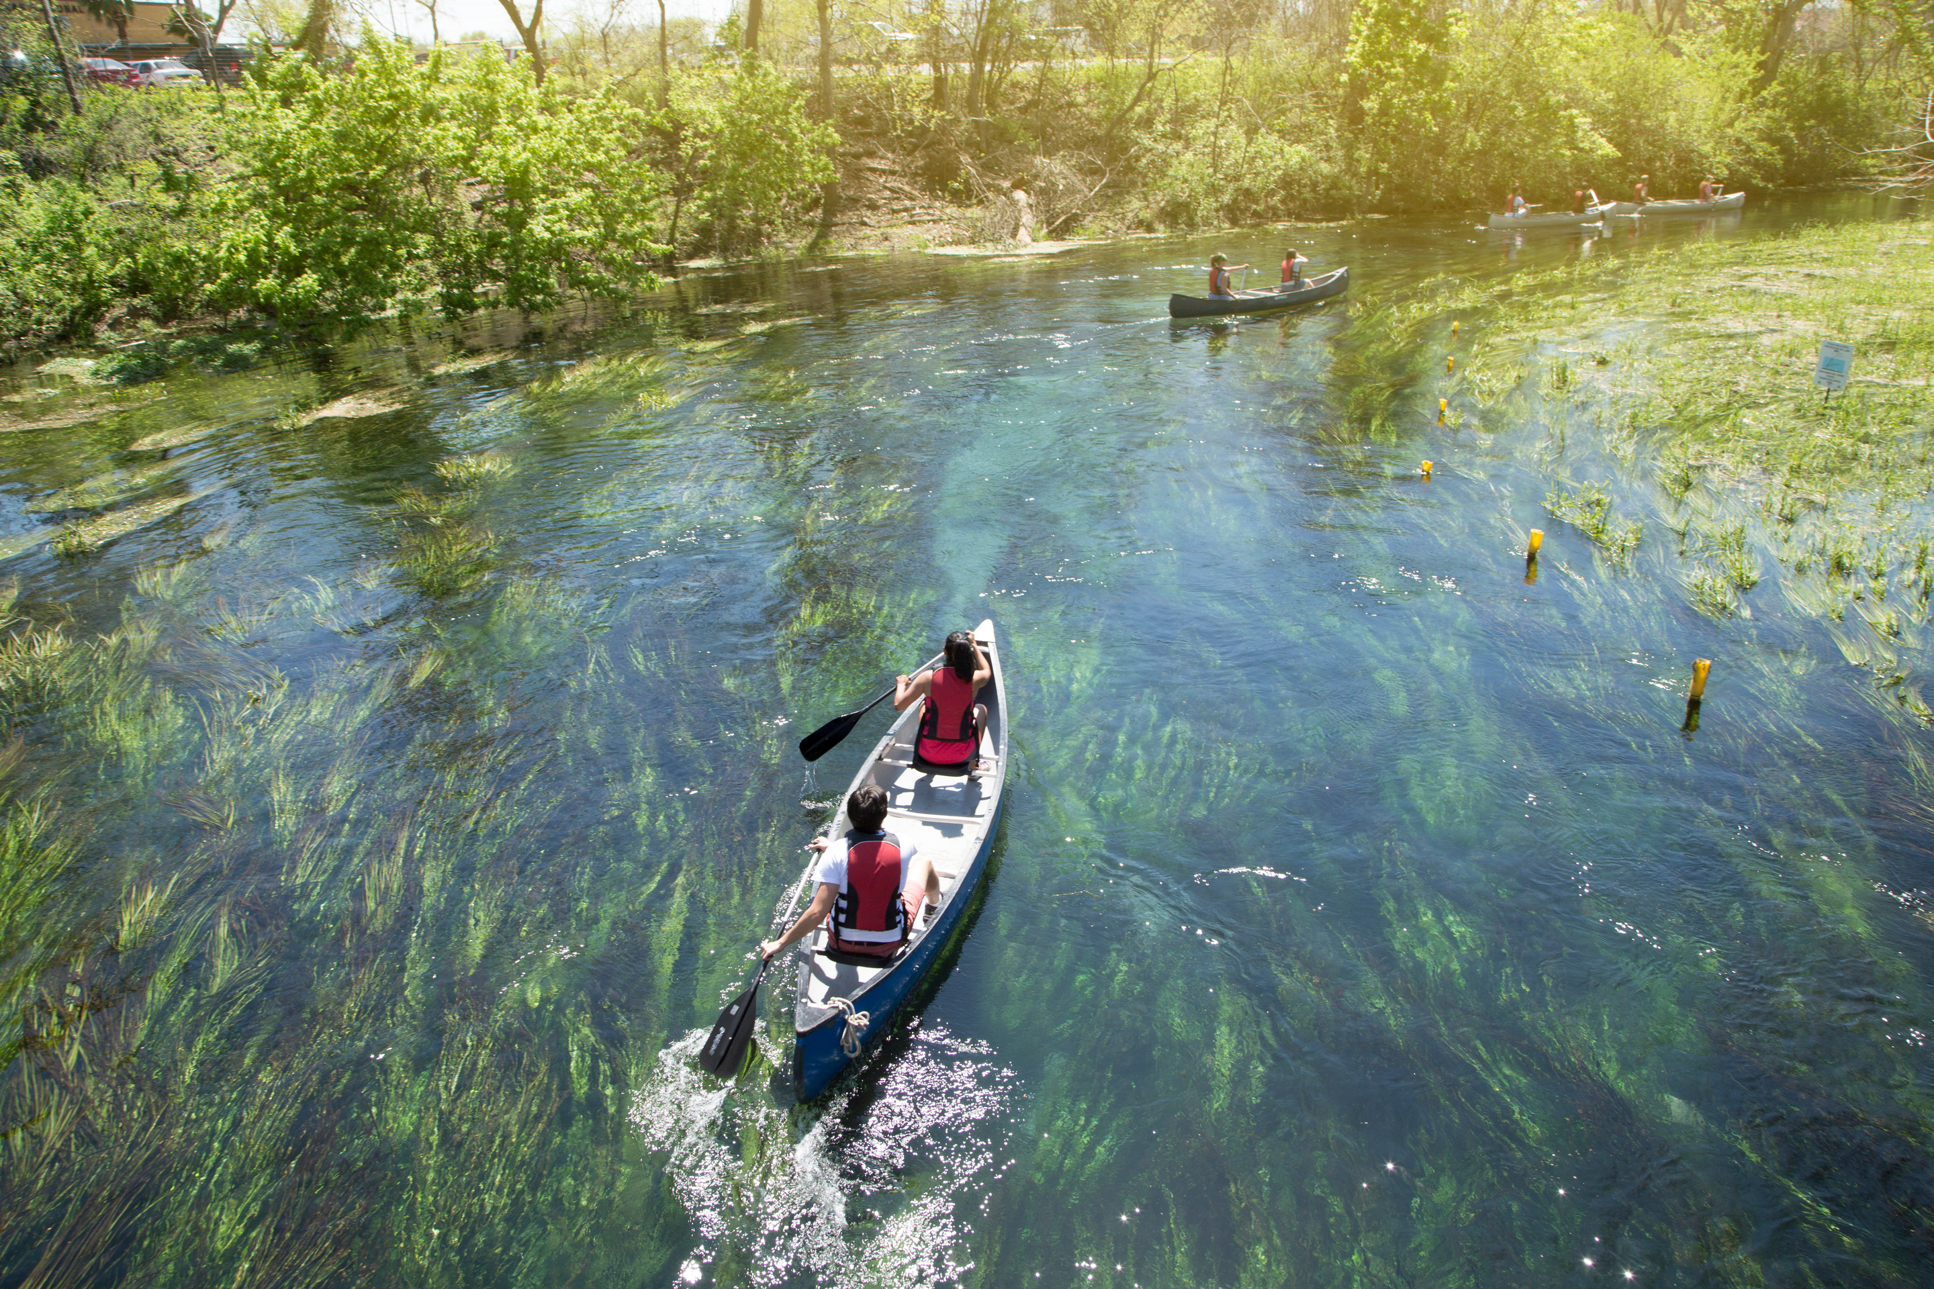
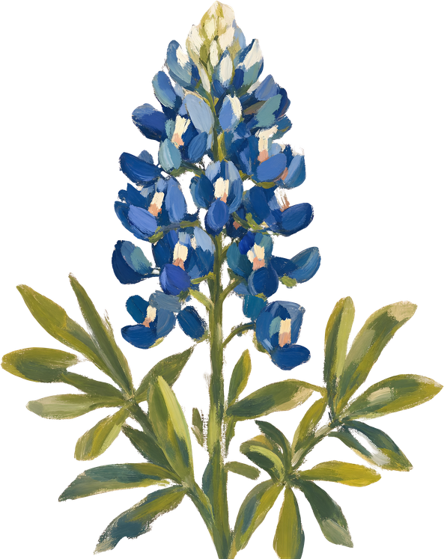
Where the Wild Things Are
San Marcos is home to a diverse array of flora and fauna that forms an ecosystem unlike any other in the state. To distinguish between categories of wildlife, scientists refer to these species in different ways. Knowing how each are distinct is essential to understanding the importance of local conservation efforts.
Native species
are species found in a given ecosystem as a result of natural distribution and evolutionary processes, as opposed to human intervention. For instance, bluebonnets are a species of wildflower native to south central Texas and northern Mexico.
Introduced or non-native species
are those that are present in an area because of purposeful or accidental introduction by humans. These can include species like agricultural crop varieties, decorative plants, or even pets.
When a non-native species becomes so abundant that it begins to outcompete native species for resources, it can then be considered invasive. Invasive species threaten the survival of other wildlife in an ecosystem.

Slide 3
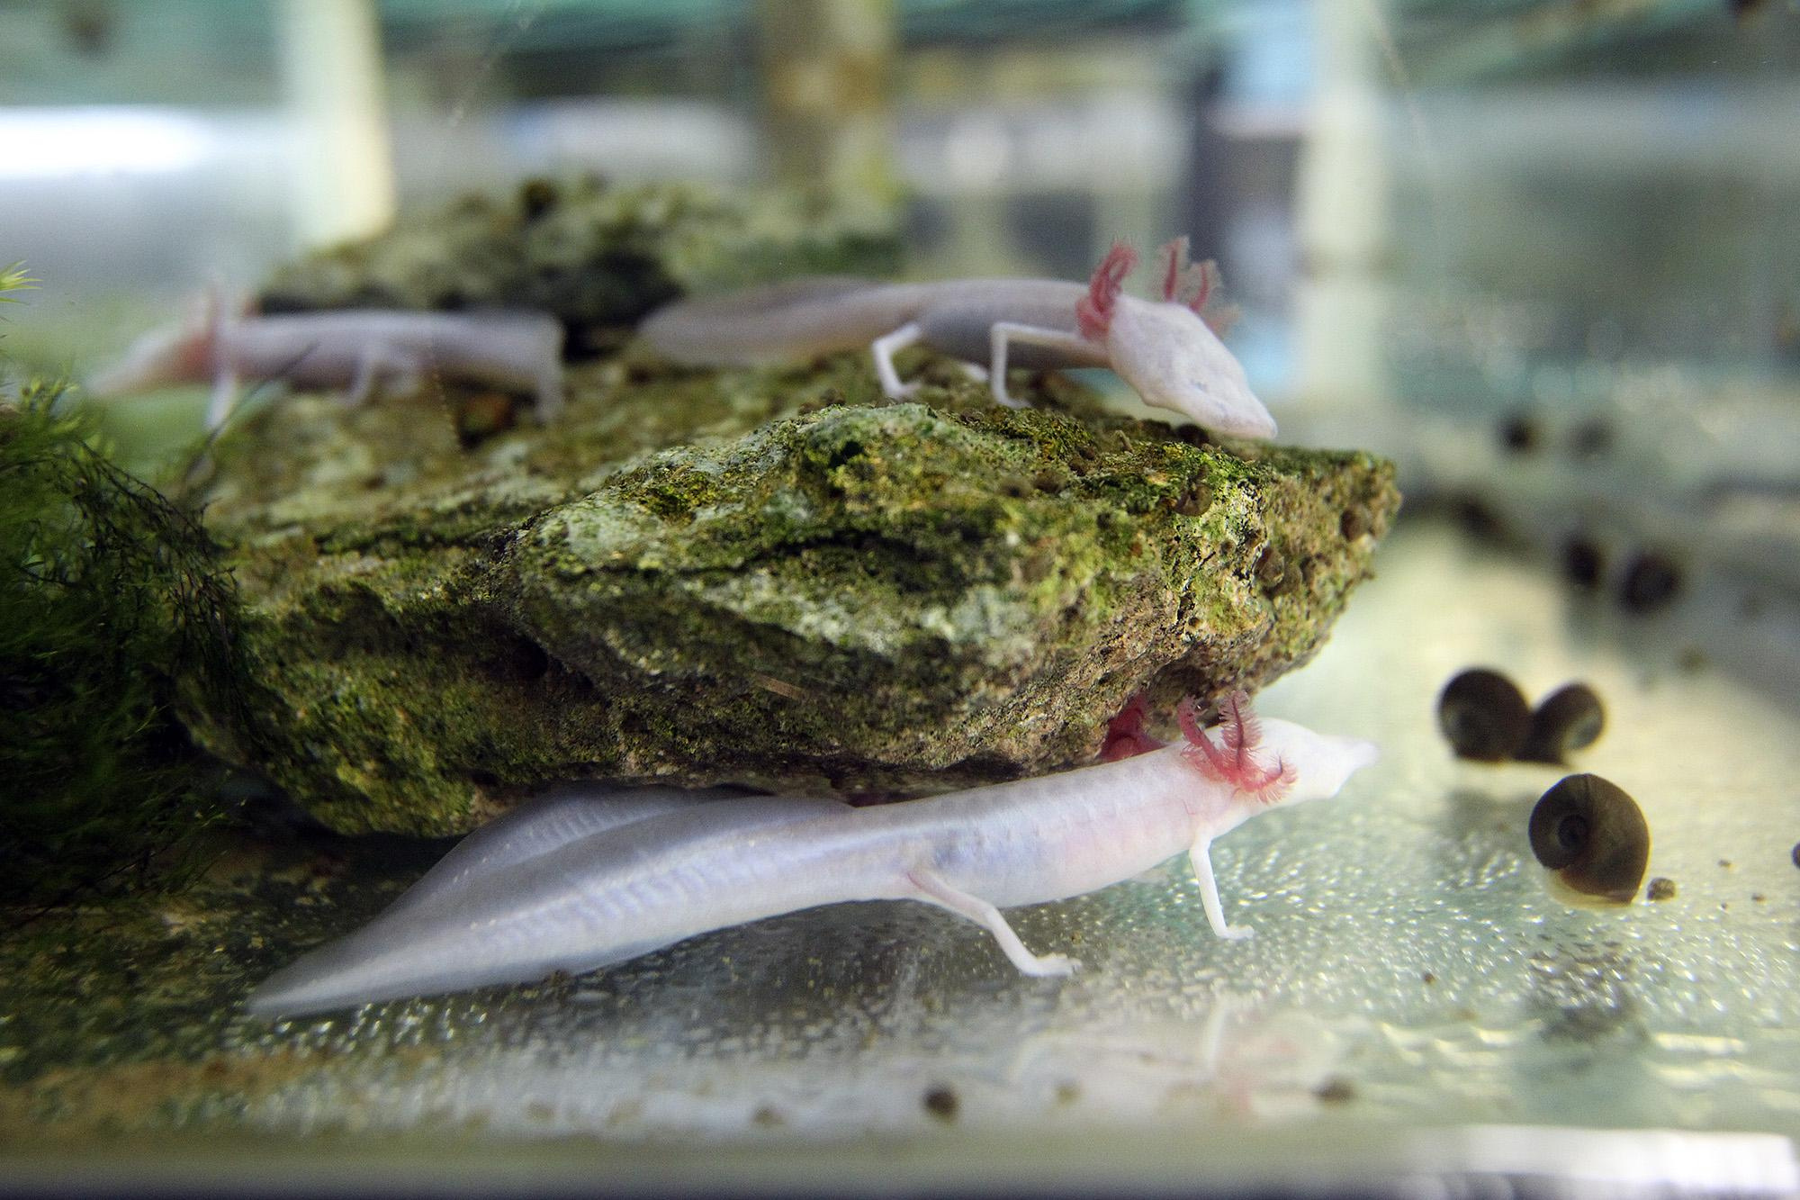
Ecological Islands
The spring systems of the Edwards Aquifer region serve as an important habitat for a very special group of rare native species that can be found nowhere else on Earth. These species can be decribed as both endemic and endangered.
Endemic species
are a type of native species whose range is constricted to a very specific, and often small, geographic area. They are highly adapted to the unique conditions of their native habitat, and thus cannot survive outside of it.
Some endemic species can only be found on islands, or in mountain ranges above a certain elevation. Others, like those in the Edwards Aquifer, can only be found in one river or spring system.
How is endemic different from endangered?
Texas Blind Salamanders. Photo by Tom Reel.
Whereas endemic is an ecological descriptor, endangered is a legal term applied to species that are protected under the
Endangered Species Act (ESA) because they are in danger of extinction in all or part of their range. The ESA outlines a program for the conservation of imperiled plants and animals, and is administered by the U.S. Fish and Wildlife Service.
The ESA makes it illegal to harm or “take” endangered wildlife without a permit, and requires that any habitat critical for their survival is not significantly degraded or destroyed.
Notes:
5

Slide 4
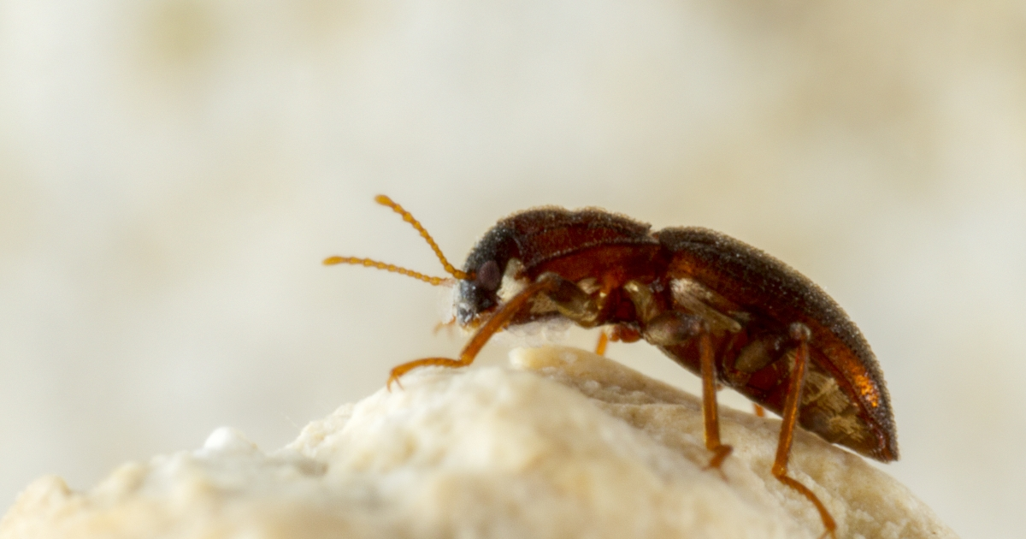
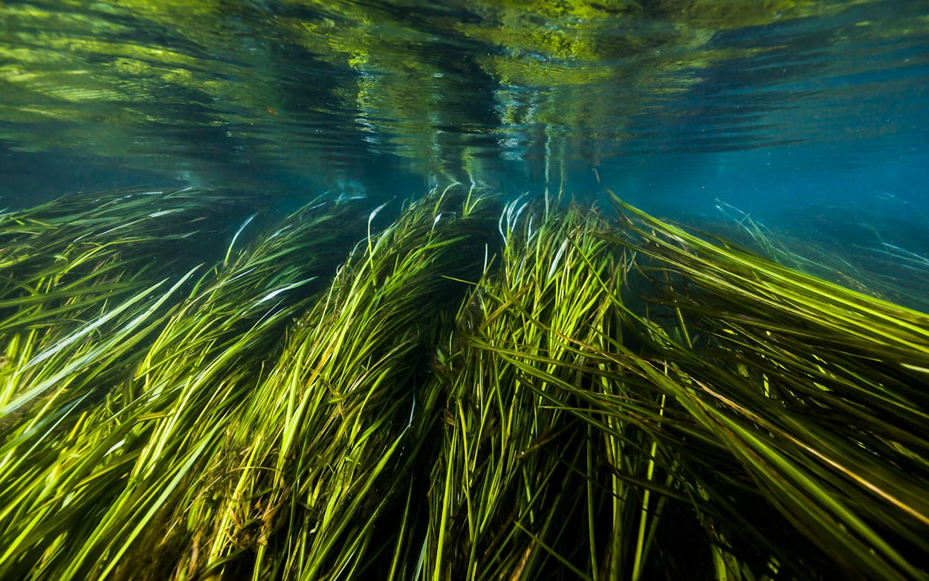
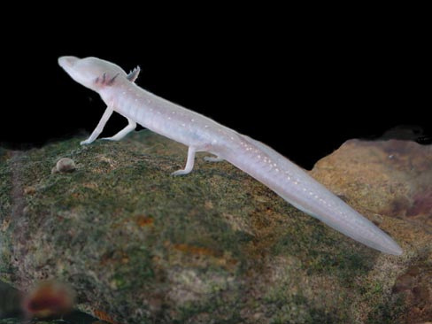
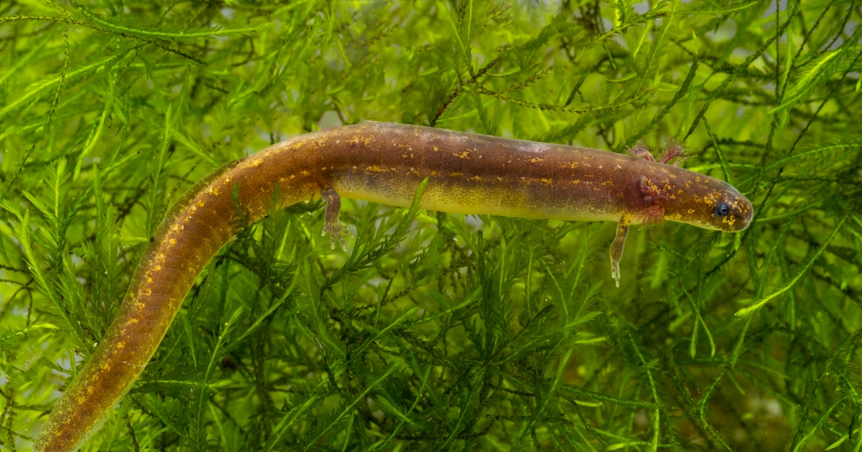
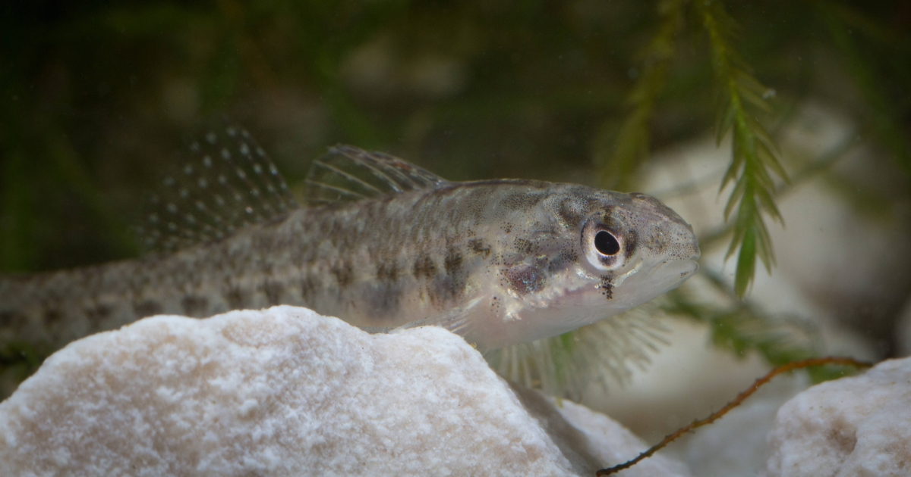
The San Marcos River is home to 5 endemic species protected under the Endangered Species Act.
Comal Springs Riffle Beetle
Texas Wild Rice
endangered
endangered
Texas Blind Salamander
San Marcos Salamander
Fountain Darter
endangered
threatened
endangered
Notes:
7

Slide 5
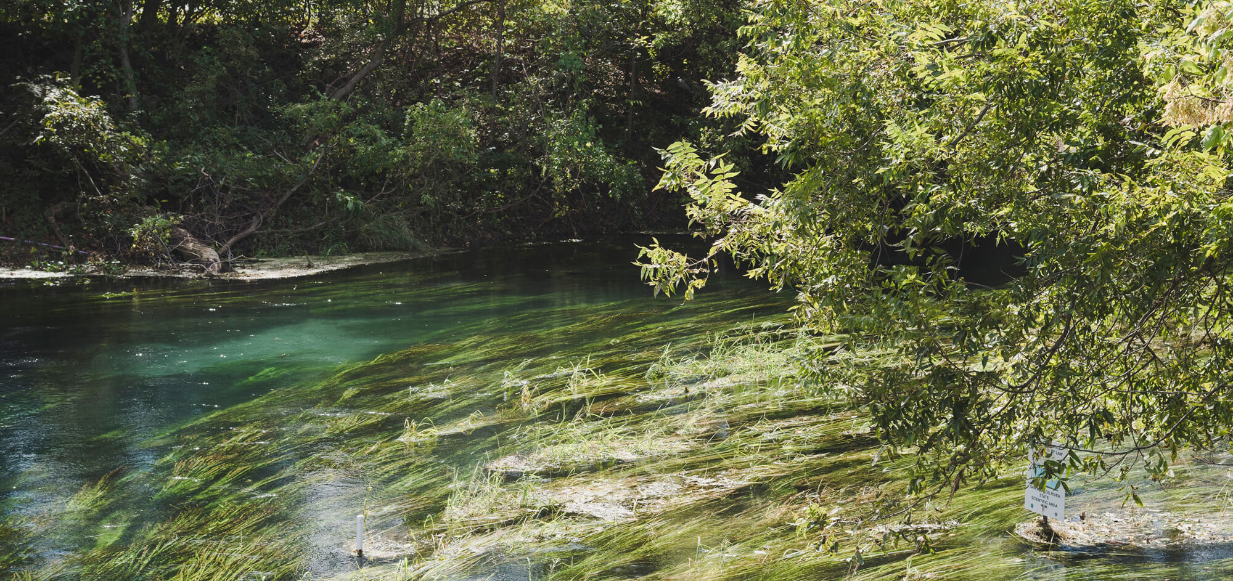
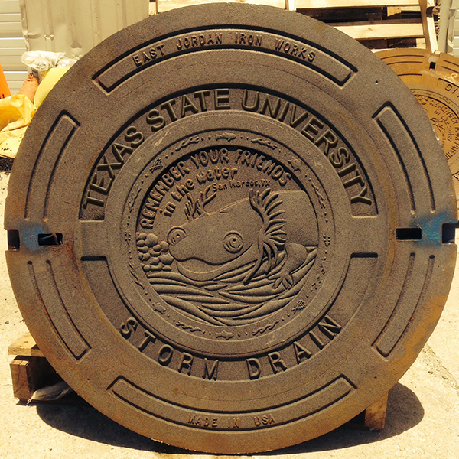
Conservation in Action
Endangered species of the San Marcos River are managed under the terms of the Edwards Aquifer Habitat Conservation Plan (EAHCP), which is administered and agreed to by the Edwards Aquifer Authority, City of New Braunfels, City of San Marcos, the San Antonio Water System, and Texas State University. The EAHCP ensures the survival of these species by engaging in three groups of strategies.
  Flow Protection Measures
  Habitat Protection Measures
  Supporting Measures
mean working with water users to ensure a continuous minimum flow in the San Marcos and Comal Rivers year-round, even in times of drought
focus on preventing damage and degradation to critical habitat, including managing river recreation, litter cleanup, and invasive species removal
include applied research, water quality monitoring, and maintaining backup refugia populations in case of a chemical spill or other ecological catastrophe
Notes:
7

Slide 6
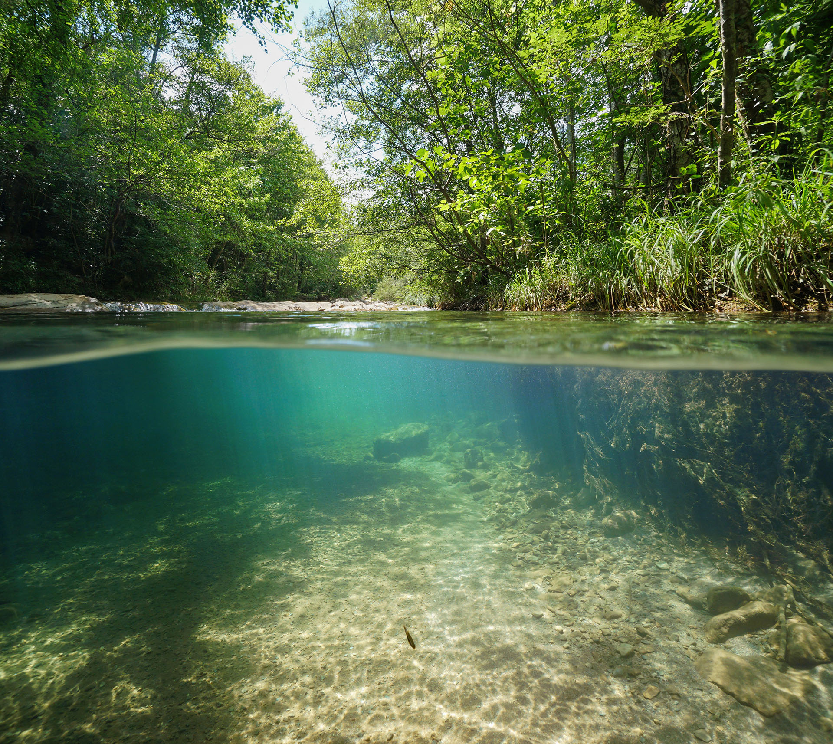

Sharing Our Home
As you explore San Marcos and enjoy its many amenities, remember that you share your habitat with a diverse ecological community. Help us keep the city a home for endemic species by following these guidelines when outdoors:
Do...
  Pick up litter in outdoor spaces on campus and around the river
  Keep pets on a leash in university and city parks, and properly dispose of pet waste
  Bring reusable containers for drinks and snacks on the river
  Purchase the appropriate fishing license before casting your line
  Take lots of pictures and share the beauty of the river with others!
Don’t...
  Disturb wildlife or interfere in their activities. Give them space!
  Trample or pull up aquatic plants in or around the river
  Construct rock dams or build structures that alter river flows
  Leave behind trash, food waste, or fishing supplies
  Erode banks by accessing the river outside of official park entry points

Slide 7
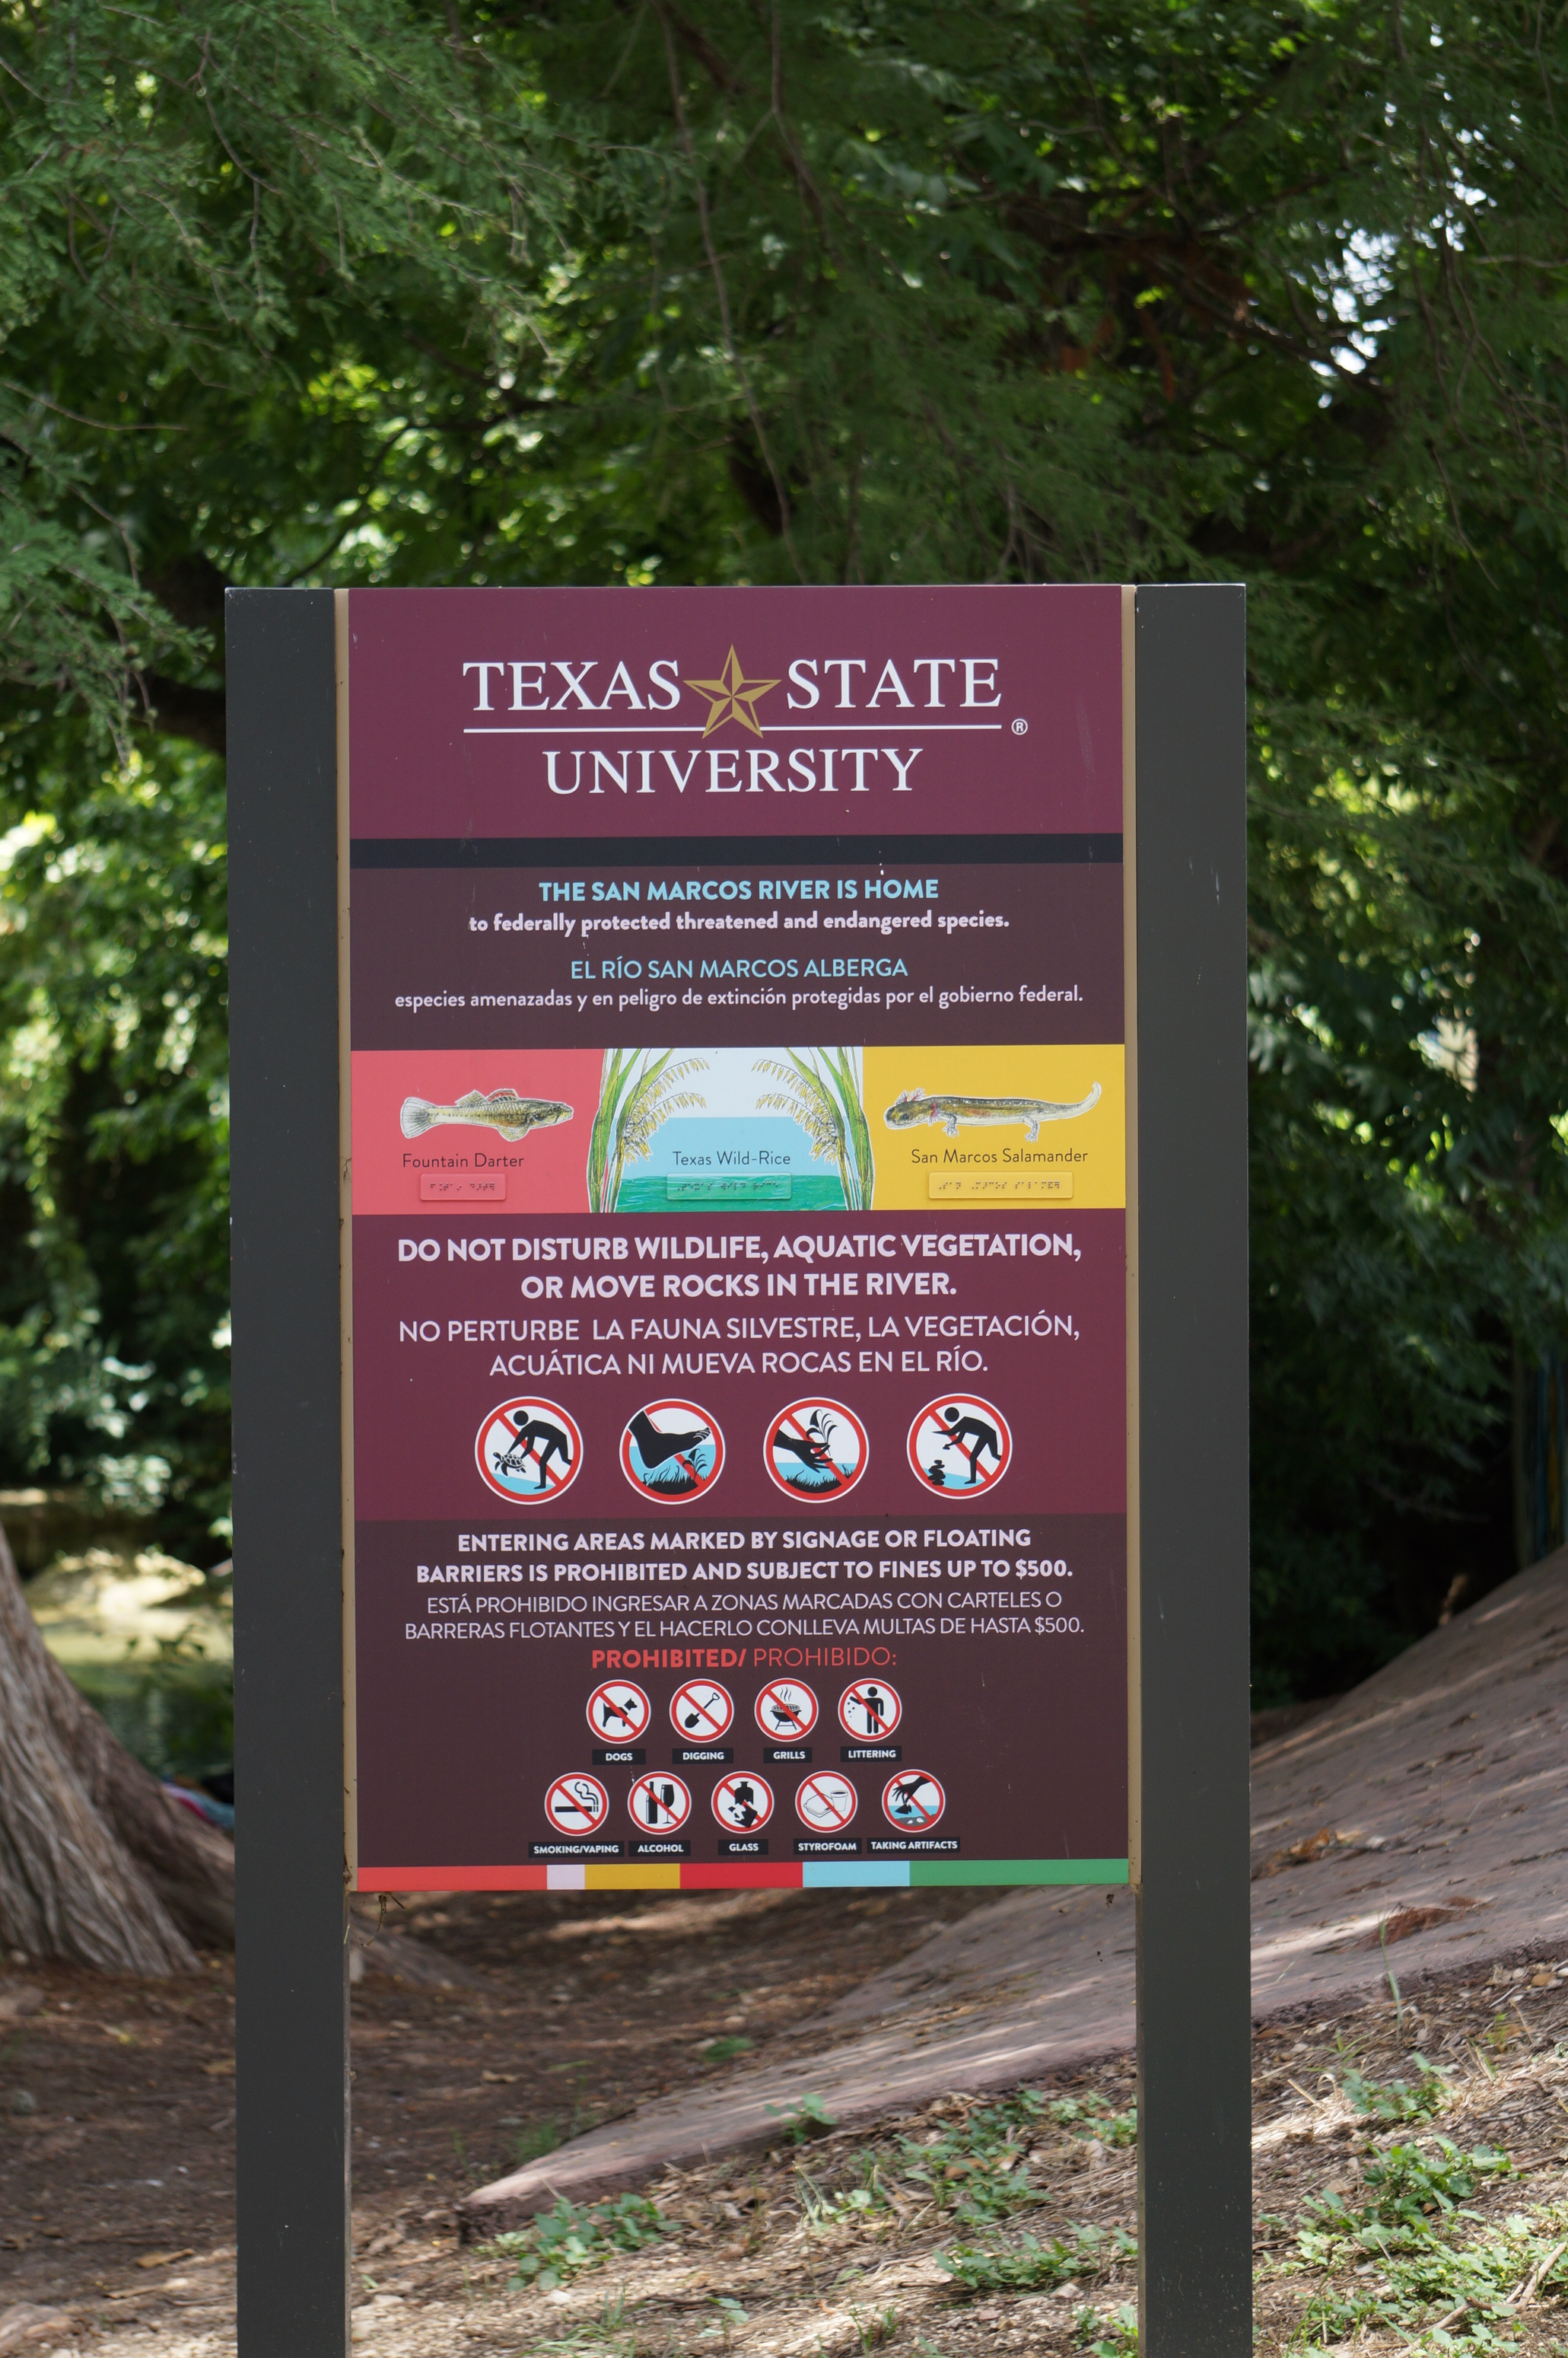
Reading the Signs
Both Texas State University and the City of San Marcos use signage in riverside parks to convey important information about water safety and habitat preservation. It is important to pay attention to ALL signage, especially since different rules apply to each park. What might be allowed in one area could be prohibited in another, and engaging in behavior that breaks a park ordinance could result in a fine.
Always remember that information on posted signage...
KEEPS YOU SAFE
KEEPS PARKS CLEAN
KEEPS ECOSYSTEMS HEALTHY
KEEPS WILDLIFE SAFE

Slide 8
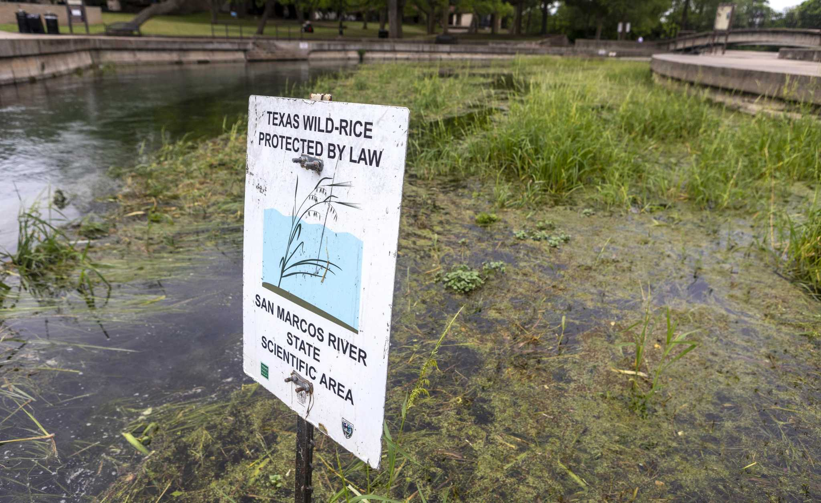
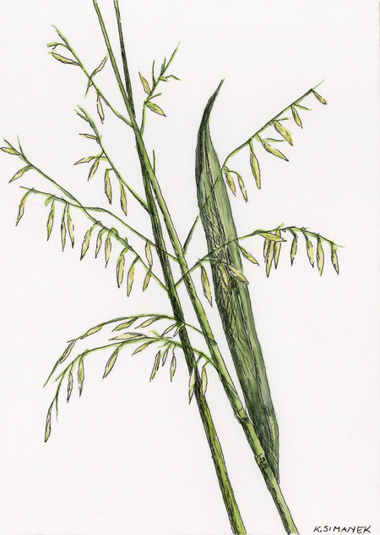
The River’s Living Anchor
One common type of signage you may see on the river outlines the protected habitat of one of our most important endangered species- Texas Wild Rice. It is against federal law to tamper with or destroy these habitats, which are managed as State Scientific Areas.
Wild rice populations keep the river clear and healthy by stabilizing sediment, filtering water, and providing shelter for other native species. Without wild rice, the San Marcos River would be a very different and much more unstable place.
Be sure to navigate around Texas Wild Rice habitat when tubing or swimming in the river. State Scientific Areas are demarcated by signs and buoy lines which should not be crossed.
For more information about Texas Wild Rice or to get involved in conservation efforts, keep up with the River Education & Stewardship Alliance on Instagram at @resa.txst

Slide 9


All Creatures Great and Small
Just like how every endemic species has a unique role in their ecosystem, we too each have an important role to play in the protection of our natural environment. Even the smallest actions can have a large impact on ecosystem balance. Conservation is a community effort.
The future of our university is intertwined with the future of our river and all its inhabitants. Only together can we ensure that what makes San Marcos beautiful today can be enjoyed by Bobcats for generations to come.
Remember your friends in the water!

