Slide 1
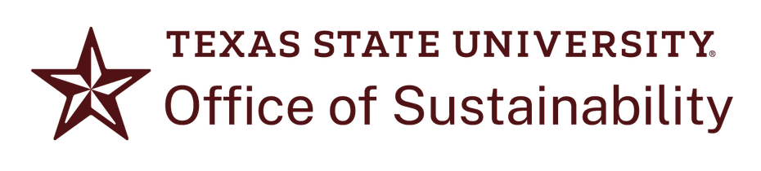
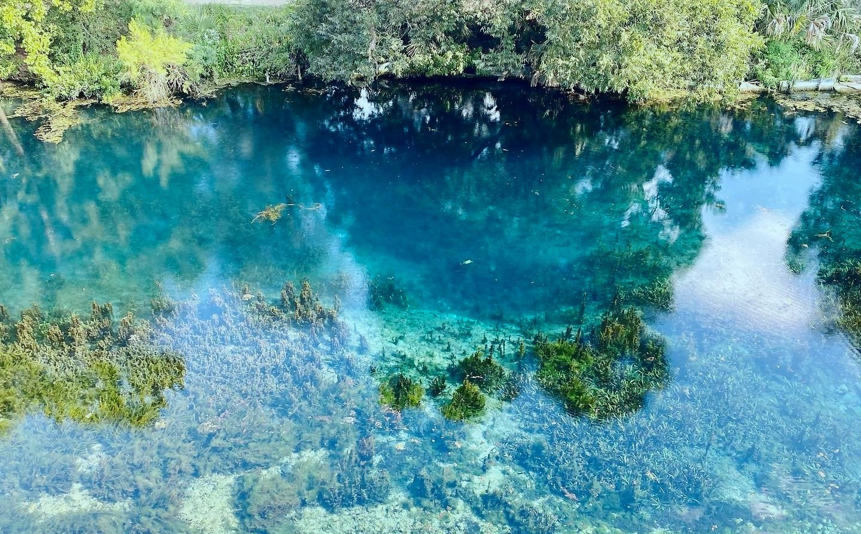

We Are What We Drink
A Bobcat’s Guide to Campus Water Resources

Slide 2
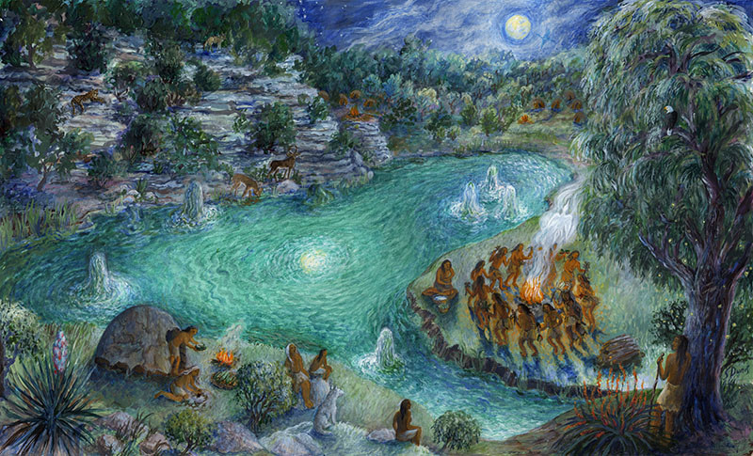
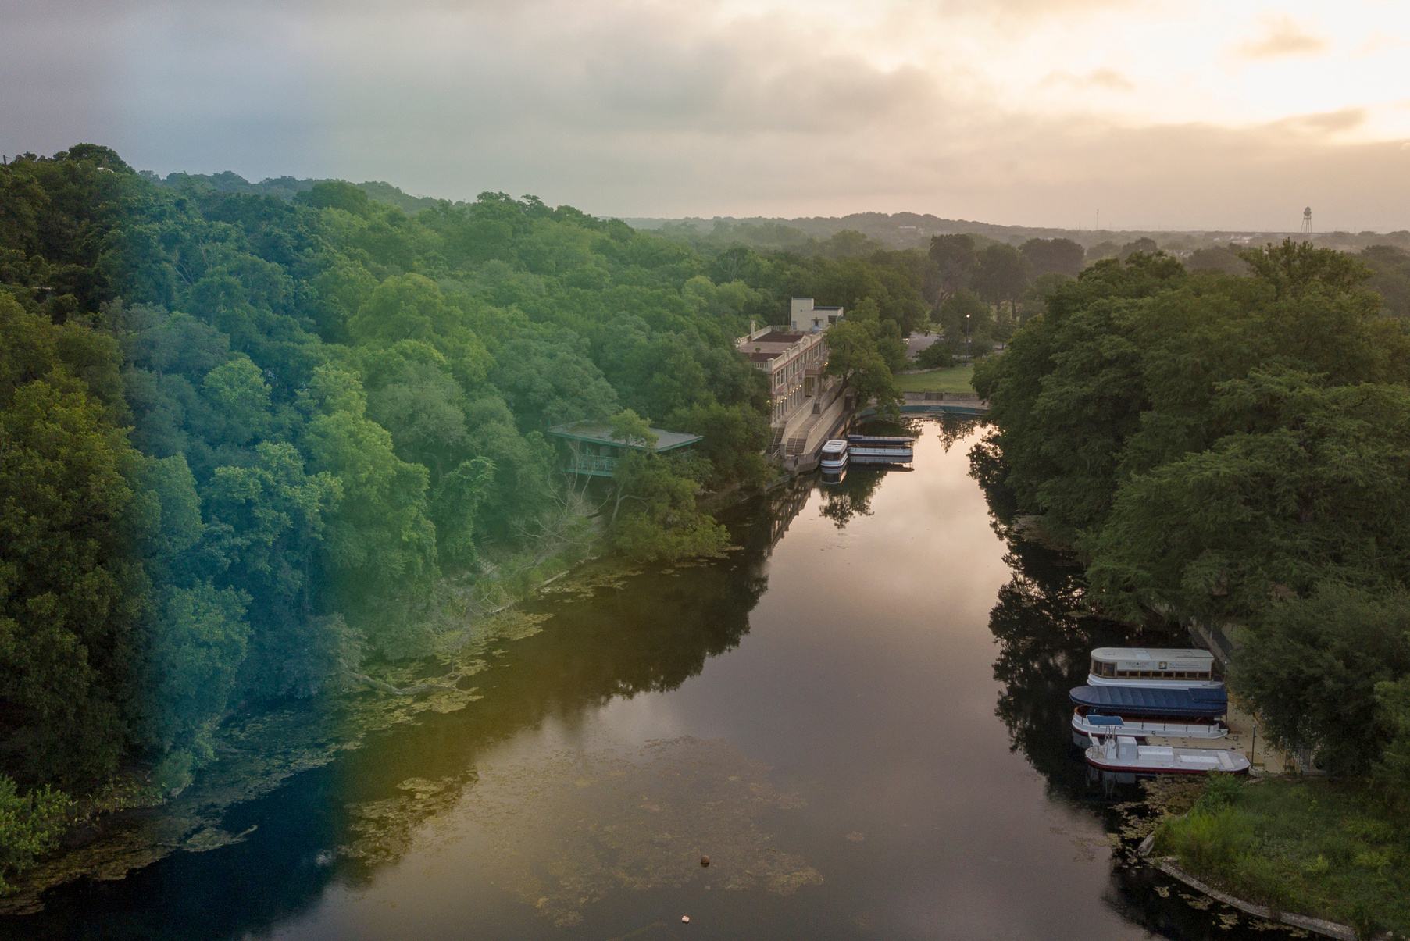
San Marcos Springs by Susan Dunis, 2014
People and Water in San Marcos
Supported by the year-round flow of fresh water, humans have lived around the headwaters of the San Marcos River for almost 13,000 years. Archaeological evidence indicates that the springs may be one of the oldest continually inhabited places in North America.
Living History
Today, our unique aquifer and spring fed river continue to make life possible in San Marcos and at Texas State University.
Becoming a steward of campus water resources is an important part of TXST culture and student life. Ensuring that future Bobcats have a clean, flowing river and drinkable water is our collective responsibility.

Slide 3
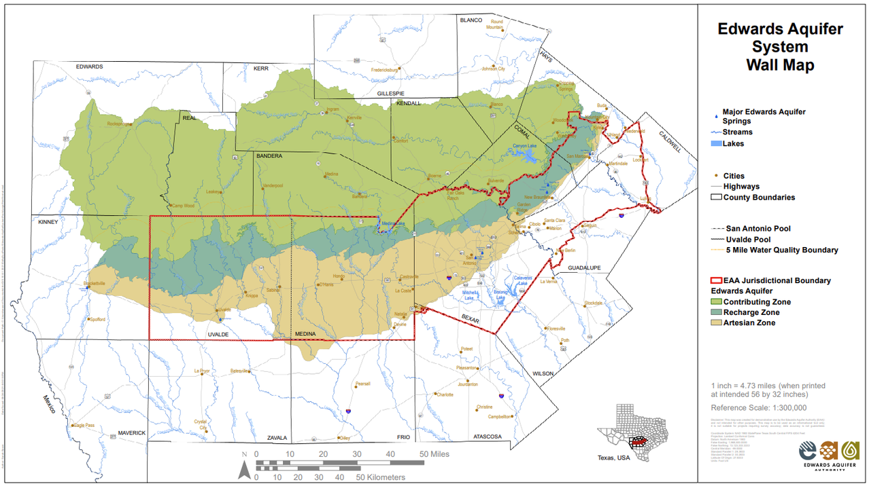
Where does our water come from?
YOU ARE HERE
Introducing the Edwards Aquifer
What is an aquifer?
An aquifer is a natural underground reservoir of water made up of porous rock, sand, or gravel. Aquifers store usable groundwater in significant quantities, all unseen just below our feet.
Map by Edwards Aquifer Authority
How does water get into the aquifer?
What makes our aquifer special?
Aquifers are refilled when rain and runoff percolates back into the ground in certain permeable areas called recharge zones. An aquifer’s recharge rate varies depending on a region’s geology and how much water regularly exits the aquifer through wells and springs.
The Edwards Aquifer is a karstic aquifer that stretches over 3,600 square miles, encompassing parts of 10 Texas counties. It is made of porous, honeycomb-like limestone formations that store water like a sponge and allow it to travel underground. It is one of the most productive aquifers in the United States and is the primary source of water for San Antonio, Austin, and the I-35 corridor.
Notes:
5

Slide 4
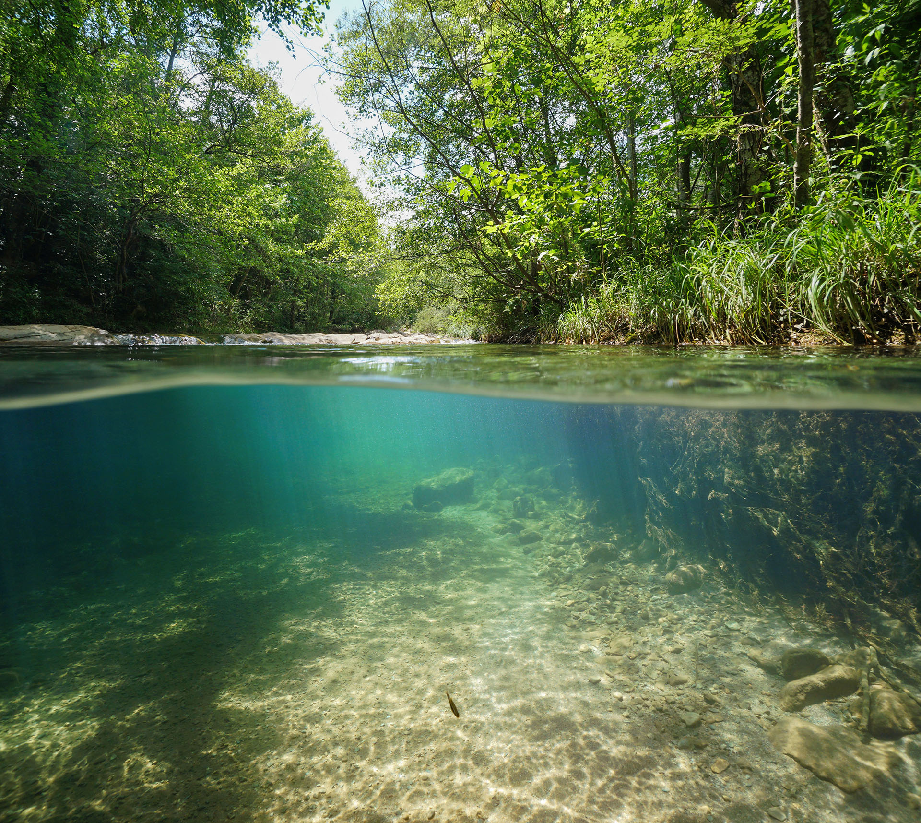
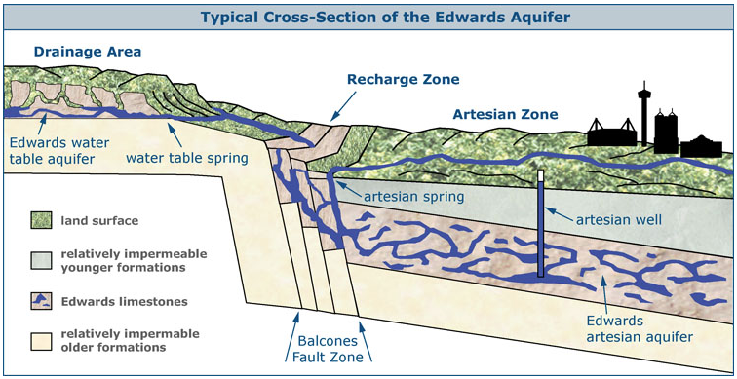
All Water is Connected
Groundwater and surface water may seem separate, but they are both parts of the same hydrologic cycle.
In San Marcos, groundwater stored in the Edwards Aquifer emerges through a collection of natural artesian springs found right on campus at Spring Lake. These springs form the headwaters of the San Marcos River, which eventually joins the Guadalupe River before flowing all the way to the Gulf of Mexico.
Gregg Eckhardt, 1995
Notes:
7

Slide 5
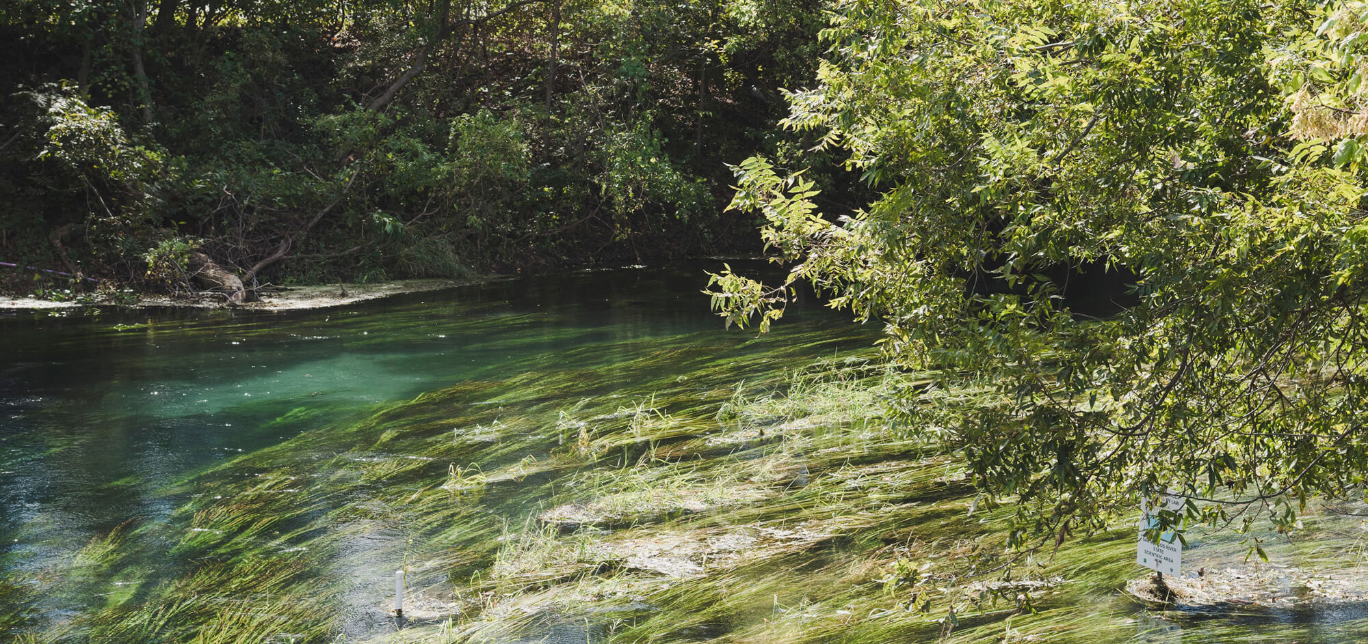
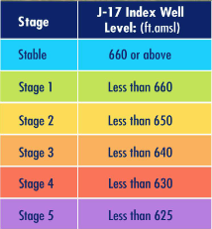
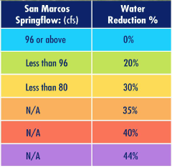
Water Scarcity in
the Edwards Aquifer
Edwards Aquifer Authority Drought Stages
Droughts occur when the rate of aquifer recharge falls below the level necessary to maintain regular springflow. The regulatory entity in charge of measuring and designating regional drought stages is the Edwards Aquifer Authority, which determines how and when water use should be reduced by permit holders like TXST.
Droughts are caused by extended periods of reduced rainfall and higher-than-average temperatures, but they can be worsened by human behavior. Poor water management and overpumping are examples of anthropogenic, or human-induced, factors that can exacerbate drought conditions.
Notes:
7

Slide 6
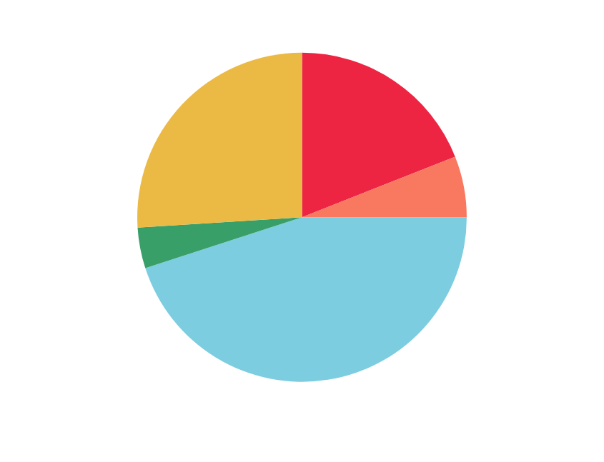
Where is TXST water going?
Roughly 60% of water use from main campus wells is utilized domestically, and nearly half of this domestic use occurs in residence halls.
Estimated Domestic Campus Water Use from Jackson Well
Every time we turn on the tap, we draw water directly from the Edwards Aquifer. To help meet restrictions during times of drought, Bobcats living on campus can adopt certain practices to help conserve water on an individual and community wide scale.
Did you know?
10,000 residents each taking a 15-minute shower would use approximately 375,000 gallons of water in total. That's enough to cover the Bobcat football field in 10.5 inches of water!

Slide 7
How You Can Help
Contribute to campus-wide water conservation efforts by engaging in one or all of these small strategies:
Save
Report
Volunteer
Advocate
water in residence halls and during daily activities
spills and maintenance issues with water infrastructure
with university or local organizations involved in water stewardship
for water resource protection to local and state government
Help reduce domestic water use in on-campus housing by shortening shower time and turning the tap off while brushing your teeth or shaving. Wash your laundry in full loads to take advantage of the water amount in each cycle, and with cold water to save energy. Becoming a water steward begins with weaving conservation into everyday habits!
Notice something off with a faucet or irrigation line? Report it to our experts to make sure it’s addressed as soon as possible.
For issues in residence halls,
submit a maintenance
request in your
Student Housing Portal.
For other parts of campus, contact our Facilities team through Bobcat FixIt.
To report a chemical spill, call
512-245-3616.
Get involved in city and campus efforts to maintain clean, high quality waterways.
Participate in My TXST My Home campus cleanups to keep campus and the river free of litter.
Join Bobcat Stream Team to learn about water quality testing and ecology.
Keep up with the TXST Office of Sustainability to hear about upcoming stewardship opportunities.
The biggest influence on aquifer levels and water scarcity in San Marcos is urban development. What types of businesses, industries, and housing projects are being built, and how much water are they using?
You can participate in the process for approving or blocking certain kinds of development in San Marcos by speaking to elected officials and attending public government meetings. Remember to make your voice heard!

Slide 8
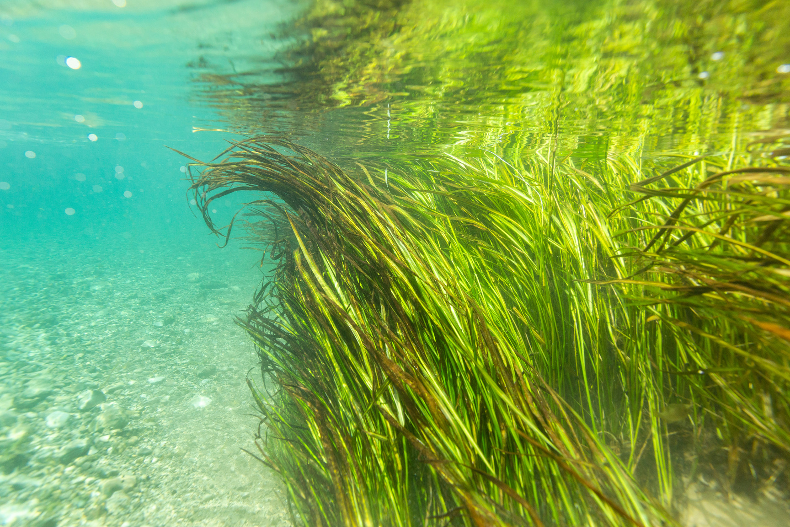
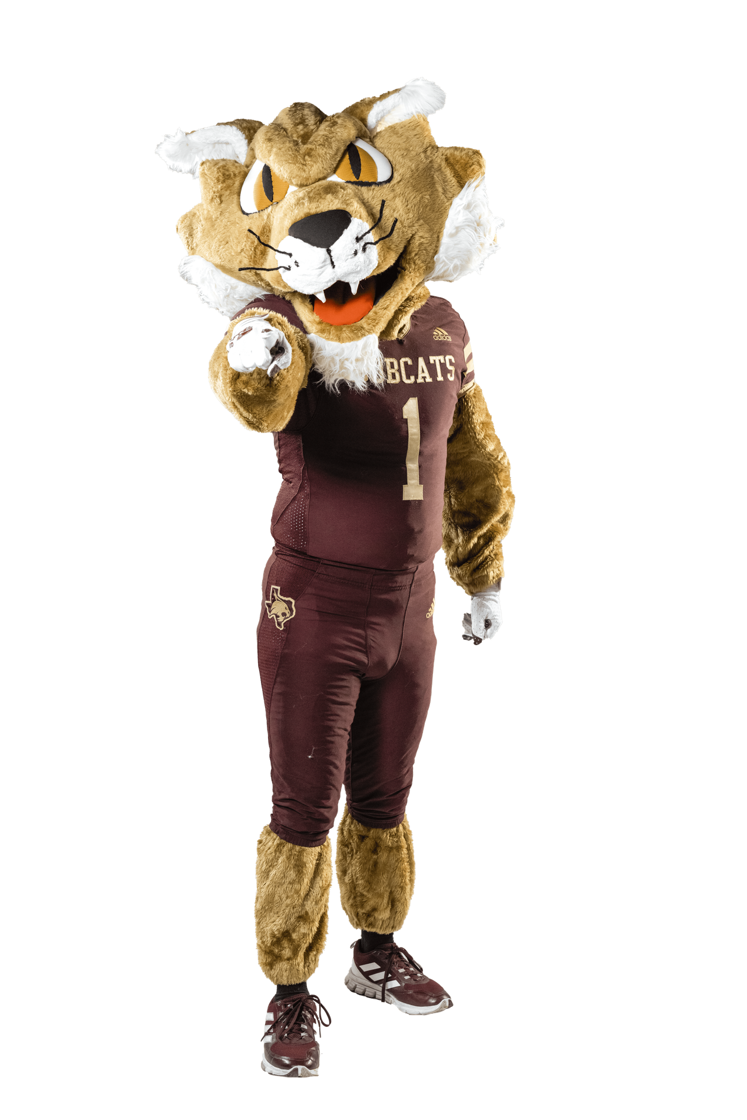
Every Drop Counts!
Every effort made towards water conservation and stewardship has a downstream effect, even if it feels small.
When everyone pitches in to preserve water resources, together we can ensure a future of healthy ecosystems and healthy communities.
Protect our aquifer- it’s the Bobcat way!

